Slide 1

PWG1: Global Observables and Centrality of Nuclear Collisions at MPD/NICA
Grigory Feofilov,
Saint-Petersburg State University
(for PWG1-MPD@NICA team)
V-th Collaboration Meeting of the MPD Experiment at the NICA Facility
Friday, 24th of April 2020, 12-30. ZOOM connection

Slide 2
Layout
Introduction.
Global observables
Brief overview of experimental landscape
Centrality of nuclear collisions at NICA
Disclaimer: this report covers only some of the tasks discussed at the PWG1
See also the next report at this meeting: Eleazar Cuautle, “Status report from MexNICA team to PWG1

Slide 3
PWG1-MPD – status
Participating institutes:
SPbSU (St.Petersburg),
INR RAS (Troitsk),
MEPhI (Moscow) and
MexNICA Collaboration (Mexica)
PWG1 co-conveners:
Alexander Ivashkin (INR RAS, RF) ivashkin@inr.ru
Grigory Feofilov(SPbSU,RF) g.feofilov@spbu.ru
You may visit our PWG1 WEB page:
https://indico.jinr.ru/category/343/
Send us an e-mail to join the group

Slide 4
Introduction:
Global Observables
Task 1)
To measure event-by-event in pA and A+A collisions,
under well defined initial conditions, the following :
Event charge particle multiplicity
Event mean transverse momentum (p_{T})
Event transverse energy (E_{T})
Particle types and ratios
Event net charge
Number of nucleon-participants (N_{part})
Event-plane
PWG1: Global Observables
-

Slide 5
Introduction:
Global Observables
Task 2)
To get at the next step of analysis
the mean values of observables for carefully selected classes of events (-- i.e. for classes of well defined initial conditions) :
Mean charged particles density at midrapidity (<dN_{ch}/dη _{|η=0}>) for a given class of selected events
Pseudorapidity distribution (dN_{ch}/dη),
Total mean multiplicity (N_{ch})
Mean transverse momentum (<p_{T}>) and
Mean event transverse energy (<E_{T}>)
Mean values of particle ratios
PWG1: Global Observables
-

Slide 6
Introduction:
Global Observables
Task 3)
To define criteria for selection of classes of events (classes of well defined initial conditions).
…
Different estimators of centrality of A+A collision could be considered as a proxy for the impact parameter b:
-- Spectator nucleons (N_{s}) and number of nucleons-particpants(N_{part});
-- Event transverse energy (E_{T});
-- Multiplicity .
Selection of classes of events is very important for further studies of fluctuations and various correlations of observables, for studies of flow harmonics, light and heavy flavour yields, event shape engineering etc.
--- …..
PWG1: Global Observables
-

Slide 7
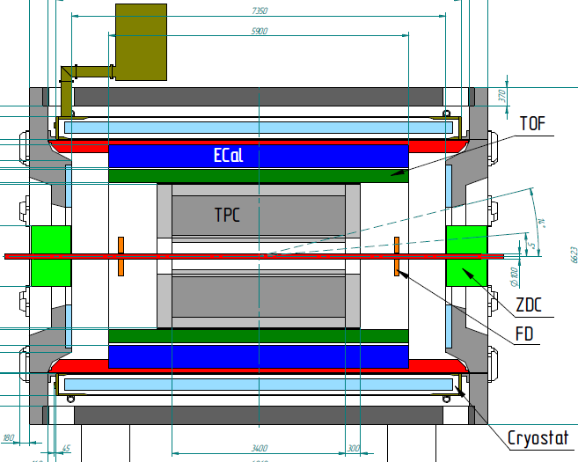
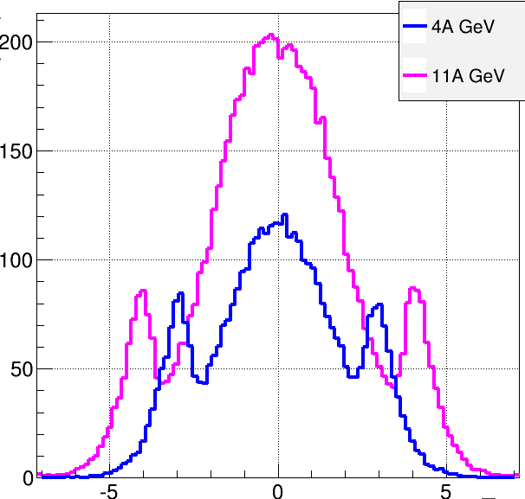
Multi-Purpose Detector (MPD)
stage I: TPC, TOF, ECAL, FHCal, FFD
stage II ( 2023): + ITS + EndCap (CPC, Straw, TOF, ECAL)
stage II
acceptance
URQMD
charged
b<11 fm
11 A GeV
4 A GeV
dN/dη
TPC
CPC
TOF
ECal
FFD
FHCal
FHCal
FFD
η
stage I: put in operation in 2022
Notes:
The MPD will be put in operation at two stages. At the first one the barrel part will be equipped with major tracking detector TPC, TOF end ECAL. FHC and FD will be operational as well.
At the second stage the detector will be supplemented with IT and end cap subdetectors.

Slide 8
PWG1-MPD – tasks in view of existing panorama of data
Our general task is to develop a detailed experimental program for Global observables at the MPD with the account of the existing experimental landscape (BES-1 and BES-II programmes and NA49 and NA61/SHINE results)

Slide 9
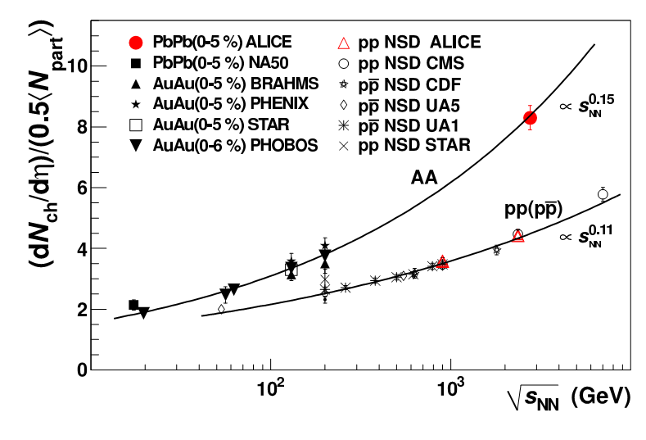
Brief overview of experimental landscape
Charged particle pseudo-rapidity density vs. √s_{NN}
At LHC:
an increase of about
a factor 1.9 relative to pp collisions at similar collision energies,
an increase of about
a factor 2.2 to central Au-Au collisions at √s_{NN} = 0. 2 TeV !
Faster growth with √s_{NN} in AA than in pp!
Logarythmic extrapolation is rulled out
Important constraint for the models!
arXiv:1011.3916 [nucl-ex]. Phys. Rev. Lett. 105 (2010) 252301
9

Slide 10
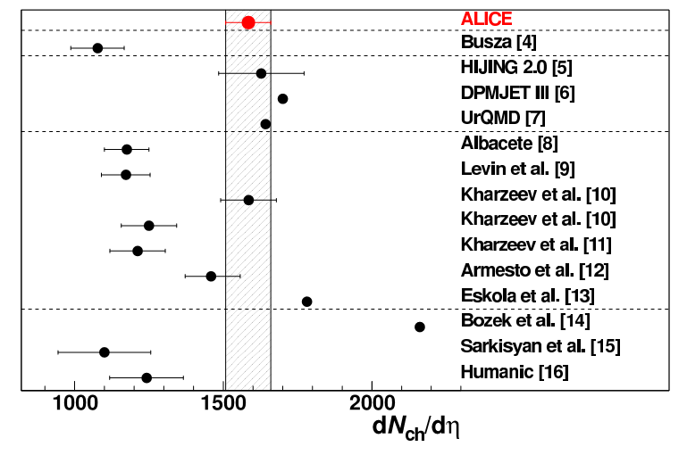
Charged-particle multiplicity density at mid-rapidity (central Pb-Pb collisions at √s_{NN} = 2.76TeV)
Multiplicity:
the initial energy density is the 1st important constraint for the models!
Comparison of ALICE measurement
with model predictions.
Bjorken energy density in ALICE: 2.8 x RHIC for 5% of most central collisions
arXiv:1011.3916 [nucl-ex]. Phys. Rev. Lett. 105 (2010) 252301
Notes:
We measure a density of primary charged particles at mid-rapidity dNch/dETA = 1584+ 4 (stat. )+ 76(sys. ).
J.Harris, ALICE
Transverse energy density per participant pair: 2.5 x RHIC Consistent with 20% increase in <pt>.
Bjorken energy density: 2.8 x RHIC for 5% of most central collisions
Empirical extrapolationfrom lower energy data [4] signicantly underpredicts the measurement. Perturbative QCD-inspired Monte Carloevent generators, based on the HIJING model tuned to 7 TeV pp data without jet quenching [5], on the DualParton Model [6], or on the Ultrarelativistic QuantumMolecular Dynamics model [7] are consistent with the
measurement. Models based on initial-state gluon density saturation have a range of predictions depending on
the specific implementation [8{12], and exhibit a varying level of agreement with the measurement. The prediction
of a hybrid model based on hydrodynamics and saturation of final-state phase space of scattered partons [13]
is close to the measurement. A hydrodynamic model in which multiplicity is scaled from p+p collisions overpredicts the measurement [14], while a model incorporating scaling based on Landau hydrodynamics underpredicts
the measurement [15]. Finally, a calculation based on modified PYTHIA and hadronic rescattering [16] under-predicts the measurement

Slide 11
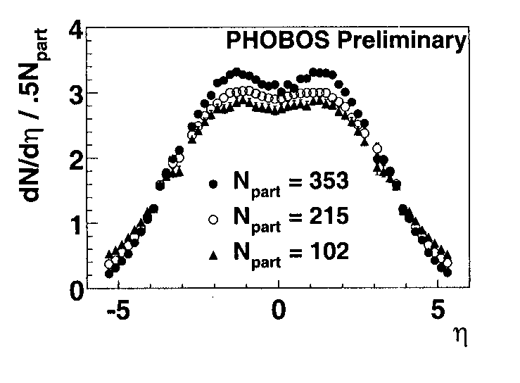
Pseudorapidity distributions at various N_{part} (example of PHENIX at RHIC)
Pseudorapidity distribution, PHENICS. Au+Au collisions , 130 GeV. P.A.Steinberg, Nuclear Physics A698 (2002)314c-322c).

Slide 12
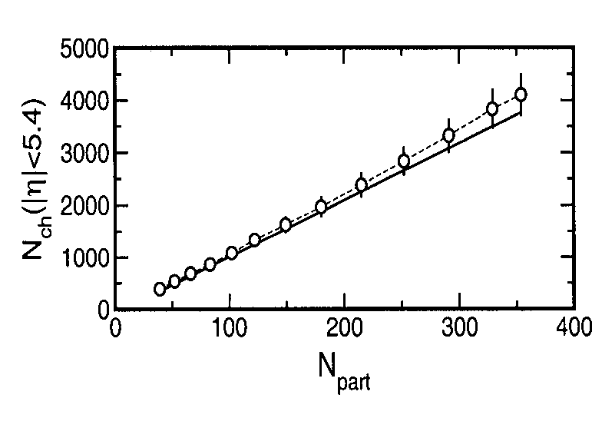
By integration of dN_{ch}/dη we can get the total N_{ch} vs. N_{part}
PHOBOS data on total Nch vs. Npart. P.A/Steinberg, Nuclear Physics A698(2002)314c0322c). Au_Au, 130 GeV

Slide 13
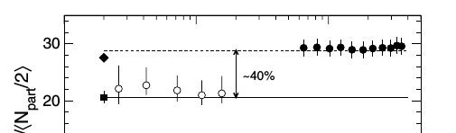
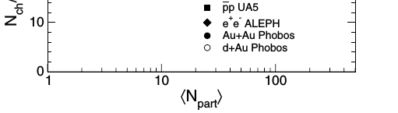

Scaling with N_{part}
B.B.Back. Studies of multiplicity in relativistic heavy-ion collisions Journ.of.Phys.Conf/Ser/5(2005)1-16; DOI: 10.1088/1742-6596/5/1/001

Slide 14
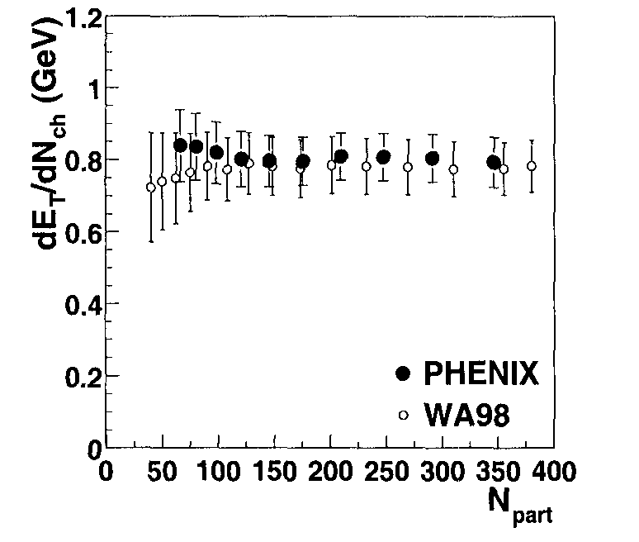
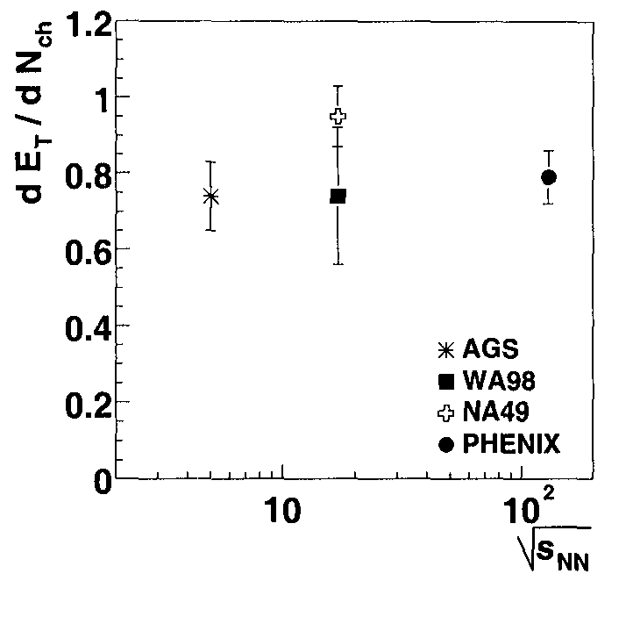
Average transverse energy E_{T} per charged particle (dE_{T}/d_{Nch}) vs. N_{part}
PHENIX and WA98 data on dE_T/dNch(GeV)
vs. Npart. P.A/Steinberg, Nuclear Physics A698
(2002)314c0322c).
PHENIX, Au+Au, 130 GeV.
WA98 at SPS, Pb+Pb sqrt(s)=17 GeV
PHENIX, AGS and SPS results on dE_T/dNch as a function of sqrt(s_NN). See Fig.8 in: P.A/Steinberg, Nuclear Physics A698(2002)314c0322c). Au+Au, 130 GeV
Notes:
There is a need to study the global observ- ables like ET /Nch in more details including the collectivity in the system to understand its energy and centrality de- pendence and to put some light on possible effects from other sources like the gluon saturation.

Slide 15
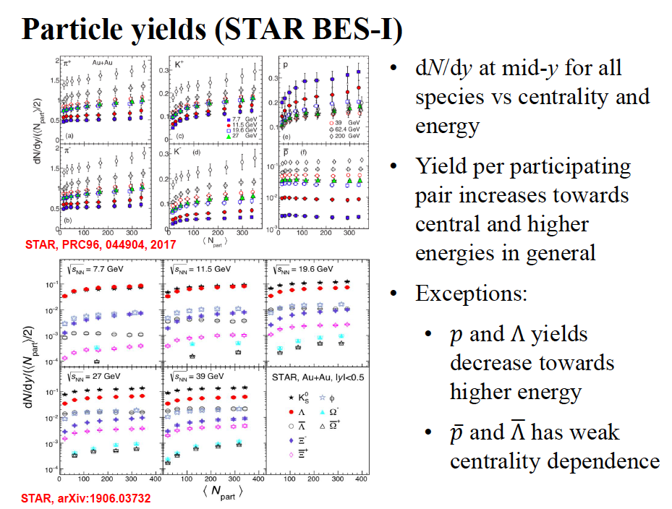
.
by Xianglei Zhu

Slide 16
What could be new with the MPD data on Au+Au (Pb+Pb or Bi+Bi collisions), at √s_{NN}=9 GeV?
In case of the PID with the TPC of the MPD installation it could be possible to measure with better statistics, for √s=10 GeV in Au+Au (or Bi+Bi) collisions, the yields and ratios of charged particles π, K, p, anti-p ( in particular, p and anti-p) and to check scaling of yields with <N_{part} >
Is it relevant to the baryon stopping mechanism?

Slide 17
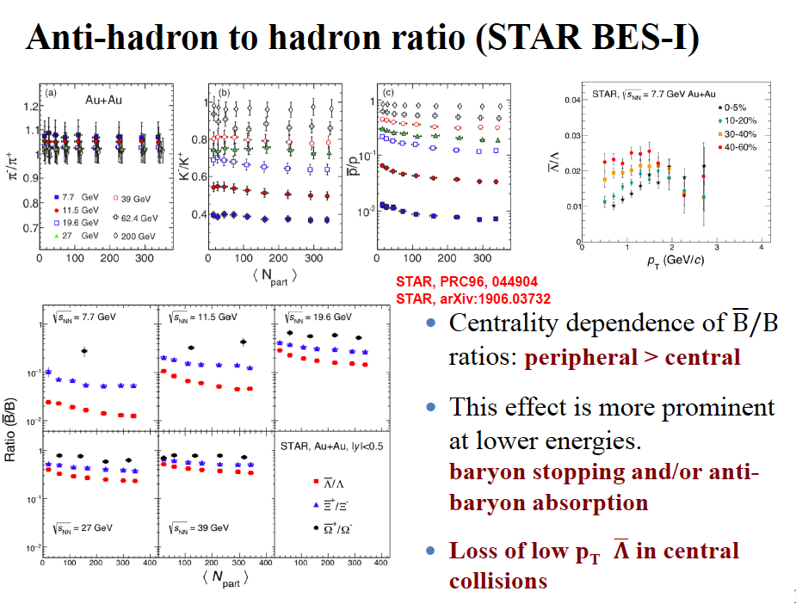
?
by Xianglei Zhu

Slide 18
What could be new with the MPD data on Au+Au
(Pb+Pb or Bi+Bi) collisions at √s=10 GeV?
To check scaling of yields of charged particles observed with <N_{part} >
– Is it relevant to baryon stopping or to anti-baryon absorption?
…
To measure with better statistics the yields and ratios of anti-Λ/Λ vs. p_{T} and for several centrality classes
To measure with better statistics the yields and ratios of anti-p/p vs. p_{T} and for several centrality classes
To measure with better statistics the ratios of particles: π-/π+, K-/K+, anti-p/p vs. <Npart>
-- To clarify the role of resonances in charge-transfer mechanism of particle production

Slide 19
Centrality determination at the MPD
In order to compare the results with a majority of existing data, the MPD experiment centrality classes are supposed to be defined based on two signals:
(i) the charged particle multiplicity in the TPC (Time Projection Chamber) or
(ii) the energy deposition in the FHCal (Forward Hadron Calorimeter).
Notes:
References
[1] M. Golubeva et al., J. Phys. Conf. Ser. 798, no. 1, 012074 (2017). doi:10.1088/1742- 6596/798/1/012074
[2] M.Golubeva et al., http://mpd.jinr.ru/
wp-content/uploads/2018/05/MPD_TDR_ FHCal_28_05_2018.pdf
[3] C. Loizides, J. Nagle and P. Stein- berg, SoftwareX 1-2, 13 (2015) doi:10.1016/j.softx.2015.05.001 [arXiv:1408.2549 [nucl-ex]].
[4] E. Zherebtsova, V. Klochkov, I. Se- lyuzhenkov, A. Taranenko and E. Kashirin, EPJ Web Conf. 182,

Slide 20
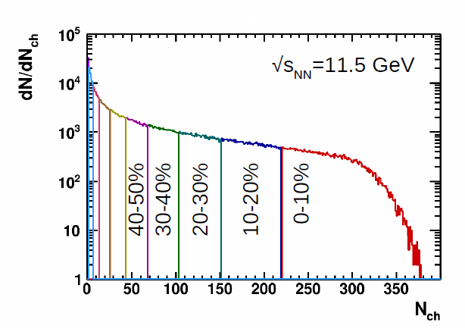
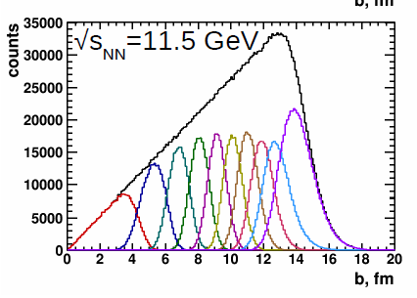
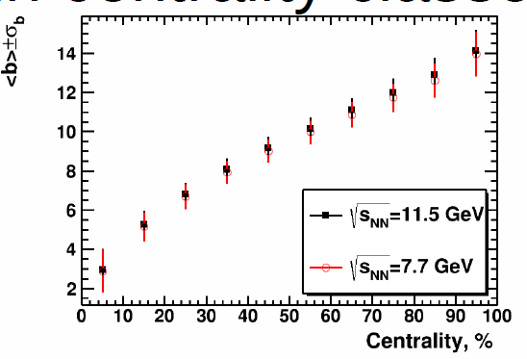
Example (i): Centrality determination with multicity in TPC.
Report by Petr Parfenov, Classes of centrality for the 1st MPD data analysisdata, PWG1 meeting, 16.01.2020

Slide 21
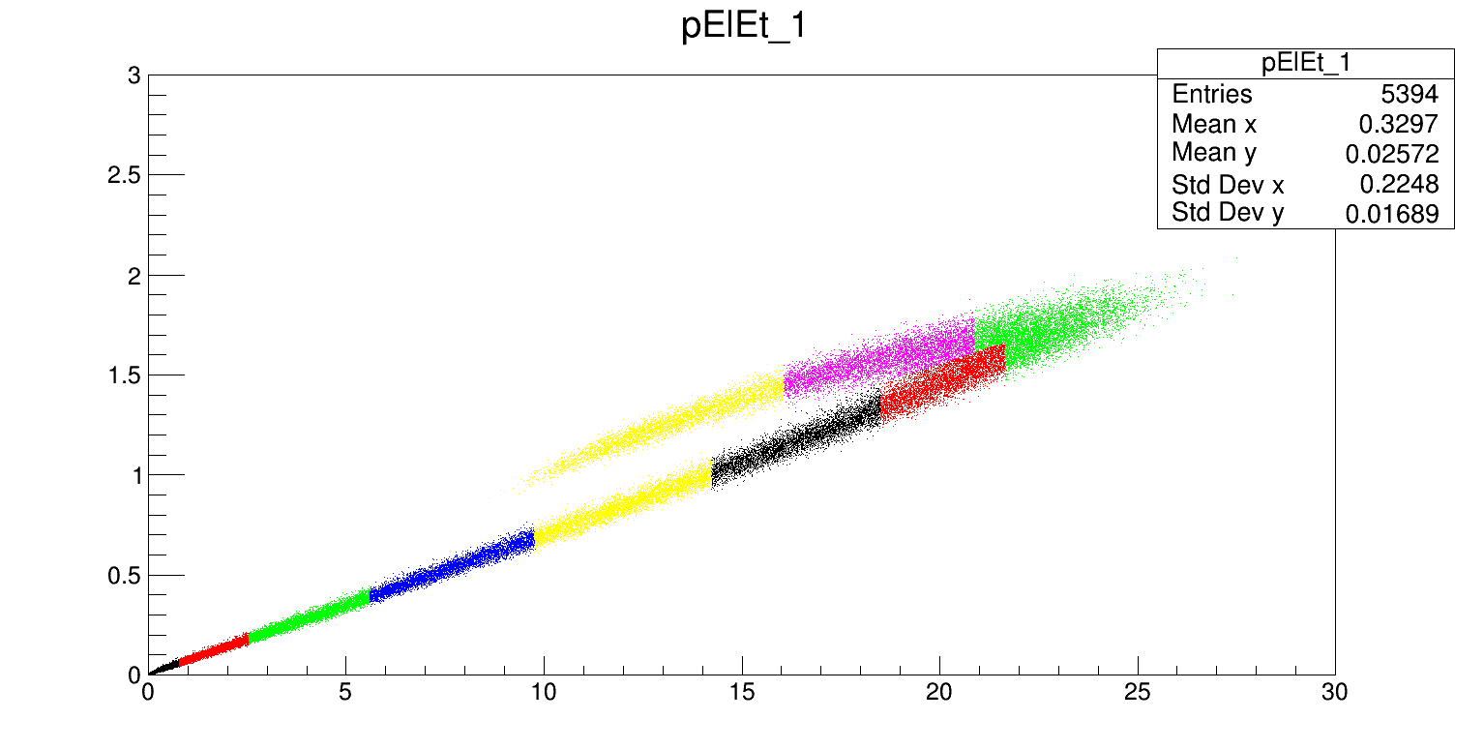
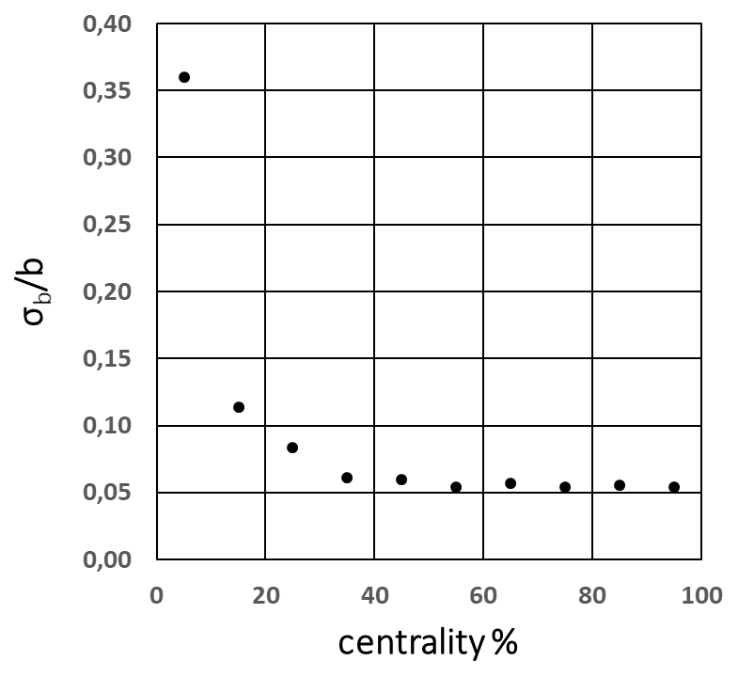
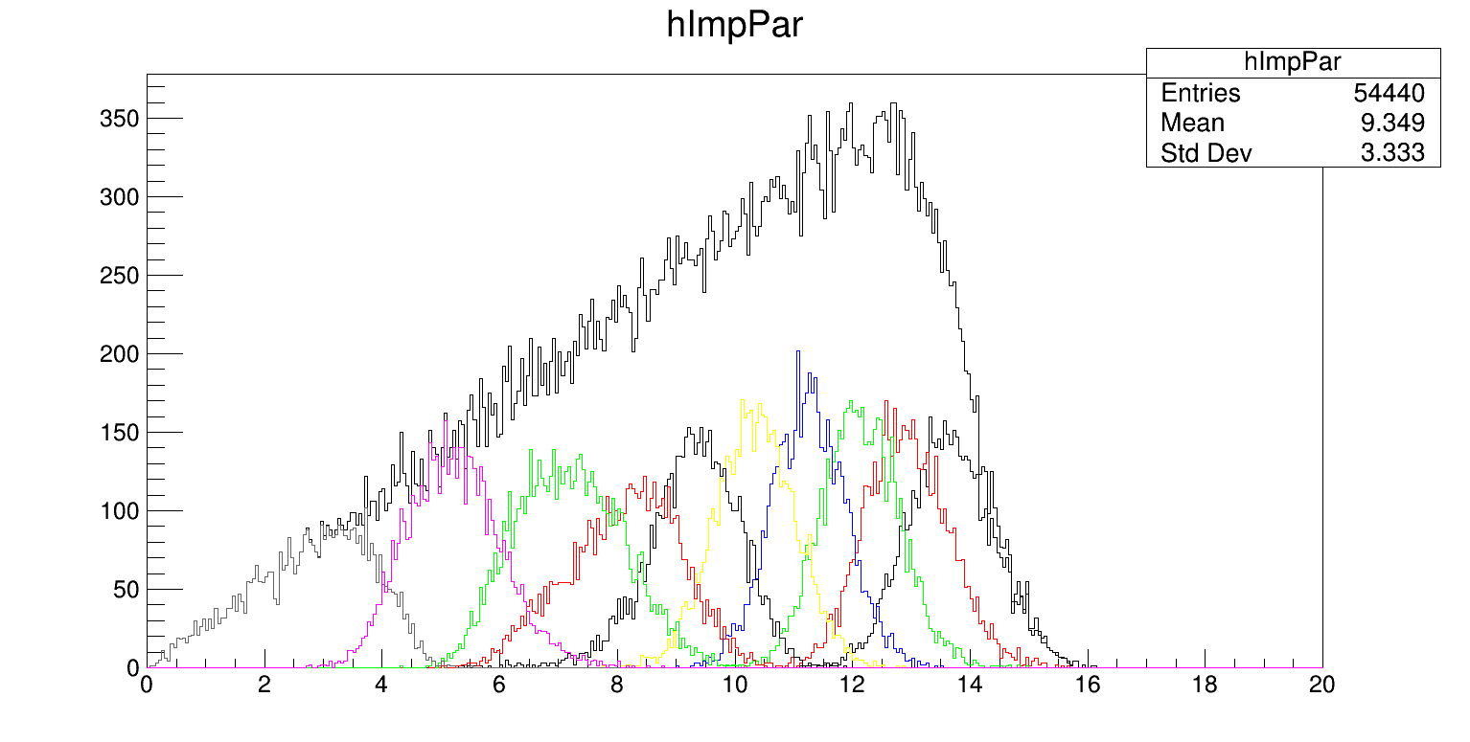
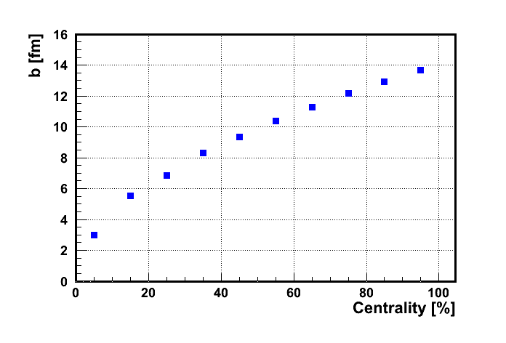
Example (ii): Centrality for (E_{T}, E_{L}) correlations in FHCal (New!)
Each color bin is 10% fractions of the total number of events.
Dependence of resolution of impact parameter on centrality
E_{T}(GeV)
E_{L}(GeV)
Impact parameter [fm]

Slide 22
Centrality of relativistic heavy ion collisions
^{In various experiments:} ^{ALICE as an example}
PHYSICAL REVIEW C 88, 044909 (2013)
FIG. 10. (Color online) Distribution of the sum of amplitudes in the VZERO scintillators. The distribution is fitted with the NBD- Glauber fit (explained in the text), shown as a line. The centrality classes used in the analysis are indicated in the figure. The inset shows a zoom of the most peripheral region.
Results indicate that selection of a narrow centrality class in multiplicity does not assume real selection of very central events in terms of the impact parameter

Slide 23
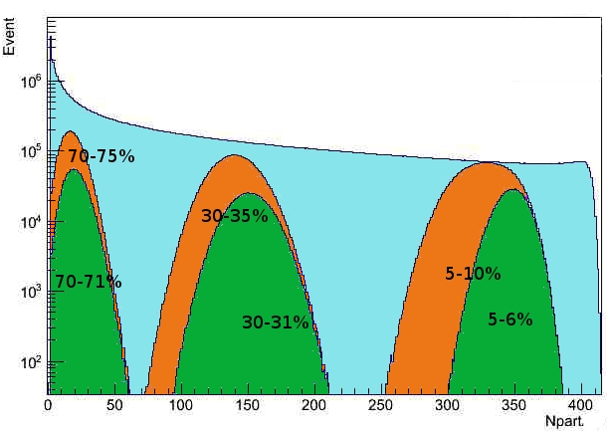
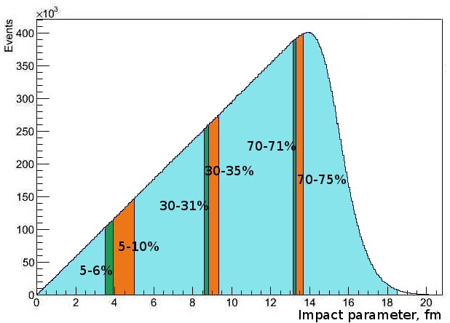
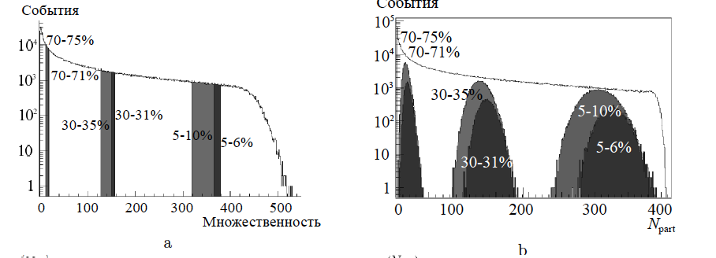
Impact parameter b, multiplicity and N_{part} in MC Glauber model
Percentile
MC Glauber, PbPb 2.76TeV
b
b
Some impact parameter centrality classes
Npart distribution in the different centrality classes
“Centrality and multiparticle production in ultrarelativistic nuclear collisions”
Drozhzhova T.A., Kovalenko V.N., Seryakov A.Y., Feofilov G.A.
Physics of Atomic Nuclei. 2016. Т. 79. № 5. С. 737-748.

Slide 24
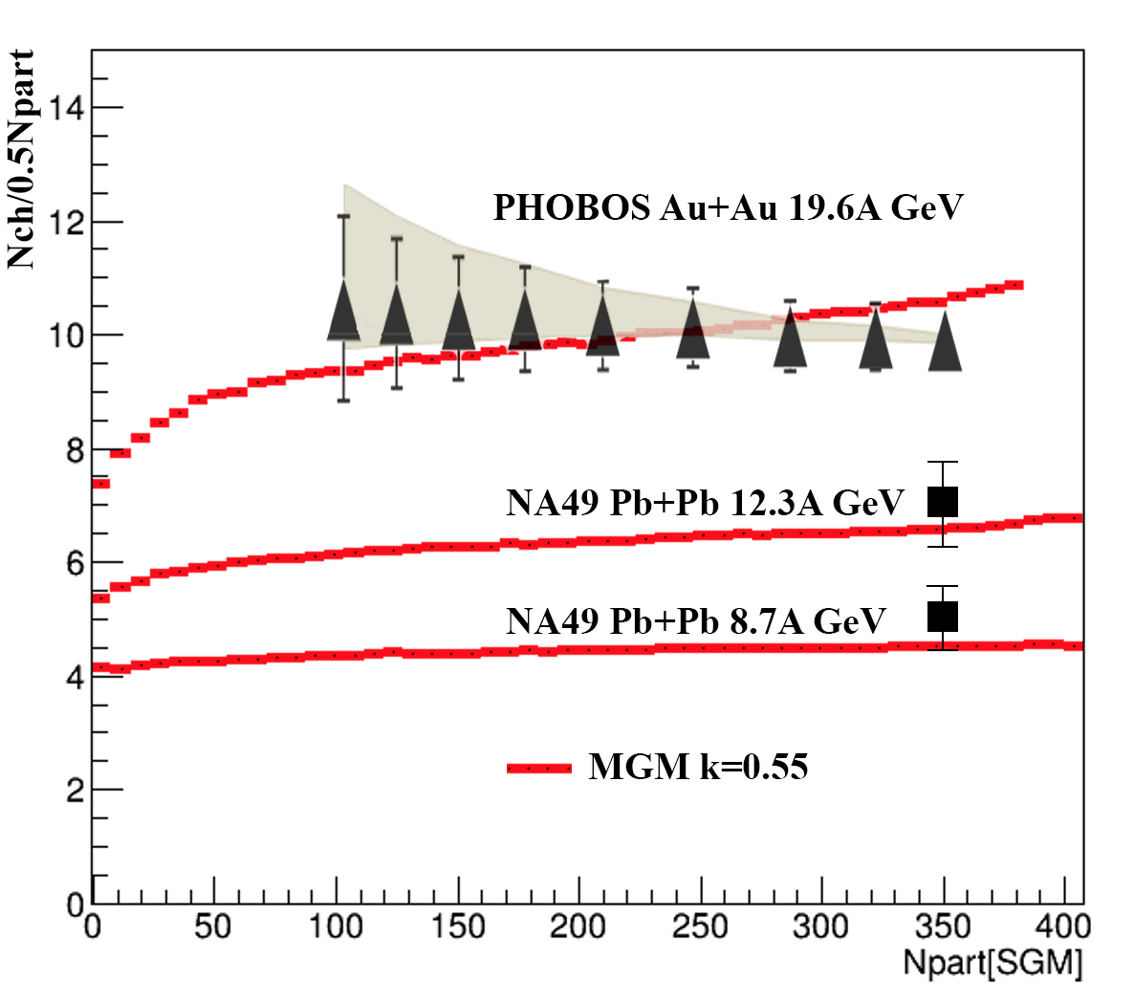
Modified Glauber Model [1] for Au+Au collisions at NICA energies
The fixed portion (1-k) of momentum in the center of mass system[1] is lost by nucleon in each inelastic collision
Losses are due to the production of charged and neutral particles
Parameter k is defined by fitting the available experimental data on charged-particle multiplicity yields in AA collisions
Modified Glauber Model (MGM) calculations for Au+Au collisions at NICA energies (red lines – new results [A.Seryakov,G.Feofilov])
[1] G. Feofilov, A. Ivanov, Journal of Physics G CS, 5, (2005) 230-237.

Slide 25
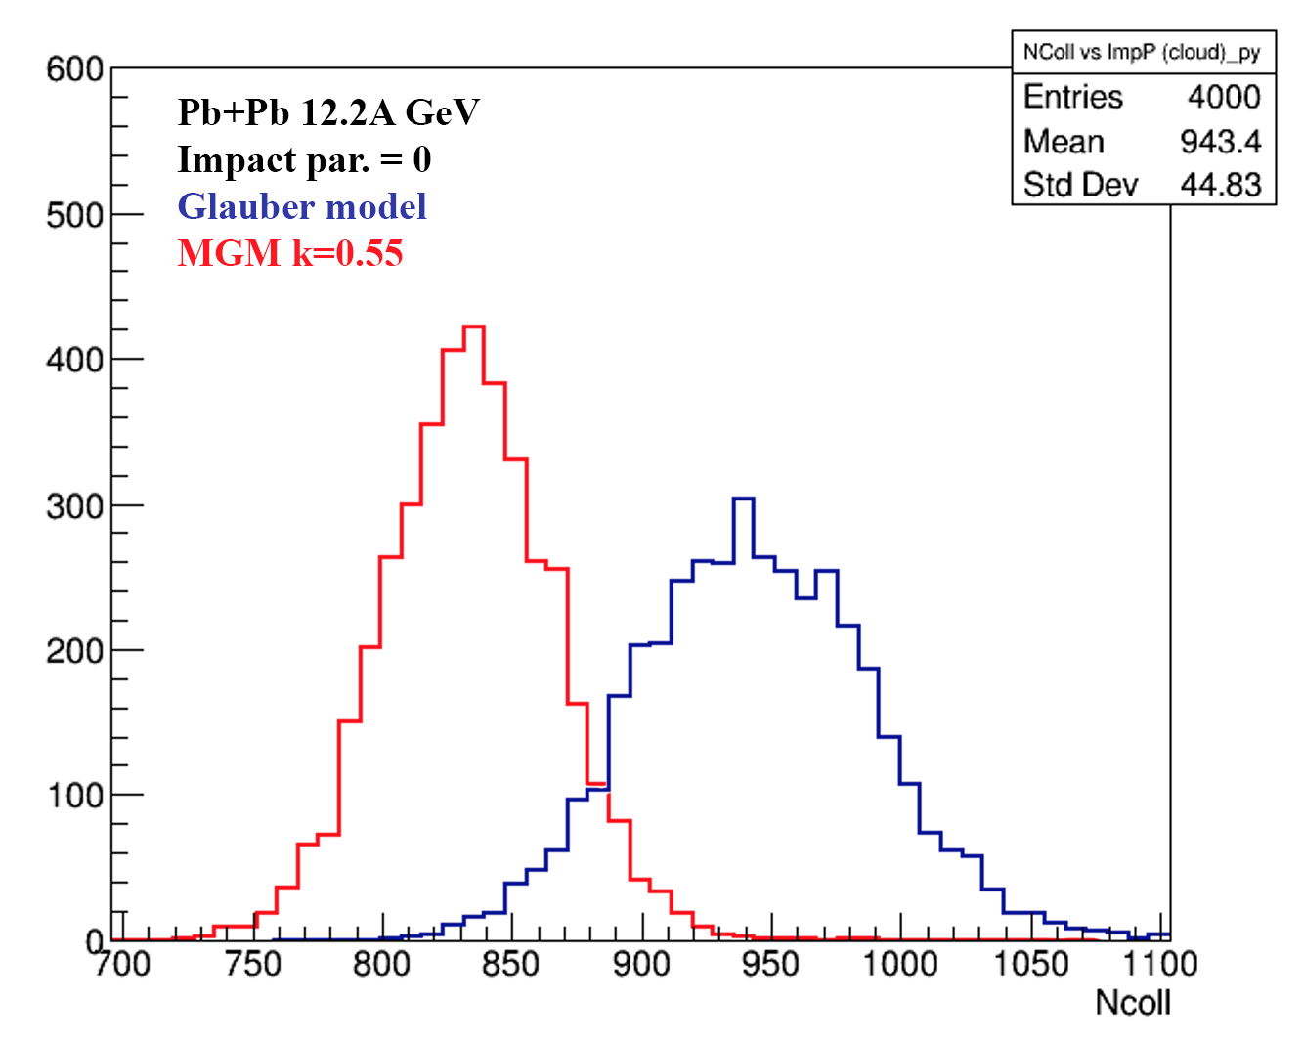
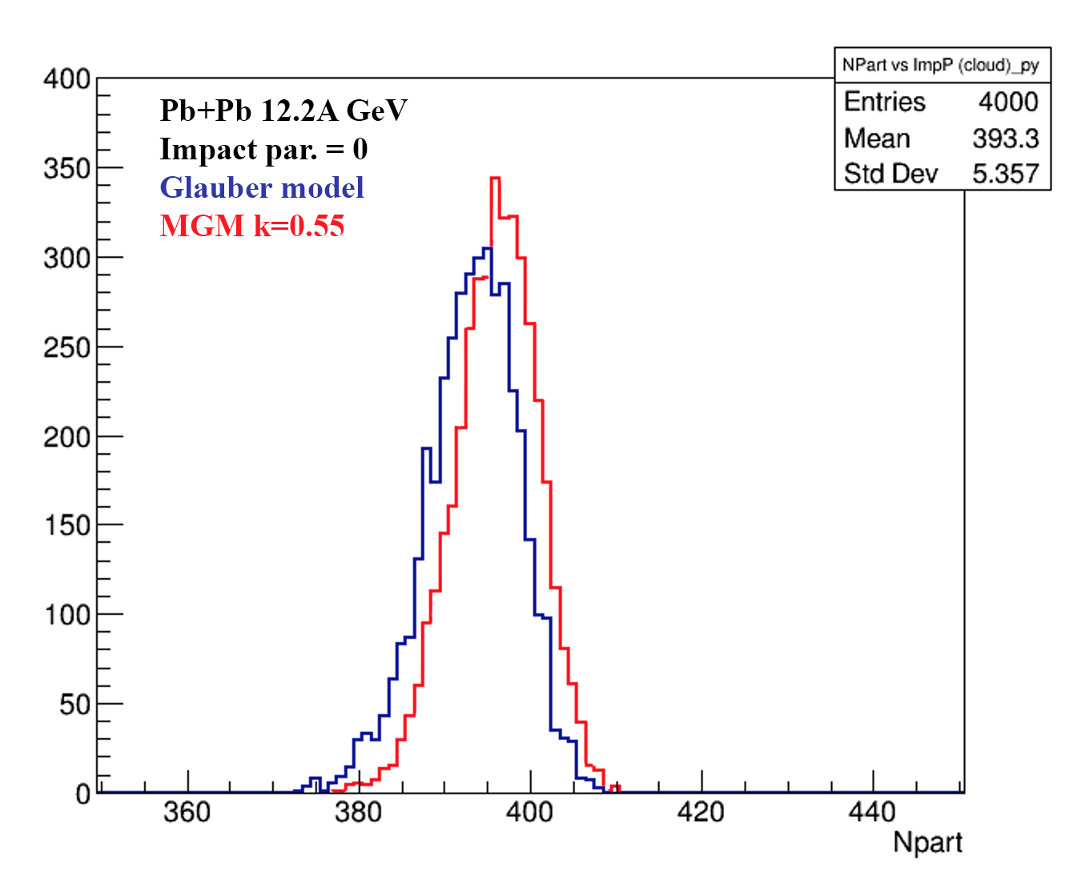
Sandard Glauber and MGM calculations for Au+Au collisions at NICA energies: fluctuation in N_{coll} and N_{part}
Glauber model and MGM calculations of N_{part} (left) and N_{coll} (right) for b=0 Au+Au collisions at NICA energies (red lines – new results [A.Seryakov,G.Feofilov])
Account of energy-momentum conservation in multiparticle production process decreases considerably values of N_{coll}

Slide 26
PWG1 strategy for 2020:
To define the main lines for the PWG1 aimed at the “FIRST-DAY” data analysis
To define and discuss and proceed with the long-term plans to be included into the MPD Physics Performance Report
To proceed with MC simulations
To proceed with regular reports and discussion at the PWG1 seminars
Keep in touch!

Slide 27
BACK-UP SLIDES

Slide 28
Physics at PWG1 meetings in 2019
23.07.2019, G.Feofilov (SPbSU,Russia), ”The 1st PWG1 meeting: Global observables - topics of interest”
03.09.2019 Vladislav Sandul (SPbSU,Russia),"Impact-parameter and multiplicity in nuclear collisions at NICA energies: SMASH modeling”
24.09.2019 Pedro Nieto (Mexican group), “Magnetic Fields in Heavy Ion Collisions at NICA energies”
17.10.2019 Denis Uzhva(SPbSU,Russia): Convolutional neural network for centrality in fixed target experiments
07.11.2019 Petr Parfenov (MEPhi), "Centrality Determination in Heavy-ion Collisions with MPD (NICA) using MC Glauber".

Slide 29
Physics at PWG1 meetings in 2020
16.01.2020, Prepartion for First Physics with MPD:
--G.Feofilov, Proposals for the physics analysis plans for the "First Day" MPD/NICA data
--Ivonne Maldonado, Proposals from Mexican group
--Alexander Ivashkin(INR), Petr Parfenov(MEPhI, Moscow), Classes of centrality for the 1st MPD data analysis data
30.01.2020, G.Feofilov, “Brief news from the PWG Convenors meeting: status of the preparation of the "First Physics" document”.
01.04.2020, “Discussion on existing productions: QA, issues/questions. “
Speakers: Alexander Mudrokh (JINR), Alexey Aparin (JINR), Andrey Seryakov (SPbSU), Daria Prokhorova (SPbSU), Evgeny Andronov (SPbSU), Igor Altsybeev (SPbSU), Pavel Batyuk (JINR), Peter Parfenov (MEPhI), Vladimir Kovalenko (SPbSU)

