Slide 1
Ivan Slepov, JINR, Dubna 20.04.2020
5th Collaboration Meeting of the BM@N Experiment at the NICA Facility
New architecture of the information services for BM@N

Slide 2
Nuclotron-based Ion Collider fAcility
BM@N
SPD
MPD

Slide 3
Introduction
Resources of information about the BM@N - 2019
mpd.jinr.ru – NICA experiments website
bmnshift.jinr.ru – first document server for BM@N
bmn.jinr.ru/experiments – first collaboration website
BMN.JINR.RU
Main website with links to all BM@N resources
Migration for centralized access to BM@N information and services

Slide 4
Main web services
bmn.jinr.ru – main website and links to all resources
But many web services required their own domains:
bmn-wiki.jinr.ru – documentation service
bmn-ipa.jinr.ru – Identity and Authentication service
bmn-elog.jinr.ru – Online Electronic Logbook
bmn-forum.jinr.ru – collaboration forum
bmn-tango.jinr.ru – Slow Control Interface
bmn-web.jinr.ru – BM@N Experiment Database
bmn-scheduler.jinr.ru – NICA Scheduler Configurator
git.jinr.ru/nica/bmnroot – BM@N software repositories

Slide 5
Main collaboration website
Website –
bmn.jinr.ru
Platform – WordPress
Architecture –
PHP + MySQL + WP Plugins
Apache with SSL
Server –
159.93.63.29

Slide 6
Main collaboration website
Information about:
Collaboration
Physics
Detectors
Software
Computing
Web Services
Example: HowTo page

Slide 7
Wiki documentation service
Website –
bmn-wiki.jinr.ru
Platform – Xwiki
Architecture –
Docker containers:
Xwiki + MySQL
Apache Reverse Proxy with SSL to Docker local port
Server –
159.93.63.29

Slide 8
Wiki documentation service
Documents about:
BM@N Subsystems
Run Control
SRC for BM@N
Comon documents
Reports
Software
Computing
Archive
Example: ZDC detector page

Slide 9
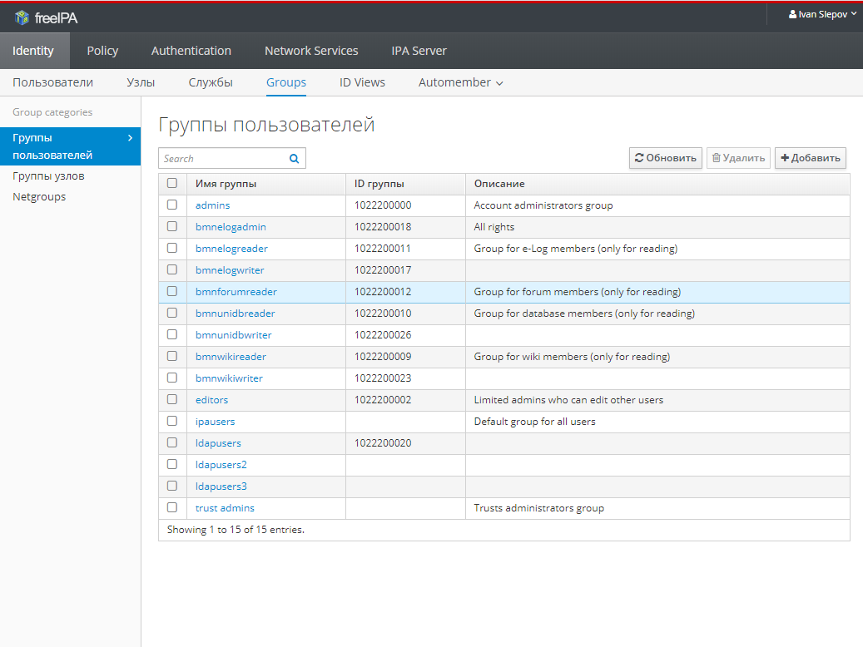
Identity and Authentication service
Website –
bmn-ipa.jinr.ru
Platform – FreeIPA
Architecture –
bind + sssd + krb5 + apache with SSL
Server –
159.93.63.23

Slide 10
Identity and Authentication service
Resource Access Request
Web page –
bmn.jinr.ru/registration/
The required fields are filled in and the request is sent by e-mail to the resource manager
It is impossible to register yourself on the resources only by sending this request
You must specify the mail, select resources and specify the necessary rights

Slide 11
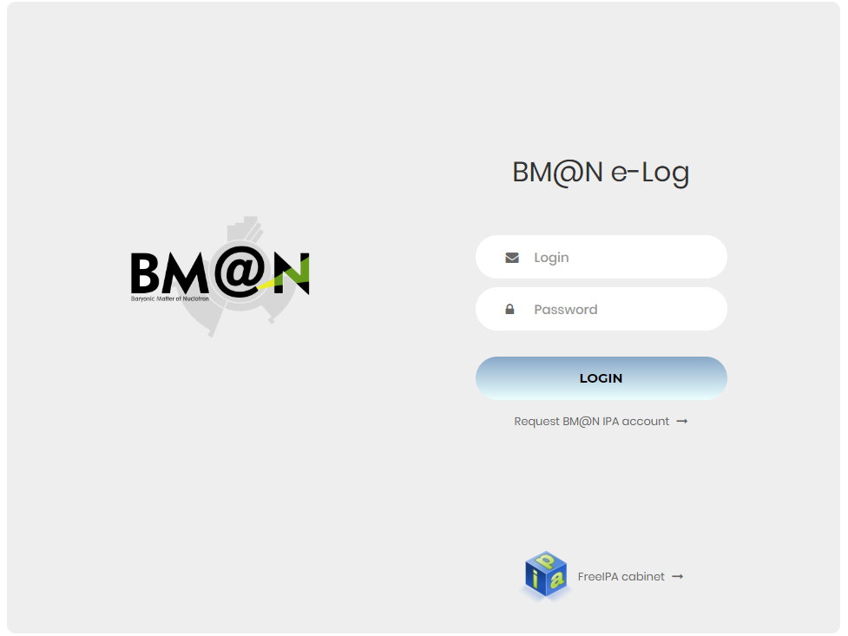
Online Electronic Logbook
Website –
bmn-elog.jinr.ru
Platform – self-written
Architecture –
PHP + PostgreSQL
Apache with SSL
Server –
159.93.63.29

Slide 12
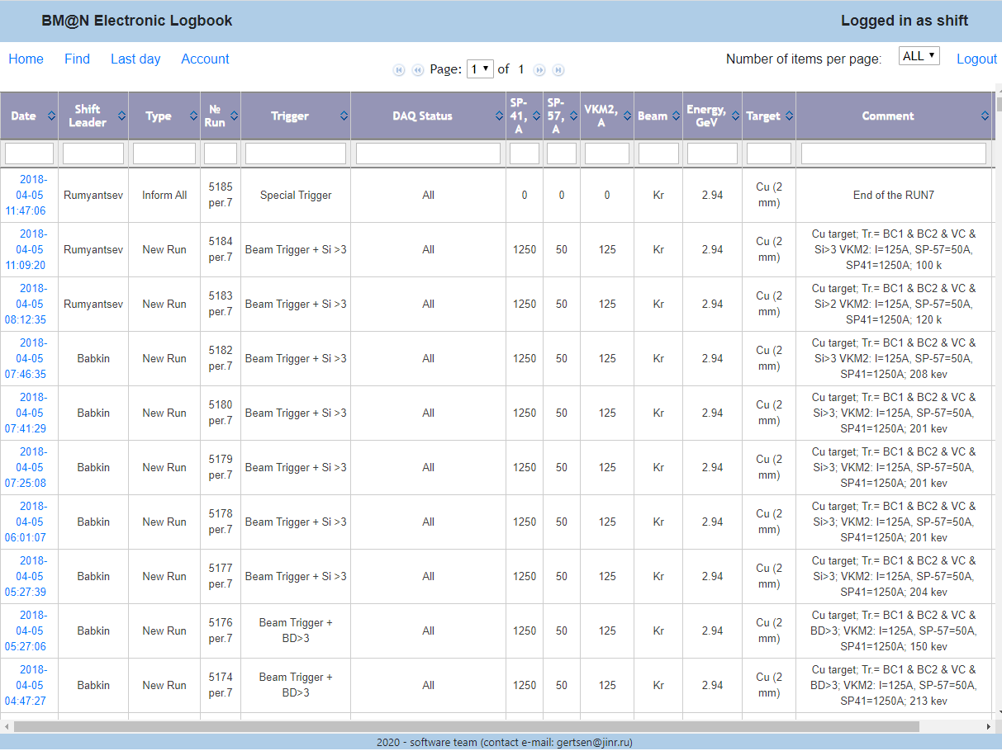
Online Electronic Logbook
Information about runs:
Date
Shift Leader
Type of record
Number of run
Trigger
DAQ status
SP-41
SP-57
VKM2
Beam
Energy
Target
Comments
Example: last runs

Slide 13
Collaboration forum
Website –
bmn-forum.jinr.ru
Platform – Discourse
Architecture –
Docker containers with
own launcher
Redis + sidekiq + Discourse Nginx + PostgreSQL
Apache Reverse Proxy with SSL on Docker local port
Server –
159.93.63.29

Slide 14
Collaboration forum
Forum groups:
News
Support
Software development
Event reconstruction
Particle Identification
Data Analysis and Simulation
Hyperon Reconstruction and Simulation
SRC Data Analysis and Simulation
Physics Analysis Issues
Example: software group page

Slide 15
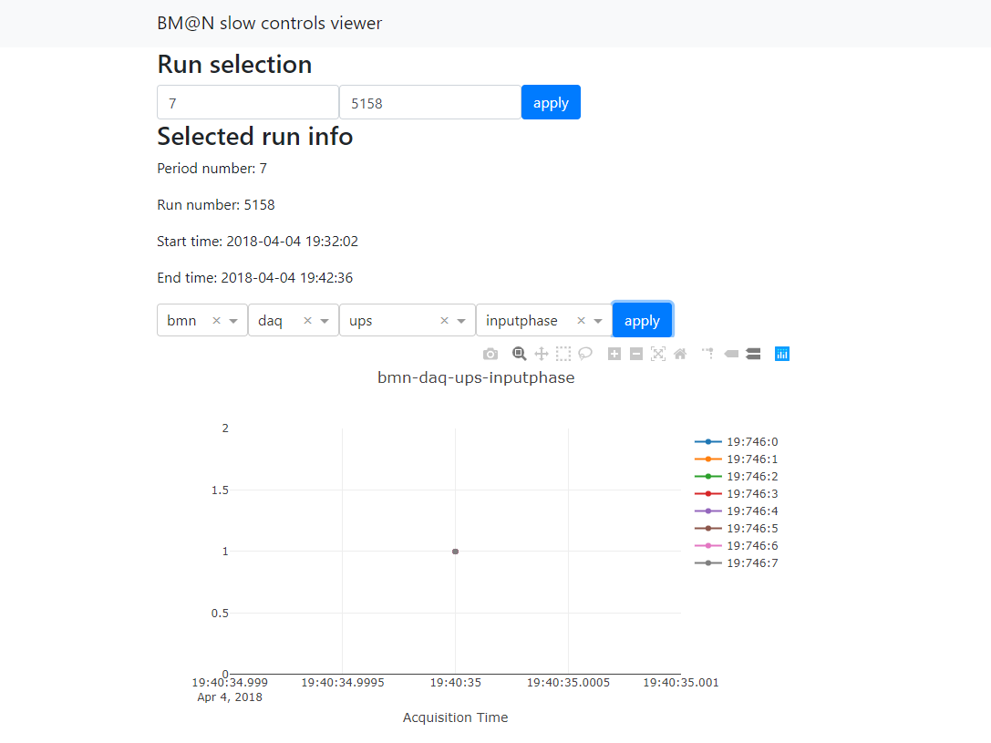
Slow Control Interface
Website –
bmn-tango.jinr.ru
Platform – self-written
Architecture –
Docker containers with
own launcher
Python + PostgreSQL
Apache Reverse Proxy with SSL on Docker local port
Server –
159.93.63.29

Slide 16
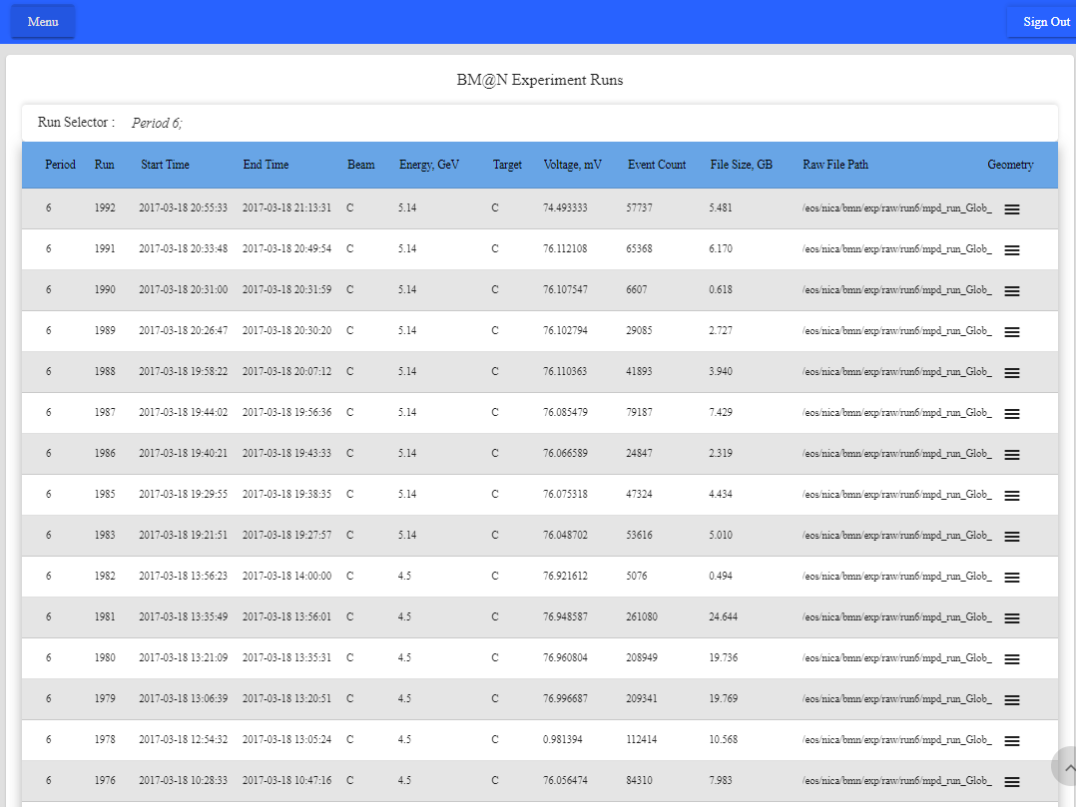
BM@N Experiment Database
Website –
bmn-web.jinr.ru
Platform – Vue.js
Architecture –
NPM + Vue.js + RawGit + PostgreSQL
Server –
159.93.36.68

Slide 17
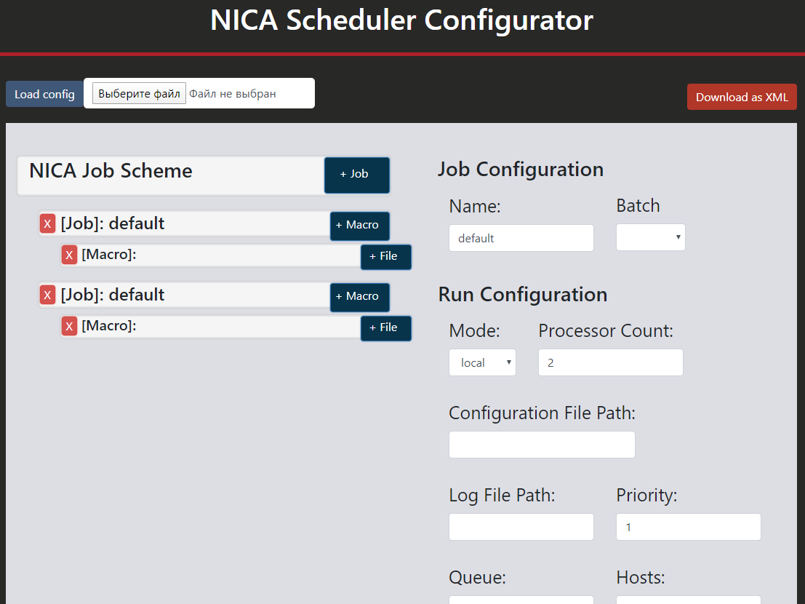
NICA Scheduler Configurator
Website –
bmn-scheduler.jinr.ru
Platform – self-written
Architecture –
HTML + JavaScript
Apache
Server –
159.93.63.29

Slide 18
Conclusion
The services reviewed are constantly evolving, so stay tuned for the main website and collaboration forum
The current web services architecture is completely fine with us
We try to keep up to date and use the latest software technologies for the development of BM@N collaboration services

Slide 19
Thank you for your attention!

