Slide 1
Online Electronic Logbook Improvement for the future BM@N runs
A. Chebotov, K. Gertsenberger, A. Moshkin
Veksler and Baldin Laboratory of High Energy Physics, JINR

Slide 2
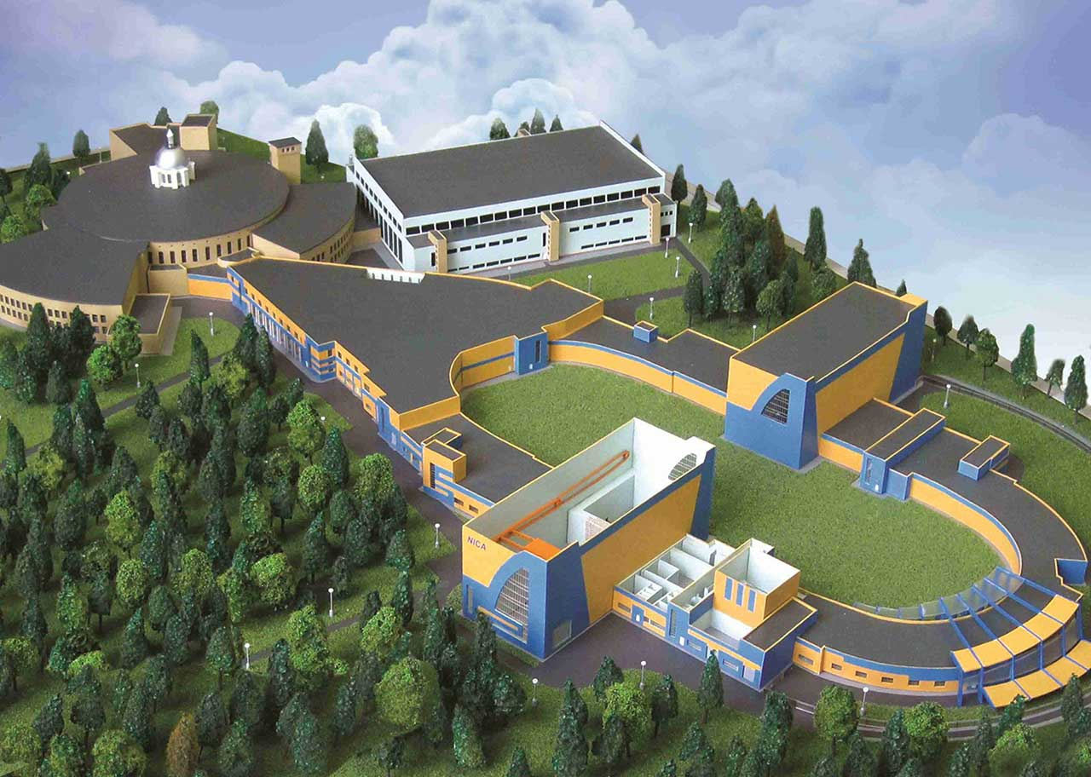
Nuclotron-based Ion Collider fAcility
BM@N
Nuclotron
SPD
MPD
Beams: from $d^{↑}, C$to${Au}^{79+}$
Fixed target experiment: BM@N (2018)
Official site: bmn.jinr.ru
Trigger rate: up to ${5∗10}^{5}$($2022−2023$)
Collision energy: $E_{lab}$ = 1 – 6 AGev
20 April 2020
2

Slide 3
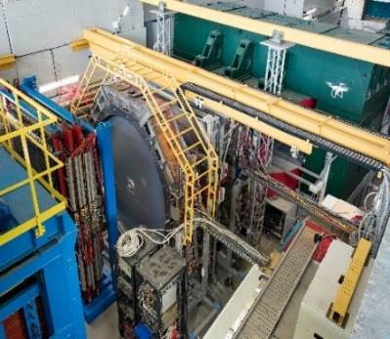
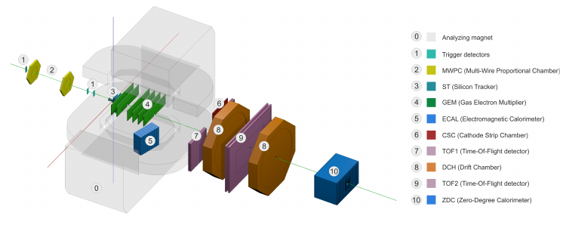
Baryonic Matter @ Nuclotron
BM@N Sessions (2015 – 2018)
Session №51 (d,C) Feb. 22 – Mar. 15, 2015
Session №52 (d) June 29 – June 30, 2016
Session №53 (d, $d^{↑}$) Dec. 9 – Dec. 23, 2016
Session №54 (C) Mar. 7 – Mar. 18, 2017
Session №55 (C,Ar,Kr) Mar. 3 – Apr. 05, 2018
20 April 2020
3

Slide 4
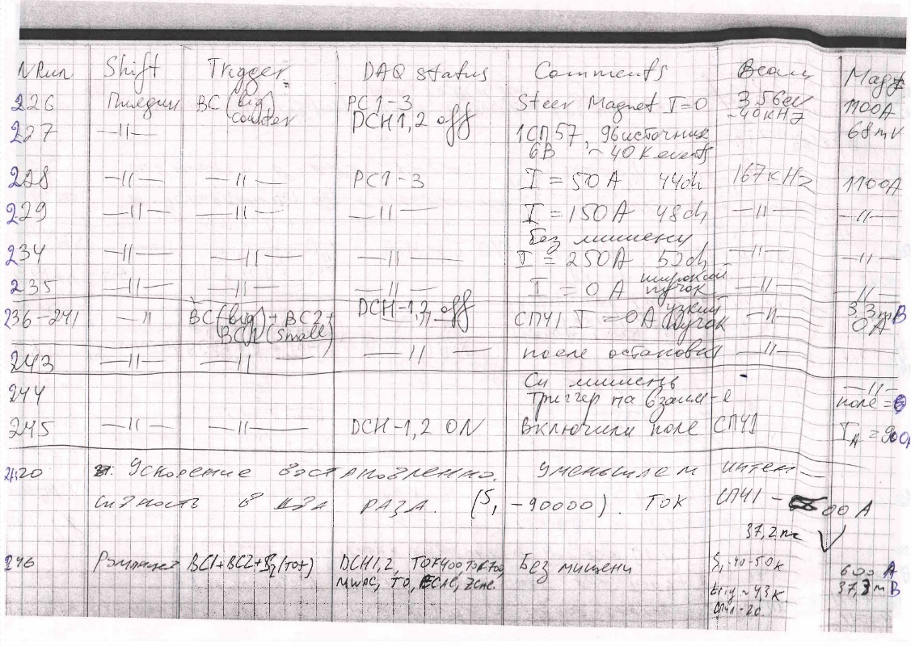
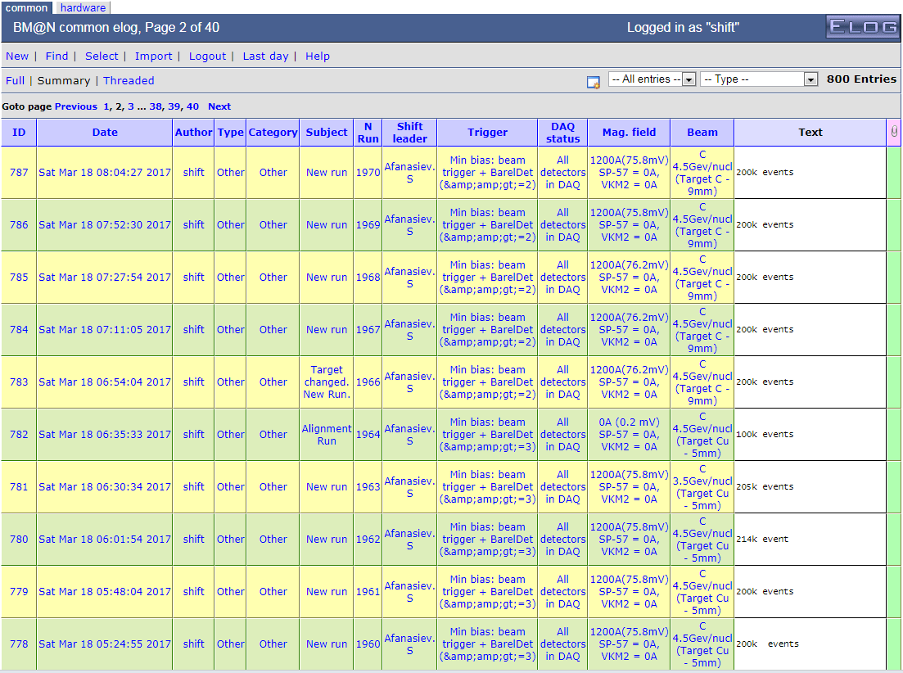
Old Version of the logbook: electronic Web-table
20 April 2020
4

Slide 5
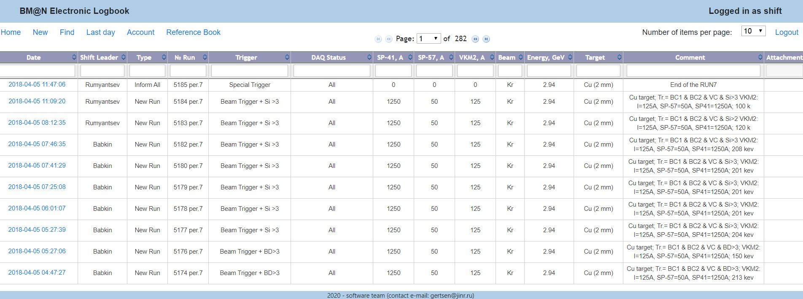
Current version of the logbook: electronic Web-table
Create a
new run
Current
day records
Work with
dictionary
Number of records per page
Username
Advanced find
Cabinet
Page number
Fast
search
20 April 2020
5

Slide 6
Electronic Logbook
What is an e-Log and why is it needed?
The online electronic logbook allows shift members to record information on current events, states of various systems, operation conditions of detectors., which are further used in processing and physics analysis of the particle collision events.
The system provides collaboration members with tools for convenient viewing, managing and searching for the required information in the logbook.
20 April 2020
6

Slide 7
e-Log platform
The e-Log platform uses a developed Logbook Database based on PostgreSQL.
The e-Log uses the implemented Logbook Database to store the experiment logbook data, ensure correct multi-user access, data consistency, integrity and provide automatic regular data backup for cases of software errors or hardware failures.
Developed interfaces provides an unified access to required logbook data for various online and offline systems, such as: BmnRoot and Online Monitoring
A part of e-Log data is automatically transferred to the Unified Database of the experiment to use in offline analysis.
20 April 2020
7

Slide 8
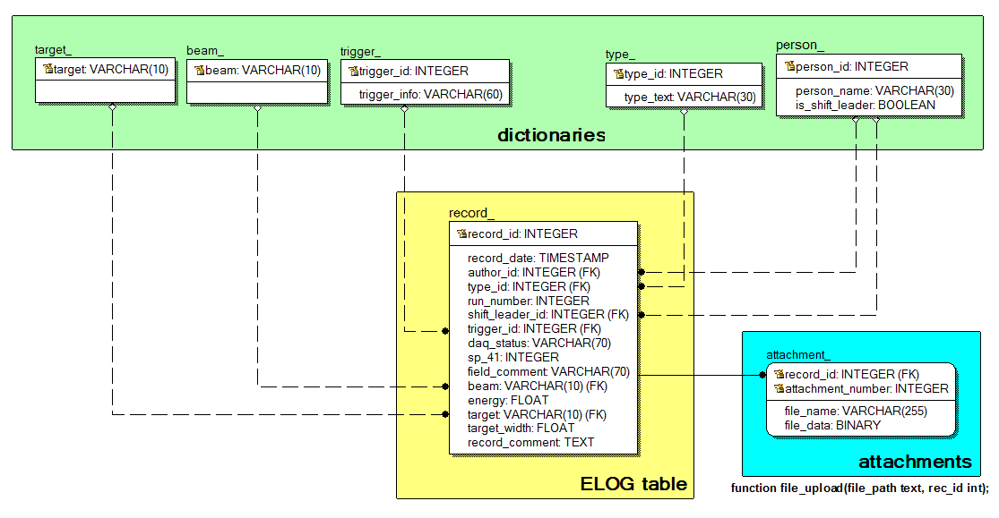
e-Log database scheme
20 April 2020
8

Slide 9
e-Log dictionary
The main table with all logbook records (record_ table located in the center of the figure) uses the following set of dictionaries:
a dictionary of all possible beam particles;
a dictionary of all possible targets;
a dictionary of all possible trigger types;
a dictionary of record types, such as ‘shift started’, ‘problem report’, ‘configuration’, ‘new run’;
a list of the collaboration members.
20 April 2020
9

Slide 10
e-Log: Authentication/Authorization service
Three-step process
Identification
Authentication
Authorization
Identification happens when a user claims an identity.
That is the authentication process: verifying a claimed identity.
This stage provides access to functions the service (system) depending on access only do what you have permissions
Access control systems grants access to resources only to users whose identity has been proved and having the required permissions.
20 April 2020
10

Slide 11
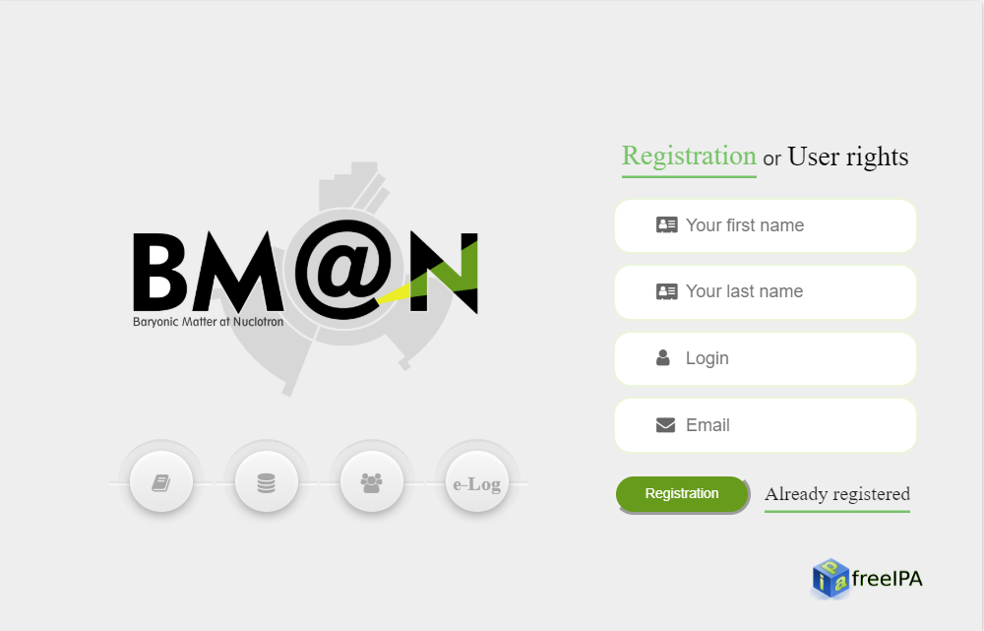
e-Log: Authentication/Authorization service
20 April 2020
11
Notes:
Тут 3 картинки с анимацией

Slide 12
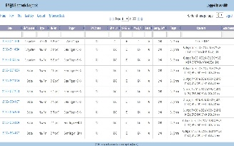
e-Log: Access scheme
admins
shift
operators
users
Web
interface
Database
20 April 2020
12

Slide 13
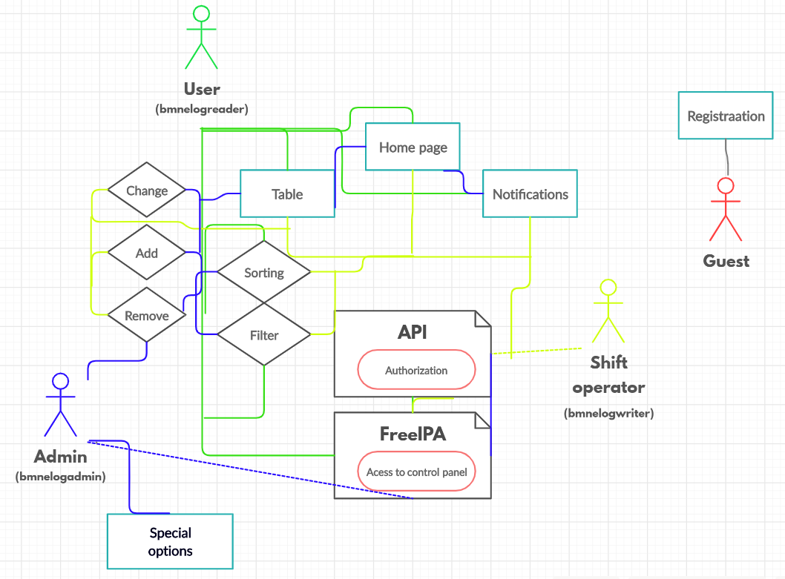
e-Log: Group users
20 April 2020
13

Slide 14
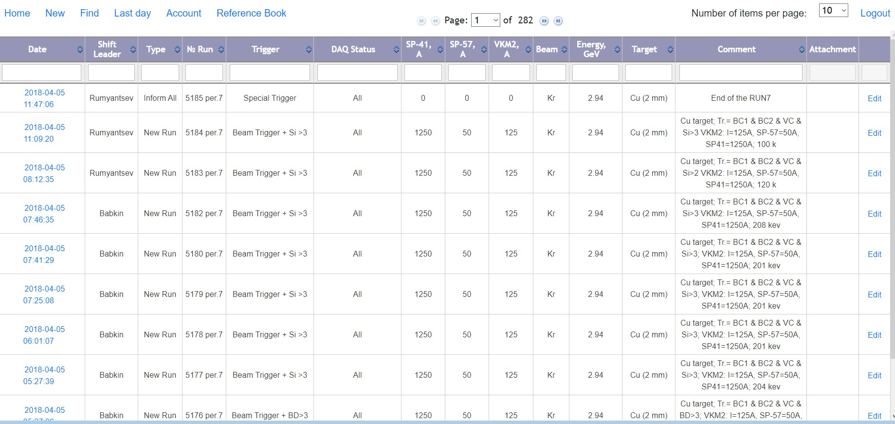
e-Log: Functions
Administrator access
20 April 2020
14

Slide 15
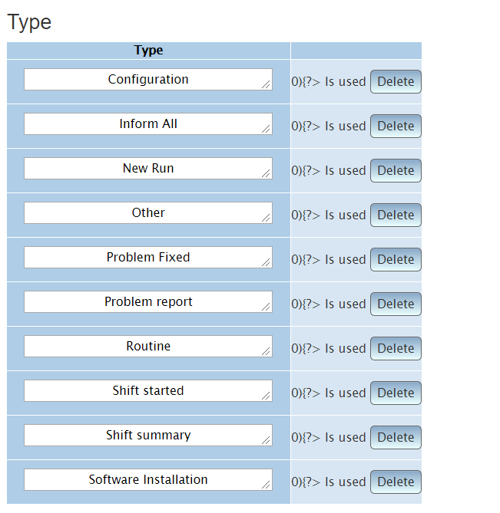
e-Log: Functions
Dictionary of installed event type
Advanced administrator settings
20 April 2020
15
Notes:
Problem fixed– это сообщение типа “проблема исправлена” Problem report– сообщение о возникшей проблеме
Routine– какой-то этап наладки работы
Software installation – сообщение о новом программном обеспечении

Slide 16
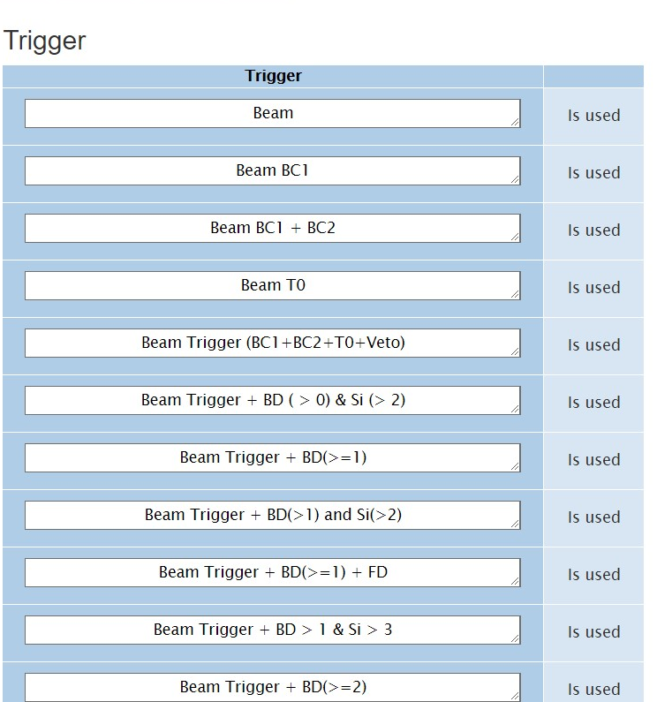
e-Log: Functions
Dictionary of installed event triggers
Advanced administrator settings
20 April 2020
16

Slide 17
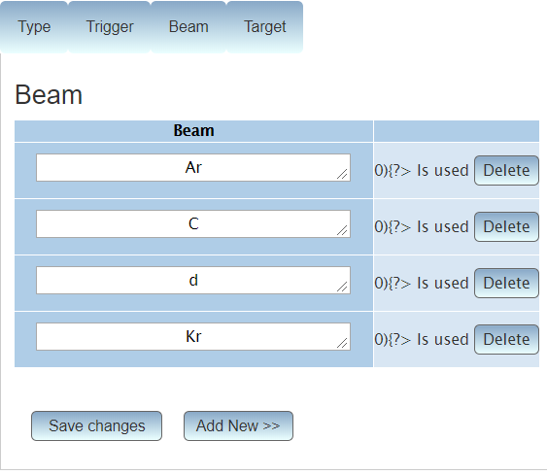
e-Log: Functions
Dictionary of installed event beam
Advanced administrator settings
20 April 2020
17

Slide 18
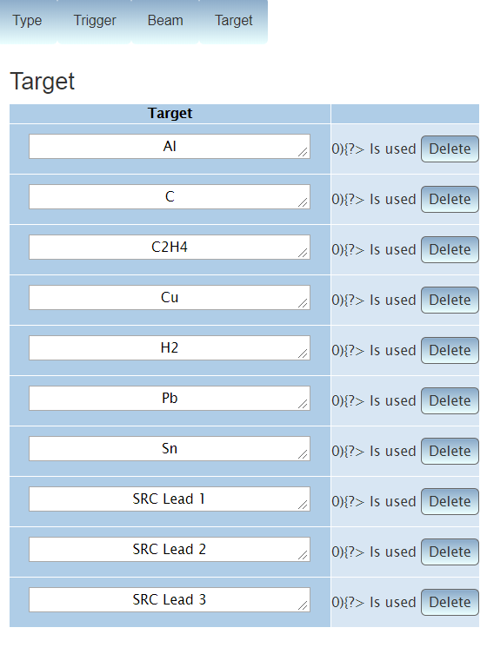
e-Log: Functions
Dictionary of installed event target
Advanced administrator settings
20 April 2020
18

Slide 19
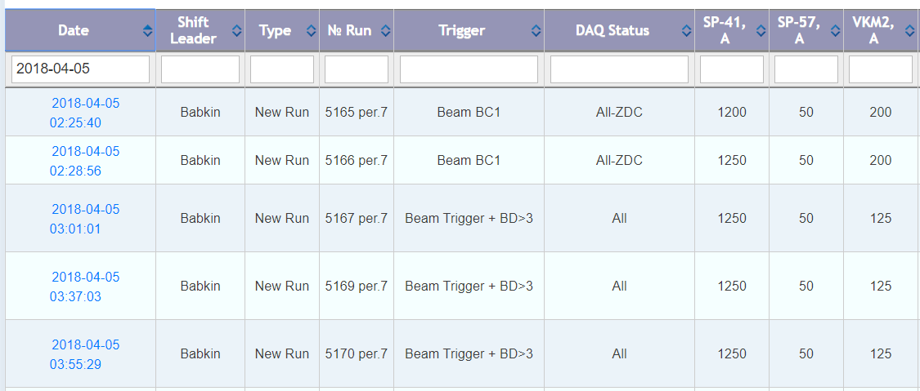
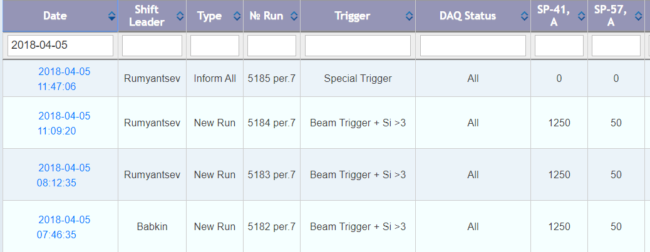
e-Log: Functions
Sort data by selected parameters
20 April 2020
19

Slide 20
e-Log: Functions
Fast data filtering
20 April 2020
20

Slide 21
e-Log: Last day
is a useful feature during sessions
This is a table of current day events for shift work.
20 April 2020
21

Slide 22
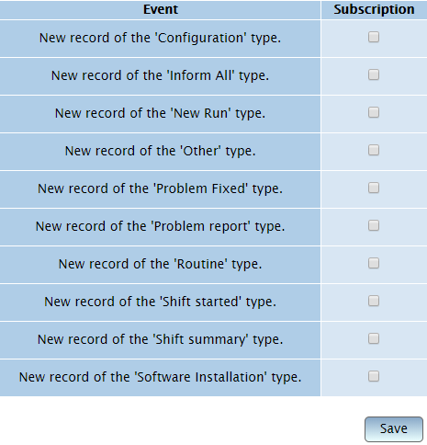
e-Log: Account
In your account you can subscribe to the newsletter for selected types of events
20 April 2020
22

Slide 23
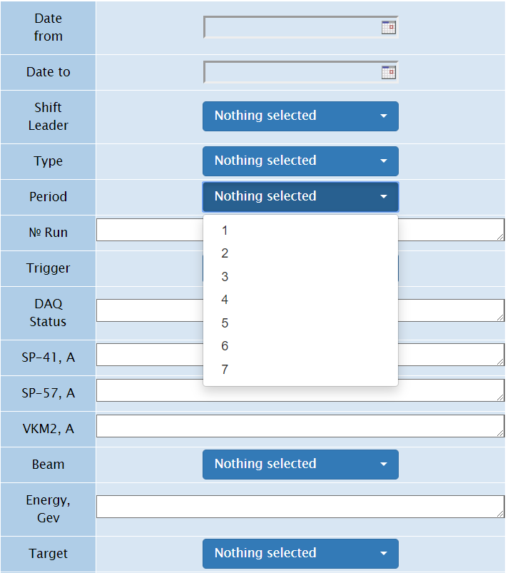
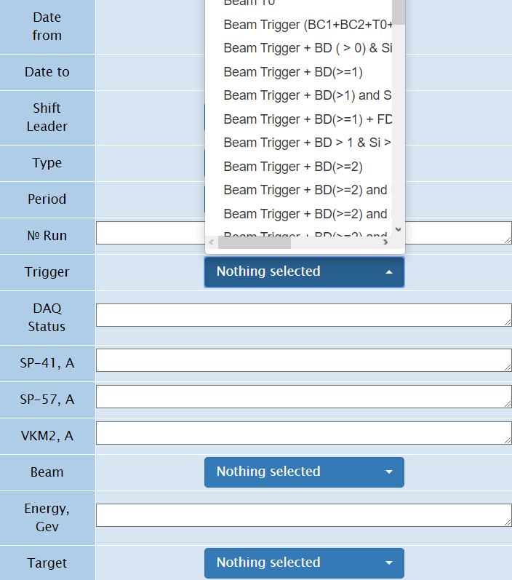
e-Log: Functions
Advanced filter
20 April 2020
23

Slide 24
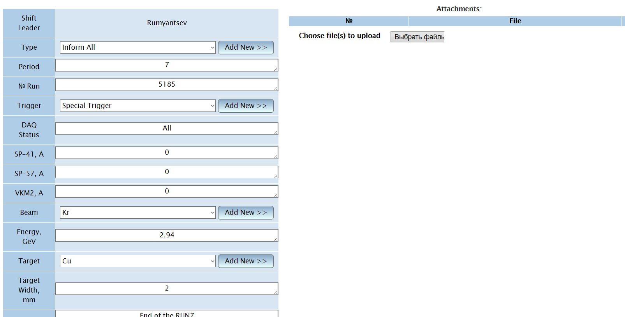
e-Log: Functions
Only users belonging to the administrator or shift operators role can create or change records.
20 April 2020
24

Slide 25
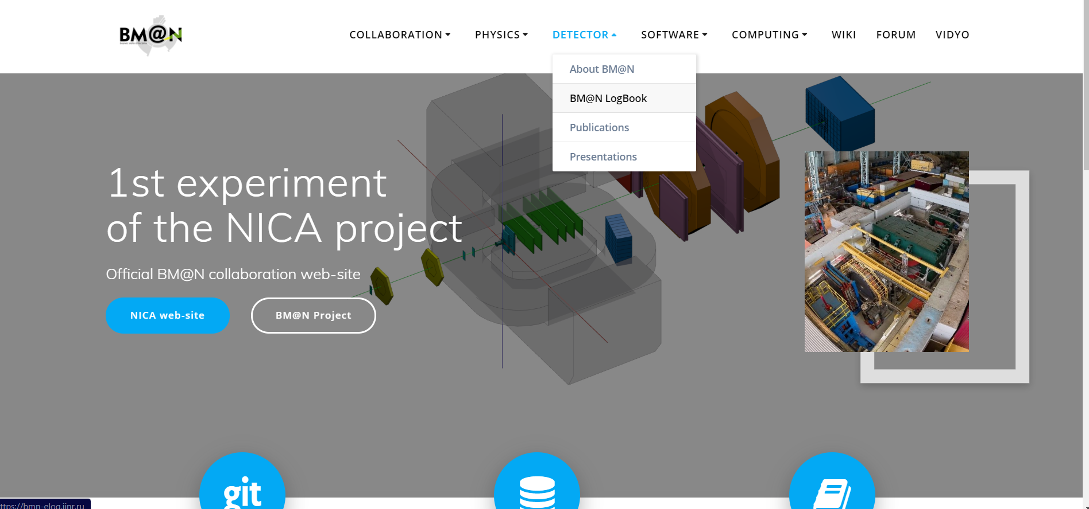
e-Log on the BM@N official Web site
20 April 2020
25

Slide 26
Summary
e-Log platform is an information system for viewing, modifying and visualizing the information on BM@N experiment for shift crews. Platform stored information of events or problems occurring in the experiment during its operation.
The e-Log system uses the developed Logbook Database based on PostgreSQL which ensures data consistency, integrity and automatic backup of the stored data.
The platform integrates access control functions for service administrators using the FreeIPA system.
RFBR support with the NICA three-year grant (№18-02-40125) enables to develop and improve the Information Systems for online and offline data processing including the online Electronic Logbook system.
20 April 2020
26
Notes:
Буквы расползлись

Slide 27
Thank you for your attention!
20 April 2020
27

Slide 28
20 April 2020
26

Slide 29
20 April 2020
26

