Slide 1
Visualization and auxiliary tools development in BM@N experiment
Peter Klimai

Slide 2
MIPT-NPM Projects for BM@N
MIPT-NPM projects for BM@N:
Visualization service event display
Monitoring service
NICA-Scheduler multiplatform GUI
Slow control viewer
The work is supervised by Tagir Aushev from MIPT-HEP laboratory.
About MIPT-NPM:
http://npm.mipt.ru/ru/
https://research.jetbrains.org/groups/npm

Slide 3
Visualization – Event Display Next-Gen
Sponsored by

Slide 4
Service-based architecture
Harder to implement, but much easier to maintain
Services could be developed or replaced without changing core functionality
Fast service development cycle
Easy to move to new infrastructure or scale
https://dev.to/alex_barashkov/microservices-vs-monolith-architecture-4l1m
Notes:
Monolith problems:
All components use tight coupling -> a lot of errors
Everything must be deployed as a single bundle/framework -> slow feature implementation
Must be one size to fit them all -> no customization

Slide 5
Visualization as a service
Visualization runs as a stand-alone service
It communicates with other services via HTTP
The service itself uses plugin system to include new visualization types
Adapters are made to convert ROOT/GEANT/whatever format into visualization tree

Slide 6
Introducing DataForge-VIS
Developed as Kotlin multiplatform application
Available at https://github.com/mipt-npm/dataforge-vis
DataForge-VIS features
Working Three-JS rendering engine
Caching and template usage for performance optimization
Styling capabilities
Layering
Implementation for all primitives needed for BM@N geometry
Basic online object manipulation capabilities
Complete reader for GDML format

Slide 7
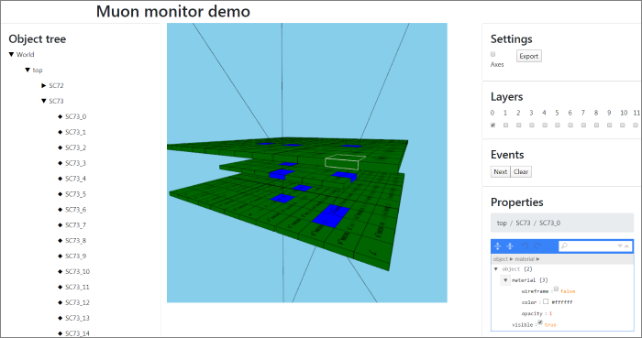
Muon Monitor Demo

Slide 8
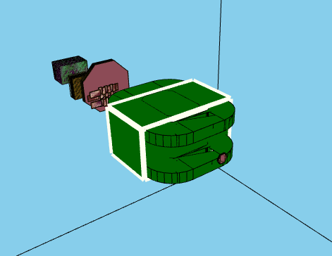
BM@N Geometry

Slide 9
Current work and plans
Finalization of ROOT plugin to convert TGeoManager to JSON
https://github.com/Unrealf1/RootExtraction
VR via Three-JS
OpenGL backend
Non-3D plugins
jupyter-kotlin integration (JetBrains internships, summer 2020)

Slide 10
Monitoring Service

Slide 11
Monitoring Service - Task
Monitoring Service Features
Ping and PG-SQL request to check database status
Configurable via JSON file
Email notifications
Response time stored in InfluxDB
Use Grafana for visualization and additional alerting
Sources:
https://git.jinr.ru/nica/bmnroot/-/tree/dev/uni_db/services/monitoring

Slide 12
Monitoring Service - Components
Monitoring Service
Monitored Host(s)
Monitored Hosts
Monitored Hosts
Mail server
ICMP ping
PG-SQL request
InfluxDB
Grafana Web UI
Grafana

Slide 13
Configuration File Example
{
"PING": {
"server1": {
"IP": "192.168.65.116",
"NOTIFY": "mail1.jinr.ru"
},
"router1": {
"IP": "10.254.0.41",
"NOTIFY": "mail2.jinr.ru"
}
},
"DATABASE": {
"server1": {
"SERVER": "192.168.65.116",
"DBMS": "PGSQL",
"PORT": 5432,
"DBNAME": "testdb",
"USER": "testuser",
"PASS": "***",
"NOTIFY": "mail3.jinr.ru"
},
"server-centos2": {
"SERVER": "192.168.65.62",
"DBMS": "PGSQL",
"PORT": 5432,
"DBNAME": "books_store",
"USER": "bookuser",
"PASS": "***",
"NOTIFY":
"mail5.jinr.ru,mail6.jinr.ru"
}
},
"OUTPUT": {
"DBMS": "INFLUXDB",
"SERVER": "192.168.65.52",
"PORT": 8086,
"DBNAME": "pgsqltest",
"USER": "influx",
"PASS": "***",
"NOTIFY": "mail1.jinr.ru,mail2.jinr.ru"
},
"INTERVAL_SEC": 60,
"MAIL": {
"SERVER": "smtp.yandex.ru",
"PORT": 587,
"USER": "***",
"PASS": "***"
},
"LOG": "mail1.jinr.ru,mail2.jinr.ru",
"NAME": "Monitoring Service"
}

Slide 14
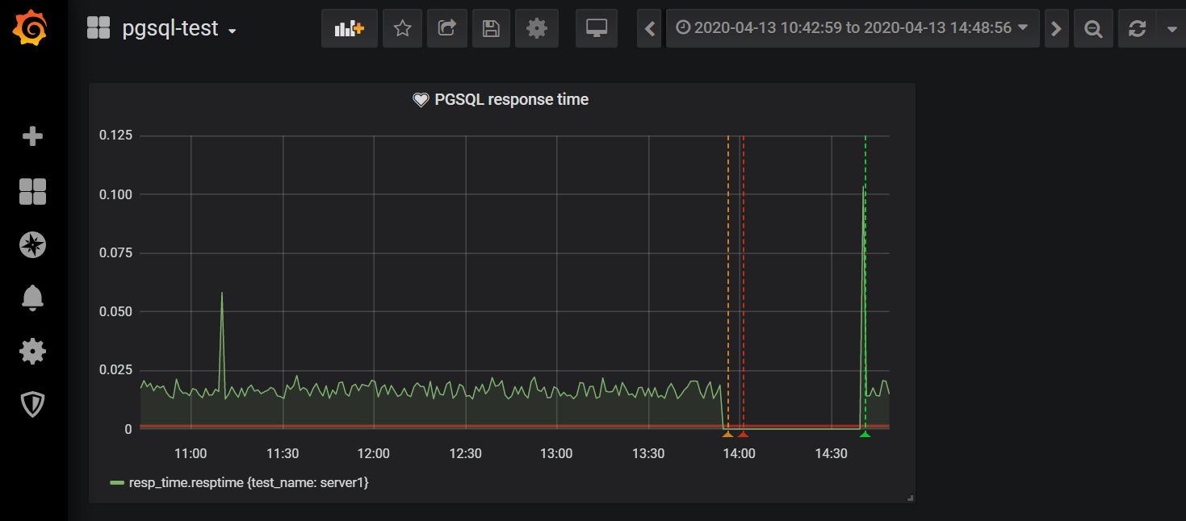
Grafana View

Slide 15
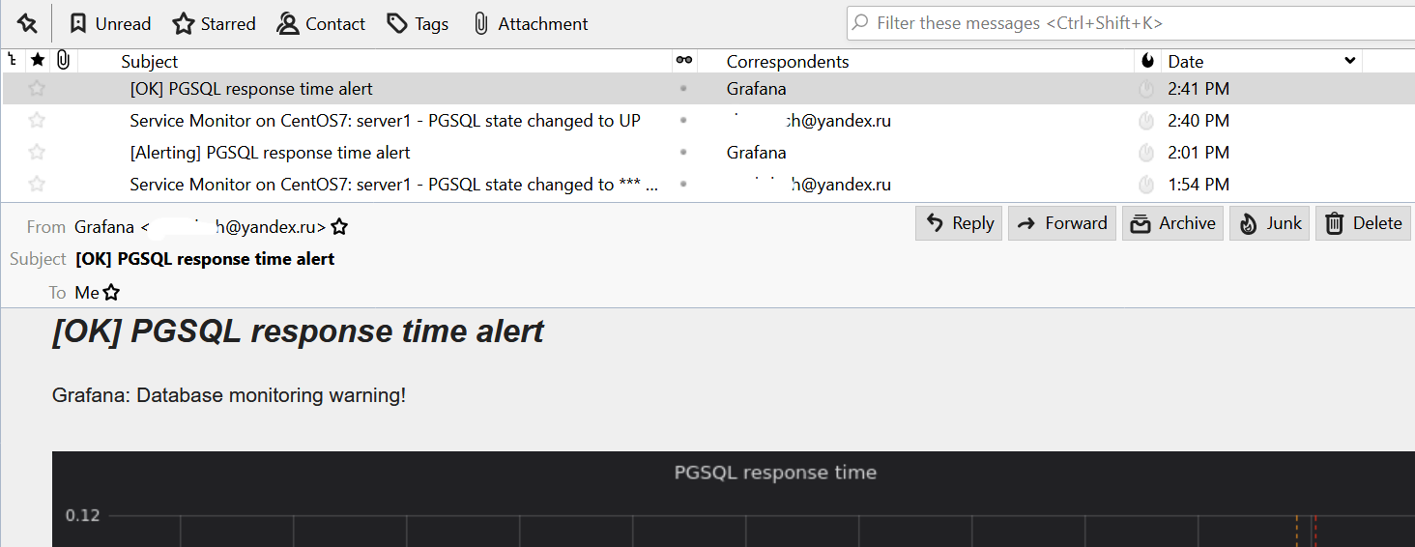
Email Examples

Slide 16
Scheduler-GUI

Slide 17
NICA Scheduler Configurator: Task
NICA-Scheduler is a module of BmnRoot software
Uses existing batch system (SLURM, SGE, Torque) to distribute user jobs on the cluster
Jobs for distributed execution are described and passed as XML file: $ nica-scheduler my_job.xml
Details: http://bmn.jinr.ru/nica-scheduler/
Task: Create a GUI editor for scheduler XML files

Slide 18
Example of NICA-Scheduler Job
<job name="reco_job">
<macro path="$VMCWORKDIR/macro/mpd/reco.C" start_event="0" event_count="1000" add_args="local">
<file input="$VMCWORKDIR/macro/mpd/evetest1.root" output="$VMCWORKDIR/macro/mpd/mpddst1.root"/>
<file input="$VMCWORKDIR/macro/mpd/evetest2.root" output="$VMCWORKDIR/macro/mpd/mpddst2.root"/>
<file sim_input="energy=3,gen=urqmd" output="~/mpdroot/macro/mpd/evetest_${counter}.root"/>
</macro>
<run mode="global" count="25" config="~/mpdroot/build/config.sh"/>
</job>
It is perfectly fine to create such a file using a text editor.
You have to remember or look up XML tag and attribute names and make sure XML syntax is valid.

Slide 19
NICA-Scheduler-GUI Details
Written as a Kotlin Multiplatform application
Runs as JavaScript in browser, or in JVM
Using the same data model defined in Common part
Libraries used:
xmlutil (https://github.com/pdvrieze/xmlutil)
Kotlinx-HTML (https://github.com/Kotlin/kotlinx.html)
Bootstrap (https://getbootstrap.com/)
TornadoFX (https://github.com/edvin/tornadofx)
Available at https://git.jinr.ru/nica_modules/mpd-scheduler-gui

Slide 20
Going multiplatform
JVM
JVM
Cross-platform on desktops
Easier to develop and maintain
In future can support: Full execution control
Problems with deployment on systems without JVM
JavaScript GUI using the same model
Does not require installation. Could be run from Web site or from local file
Shares model with desktop via Kotlin-multiplatform technology
Has almost the same functionality
JS

Slide 21
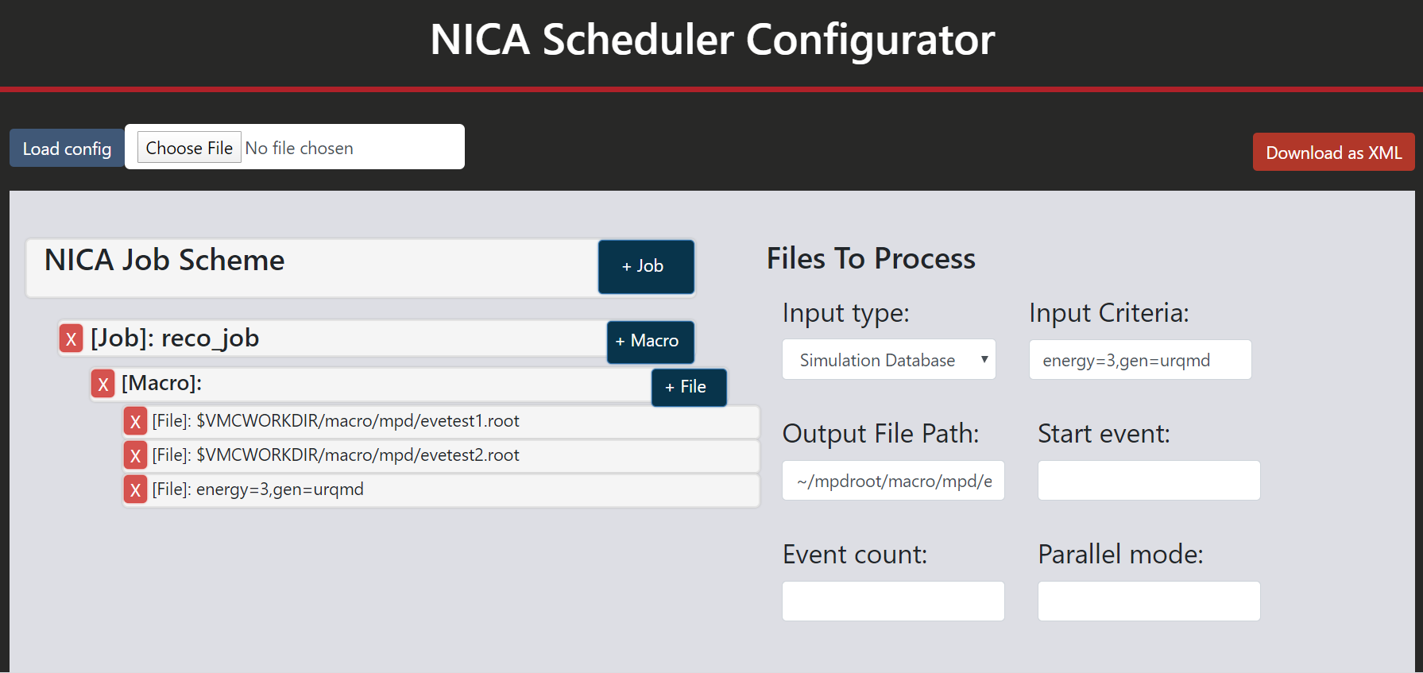
New design for JS version

Slide 22
Slow Control Viewer

Slide 23
Slow control viewer example
SC data
Run data

Slide 24
Slow control viewer status
All components prepared and tested
Repository available at https://git.jinr.ru/vchernov/bmn-visualisation

Slide 25
Thank You!

