Slide 1
Project Activity Report "Development of a wide-aperture backscattering detector (BSD) for the HRFD diffractometer".
THEME: Development of Experimental Facilities for Condensed Matter Investigations with Beams of the IBR-2 Facility
THEME CODE: 04-4-1122-2015/2020
Authors:
Balagurov А.М. | - Dubna, JINR
Bobrikov I.А. | - Dubna, JINR
Bokuchava G.D | - Dubna, JINR
Kruglov V.V. | - Dubna, JINR
Simkin V.G. | - Dubna, JINR
PROJECT LEADER Kruglov V.V.

Slide 2
Table of contents
Introduction
Description of the wide-aperture backscattering detector (BSD)
Technical design of the backscattering detector (BSD) at HRFD
Work stages and project costs
Infrastructure and staff
References

Slide 3
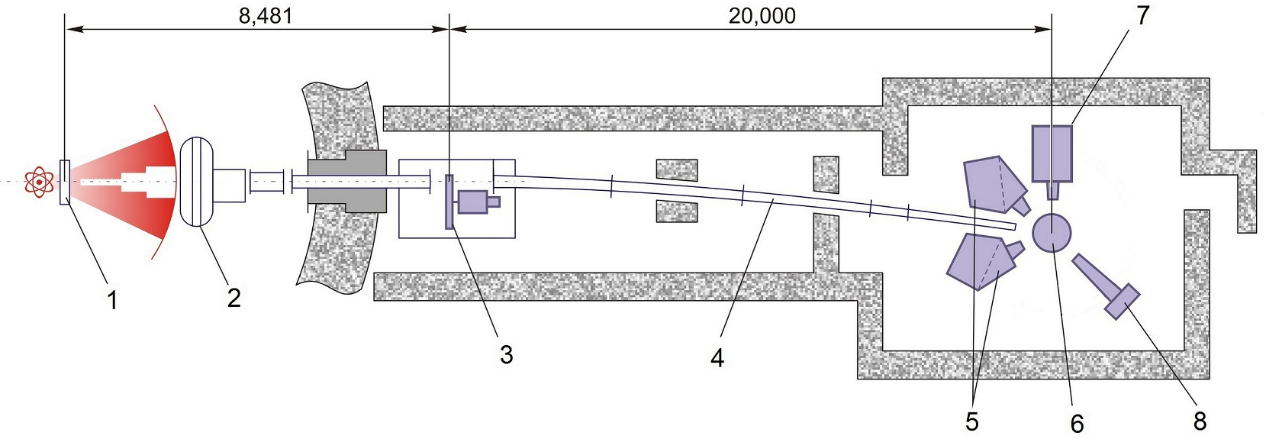
Introduction
The High-Resolution Fourier Diffractometer (HRFD) developed in the framework of collaboration between FLNP JINR (Dubna), PNPI (Gatchina) and VTT (Espoo, Finland) has been operating at the IBR-2 reactor since 1995. In the past few years, some of the key units that became morally obsolete or worn out, have been replaced. Particularly, in 2016 a new mirror neutron guide and fast Fourier chopper were put into operation and previously there had been a complete replacement in the data acquisition and experiment control electronics. The current status of HRFD is described in [1], and its layout at the IBR-2 reactor is presented in Fig.1. At present, the most important element of the program for further modernization of HRFD is the replacement of existing backscattering detectors with a new version.
Fig.1. The layout of the HRFD at the IBR-2 reactor (distances in mm): 1 - water moderator, 2 - background chopper, 3 - Fourier chopper, 4 – neutron guide, 5 – backscattering detectors, 6 – sample position, 7 - 90°-detector, 8 – position-sensitive detector at low scattering angle.

Slide 4
Two main drawbacks of present BSD detectors.
Li-glass-based scintillators − high sensitivity to the γ- background.
Small total solid angle ~ 0.16 sr.
Due to this, the resulting diffraction spectra have a rather high background and low (by modern criteria) data set rate, despite the fact that the neutron flux at the sample position is sufficiently high (10⁷n/cm²/s).
New detector will allow an approximately two- to three-fold increase in the number of conducted experiments, and in this respect will make it possible to substantially improve the accuracy of the obtained structural information, as well as to significantly enhance the capabilities of the diffractometer in performing experiments under various external conditions on the sample.

Slide 5
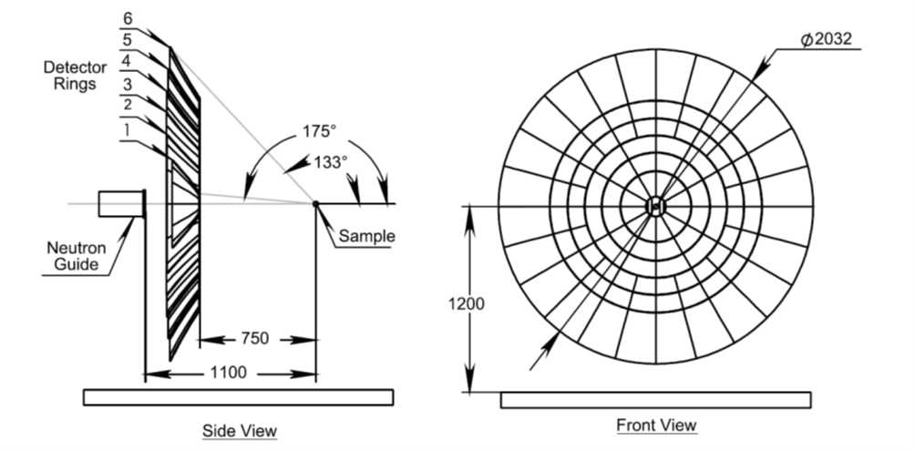
Description of the wide-aperture backscattering detector (BSD)
Fig. 2. Schematic of the large-aperture backscattering detector.
The detector comprises 6 rings of scintillation screens. The three outer rings are divided into sectors of 15°, and the three internal ones – into sectors of 30°. Six rings completely cover the scattering angle interval 2Q=(133-175)°. The total solid angle of the detector is Ω_{D}≈2.0 sr.
Each sector in the schematic is an independent detector element consisting of a scintillation screen, WLS fibers for light collection and a photomultiplier. A scintillation screen in each sector is not solid, but consists of smaller, tightly fitted to each other fragments which follow the surface shape of space-time focusing with the required accuracy.
The output of each photomultiplier is connected to the Data Acquisition and Accumulation (DAQ).

Slide 6
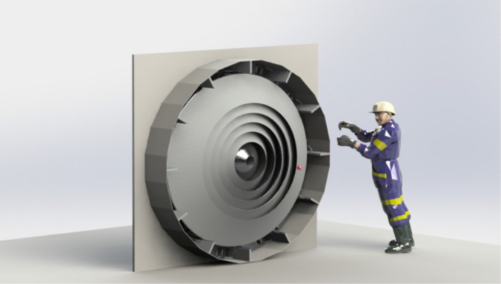
Technical design of the backscattering detector (BSD) at HRFD
The general view of the developed BSD in full configuration is presented in Fig. 3. The detector consists of 12 identical independent from each other 30°-sectors. The design of an individual sector is shown in Fig. 4.
Fig. 3. General view of BSD.

Slide 7
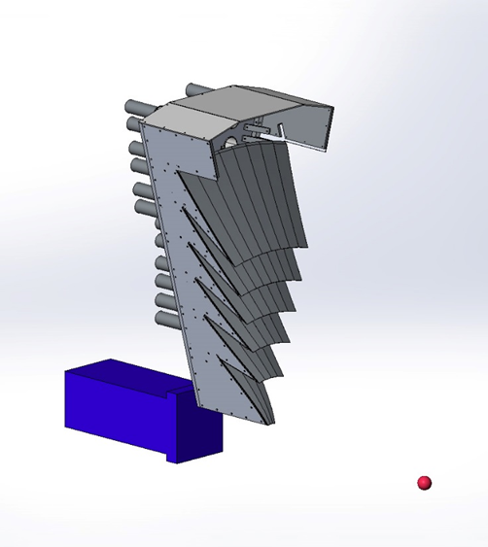
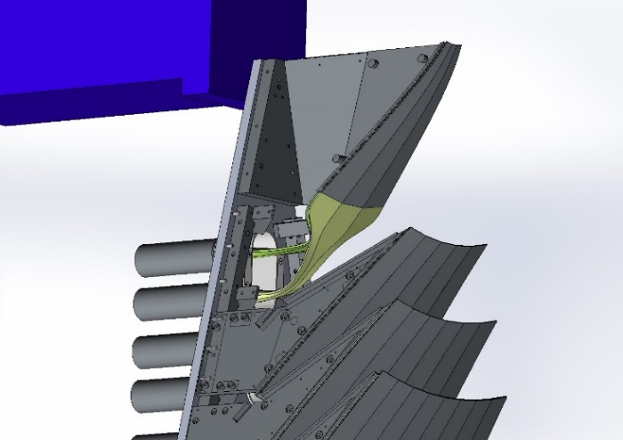
Fig. 4. General view of the 30°-sector of BSD.
Fig. 5. Fragment of the 30°-sector of BSD

Slide 8
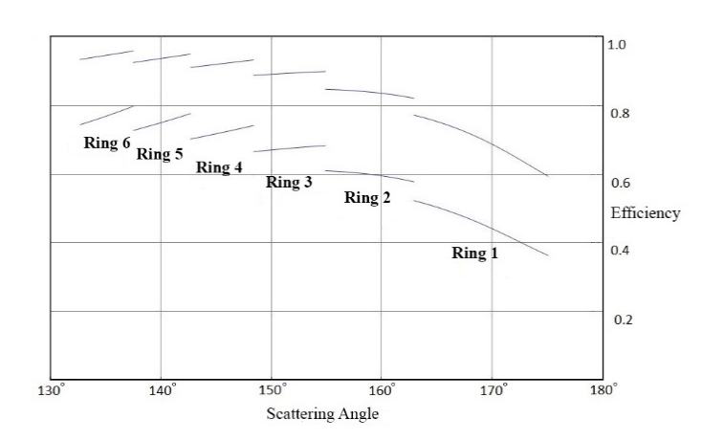
Dependence of the detector efficiency on the scattering angle.
Two layers of detecting elements
One layer of detecting elements
Detector efficiency for one-layer structure − from 36% to 80% (~ 65% on average).
Detector efficiency for two-layers structure − from 59% to 96% (~ 85% on average).

Slide 9
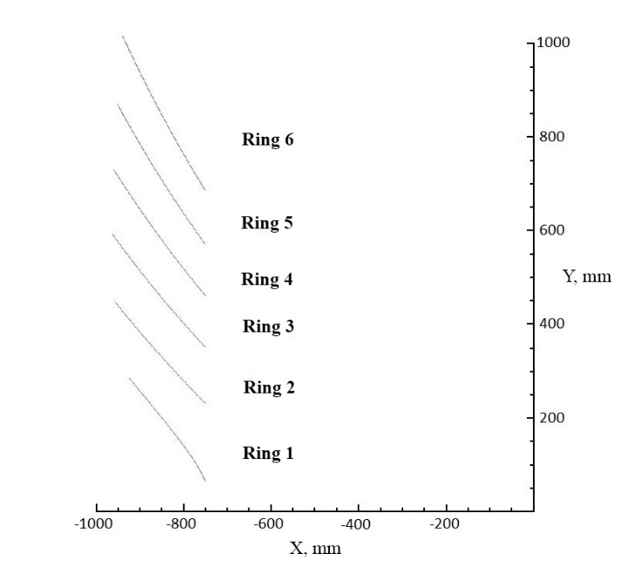
Shape of the detector elements of the rings.
The space-time focusing condition.
The perfect surfaces of space-time focusing are the surfaces of revolution.
The contribution to the total resolution of the diffractometer is zero.
Manufacturing of the perfect surfaces is of great complexity.
The surfaces of revolution have been approximated by umbrella-type surfaces.
The umbrella-type surfaces are much easier for manufacturing.
The detector rings within one sector are divided: Ring 1 - into 3 segments; Ring 2 - into 4 segments; Ring 3 –
into 5 segments; Ring 4 - into 6 segments; Ring 5 - into 8 segments; Ring 6 - into 8 segments. In this case,
the contribution to the total resolution of the diffractometer does not exceed$4×{10}^{−5}$.

Slide 10
Work stages and project costs
Project activities are carried out in accordance with the project schedule.
The schedule includes a number of key points:
Development of the technical design of the backscattering detector (BSD) for HRFD;
Adaptation of the existing technology of manufacturing scintillation detectors for the backscattering detector at HRFD (FLNP JINR);
Design and manufacturing of the instrumentation for mass production of sectors of the detector;
Design and manufacturing of the mechanical components of the detector;
Design and manufacturing of a test stand for testing detector sectors;
Manufacturing of one sector of the detector and its testing on the test stand;
Manufacturing and adjustment of the MPD modules of the detector electronics and the data acquisition and accumulation electronics; development and debugging of the software.

Slide 11
Up to date, a significant part of the activities scheduled within the framework of the current project has been completed, namely:
The technical design of the backscattering detector (BSD) for HRFD has been developed, including a set of design drawings;
The technology of manufacturing of scintillation detectors for BSD at HRFD has been adapted;
The instrumentation for mass production of sectors of the detector has been designed and mostly manufactured. Merely the manufacturing of the very part of the instrumentation which requires a complete set of manufactured mechanical components of the detector has not been completed yet;
A complete set of design drawings has been submitted to SPA “ATOM”; here the manufacturing of mechanical components for the first sector of the detector is currently nearing completion;
A test stand for testing detector sectors has been designed and developed;
A set of MPD modules of the detector electronics and the data acquisition and accumulation electronics, as well as the related software for testing of the first sector of BSD has been manufactured and adjusted;
By the end of this year, it is planned to complete the manufacturing of the first sector of the detector and conduct its testing on the test stand.

Slide 12
In accordance with the project schedule, the development of new modules of the electronics, as well as the software of the data acquisition system for BSD is in progress. With reference to the results obtained in the course of debugging the prototype of the new MPD32-based data acquisition module, including a 32-channel discriminator, time encoder, gigabit transceiver and USB3.0 interface, a working draft of the documentation has been developed and the prototypes of printed circuit boards and modules have been produced called MPD32- USB3.
In the framework of the project, studies of signals from the scintillation counters of thermal neutrons are carried out aimed at improving their counting capacity.
Along with the activities listed above, a large number of component parts and consumables (PMTs, scintillator and wavelength-shifting optical fibers), as well as electronic modules for the test stand and multi-channel high-voltage modules have been purchased.
The successful implementation of this project is an important step towards the development of a full-scale backscattering detector for the HRFD diffractometer.
In 2018-2019, the expenses within the theme related to the implementation of the project under expenditure items “Materials and Equipment” amounted to 700 kUSD.

Slide 13
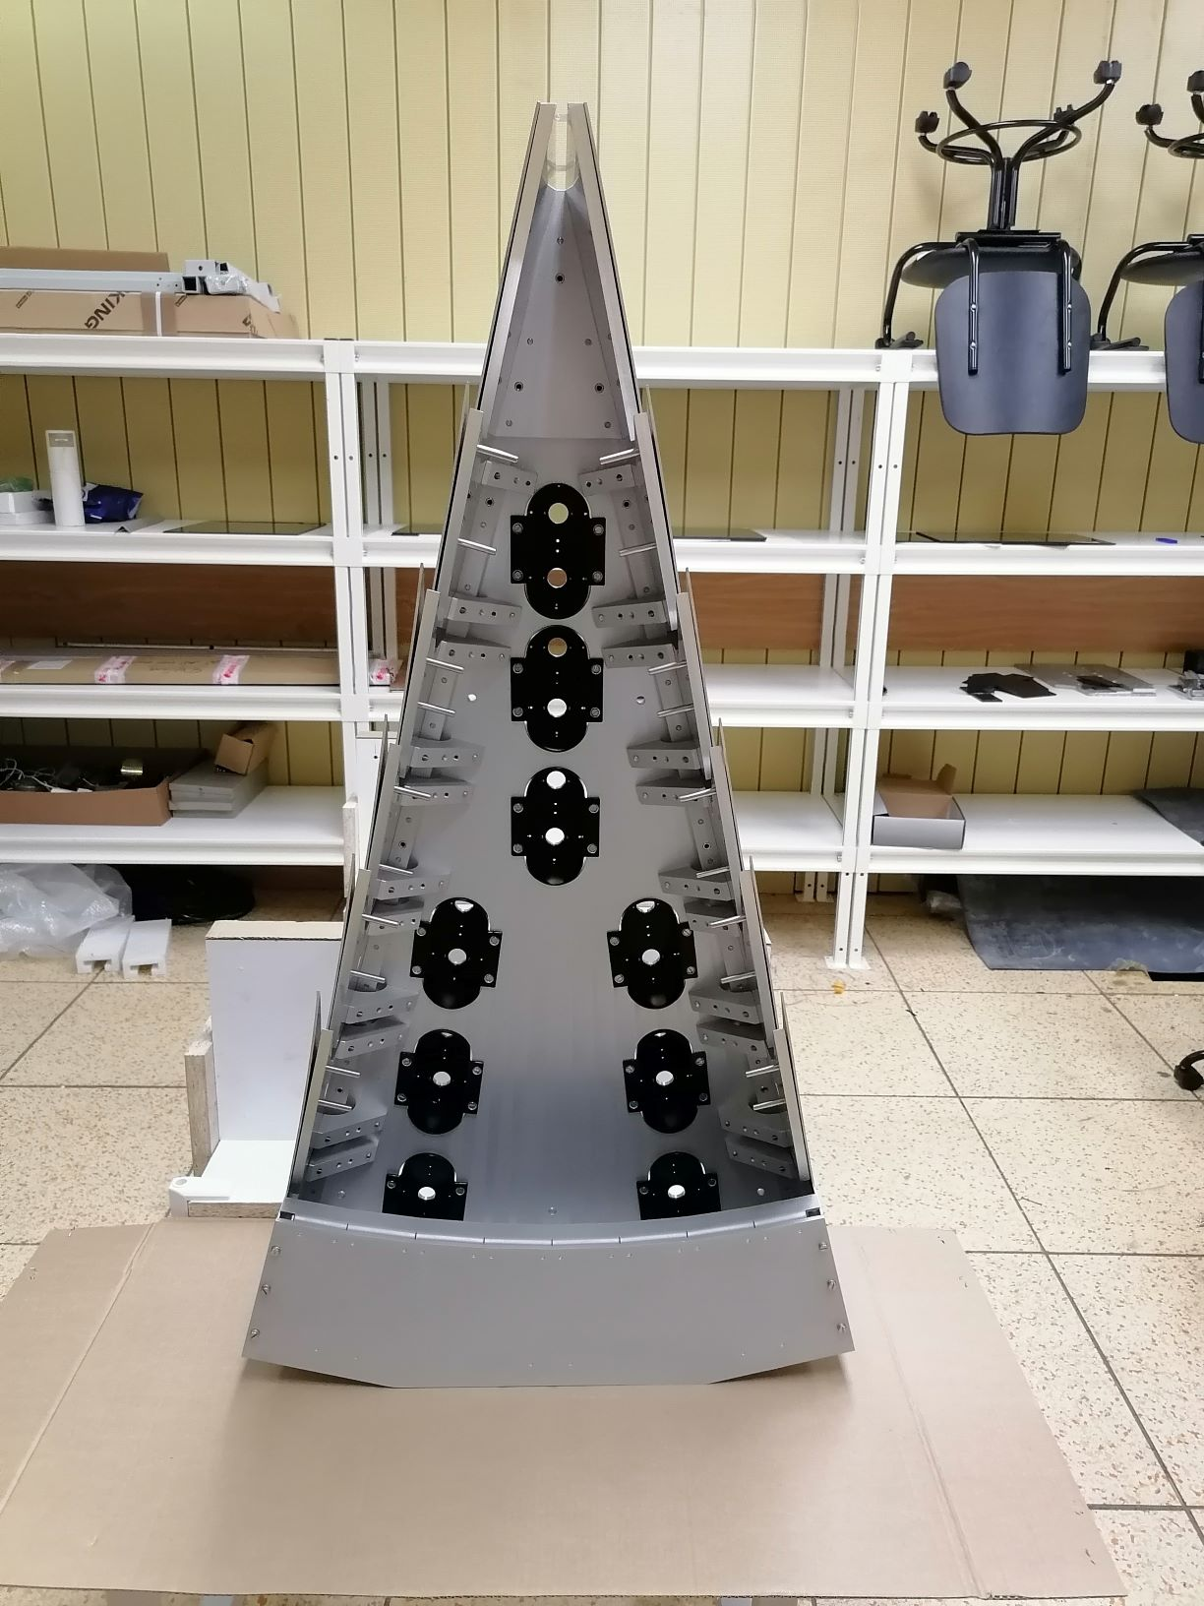
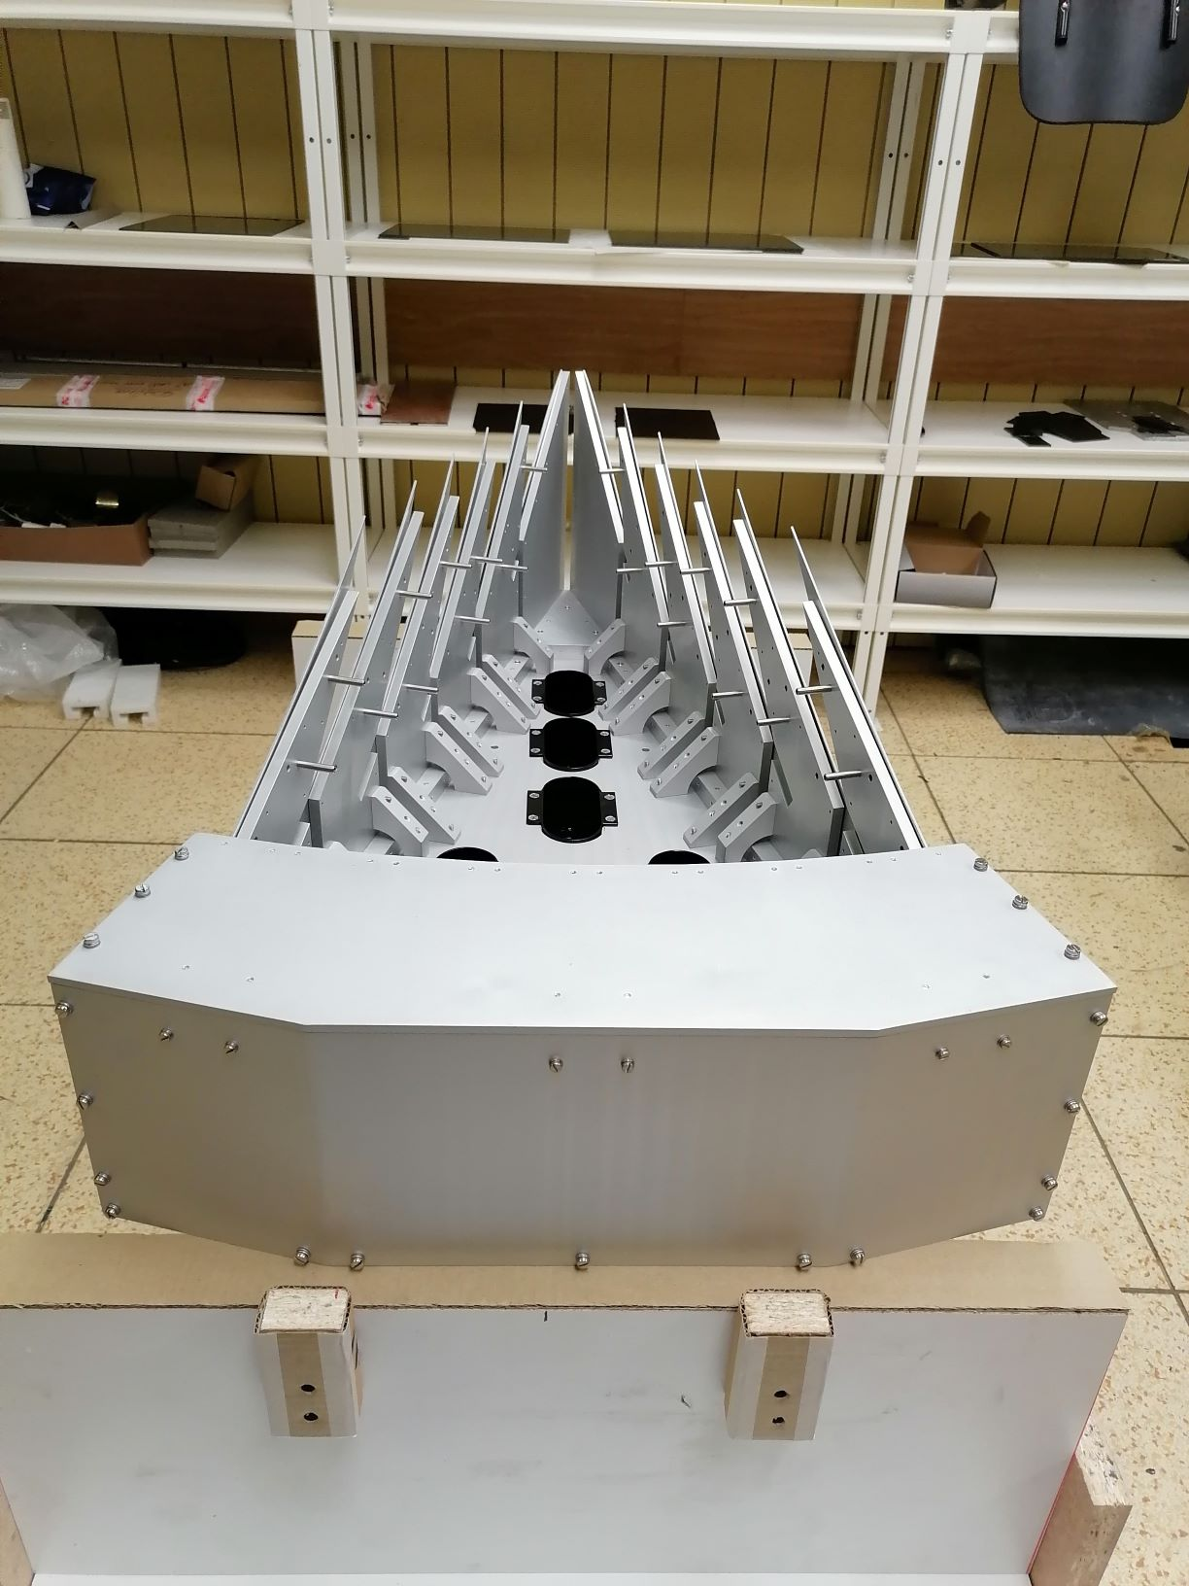
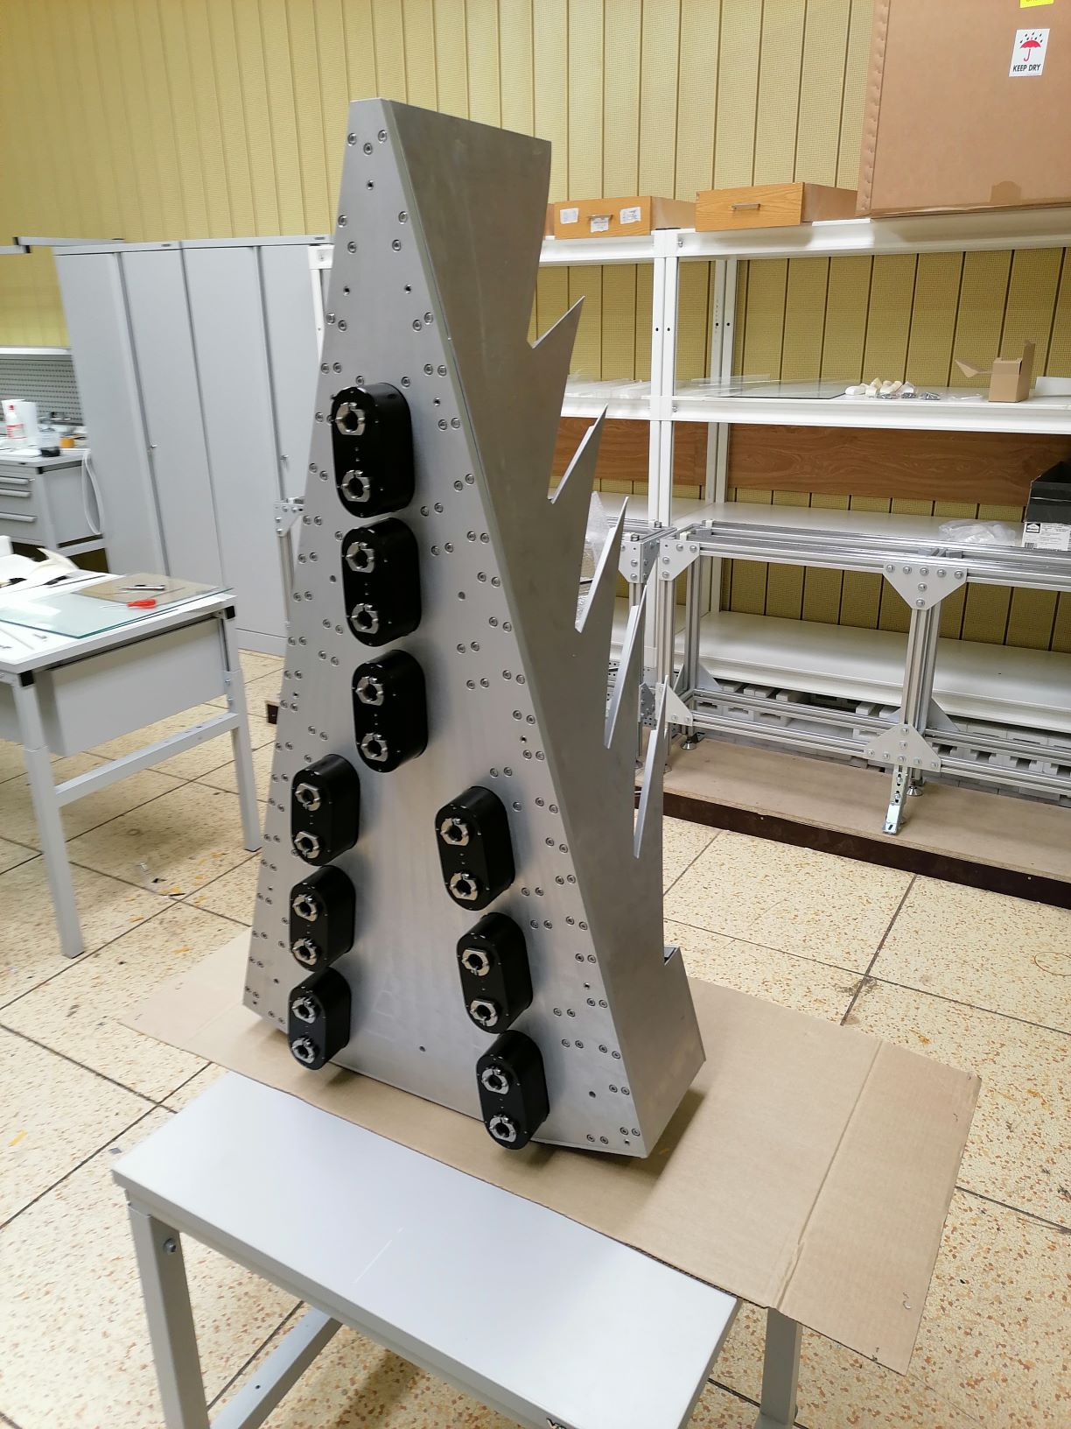
Mechanical components for the first sector of the detector
is manufactured completely by SPA “ATOM”.

Slide 14
Infrastructure and staff
An important stage in the implementation of this project was development of the necessary infrastructure and training of the highly skilled staff.
For this purpose, three workrooms were provided, equipped with the necessary laboratory furniture and equipment.
They include:
1. Workroom for "clean" work with scintillators and optical fibers;
2. Workroom for mounting and assembly of detectors;
3. Workroom for mechanical work.
At present, the team of employees directly involved in the development activities of the detector, consists of 9 specialists including:
• Scientific researchers - 2;
• Design engineer - 1;
• Technician - 1;
• Laboratory assistants - 4;
• Postgraduate student - 1.
All the employees are highly qualified and skilled specialists.

Slide 15
Publications
During the project implementation period, the following papers have been published by the authors:
Balagurov A.M., Balagurov D.A., Bobrikov I.A., Bogdzel A.A. et al., High-resolution neutron Fourier diffractometer at the IBR-2 pulsed reactor: a new concept. Nuclear Inst. and Methods in Physics Research B 436 (2018), pp.263-271
Shvetsov V.V., Drozdov V.A.. "Increasing Bandwidth of Data Acquisition Systems on IBR-2 Reactor Spectrometers in FLNP". Proceedings of the XXVI International Symposium on Nuclear Electronics & Computing (NEC’2017) Becici, Budva, Montenegro, September 25 - 29, 2017, European repository of the CEUR Workshop Proceedings Vol-2023, pp. 293-298.
Bogdzel A., Drozdov V., Kruglov V., Murashkevich S., Prikhodko V. Shvetsov V., «The new data acquisition system MPD-32 for the high-resolution Fourier diffractometer at the IBR-2 pulsed reactor». Proceedings of the 27th International Symposium Nuclear Electronics and Computing (NEC’2019) Budva, Becici, Montenegro, September 30–October 4, 2019, CEUR-WS Vol-2507 (ISSN 1613-0073), pp.142-146.

Slide 16
New project ”Construction of a wide-aperture backscattering detector (BSD) for the HRFD diffractometer”. "
THEME: Scientific and methodological research and developments for condensed matter
investigations with IBR-2 neutron beams
THEME CODE: 04-4-….-2021/2025
AUTHORS:
Balagurov A.M. | - Dubna, FLNP JINR
Bobrikov I.A. | - Dubna, FLNP JINR
Kruglov V.V. | - Dubna, FLNP JINR
Milkov V.M. | - Dubna, FLNP JINR
Simkin V.G. | - Dubna, FLNP JINR
PROJECT LEADER: Kruglov V.V.
PROJECT DEPUTY LEADER: Milkov V.M.

Slide 17
Expected results and new developments
Within the framework of the proposed project it is planned:
To manufacture 11 sectors of the backscattering detector at HRFD;
To design and manufacture a platform for positioning the sectors of BSD at the HRFD diffractometer;
To manufacture the required number of units of the data acquisition and accumulation system MPD32-USB3;
To install and test the BSD sectors in regular positions at HRFD as they are manufactured;
To install and debug the electronics and software for data acquisition and accumulation on BSD using MPD32-USB3 units at HRFD;
Assembly and commissioning of BSD at HRFD with the data acquisition and accumulation system.
Competitiveness
The detector is unique scientific and technical development, the construction of which will bring HRFD diffractometer to the world leaders among similar experimental instruments.

Slide 18
The proposed schedule and the resources required for implementation of the Project “Construction of a wide-aperture backscattering detector (BSD) for the HRFD diffractometer”
Main units of equipment, resources, financing sources |  |  | Costs (k$) Resource requirements | Proposal of the Laboratory on the distribution of finances and resources
 |  |  |  | 2021 | 2022 | 2023
Main units of equipment |  | Sets of mechanical parts for detector sectors | 220 | 80 | 80 | 60
 |  | Data acquisition and accumulation electronics | 165 | 60 | 60 | 45
 |  | Mount fitting and consumables | 120 | 60 | 30 | 30
 |  | Materials | 90 | 30 | 30 | 30
Required resources | Standard hour | Ресурсы
 |  | – Laboratory pilot production | 600 | 200 | 200 | 200
 |  | – reactor | 360 | 120 | 120 | 120
Financing sources | Budgetary funds | Budget costs, including foreign currency | 595 | 230 | 200 | 165

Slide 19
Network schedule of the Project
“Construction of a wide-aperture backscattering detector (BSD) for the HRFD diffractometer”
N |  | 2021 |  | 2022 |  | 2023
 |  | I | II | I | II | I | II
1 | Manufacturing of 11 sectors of the backscattering detector at HRFD.
2 | Design and manufacturing of a platform for positioning the sectors of BSD at the HRFD diffractometer.
3 | Manufacturing and configuration of the units of the data acquisition and accumulation system MPD32-USB3.
4 | Installation and debugging of the electronics and software for data acquisition and accumulation on BSD using MPD32-USB3 units at HRFD.
5 | Installation and testing of BSD sectors in regular positions at HRFD as they are manufactured.
6 | Assembly and commissioning of BSD at HRFD with the data acquisition and accumulation system.

Slide 20
Estimate of expenditures for the Project
“Construction of a wide-aperture backscattering detector (BSD) for the HRFD diffractometer”
№ | Expenditure items | Total cost | 2021 | 2022 | 2023
 | Direct expenses for the Project
1. | Accelerator, reactor | h | 120 | 120 | 120
2. | Pilot production | h | 200 | 200 | 200
3. | Materials | k$ | 30 | 30 | 30
4. | Equipment | k$ | 200 | 170 | 135
5. | Payments for contract-based research | k$ | 10 | 10 | -----
6. | Travel allowance, including a) non-rouble zone countries b) rouble zone countries c) protocol-based | k$ according to the plan of MTS | 8 2 ----- | 8 2 ----- | 8 2 -----
 | Total direct expenses | 645 | 250 | 220 | 175

Slide 21
Thank You
for Attention!

