Slide 1
Programme Advisory Committee for Nuclear Physics
Implementation of the recommendations of the 51st PAC meeting
Marek Lewitowicz

Slide 2
Programme Advisory Committee for Nuclear Physics,
51st meeting, 30–31 January 2020
4. Research activities under the theme “Investigations of Neutron Nuclear Interactions and Properties E. Lychagin
of the Neutron”: status and prospects
5. Letter of intent to open a new project: “Modernization of the EG-5 accelerator and development A. Doroshkevich
of its experimental infrastructure”
6. Proposal for opening a new project: “BECQUEREL” P. Zarubin
7. Status of the Factory of superheavy elements V. Semin, V. Utyonkov
8. Prospects for the study of multinucleon transfer reactions A. Yeremin
9. Poster presentations by young scientists
10. Scientific reports:
10.1. “Fusion reactions in nuclear astrophysics” V. Sargsyan
10.2. “Prompt neutron investigation in nuclear fission induced by resonance neutrons” S. Zeynalov

Slide 3
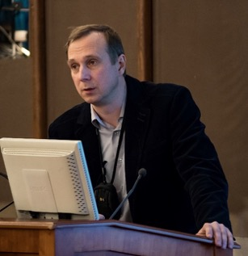
Research activities under the theme “Investigations of Neutron Nuclear Interactions and Properties of the Neutron”: status and prospects
REMINDER: 50th PAC for NP recommendations for this theme
Egor Lychagin
In the future the PAC expects more details on the programme of nuclear data measurements, in particular the objectives, the priorities and the complementarity with the worldwide programmes.
The FLNP Directorate is advised to focus on the modernization of experimental halls and pavilions.
The PAC recommends that special attention be given to the beam delivery systems to increase neutron fluxes at the experiment places. The PAC expects a detailed report on this topic to be presented at the next meeting.

Slide 4
Research activities under the theme “Investigations of Neutron Nuclear Interactions and Properties of the Neutron”: status and prospects
Egor Lychagin was appointed the leader of this theme replacing Valery Shvetsov
The very broad research program in the framework of the theme includes:
research of quantum-mechanical phenomena with ultracold and cold neutrons;
  Including Development of the advanced Very Cold Neutron Source
study of properties of the neutron;
  Including Investigation of possibility of the neutron lifetime measurement at IBR-2 beam
study of nuclear reactions induced by neutrons;
  Including program at TANGRA facility
  Including investigations of various fission parameters and characteristics of Prompt Fission Neutron (PFN) emission
applied research using nuclear physics methods.
  Including development of the Neutron Activation Analysis (NAA) and Neutron Resonance Capture Analysis (NRCA)

Slide 5
Research activities under the theme “Investigations of Neutron Nuclear Interactions and Properties of the Neutron”: status and prospects
Development of the advanced Very Cold Neutron Source
Collaboration in the framework of
CREMLINplus WP3 T3.1 between:
ILL (Grenoble, France),
NRC KI-PNPI (Gatchina Russia),
JINR (Dubna, Russia),
PTI (St-Petersburg, Russia),
UCA (Clermont-Ferrand, France),
UNIMIB (Milano, Italy),
ESS (Lund, Sweden)
NCSU (Raleigh, NC, USA)
During the last year, a lot of simulation and experimental work (NAA, SANS, XRD, PGA etc.) was done to define optimal parameters of the powder and its production.
In 48 months (starting from February 2020 in the framework of the EU funded CREMLINplus project) the prototype of the VCN source should be developed and tested experimentally.
5

Slide 6
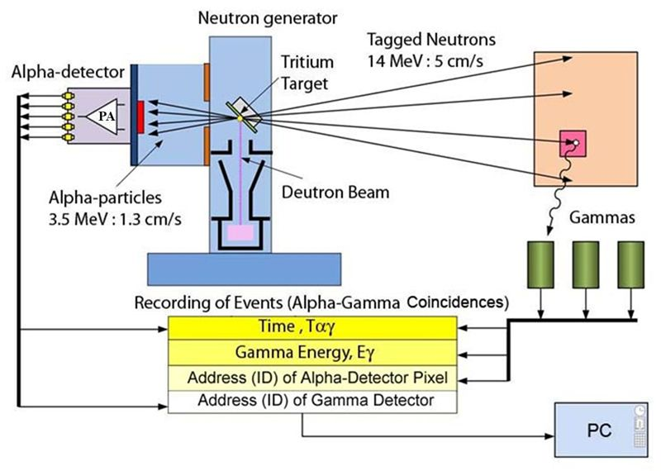
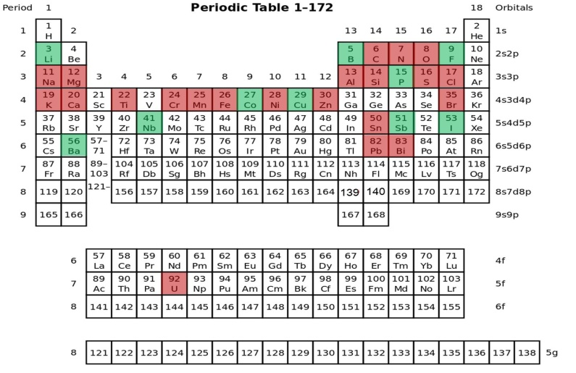

Measurements of yields and gamma rays' angular correlations in reactions with 14.1 MeV neutrons (TAgged Neutrons & Gamma-Rays -TANGRA project).
Measured nuclei
Closest plans
Modernization of the TANGRA facility using an HPG detector are planned in 2020-2022 :
further measurements of yields and angular correlations of gamma rays
measurement of the reactions (n, 2n) and (n, f)
theoretical analysis of experimental data
Current status of TANGRA modernisation:
1. TANGRA was moved to a new larger experimental hall;
2. Two HPGe detectors for high resolution measurements have been purchased (expected delivery - second half of 2020);
3. A neutron detector array is being designed for measurements of (n,2n) and (n,n') using TOF method.

Slide 7
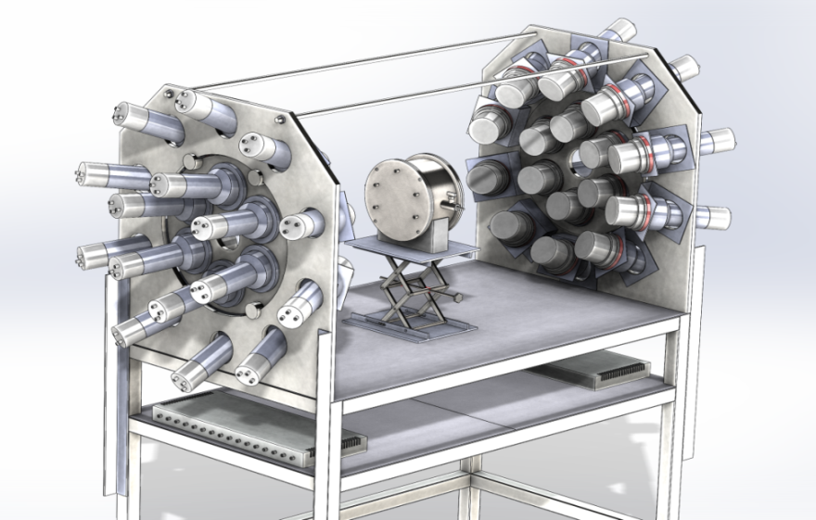
Research activities under the theme “Investigations of Neutron Nuclear Interactions and Properties of the Neutron”: status and prospects
Investigations of various fission parameters and characteristics of Prompt Fission Neutron (PFN) emission.
A double ionization chamber was designed to measure the kinetic energies, masses, and the orientation of fission axis in the 3D space for the correlated fission fragments.
The accuracy of direction cosines definition is better than 0.05
32 PFN detectors were placed close to the axis of the ionization chamber to guarantee the maximum PFN detection efficiency ~0.8π.
The set-up was totally assembled, the work place at the beam line №2 of IREN was prepared.
The first experiments planned to start in July 2020

Slide 8
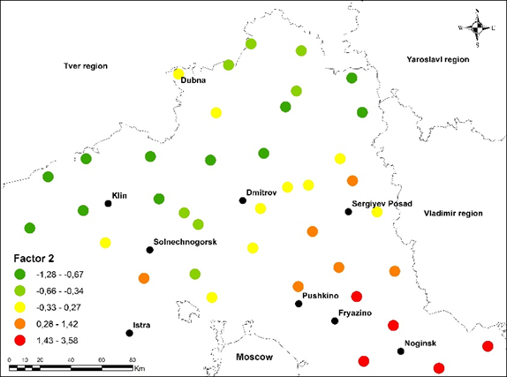
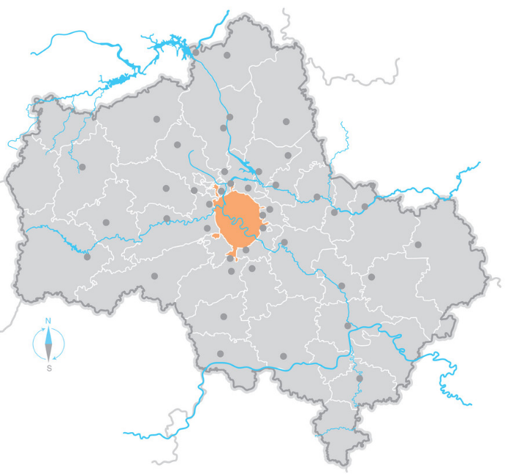
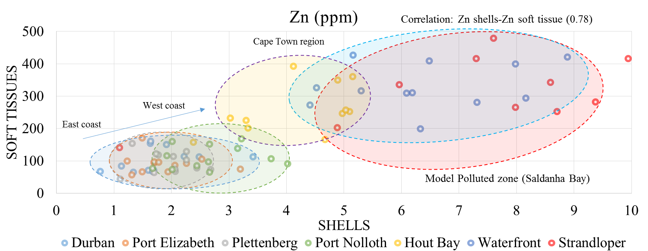
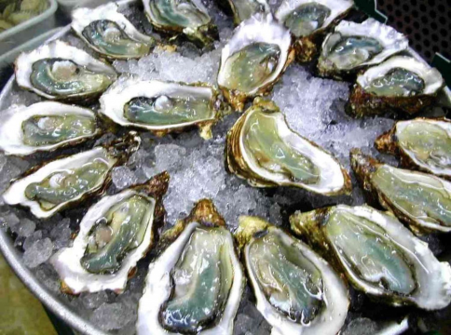
Research activities under the theme “Investigations of Neutron Nuclear Interactions and Properties of the Neutron”: status and prospects
Applied Research
Experimental methods and setups
NAA, XRF (REGATA, REGATA-2 )
Neutron resonance spectroscopy (at IREN)
Experiments at Van-der-Graaf EG-5 (modernization of the accelerator)
Further plans for Neutron Activation Analysis (NAA)
Including the REGATA facility in the FLNP User Programme;
Improvement of the NAA at the REGATA facility at IBR-2;
Development and construction of the low-background γ-ray spectrometer and the α spectrometer;
Participation in the 2020/2021 European moss survey;
Research in the field of environmental studies, geology, material science, medicine, nanotoxicology, etc.
International program "Heavy metal atmospheric deposition in Europe”
Mo, W and Sb
In 2019 in the framework of the “Mussel watch” project of JINR-SA mussels were collected at the six stations along the South African coast, The obtained data showed that the most polluted place is the area near Capetown.
Moscow

Slide 9
PAC for NP recommendations for the theme
“Investigations of Neutron Nuclear Interactions and Properties of the Neutron”
The PAC recommends that priorities of this theme be better focused.
Special attention should be paid to the development of key technologies for the new neutron source.
The PAC appreciates the development of activities related to Intense REsonance Neutron Source (IREN).
The PAC encourages an active use of the extracted beams for both basic and applied research in order to make more efficient use of the facilities operating time.

Slide 10
The SC notes that the FLNP has good prospects for further development of scientific work.
The scientific programme for the period 2020–2022, reviewed by the PAC for Nuclear Physics, is broad with a large spectrum of activities developing in parallel under the theme “Investigations of Neutron Nuclear Interactions and Properties of the Neutron”.
The SC recommends that the priorities of this theme be better focused. In particular, special attention should be given to the development of key technologies for the new neutron source.
Current status: The theme leaders try to concentrate on the main tasks by separating them into independent projects (e.g., TANGRA, other projects are being prepared: modernization of EG-5 and development of a polarized nuclear target).
The SC appreciates the development of activities related to IREN and encourages an active use of the extracted beams both for basic and applied research in order to make more efficient use of the facility’s operating time.
Current status: To date, a project for the modernization of the experimental hall and IREN pavilions is under approval. The implementation of this project will allow updating the infrastructure of the IREN beams and using the beams more efficiently, however, it will require significant financial and human resources. Currently, work is underway to commission the 1st channel (in addition to the working channels No. 2, 3, 4).

Slide 11
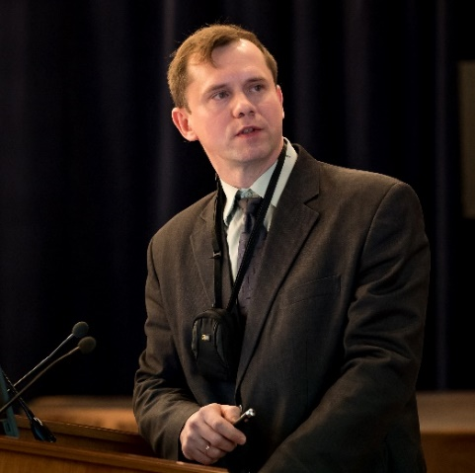
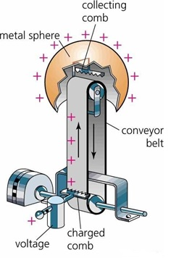
Letter of intent to open a new project: “Modernization of the EG-5 accelerator
and development of its experimental infrastructure”
New project
Technical task:
Restoring the technical parameters of the EG-5 accelerator:
energy up to 4.1 MeV (2,9 MeV today)
current above 50μA (100nA today)
Ways to solve:
Tube replacement;
Modernization of infrastructure;
Young staff training.
Alexander Doroshkevich
Plans
Development of the experimental infrastructure
1. New spectrometers.
2. Microbeam Project.
3. Use of multibeam configuration
The estimated 3-years project cost is 1,5M$

Slide 12
PAC for NP recommendations for the letter of intent to open a new project:
“Modernization of the EG-5 accelerator and development of its experimental infrastructure”
The PAC supports the presentation of a full proposal within the theme “Investigations of Neutron Nuclear Interactions and Properties of the Neutron”.
The project should define expected accelerator specifications in accordance with the priorities of the scientific programme.
The PAC recommends comparing carefully the two options: modernization of the present EG-5 accelerator or purchase of a new accelerator taking into account the risk associated with the proposed upgrade.
The full project should include detailed information about the schedule, human and financial resources as well as a risk analysis.
The Scientific Council concurs with the PAC that the work on modernization of the EG-5 accelerator at FLNP is important. In preparing a full proposal for this project, expected accelerator specifications should be clearly identified in accordance with the priorities of expanding the research programme. Also, two options should be carefully compared: modernization of the present EG-5 accelerator or purchase of a new accelerator, taking into account the risk associated with the proposed upgrade.
Today Alexander Doroshkevich will present a status of this project

Slide 13
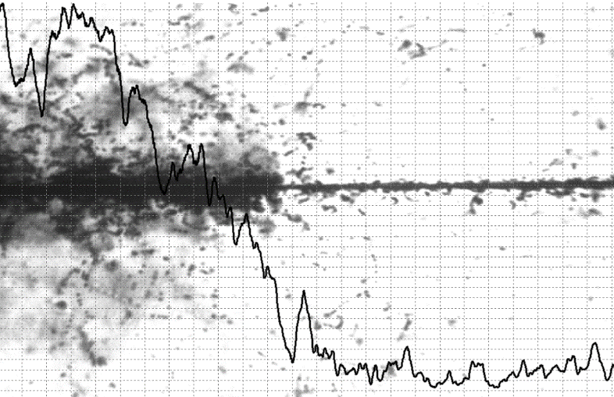
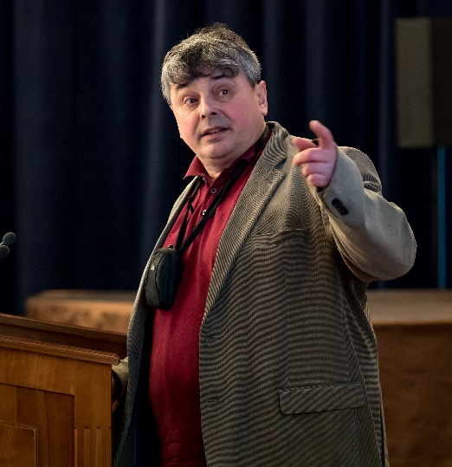
Proposal for opening a new project: “BECQUEREL”
Pavel Zarubin
Studies of nuclear fragmentation using nuclear emulsions have a very long history. Nevertheless this method still keeps promising opportunities, in particular due to the high resolution in determination of emission angles of relativistic fragments. The project is devoted to experiments with various accelerators, apart from studies of multifragmentation processes, authors plan to search for unstable states in nuclei.
The PAC recommends that the VBLHEP Directorate provide financial support for renovation of the equipment used in the BECQUEREL experiment in 2021. The proposal should be presented at the PAC meeting in January 2021.

Slide 14
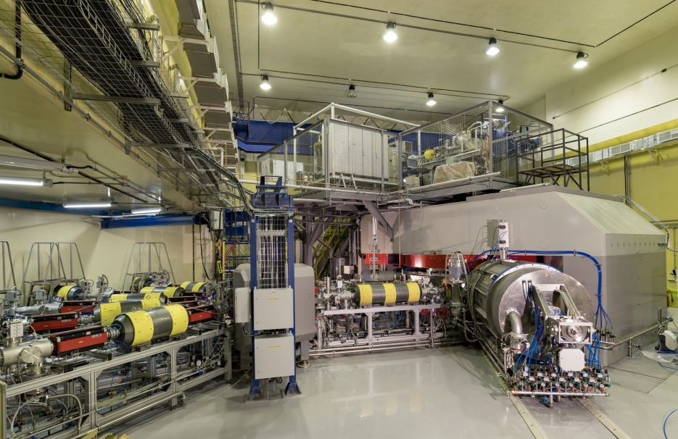
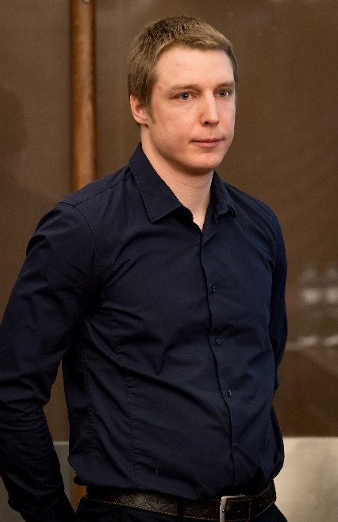
Status of the Factory of superheavy elements: DC-280 cyclotron
Vasiliy Semin
Accomplished tasks:
Test of accelerator systems with high intensity
Testing of cyclotron systems during longtime operation
Investigation of stability of accelerated beams
Debugging of high voltage elements
Staffing of the DC-280 work group

Slide 15
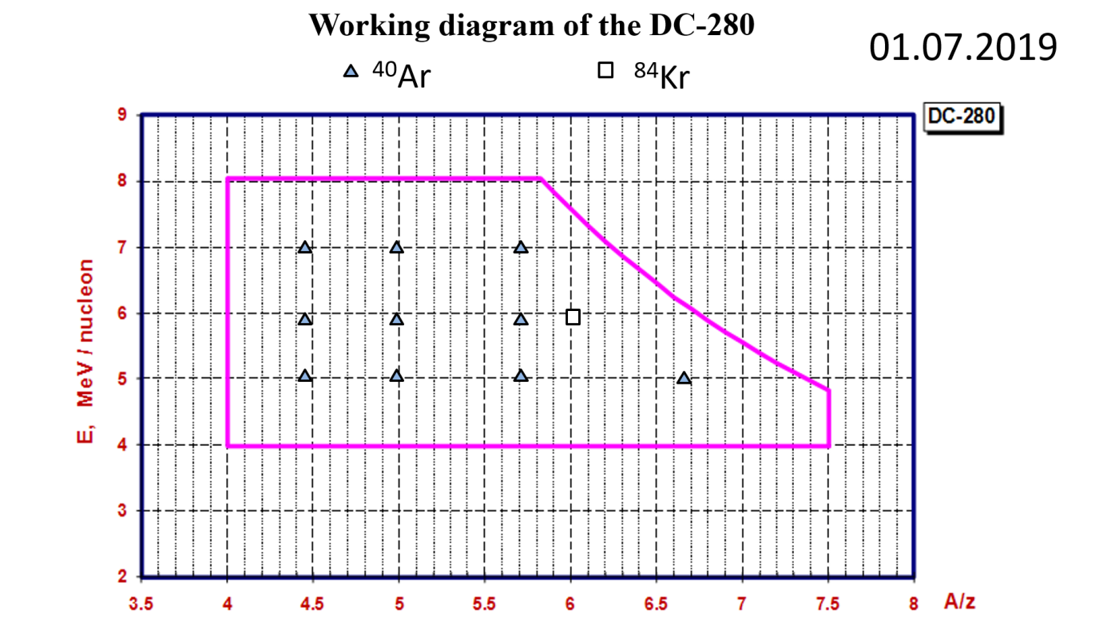
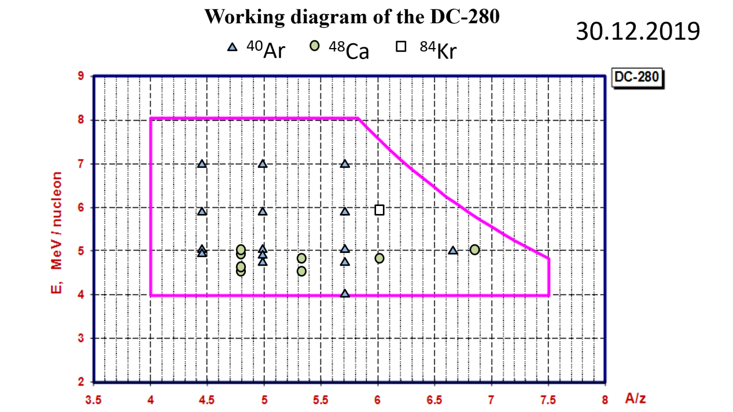
Status of the Factory of superheavy elements: DC-280 cyclotron
Reached today:
⁴⁰Ar beam intensity 10 pμA;
⁴⁸Ca beam Intensity 5 pμA;
50% efficiency from axial injection to transport channel;
90% efficiency through transport channel to the separator;
5% beam current stability;
Ongoing tasks:
HF amplifier power supply stability;
Commissioning of Flat-Top System;
Curing electrical breakdowns of some HV elements;
Improvement of the overall efficiency

Slide 16
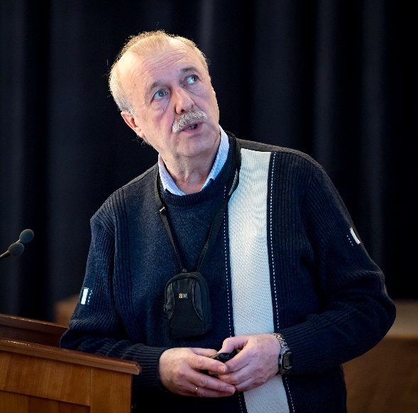
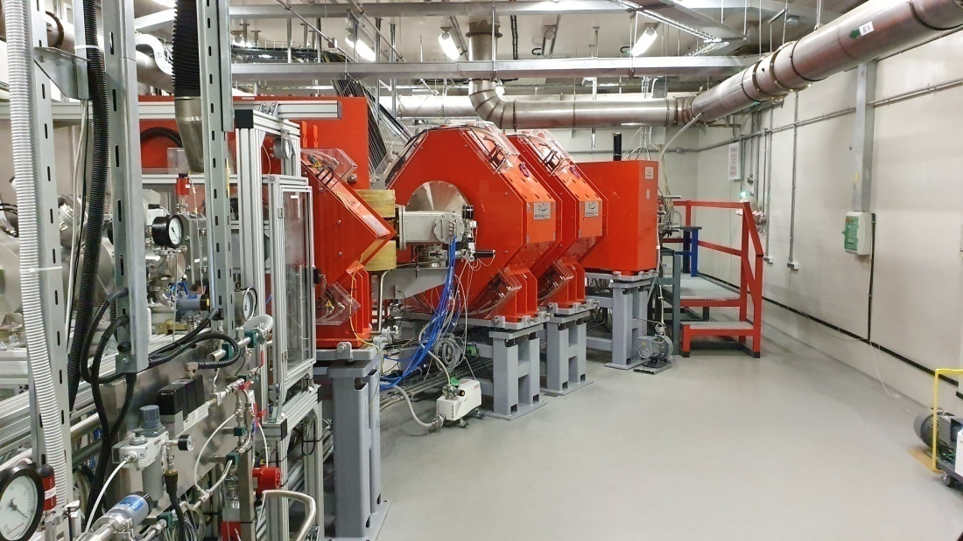
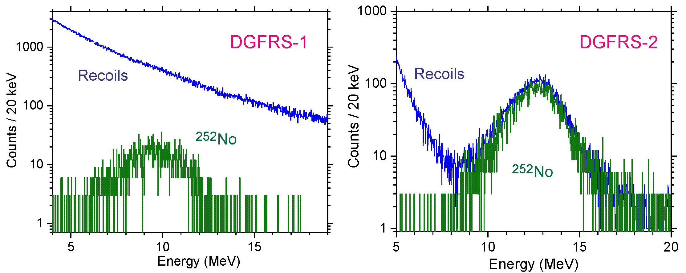
Status of the separator DGFRS-2: results of test experiments
The installation and commissioning of the new gas-filled separator (GFS-2) was completed.
Test reactions:
^{nat}Yb+⁴⁰Ar→²⁰⁷⁻²¹²Ra,
¹⁷⁰Er+⁴⁸Ca →^{214,215}Ra, ^{nat}Yb,¹⁷⁴Yb+⁴⁸Ca →^{216,217}Th,
²⁰⁶Pb+⁴⁸Ca →²⁵²No
Vladimir Utyonkov
The experiments showed excellent background event suppression in the focal plane of the separator
Adjustment of optical elements Q_{v}, D_{h}, Q_{h}, Q_{v}, D
Transmission
Image size on detector
Dispersion
Background
Optimal gas pressure
Systematics of charge states
Target stability vs. beam intensity
Yield vs. target thickness
Test of digital and analog
data acquisition systems

Slide 17
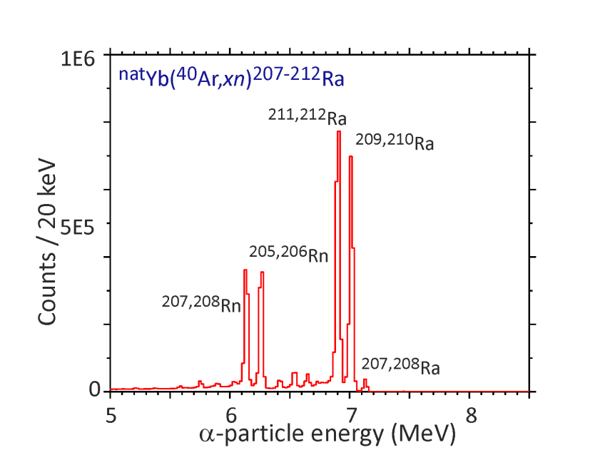
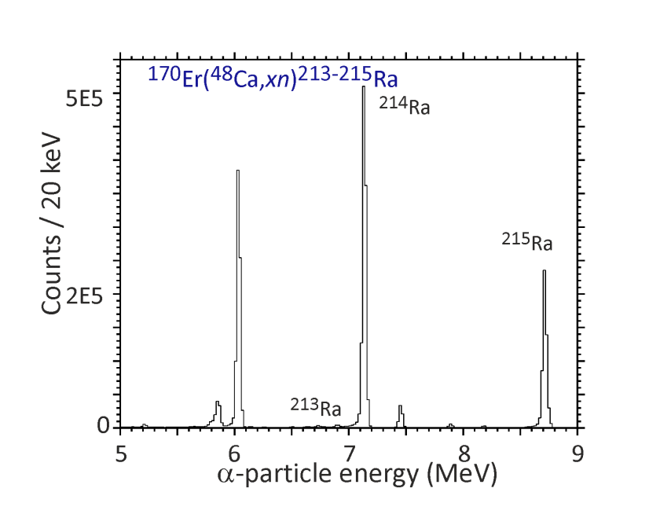
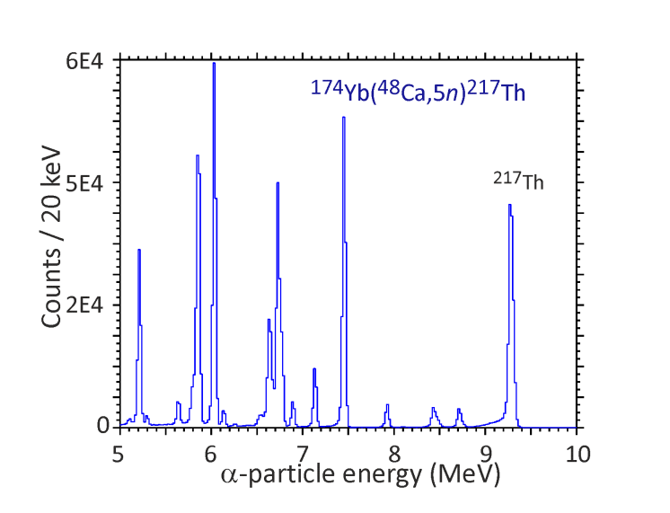
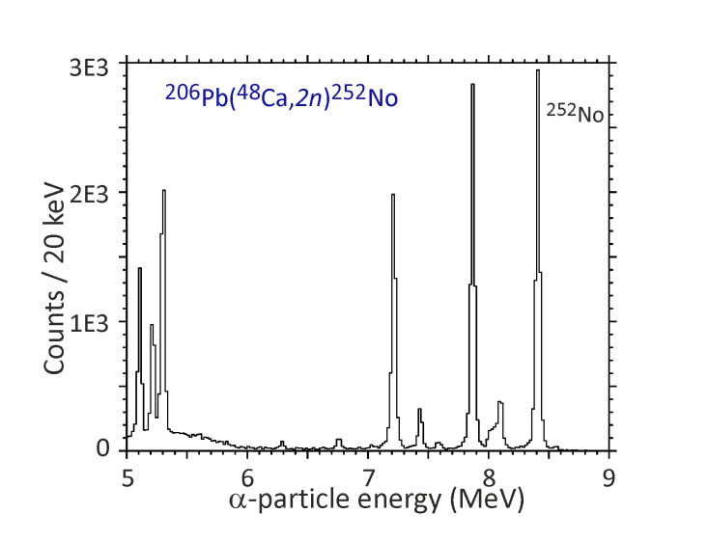
Status of the separator DGFRS-2: results of test experiments
Cross sections ~10⁸⁻⁹ pb
Test reactions:
^{nat}Yb (0.21, 0.43, 0.54, 0.64 mg/cm²)+⁴⁰Ar→²⁰⁷⁻²¹²Ra
¹⁷⁰Er (0.54 mg/cm²)+⁴⁸Ca →^{214,215}Ra
^{nat}Yb (0.21, 0.43, 0.54, 0.64 mg/cm²)+⁴⁸Ca →^{216,217}Th
¹⁷⁴Yb (0.35 mg/cm²) +⁴⁸Ca →^{216,217}Th
²⁰⁶Pb (0.43 mg/cm²) +⁴⁸Ca →²⁵²No

Slide 18
PAC for NP recommendations related to “Status of the Factory of superheavy elements: DC-280 cyclotron”
The PAC congratulates the Flerov Laboratory of Nuclear Reactions for the excellent work in this highly demanding field of SHE research.
The intensities achieved at DC-280 are already among the highest in the world, and the results are extremely encouraging for the continuation of this research programme.
The PAC recommends that FLNR continue the efforts of completing the test experiments and starting the implementation of the experimental programme at the SHE Factory.

Slide 19
The main goal of the FLNR Factory of superheavy elements in 2019 was to commission the DC-280 cyclotron, including obtaining all necessary permits for work and the production of heavy-ion beams within the design parameters. The operation of the DC-280 cyclotron was officially started on 25 March 2019. To date, beams of ¹²C, ⁴⁰Ar, ⁴⁸Ca, and ⁸⁴Kr with intensities of a few particle microamperes (pμA) have been extracted. In particular, the intensity of accelerated ⁴⁸Ca ions exceeded 5 pμA. The acceleration efficiency was 51%.
Current status: The installation and commissioning of the new gas-filled separator (GFS-2) was completed. Furthermore, test experiments were conducted with beams of ⁴⁰Ar and ⁴⁸Ca which were delivered to GFS-2 situated in the experimental hall. The experiments showed excellent background event suppression. Experiments with ⁴⁸Са beams and targets of ^{nat}Yb, ¹⁷⁴Yb, ¹⁷⁰Er, and ²⁰⁶Pb were carried out. The main goal was to determine the separator’s transmission and target stability when irradiated with high-intensity heavy-ion beams. The synthesis of Mc isotopes in the ⁴⁸Ca+²⁴³Am reaction will be the first test reaction for the production of superheavy nuclei. The beginning of the experiment is planned for the autumn of this year.
The SC congratulates the Flerov Laboratory for the excellent work in this highly demanding field of SHE research. The intensities achieved at DC-280 are already among the highest in the world, and the results are extremely encouraging for the continuation of this research programme.
The SC recommends that FLNR continue the efforts of completing the test experiments and starting the implementation of the experimental programme at the SHE Factory.

Slide 20
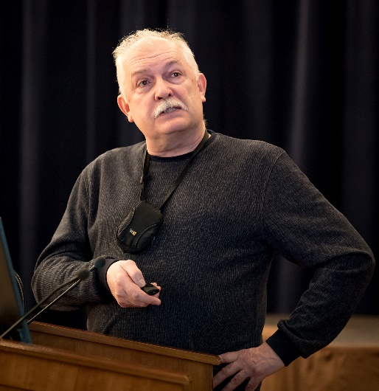
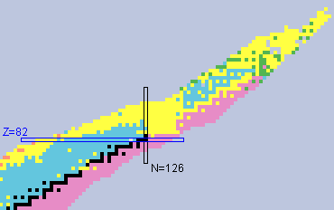
Prospects for the study of multinucleon transfer reactions (MNT)
Regions of interests in MNT reactions
3
1
Study of neutron deficient isotopes in the region 82 < Z < 100
1
Alexander Yeremin
2
Study of isotopes in the region N = 126, r – process in astrophysical nucleosynthesis
3
Study of neutron rich isotopes in the region Z > 100
2

Slide 21
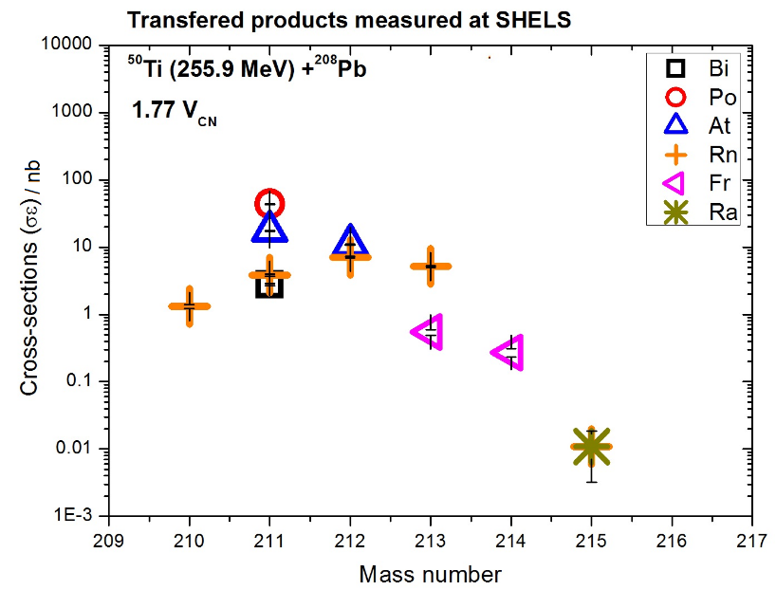
Prospects for the study of multinucleon transfer reactions (MNT)
Feasibility studies at SHELS
Isotopic distributions of MNT products measured in collisions of Ti + Pb at SHELS
→ sensitivity: 10 pb/sr in 5 hours of irradiation
Next experiment : ⁴⁸Ca + ²⁴³Am, study of MNT products, 1 week – postponed due to pandemic causing a shutdown of accelerators

Slide 22
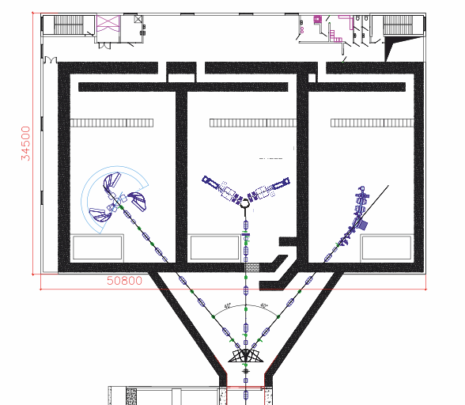
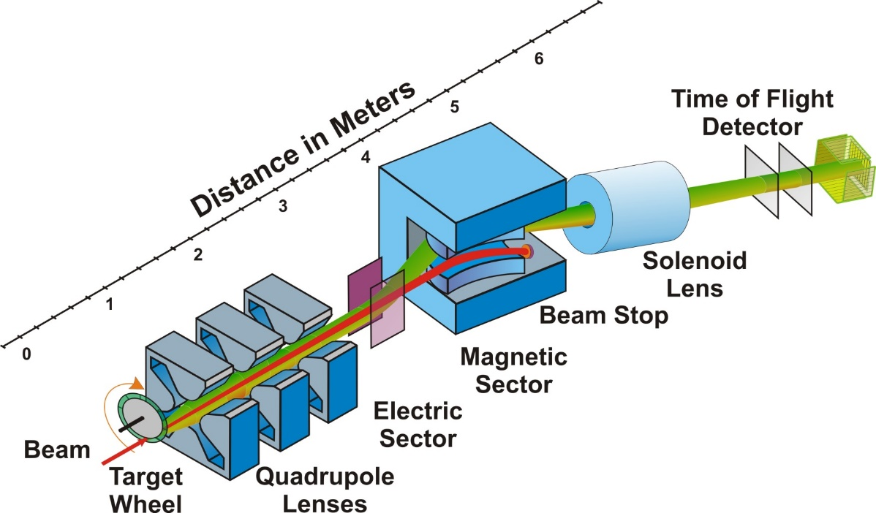
Prospects for the study of multinucleon transfer reactions (MNT)
Future Plans at FLNR
Are MNT reactions suitable for the production of (super)heavy nuclei?
  Z > 92, N ≈ 126 → MNT might be favourable for n-deficient transuranium isotopes
  n-rich SHE → study of new isotopes up to Z ~ 108 seems to be feasible
Future development of dedicated experimental set up analysis of MNT products under different angles.
New project of set-up Separator for TransActinide Research (STAR).
STAR

Slide 23
PAC for NP recommendations for “Prospects for the study of multinucleon transfer reactions (MNT)”
The PAC remarks that, along with the study of new isotopes, the exploration of MNT-reaction mechanism is of great importance, and strongly supports the development of a specialized set-up dedicated to a comprehensive study of such mechanism. Investigations of MNT reactions will highly benefit from the upgrade of the U-400 cyclotron complex, where it is planned to produce also an uranium beam of sufficient intensity.
The PAC recommends presenting as soon as possible a detailed project of a new dedicated set-up aimed at measuring features of the MNT reactions and their products (for instance, mass, energy, angular distributions, and possibly charge).
The PAC also recommends substantiating this project with an in-depth theoretical study aimed at clarifying the correlation of the entrance channel of the reaction with the above mentioned features of the MNT reactions and products.

Slide 24
SC: The observation of nuclei produced in multinucleon transfer reactions (MNT reactions) with proton numbers up to Z = 102 at the SHIP (GSI) and SHELS (FLNR) separators shows that these reactions can be considered as an alternative pathway to extend the nuclear chart towards the heaviest neutron-rich nuclei. The Scientific Council expects that investigations of MNT reactions will highly benefit from the upgrade of the U-400 cyclotron complex, where it is planned to produce also a uranium beam of sufficient intensity.
Common issues
The Scientific Council strongly supports the recommendation of the PAC for Nuclear Physics that all proposals for new projects and requests for extension of themes or projects contain full information on required financial and human resources and a SWOT analysis.

Slide 25
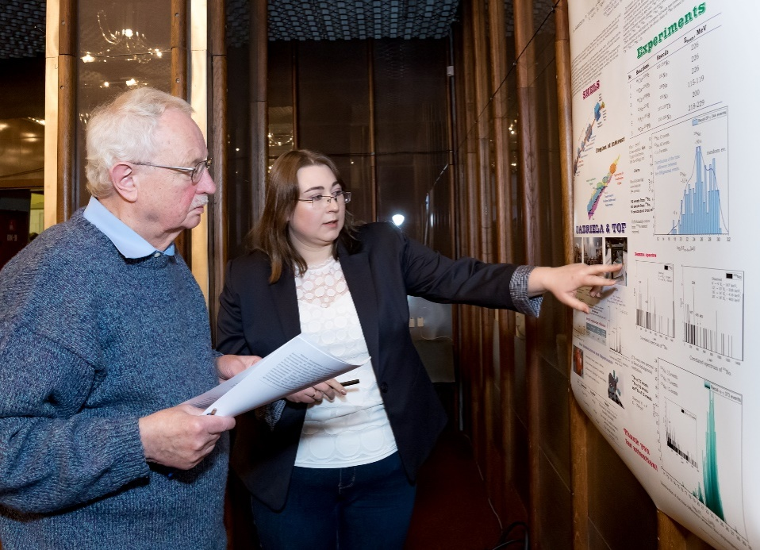
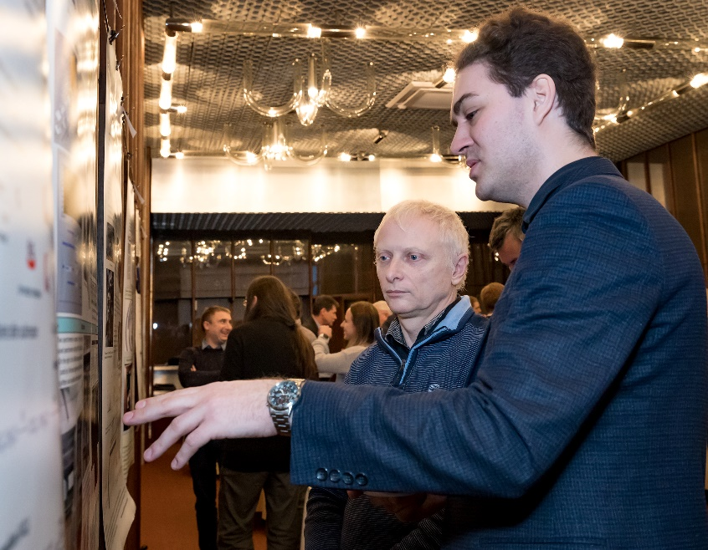
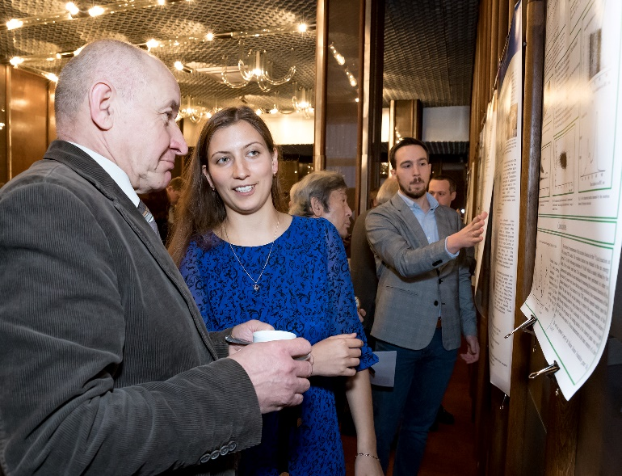
Poster session
The PAC reviewed 13 poster presentations in the field of nuclear physics research by young scientists from FLNR.
The best posters selected are:
“Study of No isotopes with the GABRIELA array” presented by Alena Kuznetsova
“Effective method of excitation function measurement for (α, n) reactions at low energies” presented by El’vira. Gazeeva
“Data acquisition and control systems developed for the synthesis of superheavy elements at the experiment DGFRS-II FLNR JINR” presented by Leo Schlattauer
“Study of No isotopes with the GABRIELA array” was presented at the 127th session of the Scientific Council in February 2020.
Leo Schlattauer
Alena Kuznetsova
El’vira Gazeeva

Slide 26
THANK YOU FOR YOUR ATTENTION!

