Slide 1
Simulation of the drift chambers for the BM@N experiment
Dubna State University
ENU named after L.N. Gumilyov
Student:
Gulfairuz Serikbayeva
Thesis supervisor:
Maria Patsyuk, PhD, JINR LHEP

Slide 2
Purpose of the thesis
To improve the existing simulation of the drift chambers for the BM@N experimental setup
Tasks of the thesis research were following:
Study of basic principles of drift chambers
Explore and learn to use the BmnRoot software framework
Master the object-oriented environment ROOT
Develop the simulation programming code

Slide 3
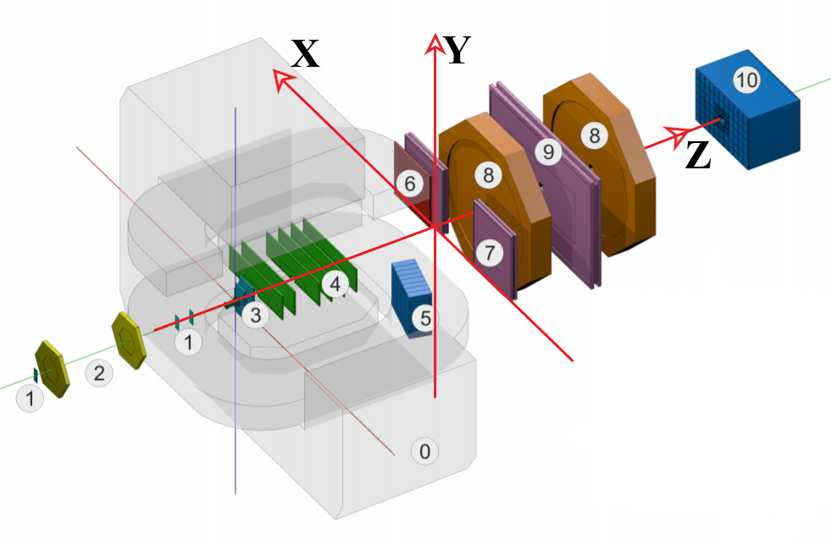
The subject of the thesis
Event generator
(UrQMD, LAQGSM, Pythia...)
Detector simulation
(Geant3, Geant4)
Digitization
Reconstruction/Analysis
Software of the experiment
(BmnRoot, FairRoot...)
Fig. 1. The layout of the BM@N experiment [1]. Drift chambers are labeled by 8.

Slide 4
Drift chambers (DCH) at the BM@N setup
DCH-2
DCH-1
DCH-2

Slide 5
The following steps were done:
1. The accurate shape of background noise was accomplished by fitting XY distribution of DCH hits from ¹²C ion beam with applied magnetic field of 2.7 Tm.
2. The precise positioning of 8 wire planes of each drift chamber was reconstructed with ROOT macro.
3. Physical and background hits are separated according to reference index.
4. Individual hits were plotted for each wire plane to illustrate the wires' orientation.

Slide 6
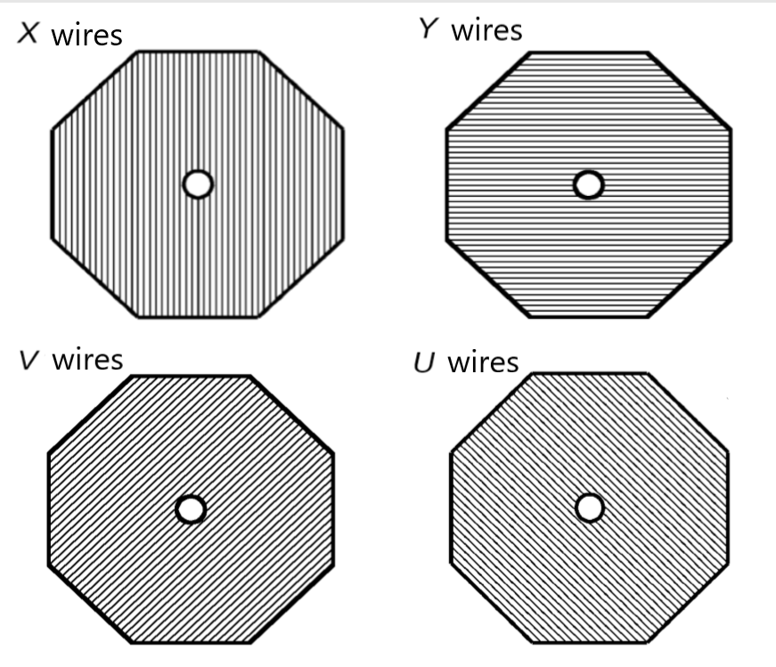
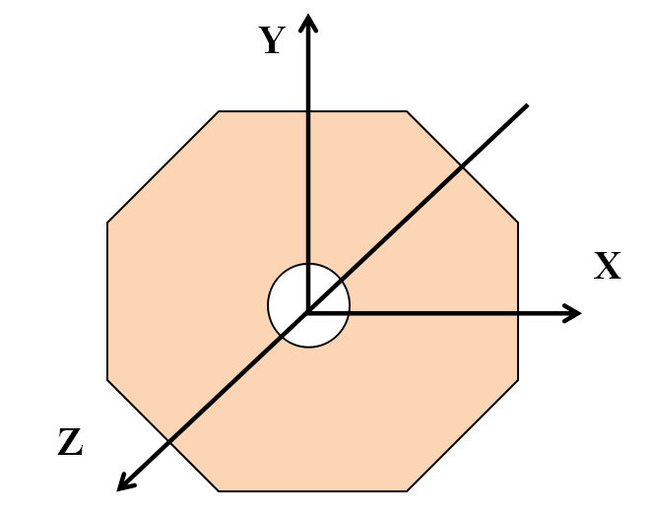
Geometry of the DCH
Octagonal shape
8 wire planes in each DCH
Fig. 2. Four different directions of wires in each DCH, orthogonal to the beam axis (Z axis) [3].

Slide 7
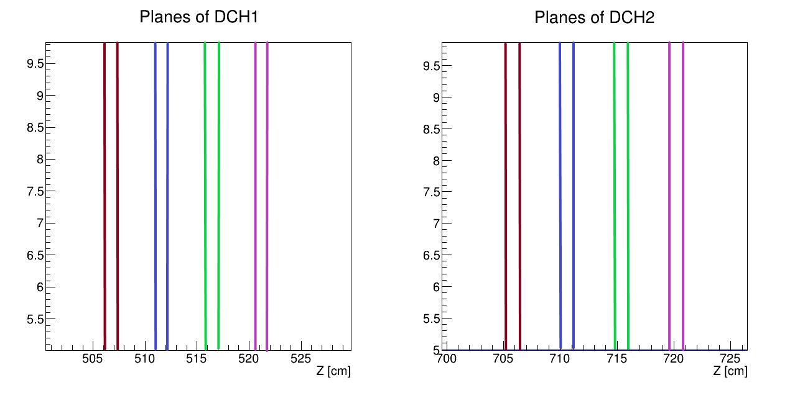
Positioning of wire planes in the DCH based on simulation
V-oriented wire plane
U-oriented wire plane
Y-oriented wire plane
X-oriented wire plane
Fig. 3. Z coordinates of wire planes in drift chambers.

Slide 8
X-profile distribution of experimental hits
Charged particles are bent to the side of chambers because of magnetic field influence.
Fig. 4. Distribution of experimental hits in the DCHs according to X coordinate.

Slide 9
X-profile fitting
The fitting function was chosen as sum of several functions at different intervals of X axis to achieve adequate fitting parameters.
Gaussian
Gaussian
pol4
pol6
Fig. 5 . Fitting of hits distribution according to X coordinate.

Slide 10
Y-profile distribution of experimental hits
Fig. 6. Distribution of experimental hits in drift chambers according to Y coordinate.

Slide 11
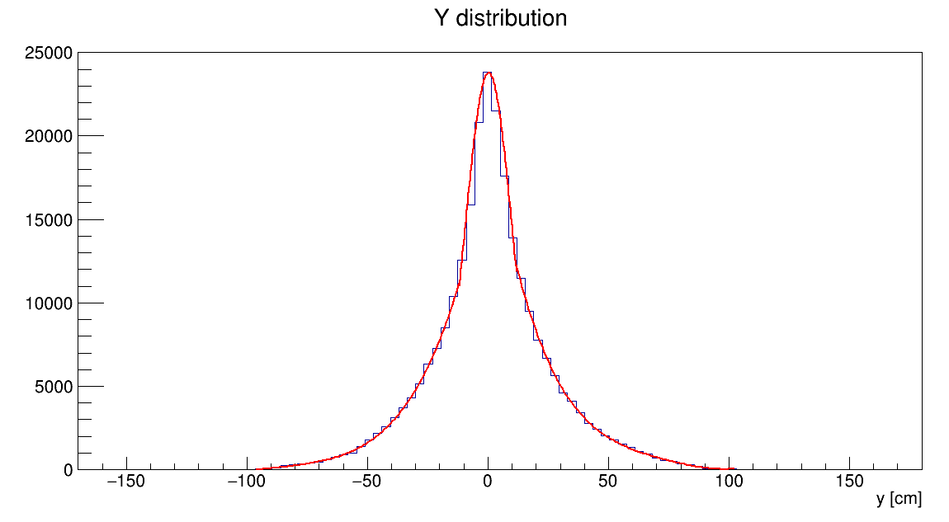
Y-profile fitting
The fitting function was chosen as sum of several functions at different intervals of Y axis to achieve adequate fitting parameters.
Gaussian
pol4
pol4
Fig. 7. Fitting of hits distribution according to Y coordinate.

Slide 12
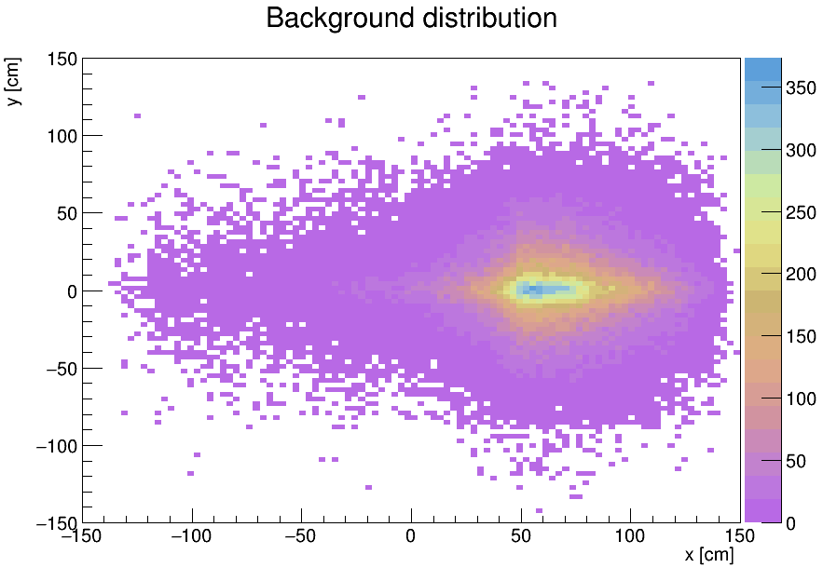
Simulated background hits
1000 events
10 background hits per wire plane in each event
Fig. 8. Distribution of simulated background hits in drift chambers.

Slide 13
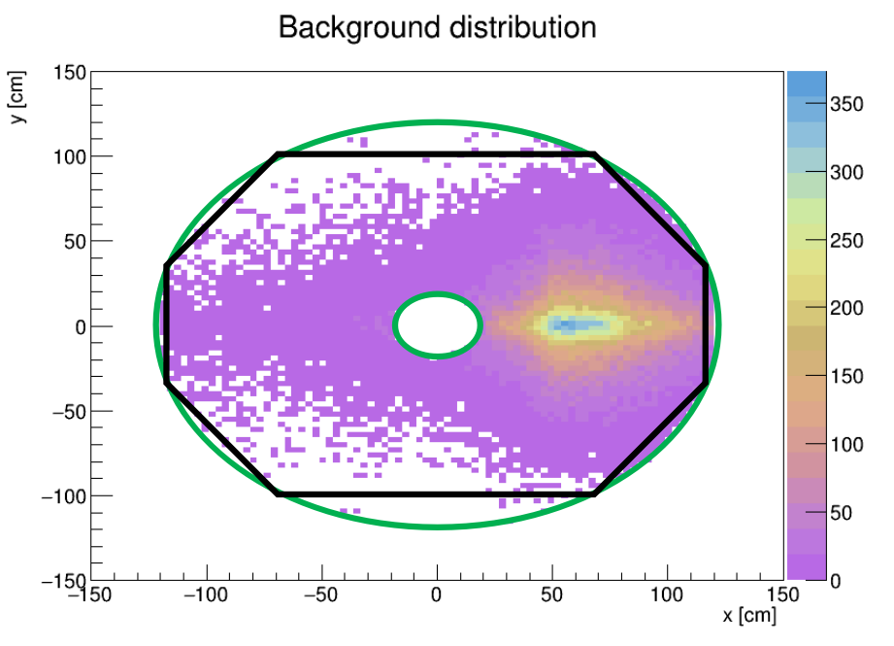
The geometry of the DCH for simulated background hits
1000 events
10 background hits per wire plane in each event
Fig. 9. Geometry for simulated background hits distribution. Green lines are circles of beam hole and outer sides of drift chambers. Black line - octagon fitted into circle.

Slide 14
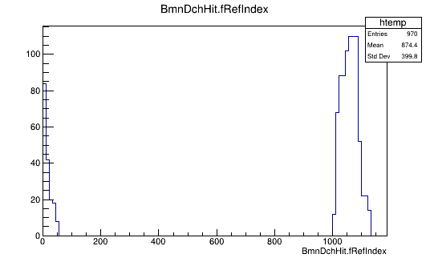
Separation of the simulated physical and background hits
For testing purposes reference index for background hits starts with 1000.
Simulated physical hits
Background hits
Fig. 10. Reference indices of simulated physical and background hits.

Slide 15
Simulated physical and background hits
100 events
5 protons per event
10 background hits per wire plane in each event
Momentum of protons: 5 GeV/c
Azimuth angle range: (0; 360)
Polar angle in lab system range: (0; 5)
Fig. 11. Simulated physical and background hits in drift chambers.

Slide 16
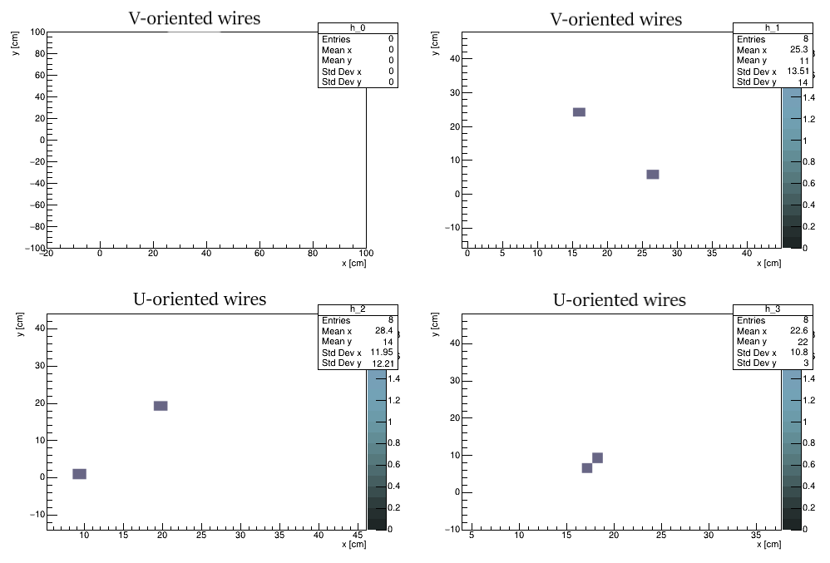
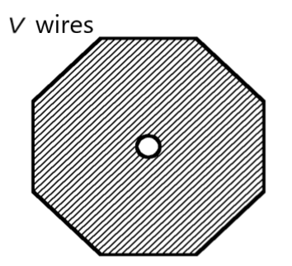
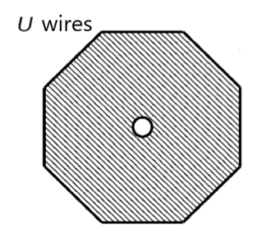
Simulated hits in the 1st DCH
Simulated physical and background hits are duplicated in the same way.
Fig. 12. Simulated hits on the 1st-4th wire planes in the 1st drift chamber.

Slide 17
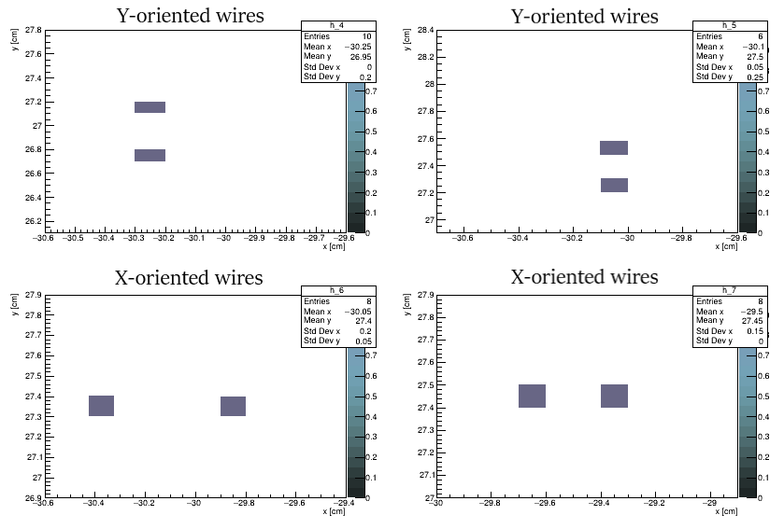
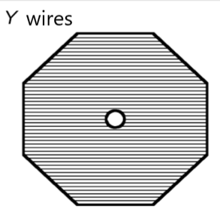
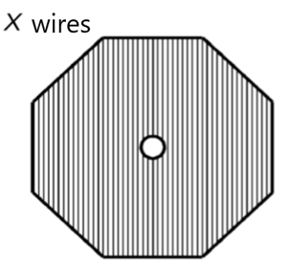
Simulated hits in the 1st DCH
Simulated physical and background hits are duplicated in the same way.
Fig. 13. Simulated hits on the 5th-8th wire planes in the first drift chamber.

Slide 18
Results
The XY-profile of background noise was added into hit producing class for DCH of BM@N software.
The exact Z coordinates of planes are added into background generation algorithm of BM@N software.
The distribution of background hits is verified to be match the XY geometry of DCH.
A method of addition of background hits to simulation macro was developed.
A macro code for testing and visualization of the hits was developed.
The results of improved simulation will be used to determine the efficiency of drift chambers and improve the track reconstruction.

Slide 19
Thank you for your attention!

Slide 20
Backup slides

Slide 21
References
1. Official BM@N collaboration web-site: https://bmn.jinr.ru
2. The BM@N experiment at JINR: status and physics program / Baranov D., Kapishin M., Mamontova T., Pokatashkin G., Rufanov I., Vasendina V., Zinchenko A. - Dubna: JINR, 2018.
https://knepublishing.com/index.php/KnE-Energy/article/view/1757
3. Ján Fedorišin. Calibration, autocalibration and alignement of drift chambers in BMN experiment - Dubna: JINR, 2015.
http://bmnshift.jinr.ru/wiki/lib/exe/fetch.php?media=bmn_dch_oct2015_fedorishin.pdf
4. BM@N collaboration. BmnRoot: simulation and analysis framework for BM@N experiment - Dubna: JINR, 2016.
https://bmn.jinr.ru/wp-content/uploads/2019/07/BmnRoot_Start_Guide.pdf

Slide 22
NICA experiment
Fig. 14. NICA facility [4].

Slide 23
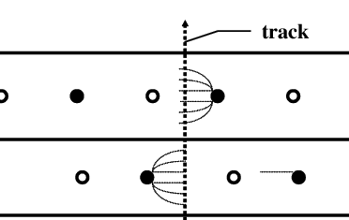
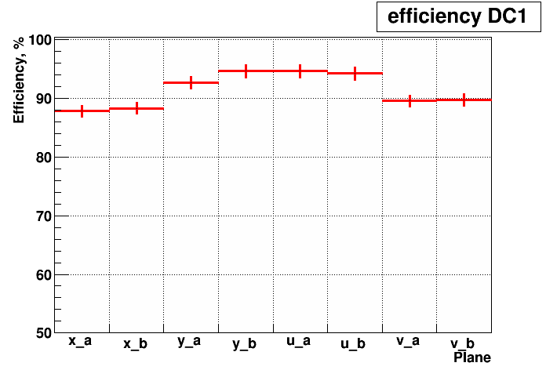
Operation of the drift chamber
sensitive wires
resistive wires
Trigger
4 double coordinate planes: 2x; 2y, 2u, 2v;
wire angles 0°,90°,±45°;
radius of central hole = 10 cm;
2048 wires per chamber.
Fig. 15. Efficiency per layer in the 1st drift chamber.

Slide 24
Table 1. Fitting functions for X-profile distribution of experimental hits

Slide 25
Table 1. Fitting functions for X-profile distribution of experimental hits

Slide 26
Table 2. Fitting functions for Y-profile distribution of experimental hits

Slide 27
Table 2. Fitting functions for Y-profile distribution of experimental hits

Slide 28
Simulated physical hits in the 1st DCH
V
V
U
U
Fig. 16. Simulated physical hits on the 1st-4th wire planes in the first drift chamber.

Slide 29
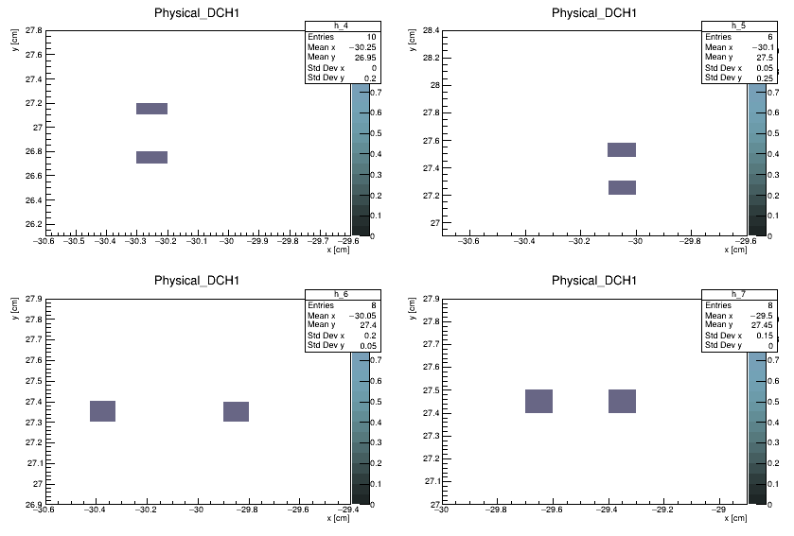
Simulated physical hits in the 1st DCH
Y
Y
X
X
Fig. 17. Simulated physical hits on the 5th-8th wire planes in the first drift chamber.

Slide 30
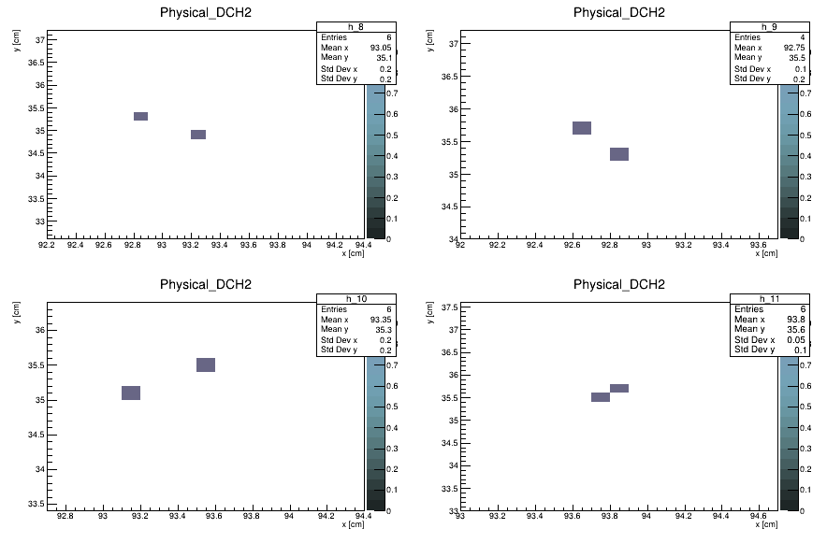
Simulated physical hits in the 2nd DCH
V
V
U
U
Fig. 18. Simulated physical hysical hits on the 1st-4th wire planes in the second drift chamber.

Slide 31
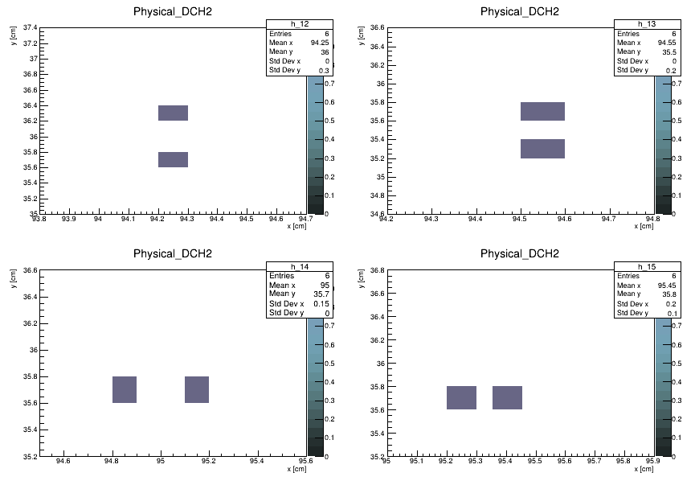
Simulated physical hits in the 2nd DCH
Y
Y
X
X
Fig. 19. Simulated physical hits on the 5th-8th wire planes in the second drift chamber.

Slide 32
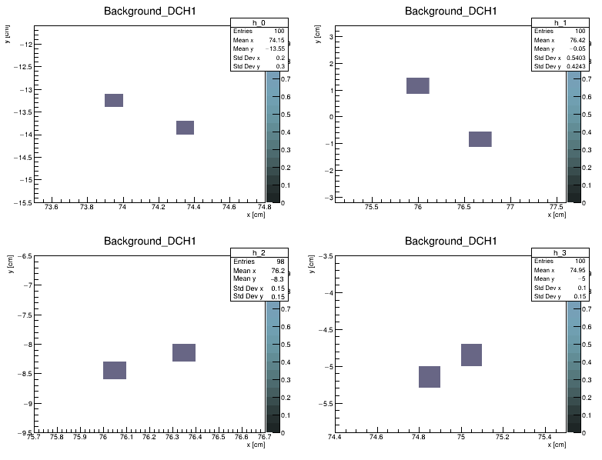
Simulated background hits in the 1st DCH
V
V
U
U
Fig. 20. Simulated background hits on the 1st-4th wire planes in the first drift chamber.

Slide 33
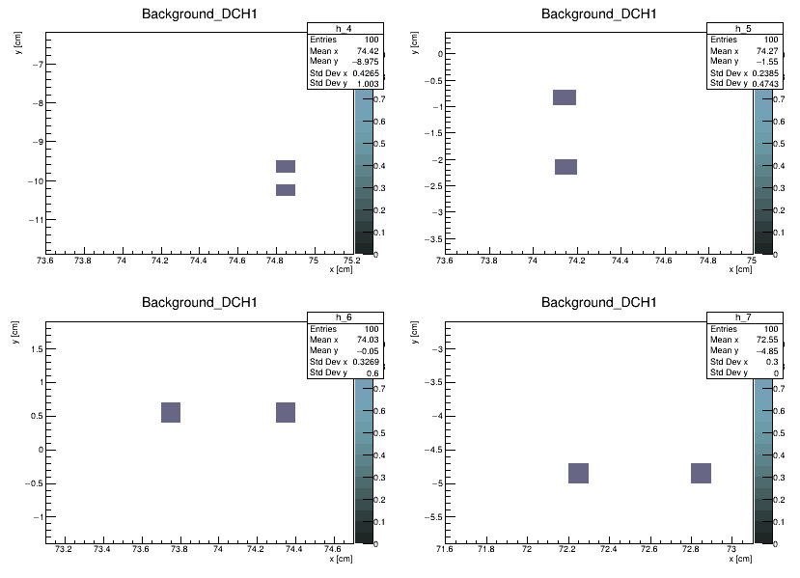
Simulated background hits in the 1st DCH
Y
Y
X
X
Fig. 21. Simulated background hits on the 5th-8th wire planes in the first drift chamber.

Slide 34
Simulated hits in drift chambers
Charged particles are bent to the side of chambers because of magnetic field influence.
1000 events
1 proton per event
Momentum of particles:
5 GeV/c
Azimuth angle range:
(0; 360)
Polar angle in lab system range:
(0; 5)
Fig. 22. Hits, generated with a single proton events in drift chambers.

