Slide 1
Estimation of Magnetic Field Growth and Construction of Adaptive Mesh in Corner Domain for Magnetostatic Problem in 3-Dimensional Space
Perepelkin E. and Tarelkin A.

Slide 2
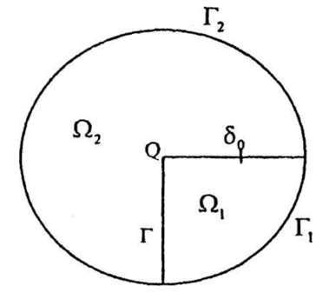
Introduction
Boundary value problem is formulated as:
There is an issue with calculation accuracy
in domain includes the corner point
$Ω_{1}$— ferromagnetic region
$Ω_{2}$— vacuum region

Slide 3
Outline
4
Estimation of magnet field’s growth
Calculation
-model body
-mesh
Results
10
11
15
16
Исследование поведения решения линейного уравнения дивергентного типа

Slide 4
I. Estimation of magnet field’s growth
Estimation of Magnetic Field Growth and Construction of Adaptive Mesh in Corner Domain for Magnetostatic Problem in 3-Dimensional Space

Slide 5
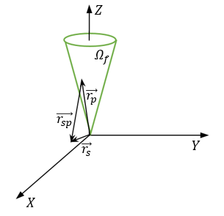
Estimation of magnet field’s growth
Integral formulation of magnetostatic problem in 3D:
— field from the current sources, it is limited
— ferromagnetic magnetization vector

Slide 6
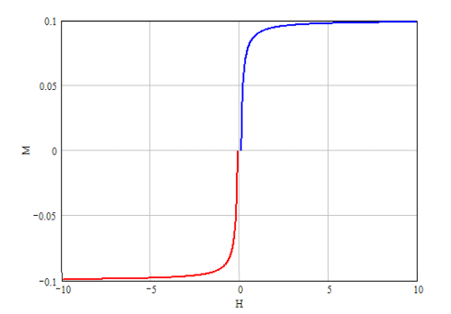
Estimation of magnet field’s growth
Ferromagnetic magnetization vector
is constant
The representation when is valid
and are positively constant
when
is limited by constant
,

Slide 7
Estimation of magnet field’s growth
Assess the second part of initial equation
where

Slide 8
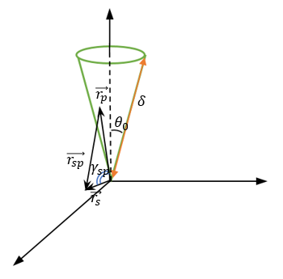
Estimation of magnet field’s growth
$$Z$$
where
Then we use the expression for the generating function
$$Y$$
$$X$$

Slide 9
Estimation of magnet field’s growth
where is limited,

Slide 10
II. Calculation
Estimation of Magnetic Field Growth and Construction of Adaptive Mesh in Corner Domain for Magnetostatic Problem in 3-Dimensional Space

Slide 11
Model body

Slide 12
Parameters
B_{center} = 0.35 T
Current density J = 1.0 A/mm²
Coil cross section S = 5.0 x 5.0 mm²
Full current I = 25.0 A

Slide 13
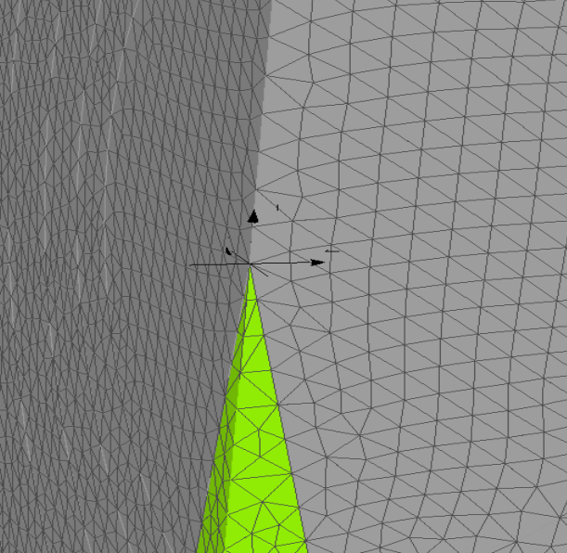
Uniform mesh

Slide 14
Adaptive mesh creation
$$Δl_{i}$$
$$Δl_{j}$$

Slide 15
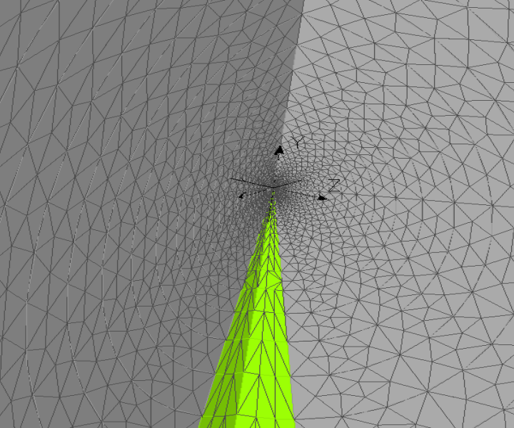
Mesh

Slide 16
Visible difference between adaptive and uniform meshes
uniform
adaptive

Slide 17
III. Results
Estimation of Magnetic Field Growth and Construction of Adaptive Mesh in Corner Domain for Magnetostatic Problem in 3-Dimensional Space

Slide 18
on the disk
Disk parameters:
Coordinates of center
Plate
Radius 5 mm

Slide 19
Field along line
X-directed line:
Start at
Finish at

Slide 20
Field near the corner point
$$∗$$
30 nodes in linear dimension for adaptive mesh correspond
120 for uniform mesh on the same region,
so there is gain:
$∗$number of nodes in linear dimension

Slide 21
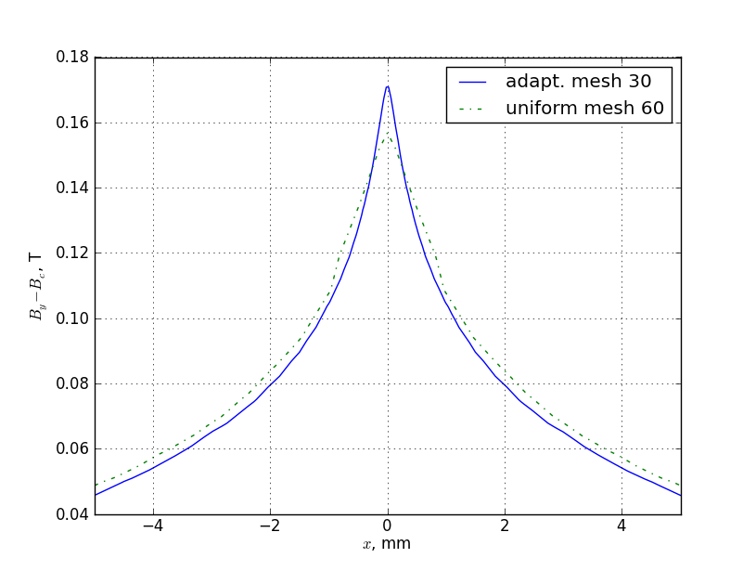
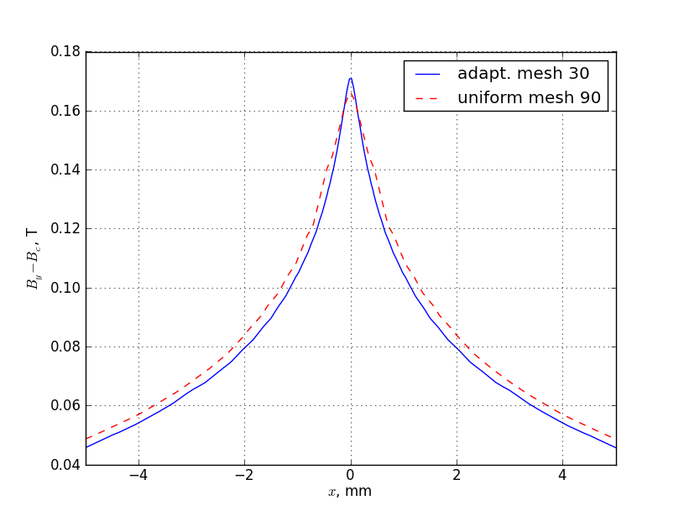
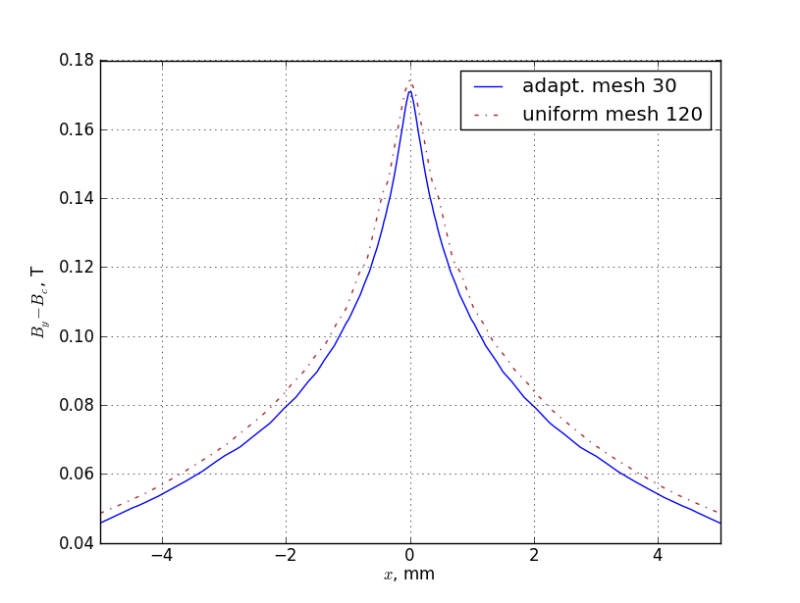
Field near the corner point

Slide 22
Conclusion
Upper estimation of the field growth near the corner point is obtained for case when magnet permeability is limited
1
2
Adaptive mesh for simple model is created
3
Adaptive mesh gives a gain in the number of nodes around at 64 times

Slide 23
Thank you!

Slide 24
Appendix

