Slide 1
Investigation of the entropy of a system of many particles with gravitational interaction
Presented for MMCP 2017
3 July 2017
E. Perepelkin, D. Suchkov

Slide 2
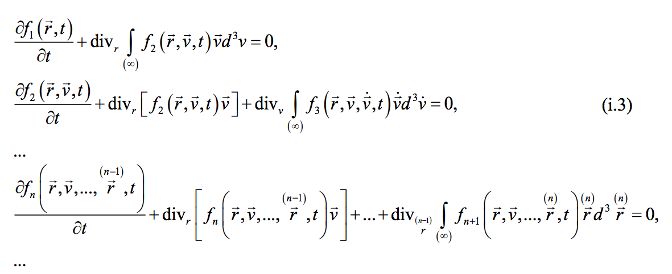

Theoretical introduction
Vlasov chain of equations
In a middle of XX century Vlasov obtained the infinite chain of equations for the probability distribution density functions:

Slide 3
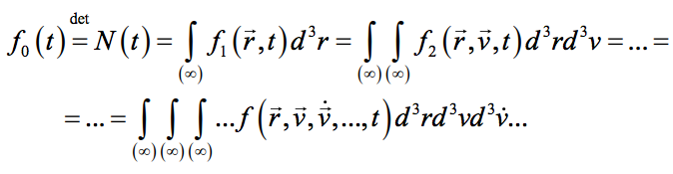
Theoretical introduction
Vlasov chain of equations
The probability density functions satisfy the relations:
Many thermodynamic characteristics can be obtained by using these distribution functions.
The most interesting function in this respect is f₂(r,v,t).

Slide 4

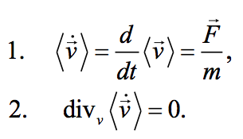
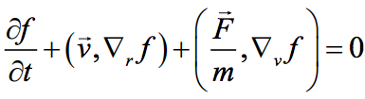
Theoretical introduction
Сutoff of the chain of equations
The second equation from the Vlasov equation chain can be rewritten in the form:
1
For this equation Vlasov considered the following particular case
Substituting expression into equation gives the famous Vlasov equation
2

Slide 5
Purpose of the study
In THE NEW MODIFIED VLASOV EQUATION FOR THE SYSTEMS WITH DISSIPATIVE PROCESSES were shown, that relations considered by Vlasov are not always fulfilled
Equation (2) in its structure is the Liouville equation. As a consequence, it describes only systems with constant entropy.
The main goal of the research is to develop effective algorithms for solving a more general equation (1) by investigating the solutions of equation (2)
2
1
2

Slide 6
Plan
1. Numerical solution of the Vlasov equation
2
A
Method of particles in cells
Algorithm description
Simulation results and Performance comparison
B
Finite difference method
Algorithm description
Simulation results and its comparison with method of particles in cells
2. A few words about the solution of the Vlasov equation
1
3. Conclusion

Slide 7
Numerical solution of the Vlasov equation (particles in cells)

Slide 8
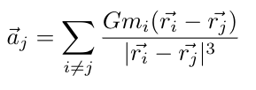



Method of particles in cells
Algorithm
The evolution in time of a system is obtained by Verlet integration:

Slide 9
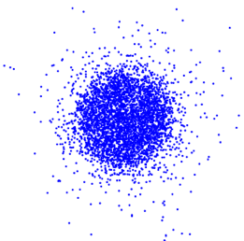
Method of particles in cells
Algorithm
Constructing f₁(r,t)

Slide 10
Method of particles in cells
Algorithm
Constructing f₁(r,t)

Slide 11
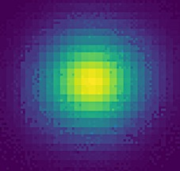
Method of particles in cells
Algorithm
Constructing f₁(r,t)

Slide 12


Method of particles in cells
Algorithm
Similarly, we can construct f₂(r,v,t).
Using this, we can find many of the characteristics of the system that we are interested in, including the entropy H(t).

Slide 13
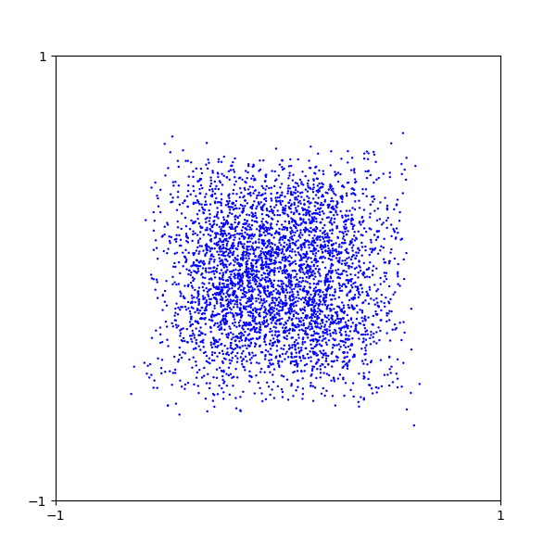
Method of particles in cells
Simulation results
Visualization of system evolution

Slide 14
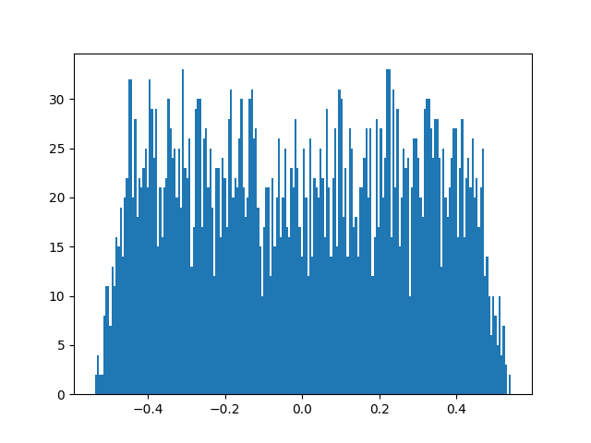
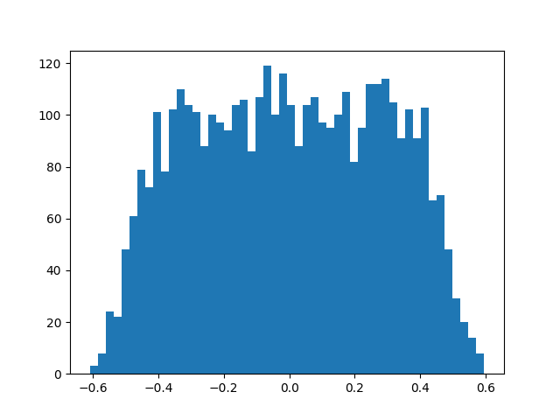
Method of particles in cells
Simulation results
Coordinate distribution
Velocity distribution

Slide 15
Numerical solution of the Vlasov equation (Finite difference)

Slide 16


Finite difference method
Algorithm
The algorithm consist of two steps:
Step 1: Explicit in the first and implicit in the second direction
Step 2: Explicit in the first and implicit in the second direction

Slide 17



Finite difference method
Algorithm
U is recalculated at each step by solving Puasson equation for Gravitational potential:
For an isolated system, the boundary condition is the zero value of the potential at infinity
Similarly, the boundary conditions for f₂ :

Slide 18
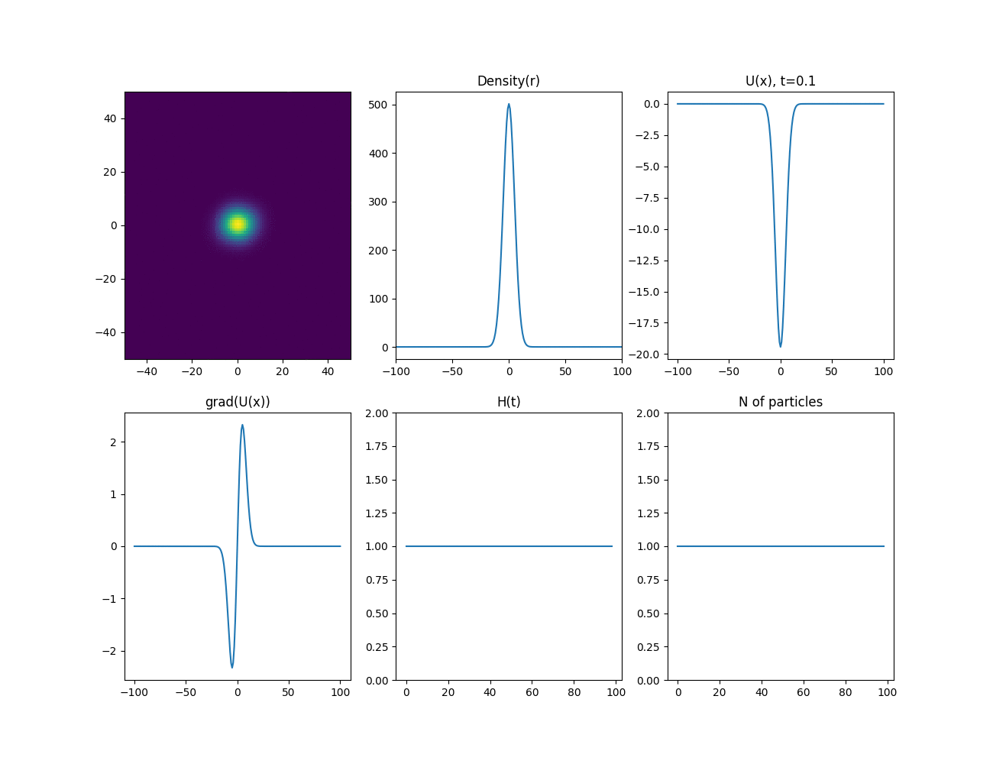
Finite difference method
Simulation results

Slide 19
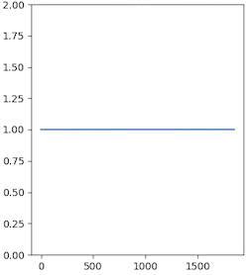
Finite difference method
Simulation results and its comparison with method of particles in cells
Evolution of the entropy of the system H(t) (in relative units)
Method Particles in cells
Finite difference method

Slide 20
Cluster characteristics
Characteristics of one node:
2 deconuclear processors IBM POWER8 (2.86 GHz)
memory ECC, 256 GB;
2 х 1 ТB 2.5” 7K RPM SATA HDD;
2 x NVIDIA Tesla P100 GPU, NVLink.
Cluster Performance (Tflop/s): 55,84 (Peak), 40,39 (Linpack)

Slide 21

Comparison of CPU and GPU
Integration of the equations of motion
N particles | CPU | GPU | Acceleration
1024 | 1,0 | 0,0 | 27,8
4096 | 3,9 | 0,1 | 34,7
32768 | 30,5 | 0,8 | 39,1
Calculation of the distribution function
N particles | CPU | GPU | Acceleration
1024 | 1,0 | 0,0 | 130,3
4096 | 9,1 | 0,1 | 180,5
32768 | 183,1 | 0,6 | 305,3

Slide 22
A few words about the solution of the Vlasov equation

Slide 23

Conclusion
Two different algorithms for calculating the Vlasov equation with constant entropy and gravitational interaction are developed.
The obtained results are the same as the exact solutions.
It is planned to realize this for systems with dissipation (and as a consequence with non-constant entropy)
The plans to implement algorithms for multi-GPU

Slide 24
Thank you!

