Slide 1

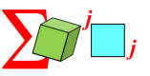
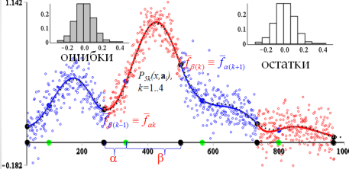
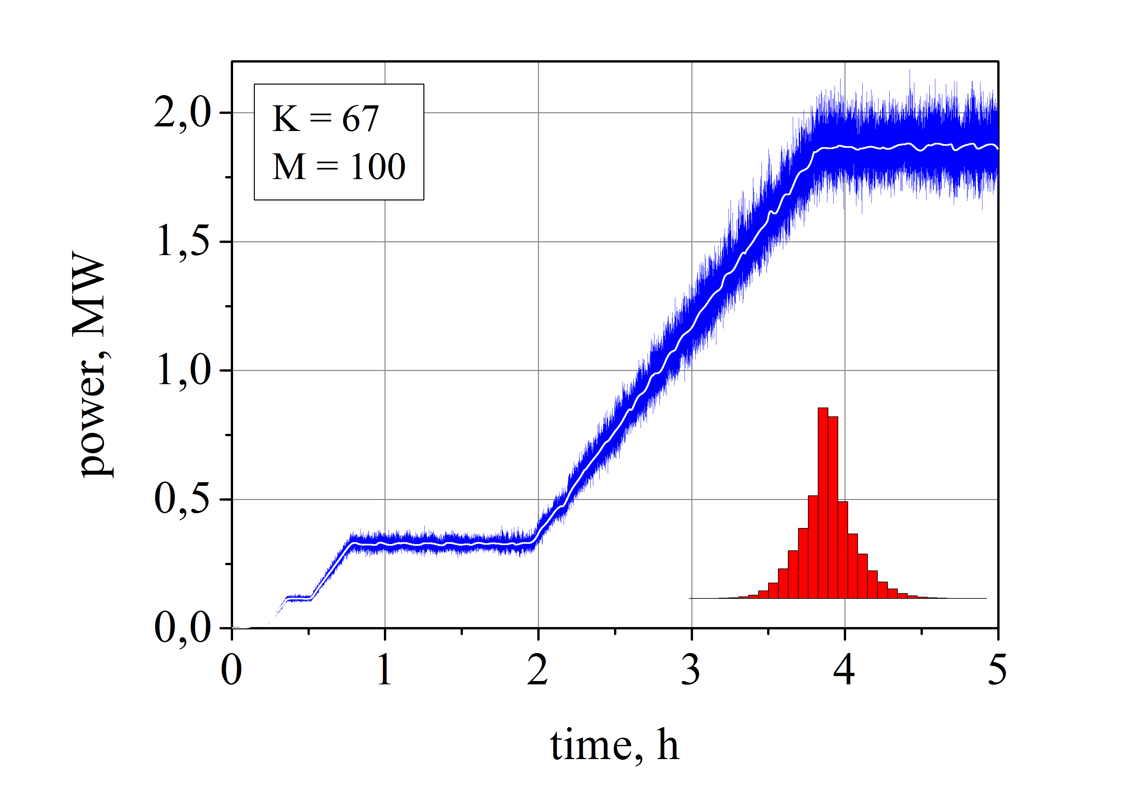
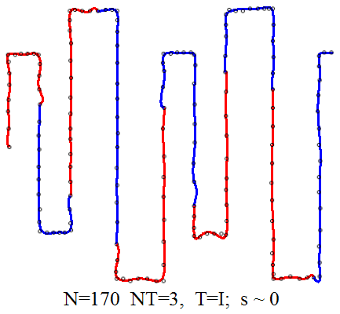
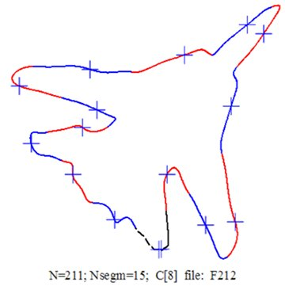
Shape Approximation Based on
Higher-Degree Polynomials
Content
The planar shape (contour) of the object is a fundamental source of information not only in pattern recognition but also in information technologies as well.
Goal: We propose to use higher-degree BEM-polynomials for approximation and smoothing of planar shapes (contour lines) in order to increase the efficiency of recognition algorithms and image processing.
I . Shape Representation and Description Techniques.
II. Higher-Degree Polynomials (Pro and Contra).
III . Basic Element Method (BEM).
IV . Segmentation of 2D Curves by BEM-Polynomials.
V . Extraction of Informative Signs of the Planar Shapes.
Examples.
VII. Conclusion. References.
To recognize objects at complex image in real time, the processor's performance should be approximately
10⁸ - 10¹⁴ elementary operations per second.
Therefore, instead of processing each point of the object, only its contour is processed.
N.D. Dikusar
dnd@jinr.ru
JINR, LIT
Analytical curves such as pieces of straight lines, circle’s and spiral’s arches, cubic splines, etc. are used more often in approximation of contour lines [1,2,9,10,11,15] (SA).
MMCP 2017
Dubna

Slide 2
Approximation and smoothing become simple when they are based on higher-degree BEM -Polynomials.
Higher-Degree Polynomials (Pro and Contra)
Not the goal is the subject of decision,
but the means to the goal ...
Aristotle
What is a BEM-Polynomial?
The Basic Element Method
Higher-order (n>6) polynomial approximation allows to
increase the length of intervals;
decrease errors of approximation;
decrease the number of segments on the contour;
more exact calculation of informative signs.
get more information about an approximated curve
The BEM-polynomial is based on Chebyshev's idea about approximation of smooth function by a polynomial on an interval of limited length (1853).
The Basic Element Method (BEM) has been developed recently in the Laboratory of Information Technologies*).
☺
To reduce these difficulties
a new design of the polynomial (BEM-polynomial) is proposed.
The following conception underlies in the construction of
the BEM-polynomial:
*)
http://link.springer.com/article/10.1134%2FS2070048211040053
At the same time,
an increasing in the degree of the polynomial leads to
1) loss of stability;
2) considerable emission of the
predicted value at extrapolation;
3) increase of the order of derivatives;
increase of computational complexity.
http://link.springer.com/article/10.1134/S2070048216020058
" analytical connection between nodes of a three-point grid and relevant triplets of pivot points of a polynomial and of its derivatives ".
http://link.springer.com/article/10.1134%2FS2070048214050020
http://www.mathnet.ru/php/archive.phtml?wshow=paper&jrnid=mm&paperid=3056&option lang=rus
http://www.mathnet.ru/php/archive.phtml?wshow=paper&jrnid=mm&paperid=3651&option_lang=rus
formulas of smoothing by higher-degree polynomials
almost are not used … ☹
http://www.mathnet.ru/php/archive.phtml?wshow=paper&jrnid=mm&paperid=3457&option_lang=rus
2

Slide 3
The Three-Point Grid
But very often it is important for an error to be reduced to zero within the limits of the interval [*]
P. L. Chebyshev
The three-point grid (BEM)
α
β
|f-p_{BEM}|
☺
τ
τ
τ
0
0
α
β
γ
|f-p_{T}|
An interrelation between four points is established by the cross-ratio functions (CRF). !!!
A one-point grid (Taylor)
τ
0
[*] P. L. Chebyshev, Selected Works (Akademia Nauk SSSR, Moscow, 1955).

Slide 4
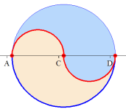
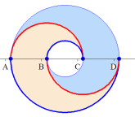
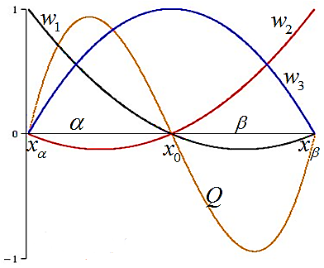
Cross-Ratio Functions (CRF)
“wurf ”
(β−τ)
:
γ=β−α
γ
[13]
[23]
τ
1
α
β
τ
2
3
0
4
[24]
α
[14]
τ
►
=
w₁(τ,α,β )
τ(τ− α )
τ
α
β
0
=
w₂(τ,α,β )
= w
►
γβ
τ
β
α
0
(τ- α )(τ-β )
τ
α
0
β
►
=
w₃(τ,α,β )
βα
τ
0
α
β

Slide 5
The Basic Elements
Properties of the Basic Elements:
w₁,w₂,w₃, Q
are called as four Basic Elements (BE)
I. BE form a structure.
II. Natural normalization:
The Basic Elements depend on a variable τ and continuous parameters α and β: w_{i}(τ, α, β), Q(τ, α, β); τ, α, β ϵ R.
The parameter x₀ is used for
three-point grid translation;
moving x₀ within the three-point grid in order to change
parameters α, β and basis functions as well.
These properties allow to optimize the PPA task solution.
III. BE possess partial symmetry with
respect to the permutation of parameters
IV. Scale invariance of
☺
V. Uniformity of Q :

Slide 6
A Construction of the BEM-Polynomial is based on the four geometrical primitives or Basic Elements:
w₁
w₂
w₃
Q
one cubic and three quadratic parabolas are used for building the BEM-polynomial P_{BEM} :
Σ
Σ
coefficients
[n/3]
[ ]
P_{n} = P_{BEM} =
*
* r_{jα}+ r_{jβ}+ r_{j0}
j
w₁
w₂
w₃
Q
j=0
[n/3]
n
Σ
a_{k} x^{k}=
☺
Q ^{j}
w^{T}r_{j}
k=0
j=0
Notes:
r₂

Slide 7
The BEM-Polynomial is a new form of the polynomial, defined on the three-point grid : **)
where
are quadratic parabolas,
is a cubic parabola,
are coefficients.
**) N. D. Dikusar. Higher-order polynomial approximation //MMCS, 2016, v.8 №2, pp.183-200. http://link.springer.com/article/10.1134/S2070048216020058

Slide 8
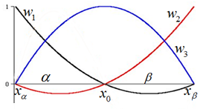
Straight Lines and Parabolas in Terms of BE
y=a₀+a₁x+a₂x², x_{α}< 0 <x_{β} , y_{ν}=y(x_{ν}), ν = α, β, 0.
y= Π₀=w^{T}y =w₁y_{α}+w₂y_{β}+w₃y₀ ,
“Lagrange elements”
Basic Elements

Slide 9
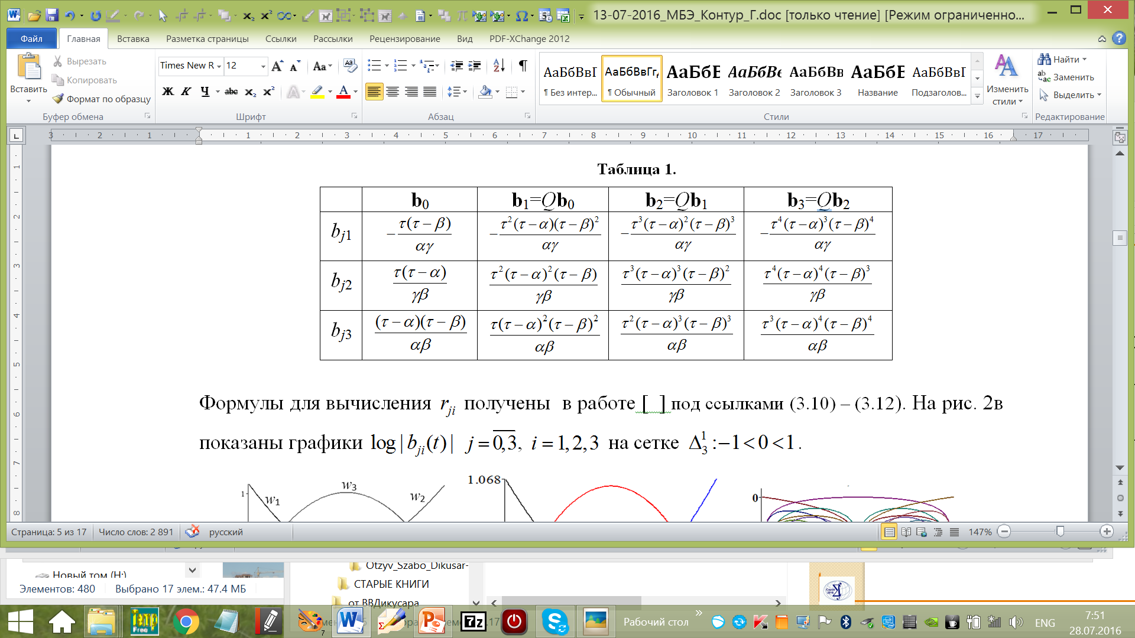
The BEM-model
BEM-basis
☺

Slide 10
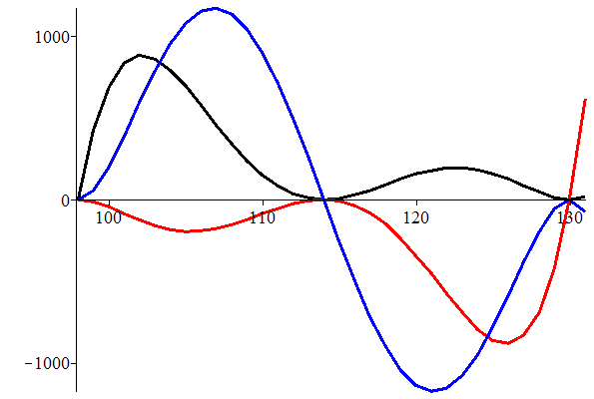
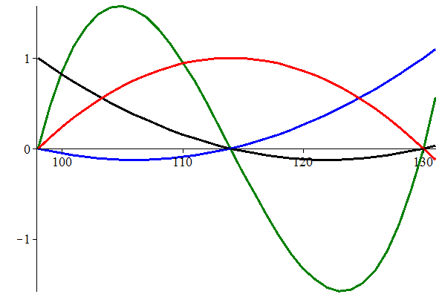
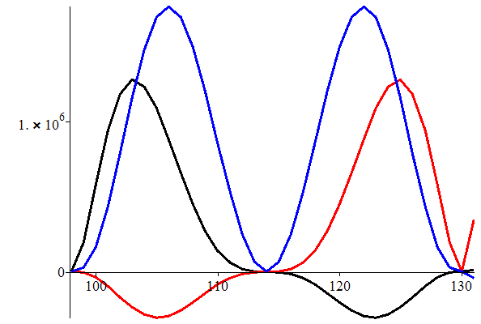
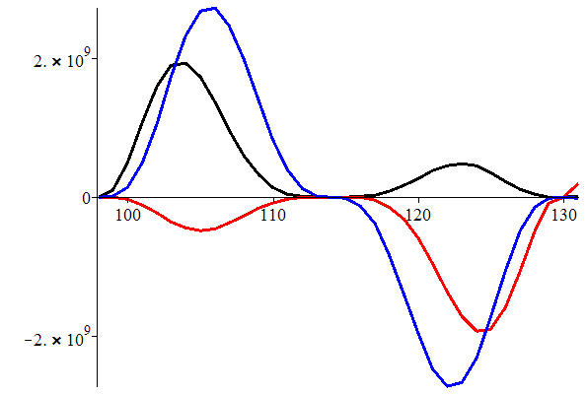
Plots of Components of the Basis Functions
(j=0,1,2,3)
b₀
2
b₁
w₃
w₁
w₂
1
Q
3
b₂
b₃
2
1
1
2
3
3
The basis functions are polynomials of degree 3j+2 with respect to τ and have zeros at nodes of the three-point grid
☺

Slide 11
Formulas for Calculation of Coefficients
(nonuniform grid )
r_{j}
  n=11 m=3
©
A quantity of arithmetical operations can be reduced using look up table (LUT) at calculation of coefficients r_{j}.
For example, 8, 18 and 30 simple operations are used for calculation of in polynomials of 5th,8th and 11th degree respectively [3].
☺ !

Slide 12
Formulas for calculation of coefficients d_{i} (uniform grid )
©
☺

Slide 13
Requirements to Data Handling Algorithms:
The efficiency of smoothing algorithms is dependent on the following factors :
    Accuracy of calculations (I)
    Stability of calculations (II)
    Decreasing of computing complexity (III)
    Robustness (IV)
    High quality of approximation (V)
    Flexibility (VI)
    Adaptability (VII)
Computational complexity (cc).
Degree of the polynomial (n).
Basis functions (bf).
Length of intervals (W).
Arrangement of knots (h).
Errors of data (e).
Robustness (r).
Smoothness order (o).
BEM provides requirements (I-VII):
II, VI and VII are provided using the continuous parameterization
of the Basic Elements (Basis Functions) [2], [6].
III provides by decreasing of an order of derivatives [3], [4].
☺
I, IV, V are provided by Piecewise Polynomial Approximation (PPA)
of a high order [2], [3], [4], [6] (BEM).
PPA within the limits of the BEM have a number of advantages in comparison with approximation and smoothing by splines [6].

Slide 14
The BEM-Approximation (How it works?)
The BEM-model:
(Horner’s scheme type)
Taylor coefficients
© BEM synthesizes properties of the Taylor polynomial and the Lagrange polynomial of the second degree.
p_{Т}≈ f
y
|f-p_{T} |
p_{BEM}≈ f
BEM coefficients
☺
f
Π₀(x,r₀)
Π₁(x,r₁)
Π₂(x,r₂)
Π₃(x,r₃)
x
x₀+α
x₀
x
x₀+α
x₀+β
Q(x)
W_{Т}
W_{BEM}

Slide 15
Piecewise Polynomial Approximation (PPA)
On practice contour of complex topology is approximated by segments using Splines or
Piecewise Polynomial Approximation (PPA).
Main difficulties of PPA:
Optimum arrangement of nodes on the grid.
Smoothness order at junction knots.
Unfortunately,
the use of cubic splines for approximation of complex shapes gives us a large quantity of segments !
The higher the degree of the polynomial, the smaller of the grid nodes, and the accuracy and quality of the approximation is better.
☹
☹
The curve approximating contour of an object should lie near to measurement points, and its representation will be the most effective if we use minimum possible number of segments K.

Slide 16
BEM and Mean-Squares Approximation (BEM-MSA)
BEM-MSA (K=1)
Let’s consider two polynomial models:
II stage: Smoothing u-data
BEM-MSA smoothing algorithm performs calculations at two stages :
I stage MBE:
☺

Slide 17
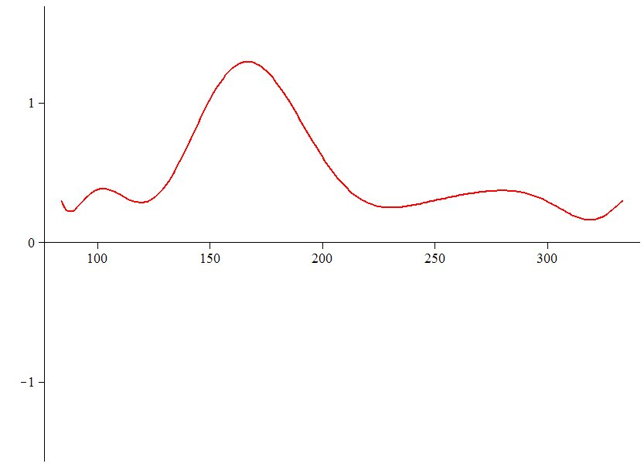
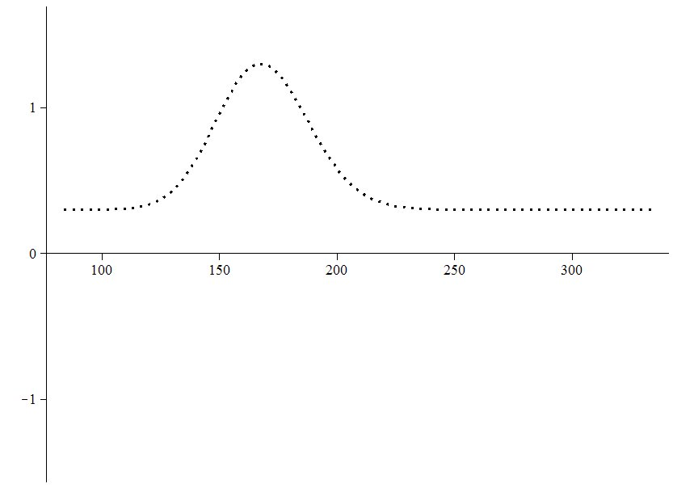
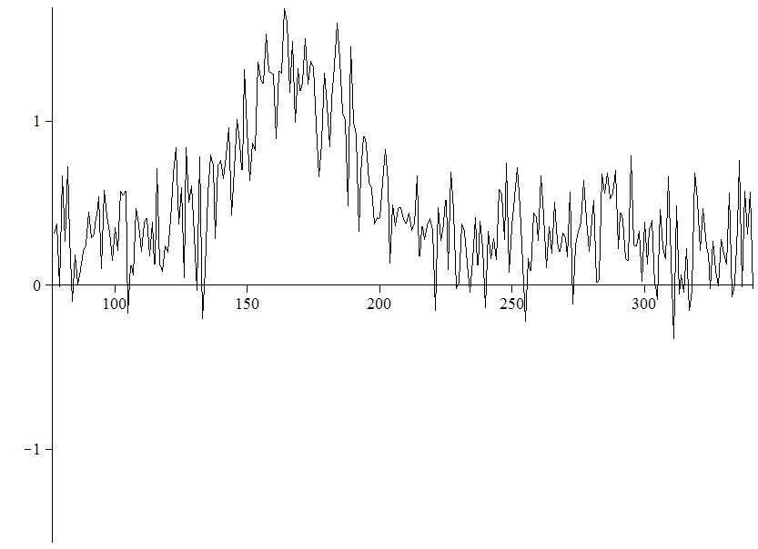
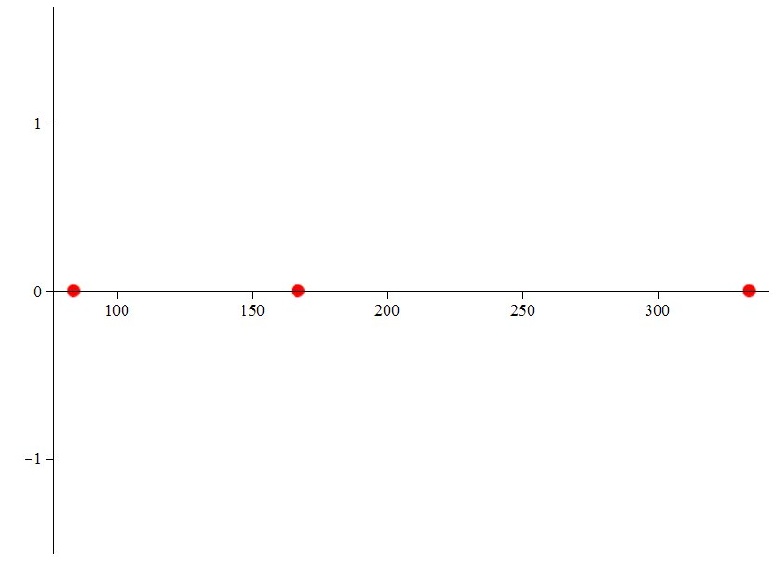
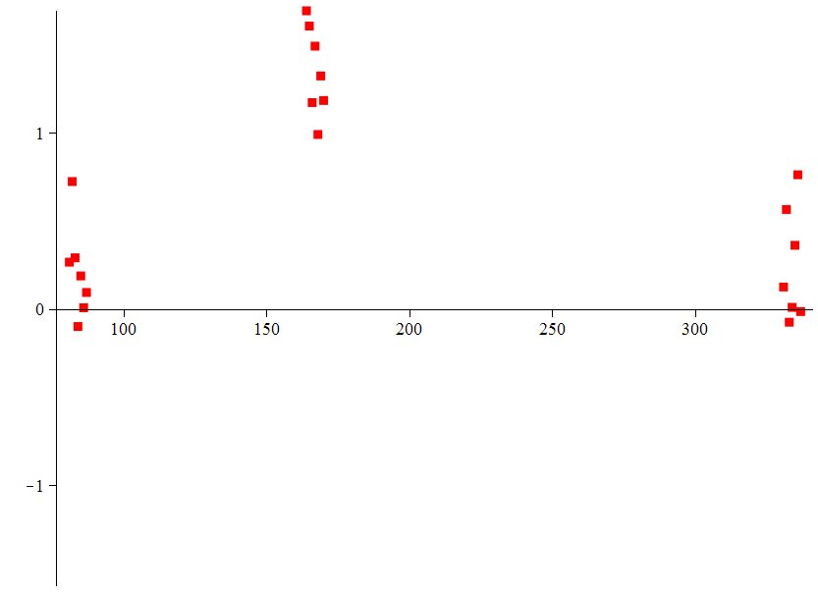
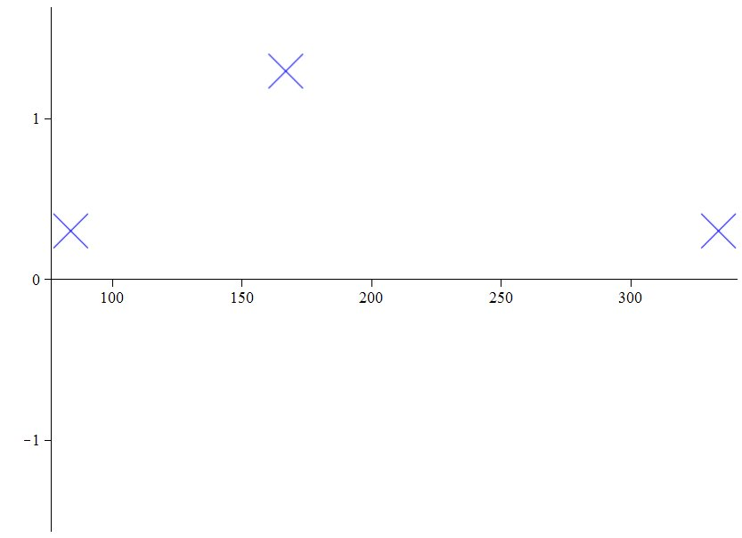
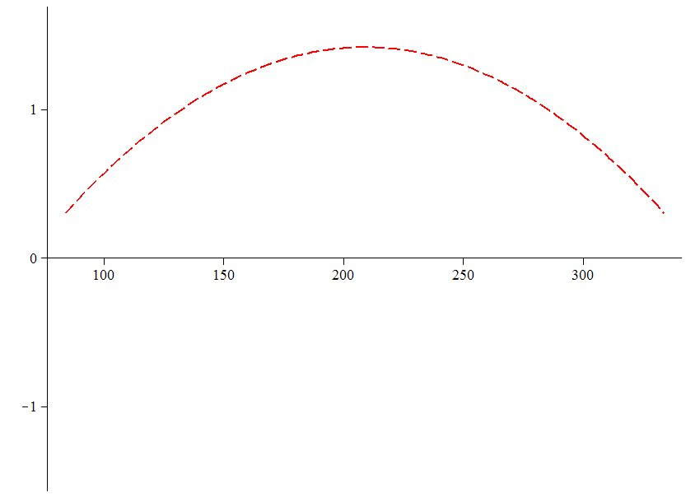
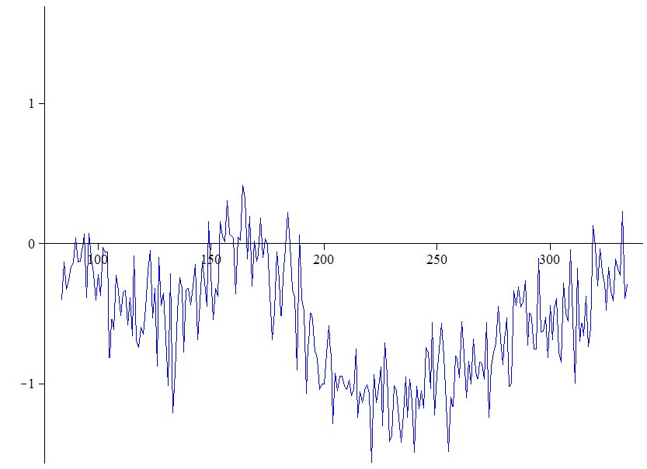
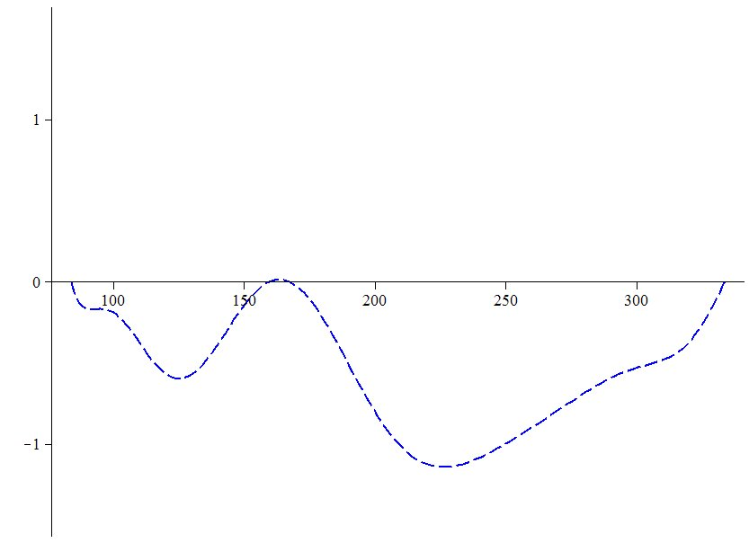
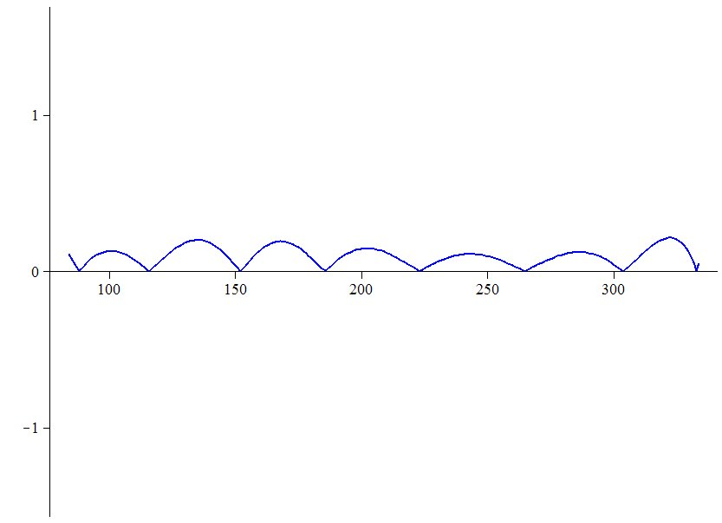
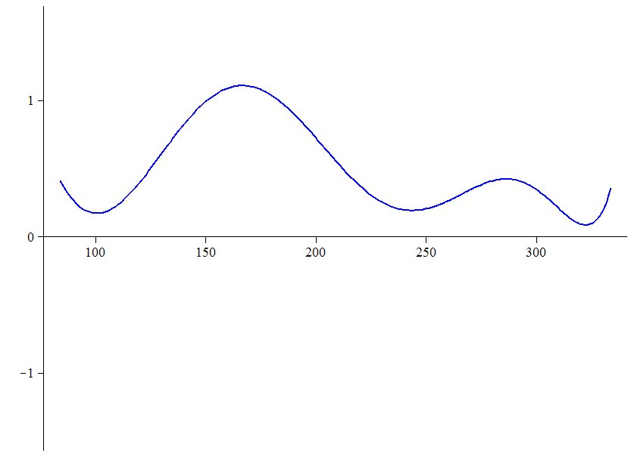
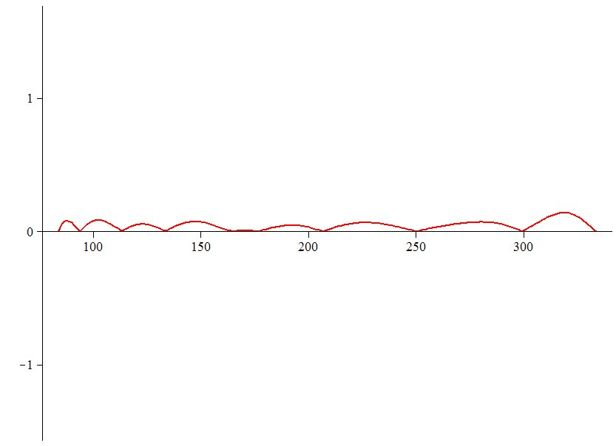
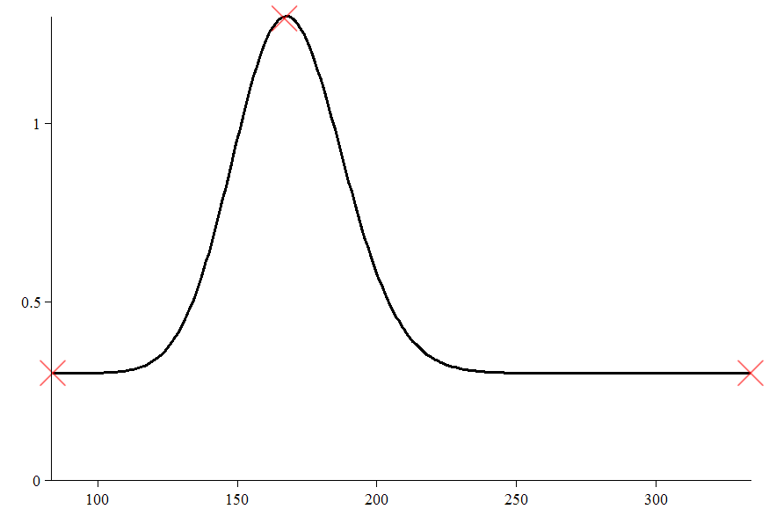
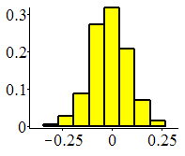
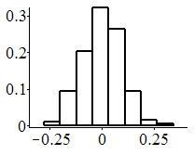
7 Steps of the BEM-MSA Algorithm (M=3, K=1)
1. Input data
2. Nodes of three-point grid.
Installation of parameters α, β,x₀
A
+
3. 2M+1 points near nodes
4. Estimation of r₀ and Π₀
5. MD: Modification of the input data
B
6. MSA-smoothing of MD
F=C+A
7. Obtaining of the regression polynomial
+
+
x₀
☺
β
f(x)=exp{-0.5 (x-1.3)²/(0.025x-0.02665)²}+0.3,
xϵ[1.25,1.4], h=0.0003
α
B-A
C
Reducing of the order of the model on 3
errors
residuals

Slide 18
Five Parameters for Optimization of BEM-MSPPA
(Mean Squares Piecewise Polynomial Approximation):
☺
- shift parameter.
- parameters of local smoothing.
- parameter of global smoothing,
where
- parameters of the three-point grid
- number points for calculation of
- number of segments

Slide 19
Properties of the BEM-Polynomials
☺
1. BEM-polynomials are set on the three-point grid.
2. All variables and parameters are measured values.
3. Parametrical control of the basis functions.
4. Decreasing of an order of derivatives and increasing in a step of the grid.
5. Decreasing of computing complexity.
6. Quality control of regression matrixes in LSM.
7. Stability of calculations to input errors (robustness).
8. Optimization of smoothing parameters.
9. Physical realizability.
10. Expansion of borders of applicability of existing methods.
BEM is a new tool for the solution of problems of applied mathematics.

Slide 20
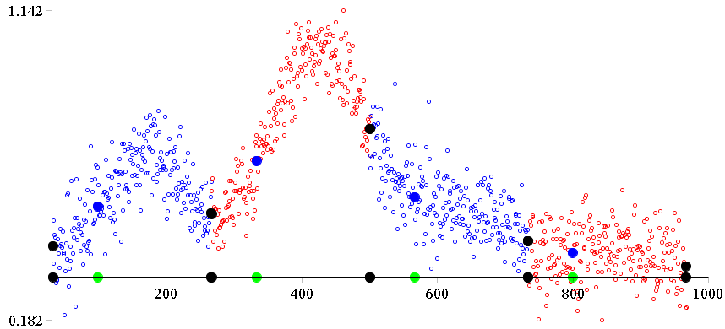
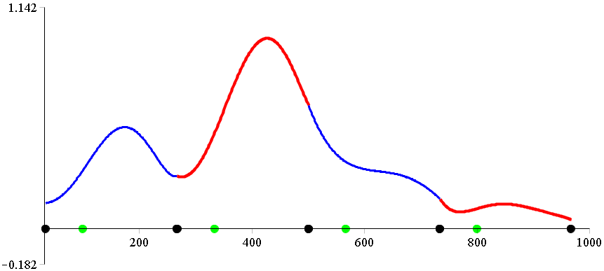
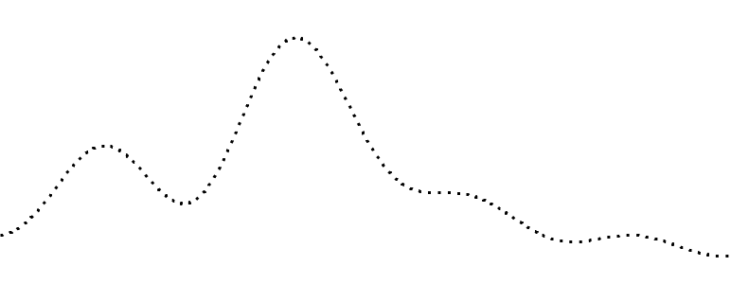
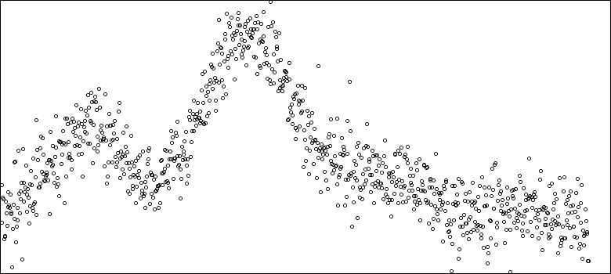
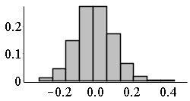
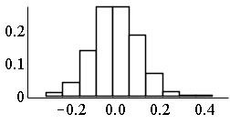
Segmented Polynomial Regression (BEM-MSPPA)
BEM-model (n=5/m=1).
σ = 0.1
errors
☺
BEM-MSA
Π₀
residuals
α
β
(K=4)

Slide 21
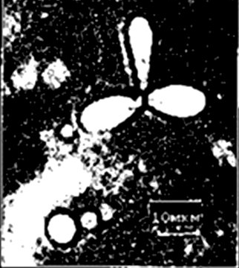
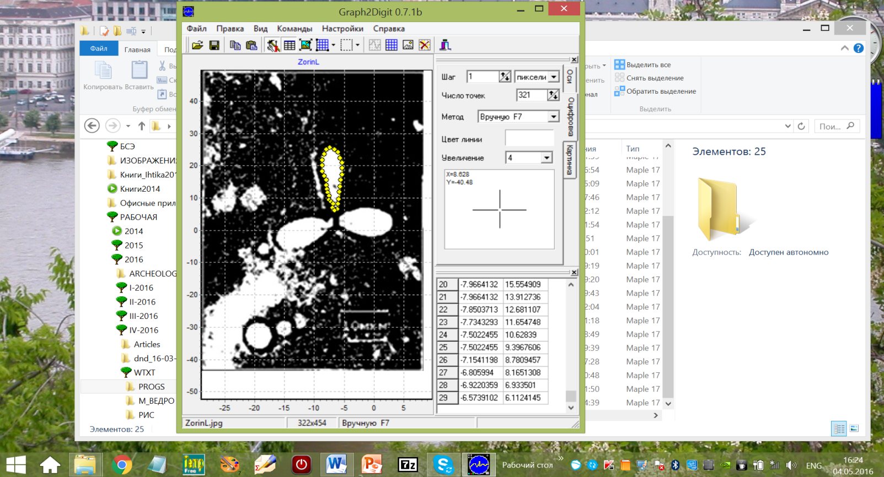

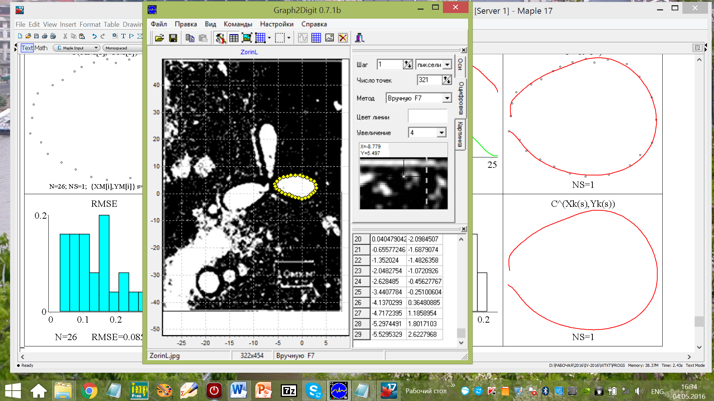
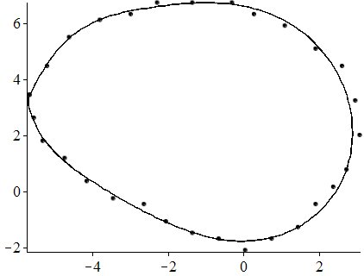
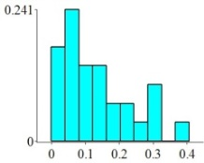
Example.
The sixth order BEM-MSPPA.
Data from IBR-2М (180000 points)
Micro photo of a triplet of tracks-particles.
α=-14
x₀=15
β=15
K=1
M=0
3
2
1
N.V. Korepanova,
N.D. Dikusar,
Y.N. Pepelyshev,
M. Dima
y
Basic element method for neutron noise analysis // (prepare for publication)
x(s)=-16.28411-0.43558s+0.47093s²+0.04332s³-0.04458s⁴+0.01000s⁵-0.00116s⁶+0.00008s⁷+0.00000s⁸+8.47564x10 ⁻⁸s⁹-1.19113x10⁻⁹s¹⁰+7.14724x10⁻¹²s¹¹
Micro photo of a triplet of tracks-particles. Traces of interaction of fast neutrons with kernels of the polymer, tracks of kernels of return (dispersion) causing occurrence and the charged particles (Nuclear reactions)^{*)}.
*) G.N.Zorin, А.V. Marksmen, S.P.Tretjakova, А.М. Voinov, V.M.Gorbachev, B.A.Emeljanov, R.Ilich, J.Skvarch. Studying of possibility of registration of thermonuclear neutrons in the conditions of a high background of the nuclear reactor.//Atomic energy, 1996, Т.80, №6, with. 473-474 (in Russian).
rmse=0.1091
y(s)=10.38376-8.56007s+8.36636s²-3.18876s³+0.67222s⁴-0.08700s⁵+
0.00723s⁶-0.00039s⁷+0.00001s⁸-3.15177x10⁻⁷s⁹+4.04712x10⁻⁹s¹⁰-2.26925x10⁻¹¹s¹¹
x

Slide 22
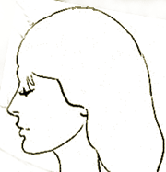

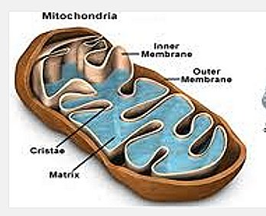
Planar Shape Approximation
Planar Shape Description
Informative sings of the shape:
Examples of shapes of complex topology:
In a practice points of a contour line (CL) are measured with errors.
Length .
☹
The relation of a thickness
Parametrically CL is presented in the form of two functions
and depending on parameter (length of an arch):
Differential informative signs .
Zeros of a curvature .
High degree BEM-polynomials are used for obtaining analitical dependence of borders of complex geometric shapes through approximation (smoothing) of 2D curves.
Others…

Slide 23
BEM-Segmentation of a Contour Line
Preparation of the three-point grids
I
I
I
I
I
I
where
is the number of points on the grid .
K is the number of segments.

Slide 24
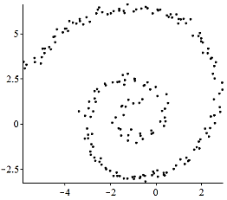
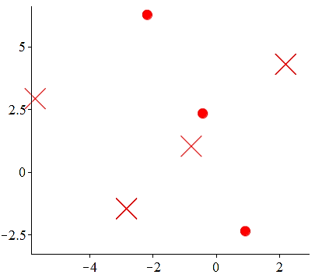
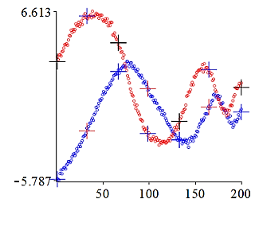
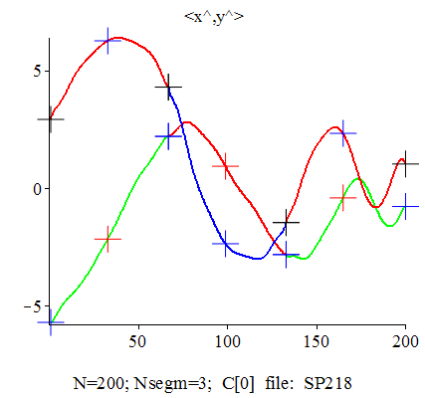
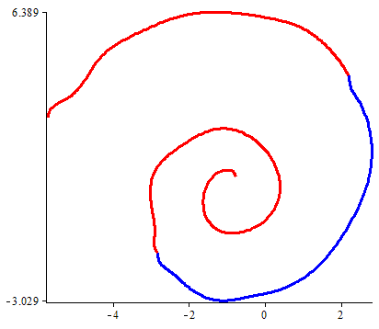
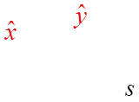
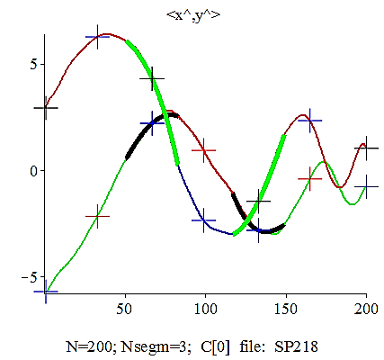
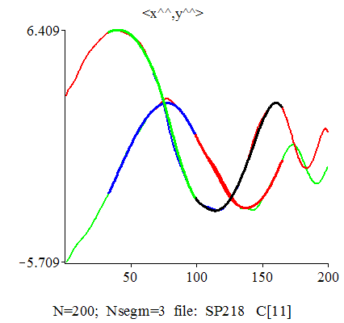

Three Stages of BEM-MSPPA Algorithm for Planar Curves Approximation
I. Computation of three-point grids and of Basis Functions
II. BEM-Parametric Smoothing
III. BEM-Approximation (Regularization). Cubic “joining” of segments.
CL is a parametric curve. It is presented in the form
I
II
C⁰
III
C³
☺

Slide 25







Example. CL of complex topology was made in pencil by hand.
N=311K=10M=0
α=-17
β=16
2x12x10=240 coefficients
C⁰-smoothing
Contour Line has 21 self-intersection points
For most shape we don’t know what the equation of the curve is.

Slide 26








Shape Representation and Description Techniques
“Shape is an important visual feature and it is one of the basic features used to describe image content”.
( Zhang D, Lu G. Review of shape representation and description techniques. Pattern Recognition. 2004; v37: pp.1-19, p.2. Elsevier Ltd.)
Γ(x,y)
Objects are represented by their boundary curves Γ ⊂ R².
Measurement points on the border of the shape
(Contour Line)
contour
Piecewise Polynomial
Approximation
Object
Transforms
PPA is used to calculate
curvature, shape's invariants, histograms of features, etc.
26

Slide 27
Signature curves. Informative Signs
Geometrical Transformations
A point z(s) ∈ Γ is called regular if κ_{s}(s) ≠ 0.
Isometric (T_{I})
is an internal nod of kth segment on Γ.
It is possible to use various functions depending on points of the phase curve as an informative sign.
Similarity (T_{S})
I
I
I
I
I
Affine (T_{А})
N_{T} is the number
of transforms.
I
Remark. The smoothness of segments in breakpoints is not critical under such choice of internal nodes.

Slide 28











Signature curves are invariant under isometric transformations (T_{I})
Differential Invariants:
Signature curves very useful for developments
in computer vision applications [2], [3]:
• In artificial intelligence.
• In medical imaging devices such as CAT or MRI scans.
• In the study of DNA.
• Applications to the Military.
…
and
C⁰
where κ is the curvature and κ_{s} is the ﬁrst derivative with respect to arc length s.
K=4
29.3
C. Shakiban. (Slides)
Signature Curves In Classifying DNA Supercoils
Both κ and κ_{s} (as well as all higher order arc length derivatives) are Euclidean diﬀerential invariants, meaning that they are unchanged under rigid motion. *)
Example.
DNA Supercoiled Model.
K=6
12.12
13.87
Measurement points:
\
25.75
K=4
BEM-MSPPA
N=56
N=76
N=89
N=98
K=6
T_{S}, T_{A} ?
BEM-MSPPA
[2] D.Calabi, E. Olver, P.J., Shakiban, C. Tannenbaum, A., and Haker. Differential and numerically invariant signature curves applied to object recognition. 1998.
*) Hoff, D.J., Olver, P.J. Extensions of invariant signatures for object recognition. //
J. Math. Imaging Vision 45 (2013), no. 2, 176–185.
[3] Mireille Boutin. Numerically invariant signature curves.
Int. J. Comput. Vision, 40(3), 235-248 , 2000.

Slide 29









Examples of Phase Curves
T_{I}
T_{S}
T_{A}
T_{A}
Curvature

Slide 30













Phase Curves at Similarity Transformation
Change of the informative sings under the shape transforms
Measurements
Transforms
curvatures
Phase curves
Histogram
Example.
C⁰
κ_{s}(s)
κ_{s} (s)
κ_{s} (s)
κ_{s} (s)
T_{I}
SGNT=76.58
N=282
κ(s)
κ(s)
κ(s)
κ(s)
μ=0.8
μ=0.17
μ=0.11
μ=0.1
T_{S}
SGNT=76.58
SGNT=10.01
K=4
K=6
M=0
zooming
T_{A}
TX=μT(θ,d)X
SGNT=76.47

Slide 31















Examples.
Mirror Reflection + Noise (BEM-MSPPA, K=13)
σ =0
154.27
154.27
Sigm≈0
Sigm=0.09
T_{I}
Mirror Reflection
σ =0.1
σ =0.1
noise data
154.12
154.07
153.89
154.27
154.11
156.12
Mirror Reflection + Noise
T_{A}
T_{I}
T_{I}

Slide 32












Examples. SGNT Calculation for Profiles of a Cat and a Dog
T_{I}: 77.35
K=7
T_{S}: 77.35
K=9
T_{I}: 114.50
T_{S}: 114.51

Slide 33





















Classification by SGNT (K). (T_{I})
N_{T}=5/
K=7/
K=5/
61.97
67.98
146.01
207.62
40.76
K=15/
K=13/
K=5/

Slide 34









Comparison BEM-MSPPA vs Cubic Splines
ASC: M.L. Torrente, S. Anzellotti, C. Finocchiaro and C. Fontanari.
Approximation by Spline Curves: towards an Application to Cognitive Neuroscience.
(arXiv:1507.03865v1 [math.NA] 14 Jul 2015).
N=2713
ASC
ASC
ASC
(1200 coefficients)
(800 coefficients)
(1600 coefficients)
N=281
K=10
C⁰
☺
measured points
BEM
BEM
137.97
K=10
(240 coefficients)

Slide 35












Comparison BEM-MSPPA with other methods
Piecewise Euler
 | Splines |  | BEM-MSPPA
 | object | K ([A], [B]) | K (BEM) | BEM | mse
[A] |  | K=100 | K=7 |  | 0.0238
[B] |  | K=49 | K=8 |  | 0.0036
[A] http://webee.technion.ac.il/~ayellet/Ps/10-PiecewiseEuler.pdf
☺
Approximation with clothoid splines
200 spirals : (MSE=0.0091)
Approximation with clothoid splines:
100 spirals MSE=0.0293)
C⁰ BEM
☺
N=216
121 points on an Euler Spiral
(clothoid)
[A] David Ben-Haim, Gur Harary, Ayellet Tal. Piecewise 3D Euler spirals. Proceedings of the 14th ACM Symposium on Solid and Physical Modeling, 2010, pp. 201-206. http://webee.technion.ac.il/~ayellet/Ps/10-PiecewiseEuler.pdf
BEM-approximation with
7 segments: (MSE=0.01)
[B] Ilya Baran, Jaakko Lehtinen, Jovan Popovic´, Sketching Clothoid Splines Using Shortest Paths. Computer Graphics Forum 29 (2), pp. 655-664.

Slide 36















Examples.
Picture of a knee joint
Lines on an eye retina
K=4/M=0
1. Measurements
2. Smoothing
3. Informative Signs
20.19
3. Informative Signs
13.81
36

Slide 37

































Complex Shapes are approximated by 12th order BEM-LSPPA
 | m
23.08
65.97
27.08
K=6
K=14
K=5
196.15
K=7
K=9
K=12
K=14
190.46
Dubna
K=8
K=12
K=21
K=25

Slide 38
Conclusion
A fundamentally new approach to polynomial approximation is presented (Basic Element Method – BEM).
A new expression of the polynomial in the form of basic elements is received on the three-point grid (BEM-polynomial).
BEM- polynomial of high degree provides accuracy and stability of calculations and decreases computing complexity.
An algorithm of segmentation and a 12th order smoothing of 2D curves is offered. Comparison with cubic splines is made.
Numerical estimations of differential invariant sings of the planar shapes are received.
The method is tested on not trivial examples, and in data processing of physical experiments as well.
BEM can be used for solution of the classical problems of the mathematical physics, in the domain of the digital processing of images, signals, etc.

Slide 39
References
(BEM)
(Shape Analysis)
[1] M. Worring, Shape Analysis of Digital Curves, Febodruk, Enschede, 1993.
[2] Calabi, E. Olver, P.J., Shakiban, C. Tannenbaum, A., and Haker, S. Differential and
numerically invariant signature curves applied to object recognition. 1998
[3] Mireille Boutin . Numerically invarint signature curves. 2000. Int. J. Comput.
Vision, 40(3), 235-248.
[4] Р.Дуда, П.Харт. Распознавание образов и анализ сцен. М.: Мир, 1976.
[5] Ту Дж., Гонсалес Р. Принципы распознавания образов. М.: Мир, 1978.
[6] Методы компьютерной обработки изображений / Под ред. В.А. Сойфера.
2-е изд., М.: ФМ, 2003. – 603 с.
[7] Введение в контурный анализ/ Под ред. . А.Я. Фурмана. М.: ФМ, 2002.
[8] У. Прэтт Цифровая обработка изображений. — М.: Мир, 1982. Кн. 1 и 2.
[9] A. K. Jain, "Fundamentals of Digital Image Processing", New Jersey: Prentice
Hall International, 1989.
[10] David Ben-Haim, Gur Harary, Ayellet Tal. Piecewise 3D Euler spirals.
[11] Ilya Baran, Jaakko Lehtinen, Jovan Popovi´c. Sketching Clothoid
Splines Using Shortest Paths. EUROGRAPHICS, 1981.
[12] D. Stoyan and H. Stoyan, Fractals, Random Shapes and Point Fields (Methods of
Geometrical Statistics), John Wiley & Sons: Chichester, 1995.
[13] J. Foley, A. Van Dam, S. Feiner, and J. Hughes, Computer Graphics: Principles and
Practice, Addison-Wesley: New York, 1996, pp. 478–516.
[14] Hoff, D.J., Olver, P.J. Extensions of invariant signatures for object recognition. J. Math.
Imaging Vision 45 (2013), no. 2, 176–185.
[15] M.L. Torrente, S. Anzellotti, C. Finocchiaro and C. Fontanari. Approximation by Spline Curves:
towards an Application to Cognitive Neuroscience. arXiv:1507.03865v1 [math.NA] 14 Jul 2015.
[16] Graph2Digit 0.7.1b Copyright(c) 1998-2007 V. Plisko. e-mail:plsoft@narod.ru http://plsoft.narod.ru
[1] Dikoussar N.D. Function parameterization by using 4-point transforms
// Comput. Phys. Commun. 1997, v. 99, 235-254
[2] N. D. Dikusar. The Basic Element Method// MMCS, 2011, v.3 №4, pp.492-507. http://link.springer.com/article/10.1134%2FS2070048211040053
[3] N. D. Dikusar. Higher-order polynomial approximation //MMCS, 2016, v.8 №2, pp.183-200. http://link.springer.com/article/10.1134/S2070048216020058
[4] N. D. Dikusar. Piecewise polynomial approximation of the sixth order with automatic knots detection //MMCS, 2014, v.6 №5, pp.509-522.
http://link.springer.com/article/10.1134%2FS2070048214050020
[5] N.D. Dikoussar. Adaptive projective filters for track finding.
Comput. Phys. Commun. 79 (1994) ), pp. 39-51
[6] Dikusar N.D. Optimization of a Solution in Problems of Piecewise Polynomial Approximation. Preprint JINR, З-11-2016-85 (in Russian).

Slide 40
Thanks for
Attention!

