Slide 1
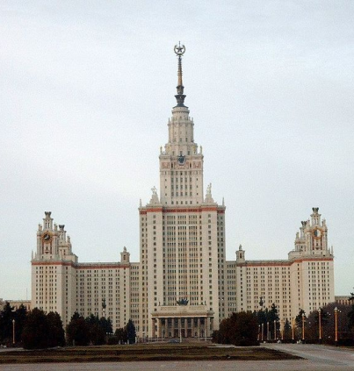
Spectral Multi Exponential Approximation as a Robust Tool for Analysis of Complex Systems
The International Conference “Mathematical Modeling and Computational Physics, 2017” (MMCP2017)
Sergei KHRUSCHEV, Tatiana PLYUSNINA
Lomonosov Moscow State University School of Biology Biophysics Department
styx@biophys.msu.ru
This work is supported by Russian Foundation for Basic Research project 17-04-00676

Slide 2
Typical experiment
F(t)
Perturbation
System
Signal

Slide 3
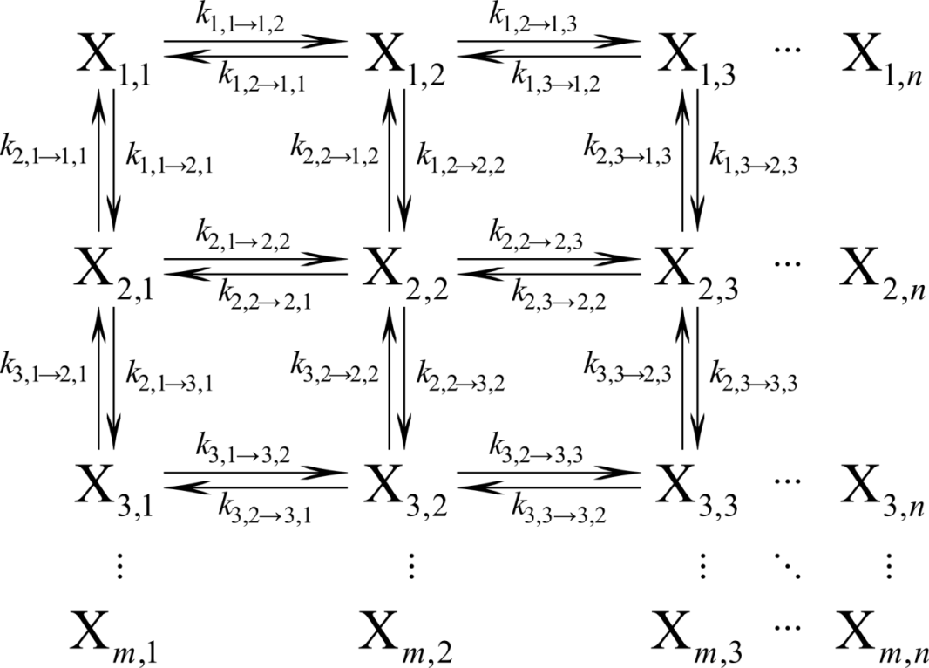
System is Markov chain

Slide 4
System of linear ODEs for individual states
Solution as a sum of exponential functions
Signal

Slide 5
Parameter estimation
x
Nonlinear regression
Spectral Multi Exponential Approximation
Plyusnina T.Yu., Khruschev S.S., Riznichenko G.Yu., Rubin A.B. (2015)
Biophysics, 60 (3): 487-495

Slide 6
Spectral Multi Exponential Approximation (SMEA)
Make the problem linear:
choose basis function over fixed scale
Preset parameters:
Estimated parameters:

Slide 7
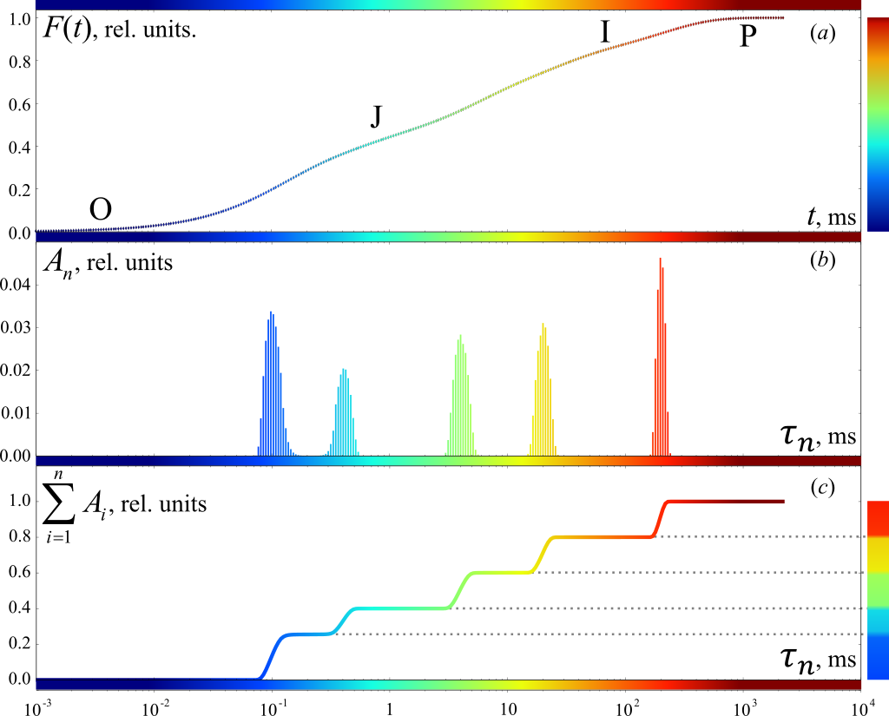
Proof of concept: applying SMEA to synthetic function combined of five exponents
 | A
200.0 | 0.20
20.0 | 0.20
4.0 | 0.20
0.4 | 0.15
0.1 | 0.25
 | A
200.3 | 0.20
20.0 | 0.20
4.1 | 0.20
0.4 | 0.14
0.1 | 0.26
Plyusnina T.Yu., Khruschev S.S., Riznichenko G.Yu., Rubin A.B. (2015) Biophysics, 60 (3): 487-495

Slide 8
Biological application: estimating chlorophyll a fluorescence transient parameters
Measuring light
450 nm
Fluorescence
680 nm

Slide 9
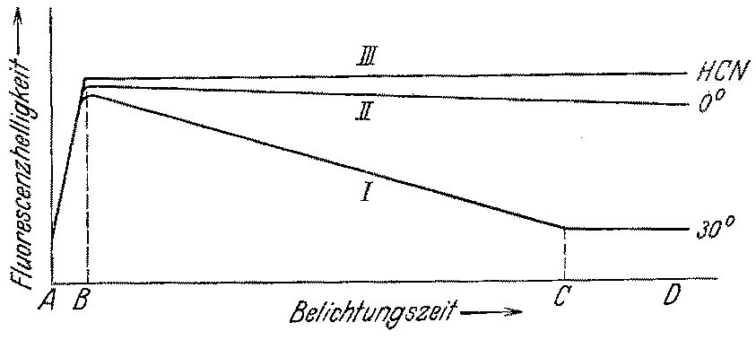
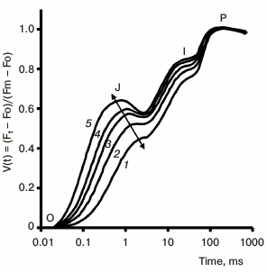
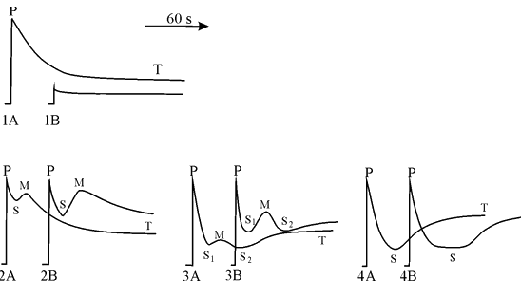
Fluorescence transient of dark-adapted plants
Kautsky H., Hirsch A. (1931), Neue Versuche zur Kohlensäureassimilation, Naturwissenschaften, 19: 964-964
Riznichenko G., Lebedeva G., Pogosyan S., Sivchenko M., Rubin A. (1996), Photosynthesis Research 49: 151-157
Stirbet A., Riznichenko G.Yu., Rubin A.B., Govindjee (2014), Biochemistry (Moscow), 79 (4): 291-323

Slide 10
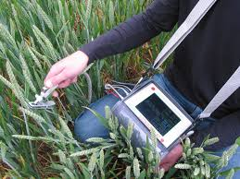
Fluorimeters are widely used to monitor plant health

Slide 11
Electron transfer in Photosystem II
causes changes in chlorophyll a fluorescence
2H_{S}⁺
stroma
Q_{B}
Q_{A}
hν
Phe
Chl
P₆₈₀
lumen
2H₂O
4H_{L}⁺+O₂

Slide 12
Spectral multi exponential approximation of Chlorella sp. chlorophyll a fluorescence transients
Fluorescence transients were automatically sampled each 1 hour of microalgae growth in biophotoreactor on Tamiya’s medium (1:20 dilution).
Appearance of additional JI phase indicates change in
PSII:PQ:PSI ratios
Prompt
fluorescence
rise indicates
stress condition

Slide 13
