Slide 1
SaaS platform for time series data handling
E. Oplachko, S. Rykunov, M. Ustinin
Institute of Mathematical Problems of Biology RAS - the Branch of Keldysh Institute of Applied Mathematics of Russian Academy of Sciences

Slide 2
Purposes:
To create a tool which can handle big amount of encephalography data. This tools should meet the following requirements:
1. It should work without local installation
2. No additional licensing
3. It should be “Software as a Service” resource
4. Only opensource libraries
5. Compatibility with .mat file
6. Users should be able to do the following:
  a. To see history of their work
  b. To save the results of work on local computer
  c. To have tool for interactive work with pictures

Slide 3
Current landscape
FieldTrip
ELAN
Brainstorm
OpenMEEG
HADES
EEGLAB
Notes:
All of them work with encephalography. And they have one common feature. User has to install some application on the local computer use them. And, These applications will use the local hardware of this computer.

Slide 4
Technologies and languages
Languages:
Python has a lot of extensions which allow to work with Matlab files
PHP, cross platform language for web applications
Javascript for client side
Technologies
- Database: MySQL
Web server: Apache
Simple Linux Utility for Resource Management (SLURM)
Notes:
I would like to briefly describe technologies were used.

Slide 5
High level MathBrain Architecture

Slide 6
Dataflow diagram
Notes:
Despite user can use 6 different methods, all of them have the same data flow. Our resource has demo mode on subdomain. All of input data are pre-uploaded here, but handling in going in real time.

Slide 7
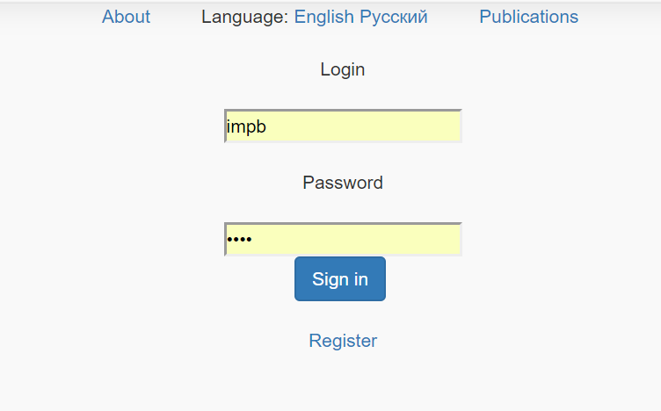
Screenshot of main page
The link to the resource is www.mathbrain.ru.
Credentials for demo mode (demo.mathbrain.ru):
user: demo, password: demo.
Credentials for main resource:
user: impb, password: impb

Slide 8
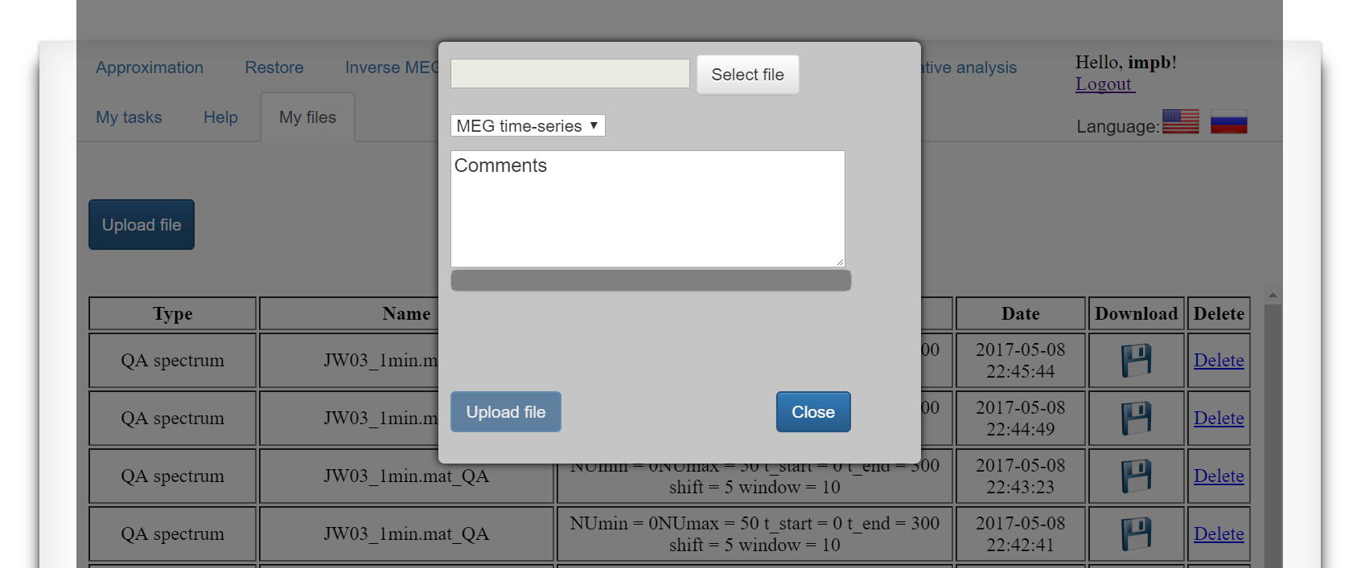
Screenshot
When user uploads file, the script checks the structure of this file, and, file extension.

Slide 9
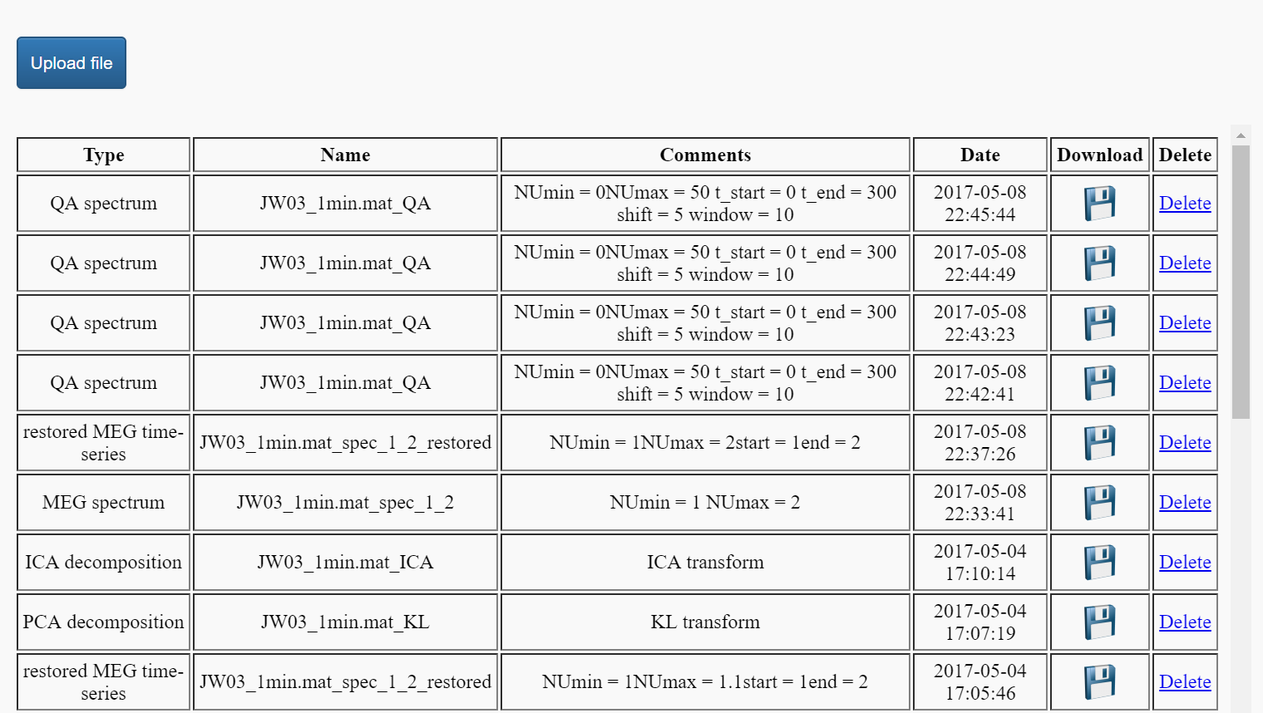
Screenshot of history page
User can download results of the work or delete them.

Slide 10
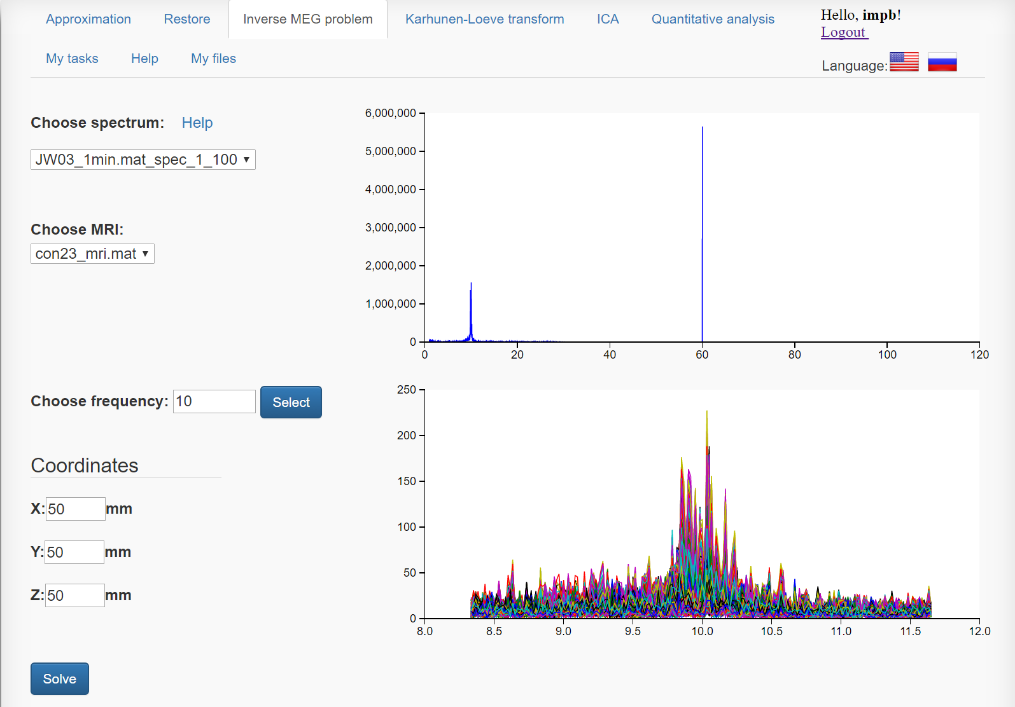
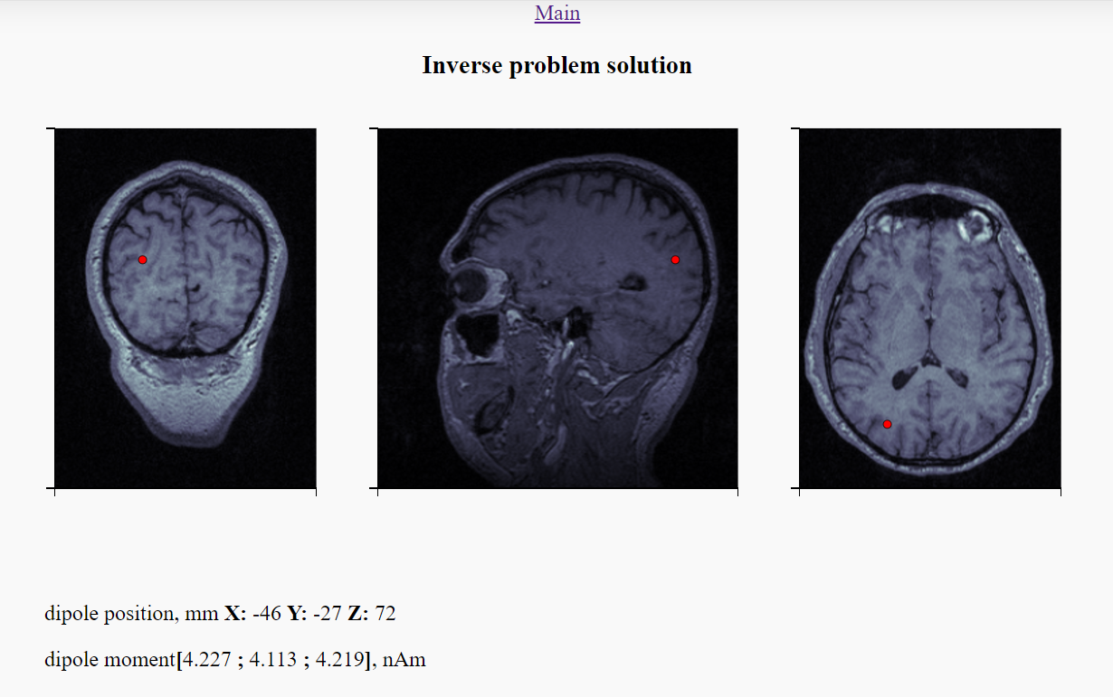
Inverse MEG problem
Notes:
Magnetoencephalography. It was the most difficult method for realization from technical side. Because we had to provide to user the tool to work with charts in interactive mode. Like to use Zoom. But all visualization usually create on client side, in our case it means the web browser. But multichannel data could weigh a lot. And, it means that we need to send to client big amount of data. So, our choice was JSON structure as the lighter format. So, how it works: use choose Spectrum and MRI files. Then automatically python script executes and user receive one channel chart where he can choose interesting frequency and then use it for calculations. After choosing of frequency, user receive multichannel chart with details. This process can be repeated as many times as user wants. As a result user see the source of signal on MRI

Slide 11
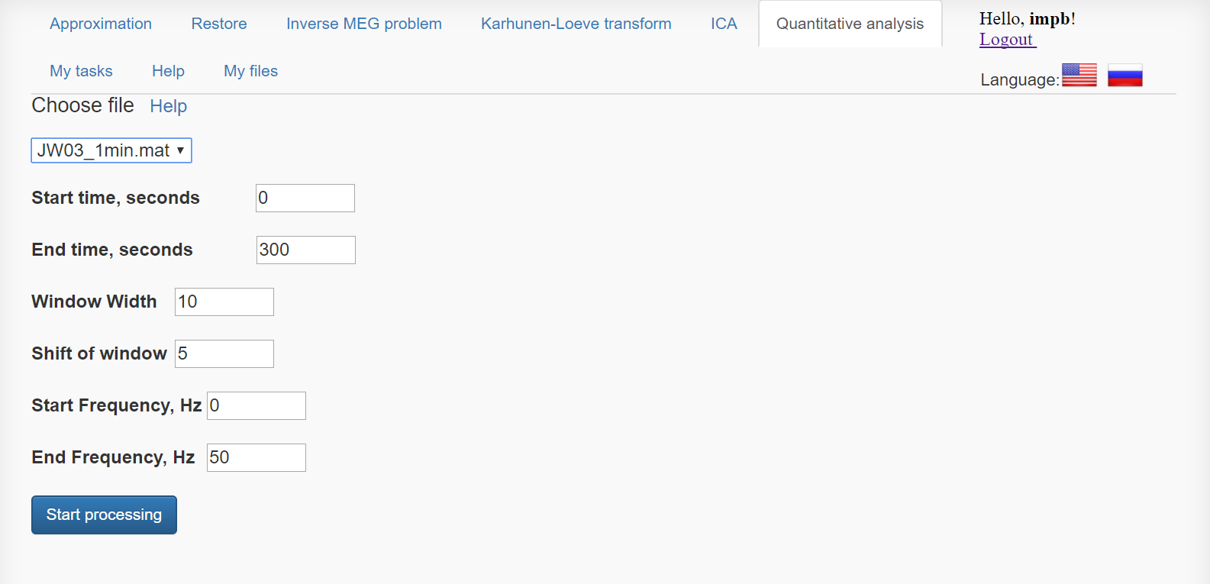
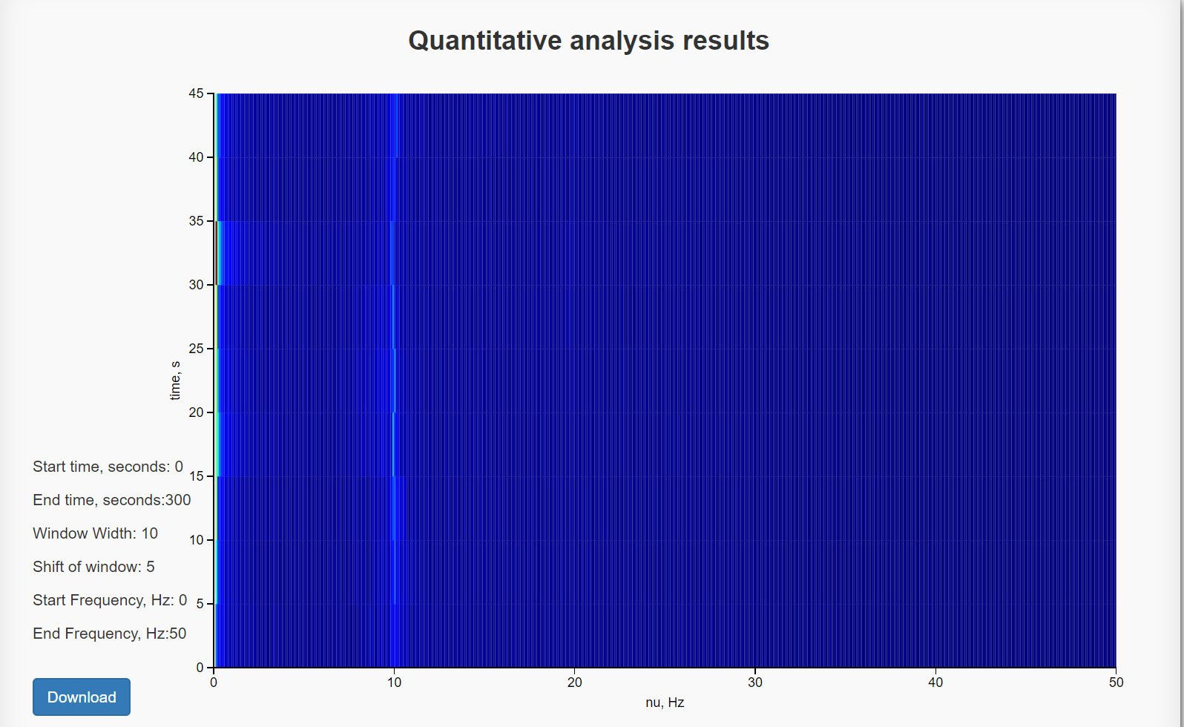
Quantitative analysis
Notes:
One more example with quantitative analysis. From technical point of view it uses the same workflow as previous method.

Slide 12
Results
We created Software as a Service resource with functions:
Fourier transform;
Karhunen-Loeve transform;
Independent Component Analysis;
Quantitative analysis;
Inverse problem solution.
Notes:
All technical requirements were met.

