Slide 1
A Scientific Workflow System
for Satellite Data Processing
with Real-time Monitoring
Minh Duc Nguyen
Space Monitoring Data Center
SINP, MSU
Notes:
Good evening!
First of all, I would like to thank the organizing committee for accepting my work and the possibility to speak here.
My name is Minh Duc Nguyen. I’m working at the Space Monitoring Data Center of Skobeltsyn Institute of Nuclear Physics as a senior software developer.
So today I would like to introduce to you our satellite data downloading and processing system. Occasionally, the accent of the talk is about the data processing workflow.

Slide 2
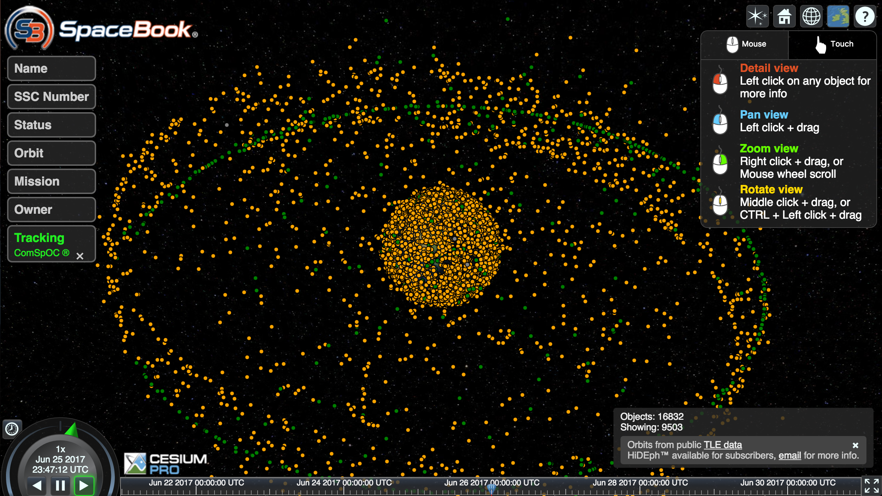
Satellites are around us
http://apps.agi.com/SatelliteViewer/
Notes:
Nowadays, satellites are around us. Let’s take a look at this picture. What we have here is the current space condition of the Earth as of June 26th with more than 16000 satellites around. The web interface is provided by the AGI service. We use satellites for different purposes: from GPS-tracking to telecommunication and also space weather forecast. Each satellite generates an enormous amount of data each day, so we need an organized place with an automatic system to collect all these data, process them correctly, do some analyses, and store them for later use.

Slide 3
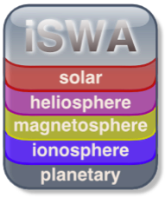
Notes:
That's why we have many space data centers around the world. Here is just a small list of them. The first two ones are from the US, in the middle is the European Space Agency, and the last two are in Moscow. Our department which is the Space Monitoring Data Center and another one is the data center at the Institute for Space Research.
The problem we're facing here is that each center provides only data from its satellite and there's no easy way to compare data from satellites of the same type neither to apply an operational space weather model to data on-the-fly, for example, via a web interface.

Slide 4
The requirements
Fully automatic
Adding a new satellite needs a minimum of coding
Support 3rd party code (instrument specific data processing and post-processing)
Real-time monitoring and notification
Data access UI for scientists
API for developers
Notes:
So at SMDC, we decided to go on, we decided to create a system which accumulates data from all available satellites and stores them in a unified storage. The system must be fully automatic and does not need human interactions in normal situations. Adding a new satellite to the system must require a minimum of coding or no coding at all. The system must support execution of 3rd party code. It's a must have feature because satellite instruments change from time to time and the developers use different tools and technique to encode and decode data. Operators must have the possibility to see in real-time what's going on inside the system. Potential errors must be detected to be notified in time. The system must provide an user-friendly interface to scientists to access data. And there must be an API for software developers so that people could build their product upon our and our data.

Slide 5
The challenge
Different types of connection to data sources (HTTP(S), FTP(S), PPTP, IPSEC, IKEv2, etc.)
Data formats (binary, txt, csv, XML, JSON, CDF3/4, HDF4/5, fits, png, jpeg, etc.)
Hierarchy of onboard instruments and their data channels
Data validation and correctness
Notes:
During the development process, we were able to solve the followings issues. Our system can automatically establish connections of different types to the data sources. The list continues to grow. The system can convert different data formats into a unified one used for internal data representation. We're able to create a metadata system that can take into account different types of the hierarchy of onboard instruments and their data channels. In such a system it's very important to have a working mechanism to validate data and estimate its correctness. This is done by the real-time monitoring subsystem, and I will talk about it later.

Slide 6
SDDS
Overview
Backend
Satellite Controller
SDDS Libs
PostgreSQL
Database
Satellite
Radio Channel
RabbitMQ Message Broker
Other backend components
Internet
Ground Station
RESTful API, WebSocket
Ethernet
Frontend
Reporter
Live Monitor
Plot Service
Data Access Service
Other Services
Storage Server -
Data Source
Internet
Users
Notes:
Here is the overview of our system. The system is called SDDS which stands for Satellite Data Downloading System. From the architectural point of view, SDDS can be divided into two big blocks: backend and frontend. The main component of the backend is the satellite controller. Each controller is responsible for the whole data processing cycle of a satellite. Each event during the cycle is recorded into a log file. All records are then sent to the RabbitMQ Message Broker and RabbitMQ, in turn, sends these records to the monitoring interface so that operators can see what is going on in real-time. If there’s no error in data processing, the level 1 data is then loaded into the PostgreSQL database system. Communication between different components of the backend and the frontend is done via the RESTful API. Real-time events are delivered to the web interface via encrypted WebSocket.
Each satellite has a number of services available via the frontend web interface. The most common ones are listed on the slide. The meaning of each service is obviously understandable, so I won't talk about it in details. Later we will stop at the Live Monitor component.

Slide 7
Software stack
Python, PHP, Javascript, Fortran, Bash
JSON, PostgreSQL
Django, Node.js, Apache, RabbitMQ
React, Websocket/SockJS, STOMP
Telegram
Notes:
Python and Javascript are the primary programming languages we use in our system. React is used where possible to develop the frontend interface. Since we have a diverse team other languages are also used. We use JSON to store the configuration of each component in our system. We use PostgreSQL as the database system.

Slide 8
SD Downloader
Notes:
From the programming point of view, each satellite controller is just an instance of the SD Downloader class so let's talk about it in more details.

Slide 9
The stages of a data processing cycle
Connecting to data sources
Downloading new data (recovery after interruptions)
Extracting instrument data (level-0) from the raw data (optional)
Processing level-0 data and producing level-1 data
Loading level-1 data to the database and calculating mean values
Moving all data to the storage (compression is optional)
Notes:
SD Downloader is a primary class used to process data. A data processing cycle consists of the six following stages which are listed. For each stage of the processing cycle, SD Downloader has its proper function, which, in turn, can be redefined for specific use.

Slide 10
Current features
Command line interface
HTTP(S), FTP(S), PPTP, IPSEC
libcurl, Python FTPLib, wget
Python, PHP, Javascript, Bash, Compiled binary decoders
Parameterised execution order
Postprocessing
Saving temporary stages
Notes:
Currently using SD Downloader one can interactively execute each stage of data processing using the command line interface if he needs to debug something.
Out of box SD Downloader supports the following types of connection.
There are three possible mechanisms to download data from a data source. If a report is needed after downloading data SD Downloader knows how to generate it.
If data of an instrument is too specific and requires a 3rd party decoder, it's possible to execute it within a stage. SD Downloader knows how to run these decoders and what parameters should be passed. Currently, decoders written in the following languages are supported.
Depending on how a satellite has been built, sometimes data of different instruments must be processed in a strict order. The order can be described in the configuration and SD Downloader will run decoders exactly in this order.
After the main processing stage, it's also possible to execute a post-processing run.
And finally, SD Downloader provides some possibility to temporarily store a processing stage so on the next run it could be taken into account.

Slide 11
Live Monitor
Notes:
In each data processing cycle, many components are involved so we need a monitoring mechanism so that we could understand what's going on in real-time. For this purpose, we've created the Live Monitor subsystem.

Slide 12
Goals
Notifying of state changes and erroneous conditions of each system component (service)
Creating reports of each run for each satellite
Operator UI
Customizable notification services for 3rd party applications
Notes:
The goals of the Live Monitor subsystem are notifying of all stage changes and erroneous conditions of each component of the whole system, creating a report after each run, providing an user-friendly interface for satellite operators, and the possibility to create a customizable notification service based on the API.

Slide 13
Live Monitor overview
Satellite Controllers
Web Client 1
Live Monitor Interface
STOMP Messages
via
Encrypted WebSocket
Current States, Errors
Instrument Data Decoders
…
Logging Library
STOMP
Messages
RabbitMQ Message Broker
Web Client N
Live Monitor Interface
DB Loader
Telegram API
Others
Current States, Errors
SMTP
Server
Operators
Notes:
The architecture of our Live Monitor subsystem is illustrated on the slide. On the left side, we have various components of our SDDS system which use the logging library to record every event to log files. The logging library also passes all records formatted by the STOMP protocol to the RabbitMQ Message Broker. RabbitMQ works as a daemon in the operating system. When a new message comes it broadcasts the message to all subscribed clients. In our case, they are the Live Monitor’s web interface that operators use.
Critical situations that require attention from operators are logged as errors. And errors are delivered directly to operators by email and Telegram Messenger Service. For the last one, we’ve created a bot purposely.

Slide 14
Logging library
Based on Python logging module
4 levels: DEBUG, INFO, WARNING, ERROR
Supports: stdout, smtp, Telegram, websocket (via RabbitMQ)
Format: [<timestamp>] [<pid>] <module>: <line_number>: <level>: <message>
Notes:
Our logging library is based on the Python logging module. We’ve created our own event handler so that it supports logging to stdout, SMTP, telegram, and RabbitMQ. There’re four levels of events. DEBUG is needed in error investigation. INFO is for normal state changes and diagnostic information. WARNING is used when an abnormal situation happens, but overall it does not lead to incorrect data or termination of data processing. And finally ERROR is used when bad things occur.

Slide 15
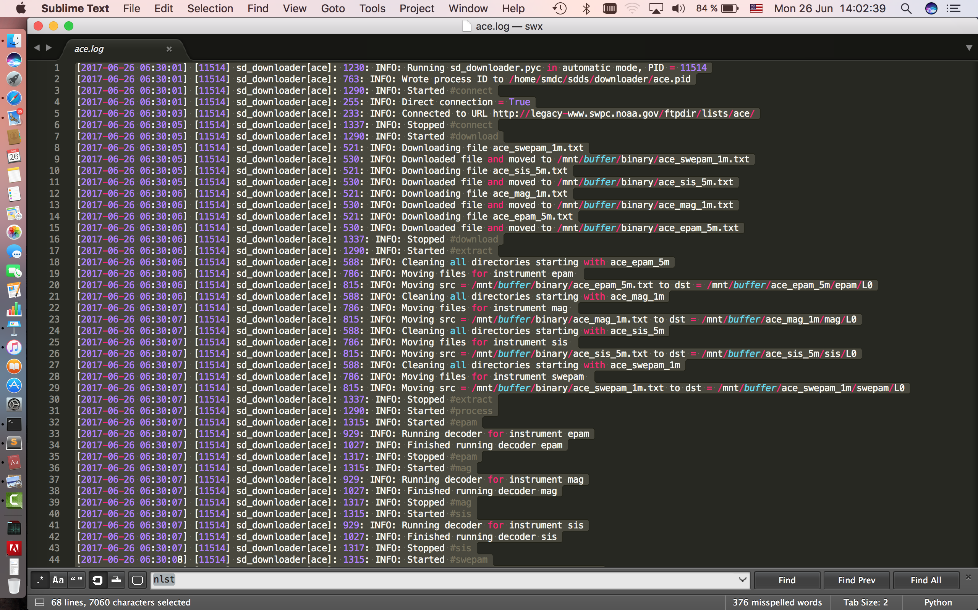
Notes:
Here we have a log demonstration. The font size might be small. Each record consists of a timestamp, a process ID, a component name, a line of code when an event occurs, and a proper logging level. So it’s quite easy to track down a problem when we need.

Slide 16
RabbitMQ
1 message queue for each service
Encrypted connection (TLS) with authentication
Publish-subscribe scenario
Simple (or Streaming) Text Oriented Message Protocol (STOMP)
Notes:
As I mentioned before we use RabbitMQ to broadcast log records to web clients. To easy the message parsing, we decided to create independent messages for different satellites. All connections from and to RabbitMQ are encrypted using the TLS protocol. The message flow is one-directional from the server to clients

Slide 17
Notification Management API
Add a service to be monitored by Live Monitor
Enable/Disable notification for the whole service
Enable/Disable notification via Telegram
Enable/Disable notification for each stage of a service(in future)
Processing control via Telegram bot - stop a service when an error occurs (in future)
Notes:
Using the Live Monitor API right now one can already add a customized service to our system so it can be monitored by Live Monitor. It’s possible now to turn on and off notification for the whole service. It’s also possible to turn on and off only telegram notification. In the future, we plan to add the possibility to control the behavior of each stage of each component and to stop a service when an error occurs.

Slide 18
Live Monitor - all satellites
Notes:
I'm running out of time so let's skip through the details of the Live Monitor subsystem and go right to the demonstration. Here you can see the main page of the Live Monitor interface where all active satellites are showed. Each rectangle represents a satellite. If the system starts a processing task for a satellite, the corresponding rectangle turns into green, and the gear symbol starts to spin.

Slide 19
Live Monitor - Electro-L2
Notes:
It's also possible to see a data processing cycle of a satellite in details just by clicking to the proper rectangle.

Slide 20
Live Monitor - Electro-L2
Notes:
Here is a typical picture of processing Electro-L2 data. We have a loading task running in the background. At the same time, the System found new data, so it starts another run to process the new data.

Slide 21
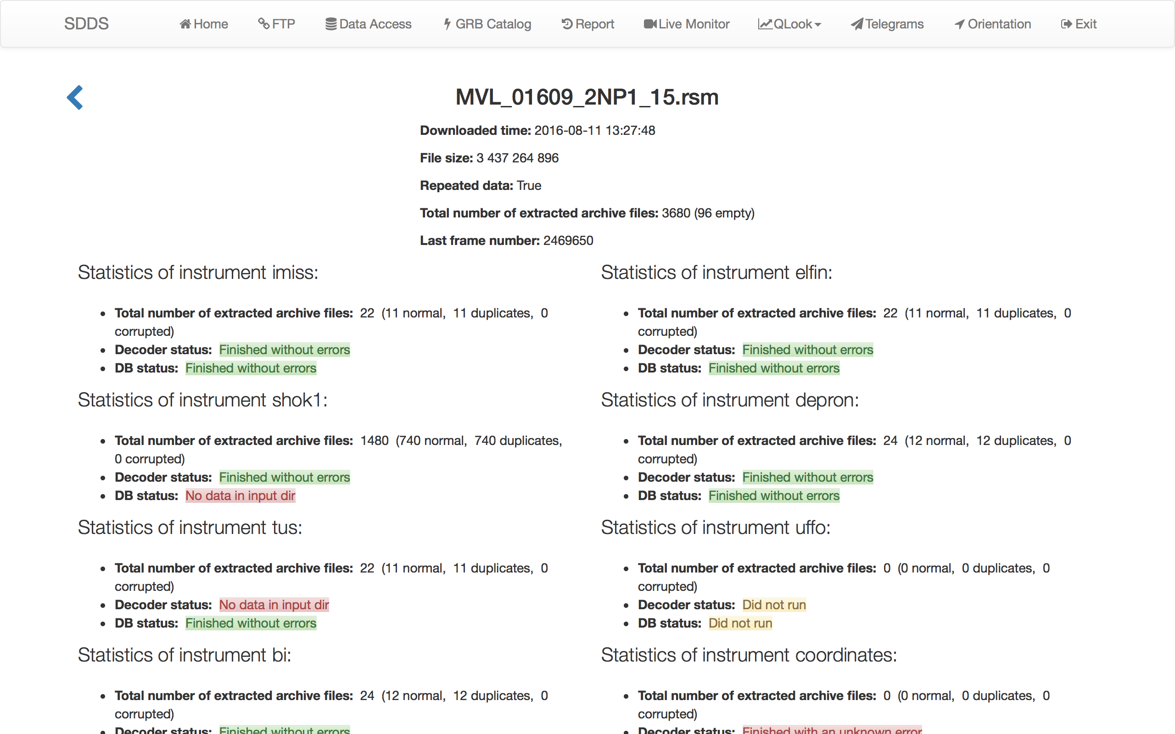
Run report
Notes:
After each run, our system generates a short report and send it via e-mail to all subscribed clients. If an error occurs during the process operators will receive its description via the Telegram Messenger.

Slide 22
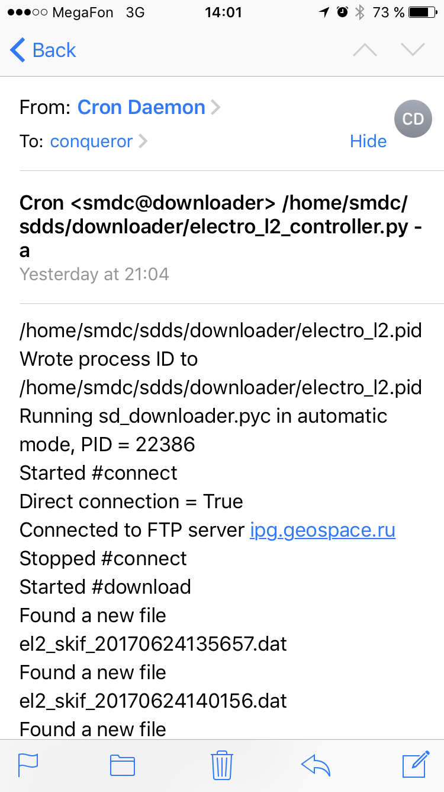
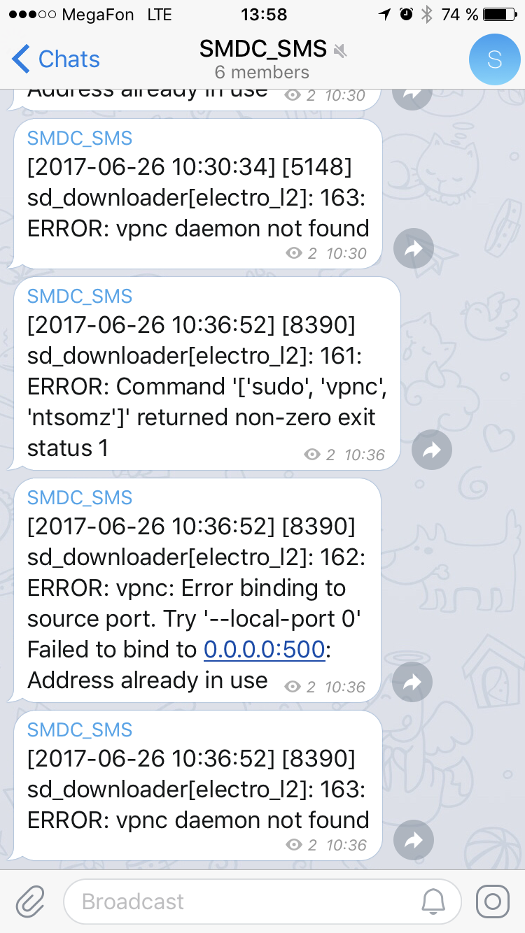
Notification - email & Telegram
Notes:
But if a critical error occurs it will be delivered directly to the telegram channel as you see on the right side. A report of each run is also delivered by email so we can have an overall picture of the run.

Slide 23
Current Status
1 year of operation
>10 GB of raw data / day
>12.3 TB of data (total)
KVM / E5-2650 2.60GHz / 8 cores / 8GB / 1Gb Ethernet / SSD
ZFS + NFS
Notes:
Here are some statistics of our system. It has been functioning for more than 1 year. It's was quite stable, and we're adding more and more satellites to the system. At the moment the system processes more than 10 GB of new data per day. The current total data stored in our system is more than 12.3 TB, but the number keeps growing. The system is running in a virtual machine with the following configuration. The global storage system which is a big ZFS pool is connected to the computing node via NFS.

Slide 24
Conclusion
A fully automatic workflow for near real-time satellite data processing
A real-time monitoring framework
UI for operators
Notification & reports via e-mails & Telegram
API for developers
Notes:
So far we’ve created a new stable system for near real-time satellite data processing, a real-time monitoring framework with an intuitive, user-friendly interface for operators. Notifications are delivered directly to the operators via the Telegram messenger. And an API has been created for developers.

Slide 25
Thank you :)
Minh Duc Nguyen
nguyendmitri@gmail.com
conqueror@dec1.sinp.msu.ru
SINP, MSU
Notes:
That’s it for today and thank you.

