Slide 1
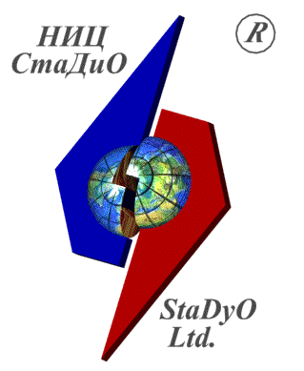
Wavelet-Based Numerical and Semianalytical Methods of Local Structural Analysis in Engineering
Prof. Pavel A. Akimov, Prof. Marina L. Mozgaleva
Research & Development Center “StaDyO”, Moscow, Russia
National Research Moscow State University of Civil Engineering, Moscow, Russia
International Conference “Mathematical Modeling and Computational Physics, 2017” (MMCP2017)
Notes:
1
1

Slide 2
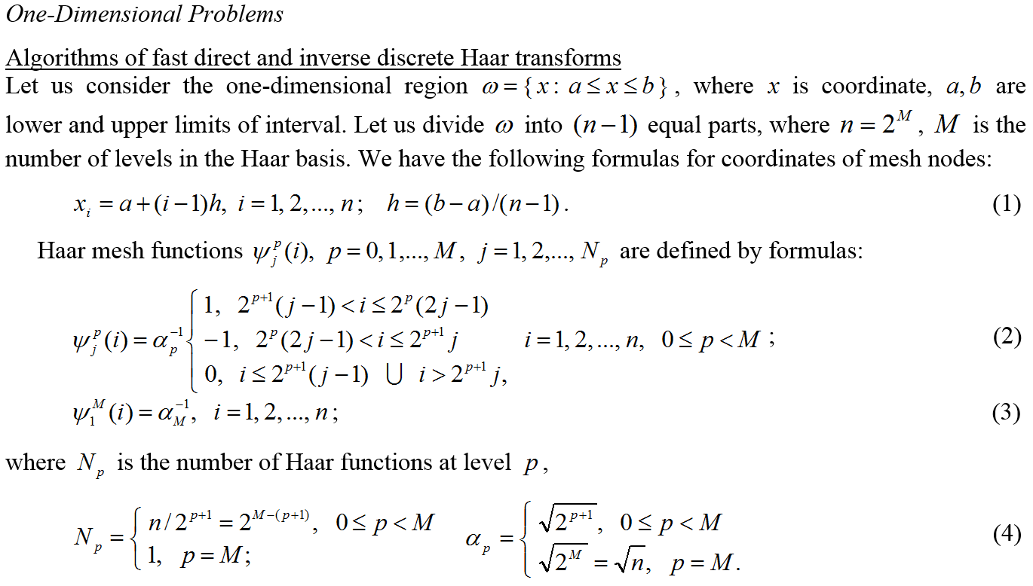
Basic formulas of fast direct and inverse discrete Haar transforms and averaging

Slide 3
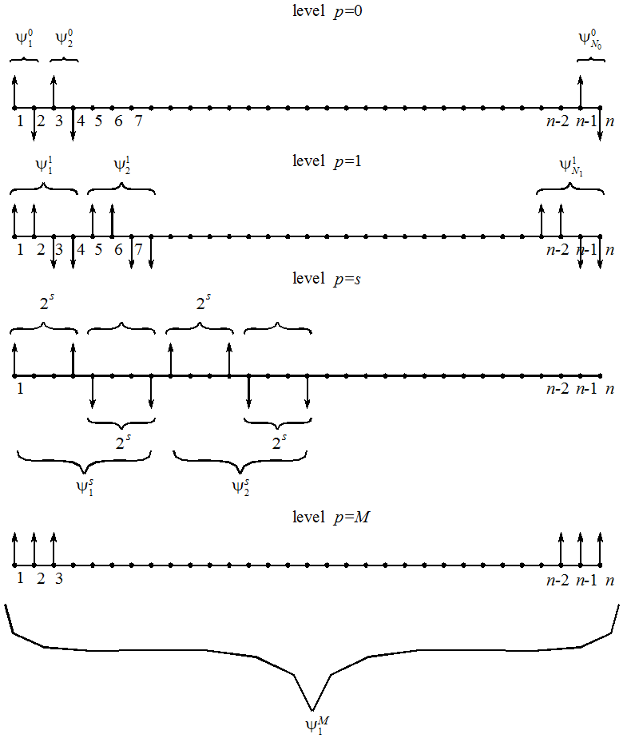
Basic formulas of fast direct and inverse discrete Haar transforms and averaging
Discrete Haar functions for one-dimensional problems

Slide 4
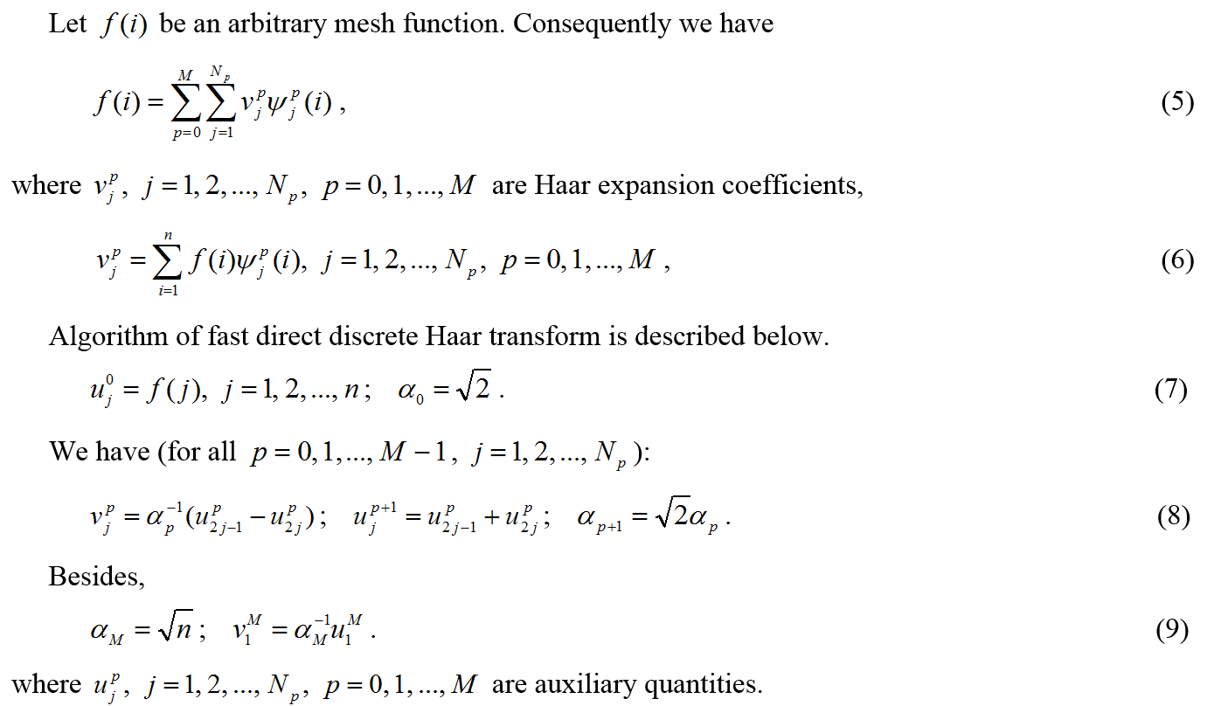
Basic formulas of fast direct and inverse discrete Haar transforms and averaging

Slide 5
Basic formulas of fast direct and inverse discrete Haar transforms and averaging

Slide 6
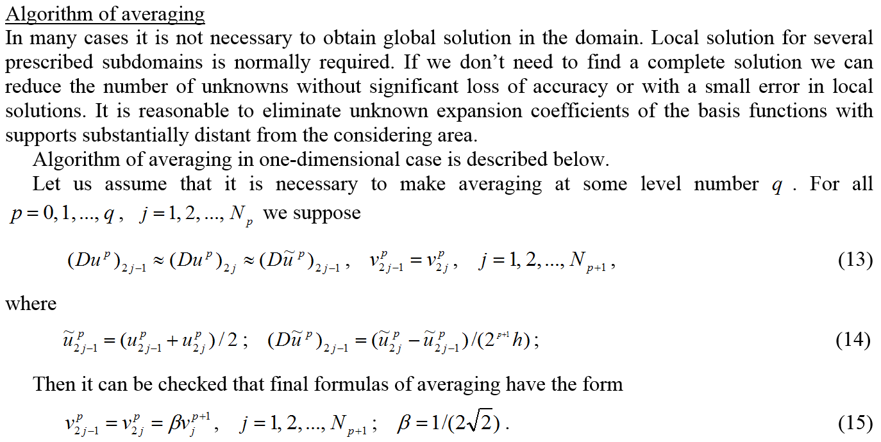
Basic formulas of fast direct and inverse discrete Haar transforms and averaging

Slide 7
Basic formulas of fast direct and inverse discrete Haar transforms and averaging

Slide 8
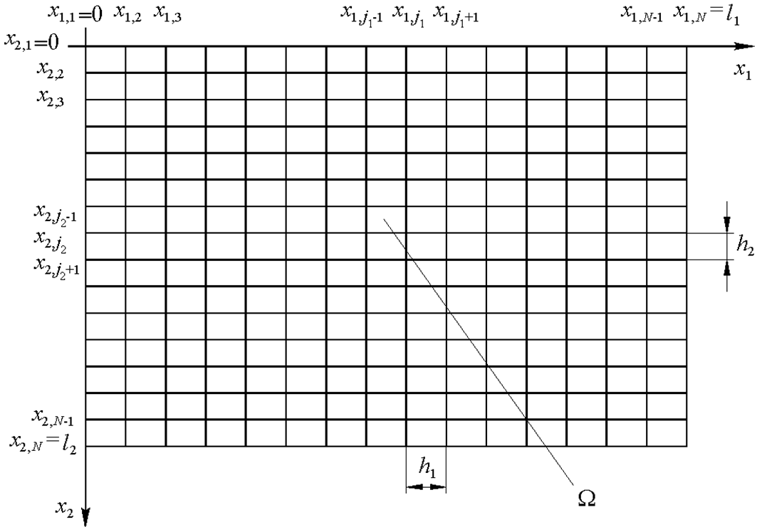
Basic formulas of fast direct and inverse discrete Haar transforms and averaging
Two-dimensional rectangular domain

Slide 9
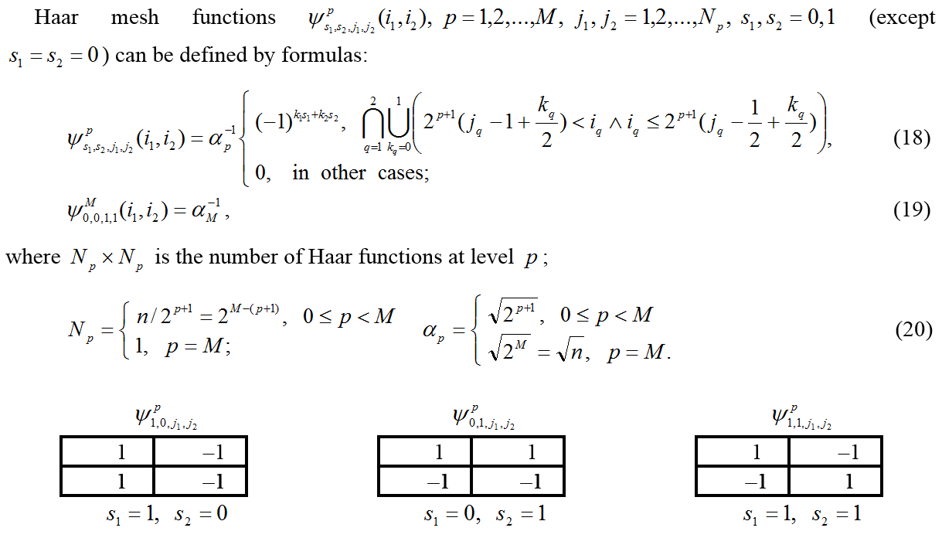
Basic formulas of fast direct and inverse discrete Haar transforms and averaging

Slide 10
Basic formulas of fast direct and inverse discrete Haar transforms and averaging

Slide 11
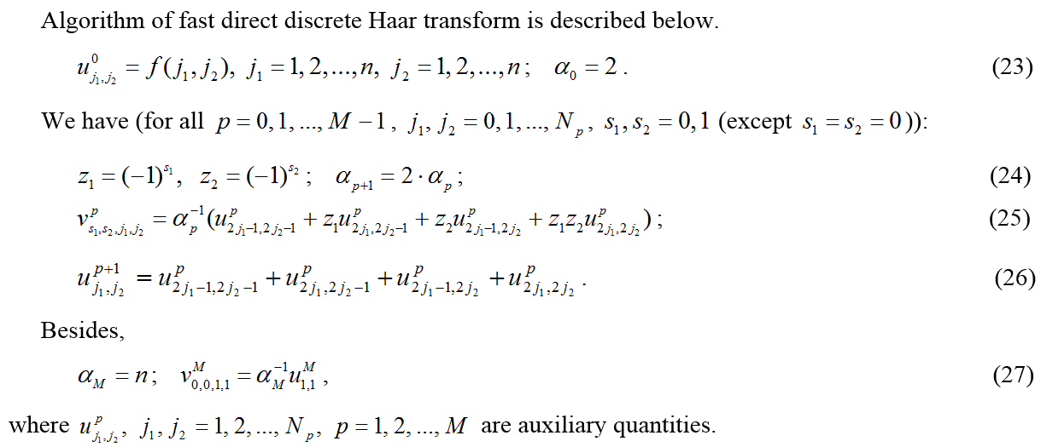
Basic formulas of fast direct and inverse discrete Haar transforms and averaging

Slide 12
Basic formulas of fast direct and inverse discrete Haar transforms and averaging

Slide 13
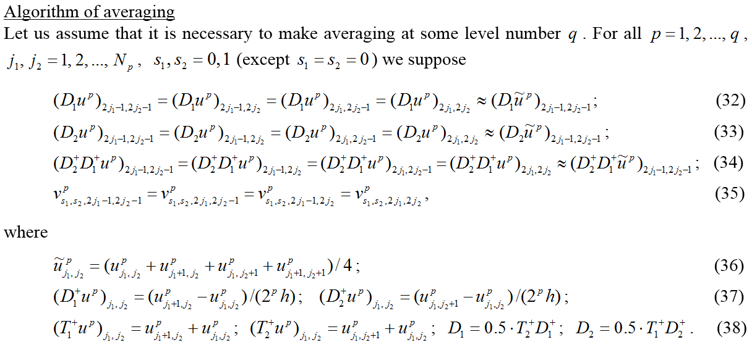
Basic formulas of fast direct and inverse discrete Haar transforms and averaging

Slide 14
Basic formulas of fast direct and inverse discrete Haar transforms and averaging

Slide 15
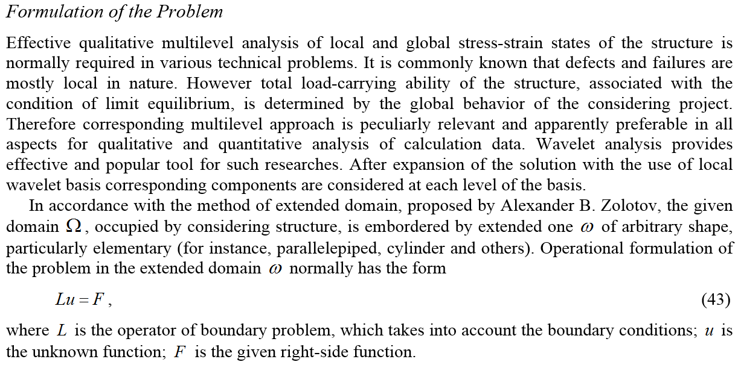
About Correct Multilevel Wavelet-Based Numerical Method of Local Structural Analysis

Slide 16
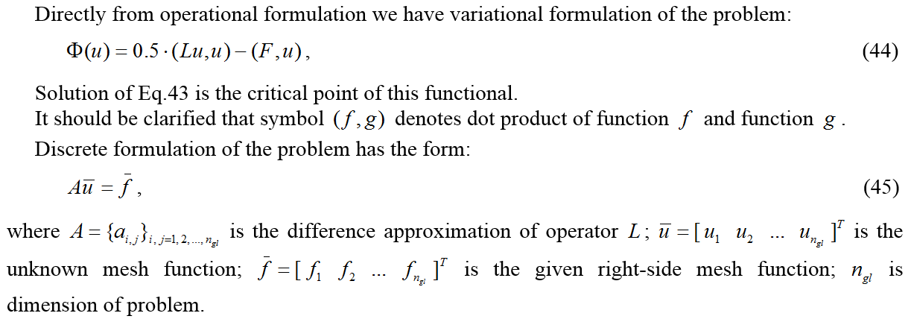
About Correct Multilevel Wavelet-Based Numerical Method of Local Structural Analysis

Slide 17
About Correct Multilevel Wavelet-Based Numerical Method of Local Structural Analysis

Slide 18
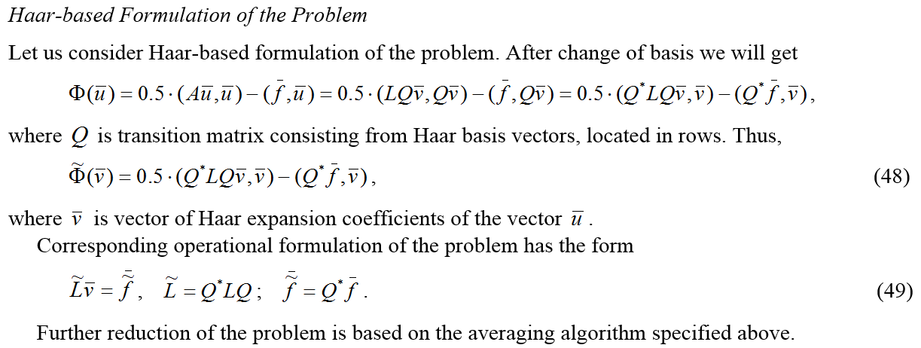
About Correct Multilevel Wavelet-Based Numerical Method of Local Structural Analysis

Slide 19
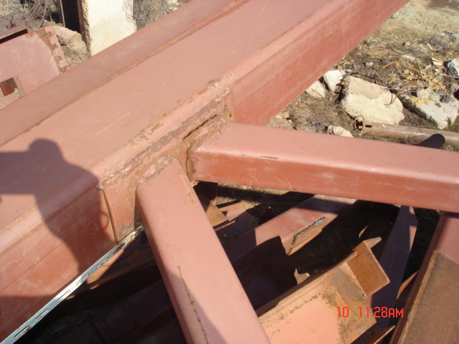
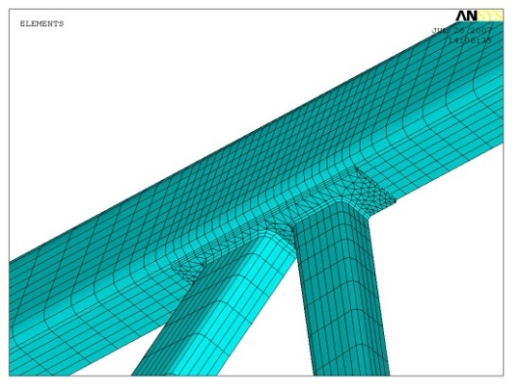
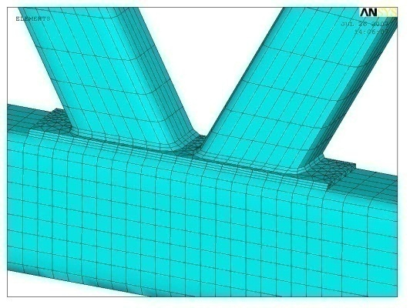
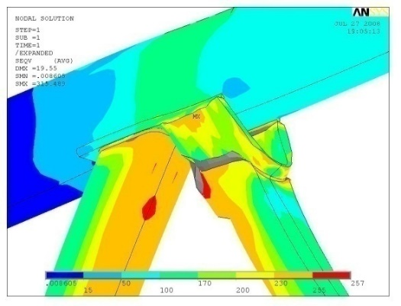
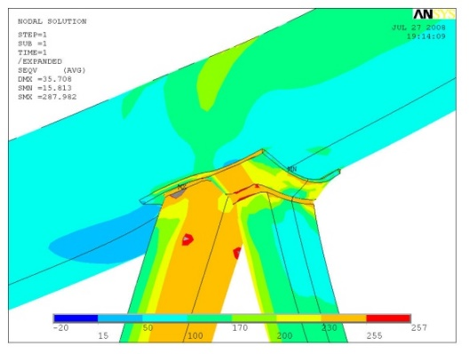
NUMERICAL AND SEMIANALYTICAL METHODS OF LOCAL STRUCTURAL ANALYSIS
The most dangerous from the standpoint of strength is the stress-strain state of the structure in places of various kinds of concentrations (cracks, joints of structural elements, etc.), local changes within the reconstruction of the object (needling, demolition of supports that interfere with the functional purpose of the structure and etc.) or in areas of local strengthening (reinforcing beams, metal ties, etc.).

Slide 20
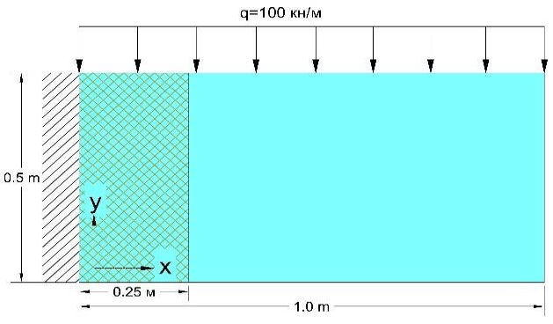
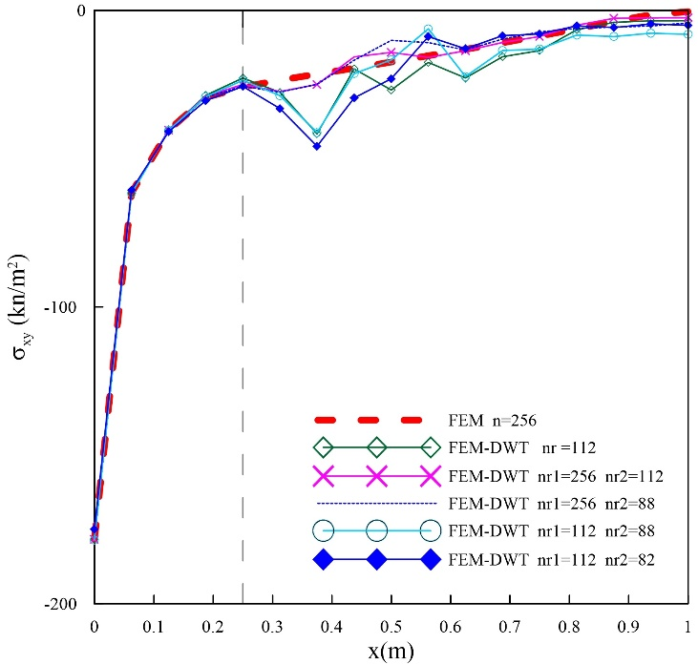
NUMERICAL METHOD OF LOCAL STRUCTURAL ANALYSIS
Local numerical simulation is based on a modern, highly efficient apparatus of multi-scale wavelet analysis.
Finite element method (FEM)
Discrete formulations of boundary problems of structural analysis (within FEM)
Reduced wavelet-based discrete formulations of boundary problems of structural analysis
Solution of resultant reduced system
of linear algebraic equations, return to the original basis
Main result: a significant reduction in the dimension of the problem, high accuracy of computing of stress-strain state in the most dangerous areas of the structure
y = 0.47 м

Slide 21
SEMIANALYTICAL METHOD OF LOCAL STRUCTURAL ANALYSIS
Local semianalytical simulation is based on a modern, highly efficient apparatus of multi-scale wavelet analysis.
Discrete-continual finite element method
Discrete-continual formulations of boundary problems of structural analysis
Reduced wavelet-based discrete-continual formulations of boundary problems of structural analysis
Exact analytical solution of resultant reduced multipoint boundary problem, return to the original basis
Comparison for the first discrete-continual finite element
Main result: a significant reduction in the dimension of the problem, high accuracy of computing of stress-strain state in the most dangerous areas of the structure

Slide 22
THANK YOU FOR YOUR ATTENTION!
Notes:
22
22

