Slide 1
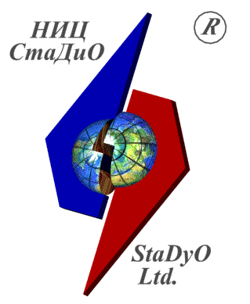
The DisCrete-Continual Finite Element Method in Engineering
Prof. Pavel A. Akimov, Mr. Oleg A. Negrozov
Research & Development Center “StaDyO”, Moscow, Russia
National Research Moscow State University of Civil Engineering, Moscow, Russia
International Conference “Mathematical Modeling and Computational Physics, 2017” (MMCP2017)
Notes:
1
1

Slide 2
INTRODUCTION
Regularity (constancy, piecewise constancy) of physical and geometrical parameters in one dimension exists in various problems of analysis of structures and corresponding mathematical models.
We should mention here in particular such vital objects as beams, strip foundations, thin-walled bars, deep beams, plates, shells, high-rise buildings, extensional buildings, pipelines, rails, dams and others.
Analytical solution is apparently preferable in all aspects for qualitative analysis of calculation data. It allows investigator to consider boundary effects when some components of solution are rapidly varying functions. Due to the abrupt decrease inside of mesh elements in many cases their rate of change can’t be adequately considered by conventional numerical methods while analytics enables study. Another feature of the proposing method is the absence of limitations on lengths of structures.
In this context discrete-continual finite element method is peculiarly relevant. Generally, semianalytical formulation are contemporary mathematical models which currently becoming available for computer realization.

Slide 3
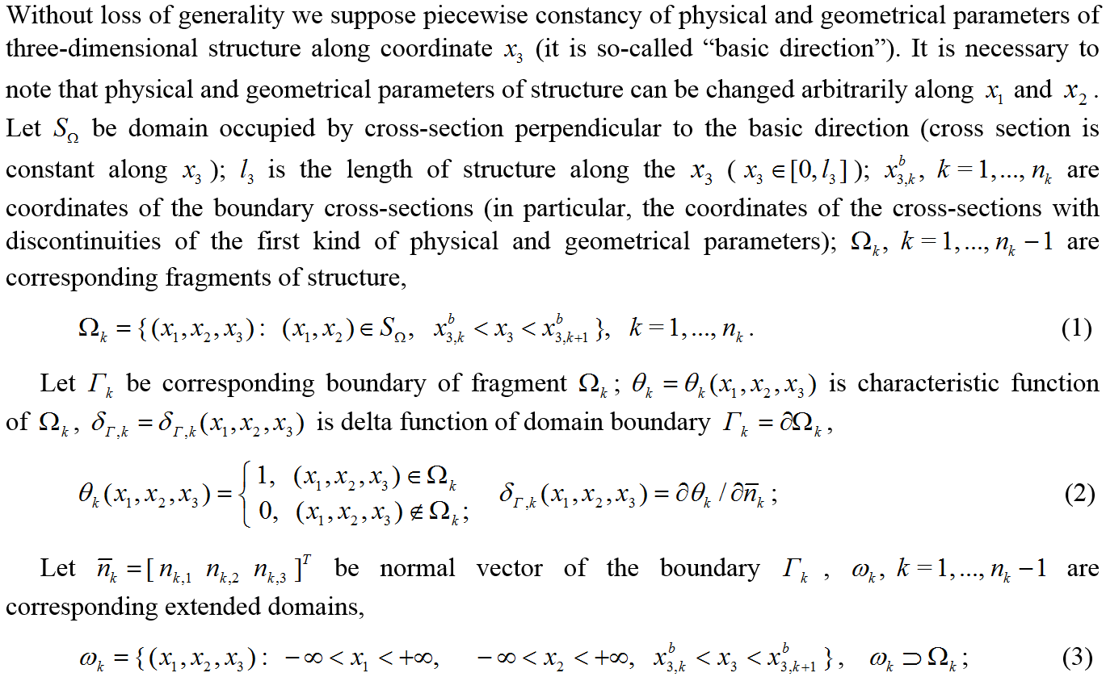
OPERATIONAL CONTINUAL FORMULATION OF THE PROBLEM

Slide 4
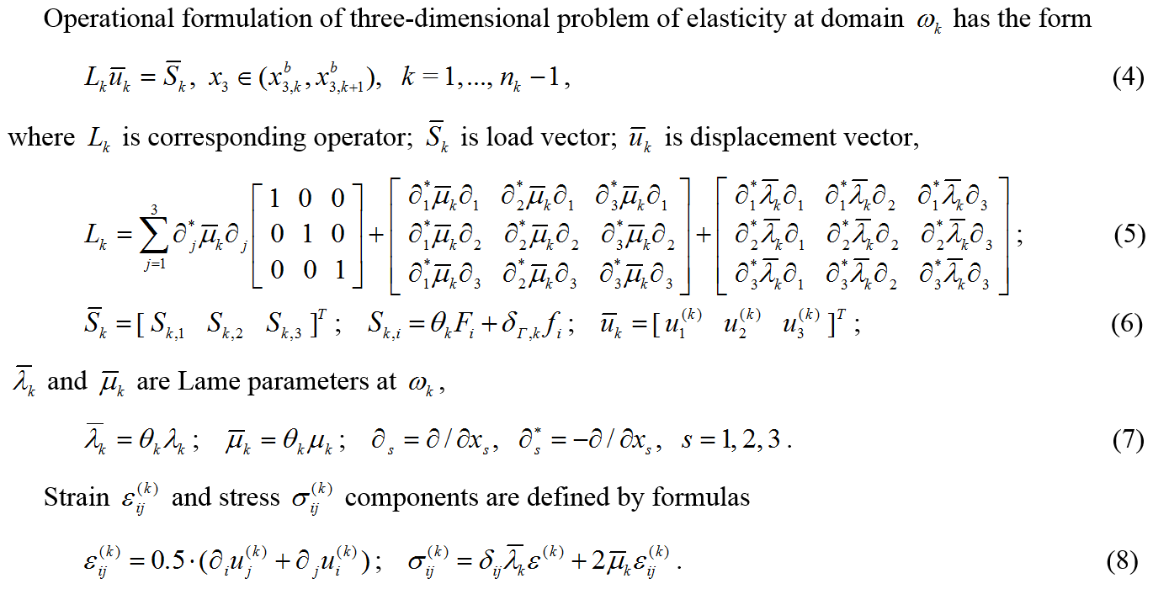
OPERATIONAL CONTINUAL FORMULATION OF THE PROBLEM

Slide 5
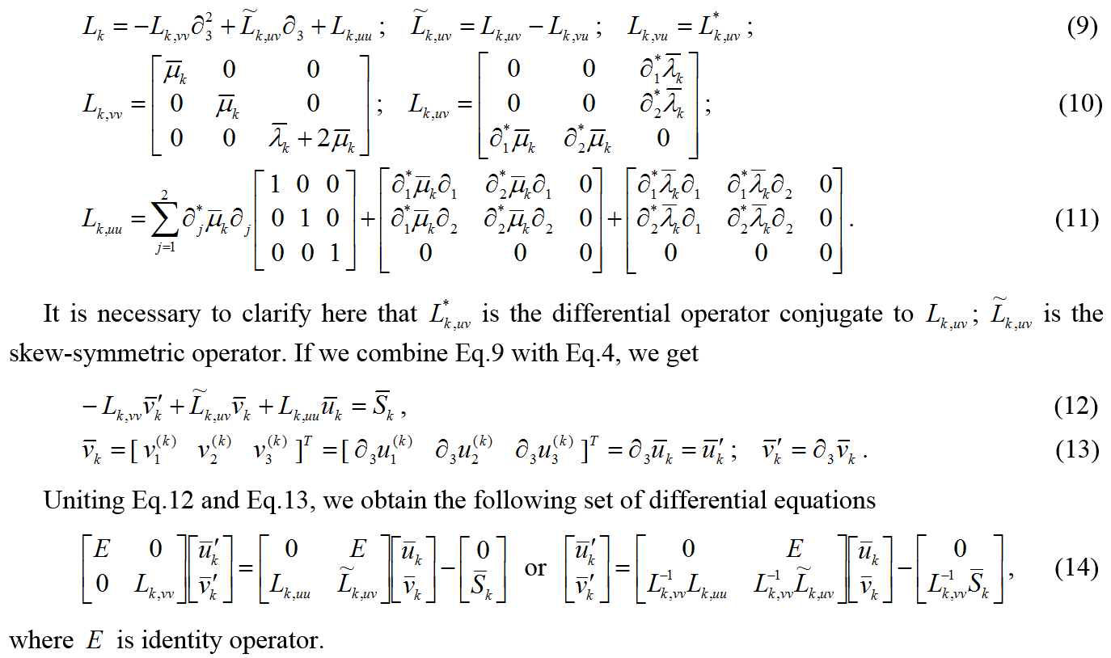
OPERATIONAL CONTINUAL FORMULATION OF THE PROBLEM

Slide 6
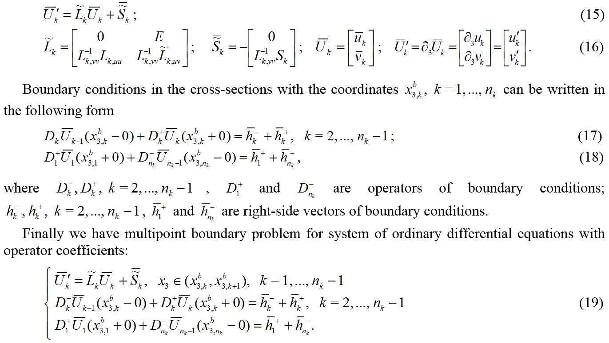
OPERATIONAL CONTINUAL FORMULATION OF THE PROBLEM

Slide 7
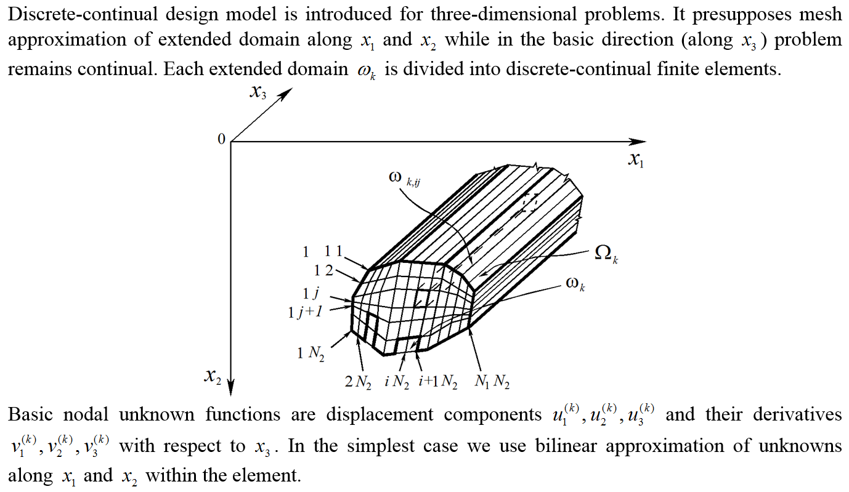
DISCRETE-CONTINUAL FORMULATION OF THE PROBLEM

Slide 8
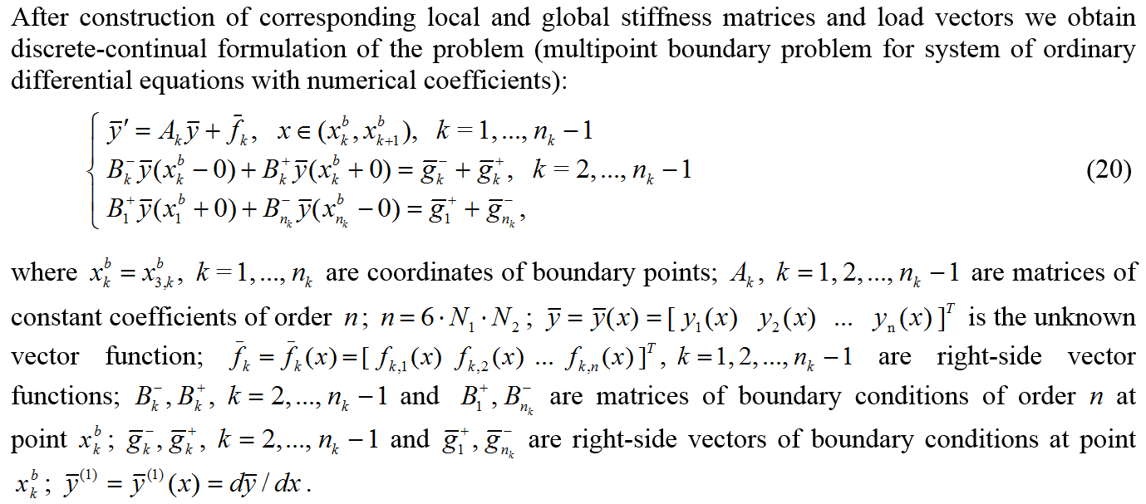
DISCRETE-CONTINUAL FORMULATION OF THE PROBLEM

Slide 9
Analytical Solution of Multipoint Boundary Problems of Structural Analysis for Systems of Ordinary Differential Equations with Piecewise Constant Coefficients
Solution of considering multipoint boundary problem of structural analysis is accentuated by numerous factors.
They include boundary effects (stiff systems) and considerable number of differential equations (several thousands). Moreover, matrices of coefficients of a system normally have eigenvalues of opposite signs and corresponding Jordan matrices are not diagonal.
Special method of solution of multipoint boundary problems for systems of ordinary differential equations with piecewise constant coefficients in structural analysis has been developed. Not only does it overcome all difficulties mentioned above but its major peculiarities also include universality, computer-oriented algorithm, computational stability, optimal conditionality of resultant systems and partial Jordan decomposition of matrix of coefficient, eliminating necessity of calculation of root vectors.

Slide 10
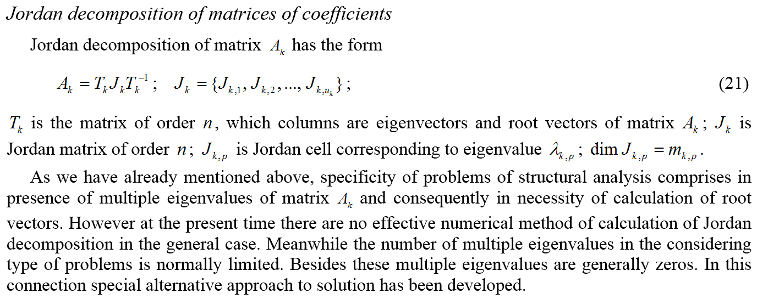
Analytical Solution of Multipoint Boundary Problems of Structural Analysis for Systems of Ordinary Differential Equations with Piecewise Constant Coefficients

Slide 11
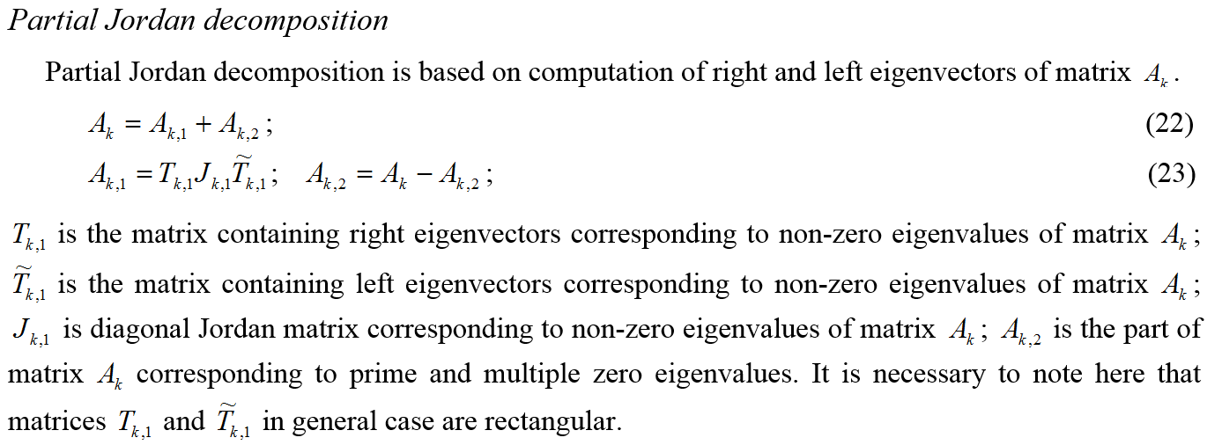
Analytical Solution of Multipoint Boundary Problems of Structural Analysis for Systems of Ordinary Differential Equations with Piecewise Constant Coefficients

Slide 12
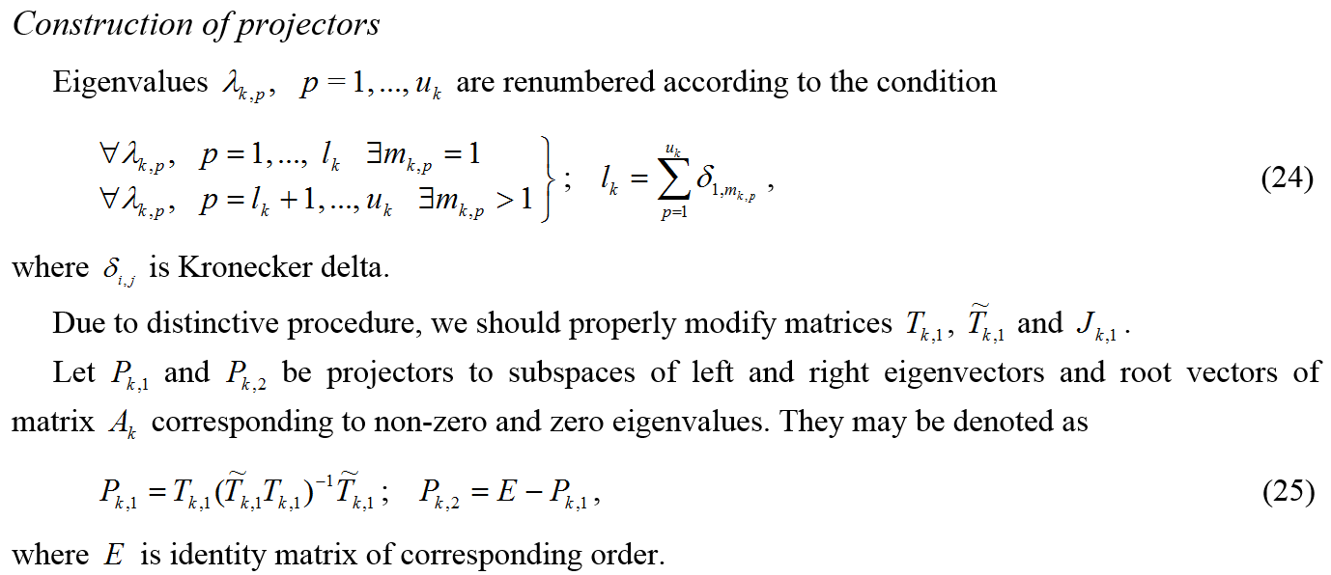
Analytical Solution of Multipoint Boundary Problems of Structural Analysis for Systems of Ordinary Differential Equations with Piecewise Constant Coefficients

Slide 13
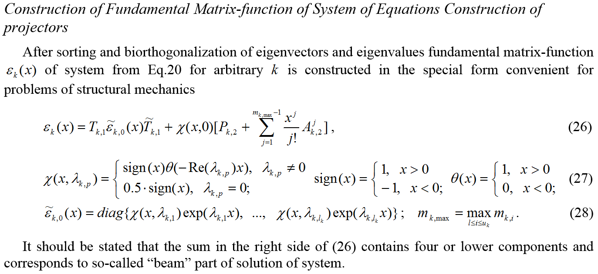
Analytical Solution of Multipoint Boundary Problems of Structural Analysis for Systems of Ordinary Differential Equations with Piecewise Constant Coefficients

Slide 14
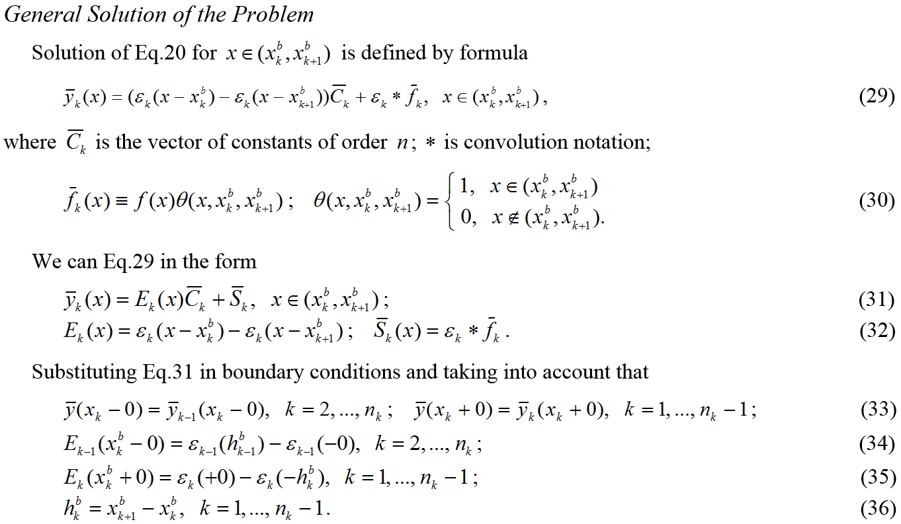
Analytical Solution of Multipoint Boundary Problems of Structural Analysis for Systems of Ordinary Differential Equations with Piecewise Constant Coefficients

Slide 15
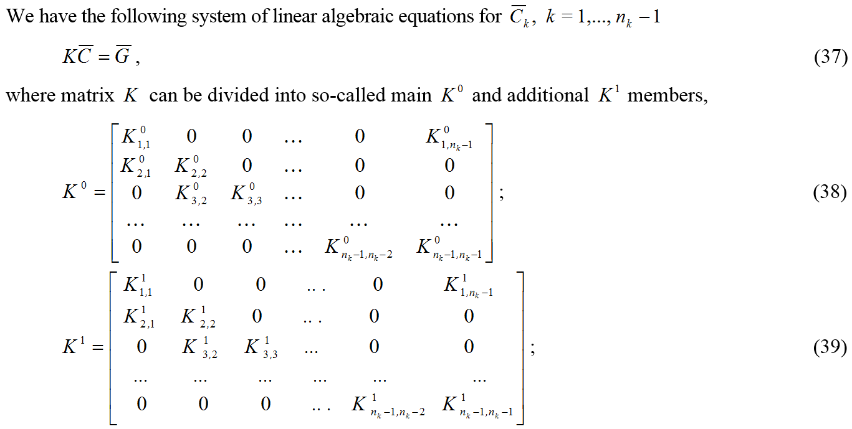
Analytical Solution of Multipoint Boundary Problems of Structural Analysis for Systems of Ordinary Differential Equations with Piecewise Constant Coefficients

Slide 16
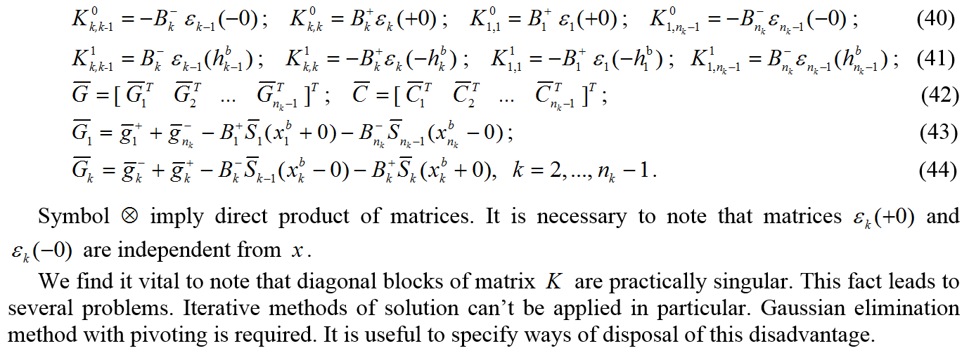
Analytical Solution of Multipoint Boundary Problems of Structural Analysis for Systems of Ordinary Differential Equations with Piecewise Constant Coefficients

Slide 17
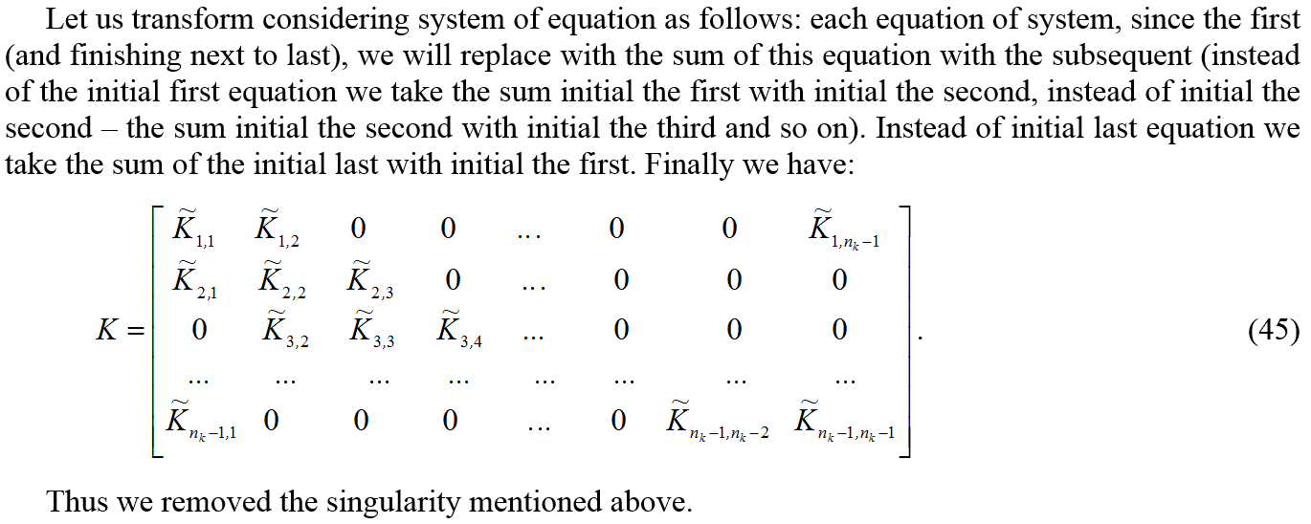
Analytical Solution of Multipoint Boundary Problems of Structural Analysis for Systems of Ordinary Differential Equations with Piecewise Constant Coefficients

Slide 18
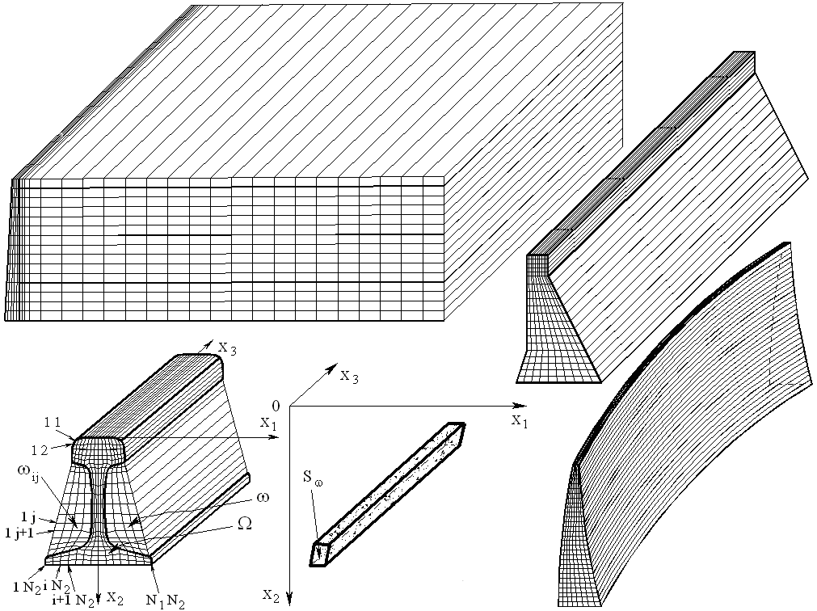
COMPUTER REALIZATION
Correct discrete-continual finite element method for analysis of structures with piecewise constant physical and geometrical parameters in one direction, considering in the distinctive paper, has been realized in software DCFEM3Dpc. Programming environment is Intel Parallel Studio 2016 XE. Program is designed for Microsoft Windows 8/8.1/10. Test, model and practically important problems of structural analysis have been solved with the use of DCFEM3Dpc.

Slide 19
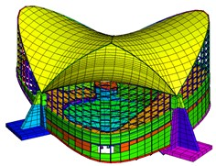
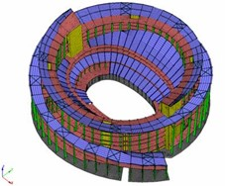
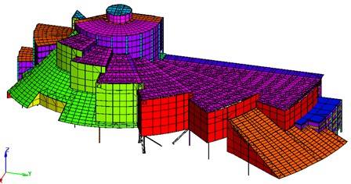
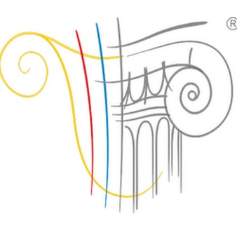
MULTILEVEL APPROACH TO STRUCTURAL ANALYSIS BASED ON COMBINED APPLICATION OF FINITE ELEMENT METHOD AND DISCRETE-CONTINUAL FINITE ELEMENT METHOD
Discrete-continual finite element method (DCFEM) is reliable basis for further development and practical application for modelling of behavior of a wide class of structures, by “integrating” DCFEM as effective alternative module into advanced finite / superelement software systems, which are used for analysis of typical and unique building structures, buildings and facilities at the stages of their design and operation – structural health monitoring.

Slide 20
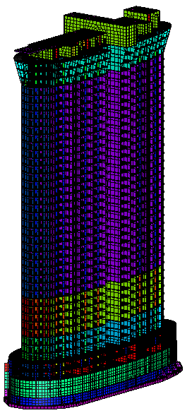
MULTILEVEL APPROACH TO STRUCTURAL ANALYSIS BASED ON COMBINED APPLICATION OF FINITE ELEMENT METHOD AND DISCRETE-CONTINUAL FINITE ELEMENT METHOD
Initial modelling object (structure, building, facility)
.
.
Fragments with regular physical and geometric parameters along one of the directions
Other fragments
Discrete-continual finite element method
Finite element method
Integrated hierarchically constructed design model
Main advantages of the method:
A wide range of applicability of the method;
High accuracy of determination of parameters of stress-strain state in fragments with regular physical and geometric characteristics along one of the directions;
Orientation to implementation in the computational software systems of industrial type

Slide 21
THANK YOU FOR YOUR ATTENTION!
Notes:
21
21

