Slide 1
Application of harmonic oscillator basis with different size parameters for calculation of ground state energy of Coulomb three-body systems
Algirdas Deveikis
Vytautas Magnus University
Vileikos 8, Kaunas 44404, Lithuania
e-mail: algirdas.deveikis@vdu.lt

Slide 2
Motivation and goals
Advantages of the HO expansion method:
systematic computations of matrix elements
translational invariance and antisymetry in finite subspaces (i.e. complete Nℏω spaces)
Drawback: slow rate of convergence for Coulomb-type long range interaction potentials.
HO functions with different size parameters in the Jacobi coordinates instead of only one unique oscillator length parameter in the traditional treatment (prof. G. Kamuntavičius, VMU)
The non-relativistic ground state energy of Coulomb three-particle systems:
Formalism for Coulomb three-particle systems with two identical particles in A. Deveikis, J. Mod. Phys. 7, 290–303 (2016),
Formalism and calculation results for non-identical particles in A. Deveikis "Lithuanian Journal of Physics" v. 57, n. 2, 2017 (accepted for publication).
New results of ground state energy calculation of a number of Coulomb three-particle systems with two identical particles.
Notes:
The ground-state energy is one of the primary observables in nuclear physics

Slide 3
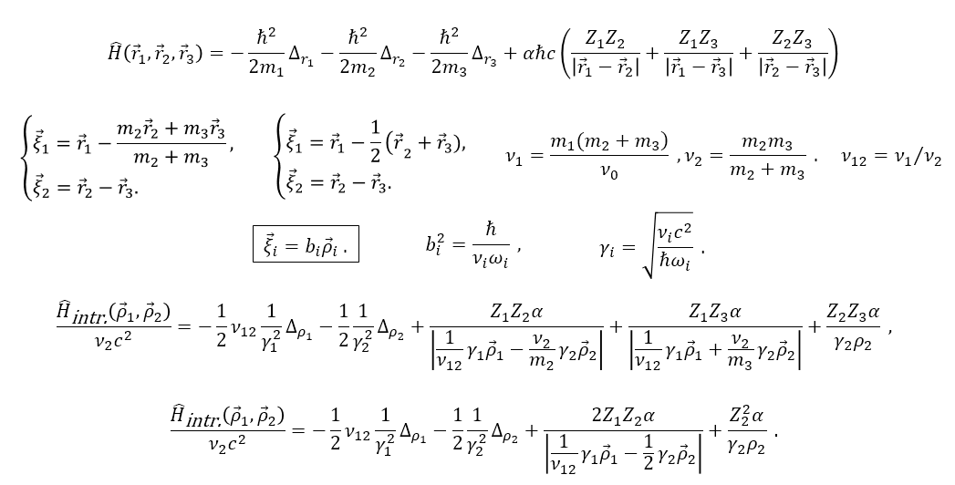
Intrinsic three-body Hamiltonian
$$=_{1}=_{2}$$

Slide 4
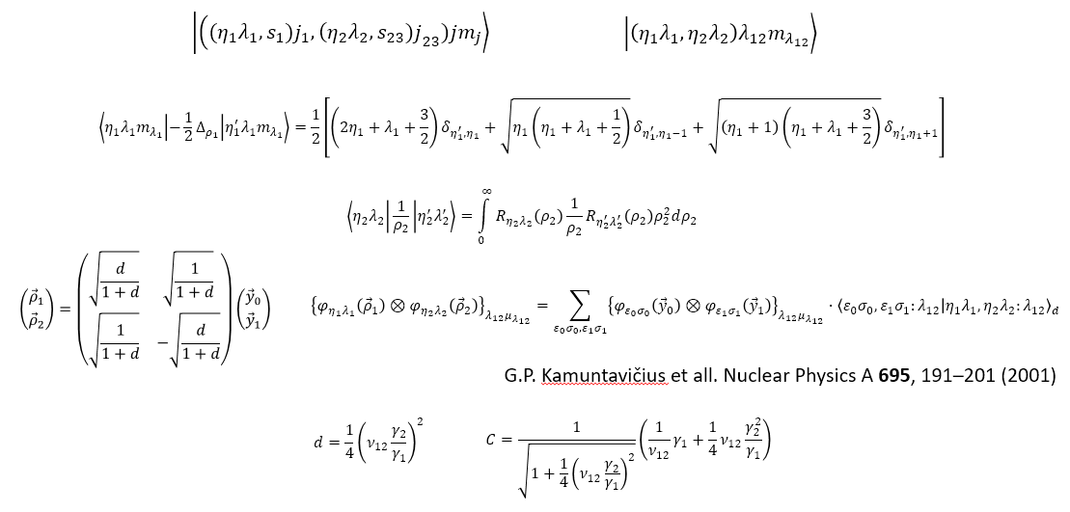
Matrix elements calculation (1)

Slide 5
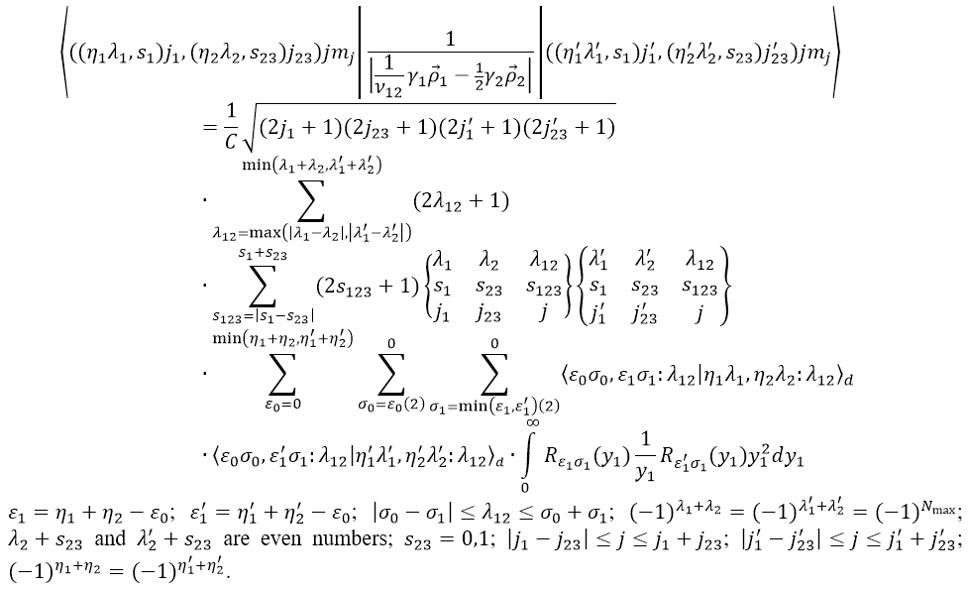
Matrix elements calculation (2)

Slide 6
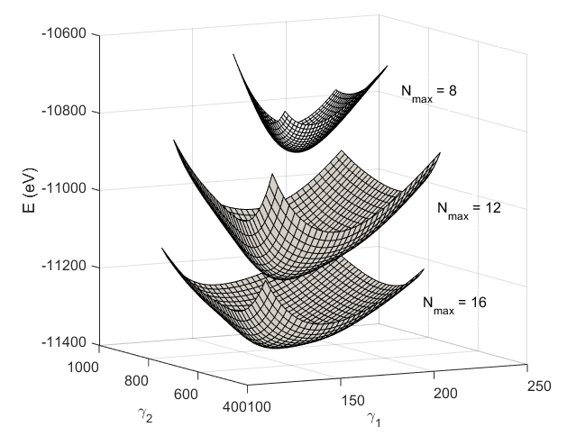
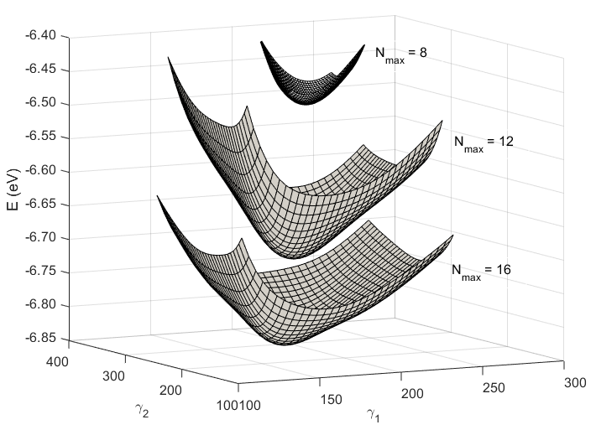
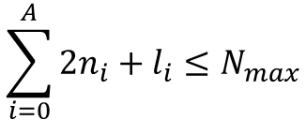
Variational surfaces of g.s. energy of three-particle systems at N_{max} = 8, 12, 16 plotted against nonlinear parameters γ₁ and γ₂
$$\sum_{i=0}^{A}{2n_{i}+l_{i}}≤N_{max}$$
Kdt
e⁺ee
A. Deveikis "Lithuanian Journal of Physics" v. 57, n. 2, 2017

Slide 7
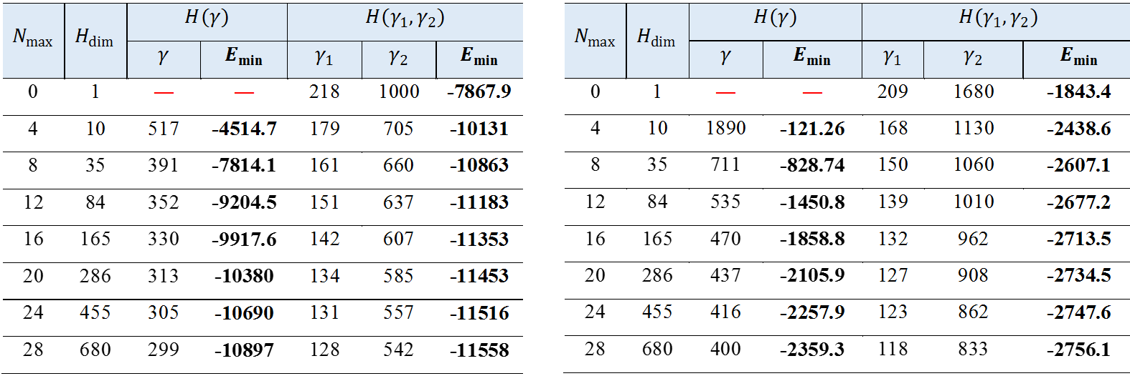
The dependence of the g.s. energy E_{min} (in eV) of three-particle systems on the number of excitation HO quanta N_{max}
″exact″ numerical g.s. energy for Kdt system is -11694.979 eV
″exact″ numerical g.s. energy for μpp system is -2781.64338 eV
A. Deveikis "Lithuanian Journal of Physics" v. 57, n. 2, 2017

Slide 8
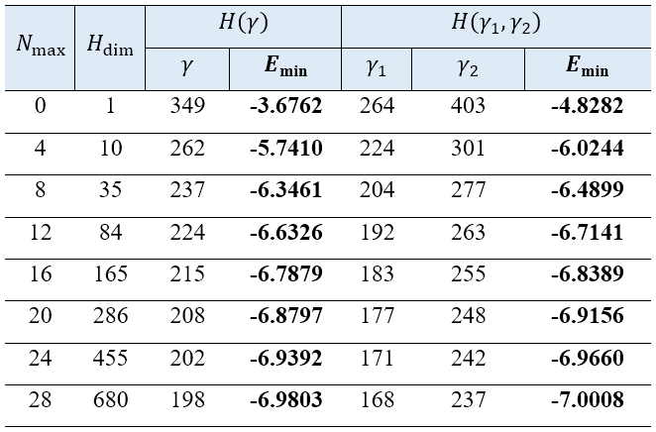
The dependence of the g.s. energy E_{min} (in eV) of e⁺ee system on the number of excitation HO quanta N_{max}
″exact″ numerical g.s. energy for e⁺ee system is -7.129520853755 eV

Slide 9
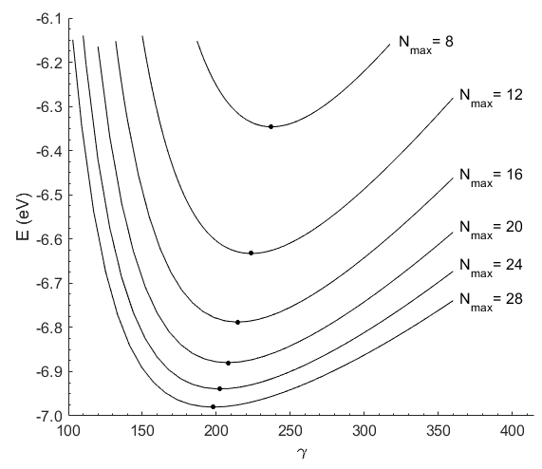
The dependence of the g.s. energy of e⁺ee system on the γ (one parameter case) at our selected values of N_{max}

Slide 10
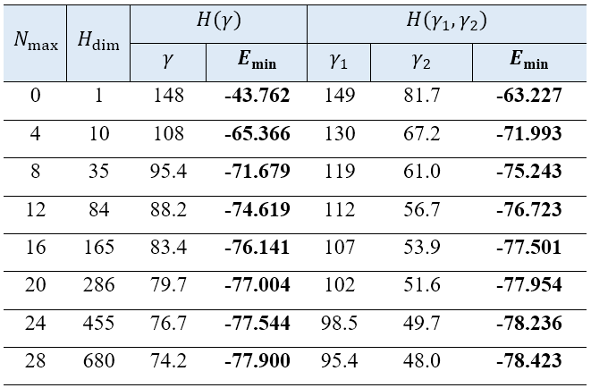
The dependence of the g.s. energy E_{min} (in eV) of He on the number of excitation HO quanta N_{max}
″exact″ numerical g.s. energy for He is -79.00293823 eV

Slide 11
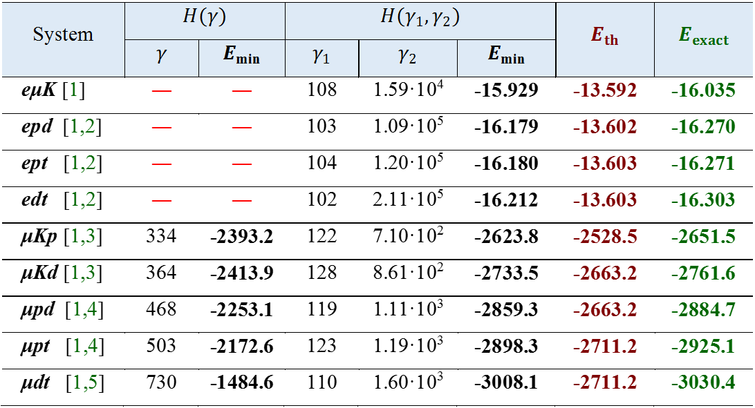
The g.s. energies (in eV) for the Coulomb three-particle systems with non-identical particles (N_{max} = 28)
[1] dx.doi.org/10.1016/j.cpc.2013.06.013, [2] dx.doi.org/10.1088/0953-4075/35/14/103,
[3] https://doi.org/10.1103/PhysRevA.46.4418, [4] dx.doi.org/10.1140/epjd/e2011-20142-0,
[5] doi.org/10.1103/PhysRevA.70.042506
A. Deveikis "Lithuanian Journal of Physics" v. 57, n. 2, 2017
Notes:
[1] E. Z. Liverts and N. Barnea, Three-body systems with Coulomb interaction. Bound and quasi-bound S-states, Comput. Phys. Commun. 184, 2596–2603 (2013), http://dx.doi.org/10.1016/j.cpc.2013.06.013
[2] A.M. Frolov, Structures and properties of the ground states in H2+-like adiabatic ions, J. Phys. B: At. Mol. Opt. Phys. 35, L331 (2002), http://dx.doi.org/10.1088/0953-4075/35/14/103
[3] A.M. Frolov and A.J. Thakkar, Weakly bound ground states in three-body Coulomb systems with unit charges, Phys. Rev. A 46, 4418 (1992) https://doi.org/10.1103/PhysRevA.46.4418
[4] A.M. Frolov and D.M. Wardlaw, Bound state spectra of three-body muonic molecular ions, Eur. Phys. J. D 63, 339–350 (2011) http://dx.doi.org/10.1140/epjd/e2011-20142-0
[5] S. Kilic, J.P. Karr, and L. Hilico Coulombic and radiative decay rates of the resonances of the exotic molecular ions ppμ, ppπ, ddμ, ddπ, and dtμ, Phys. Rev. A 70, 042506 (2004) https://doi.org/10.1103/PhysRevA.70.042506

Slide 12
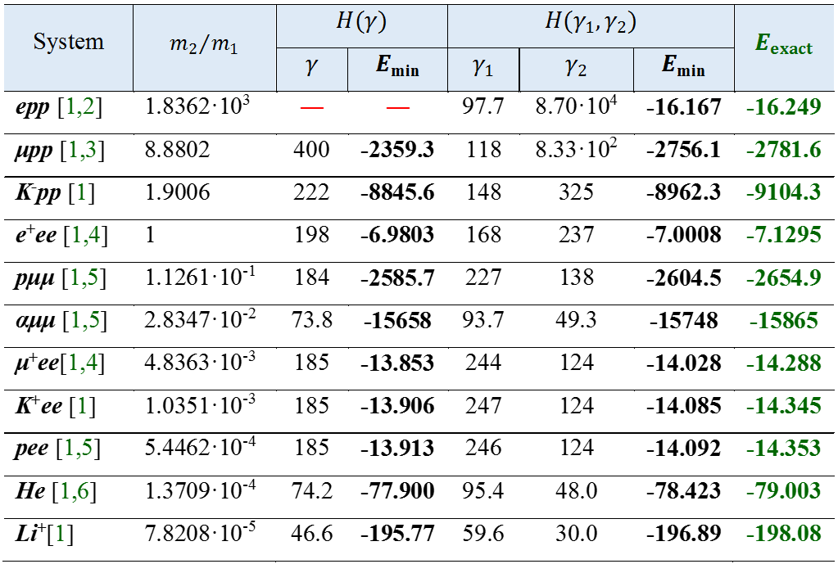
The g.s. energies (in eV) for the Coulomb three-particle systems with two identical particles (N_{max} = 28)
[1] dx.doi.org/10.1016/j.cpc.2013.06.013,
[2] doi.org/10.1088/0953-4075/37/12/004,
[3] doi.org/10.1103/PhysRevA.70.042506
[4] doi.org/10.1016/j.physleta.2005.06.017,
[5] doi:10.1051/epjconf/20100302009,
[6] doi: 10.1103/PhysRevA.66.024501
Notes:
[1] E. Z. Liverts and N. Barnea, Three-body systems with Coulomb interaction. Bound and quasi-bound S-states, Comput. Phys. Commun. 184, 2596–2603 (2013), http://dx.doi.org/10.1016/j.cpc.2013.06.013
[2] M.M. Cassar, G.W.F. Drake, High precision variational calculations for H+2, J. Phys. B 37 (2004) 2485. https://doi.org/10.1088/0953-4075/37/12/004
[3] S. Kilic, J.P. Karr, and L. Hilico, Coulombic and radiative decay rates of the resonances of the exotic molecular ions ppμ, ppπ, ddμ, ddπ, and dtμ, Phys. Rev. A 70, 042506 (2004) https://doi.org/10.1103/PhysRevA.70.042506
[4] A.M. Frolov, Positron annihilation in the positronium negative ion Ps, Phys. Lett. A 342 (2005) 430, https://doi.org/10.1016/j.physleta.2005.06.017
[5] L.U. Ancarani, K.V. Rodriguez, G. Gasaneo, Ground and excited states for exotic three-body atomic systems, EPJ Web Conf. 3 (2010) 02009, doi:10.1051/epjconf/20100302009
[6] V. I. Korobov, Nonrelativistic ionization energy for the helium ground state, Phys. Rev. A 66, 024501 (2002) doi: 10.1103/PhysRevA.66.024501

Slide 13
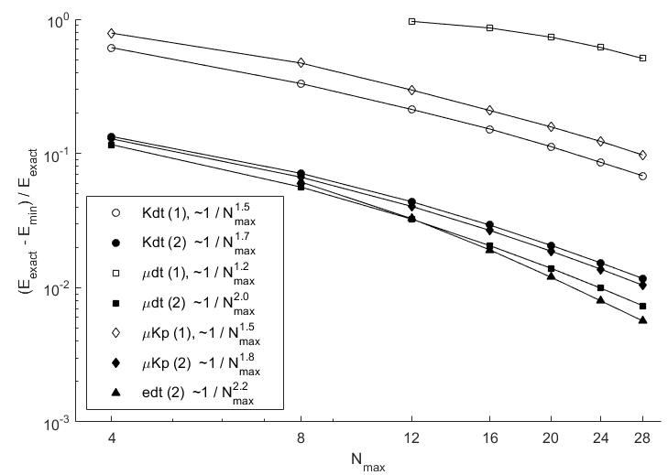
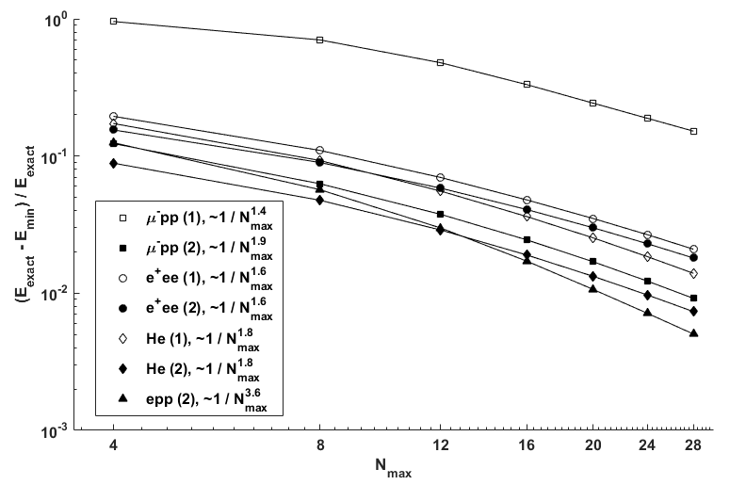
Convergence rates for variational calculations
A. Deveikis LNFK 2017 (submitted for publication)
asymptotic convergence rate for Yukawa potential: E_{min} = E_{exact} + P(N_{max})⁻² (I. M. Delves 1972)
Notes:
This is important for the atomic nucleus model.

Slide 14
Summary
The method is advantageous over the traditional one for application to the systems with asymmetric masses and small/medium values of N_{max}.
For systems with molecular character the second nonlinear variational parameter is vital for reasonable convergence.
This approach is more numerically involved than the traditional one.
The method is universal for many three-body systems: the calculations do not have to be optimized each time for a given three-body system.
The Coulomb interaction potential may be used with or changed in virtually any two-body potential.
The most direct application of this method may be for studies of atomic nuclei in a three-body model (clasterization, triton).
Notes:
Halo nuclei, realistic nucleon potentials

