Slide 1
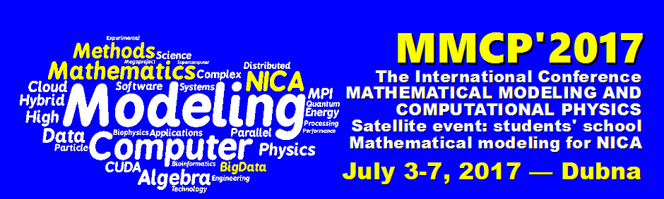
Advanced computing
in radiation biophysics
Oleg Belov
Joint Institute for Nuclear Research
Dubna, 2017

Slide 2
Introduction
Radiation Biophysics
the study of the effects of radiation on cells, tissues, biomolecules, and living organisms.
Notes:
To express observed biological effects, we need
to introduce quantitative characteristics of these effects and ionizing exposure.

Slide 3
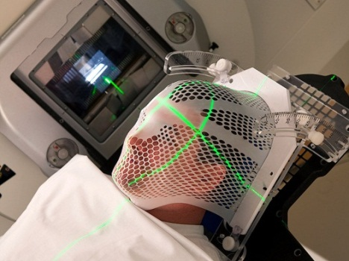
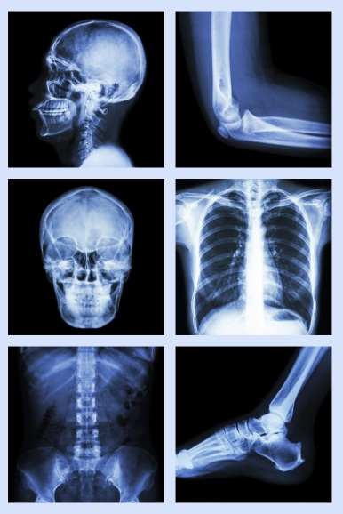
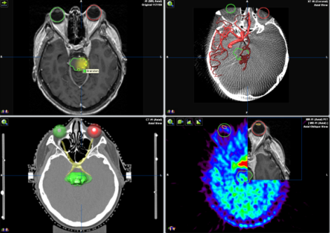
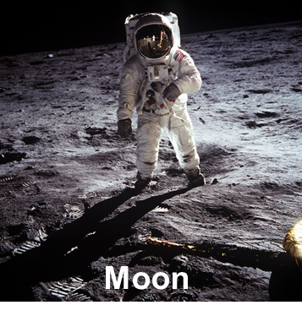
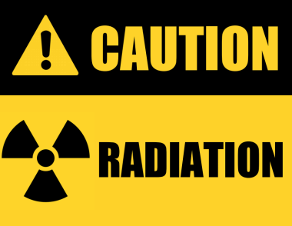
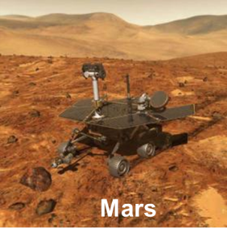
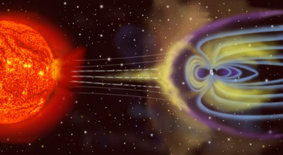
Introduction
Radiation Biophysics
Fundamental knowledge on how ionizing radiation affects living organisms
Radiation imaging
Radiation therapy
Space exploration
Radiation safety

Slide 4
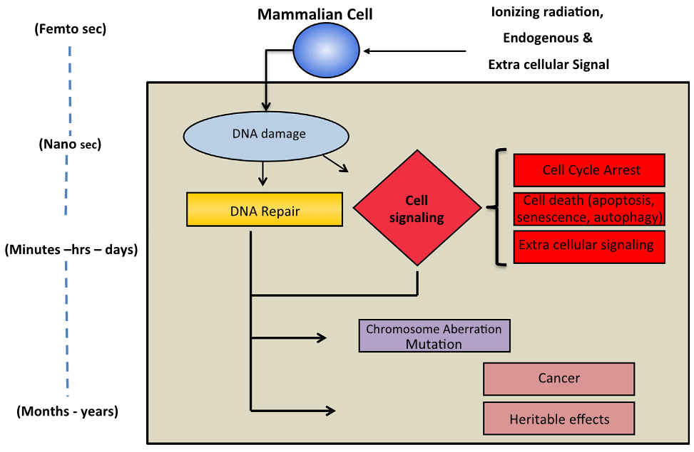
Cell Response to Ionizing Radiation
As in any science, radiobiology effects are measured with plenty
of quantitative parameters need to be organized, analyzed, and predicted.
/Modified from Nikjoo et al., 2016/
Notes:
As in any science, radiobiology effects are measured with plenty of quantitative parameters.

Slide 5
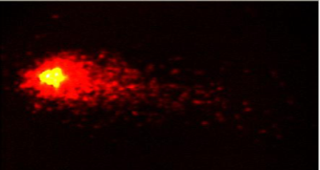
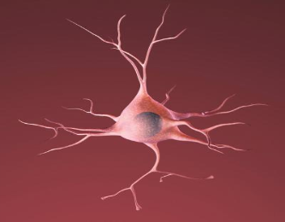
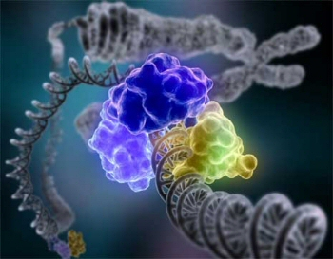
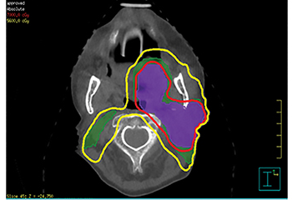
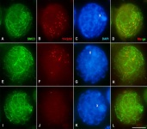
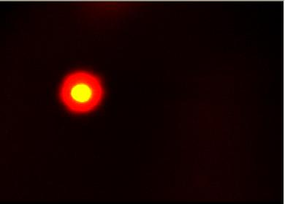
Variety of numerical models to simulate:
Radiation dosimetry and microdosimetry
DNA damage
DNA repair
Mutagenic effect of radiation
…
Fe
α
p
p
e
p

Slide 6
State-of-the-art in biophysical studies of radiation track
Monte Carlo track structure simulation of electrons and ions is now highly advanced making it possible to estimate the parameters of radiation effect with greater accuracy.
The main goal of track structure studies is to understand radiation action and radiation damage, especially of heavy ions, on the microscopic level, i.e. on a micrometer or even nanometer level.
This is in particular important for radiation damage in biological systems where DNA strands separated by only a few nanometers are accepted to be the most sensitive structures.
Notes:
In addition, also radiation transport in non-biological systems like dosimeters, ionization chambers and thin foils can be described on a microscopic level by taking into account each single interaction of a charged particle with an atom or molecule of the target material.

Slide 7
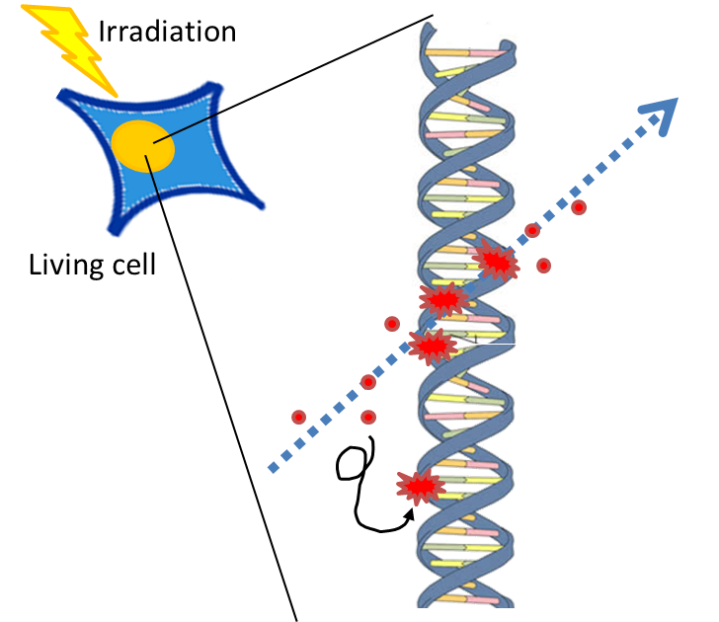
Radiation damage to DNA
Particle track
DNA lesions
DNA

Slide 8
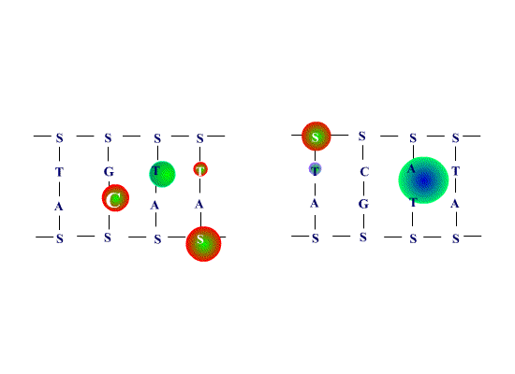


Radiation damage to DNA
Double strand break of DNA
Base damages
Clustered
DNA damage
Sugar damage
Base damages
Particle track

Slide 9
Monte-Carlo codes to simulate
particle track structure
Geant4-DNA Project
PARTRACK
KURBUC
RITRACKS
http://geant4-dna.org/
http://www.sciencedirect.com/science/article/pii/S0027510711000194
https://www.har.mrc.ac.uk/kurbuc-monte-carlo-electron-track-structure-code-range-10-10-mev-water
https://software.nasa.gov/software/MSC-25937-1

Slide 10
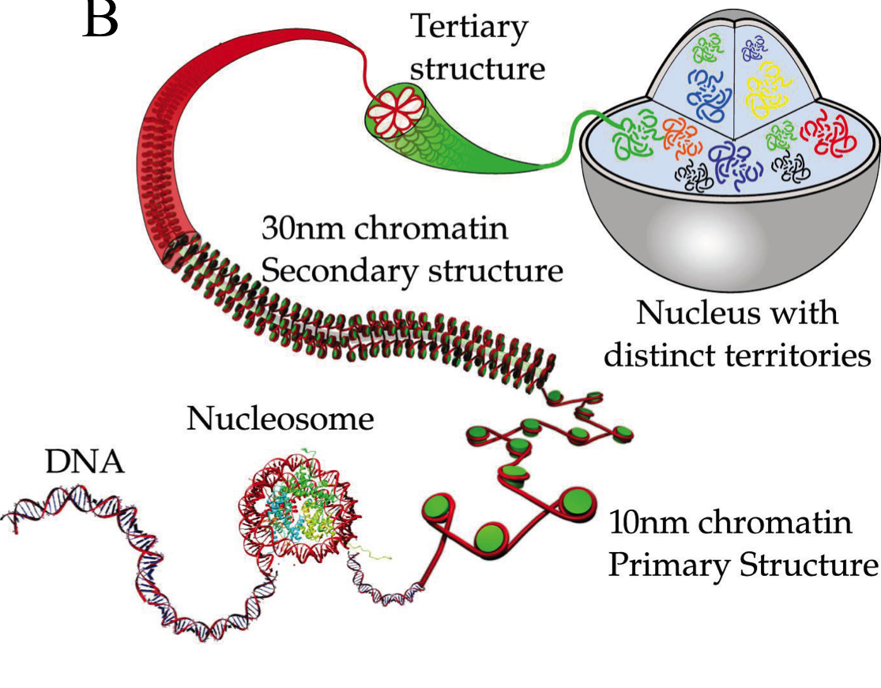
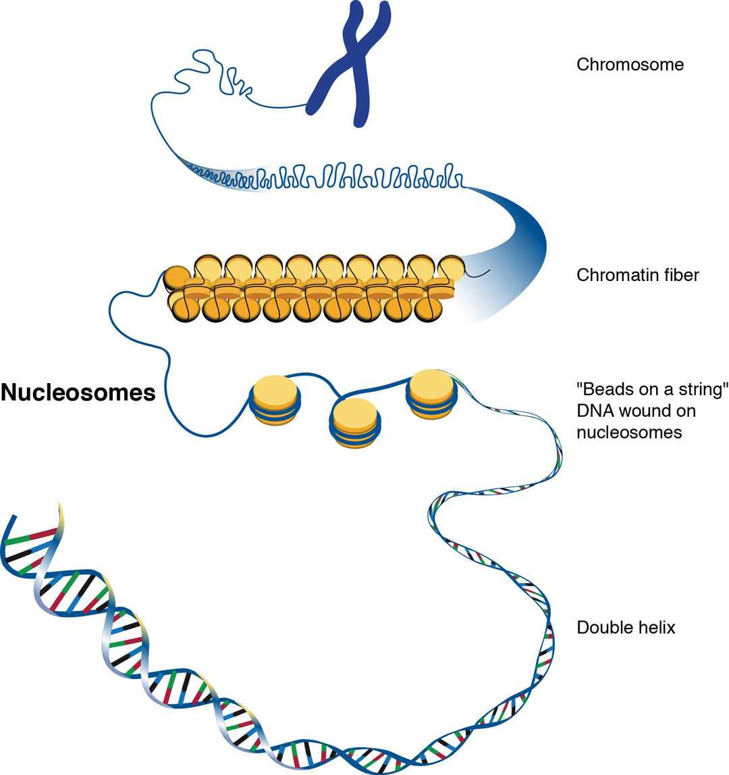
Simulation of radiation damage to DNA
1. Simulating
the target
Modified from https://mappingignorance.org/

Slide 11
Simulation of radiation damage to DNA
2. Simulating
the particle track
p⁺, 0.2 MeV/nucleon
¹²C, 0.2 MeV/nucleon

Slide 12
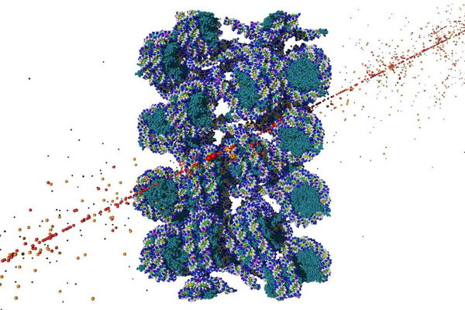
Simulation of radiation damage to DNA
3. Simulating
the DNA-track
interaction

Slide 13
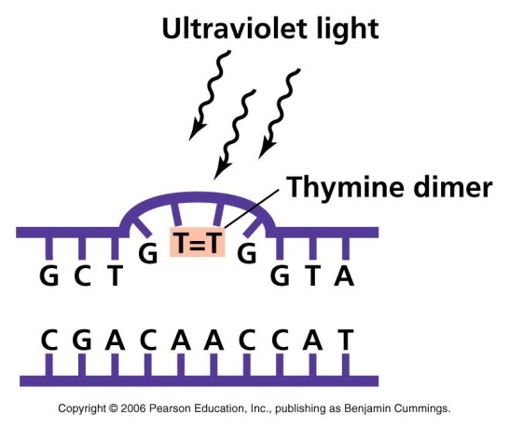
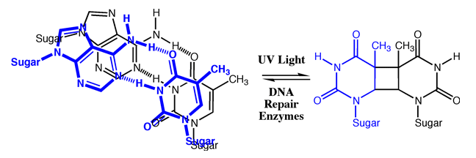
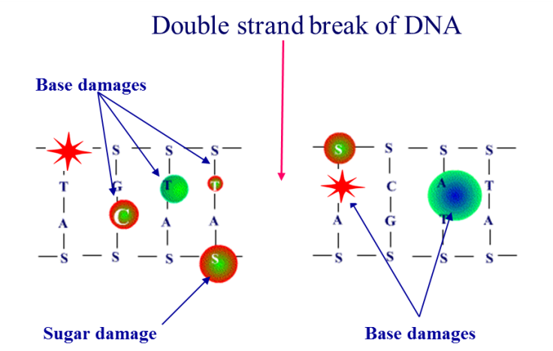
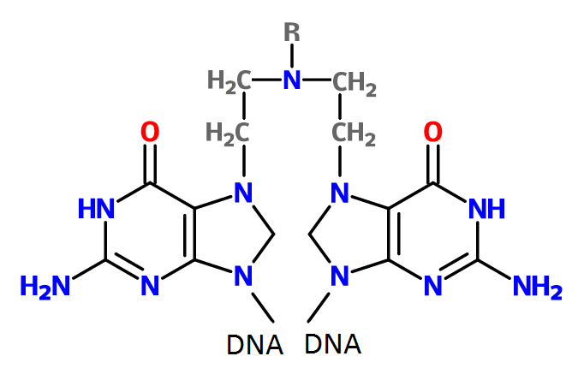
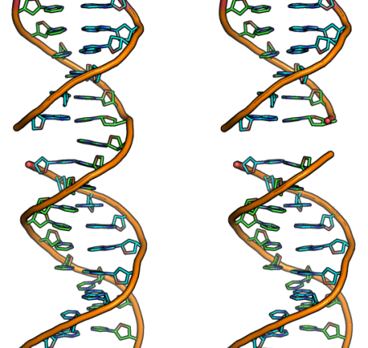
State of the art in models of DNA repair
and mutagenesis
Thymine dimers
Base damage
DNA-DNA and DNA-protein crosslinks
Single-strand breaks
Double-strand breaks
Clustered damage
Clustered DNA damage
DNA-DNA crosslink
Singe-strand break
Double-strand break

Slide 14
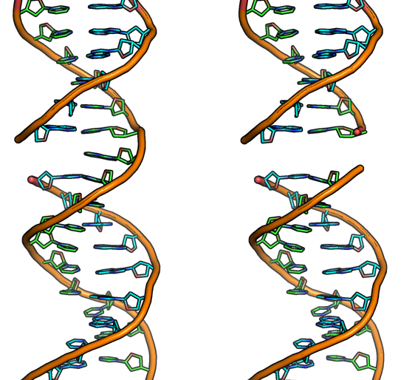
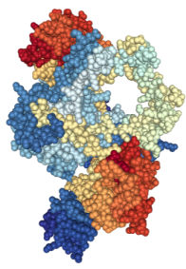
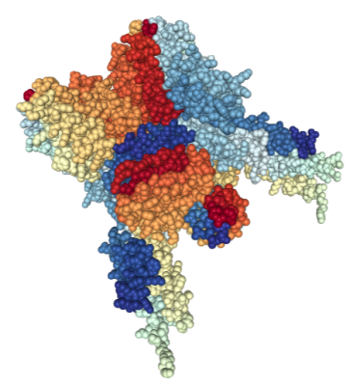

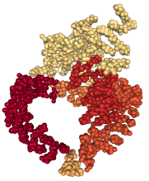
State of the art in models of DNA repair
Enzymatic processes of DNA repair
Recovered DNA
DNA damage
Charged particle track

Slide 15
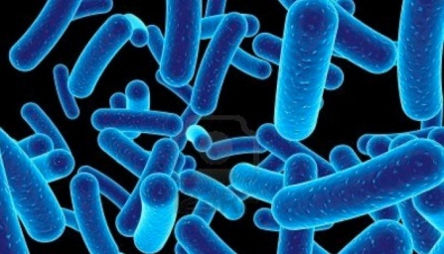
Example of DNA repair system in bacterial cells
SOS repair system
Radiation
RecA
LexA
DNA
TD
ssDNA
umuDC
PhR
RecA*
UmuD
UmuD₂C
ER
UmuD₂
SSB
RecA*
*One of the best training
topics for students
UmuDD’
UmuC
UmuDD’C
M
Pol III
UmuD’
UmuD’₂
UmuD’₂C
Pol V Mut
UV: ultraviolet irradiation
TD: thymine dimers
PhR: Photoreactivation
ER: excision repair
ssDNA: single-stranded DNA
M: mutation
RecA, LexA, RecA*, UmuD, UmuC, UmuD’, UmuD₂,UmuD’₂,
UmuDD’, UmuD₂C, UmuD’₂C, UmuDD’C, Pol V Mut, Pol III, SSB
/in Escherichia coli bacteria/
– main SOS proteins

Slide 16
Diagram of a computational model for SOS-repair
Dynamic model
of the inducing signal
(single-stranded DNA)
Mathematical model
of translesion synthesis
Dynamic model
of the lexA-recA system
Dynamic model of the basic regulatory complexes
Dynamic model
of the umuDC gene products
Dynamic model
of the dimerized umuD
gene products

Slide 17
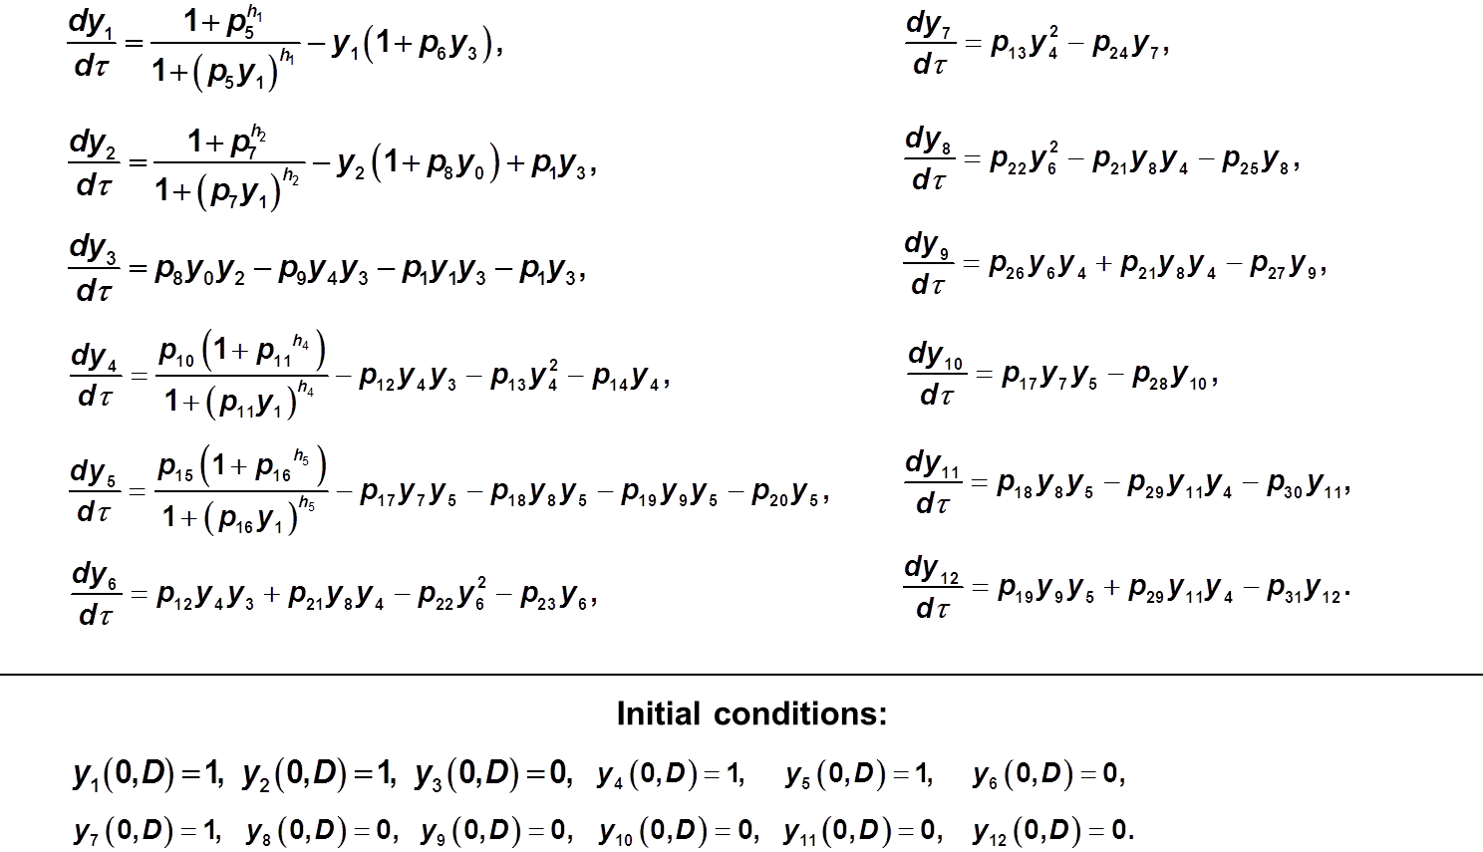
Equations of the model

Slide 18
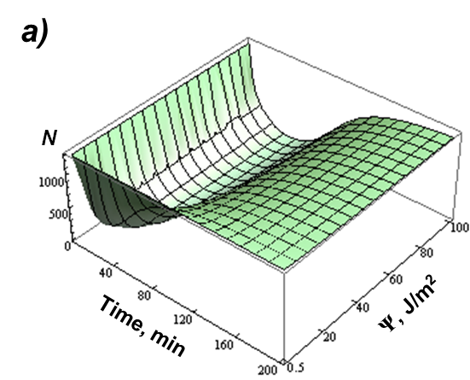
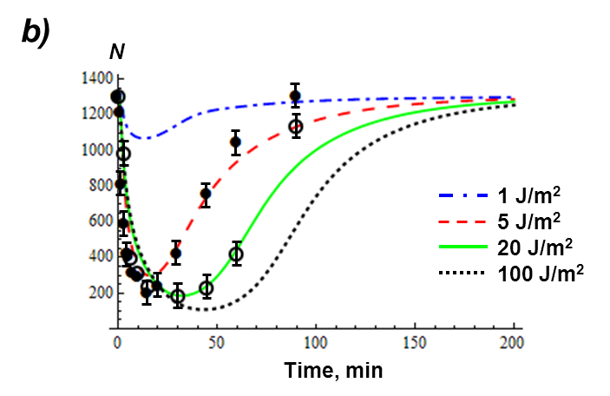
Sample results: LexA protein concentration
The dependence of the LexA concentration on fluence Ψ of UV radiation;
A set of curves for the LexA protein concentration under different UV fluences;
● experimental data for 5 J/m² [Sassanfar, Roberts; 1991];
○ experimental data for 20 J/m² [Sassanfar, Roberts; 1991];
N is the number of protein molecules per cell.

Slide 19
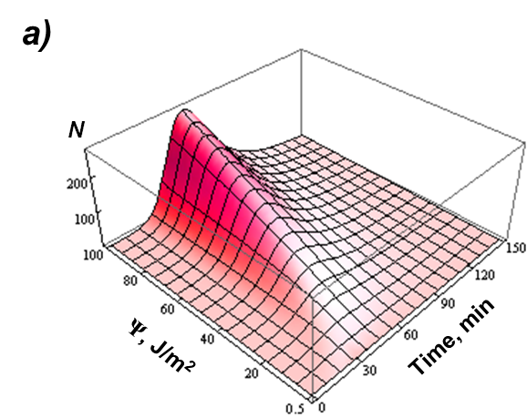
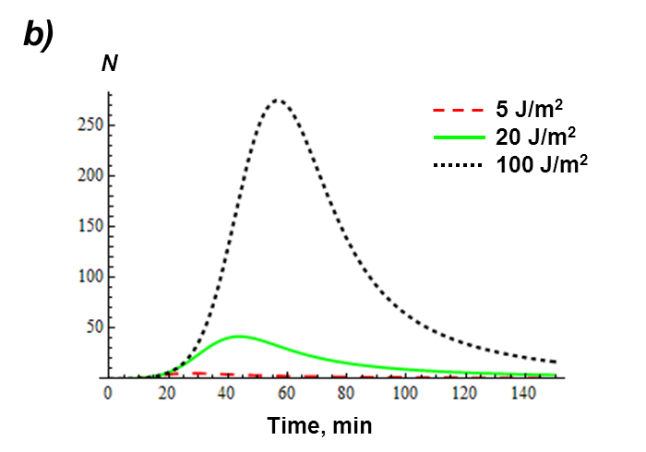
Sample results: DNA polymerase V concentration
The dependence of DNA Pol V concentration on fluence Ψ of UV radiation;
A set of curves for the DNA Pol V protein concentration under different UV fluences.

Slide 20
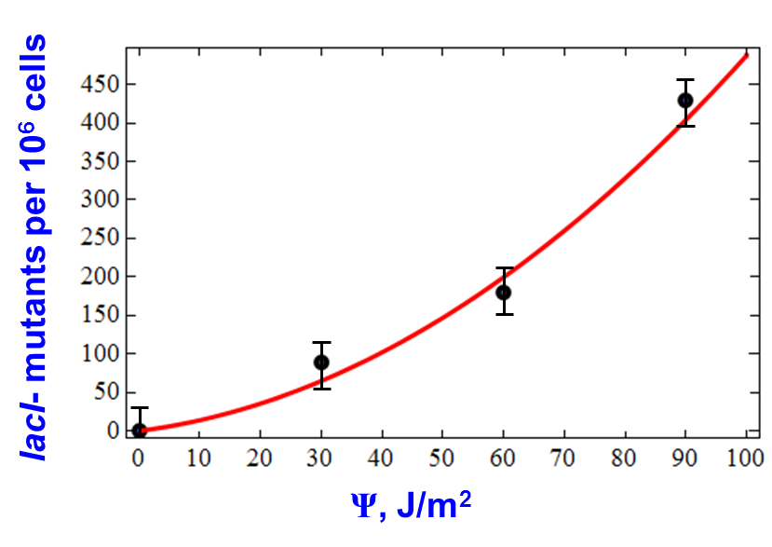
Sample results: Mutation frequency in bacteria
calculated results
experimental data [Oller et al., 1992]
/Belov et al., 2013/

Slide 21
Simulation of DNA double-strand break repair
Double strand break of DNA
Base damages
Sugar damage
Base damages
Particle track

Slide 22
Simulation of DNA double-strand break repair
Pathways to repair DNA double strand breaks
DNA double strand break repair
NHEJ
Alt-NHEJ
Non-homologous end joining
Alternative
end joining
HR
SSA + micro-SSA
Homologous recombination
Single-strand annealing

Slide 23
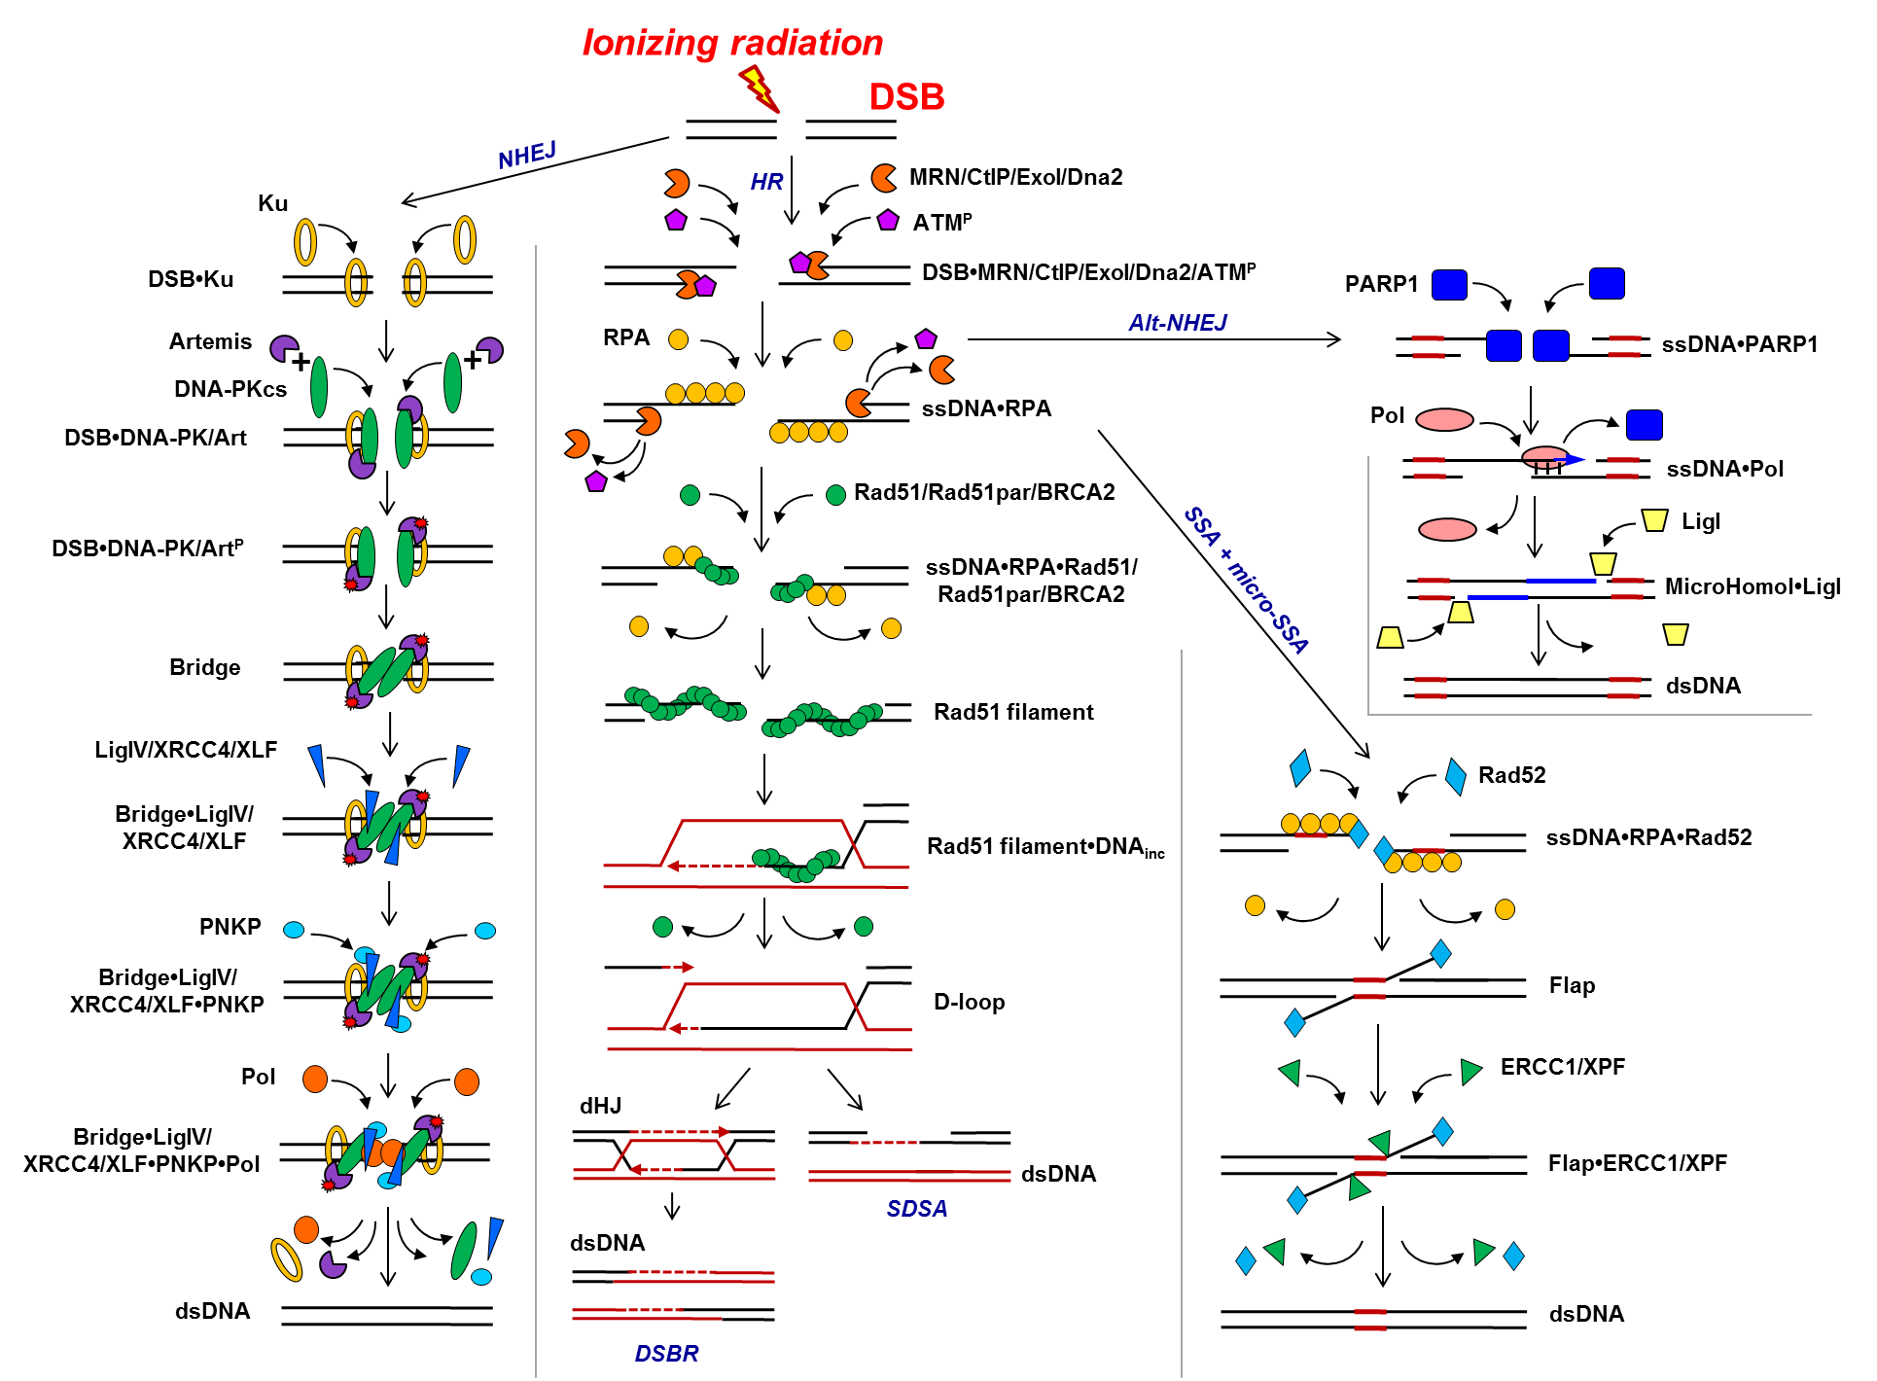
Scheme of the DNA double-strand break repair
/Belov et al., 2015/
Alt-NHEJ
NHEJ
HR
SSA
+
micro SSA

Slide 24
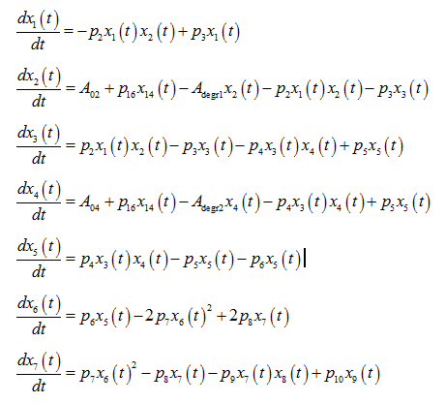
A computational model for DNA double-strand break repair
Sample system of equations:
IR
NHEJ
Double-strand break
Ku70/80
Ku binding
Artemis
DNA-PKcs
Recruitment of DNA-PCcs and Artemis
End bridging by DNA-PCcs and phosphorylation of Artemis
Ligase IV/XRCC4
PNK
Recruitment of ligase IV/XRCC4 and PNK
Pol X
Processing and gap filling
Sample initial conditions of the model:
Ligation

Slide 25
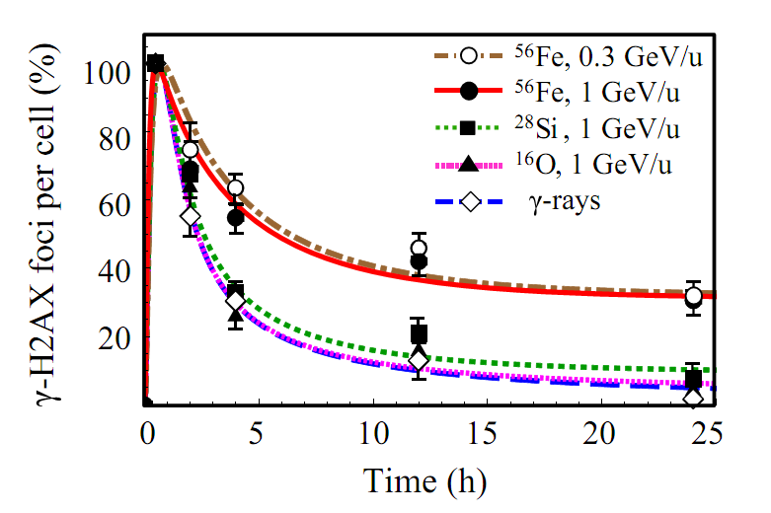
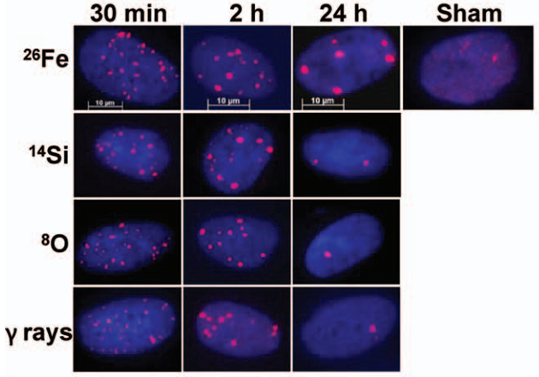
Time-course of DNA double-strand break repair
30 min 2 h 24 h Control
Fe
Si
O
γ-rays
⬄
Experimental data
/Asaithamby et al., 2008/
Time-courses of γ-H2AX remaining after exposure to 1 Gy of iron, silicon, oxygen particles and γ-rays. The curves are the calculated results; symbols are the experimental data referred to irradiation of human skin ﬁbroblasts (HSF42) (Asaithamby et al., 2008). The error bars represent SEM.
/Belov et al., 2015/

Slide 26

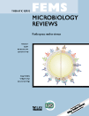


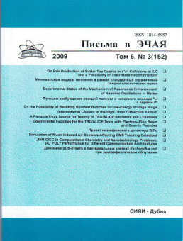
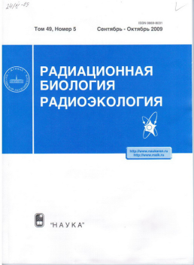

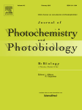
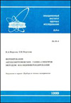
Simulation of DNA repair is an advanced technique
for radiation biophysics
Cited in:
IF: 13.806
IF: 6.092
IF: 3.960
…
IF: 2.892
…
Our papers

Slide 27
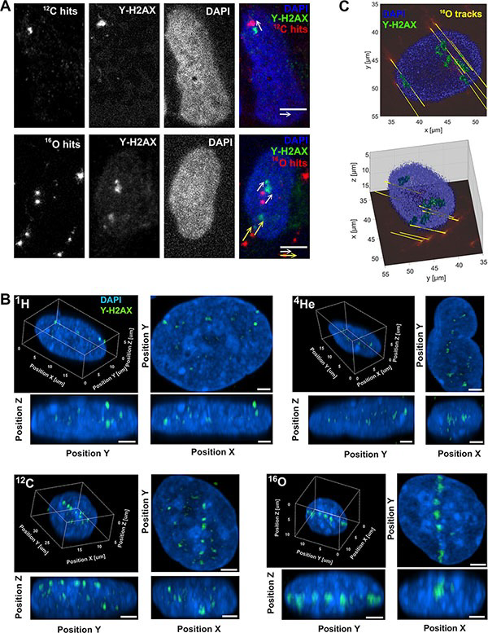
DNA damage imaging
Representative ¹⁶O and ¹²C particle traversals projection to the corresponding nuclear DNA-damage (DSB) marked by γ-H2AX foci (green) in the biological compartment
/Modified from Dokic et al., 2016/

Slide 28
State of the art in microdosimetry
of “complicated” cell structures

Slide 29
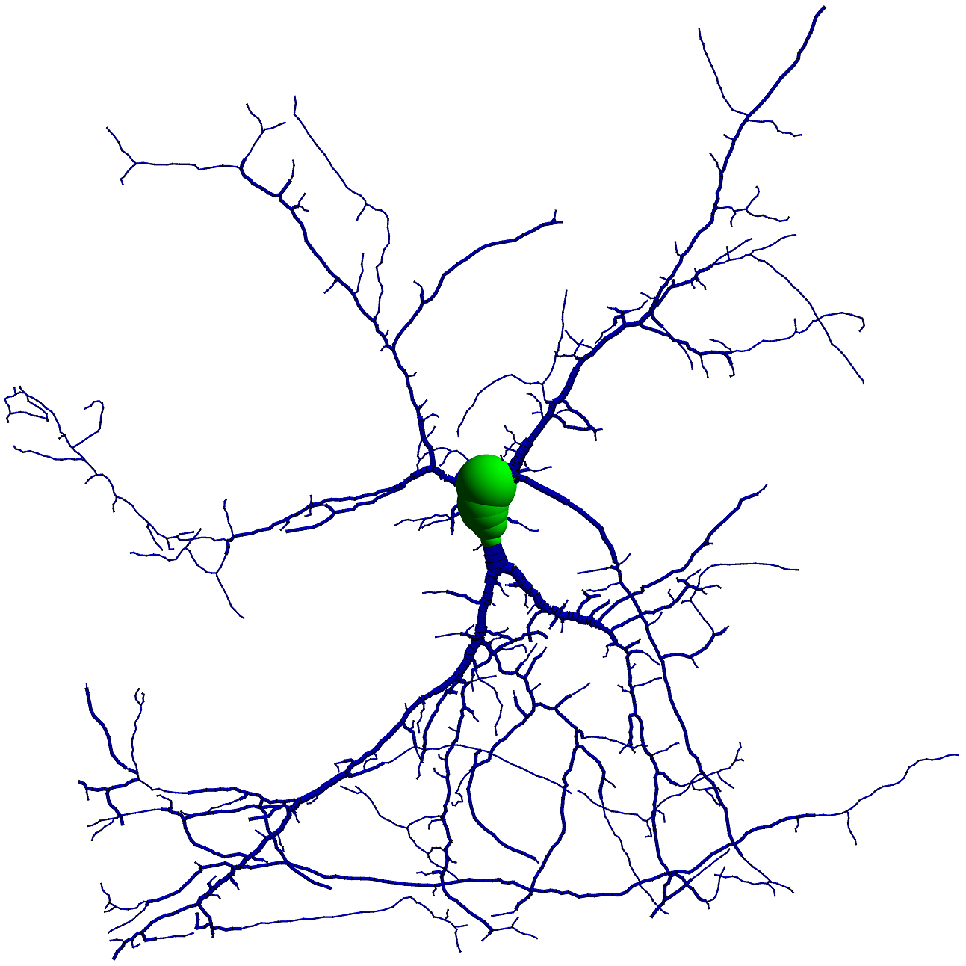
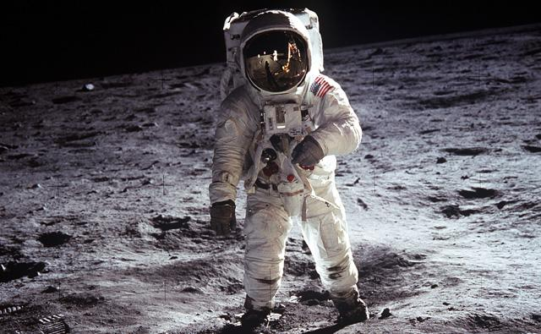
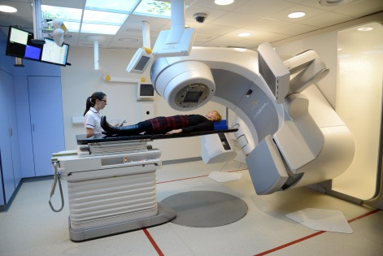
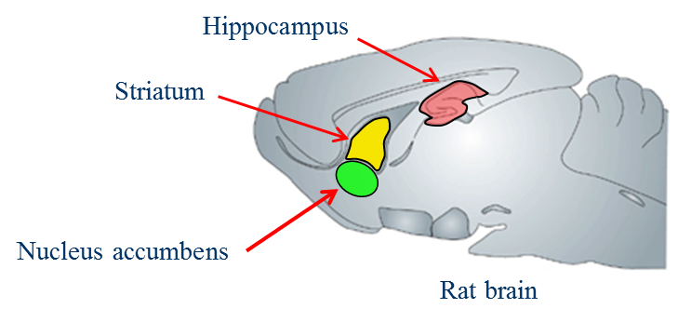
Simulation of radiation damage to neural cells
Radiation damage to the central nervous system (CNS) is a challenge
Particle traversals to neurons are the initial events of radiation damage to CNS, leading further to a variety of cognitive impairments
A neural cell is a complicate structure because of its intricate morphology
Simulation of radiation transport in neural cells is of great interest

Slide 30


Simulation tools
50 µm

Slide 31


A neural cell model in Geant4-DNA
A single pyramidal neuron in Geant4-DNA+GUI environment
Neuron model
290 MeV/u
carbon particle track

Slide 32


Sample results: Energy and dose deposition ‘maps’
290 MeV/u, 500 MeV/u carbon ions
600 MeV/u, 1000 MeV/u Iron ions
50 µm
M. Batmunkh, O. Belov, L. Bayarchimeg, O. Lhagva, N. Sweilam. Estimation of the spatial energy deposition in CA1 pyramidal neurons under exposure to ¹²C and ⁵⁶Fe ion beams // J.Rad.Res.App.Sci. 2015. V. 8. P. 498-507.

Slide 33

Sample result: Production of water radiolysis species
in neural cells
30 MeV proton
1000 MeV/u ⁵⁶Fe
A sample trajectory of a 30 MeV proton (a–c) and 1000 MeV/u ⁵⁶Fe ion (d–f) in dendritic branches of a selected pyramidal neuron, as viewed at 1 picosecond (a, d), 1 nanosecond (b, e), and 1 microsecond (c, f) after exposure. Each dot marks the location of a reactive chemical species. The different colours associated with the reactants are given in the legend on the right panel.
/Modified from Belov et al., 2016/

Slide 34
Thank you for your attention

Slide 35


Track segments method
by Howard-Flanders (1958)
Detailed track structure simulation
L = constant
particle path
track segment
n ionizations inside
Multi-target and multi-hit
formula (mid-1950s):
m is the number of targets,
n is the number of hits

