Slide 1


Carlo Vittorio Cannistraci
Machine Learning and Network Science
for systems and precision biomedicine
Biomedical Cybernetics Group
Biotechnology Center (BIOTEC)
Center for Molecular and Cellular Bioengineering (CMCB)
Center for Systems Biology Dresden (CSBD)
Department of Physics
Technische Universität Dresden (TUD)

Slide 2
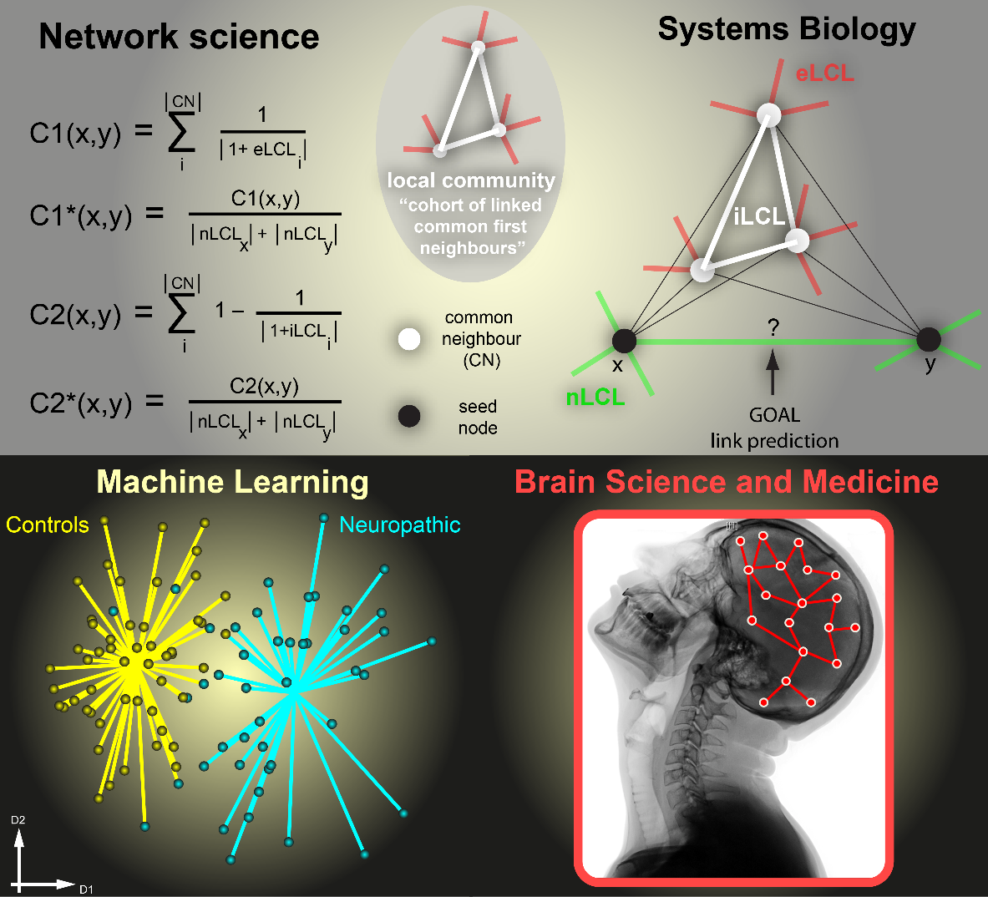
My Research
Machine Leaning
&
Information theory
Biomedical
Cybernetics
Group
Machine learning and complex-network science for personalized and systems biomedicine.
Physics of
Complex Systems
and
Networks
Systems Biology
&
Precision
Biomedicine
Multi-factors and multi-scale biomarkers in the gene/protein/lipid space for personalised therapeutical plans and individualised drug treatments
Notes:
The Biomedical Cybernetics Group that I recently established in Dresden, adopts a transdisciplinary approach integrating information theory, machine learning and network science to investigate the physics of adaptive processes that characterize complex interacting systems at different scales, from molecules to ecosystems, with a particular attention to biology and medicine.
Our theoretical effort is to translate advanced mathematical paradigms typically adopted in theoretical physics (such as topology and manifold theory) to characterize many-body interactions in quantitative biomedicine.

Slide 3
Initial acknowledgments

Slide 4
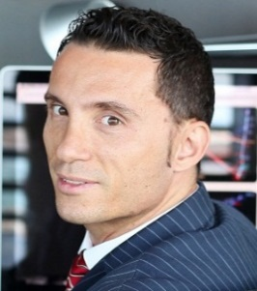
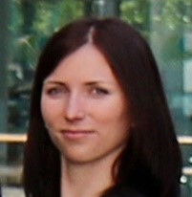
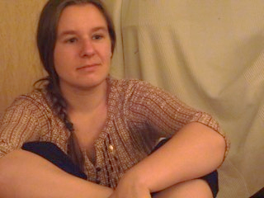

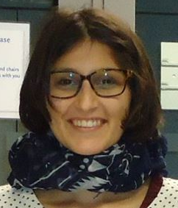
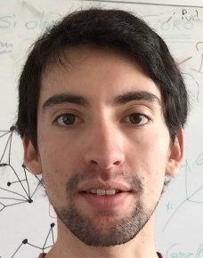
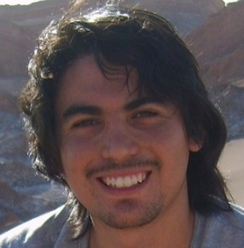
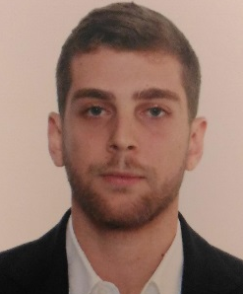

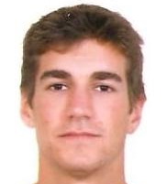
The Group
+ 6 PhD + 2 Post Doc + 1 Master Student
Administration
Complex Network Theory
Machine Learning Theory
Claudia
Phine
Alessandro
Sara
Claudio
Administrative
assistant
PhD student
PhD student
PhD student
PhD student
Aldo
Alberto
Ali
Yan
Victor
Lipidomics
PhD Student
Post Doc
PhD Student
Post Doc
Master Student
Gut-Brain interaction
Microbiota and Metabolomics
Brain Networks
Network and Systems Mechanomics

Slide 5




Acknowledgments
- Lipotype (Germany)
- Politecnico di Torino and Milano (Italy)
- Italian Interpolytechnic School of Doctorate (SIPD, Italy)
- San Raffaele Scientific Institute, Hospital and University (Italy)
- King Abdullah University of Science and Technology (KAUST, Saudi Arabia)
- University of California San Diego/ Ideker Lab (USA)
- ISMB/ECCB generously provided me (International)
- Italian National Research Council (CNR) / Bioengineering (Italy)
- Technical University Dresden (Germany)
- Klaus Tschira Foundation (Germany)
- FANTOM Consortium and RIKEN institute (Japan)
Franco Maria Montevecchi
Antonio Malgaroli
Massimo Alessio
Enrico Ammirati
Antonio Zippo
Trey Ideker
Timothy Ravasi
Gregorio Alanis-Lobato
Vladimir Bajic
Tanja Kunej
Pierre Magistetti
Michael Schroeder
Notes:
Yaser S. Abu-Mostafa

Slide 6
Machine Learning meets Network science

Slide 7
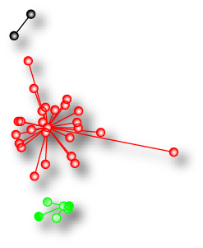
Goal: analysis of patterns
genes, proteins, lipids, metabolites
1 2 … … m>>n
Visualization & discrimination dimensionality reduction of the dataset in a 2D space
Unsupervised classification grouping the samples present in the dataset in homogeneous classes
1
...
…
n
samples
dimension reduction
and
clustering
D2
D1

Slide 8
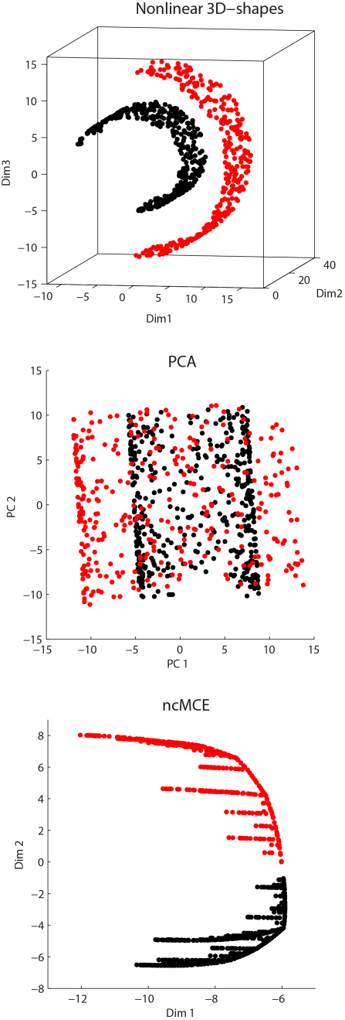
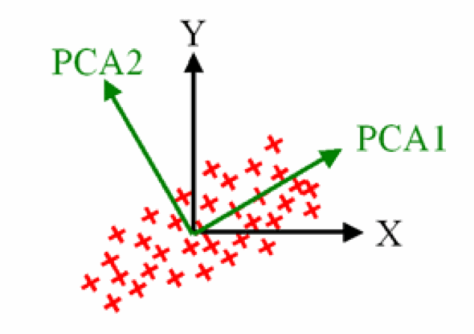

Slide 9
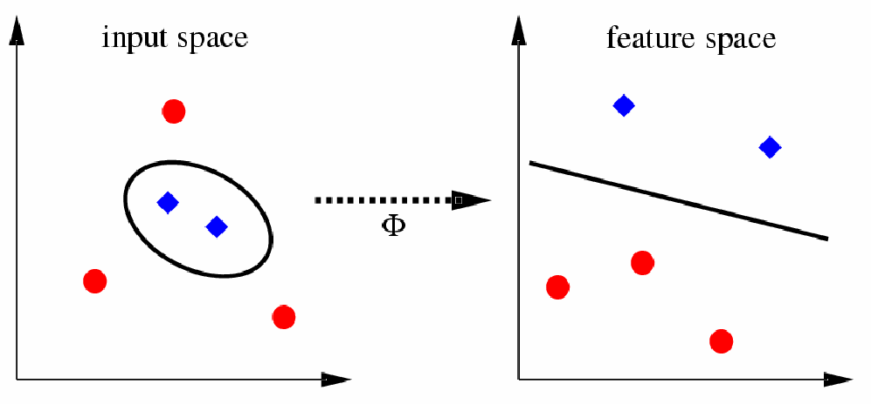
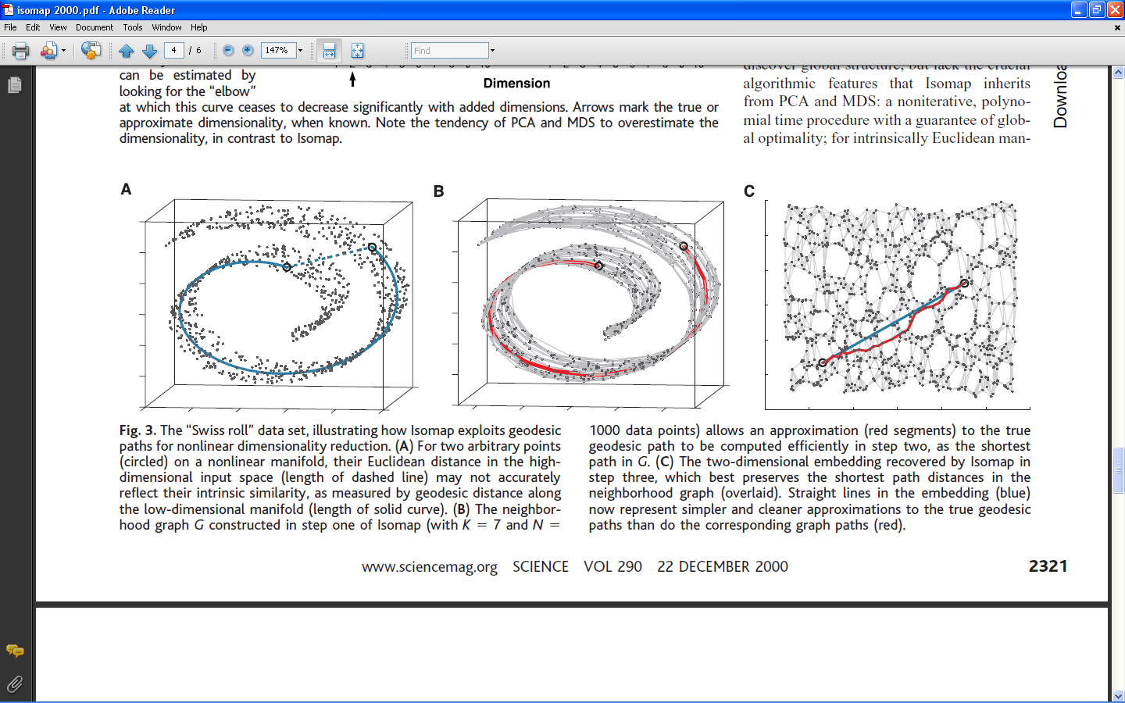
Nonlinear Dimension Reduction
z
Kernel based
{example: Gaussian-PCA}
Manifold based
{example: Isomap}
y
x
y
x
Tenenbaum et al. – Science, 2000
Issue 3: Hypothesis of local continuity of the manifold
Issue 4: presence of free parameters to tune!!!

Slide 10
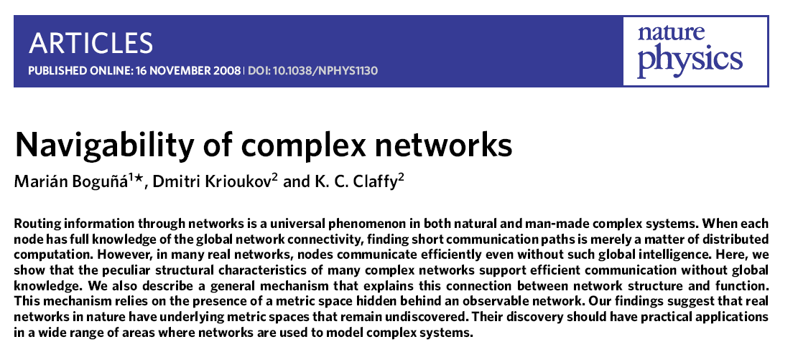
The inspiration (2008)

Slide 11
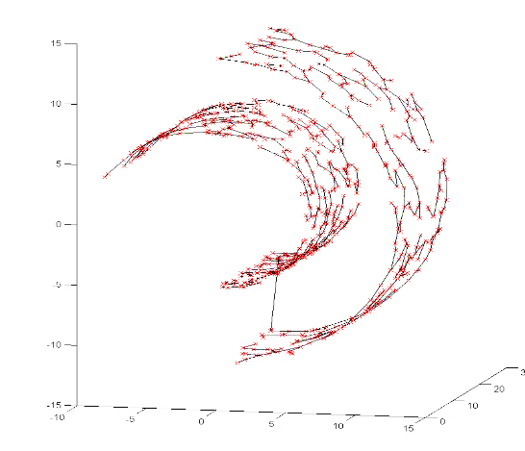
Nonlinear topological-based Dimension Reduction
Isomap
(manifold embedding)
Minimum Curvilinear embedding (MCE)
(hierarchical embedding)

Slide 12
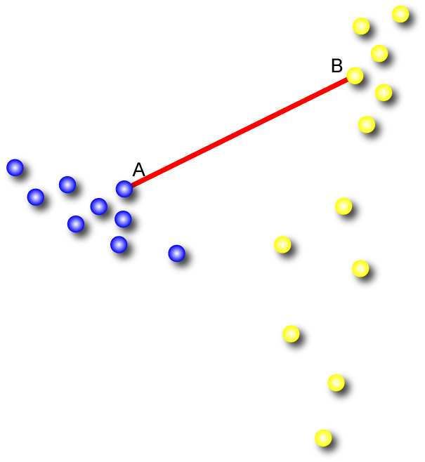
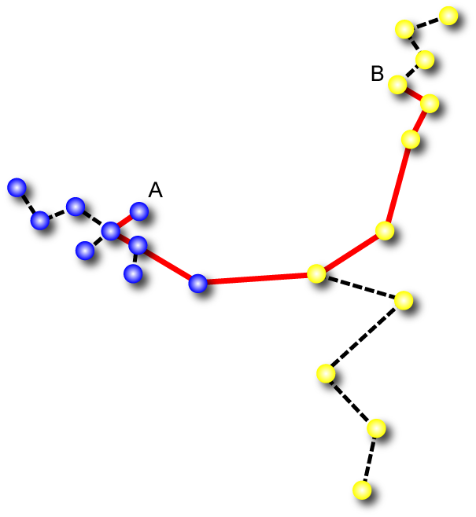
How MC works: Navigating between the points with a greedy routing process: the minimum spanning tree (MST)!
Euclidean Distance
MC ‘Distance’
MC Distance
Matrix
B
V2
-
- | -
- | - | -
- | - | - | -
A
V1
The greedy routing navigability is a way to map the hidden nonlinear topology
For MC: The global mapping and the local fitting are reciprocally dependent
MC Minimize globally and fit locally!

Slide 13
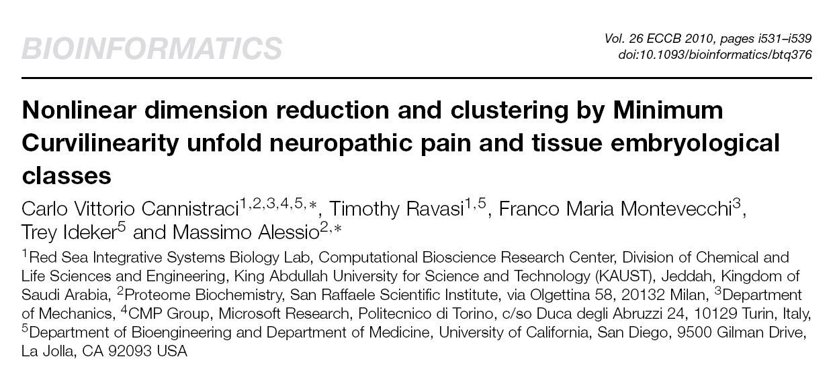
ECCB 2010, Ghent, Belgium

Slide 14
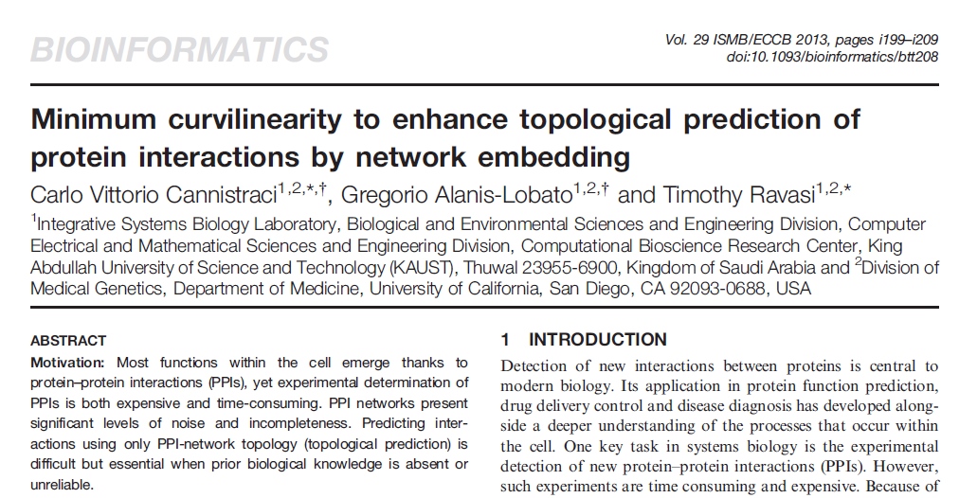
ISMB/ECCB 2013 , Berlin, Germany, July 2013

Slide 15
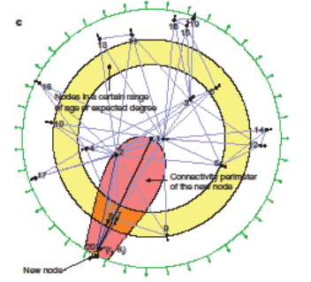
2012
Notes:
The PSO model suggests that real networks have a congruous geometrical representation in a hyperbolic space, where each network node is mapped according to the angular and the radial
coordinates of a polar system. The node similarities are related with the angular distances in the hyperbolic space: the higher the similarity between two nodes, the closer their angular
coordinates. On the other hand, the node degree is related with the intrinsic popularity of the node: the higher the node degree, the higher its popularity in the network and the lower its
radial coordinate in the hyperbolic space.
Here we show that the causal network representing the large-scale structure of spacetime in our accelerating universe is a power-law graph with strong clustering, similar to many complex networks
such as the Internet, social, or biological networks.
Gamma=1 + 1/beta where beta is popularity fading

Slide 16

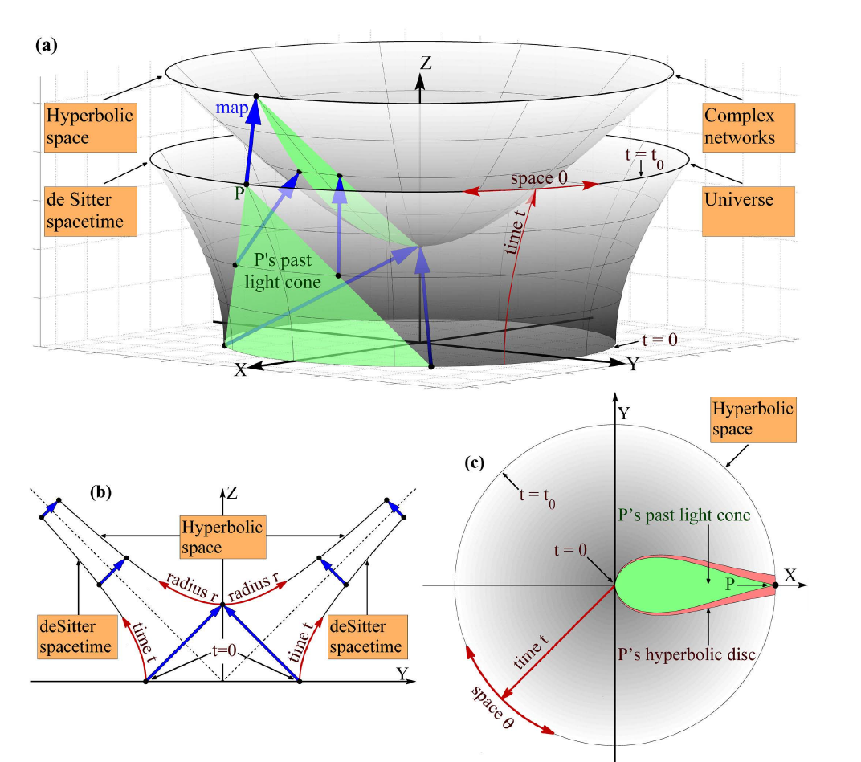
2012
2012
Notes:
The PSO model suggests that real networks have a congruous geometrical representation in a hyperbolic space, where each network node is mapped according to the angular and the radial
coordinates of a polar system. The node similarities are related with the angular distances in the hyperbolic space: the higher the similarity between two nodes, the closer their angular
coordinates. On the other hand, the node degree is related with the intrinsic popularity of the node: the higher the node degree, the higher its popularity in the network and the lower its
radial coordinate in the hyperbolic space.
Here we show that the causal network representing the large-scale structure of spacetime in our accelerating universe is a power-law graph with strong clustering, similar to many complex networks
such as the Internet, social, or biological networks.
Gamma=1 + 1/beta where beta is popularity fading

Slide 17
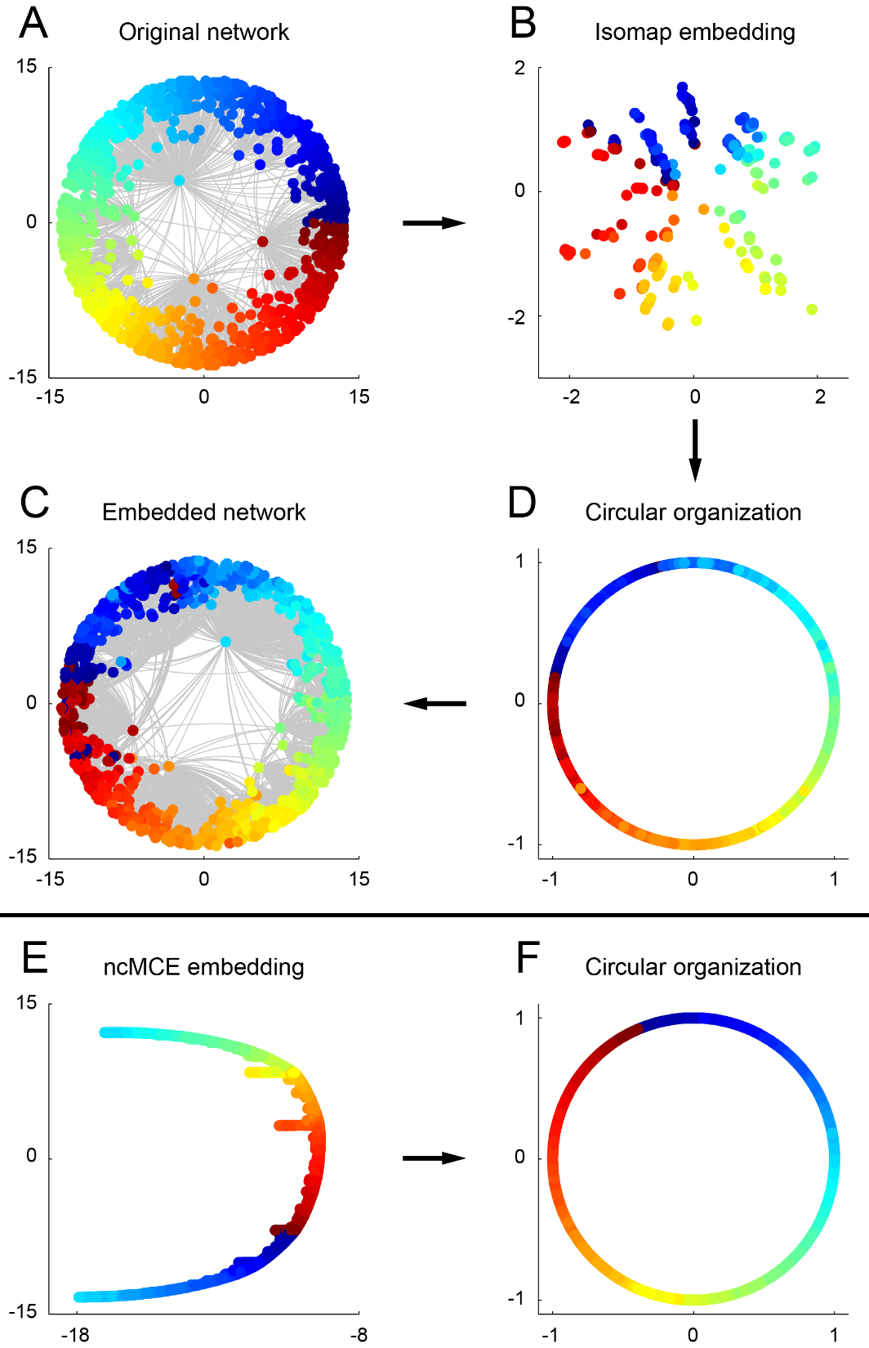
The intuition (2012)
Original Network
Isomap
(manifold embedding)
MCE
(hierarchical embedding)

Slide 18
Linear Dimension Reduction: cannot work!

Slide 19
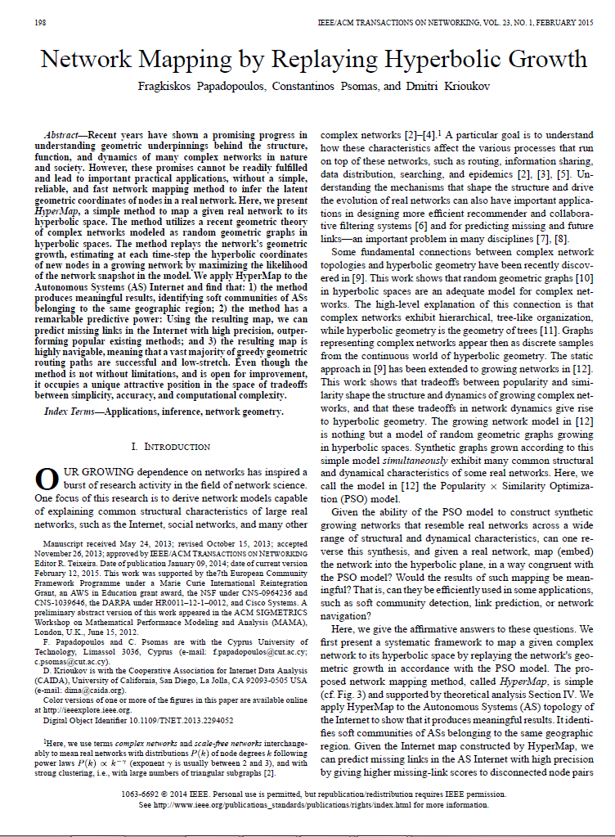
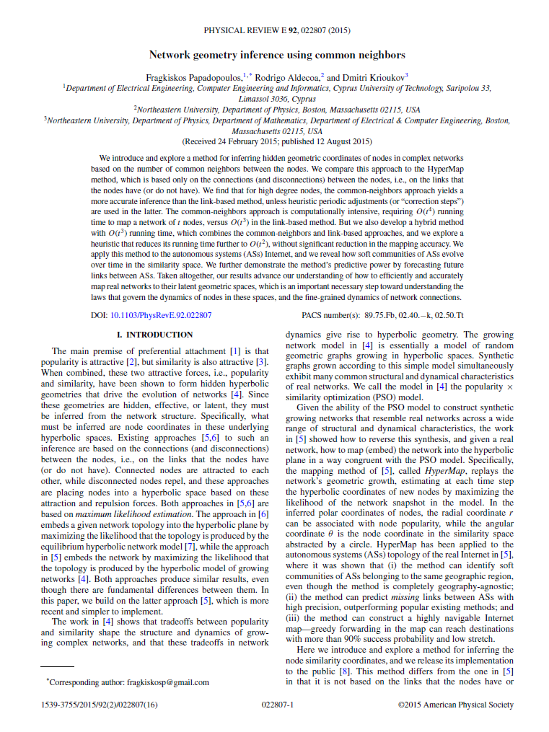
2015
Based on MLE
2015
Notes:
HyperMap
HyperMap ² is a method based on Maximum Likelihood Estimation to map a network into its hyperbolic space. It replays the hyperbolic growth of the network and at each step it finds the polar coordinates of the added node by maximizing the likelihood that the network was produced by the E-PSO model ².
For curvature $K=−1$ the procedure is as follows: (1) Nodes are sorted decreasingly by degree and then labeled $i=1, 2,…,N$ according to the order; (2) Node $i=1$ is born and assigned radial coordinate $r_{1}=0$ and a random angular coordinate $θ_{1}∈[0, 2π]$; (3) For each node $i=2, 3,…,N$ do: (3.a) Node $i$ is added to the network and assigned a radial coordinate $r_{i}=2\ln{(i)}$; (3.b) The radial coordinate of every existing node $j<i$ is increased according to $r_{j}(i)=βr_{j}+(1−β)r_{i}$; (3.c) The node $i$ is assigned an angular coordinate by maximizing the likelihood $L_{i}=\prod_{l≤j<i}{{p(h}_{ij})^{x_{ij}}(1−p(h_{ij}))^{1−x_{ij}}}$, where $β$ and $p(h_{ij})$ are the same as in the PSO model and $x_{ij}$ is the adjacency matrix. The maximization is done by numerically trying different angular coordinates in steps of $2π/N$ and choosing the one that leads to the biggest $L_{i}$.

Slide 20
Issues:
O(n³) or O(n⁴)
Unweighted networks
Only 2D embedding

Slide 21
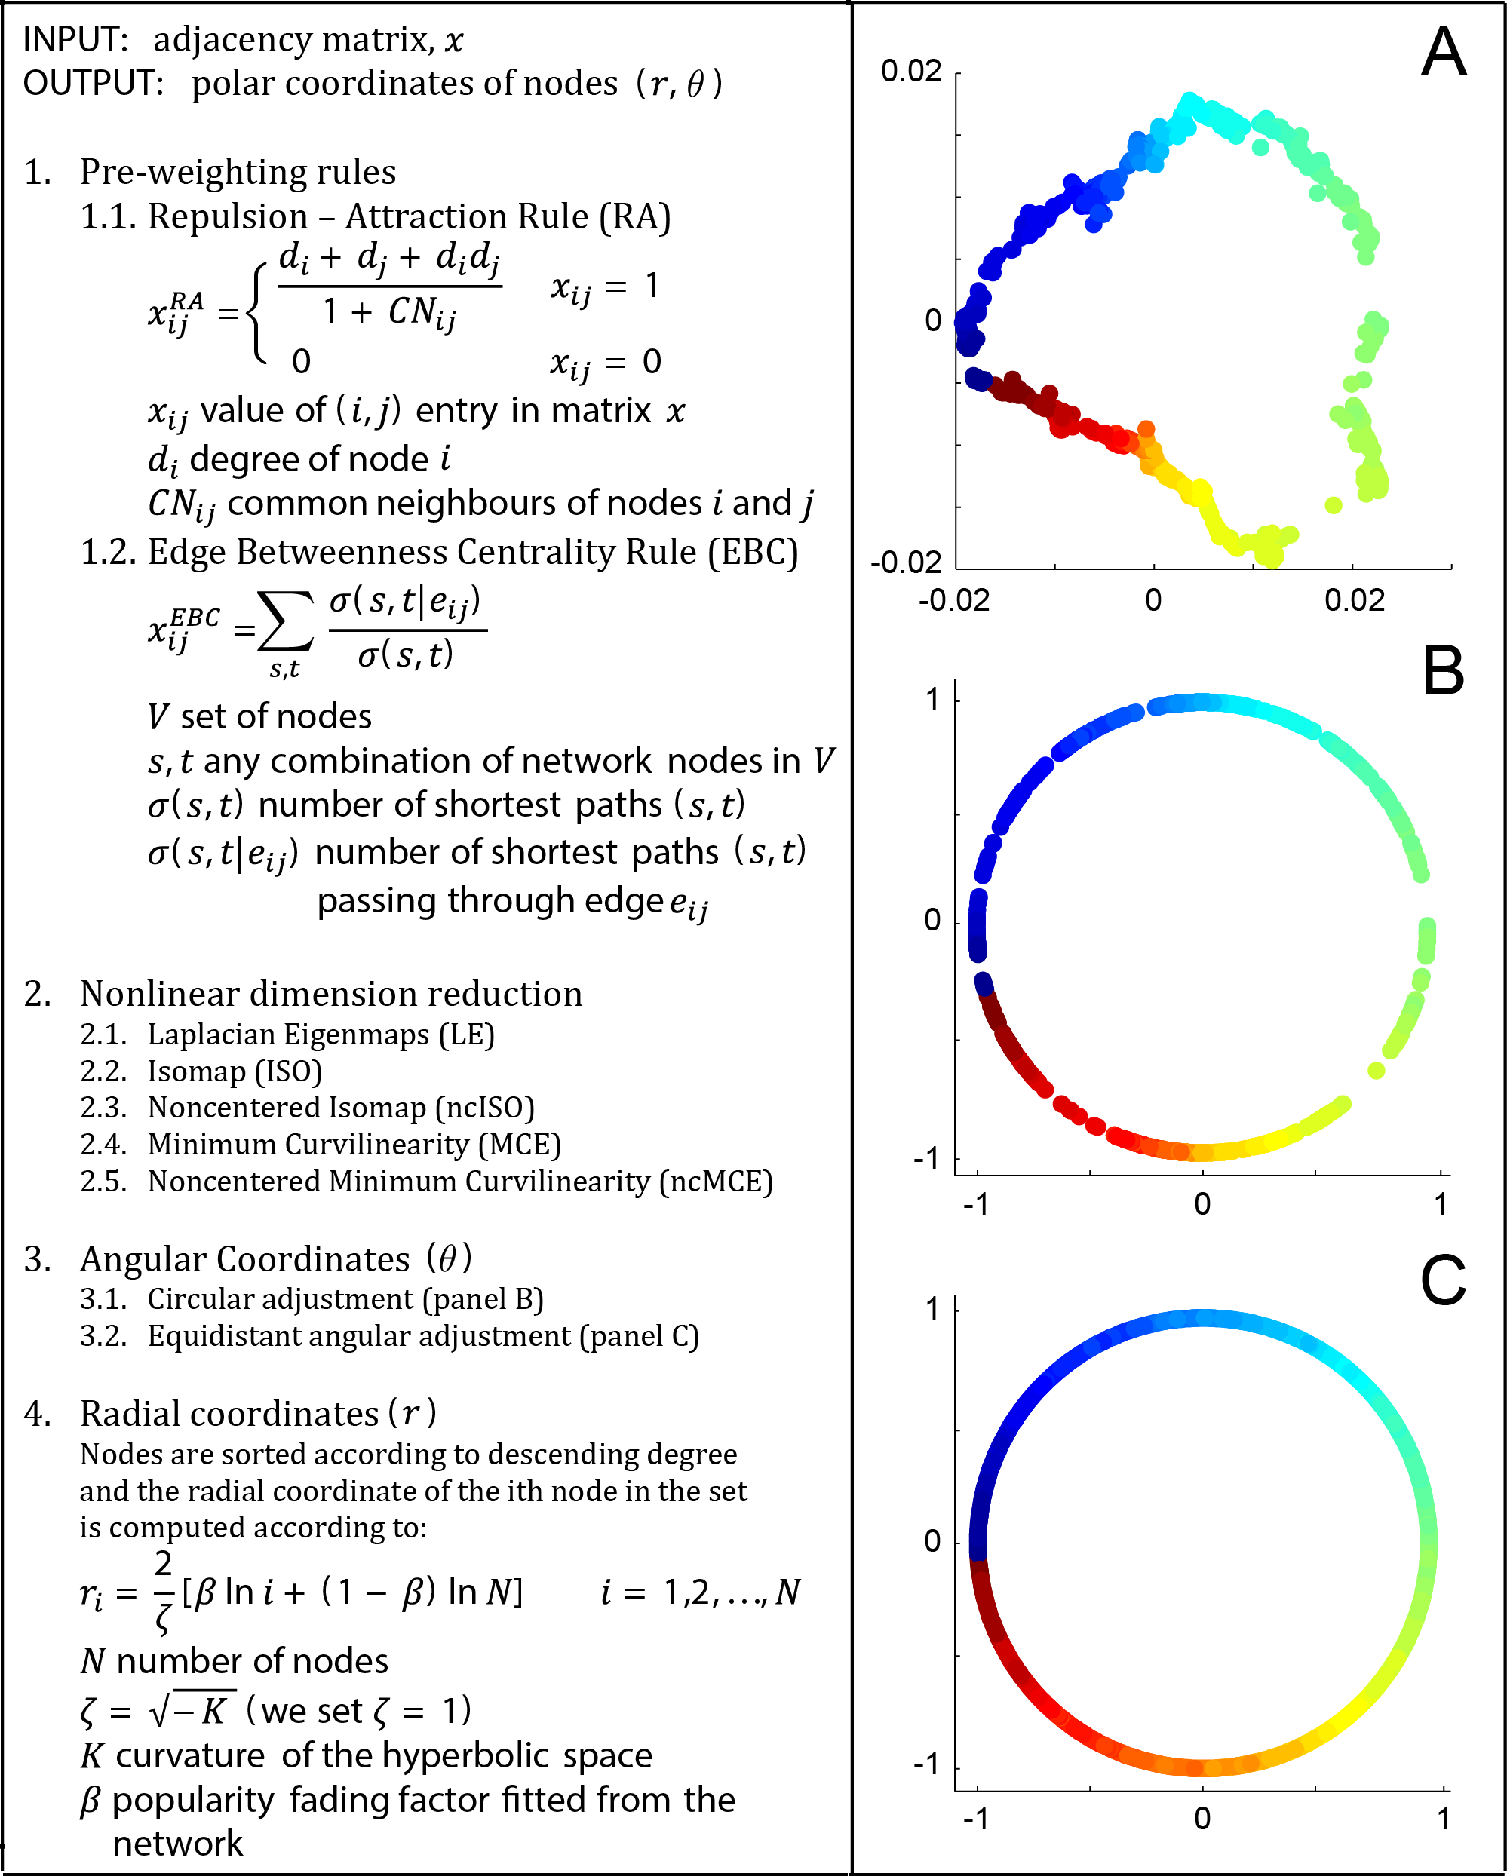

Slide 22
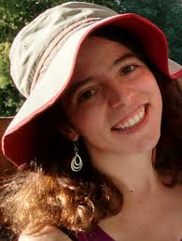
Machine learning meets complex networks: coalescent embedding
of networks in the hyperbolic space
Machine Learning
Theory
Complex Network Theory
Theoretical Physics
Phine
Alessandro
Sara
Ginestra Bianconi
PhD student
PhD student*
PhD student
Professor

Slide 23
Embedding in 2D

Slide 24
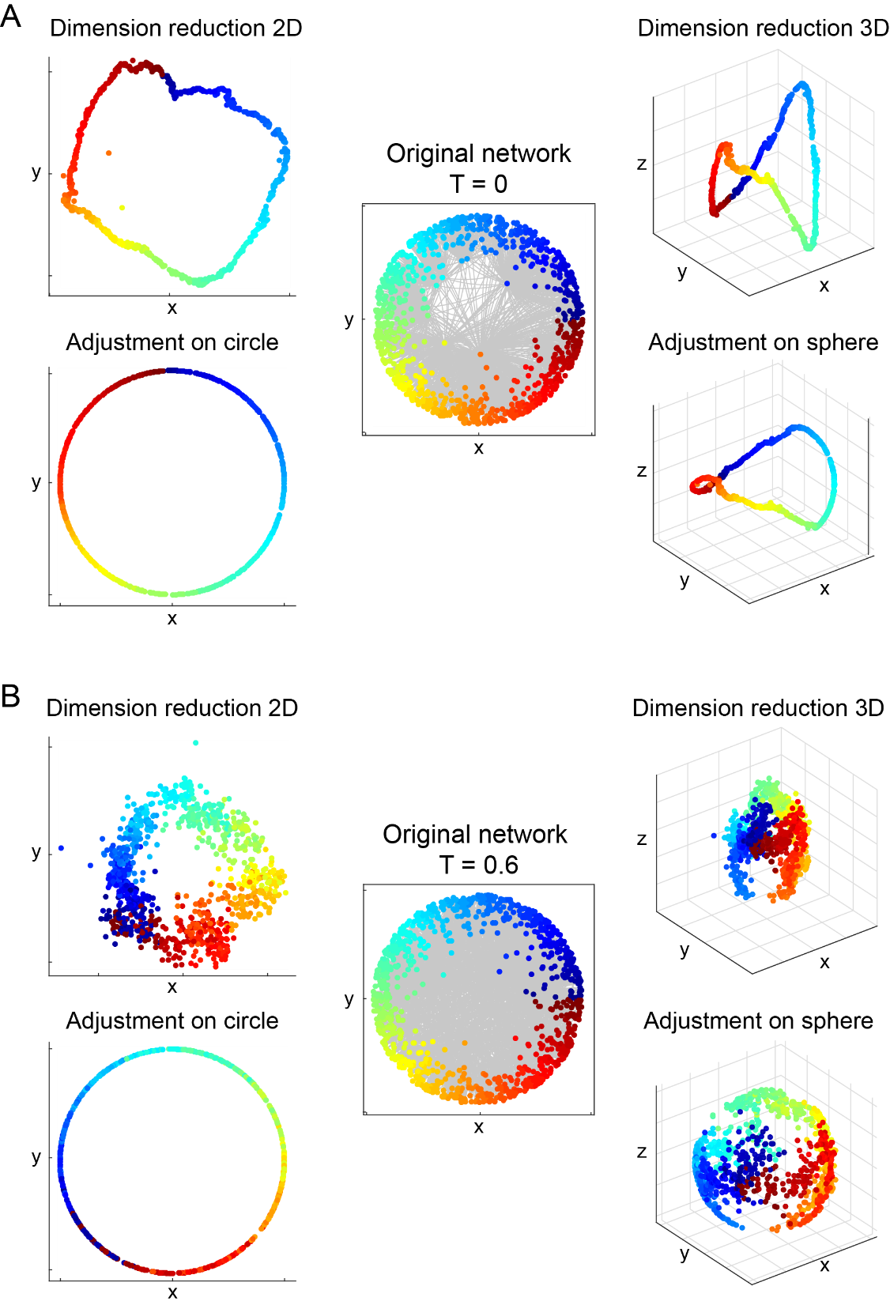
Embedding in 3D

Slide 25
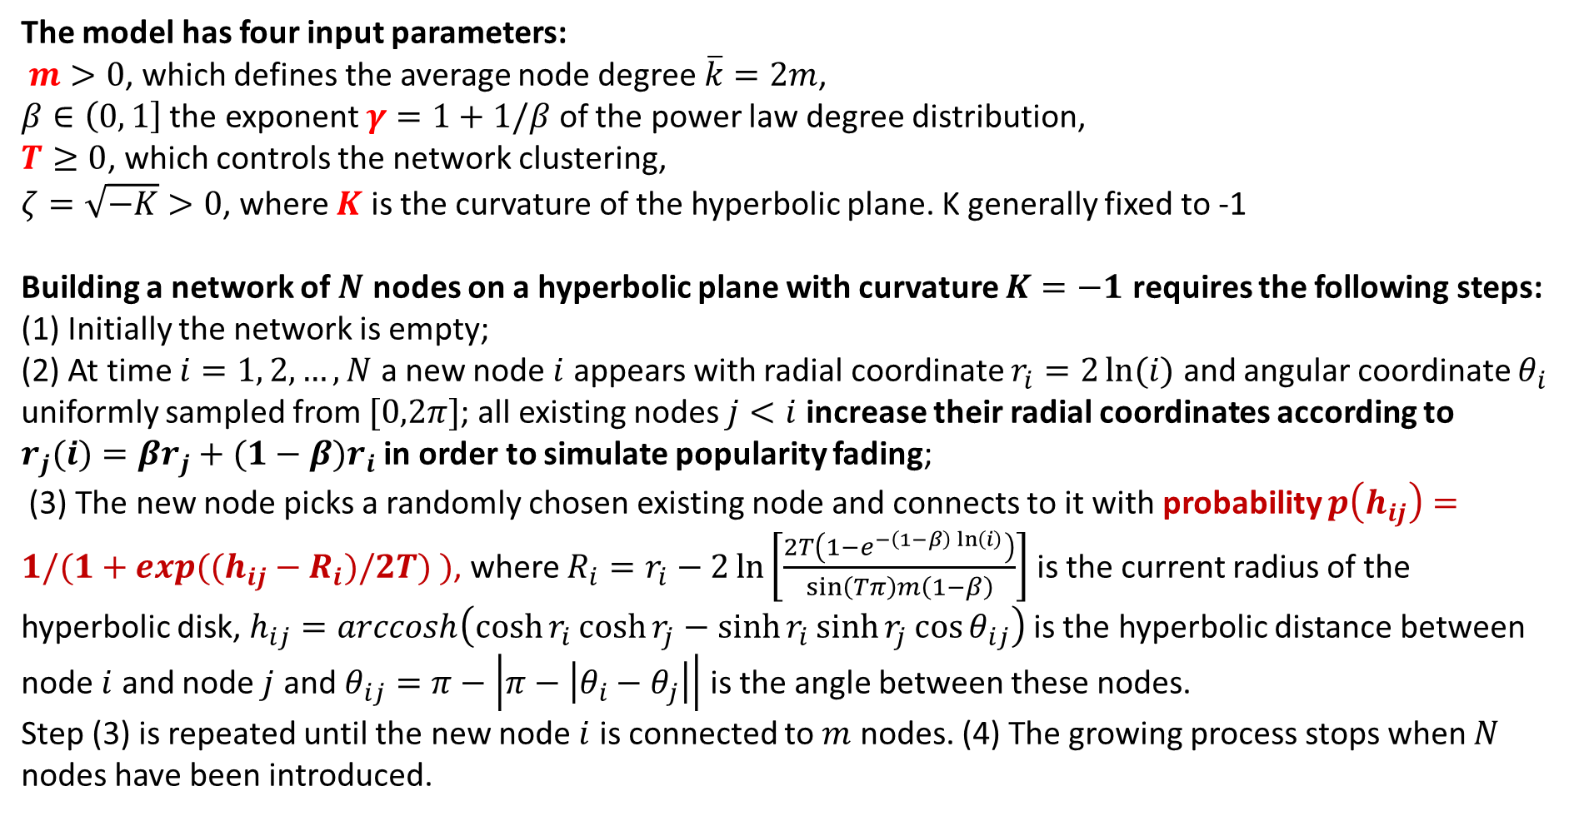
Generation of synthetic networks by the PSO model
The model has four input parameters:
$m>0$, which defines the average node degree $\overline{k}=2m$,
$β∈\left(0, 1\right]$ the exponent $γ=1+1/β$ of the power law degree distribution,
$T≥0$, which controls the network clustering,
$ζ=\sqrt{−K}>0$, where $K$ is the curvature of the hyperbolic plane. K generally fixed to -1
Building a network of $N$ nodes on a hyperbolic plane with curvature $K=−1$ requires the following steps:
(1) Initially the network is empty;
(2) At time $i=1, 2,…,N$ a new node $i$ appears with radial coordinate $r_{i}=2\ln{(i)}$ and angular coordinate $θ_{i}$ uniformly sampled from $[0,2π]$; all existing nodes $j<i$ increase their radial coordinates according to $r_{j}(i)=βr_{j}+(1−β)r_{i}$ in order to simulate popularity fading;
(3) The new node picks a randomly chosen existing node and connects to it with probability $p\left(h_{ij}\right)=1/(1+exp((h_{ij}−R_{i})/2T) )$, where $R_{i}=r_{i}−2\ln\left[\frac{2T\left(1−e^{−\left(1−β\right)\ln\left(i\right)}\right)}{\sin\left(Tπ\right)m\left(1−β\right)}\right]$ is the current radius of the hyperbolic disk, $h_{ij}=arccosh\left(\cosh{r_{i}}\cosh{r_{j}}−\sinh{r_{i}}\sinh{r_{j}}\cos{θ_{ij}}\right)$is the hyperbolic distance between node $i$ and node $j$ and $θ_{ij}=π−\left|π−\left|θ_{i}−θ_{j}\right|\right|$ is the angle between these nodes.
Step (3) is repeated until the new node $i$ is connected to $m$ nodes. (4) The growing process stops when $N$ nodes have been introduced.
Notes:
Generation of synthetic networks by the PSO model
The synthetic networks used in the simulations have been created according to the PSO model ¹, which describes how random geometric graphs grow in the hyperbolic space. The model has four input parameters: $m>0$, which defines the average node degree $\overline{k}=2m$, $β∈(0, 1]$, defining the exponent $γ=1+1/β$ of the power law degree distribution, $T≥0$, which controls the network clustering, and $ζ=\sqrt{−K}>0$, where $K$ is the curvature of the hyperbolic plane. The network clustering is maximized at $T=0$, it decreases almost linearly for $T=[0,1)$ and it becomes asymptotically zero if $T>1$.
Building a network of $N$ nodes on a hyperbolic plane with curvature $K=−1$ requires the following steps: (1) Initially the network is empty; (2) At time $i=1, 2,…,N$ a new node $i$ appears with radial coordinate $r_{i}=2\ln{(i)}$ and angular coordinate $θ_{i}$ uniformly sampled from $[0,2π]$; all existing nodes $j<i$ increase their radial coordinates according to $r_{j}(i)=βr_{j}+(1−β)r_{i}$ in order to simulate popularity fading; (3) The new node picks a randomly chosen existing node and connects to it with probability $p\left(h_{ij}\right)=1/(1+exp((h_{ij}−R_{i})/2T) )$, where $R_{i}=r_{i}−2\ln\left[\frac{2T\left(1−e^{−\left(1−β\right)\ln\left(i\right)}\right)}{\sin\left(Tπ\right)m\left(1−β\right)}\right]$ is the current radius of the hyperbolic disk, $h_{ij}=arccosh\left(\cosh{r_{i}}\cosh{r_{j}}−\sinh{r_{i}}\sinh{r_{j}}\cos{θ_{ij}}\right)$is the hyperbolic distance between node $i$ and node $j$ and $θ_{ij}=π−\left|π−\left|θ_{i}−θ_{j}\right|\right|$ is the angle between these nodes. Step (3) is repeated until the new node $i$ is connected to $m$ nodes. (4) The growing process stops when $N$ nodes have been introduced.
In this model networks evolve optimizing a trade-off between node popularity, abstracted by the radial coordinate, and similarity, represented by the angular coordinate, and they exhibit many common structural and dynamical characteristics of real networks.

Slide 26
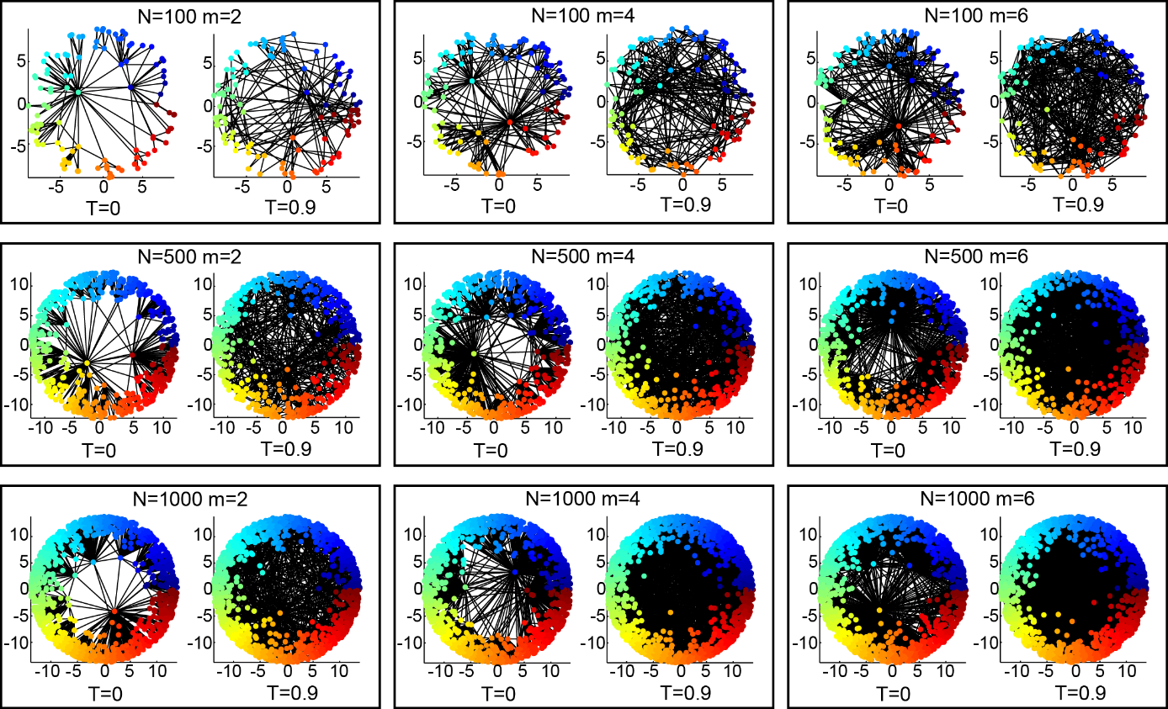

Slide 27
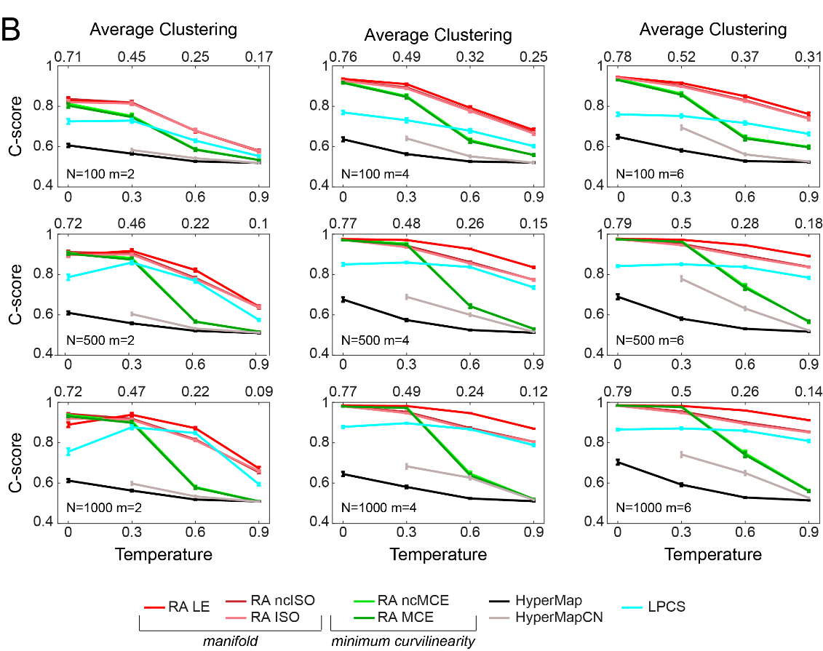
Proportion of node pairs that have correct angular ordering in the inferred models

Slide 28
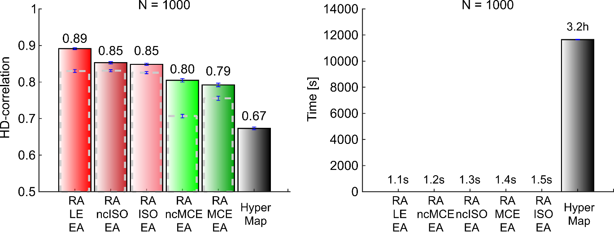
Computational time
O(N²)

Slide 29
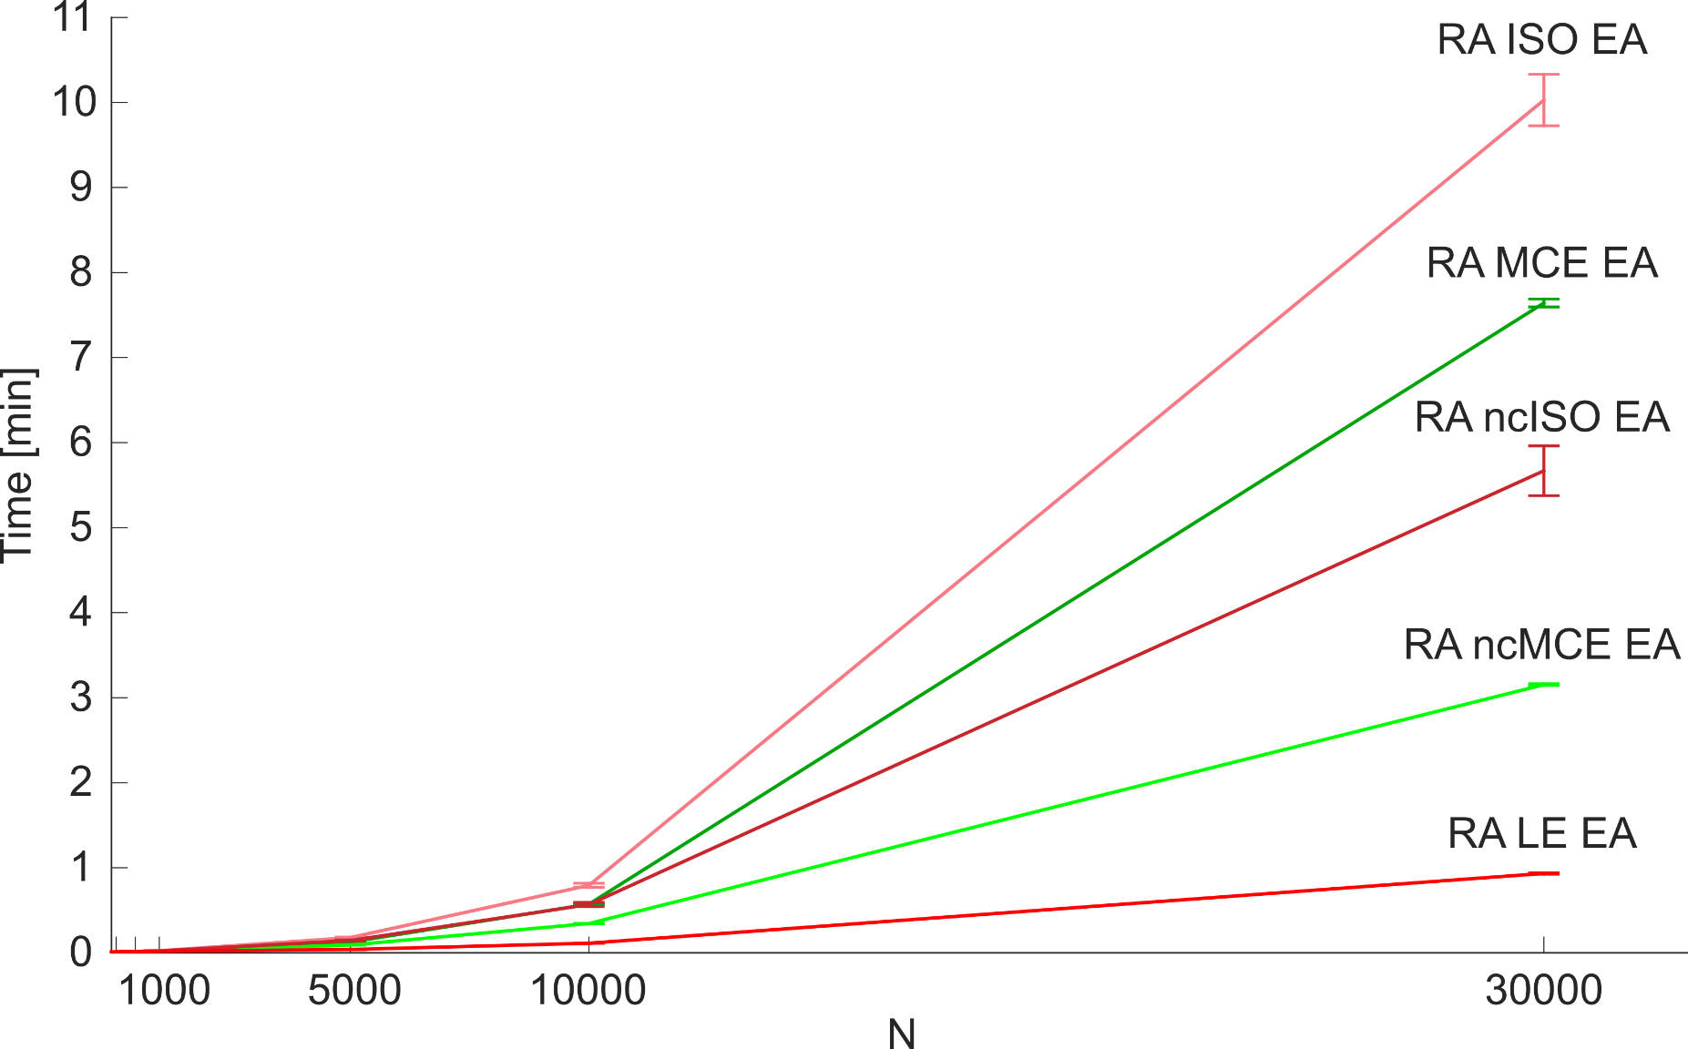
Computational time O(N²)

Slide 30
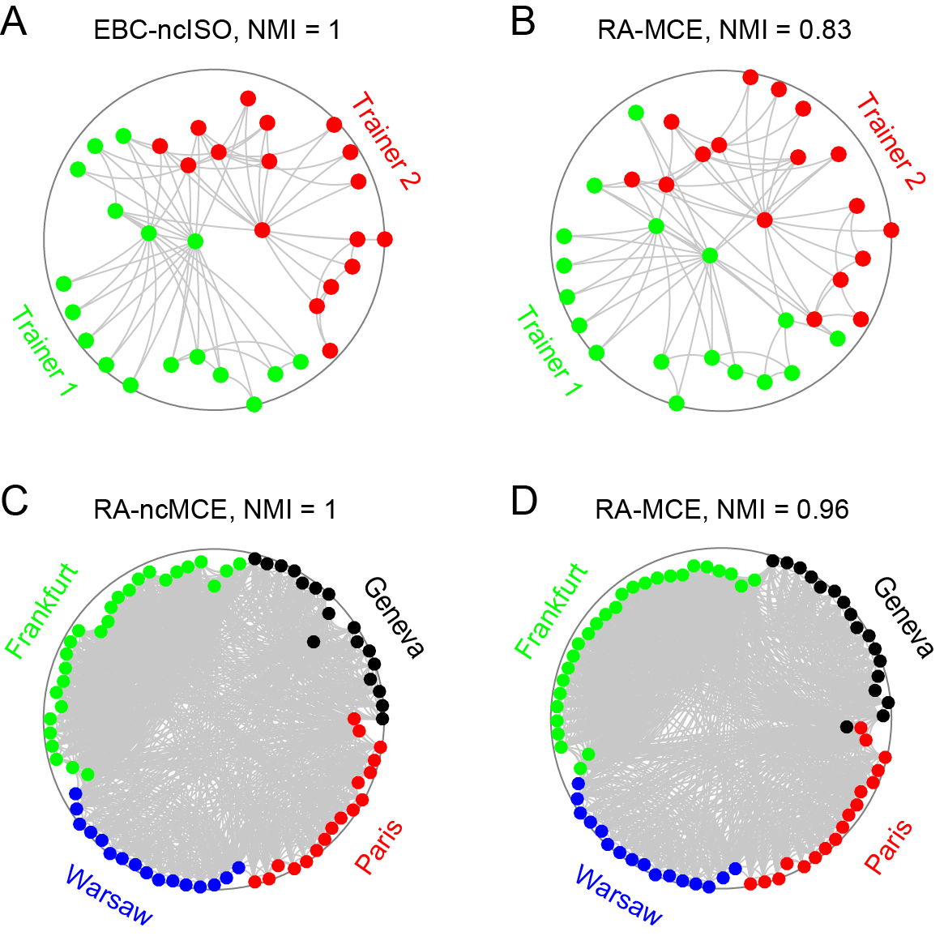
Community arrangment
Karate
Opsahl
11
Notes:
Figure. 6. Communities in Karate and Opsahl_11 networks. (A) and (B) show the Karate network embedded with EBC-ncISO-EA and RA-MCE-EA. The network represents the friendship between the members of a university karate club in the US. The two real communities are highlighted, they are formed by a split of the club into two parts, each following one trainer. The NMI obtained by the Louvain community detection algorithm is reported, where the embedding coordinates were used to weight the input matrix: observed links are weighted using the hyperbolic distances between the nodes and non-observed links using the hyperbolic shortest paths (see Methods for details). NMI is the normalized mutual information and represents the shared information between two distributions, normalized between 0 and 1, where 1 indicates that the communities detected by the algorithm perfectly correspond to the ground truth communities (see Methods for details). (C) and (D) show the Opsahl_11 network embedded with RA-ncMCE-EA and RA-MCE-EA. This is a type of intra-organisational network where a link indicates that the connected employees have both awareness of each other’s knowledge and skills on the job. The four real communities are highlighted, they are related with the location of the employers. All the approaches here adopted are adjusted according to EA strategy, although this is not explicitly reported in the subtitles for brevity. Note that the angular coordinates of the embedding in (B) and (D) have been aligned for a better visualization respectively to the ones in (A) and (C), as described for the scatterplots in Fig. 4A.

Slide 31
Conclusions
O(n³) or O(n⁴) → O(n²)
Unweighted networks → Weighted networks
Only 2D embedding → also 3D or any dimensional space
Community detection in the hyperbolic space algorithms

Slide 32
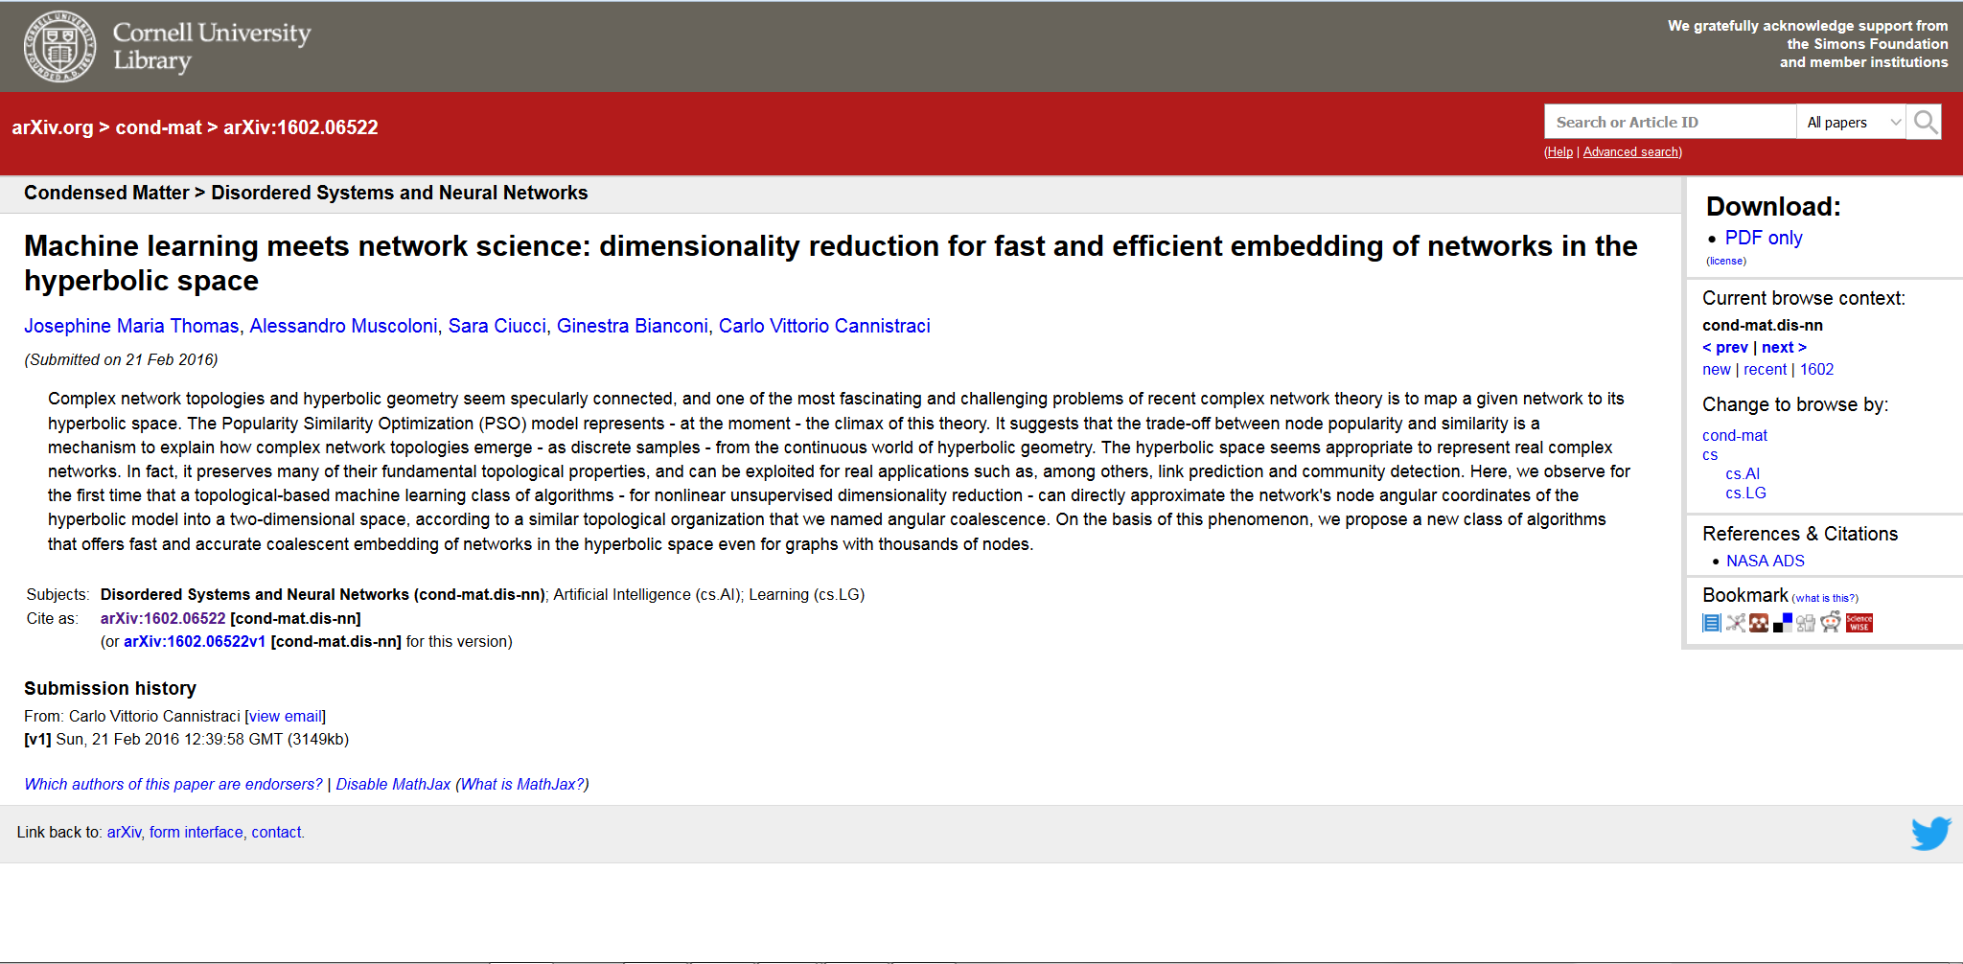


Slide 33
Network neuroscience application

Slide 34
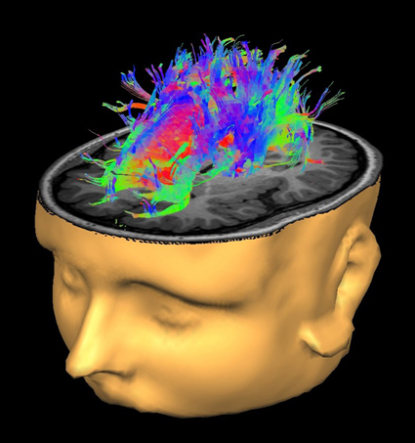
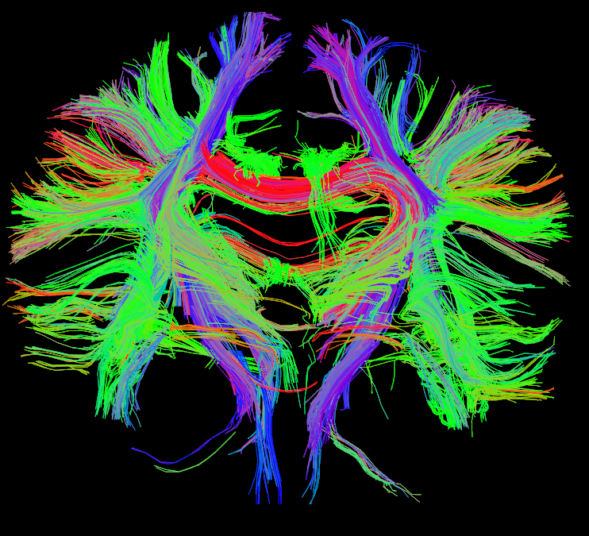
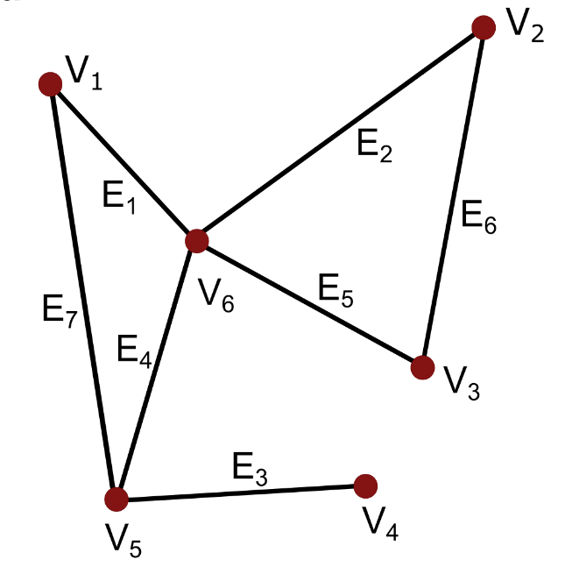
Human brain diffusion tensor imaging (DTI-MRI) structural connectomes
Notes:
Research Technology
We currently use structural magnetic resonance imaging (MRI), functional magnetic resonance imaging (fMRI), diffusion tensor imaging (DTI), and magnetoencephalography (MEG) to study the functional and structural determinants of movement recovery after stroke. We have also developed a set of sensors for measuring hand motion during imaging studies.
Structural Magnetic Resonance Imaging (MRI)
Magnetic resonance imaging can be used to obtain high-resolution images of the anatomy of the brain. We use these images to build a model of each subject's cortex and combine these cortical models together with images of brain activity (see fMRI) to localize sites of activity. In our laboratory, we also use structural images to measure the thickness of the cortex. Cortical thickness can change in response to stroke or repeated exposure to particular experiences.
Functional Magnetic Resonance Imaging (fMRI)
Functional MRI is a type of MRI that allows us to examine changes in blood flow to local parts of brain, which provides an indirect measure of brain activity. Changes in brain activity occur when a subject performs a movement or responds to stimulation. The level and pattern of activity can be altered in a person with a brain injury such as stroke or in response to therapies that improve motor function. One of our goals is to better characterize the relationship between changes in brain activity and recovery of movement after stroke.
Diffusion Tensor Imaging (DTI)
Diffusion tensor imaging is a type of MRI that allows us to measure microscopic movement of water in the brain. DTI can be used to evaluate the integrity of the white matter in the brain. White matter allows signals from one region of brain to be transferred to another region of brain. One particularly important white matter pathway for our research is the corticospinal tract. This tract allows the brain to send signals to muscle to control movement. Damage to the corticospinal tract causes loss of movement ability. The rightmost image below shows the effect of stroke on the corticospinal tract, measured by fewer fibers on the side of the stroke than on the other side.

Slide 35
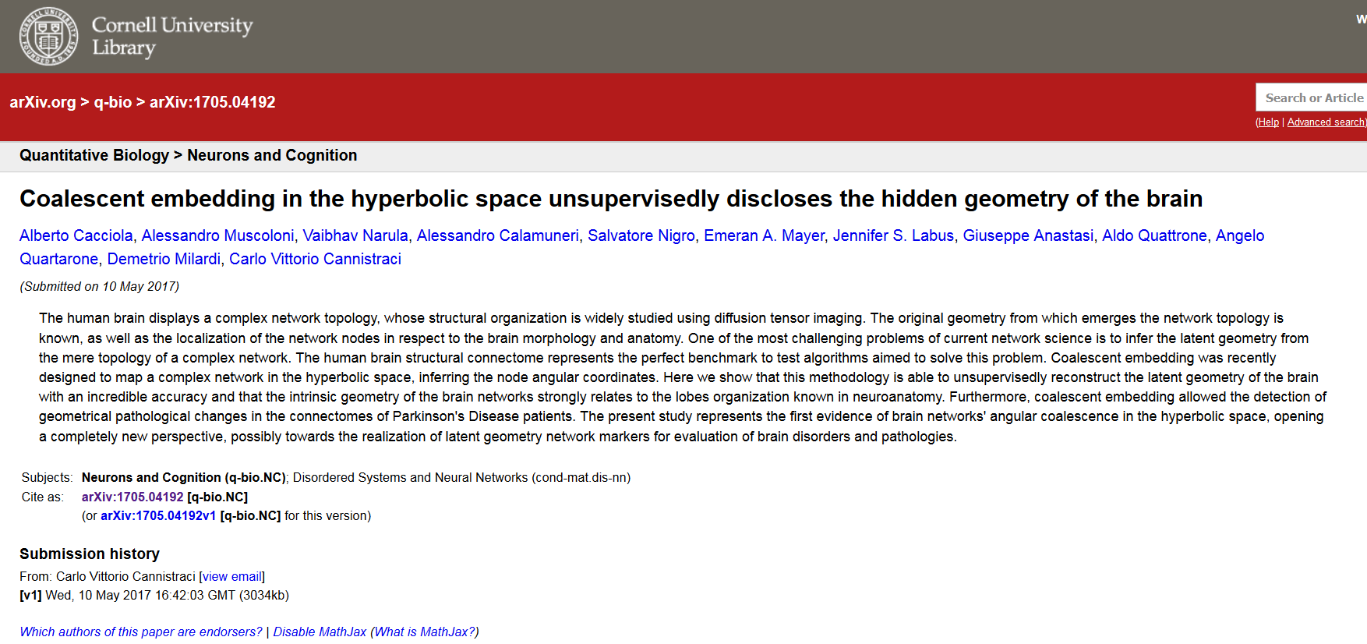

Slide 36
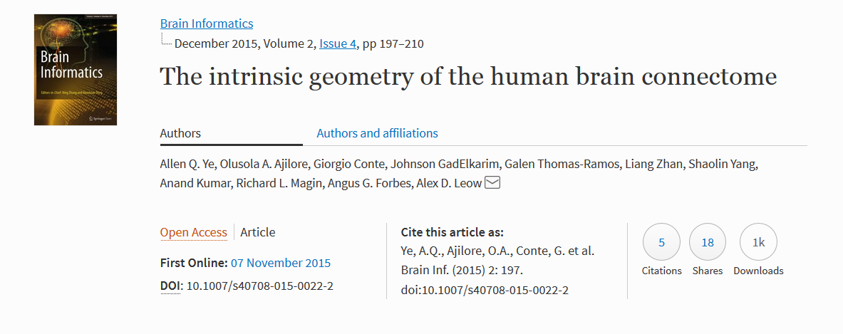
2015
“Intrinsic brain network geometry only minimally relates to neuroanatomy!”

Slide 37
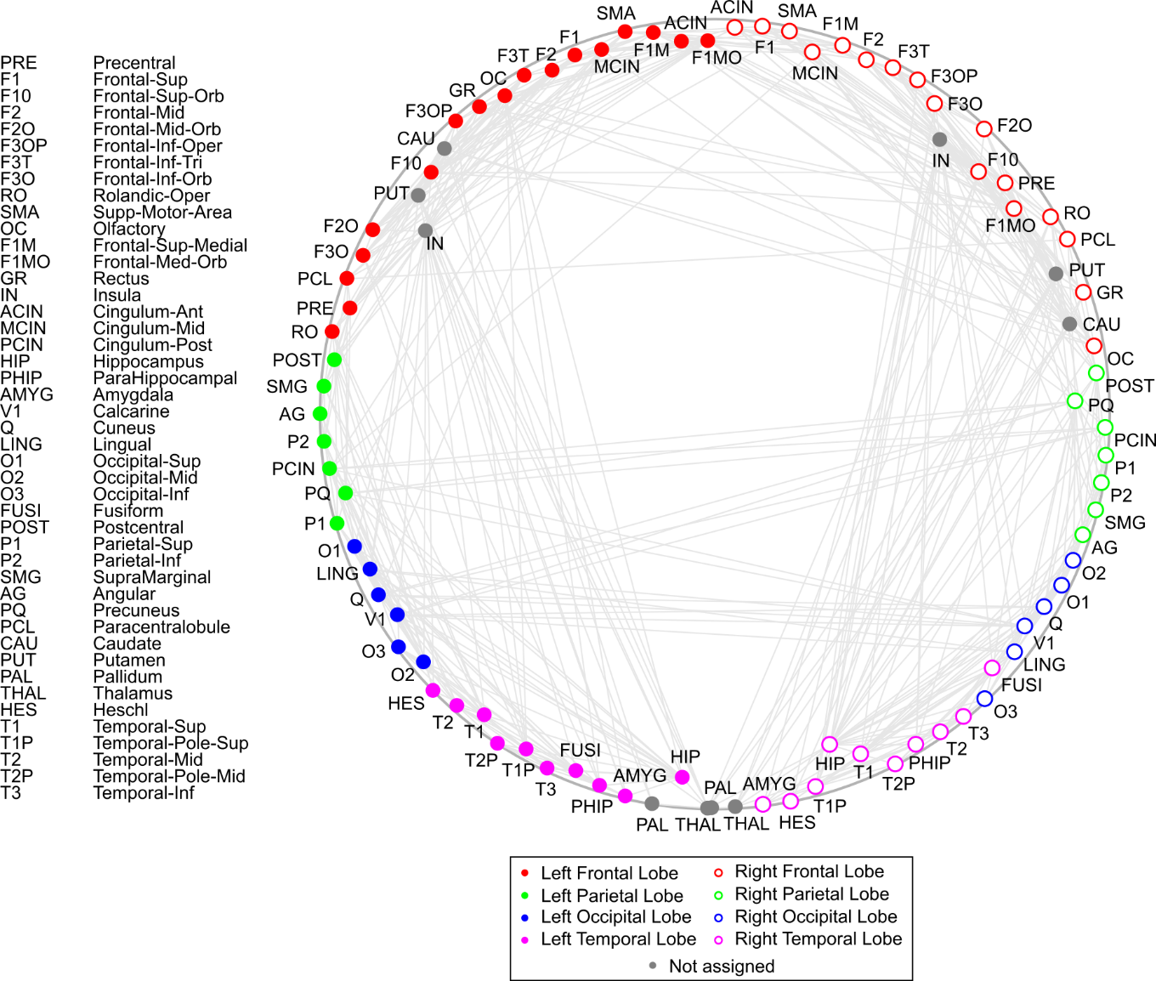

Slide 38
Geometrical modifications of the brain in de novo drug naïve Parkinson’s Disease (PD) patients compared to Healthy Controls (HC)
Coalescent embedding
 | mean marker (HC) | mean marker (PD) | MW p-value | AUC | AUPR
MCE-HSP | 14.7 | 15.7 | 0.006 | 0.87 | 0.82
ncMCE-HSP | 14.3 | 15.2 | 0.014 | 0.83 | 0.79
MCE-HD | 14.4 | 15.3 | 0.017 | 0.82 | 0.77
ncMCE-HD | 14.1 | 14.9 | 0.017 | 0.82 | 0.77
LE-HSP | 15.6 | 16.3 | 0.017 | 0.82 | 0.78
ncISO-EA-HSP | 15.9 | 16.7 | 0.021 | 0.81 | 0.78
ncMCE-EA-HSP | 15.9 | 16.7 | 0.021 | 0.81 | 0.78
ISO-EA-HSP | 15.9 | 16.7 | 0.026 | 0.80 | 0.77
ncISO-HSP | 15.5 | 16.2 | 0.026 | 0.80 | 0.76
MCE-EA-HSP | 15.9 | 16.7 | 0.026 | 0.80 | 0.77
LE-EA-HSP | 15.9 | 16.7 | 0.026 | 0.80 | 0.77
LE-HD | 15.0 | 15.6 | 0.038 | 0.78 | 0.72
ISO-HD | 14.8 | 15.4 | 0.045 | 0.77 | 0.71
ISO-HSP | 15.4 | 16.2 | 0.045 | 0.77 | 0.73
ncISO-HD | 14.9 | 15.5 | 0.121 | 0.71 | 0.64
ncISO-EA-HD | 15.2 | 15.7 | 0.121 | 0.71 | 0.69
LE-EA-HD | 15.2 | 15.7 | 0.121 | 0.71 | 0.69
ISO-EA-HD | 15.2 | 15.7 | 0.186 | 0.68 | 0.66
MCE-EA-HD | 15.2 | 15.7 | 0.186 | 0.68 | 0.66
ncMCE-EA-HD | 15.2 | 15.7 | 0.186 | 0.68 | 0.66
weights | 222.0 | 215.8 | 0.307 | 0.64 | 0.64

Slide 39
Geometrical modifications of the brain in de novo drug naïve Parkinson’s Disease (PD) patients compared to Healthy Controls (HC)
Hypermap
 | mean marker (HC) | mean marker (PD) | MW p-value | AUC | AUPR
HyperMap-HD | 13.0 | 14.0 | 0.026 | 0.80 | 0.76
HyperMapCN-HD | 12.4 | 13.9 | 0.076 | 0.74 | 0.66
HyperMap-HSP | 13.7 | 14.8 | 0.076 | 0.74 | 0.69
HyperMapCN-HSP | 12.9 | 14.5 | 0.104 | 0.72 | 0.65

Slide 40
Embedding in the 3D

Slide 41
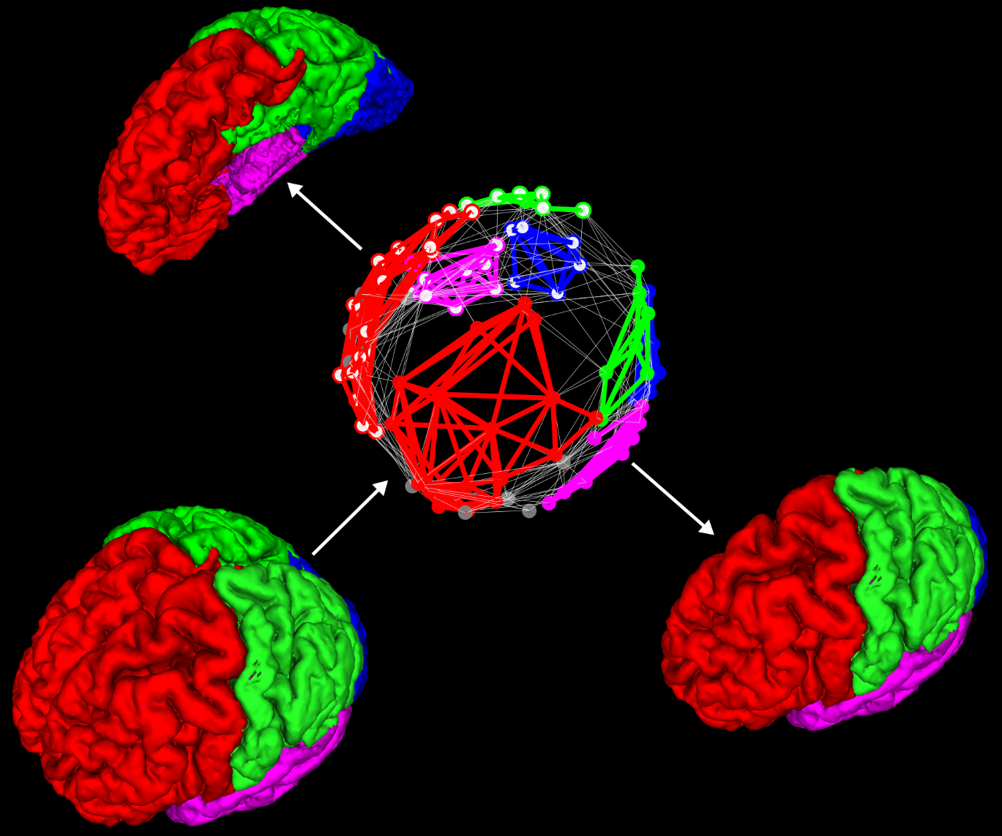

Slide 42
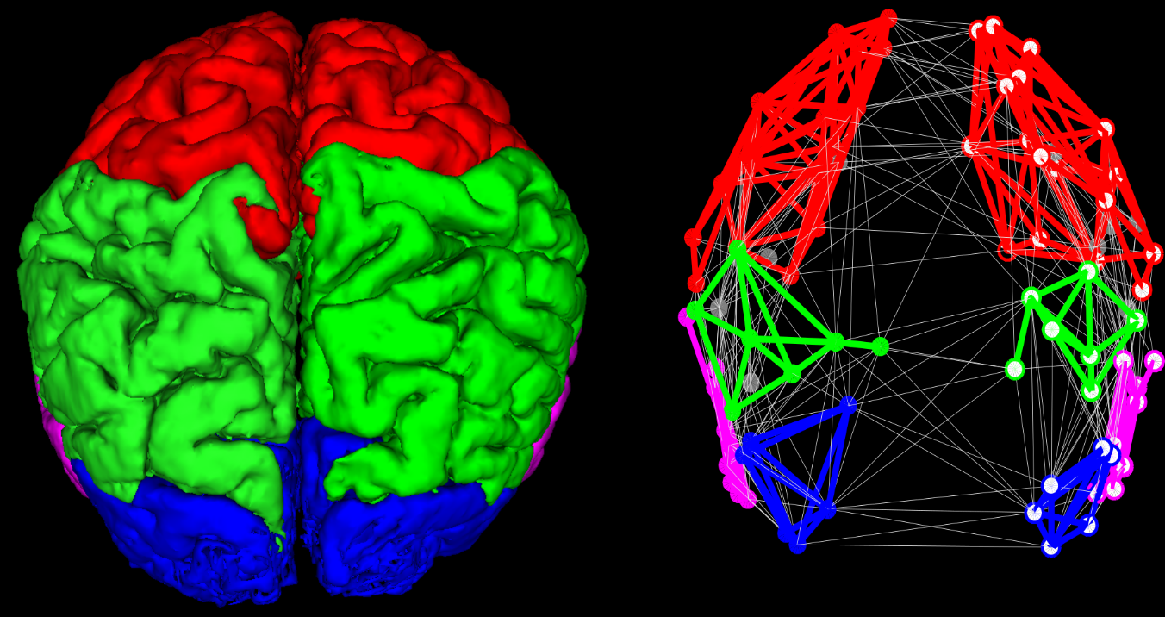

Slide 43
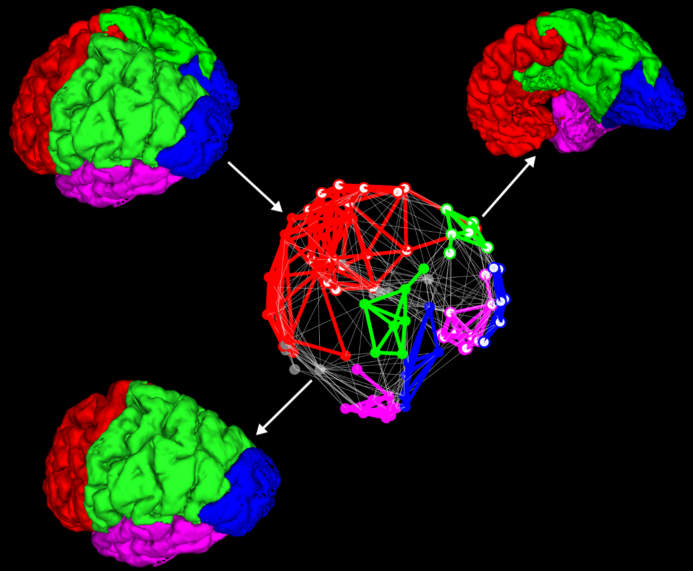

Slide 44
Conclusions
The Intrinsic brain network geometry relates to neuroanatomy in DTI brain structural connectomes
Propose the first Latent Geometry Markers (LGM) for brain disease
Offer a proof of concept that Latent Geometry Markers (LGM) can play a role in disease quantitative characterization
We have a further confirmation that Coalescent embedding (based on nonlinear dimension redaction by spectral analysis) works better than Hypermap (based on MLE)

Slide 45
Local Community Paradigm
Brain-network bioinspired computing

Slide 46
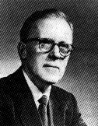
He is best known for his theory of Hebbian learning, which he introduced in his classic 1949 work The Organization of Behavior. He has been described as the father of neuropsychology and neural networks.
neurons that fire together wire together
network learning
changing
weightes of the links
MOST USED
Adding
new links
NEGLETED
(epitopological learning)
Donald Olding Hebb
(July 22, 1904 – August 20, 1985)
psychologist

Slide 47
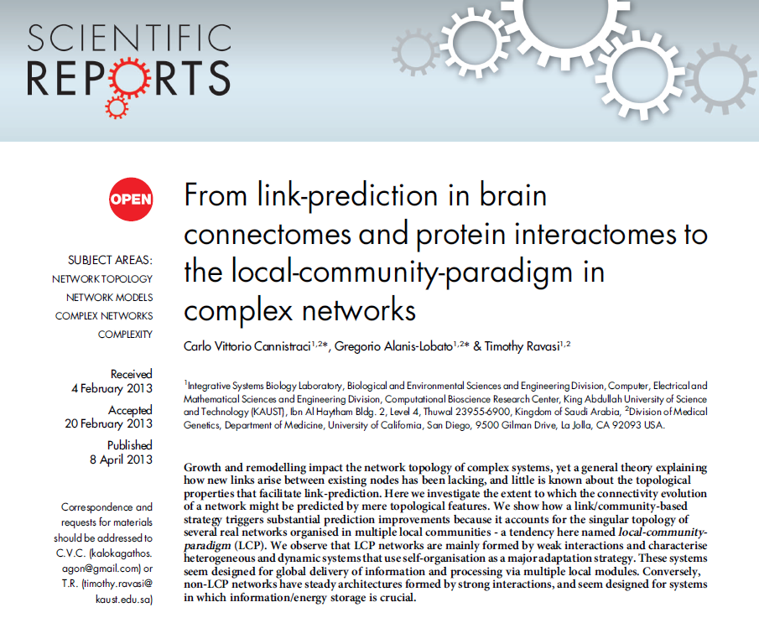
Apr 2013

Slide 48
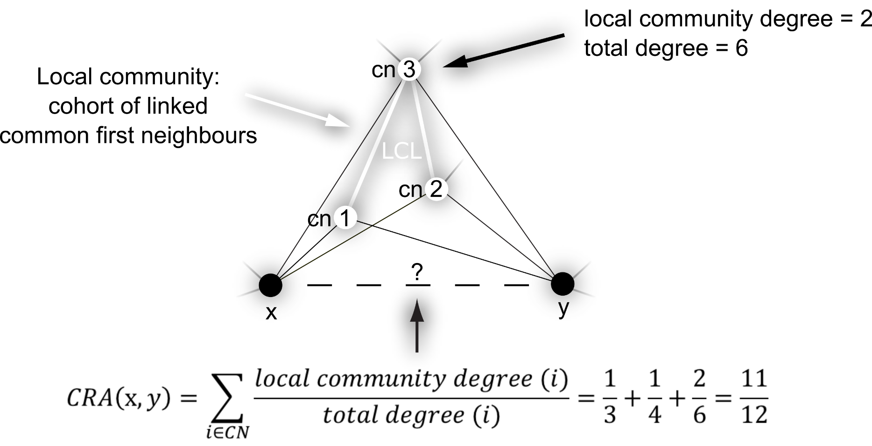

Slide 49
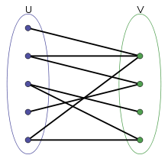
Monopartite graph
Bipartite graph
e_{x}
e_{y}
Triadic closure
Triadic closure

Slide 50
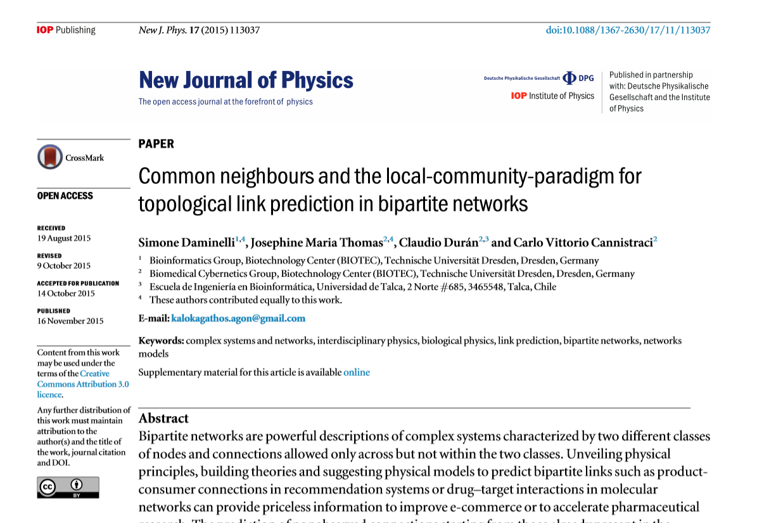
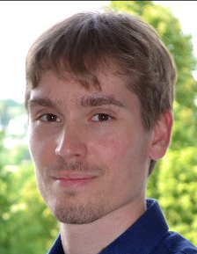
Third most downloaded article in December 2015
Simone
Phine
Claudio

Slide 51


Slide 52


Slide 53


Slide 54


Slide 55
Acknowledgments for Funding or Institution
Lipotype (company)
Klaus Tschira Foundation
DAAD
DFG
Free State of Saxony
High performance computing (ZIH)
Notes:
Yaser S. Abu-Mostafa

Slide 56
Where I want to go
Algorithms for innovative computing:
quantum computing
neuromorphic computing

Slide 57
Carlo Vittorio Cannistraci
Biomedical Cybernetics Group
WEB:
https://sites.google.com/site/carlovittoriocannistraci/home
http://www.biotec.tu-dresden.de/research/cannistraci/
EMAIL
kalokagathos.agon@gmail.com
Thanks!

Slide 59
Local Community Paradigm
Brain-network bioinspired computing

Slide 60
He is best known for his theory of Hebbian learning, which he introduced in his classic 1949 work The Organization of Behavior. He has been described as the father of neuropsychology and neural networks.
neurons that fire together wire together
network learning
changing
weightes of the links
Adding
new links
Donald Olding Hebb
(July 22, 1904 – August 20, 1985)
psychologist

Slide 61
Apr 2013

Slide 62
Prediction of New LINKS using ONLY NETWORK TOPOLOGY

Slide 63

The CAR-trick:
how to covert
classical neighbourhood indices in
local-community indices
Type | Name of the Index | Formulation
Classical | Common Neighbours (CN) | $$CN\left(x, y\right)=\left|Γ\left(x\right)∩\left.Γ\left(y\right)\right|= i_{x}= i_{y}\right.$$
 | Preferential Attachment (PA) | $$PA\left(x, y\right)=\left|\left.Γ\left(x\right)\right| ∙ \left|Γ\left(y\right)\right|\right.{=(e}_{x}+i_{x})∙{(e}_{y}+i_{y})=$$ $$=e_{x}e_{y}+ e_{x}CN(x,y)+ e_{y}CN(x,y)+{CN(x,y)}^{2}$$
 | Adamic & Adar (AA) | $$AA\left(x,y\right)= \sum_{s∈Γ(x) ∩ Γ(y)}{\frac{1}{\log_{2}(|Γ\left(s\right)|)}}$$
 | Resource Allocation (RA) | $$RA\left(x,y\right)= \sum_{s∈Γ(x) ∩ Γ(y)}{\frac{1}{\left|Γ(s)\right|}}$$
 | Jaccard (JC) | $$JC(x, y)= \frac{\left|Γ\left(x\right)∩\left.Γ\left(y\right)\right|\right.}{\left|Γ\left(x\right)∪Γ\left(y\right)\right|}=\frac{CN\left(x, y\right)}{\left|Γ\left(x\right)∪Γ\left(y\right)\right|}$$
CAR-based | CAR | $$CAR\left(x, y\right)=CN\left(x,y\right)∙LCL(x,y)=CN\left(x,y\right)∙\sum_{s∈Γ(x) ∩ Γ(y)}{\frac{\left|γ(s)\right|}{2}}$$
 | CPA | $$CPA(x,y)=e_{x}e_{y}+ e_{x}CAR(x,y)+ e_{y}CAR(x,y)+{CAR(x,y)}^{2}$$
 | CAA | $$CAA(x,y)= \sum_{s∈Γ(x) ∩ Γ(y)}{\frac{\left|γ(s)\right|}{\log_{2}(|Γ\left(s\right)|)}}$$
 | CRA | $$CRA(x,y)= \sum_{s∈Γ(x) ∩ Γ(y)}{\frac{\left|γ(s)\right|}{\left|Γ(s)\right|}}$$
 | CJC | $$CJC(x,y)= \frac{CAR\left(x, y\right)}{\left|Γ\left(x\right)∪Γ\left(y\right)\right|}$$
e_{x}
e_{y}

Slide 65
LINK Prediction in brain connectomEs AND MORE

Slide 66
LiNK PREDICTION in protein networks

Slide 67


Link PREDICTION in protein networks
Sept 2013

Slide 68
CRA against SBM on 10 real networks
method | karate | dolphins | mac_neural | football | jazz | worm_nervoussys | netsci | flightmap | email | polblog | mean | mean
 |  |  |  |  |  |  |  |  |  |  | precision | time
CRA | 0.20 | 0.14 | 0.56 | 0.36 | 0.56 | 0.12 | 0.50 | 0.54 | 0.16 | 0.17 | 0.33 | 2 s | MAT
SBM | 0.28 | 0.16 | 0.68 | 0.34 | 0.47 | 0.15 | 0.13 | 0.64 | 0.09 | 0.19 | 0.31 | 10.5 h | C++

Slide 69

CD-Based Indices for Link Prediction in Complex Network
Tao Wang, Hongjue Wang and Xiaoxia Wang
Plos One 2016

Slide 70
Extension of LCP theory to bipartite topology

Slide 71
Third most downloaded article in December 2015
Simone
Phine
Claudio

Slide 72
Monopartite graph
Bipartite graph
e_{x}
e_{y}
Triadic closure
Triadic closure

Slide 73


Slide 74

Zhou, T. et al., 2007. Bipartite network projection and personal recommendation.
Phys Rev E Stat Nonlin Soft Matter Phys, 76(4 Pt 2), p.46115.
Network based inference (NBI, also known as ProbS) (tuning-free)
Zhou, T. et al., 2010. Solving the apparent diversity- accuracy dilemma of recommender systems.
Proceedings of the National Academy of Sciences of the United States of America, 107(10), pp.4511–5.
HeatS + ProbS (one parameter to tune)
One-mode-projection

Slide 75

Bipartite projection via random-walk (BPR)

Slide 76


Slide 80


Slide 81


Slide 83
Acknowledgments for Funding or Institution
Lipotype (company)
Klaus Tschira Foundation
DAAD
DFG
Free State of Saxony
High performance computing (ZIH)
Notes:
Yaser S. Abu-Mostafa

Slide 84
Where I want to go
Algorithms for innovative computing:
quantum computing
neuromorphic computing

Slide 85
Carlo Vittorio Cannistraci
Biomedical Cybernetics Group
WEB:
https://sites.google.com/site/carlovittoriocannistraci/home
http://www.biotec.tu-dresden.de/research/cannistraci/
EMAIL
kalokagathos.agon@gmail.com
Thanks!

