Slide 1
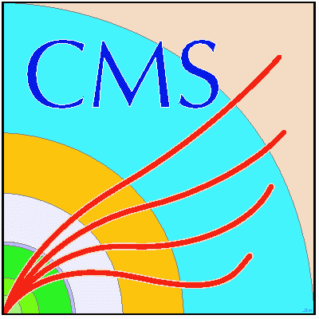

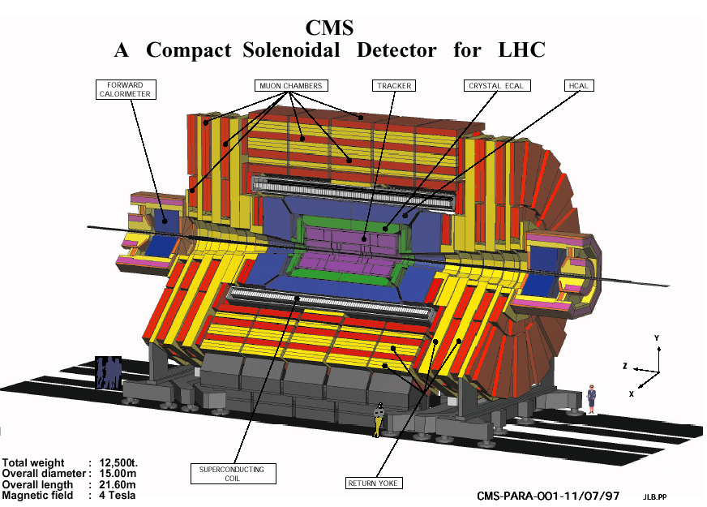
Reports on the Scientific Results
JINR Participation in Compact Muon Solenoid at the LHC
Topic 02-0-1083-2009/2019
Igor Golutvin - scientific leader
Anatoly Zarubin - project leader
Sergei Shmatov - physics coordinator
  Vadim Alexakhin JINR PAC, January 16, 2017
Project “CMS” (2010-2019)
Project ”Upgrade of the CMS Detector” (2013-2019)

Slide 2
Outline
JINR in Run 2 Operations
Participation in CMS upgrade of Phase I
within approved project “JINR Upgrade Project for CMS Phase 1” and R&D for Phase II
Participation in Physics Analysis
Computing and Data Processing

Slide 3
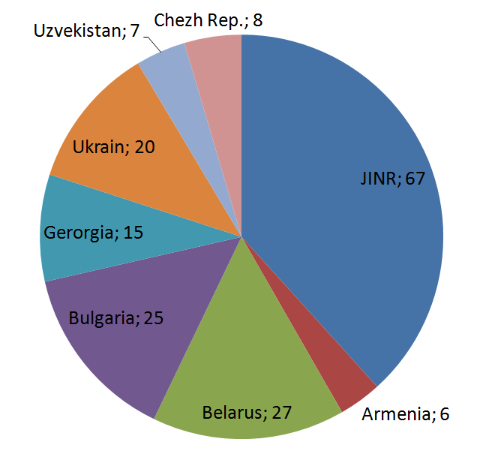
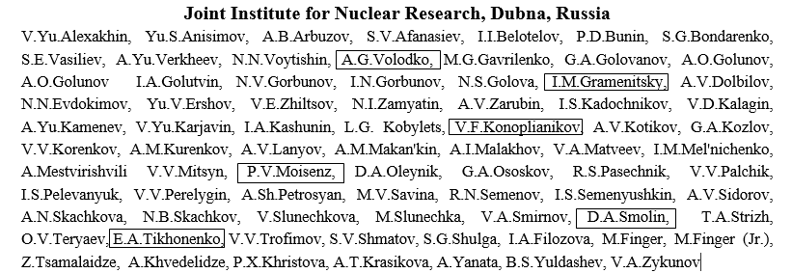
Project Participants (I)
67 participants from JINR
108 participants from JINR member states
14 paid authors and 4 unpaid authors (Ph.D. student) from JINR
10 paid authors and 1 unpaid authors (Ph.D.)
from JINR member states
Joint Institute for Nuclear Research, JINR, Dubna

Slide 4
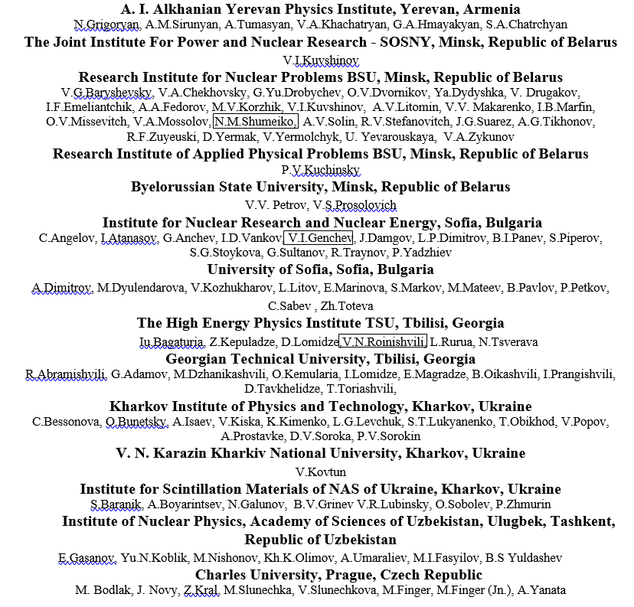
Project Participants (II)

Slide 5
Our life with LHC
2011-2013:
  Energy per beam 3.5 – 4 TeV → Low Lumi CМS Detector
  Integrated luminosity ~ 30 fb⁻¹ → main result - discovery of Higgs Boson
2013-2015:
  Long shutdown1 (20 months)→energy per beam 6.5TeV, luminosity 10³⁴сm⁻²s⁻¹
2015-2016:
  Run 2. Integrated luminosity 37.8 fb⁻¹. Energy per beam 6.5 TeV
2017-2018:
  Run 2. Integrated luminosity up to 150 fb⁻¹
2019-2020:
  Long shutdown2 (18 months), luminosity 2-3x10³⁴ сm⁻² s⁻¹ End of Phase 1
2021-2023:
  Run 3. Integrated luminosity 300 fb⁻¹
2024-2025:
    Long shutdown3 (30 months ), luminosity 4-6x10³⁴ сm⁻² s⁻¹
    → High Lumi CМS Detector – Phase 2
2026-2029
    Run 4. Integrated luminosity 3000 fb⁻¹
Today

Slide 6
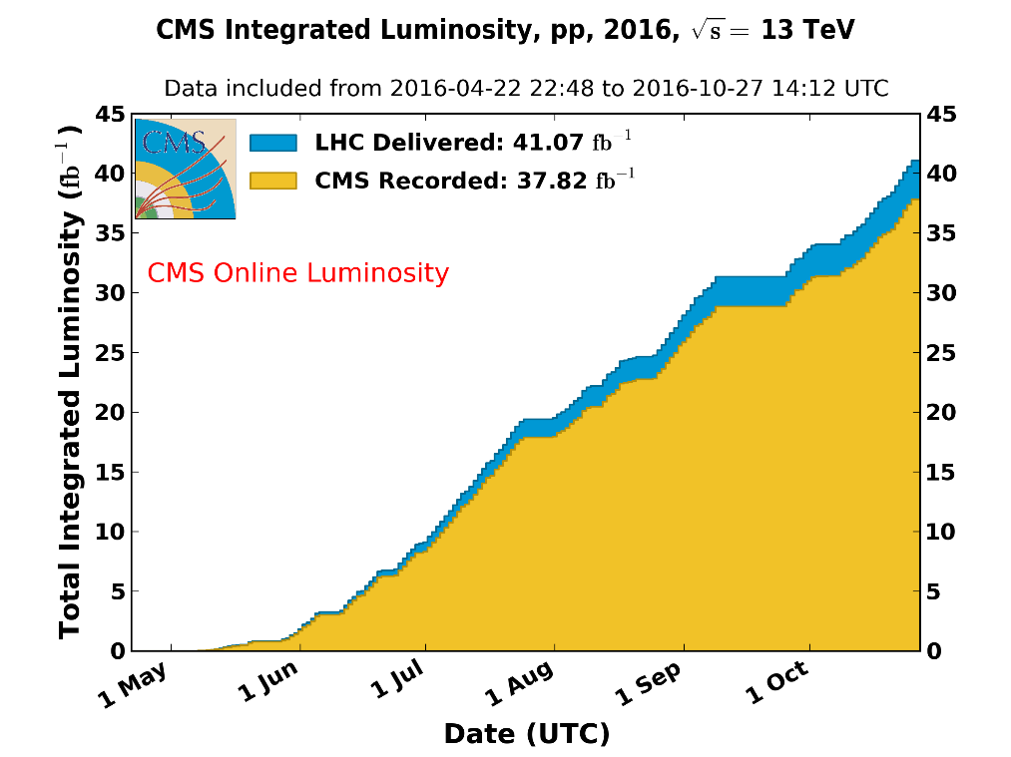
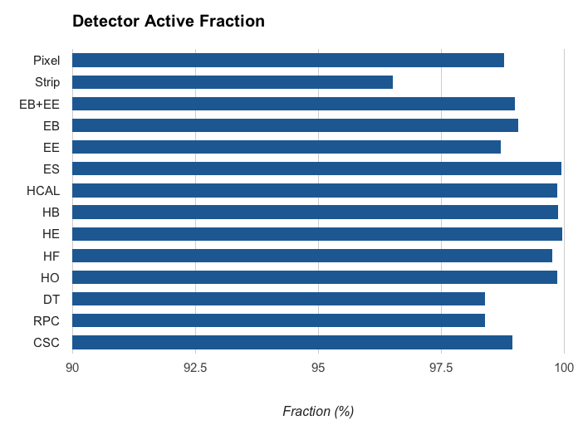
Run II Data Taking in 2016
Data Taking
Experimental data on pp-collision:
  √s=13 TeV – 37.82 fb⁻¹ delivered by LHC
92% - average data taking efficiency
94% of recorded luminosity was used for
the physics analysis (depends of scenario)
pp-collisions
L_{max} ≈ 1.52x10³⁴cm⁻²s⁻¹
Sub-Detectors Operations
Operation efficiency of detector systems
including detectors of full RDMS
responsibility (Endcap Hadron
Calorimeter & Forward Muon Stations)
was very high

Slide 7
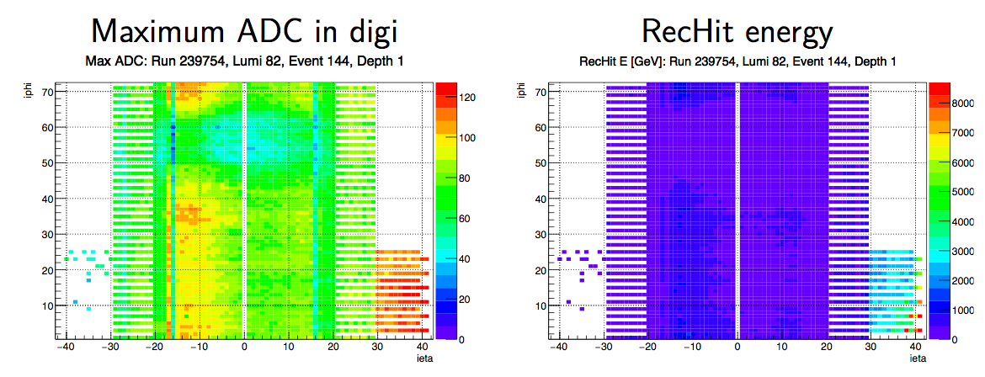
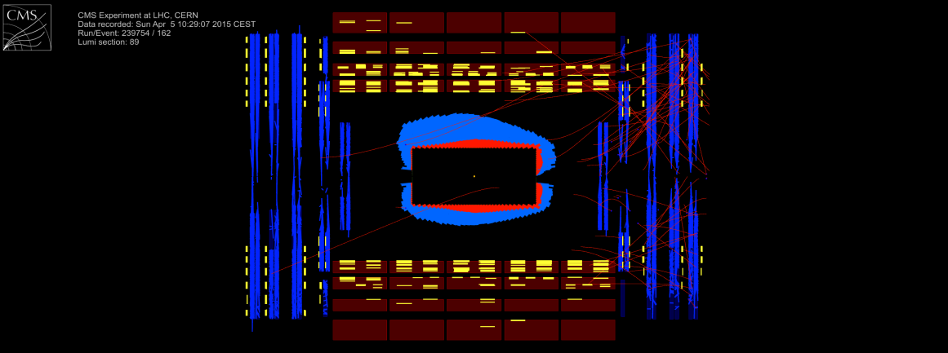
HCAL CMS Operation
During data taking commissioning of the HE in central Data Aquisition System (DAQ) were carried out:
monitoring of the HE in DAQ,
detection of the read out problems in the group of HE channels,
measurement of the signal parameters of front-end electronics,
detection of the problematic channels and the quality definition for each event in order for the data
certification (bad – good).
Hardronic Endcap shows solid running in Run2,
100% working channels.
During 2016 data taking HE was the most stable system.

Slide 8
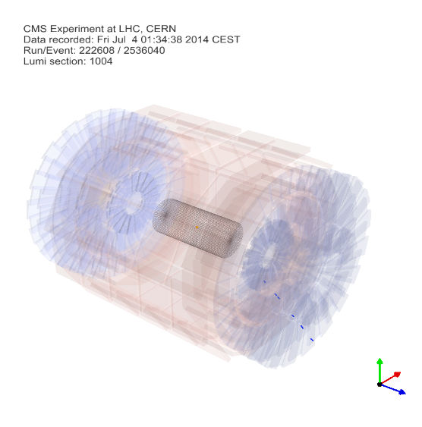
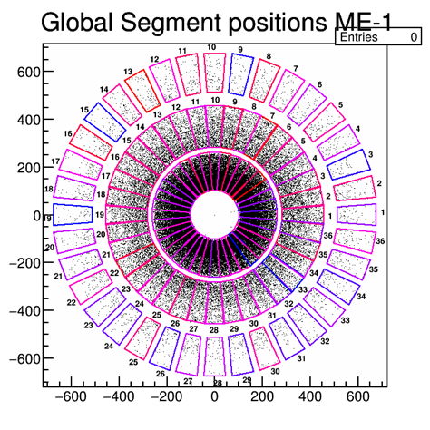
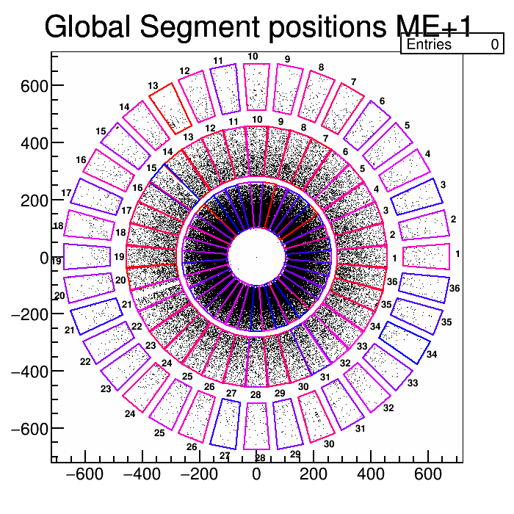
ME1/1 Operation and Performance
Track segments in muon stations ME-1 and ME+1
The ME1/1a has 20% spatial resolution improvement in comparison with 2012 is a result of CSC electronics refurbishment. To improve a reconstruction efficiency and robustness of CSC muon tracks the new algorithm of track-segment reconstruction in CSC has been developed.
The data of 2016 at 13 TeV and 2012 at 8 TeV are in good agreement.

Slide 9
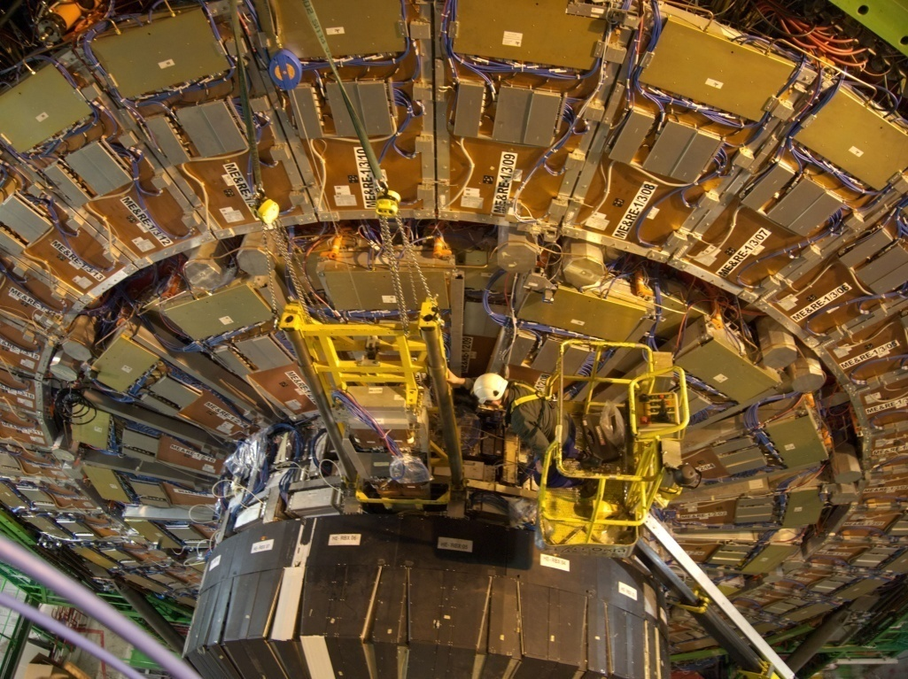
JINR Participation in CMS Phase I Upgrade
Long Stop 1 of Phase I: Within the JINR Project “CMS Upgrade up to 2020” (phase I) upgrade works have been performed to enable effective operation of experiment at high luminosity 1–2×10³⁴sm⁻²s⁻¹ and nominal LHC energy up to 14 TeV
  Upgrade of ME1/1 is completed (produced and replaced electronics at 72 chambers of МЕ1/1). The trigger acceptance is extended from 2.1 up to 2.4. The rate capability is increased up the highest luminosity @ HL-LHC. JINR (RDMS-DMS) contributed 590 kCHF.
  Upgrade of HE is well going on (all preparation works within JINR responsibility are well completed, waiting CMS decision to start installation). JINR (RDMS-DMS) contributed 468 KCHF.
Phase II: Upgrade to enable effective
operation of experiment at very high
luminosity 5×10³⁴ sm⁻²s⁻¹ and integrated
luminosity up to 1–3 ab⁻¹ (attobarn physics).
  Endcap Hadron Calorimeter (BH)
    Study of possibility of active detector
    accessibility
    Study of finger scintillator options
    Optimization of segmentation
    Study of radiation fields
  Forward Muon Station
    test ME1/1 CSC at GIF++ for HL LHC
9

Slide 10
News
10

Slide 11
Endcap Muon System Phase II Upgrade
In accordance of decison of the CMS Muon System Management the
the Endcap Muon System Phase II Upgrade will be performed in two stages
Taking into account significant contribution of JINR and Minsk in the CMS Endcap Muon System Phase 1 Upgrade and high efficient operation of the upgraded muon system the CMS Muon System Management is asking the RDMS-DMS to contribute in the Muon System LS2 Upgrade
  responsibility for design and construction of new Low Voltage Distribution Board (LVDB) for all 108 Muon inner rings (MEX/1) detectors
11

Slide 12
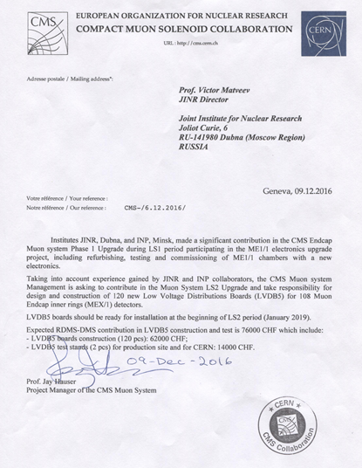
Endcap Muon System Phase II Upgrade
Expected RDMS-DMS contribution in LVDB construction and test is 76 kCHF:
62 kCHF for LVDB construction
14 kCHF for test stands in commissioning site
This upgrade work is not included in the JINR Project ”Upgrade of the CMS Detector” (2013-2019) covered period before Phase II.
This work needs extra fund for
design, R&D, stands (from beginning of 2017): 18 kUSD
production (from end of 2017): 50 kUSD
We ask Program Advisory Committee
to support request for extra fund in 2017
12

Slide 13
The JINR in CMS Physics Analyses of 2016
2012 data @ 8TeV analyses were finished (up to ~ 20 fb-1)
  Forward-backward asymmetry of Drell-Yan lepton pairs in pp collisions at 8 TeV (Eur. Phys. J. C 76, 325 (2016), arXiv:1601.04768.)
2015-2016 data @ 13TeV (up to ~ 13 fb-1)
  Search for High-Mass Resonances Decaying to Dilepton Pairs in pp Collisions at 13 TeV (arXiv:1609.05391)
  Search for Microscopic Black Holes at 13 TeV (CMS-AN-15-130, CMS-EXO-15-007)
  Drell-Yan pair production: x-sections, AFB etc (CMS PAS SMP-16-009)
18 authors from JINR (4 PhDs) + 11 from DMS
2 public papers and 6 CMS PAS
32 talks for the CMS project in 2016
1 doctoral thesis
Above 120 papers were accepted or submitted to J. High Energy Phys, Phys. Rev. Lett., Phys. Lett. B, Eur. Phys. J. based on data of Run1

Slide 14
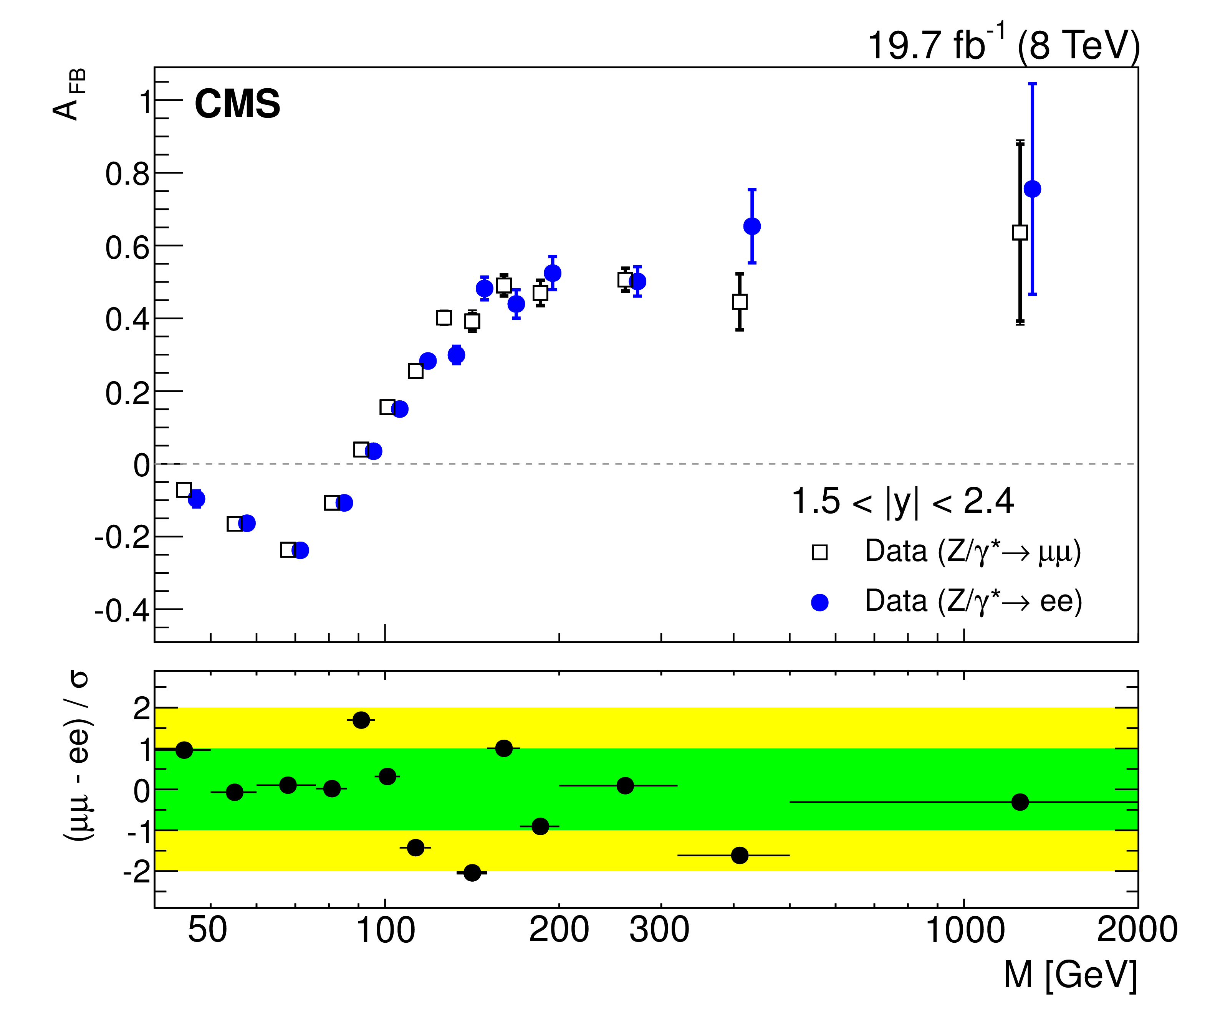
JINR Example: Standard Model @ 8 and 13 TeV
Conventional re-discovery SM @ 13 TeV (ex. with di-muons in final states )
  Detector performance,
  Monte-Carlo tunes
  Validation of Standard Model
EPJ C76, 325 (2016)
CMS-PAS-SMP-16-009
Di-muon Drell-Yan cross section
AFB asymmetry
Di-muon Drell-Yan cross section
SM remains to be strong: good agreement between data and theory,
consistence with 8 TeV data
14

Slide 15

JINR Example: Higgs Boson @ 13 TeV
Higgs “discovery” decays to bosonic channels
H →ZZ →4l
Studies of Higgs boson in ZZ → 4l to confirm or despite Run 1 results (6.8σ significance) :
Spin: 0⁺ state (J^{P})
Width: < 22 MeV (4.15 MeV in SM)
Signal Strenght: 1.0 ±0.29
Observ. (expect.) = 2.5 (3.4) σ
SM Higgs is alive again (signal strength is agreed with SM)
Studies of Higgs properties and searches BSM Higgs boson searches are going on
15

Slide 16
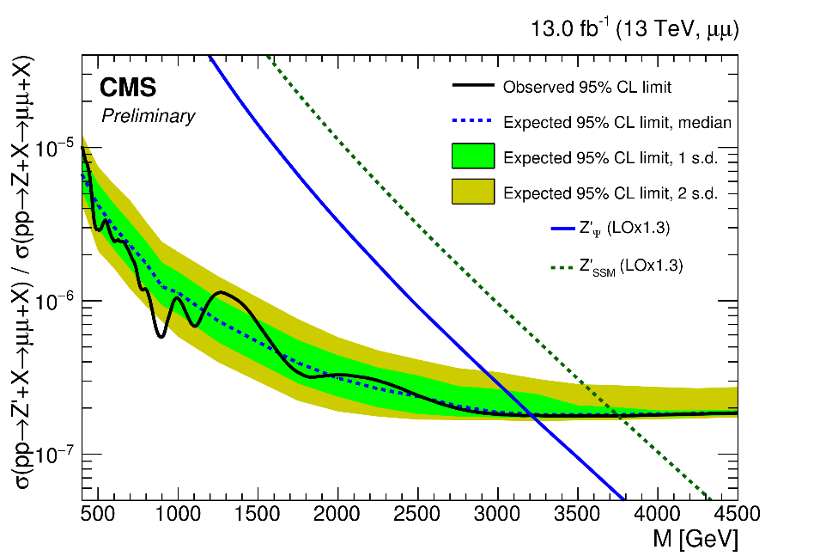
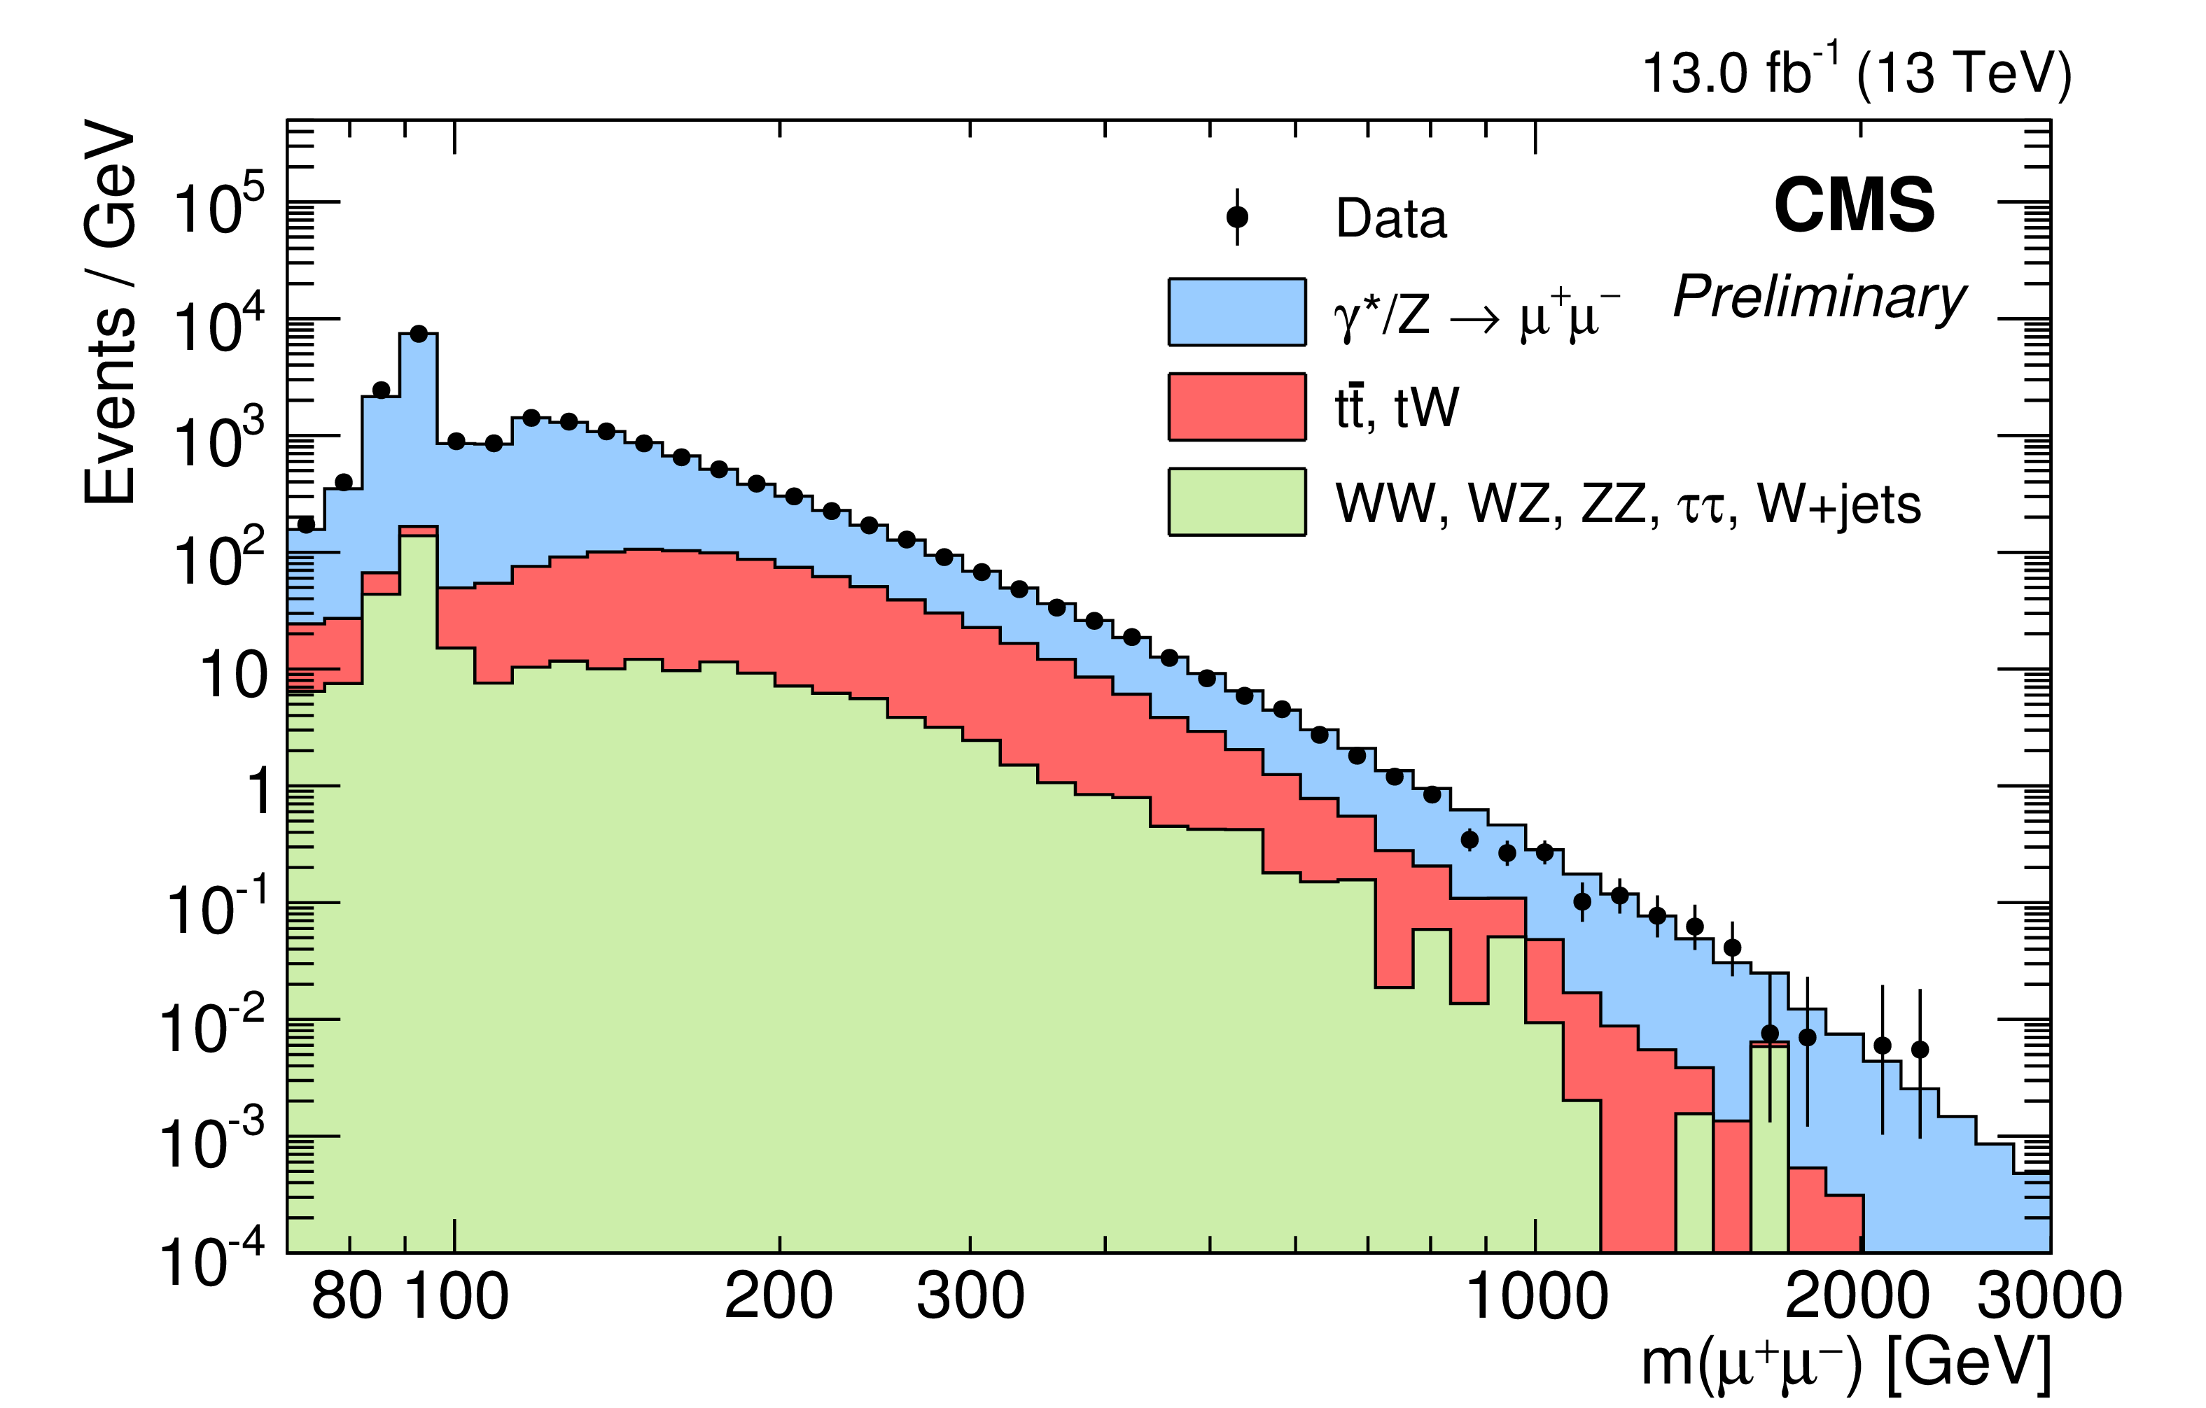
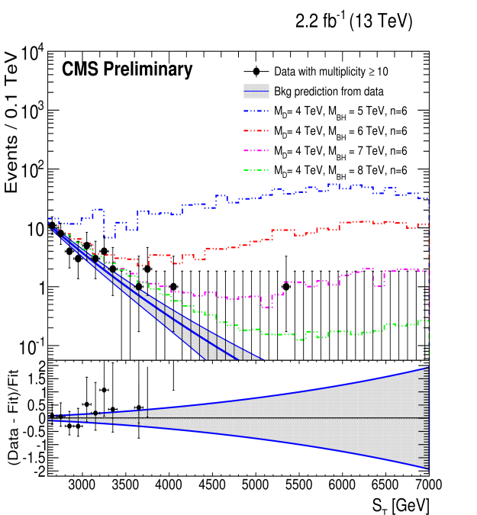
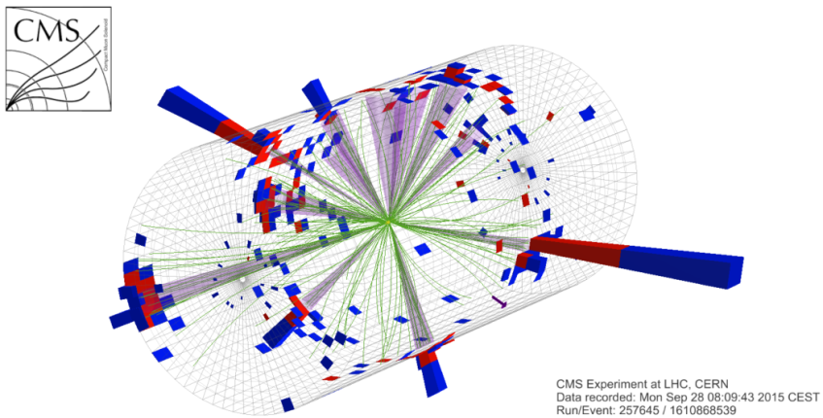
JINR Example: New Physics @ 13 TeV
New limits:
3.7 TeV for Zssm and 3.2 TeV for GUT Z’
Di-muons
Multijets (N_{jet} up to 12 with S_{T} = 5.48 TeV)
Black Hole mass > 8.7 TeV
16

Slide 17
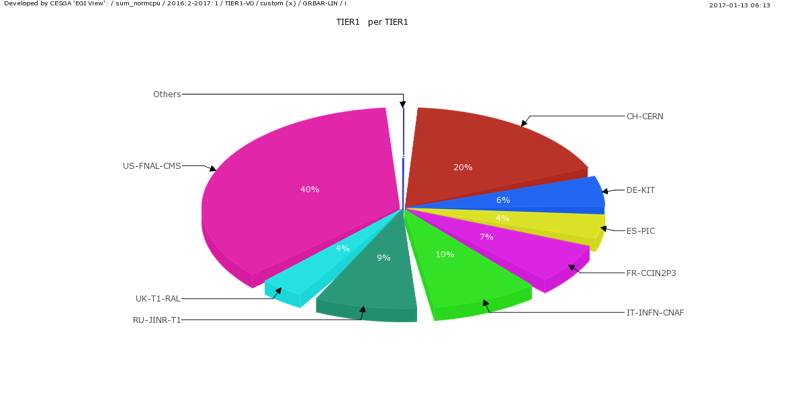
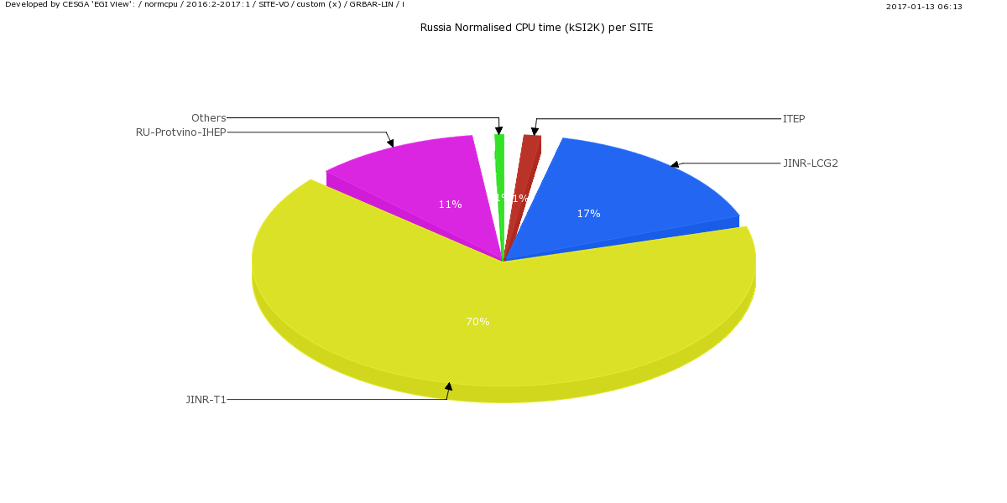
JINR Facilities for Data Processing and Analysis
CMS data processing and analysis within the Worldwide LHC Computing Grid
(WLCG) is by means of the distributed computing centers
The CMS Facilities in JINR include the Tier-1 and Tier-2 centers, and CMS
Regional Operation Center (CMS ROC)
=> to assists the RDMS aims to carry out full-scale researches in the field of particle physics at the nominal values of LHC energies and luminosity.
=> to coordinate participation of RDMS Tier-2 centers in CMS Data Processing and Analysis
JINR Tier-1 provides ~9% of Tier-1 CMS performance
JINR Computing Center provides above 77% of RDMS Computing facilities
17
17

Slide 18
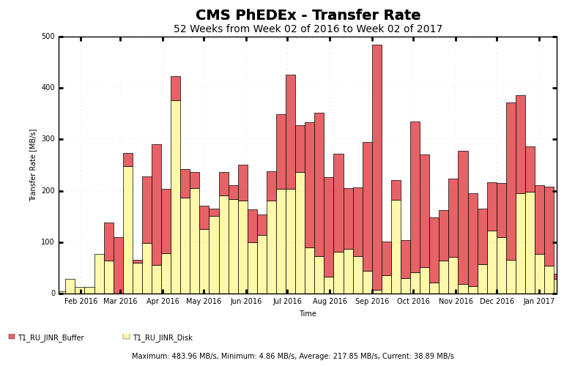
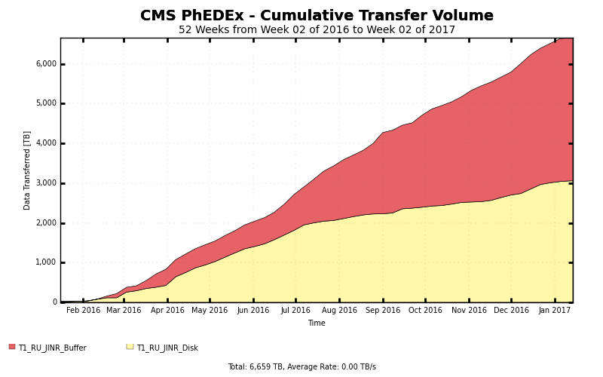
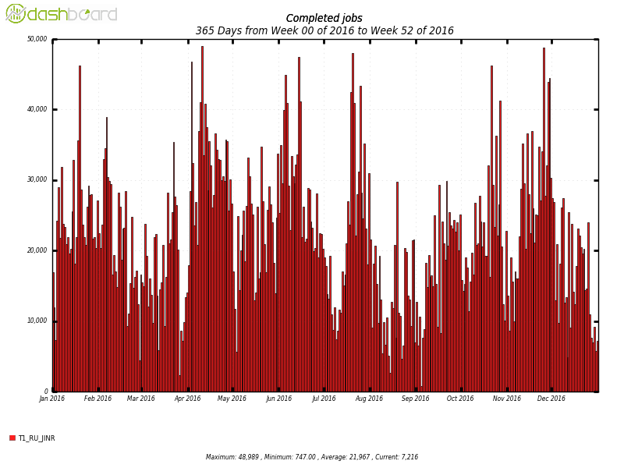
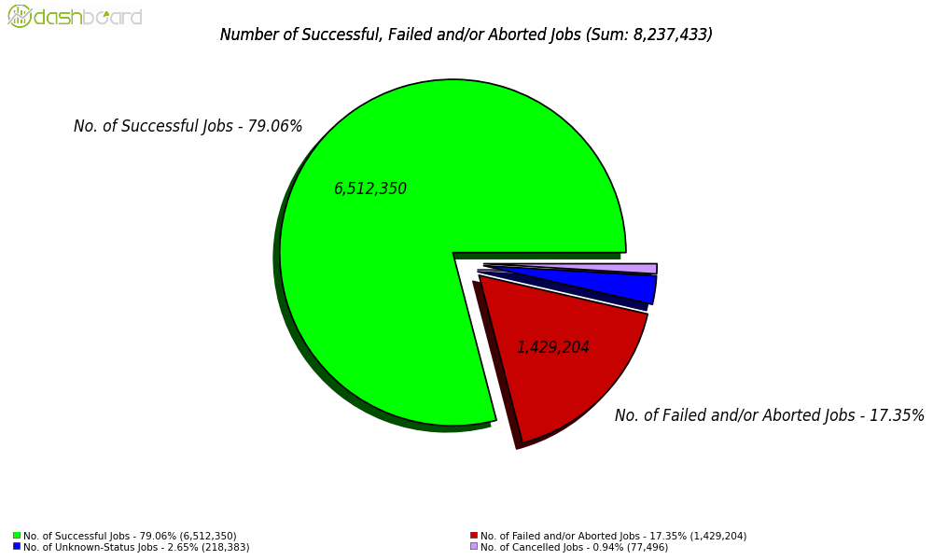
JINR Computing Performance in 2016
CMS Software and Computing infrastructure (including JINR Tier-1/Tier-2)
are stable and relevant
Max transfer rate to Dubna ~ 489.96 MB/s
~ 7 PB was transferred to/from JINR Tier-1
8 040 235 jobs were
successfully completed
79.06 % of jobs were completed successfully
18

Slide 19
Conclusions
JINR CMS team is well progressing in main Tasks:
Run II data taking and analysis at 13 TeV
  at designed LHC Lumi and Energy
Detector Operation and Maintenance
Participation in Phase I Upgrade and R&D for Phase II at HL-
LHC for Muon and Calorimetry
  according to CMS TP, TDRs, and approved JINR Project
New Low Voltage Distribution Board (LVDB) for all 108 Muon
inner rings (MEX/1) detectors will be installed during LS2
We ask Program Advisory Committee to support request for
extra fund in 2017
19

Slide 20
Thank you for your attention
20

Slide 21
BACKUP
SLIDES

Slide 22
CMS Upgrade program

Slide 23
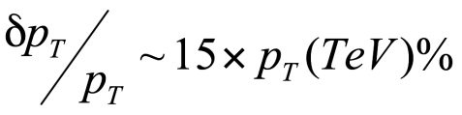
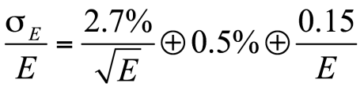
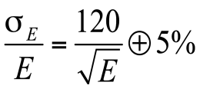
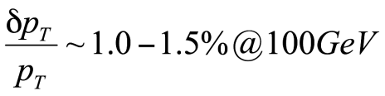
Compact Muon Solenoid - CMS
Silicon Tracker
Detector subsystems are designed to measure: the energy and momentum of photons, electrons, muons, jets, missing E_{T} up to a few TeV
Forward Calorimeter, HF
Muon Chambers
Tracker
Electromagnetic calorimeter, ECAL
Hadron calorimeter HCAL
PbWO₄ ECAL
sampling brass HCAL
weight - 14500 t
diameter – 14.60 m,
length – 21.60 m,
B-field – 3.8 Т
MUON Chambers
Superconducting Coil
diameter 6 m, length 13 m
Return Yoke

Slide 24
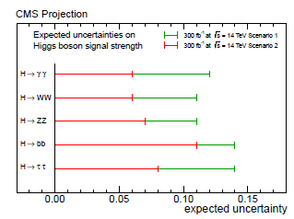
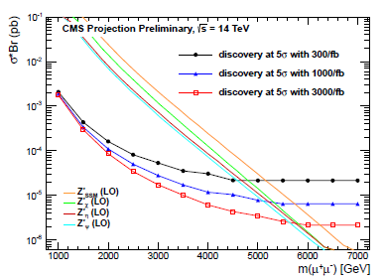
Expected Results in Run2 at 13 TeV
In 2012 the Higgs boson was discovered by the ATLAS and CMS experiment.
Contribution of JINR team was highly praised not only by collaboration.
I.Golutvin and A.Zaitsev were awarded by main prise of RAS – Cherenkov medal.
The main goals of the JINR & RDMS groups in Run 2 are:
studies of the Higgs boson properties such as the spin-parity and rare decays etc., increasing of accuracy of the measurements of the branchings (6-14 %), couplings (5-15 %), signal strength (6-14%)
precise tests of the Standard Model and searching for new physics in the dimuon channel: TeV-scale gravity, new gauge bosons with a mass up to 6 TeV
⇒ new physics can be discovered if exists (not enough data in 2015!)

Slide 25
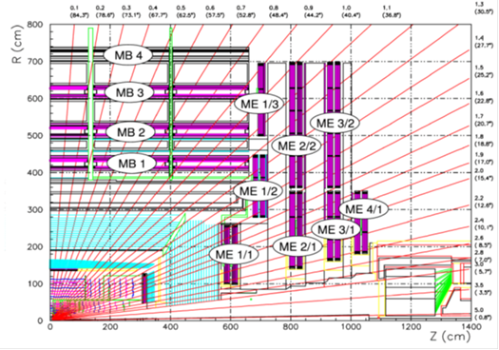

Slide 35
35

