Slide 1
Frank Laboratory of Neutron Physics, JINR
V.L.Aksenov
A 15-year forward look
at neutron facilities in the JINR
PAC on CMP, 1 July, 2016: − Research Programme
− World Neutron Landscape
− Concepts of a Future Facility
PAC on CMP, JINR, 19 January 2017, Dubna

Slide 2
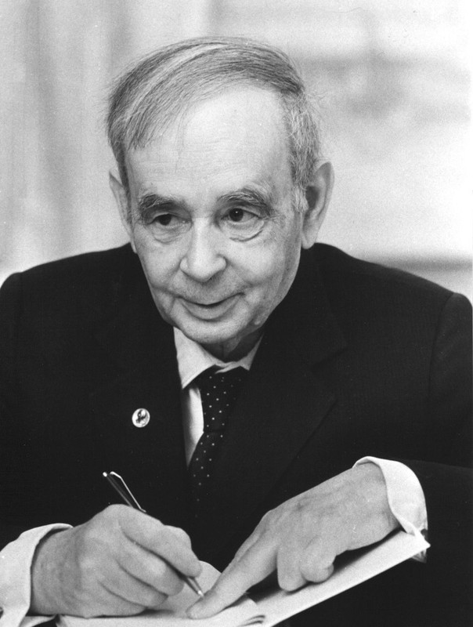
Research Program
Trends of modern sciences
Scientific traditions

Slide 4
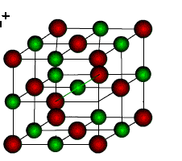
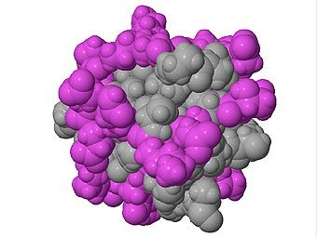
Current challenge: from soft matter to life matter
length scale intermediate between atomic size and macroscopic scales
kinetics, self-assembly
hierarchy
Crystalline Solids
Life Matter
Amorphous Solids
Quasicrystals
Low Dimension
Structures
Soft Matter
Nuclear Acids (DNA, RNA)
Proteins, Polysaccharides
Membranes
neither simple liquids
nor crystalline solid
Solid Matter
long-living, slow-relaxating structures
self-organization
irreversibility
fluctuations
relaxation

Slide 5
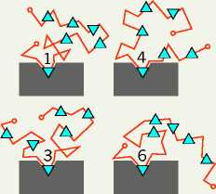
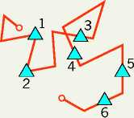
Breaking the protein rules
by Tanguy Chouard (editor for Nature in London) Nature (2011) V. 471 р.151
A central tenet in molecular biology states that the function of a protein depends on its fully folded three-dimensional structure. In the new view, protein segments can function when transiently or durably disordered.
LOCK AND KEY
SHAPE SHIFTING
FOLD AS YOU BIND
In the conventional view, an enzyme folds up immediately into a unique and stable 3D shape, the key (left). Its shape perfectly matches and allows it to bind its substrate, the lock (right).
The signalling protein Sic1 remains disordered in its bound state, and each of six phosphate groups occupies the binding site in turn. The protein is a mix of different conformations shifting around in constant dynamic equilibrium.
A disordered part of the gene-regulatory protein CREB (left) uses the lock to mould itself into the shape of the key when the two meet (right), rather than folding beforehand.

Slide 6
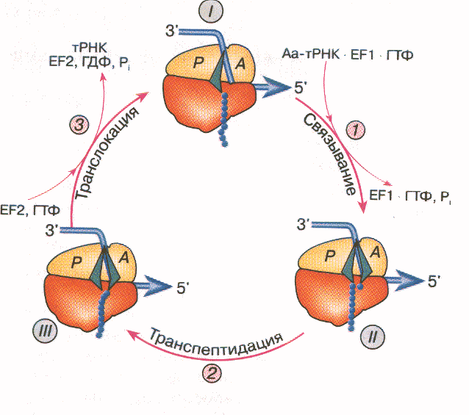
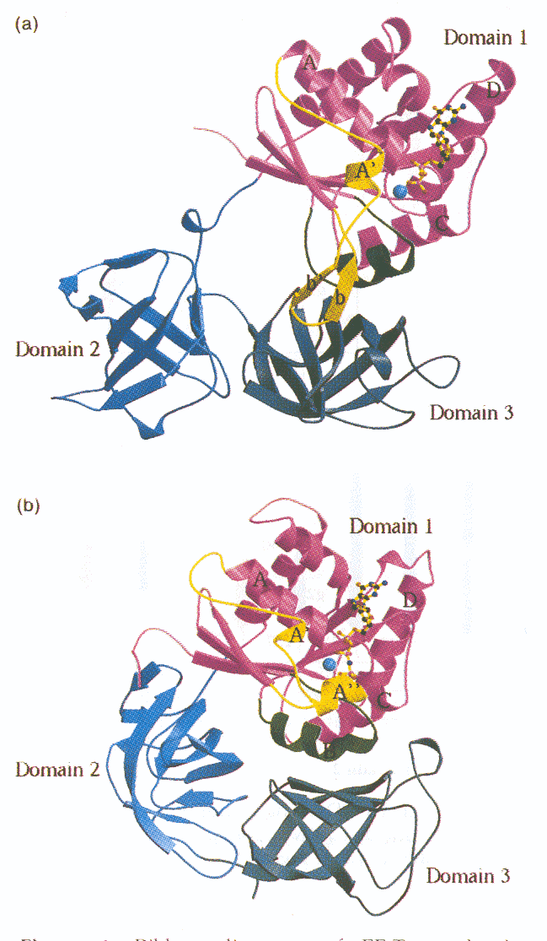
Why do we need more neutrons?
An example of an unstructured protein
Protein eEF1A − elongation factor of translation
The main role of elongation factors: to increase the rate of elongation and to facilitate accurate fixing of complexes.
Elementary elongation cycle of the ribosome, when one triplet (codon) of mRNA is read and one amino acid is added to the growing polypeptide
Structure of elongation factor
Neutron scattering experiments with isotopic substitution and polarization analysis revealed that the eEF1A protein has no fixed rigid structure in solution, and its conformation is more expanded and disordered than its prokaryotic counterparts.
A fourth native state of eukaryotic factors (the state with high cross-domain mobility) was proposed.
I.Serdyuk, V.Aksenov et al. J.Mol.Biol. 292 (1999) 633; Т.Budkevich, I.Serdyuk, V.Aksenov et al. Biochemistry, 41 (2002) 15342

Slide 7
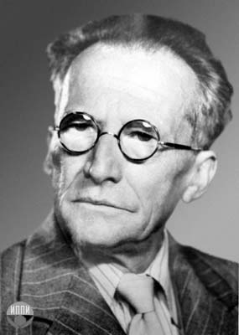
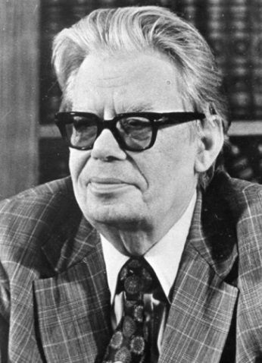
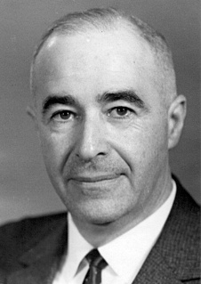
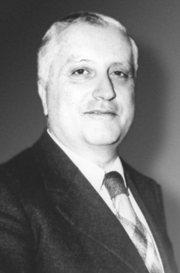
Basic Problems of Biophysics
E. Schrödinger
N.N.Bogolubov
I.M.Lifshitz
I.R.Prigogin
«What is life?
The Physical Aspects of the Living Cell»
Oxford, 1944
«Problems of a Dynamical Theory in Statistical Physics»
Moscow, 1946
«Statistical Physics
of biopolymers»
Moscow, 1968
«From being to becoming»
Brussels, 1980
Hard but solvable in the frame of the nowadays physics
Strong disequilibrium by a constant input of energy, irreversibility
Phase transitions: clew-globule, glass state etc.
Intramolecular dynamics, dynamical regimes of a cell, bioenergetics of a cell
The tertiary structure of biopolymers (prediction, self organization)

Slide 8
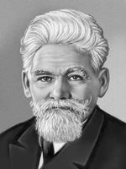
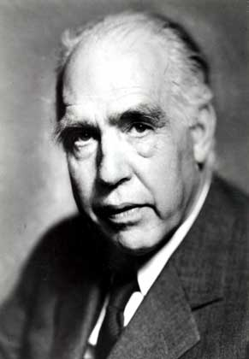
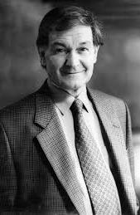
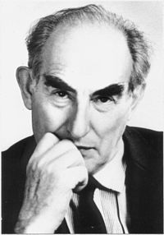
Towards a Becoming Physics
L.S.Berg
N.Bohr
R.Penrose
V.L.Ginzburg
«Nomogenes»
(non Darvin evolution)
St. Petersburg (1922)
“Discussions with Einstein” Copenhagen (1949)
«Shadows
of the Mind»
Oxford (1994)
Physics Ispekhi
169, p.419
Moscow (1999)
Nonsolvable, nowadays, problems of biophysics (L.A.Blumenfeld, 2002)
Progressive biological evolution: construction of more and more organized, structures
Individual and general consciousness (mind)
V.L.Ginzburg’s three great problems in physics (M.Mensky, 2010)
Quantum mechanics Arrow of time: where is irreversibility from?
interpretation:
What is happened Life (consciousness) and physics
at measurements

Slide 9
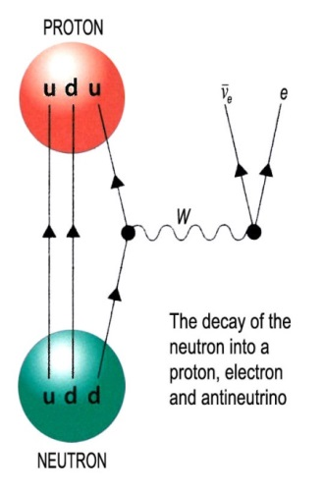
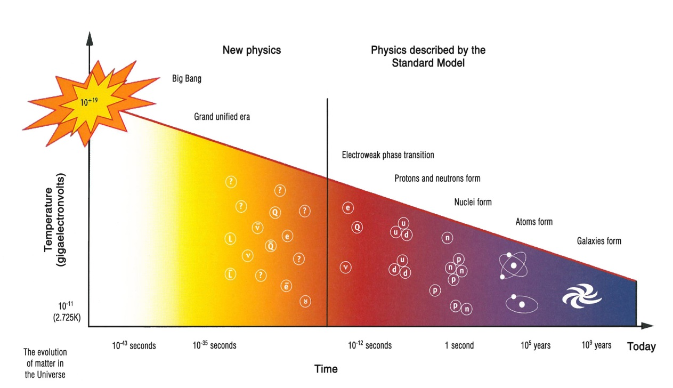
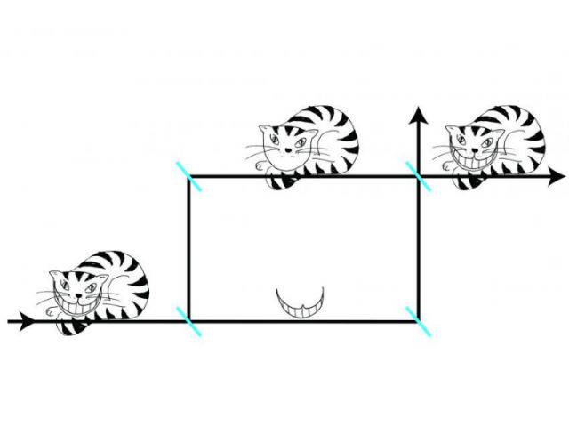
Neutrons and New Physics
Ultracold neutrons (UCN)
Neutron–Antineutron oscillations:
Barrion asymmetry, neutrino mass
Neutron–Neutron scattering:
charge symmetry breaking
Early Universe : ${τ }_{n}$
Barion asymmetry : EDM
Quantum measurements (a bridge between physics and consciousness problem)
Beyond
the Standard Model
“Chemical
Big Bang”?
Example: “Cheshire cats”
ILL polarized neutrons interferometer, 2014

Slide 10
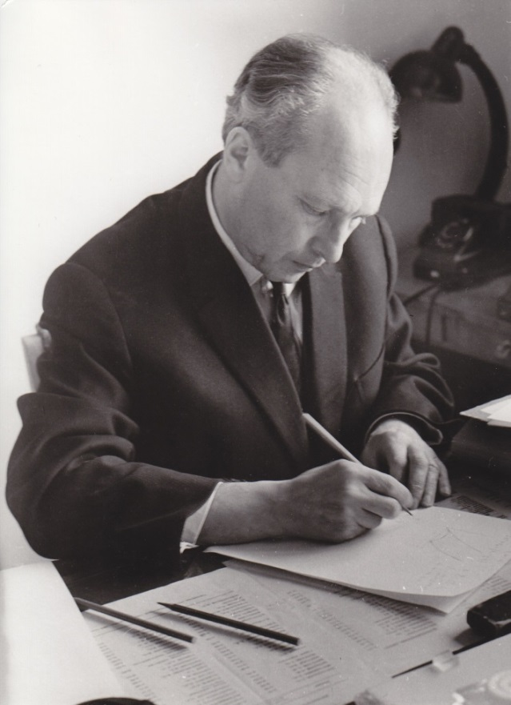
Ultracold neutrons
UCN quantum states in a gravitational field is the new field of research
Beyond of SM: dark energy and matter, gravitational properties of antimatter
Surface and thin layer physics: precise structure and dynamics explorations
1968: Dubna, F.Shapiro et al.
Methane
moderator-reflector (4 K)
Thermal neutron flux
Be (BeO)
⁴He (0.6 K)
Schematic view of the idea of the helium ultra cold neutron source at thermal neutron source
E.V. Lychagin, A.Yu. Muzychka, G.V. Nekhaev, E.I. Sharapov,
A.V. Strelkov (JINR, Dubna), V.V. Nesvizhevsky (ILL, Grenoble)
6.04.1915 – 30.01.1973

Slide 11
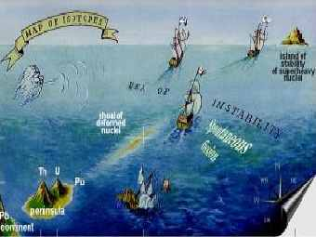
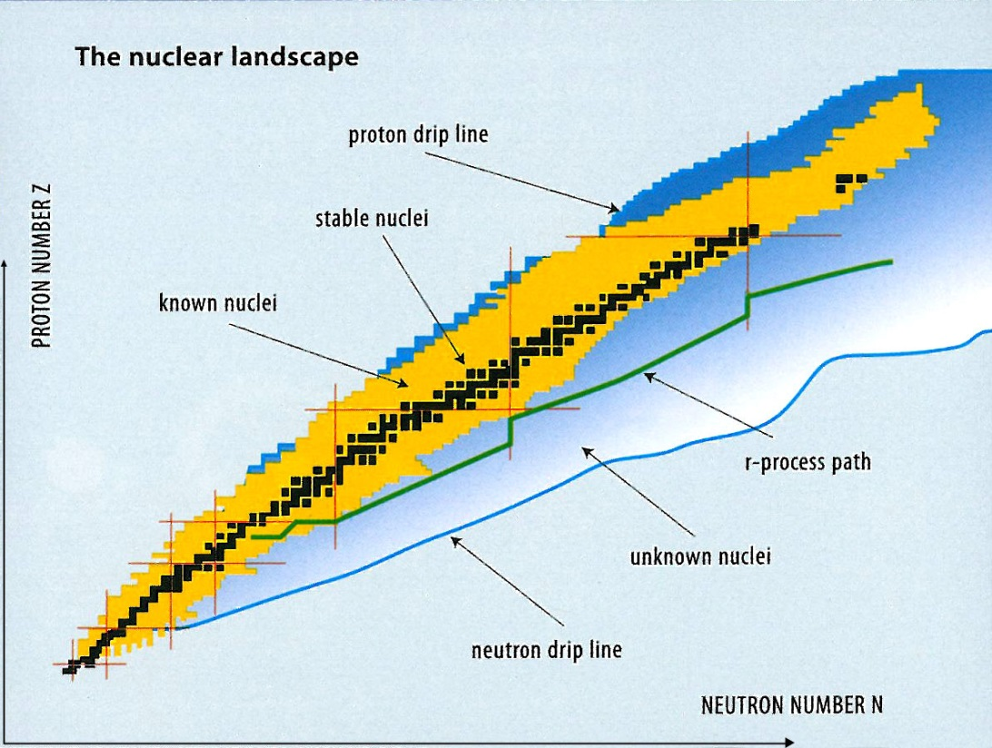
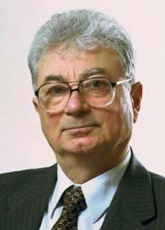
Understanding the nucleus
Fission Physics
Nuclear Data
Superheavy elements
Stability Island
Probing exotic (n-rich) nucleus
Nuclear Structure
(nuclear models)
Astrophysics
(where do the heavy elements come from?)
Phase Transitions
in nuclei
2016:
113 – Nihonium (Nh), 115 – Moscovium (Mc), 117 – Tennessine (Ts), 118 – Oganesson (Og)

Slide 12
Scientific opportunities with a high neutron flux
Structure and dynamics of soft and biological systems with high flux and polarized neutrons
Primary and tertiary structures
Intramolecular dynamics
Bioenergetics of a cell
Biomedicine and pharmacology
Crystal and magnetic structure with high resolution and real-time diffraction at high pressure and magnetic fields
New functional materials
Neutron-antineutron oscillations
Dark matter and dark energy with UCN
New Quantum phenomena with neutrons
Beyond the Standard Model
New Physics
New aspects of quantum mechanics and consciousness
Neutron-rich nuclei at isotope separator on-line system with neutrons, fission
Nuclear “Standard Model”
Irradiation, isotopes
Radiobiology, medicine
Notes:
12

Slide 13
The main parameter is neutron flux density
Soft Matter
Life Matter
Nucleus
New Physics

Slide 14
World Neutron Landscape
Status and time evolution
New advanced neutron sources
Aksenov V.L., Balagurov A.M. Physics-Uspekhi (2016) v.59 (3), p.279

Slide 15
European Larger Neutron Centers 2015
RISØ
Geesthacht
Berlin
DUBNA
ISIS
Jülich
Saclay
Munich
Budapest
PSI
Grenoble
Original design by Th.Brückel

Slide 16
Possible Neutron Scenario for Europe after 2032
ESS
PIK
ISIS
MLZ
SINQ
Original design by Th.Brückel

Slide 17
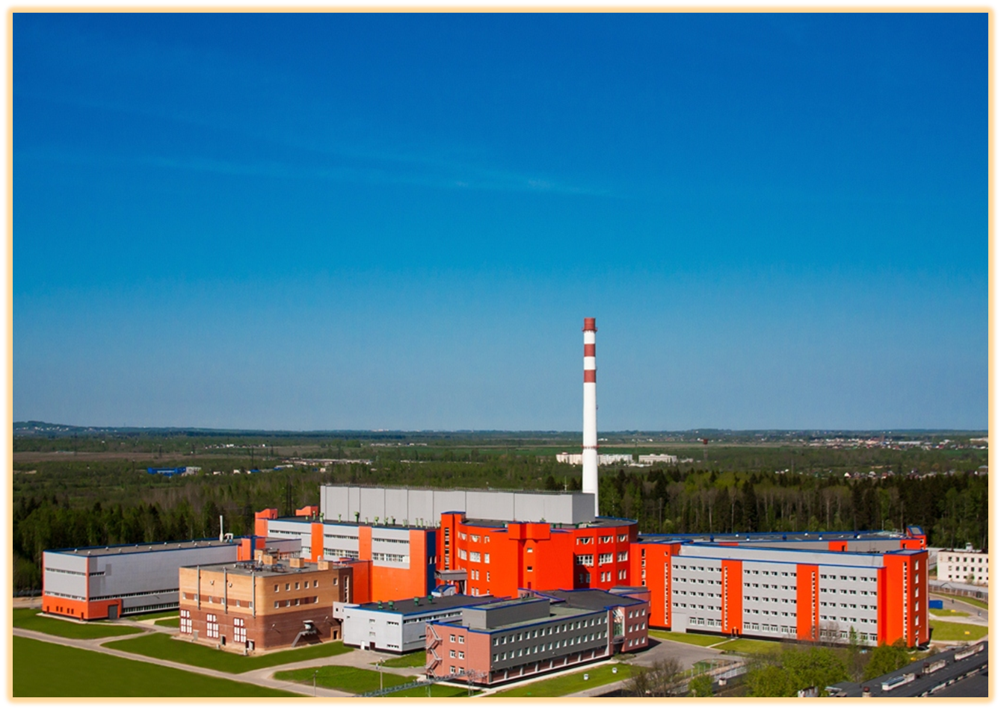
Petersburg Nuclear Physics Institute of the NRC “Kurchatov Institute”
1980
2010
2013
2013
Central part of the reactor complex PIK (2014)

Slide 18
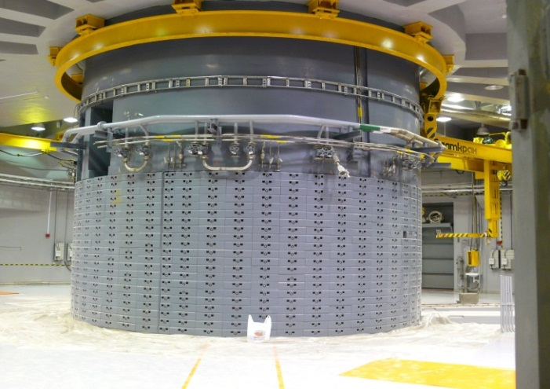
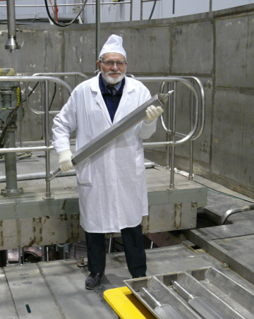
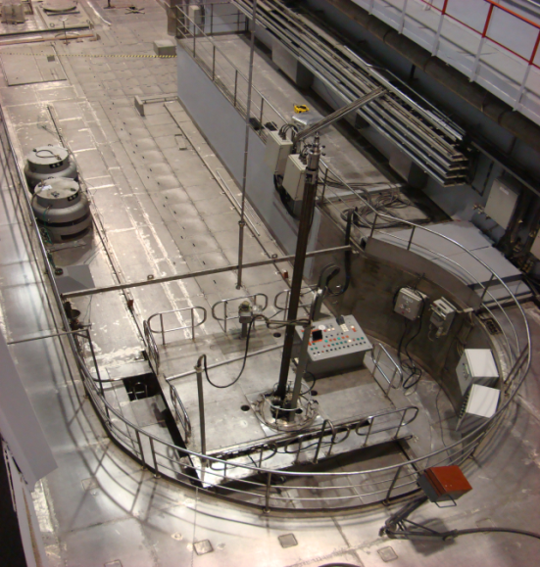
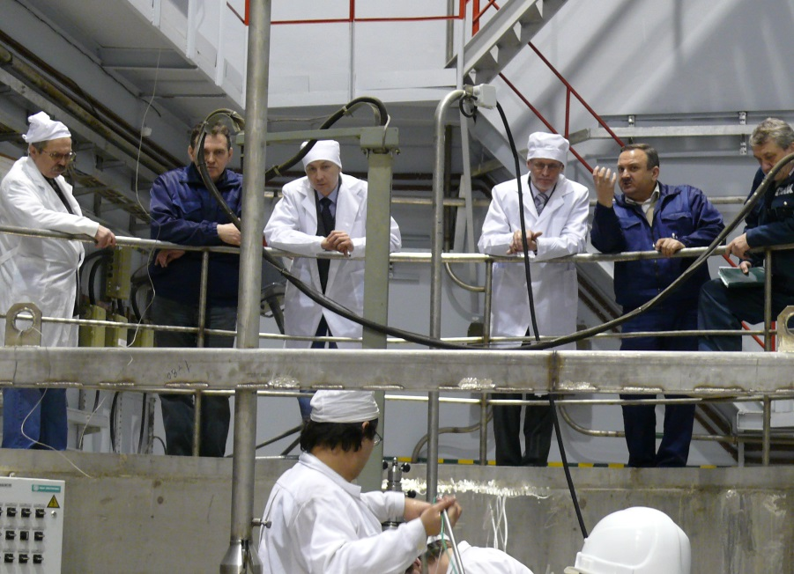
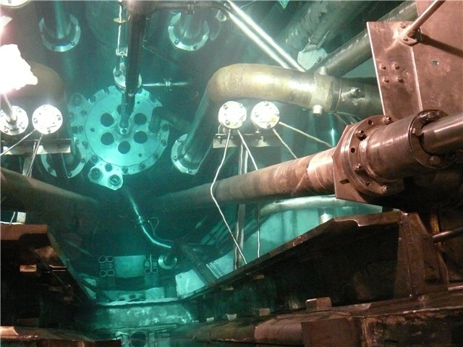
Petersburg Nuclear Physics Institute of the NRC “Kurchatov Institute”
Reactor complex PIK
Energy start up: 2018
First 12 exp. stations:
2019
2011 a critical state of the fuel assembly was achieved and a complete test of the reactor systems was produced without coolant at W = 100 W
Notes:
18

Slide 19
Petersburg Nuclear Physics Institute of the NRC “Kurchatov Institute”
Reactor complex PIK
Offices and Data Center Bldg.105

Slide 20
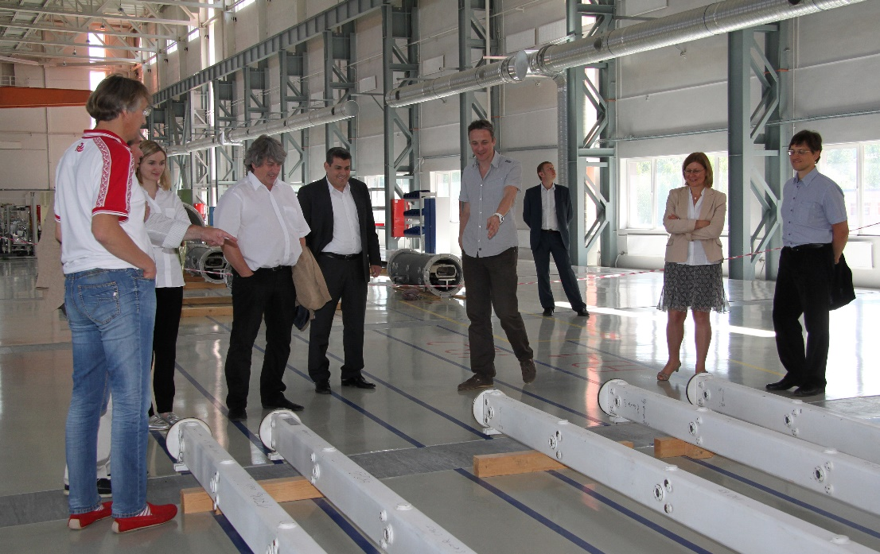
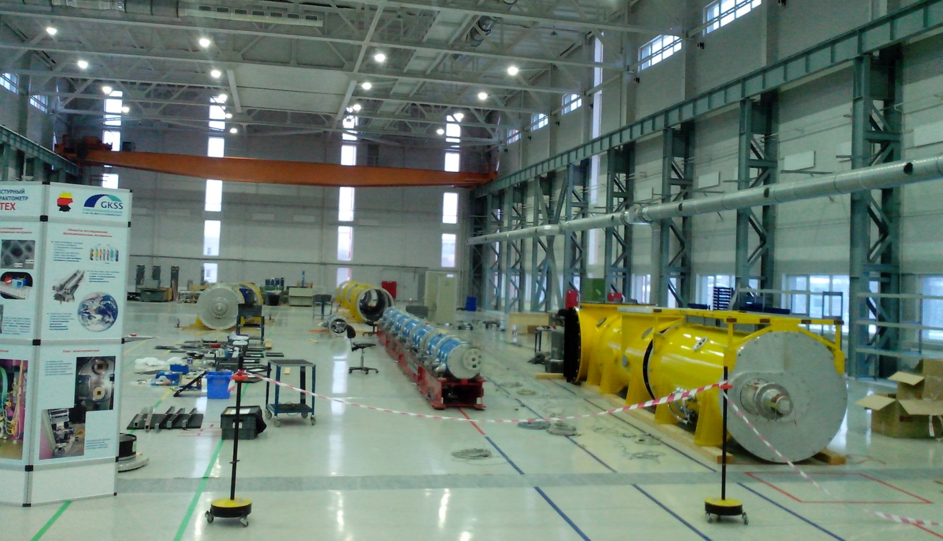
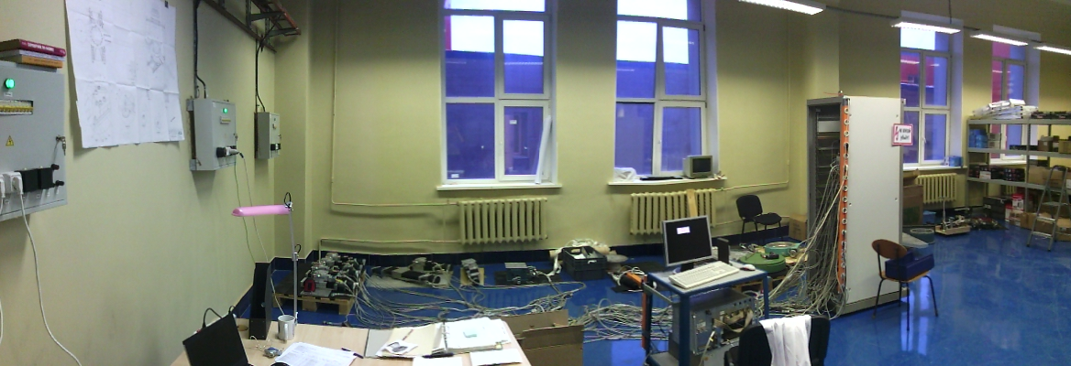
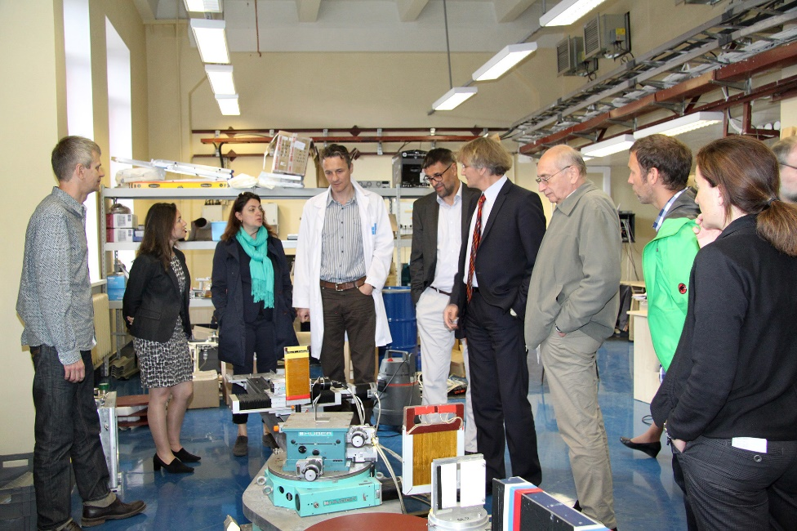
Experimental Stations for Condensed Matter
NATIONAL RESEARCH CENTRE
«KURCHATOV INSTITUTE»
PETERSBURG NUCLEAR PHYSICS INSTITUTE
Russia, 188300, Leningrad District ^{, Gatchina, Orlova Roscha}

Slide 21
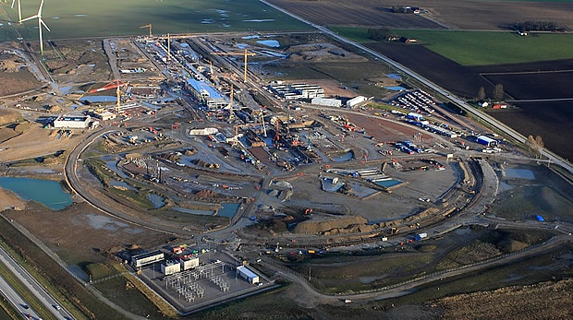
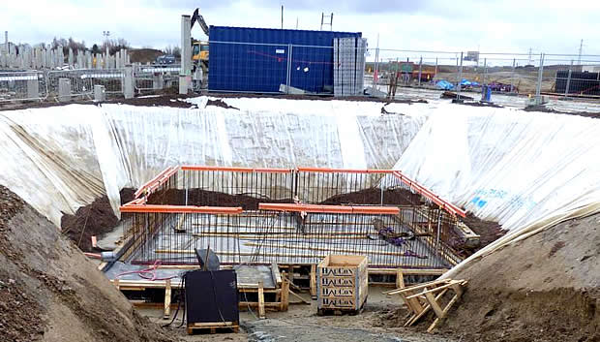
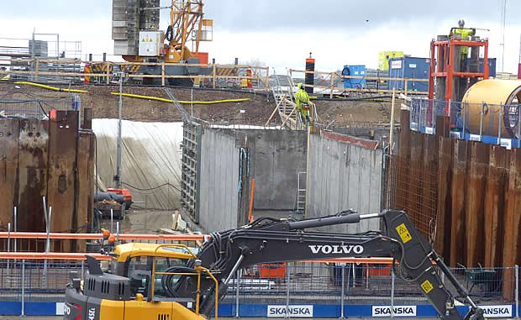
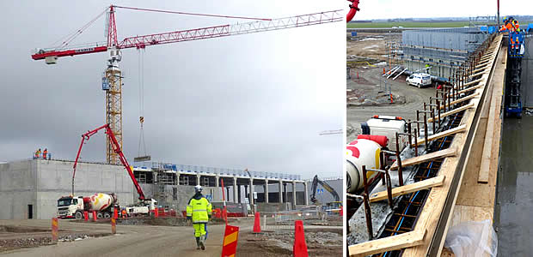
First neutrons: 2019
Experiments: 2023

Slide 22
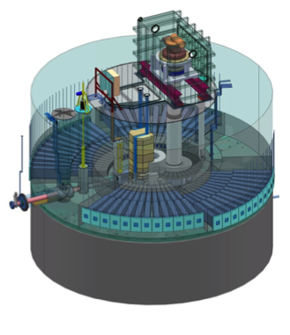
The ESS accelerator high level requirements are to provide a 2.86 ms long proton pulse at 2 GeV at repetition rate of 14 Hz. This represents 5 MW of average beam power with a 4% duty cycle on target.
The target station is a 4-tonne helium-cooled tungsten wheel. The design of the target has a direct impact on the number of neutrons that can be generated, and is therefore of utmost importance for the future scientific capabilities of the ESS facility.

Slide 23
Dubna Neutron Source
of Forth Generation
Future of IBR-2 reactor
Concepts of a new neutron sources

Slide 24
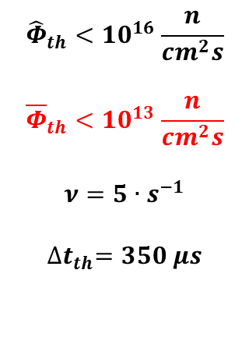
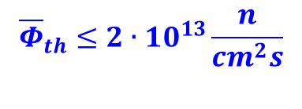
Why do we need a new project of JINR neutron source?
3-d Generation IBR-2
LIU-30 was not
realized
1-st Generation
IBR
IBR + microtron
2-nd Generation
IBR-30 stoped in 2000
IREN under constr. limited parameters
Resource 2032
Resource of buildings and equipment – 2035 → a new building complex is needed
Yu.N.Pepelyshev, A.F.Rogov, 2016 (to be published): limit parameters of IBR-2,
Safety Agency permission for IBR-2 concept is problematic → a new concept is needed

Slide 25
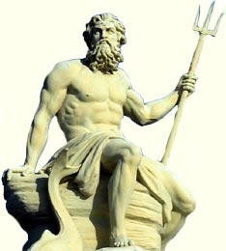
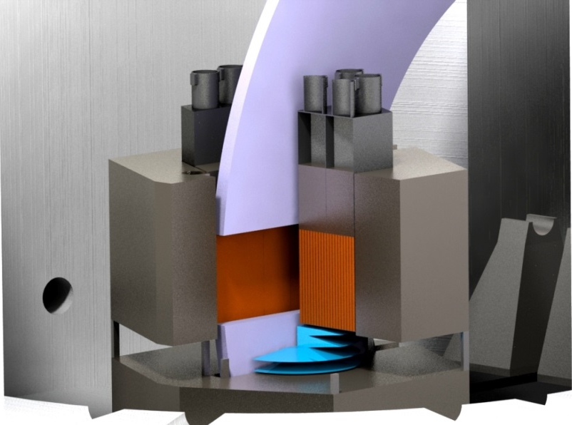
PULSED Np-REACTOR (“NEPTUN”)
Ni
drive
water
50 cm
water
cavity
Computer model
Be (Ni)
Np-core
50 cm
E.P.Shabalin, G.G.Kamyshev, A.D. Rogov (2016) to be publ.

Slide 26
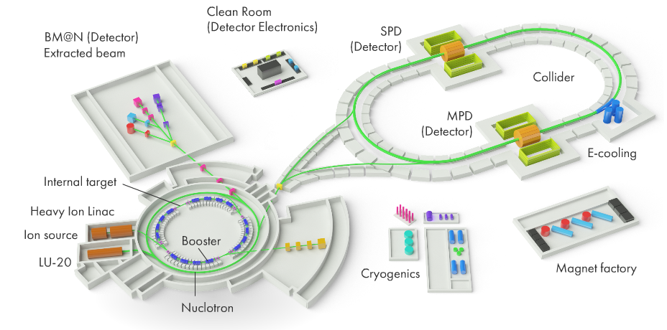
Cascade Booster Razmnozhitel (multiplayer)
proton accelerator
neutron generating target + subcritical assembly
COBRA
NICA
Complex
Variants for Accelerator:
a) NICA: Nuclotron + Booster
b) New SC Linear Accelerator
(Dolya S.N. (2015) JINR P9-2015-90)
Target
Station
Aksenov V.L., Balagurov A.M., Pepelyshev Yu.N., Rogov A.D. (2016) JINR P13-2016-49

Slide 27
Dubna Neutron Source of forth generation (DNS-IV) vs. other sources
130
DNS-IV
15 MW
Brightness,
peak × 10¹⁴
Flux
density,
time aver.
Flux
density,
peak
IBR-2 9 0.1 58
10 MEu
ESS 8 2 75
2000 MEu
PIK 2 10 10
200 MEu
DNS-IV 130 3 800
100÷600 MEu
Single-pulse source brightness as a function of time at wavelenght of 1.5 A at ESS, ILL, SNS, J-PARC and ISIS Target Stations 1 and 2.
In each case, the thermal moderator with the highest peak brightness shown. (Source: ESS)
Shabalin E.P., Rogov A.D., Komyshev G.G., Ananiev V.D., Aksenov V.L. (2016) JINR P3-2016-90

Slide 28
Conclusions
The use of neutrons in modern sciences is growing, they unique properties will be used for a long time
The number of Neutron Sources is decreasing in the World contrary to increasing needs
The research programme of the JINR in this field corresponds to the modern trends completely
FLNP asks the PAC to include the project “Developments of a concept for JINR’s new neutron source” to the theme 04-4-1105-2017/2019 (IBR-2)

Slide 29
THANKS FOR YOUR ATTENTION !

Slide 30
NEUTRON WORLD MAP
.
CMRR

Slide 32
European neutron instrument days =
= (facility operation days) x (number of operational instruments)
In practice days delivered to users will be 80-­‐85% of this value
Number of Neutron Instruments (Sources) is decreasing contrary to increasing needs
New landscape!
UK NS Roadmap by R.McGreevy

Slide 33
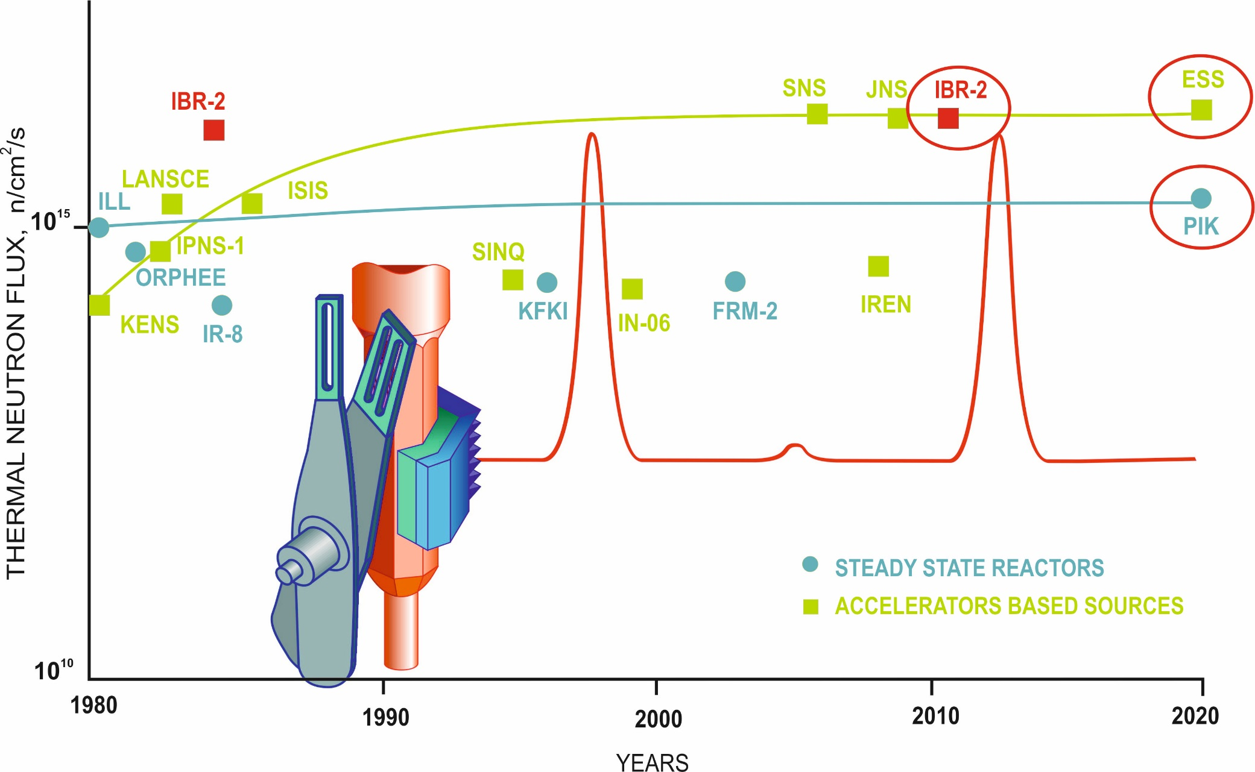
NEW ADVANCED NEUTRON SOURCES

Slide 34
Striping Neutron Source
Possible approach for a new network of smaller to medium sized sources in Europe (complements ESS)
The Oppenheimer-Phillips process (1935)
or strip reaction is
²D + ^{A}X → ^{A+1}X + ¹H
deuteron-induced nuclear reaction
The Jülich High Brilliance Neutron Source Project (HBS)
Th.Brückel et al. Eur.Phys.J.Plus (2016) 131:19
⁹Be(d, n), 25 MeV, 100 mA D⁺ → 100 kW target, pulse n⋅10¹⁶ n/s, average 4⋅10¹⁴ n/s
Compact Acceleratordriven Neutron Source (cANS) – Saclay
125 mA (d) → 1 MW target (J.Knaster et al. Proc. IPAC 2013, 1090 (2013)
ESS Bilbao 1 MW (I.Bustinduy, F.J.Bermejo Phys. Procedia 60, 157 (2014)

Slide 35
Possible Facility Layout for Booster System
innovative approach for a novel type of neutron facility
dedicated target stations with pulse structures adapted to specific instruments
high nuclear safety and relatively low cost
muons, isotopes, irradiation for biology and medicine
ultracold beamline
cold beamline
thermal beamline
Idea from Th.Brückel et al. Eur. Phys. J. Plus (2016) 131: 19

Slide 36
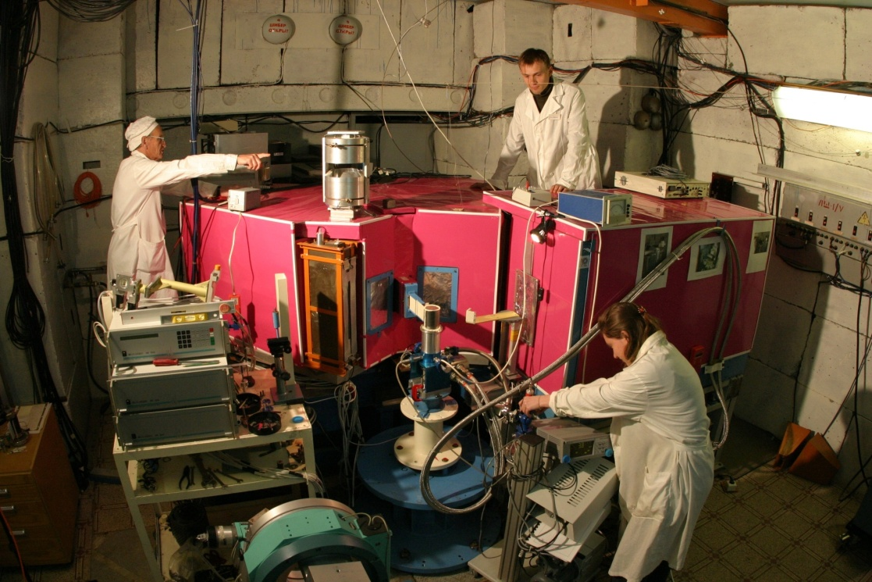
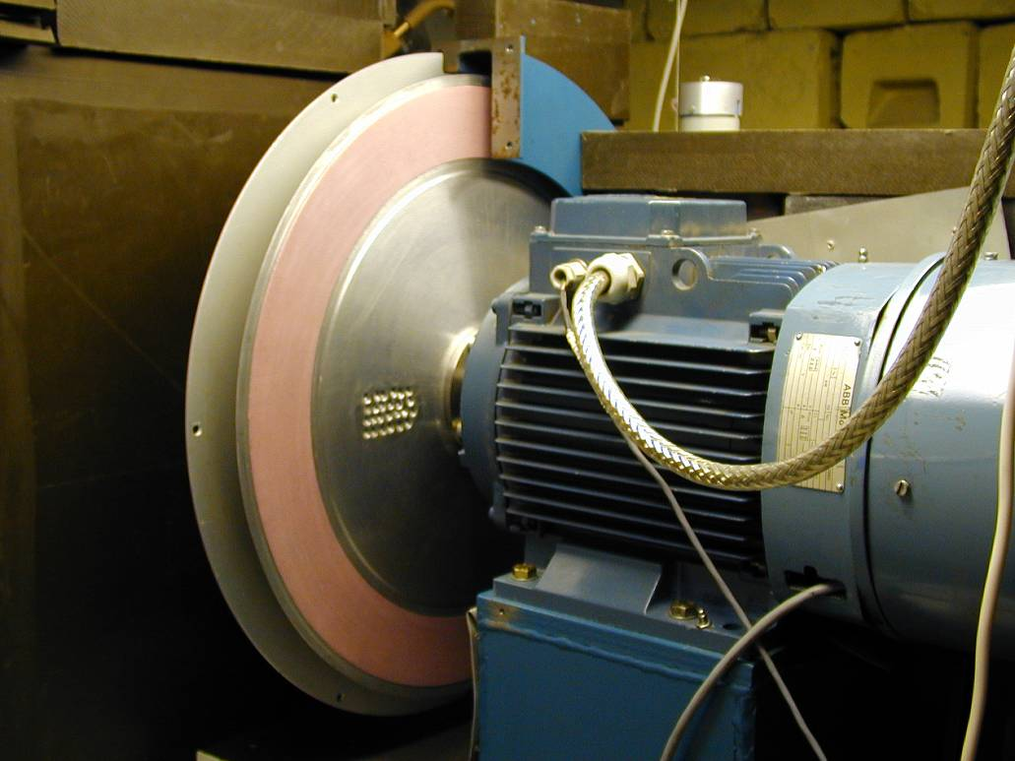
High Resolution Fourier Diffractometer (HRFD) at IBR-2
Put into operation in 1994 in collaboration between:
FLNP (Dubna), PNPI (Gatchina), VTT (Espoo), IzfP (Drezden)
Advantages:
very high resolution,
very short flight path,
- no pulse overlapping
TOF method in CMP was established in FLNP in 1964
0.7 mm
slits
Rotor
Stator
Fast Fourier
chopper
Rotor (∅ = 50 cm)
Aksenov V.L., Balagurov A.M. Physics Uspechi (2016) 186 (3) p. 293

Slide 37
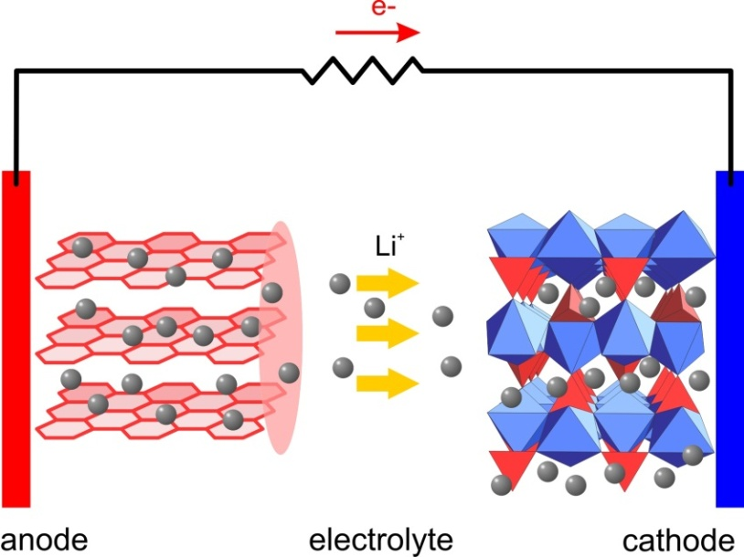
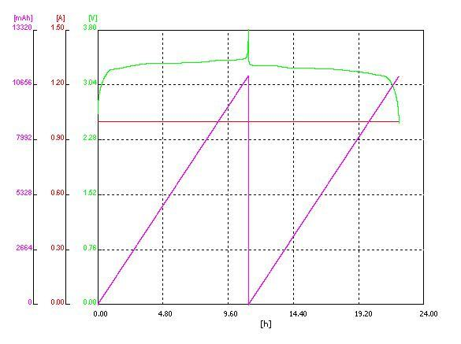
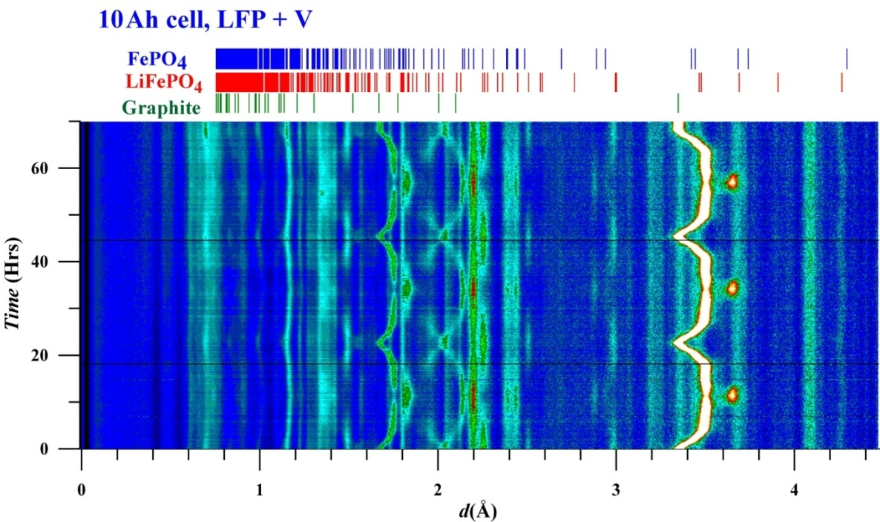
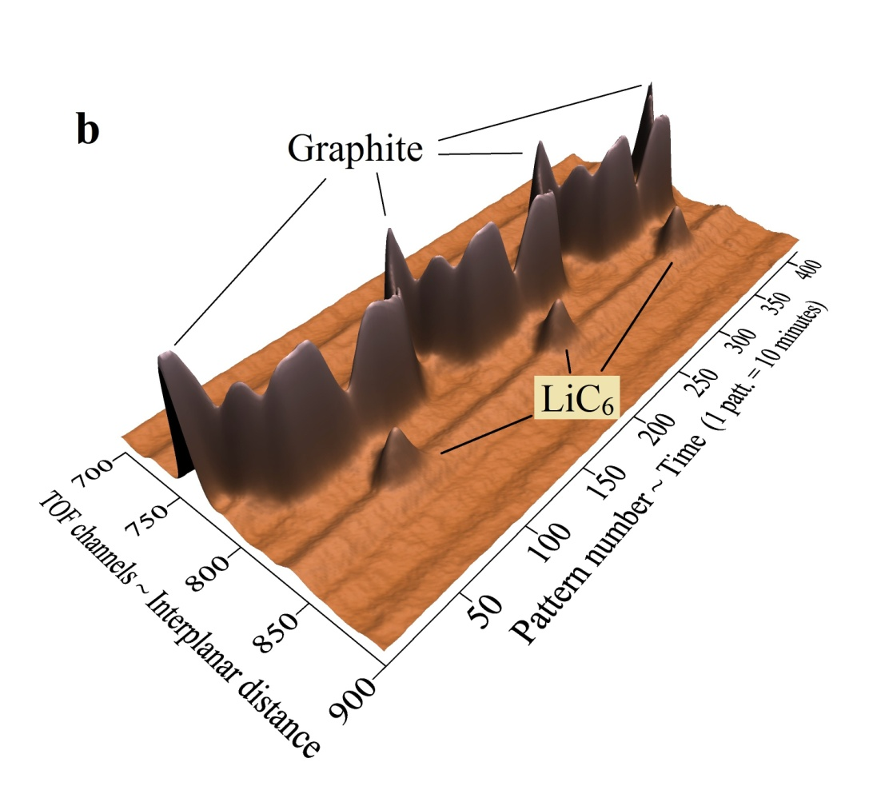
Real-time studies at IRB-2 reactor
(Balagurov et al. 1986)
Evolution of neutron diffraction patterns of Li accumulator with LiFePO4+xV
working substance during three cycles of charging-discharging
37
Bobrikov et al., Journal of Power Sources (2014), Bobrikov et al., Electrochemistry (2017)
37

