Slide 1
Condensed matter research at IBR-2: overview of main scientific results and instrumentation developments achieved in 2016
D.P. Kozlenko
Frank Laboratory of Neutron Physics, Joint Institute for Nuclear Research, 141980 Dubna, Russia

Slide 2
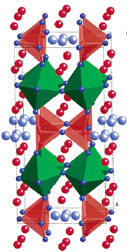
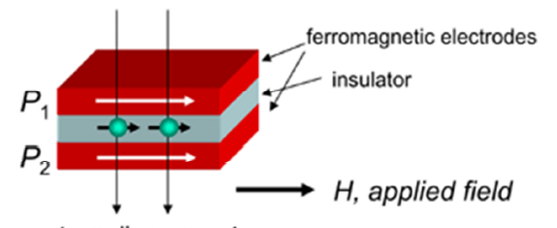
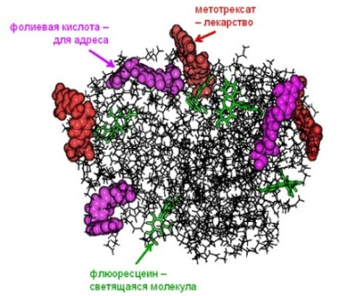
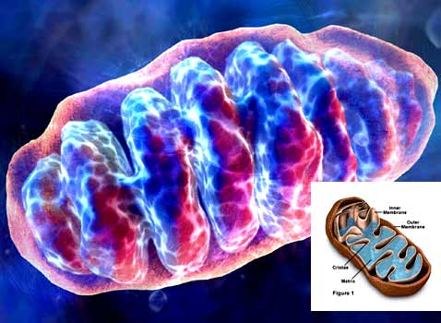
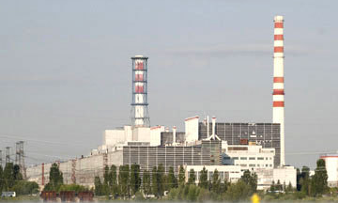
The priority directions of scientific research :
Physics and chemistry of novel functional materials;
Physics of nanosystems and nanoscale phenomena;
Physics and Chemistry of Complex Liquids and Polymers;
Molecular Biology and Pharmacology;
Materials and Engineering Sciences.

Slide 3
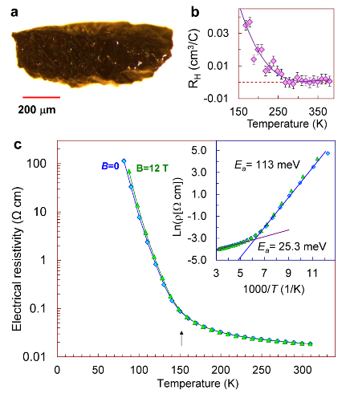
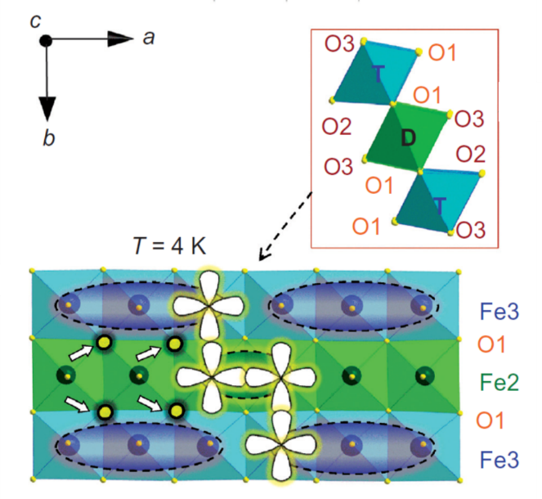
Novel type of the charge ordering state in iron oxide Fe₄O₅ involving competing dimer and trimer formation
Previously known: Fe₃O₄, Fe₂O₃, FeO
A new one: Fe₄O₅
Crystal structure of Fe₄O₅ (a), neutron diffraction patterns, measured at different temperatures and processed by the Rietveld method (b), magnetic structures at Т = 150 К (c), and Т = 10 К (d).
Formation mechanism of the dimeric and trimeric states
S.V.Ovsyannikov,.., D.P.Kozlenko, et al., Nature Chemistry (2016)

Slide 4
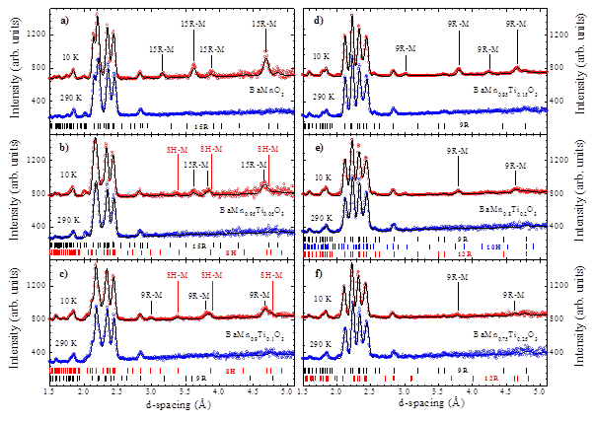
Structural and Magnetic Properties of Magnetoelectric BaMn_{1-x}Ti_{x}O₃
BaTiO₃ – large ferroelectric polarization (T_{C} = 410 K, no magnetic order)
BaMnO₃ – magnetic order, magnetoelectric effect, no FE polarization (T_{N} = 230 K)
X =0
0.1< X <0.25
X =0.05
Structural models of possible polytypes of BaMn_{1-x}Ti_{x}O₃ (0 < x <0.5
Neutron diffraction patterns of BaMn_{1-x}Ti_{x}O₃, x = 0, 0.05, 0.1, 0.15, 0.2 and 0.25, measured at 290 and 10 K and refined by the Rietveld method.
D.P.Kozlenko et al., J. Alloys and Compounds (2016)

Slide 5
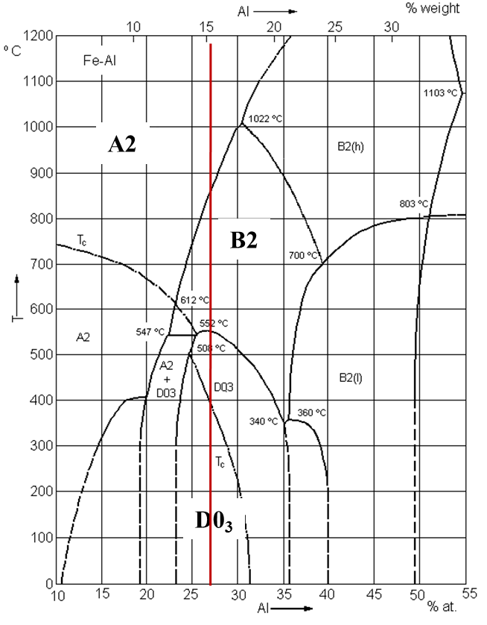
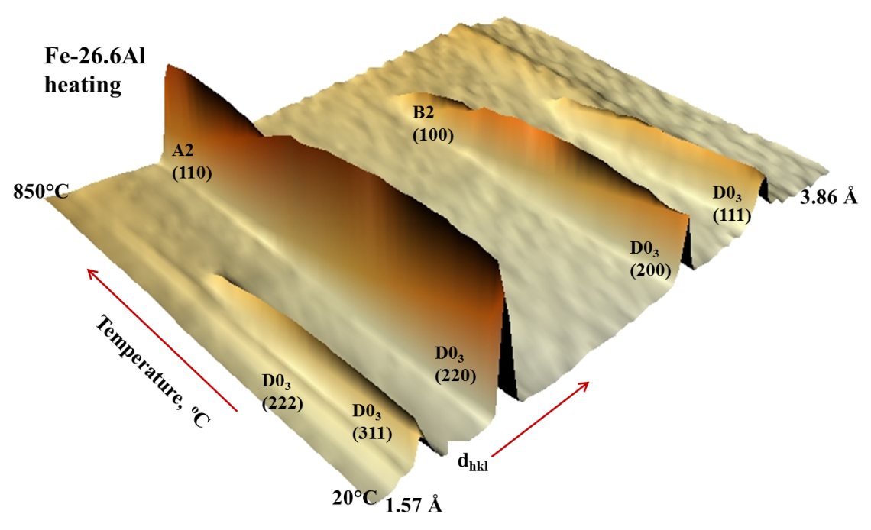
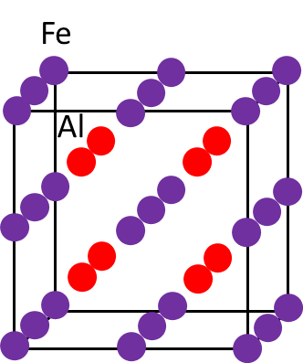
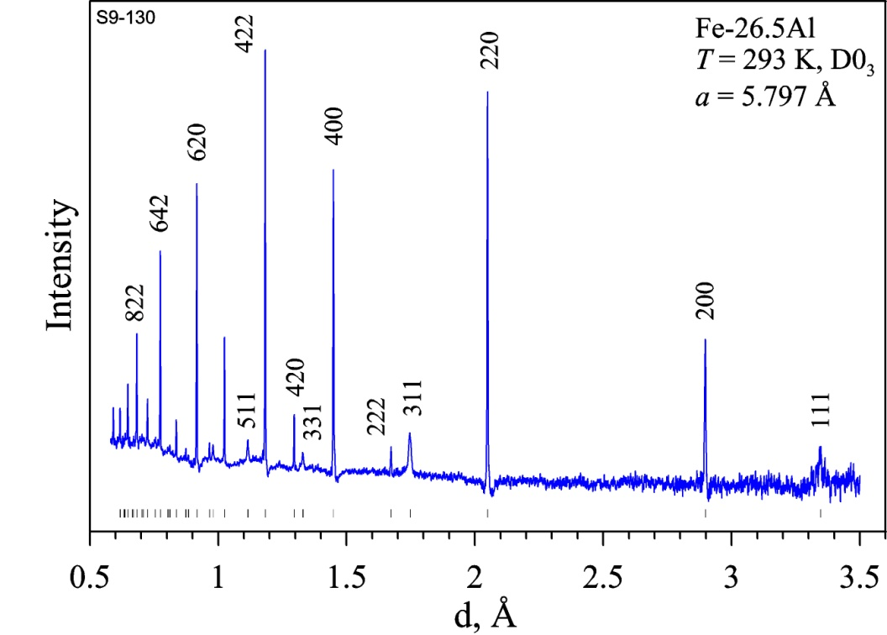
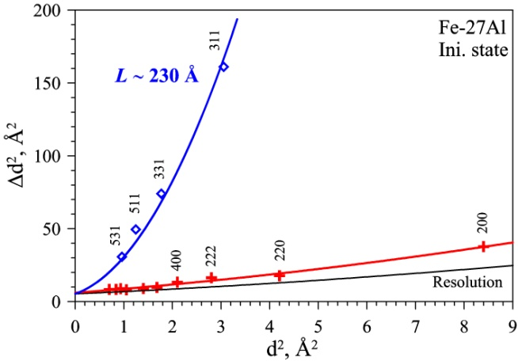
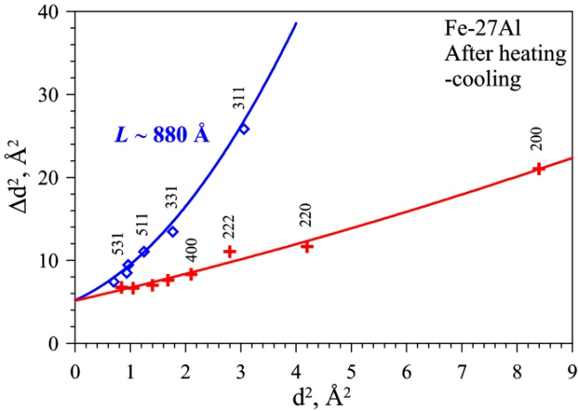
A Structural Study of the Fe-Al phase diagram
Neutron diffraction patterns of Fe-26.6Al alloy measured on heating with a rate of 1 deg/min.
An example of high resolution ND patterns and W² on d² dependences in Fe26.5 and Fe-27Al.
A.M.Balagurov et al., JETP Letters (2016)

Slide 6
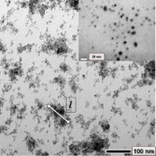
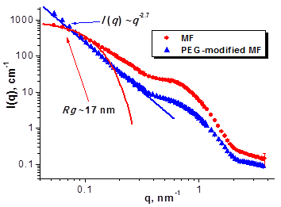
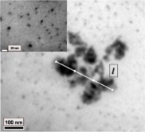
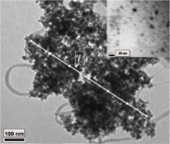
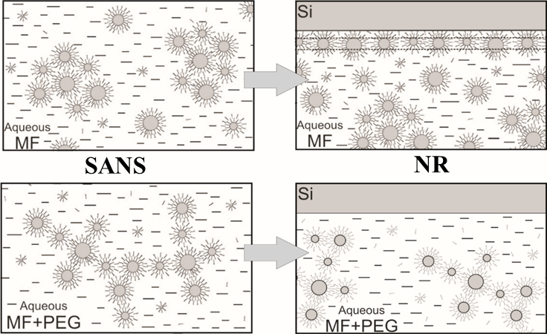
Structure and stability of ferrofluids in bulk and at interface
(FLNP JINR - IEP - KNU - CFATR - NIPNE - MPI SSR- IGIC NAS)
Impact of synthesis method on FFs bulk structure
MNPs reorganization at the PEG polymer addition
in diethylene glycol environment
cryogenic way of synthesis
microemulsion method
FFs structure at interface (Neutron Reflectometry)
Nagornyi A.V., Petrenko V.I., et al. JMMM, 2016, in press.
Kubovcikova M., Gapon I.V., et al. JMMM, 2016, in press.

Slide 7
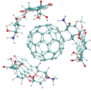
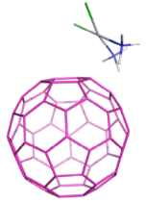
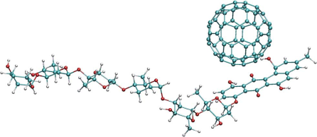
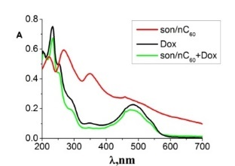
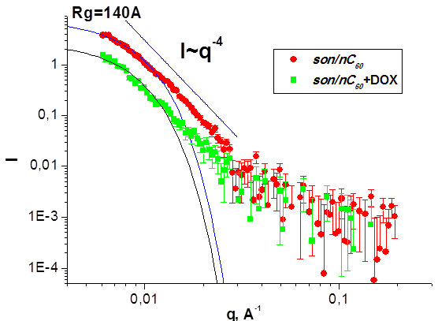
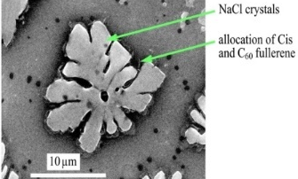
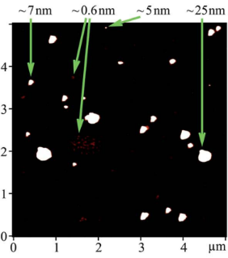
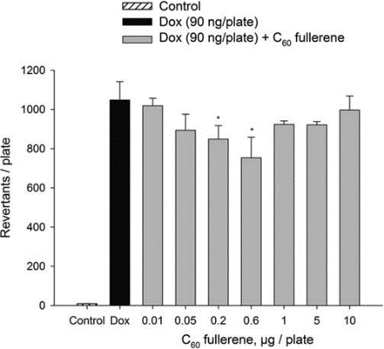
Fullerenes complexation with antitumor drugs
(FLNP JINR – Biological and Physics Department KNU)
Doxorubicin
ζ = -22 mV C₆₀
ζ = +45 mV C₆₀+Dox.
ζ = 0 mV Dox
Cisplatin
ζ = -22 mV C₆₀;
ζ = -17,6 mV C₆₀+Cis
UV-Vis
SEM
NaCl crystals
C60+Cis
Landomycin
ζ = -22 mV C₆₀
ζ =-10 mV C₆₀+LA
SAXS
AFM
SAXS
Biological tests
Mutagenic activity in Salmonella typhimurium
SANS
S.Prylutska, et al. Nano Res. (2017) accepted.
Yu.I.Prylutskyy, et al. RSC Adv. (2016).

Slide 8
A study of structural organization of organogels
4-heptyloxyphenylolithocholic acid (7OPhOLCA)
SANS curves for 7OPhOLCA in DMSO-d₆ for concentrations C = 0.005, 0.010, 0.015, 0.020 и 0.025g/ml at T = 10ºC after one cycle of heating-cooling.
Phase diagram of the gel – sol transition on heating (top) and cooling (bottom).
M.Ordon, Yu. Gorshkova et al. Thermochimica Acta (2016)

Slide 9
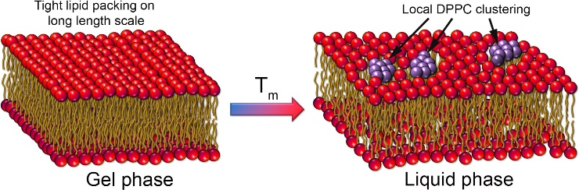
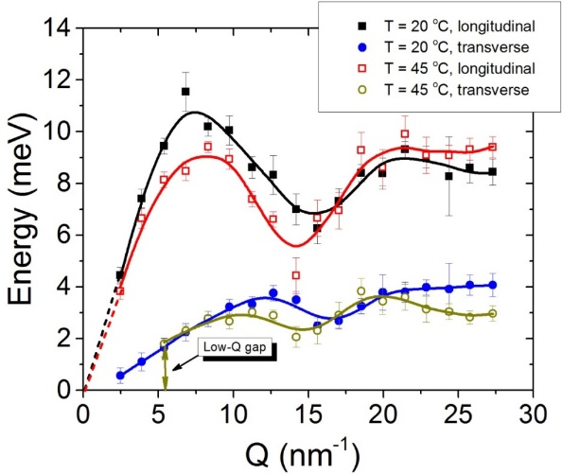
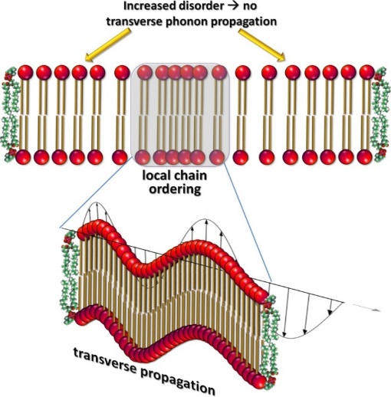
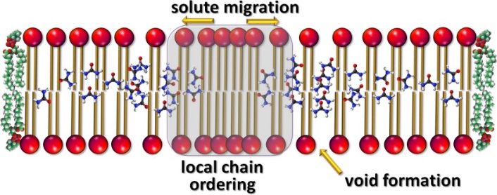
The Mechanism of Passive Transport in Lipid Bilayers
Low-Q phononic gap
No phonon propagation
at Q < Q_{gap}
Phonon-mediated nm-scale clustering
Characteristic length-scale
d_{gap} = 2π/Q_{gap} of a local “order”
(no phonons at smaller Q → more disorder on long scale! )
The cut-off value Q_{gap}
(at which gap occurs)
NO phononic gap
Low-Q phononic gap
Q_{gap}
We observe:
nm-scaled short-lived molecular clusters → local chain ordering, or density fluctuations
Increased disorder beyond the cluster size → indication of the transient voids formation
Size and the life time of the clusters agrees well with the theory prediction
the cluster size d_{gap} = 2π/Q_{gap} is ~ 1.1-1.6 nm
Lifetime: ~1 ps (agrees well with common
assumptions – a few ps)
M.Zhernenkov, .., D.Soloviov, et al. Nat. Commun. (2016)

Slide 10
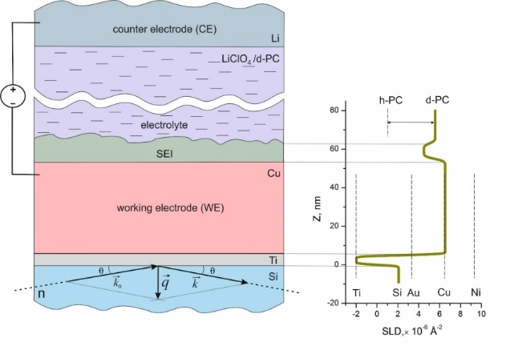
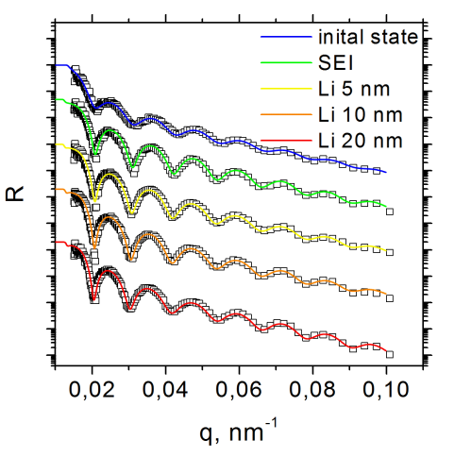
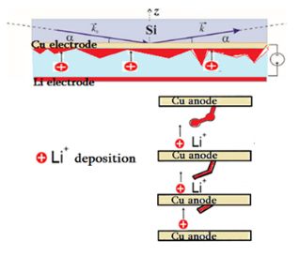
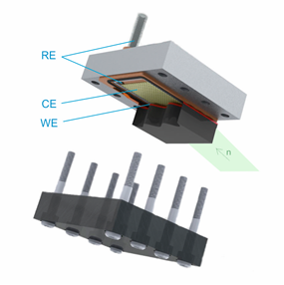
Monitoring of electrochemical processes at the interface metal electrode/liquid electrolyte by neutron reflectometry (FLNP JINR – Dep. Chem. MSU)
Electrochemical interface with a metal electrode and lithium-containing liquid electrolyte
Experimental NR curves and fitting results
Electrochemical cell for NR experiments
SLD profiles
Working electrode (WE)
Counter electrode (CE)
Reference electrode (RE)
M.V.Avdeev, et al. Appl. Surf. Sci. (2016) submitted.

Slide 11
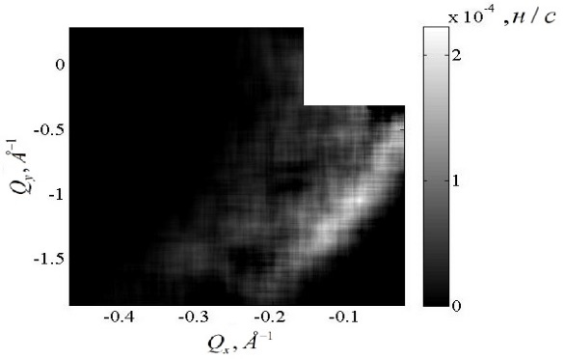
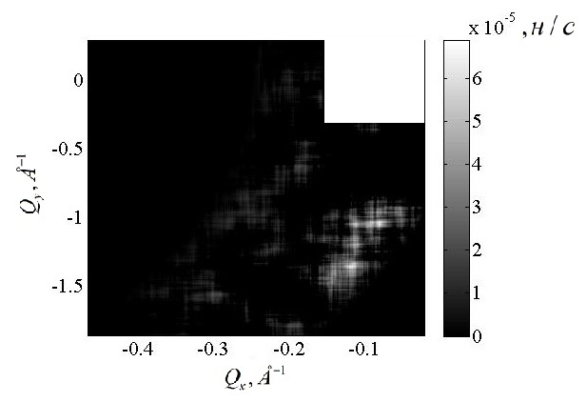
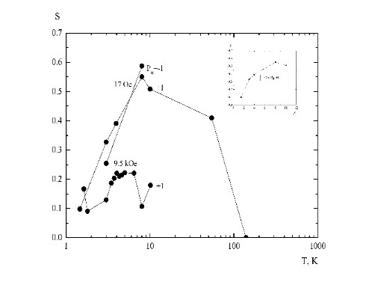
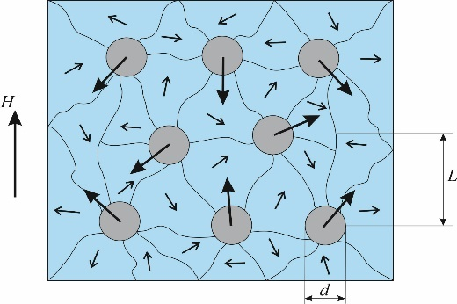
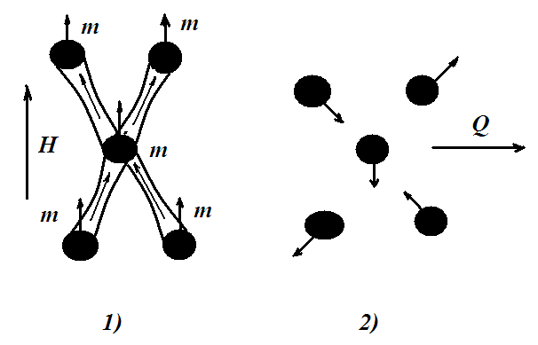
Observation of cryptoferromagnetic domain state in layered structure
V(150nm)/Fe(7%)+V+Nb)(20nm)/Nb(150nm)
Scattering at 10K, 2. Scattering at 1.5K, 3. Decreasing of scattering in range 1.5K-150K,
4. Transformation of cluster structure from 8K to 1.5 K at H=0
5. Structure at T=1.5K and H=1 kOe – Clusters and Domains (cryptoferromagnetism)

Slide 12
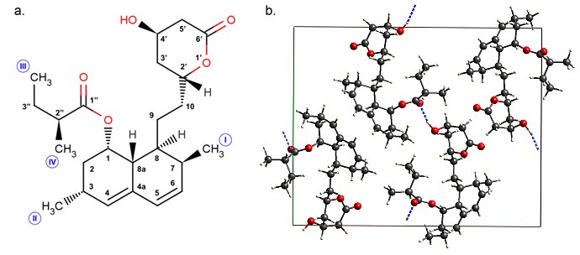
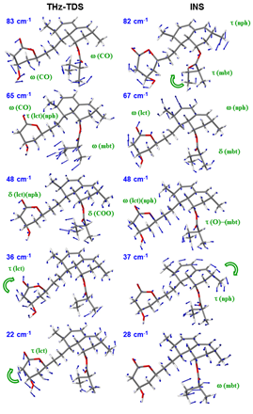
A study of structure and dynamics of lovastatine
С.
d.
Molecular (left) and crystal (right) structures of lovastatine (LOV; (1S,3R,7S,8S,8aR)-8-{2-[(2R,4R)-4-Hydroxy-6-oxooxan-2-yl]ethyl}-3,7-dimethyl-1,2,3,7,8,8a-hexahydronaphthalen-1-yl (2S)-2-methylbutanoate) (b).
Theoretical (harmonic DFPT PBE-TS approach) and experimental vibrational spectra of lovastatine according to inelastic incoherent and terahertz spectroscopy (с). The most important vibrational modes are visualized (d).

Slide 13
FSD-2016: Residual stress analysis in multi-pass welded specimen
20 mm thickness
FEM calculations - by group of Prof. Dr. V. Michailov (Brandenburg Uni. of Technology, Germany)
Sample preparation - by group of Prof. P. Petrov (Institute of Electronics of BAN, Sofia, Bulgaria)
Experiments were performed with new radial collimators
Multi-pass welded test specimen
1st weld pass: MSG (Metal Active Gas welding)
2nd and 3rd weld passes: SAW (Submerged Arc Welding)
Residual lattice strain (top) and stress (bottom) compared with FEM results
FEM results for longitudinal residual stress

Slide 14
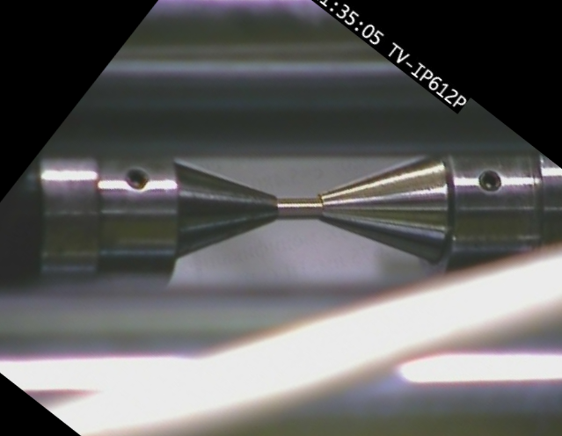
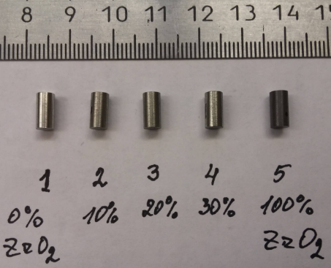
FSD-2016: TRIP steels (in collaboration with IMF of TU Bergakademie Freiberg)
Typical image from camera
Image profile analysis: changes in sample dimensions
4 phases: austenite, α- and ε-martensite, ZrO₂ (amorphous)
Phase contents vs. plastic deformation
Changes in diffraction pattern vs. plastic deformation
Studied samples

Slide 15


Deformation inside a paleosubduction channel – Insights from microstructures and crystallographic preferred orientations of eclogites and metasediments from the Tauern Window, Austria.
Microstructural observations
Geological location
Crystallographic preferred
Orientation (texture)
Keppler et al. (2016) J. Struct. Geol. 82, 60-79.
[doi: 10.1016/j.jsg.2015.11.006]

Slide 16
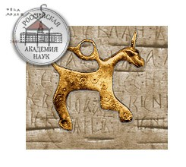
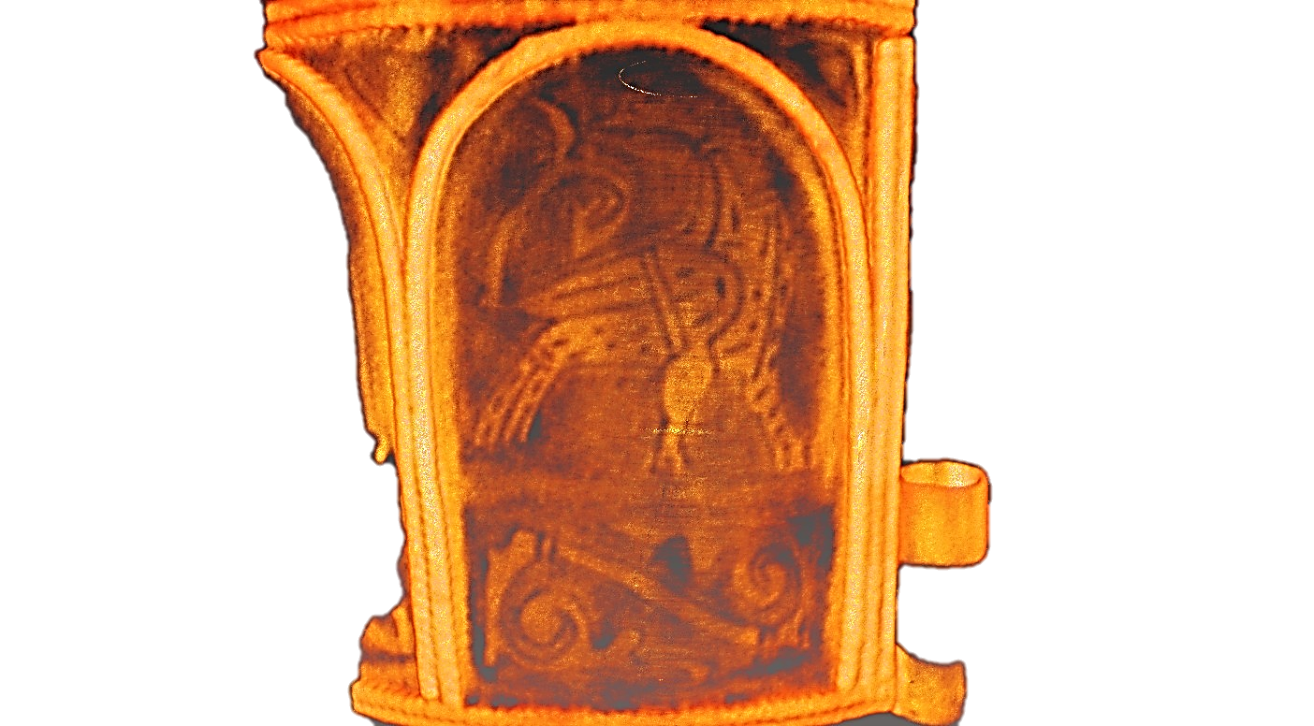
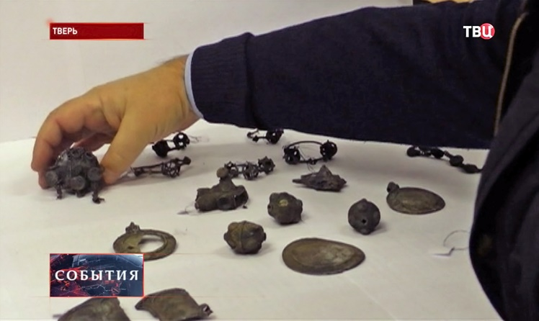
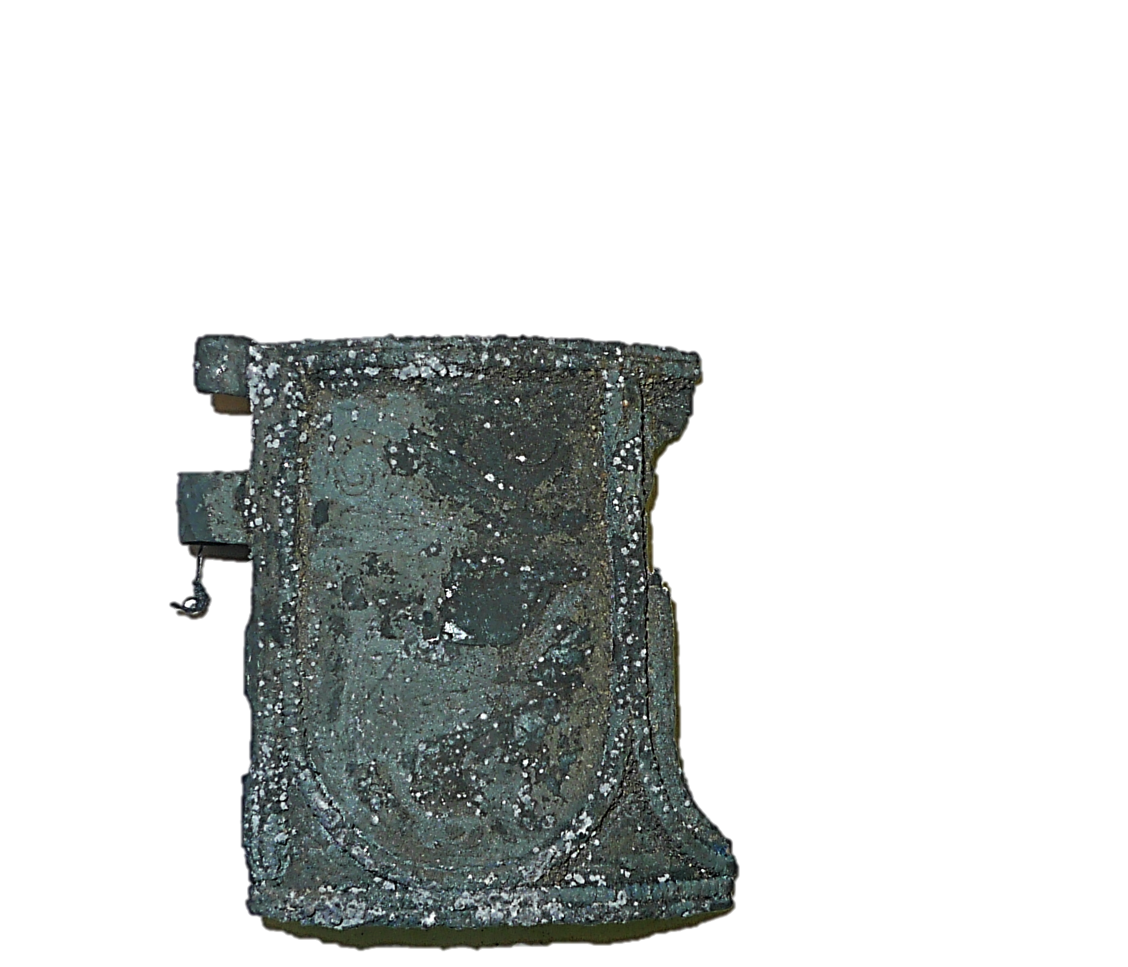
Neutron radiography and tomography facility: cultural heritage studies
Institute of Archaeology of Russian Academy of Science
«Tver’ treasure» was found in 2014
Neutron tomography reconstructed model
with “hidden” gilding pattern
The part of Old-Russian ancient bracelet dated to XIV century.

Slide 17
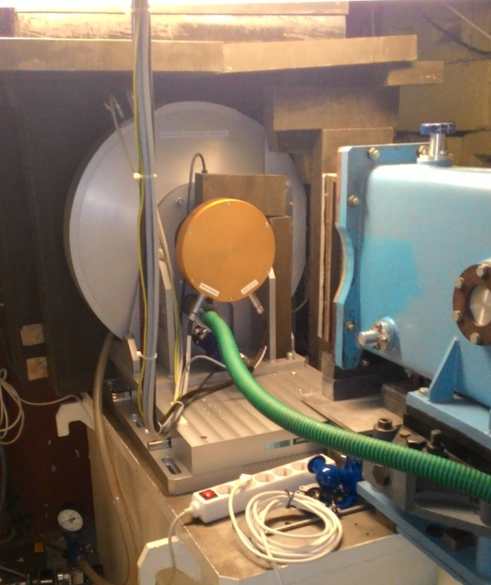
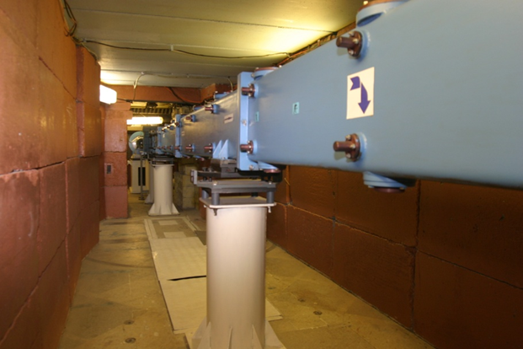
Global modernization of the HRFD diffractometer
New Fourier chopper in work position.
Comparison of the old (V-14-10) и new (V-16-10) incident neutron spectra measured using vanadium sample (a). The gain factor of neutron intensity as function of neutron wavelength measured using the standard Al2O3 sample (b).
Neutron guide with vertical parabolic focusing. New mirrors were mounted in old vacuum casing.

Slide 18





FSD-2016: NEW radial collimators (G.V.=1.8×1.8 ×1.8 mm³)
Beam profiles:
analytical calculations and Monte Carlo simulation
Radial collimators on FSD for gauge volume definition in bulk sample during stress measurements
Two radial collimators
by JJ X-Ray (Denmark)
Two strain components can be measured simultaneously using both collimators
Webcam for sample control:
top view of sample position
with radial collimators

Slide 19

Reconstruction of the Reflex reflectometer into the SESANS spectrometer
End part of a new neutron guide assembled at the 9th beamline.
Incident neutron wavelength distribution spectra on 9th beamline at the previous instrument configuration (black) and with a new neutron guide (red). Long wavelength limit is shifted by 11 Å, due to the move of the background chopper to the new position closer to the source.

Slide 20





SANS-YuMO: New thermobox and sample holder
New Vacuum system for detectors tube

Slide 21
Realization of the User Programme at the IBR-2 reactor
On behalf of
D.M. Chudoba
Frank Laboratory of Neutron Physics, Joint Institute for Nuclear Research, 141980 Dubna, Russia

Slide 22

IBR-2 reactor operation for physics experiments
(two rounds)
9 cycles (6 – water moderator, 3 cryogenic moderator)
2492 hr (1021 - first round)
(two rounds)
9 cycles (7 – water moderator, 2 cryogenic moderator)
2646 hr (1426 – first round)
2016 (two rounds)
8 cycles (7 – water moderator, 1 cryogenic moderator)
2447 hr
FLNP User Program
2 rounds
Scientific experts in 3 fields:
Atomic and Magnetic Structure
(7 facilities) – 9 experts from RU, PL, CZ, RU, MGL
Lattice and Molecular Dynamics
(2 facilities) – 3 experts from RU, PL
Nanosystems and Soft Matter
(4 facilities) – 14 experts from HU, RU, PL, FR, SK, EST, UA
Second round 2016: each proposal – 2 experts

Slide 23
2014 – 163 proposals; 150 accepted; 17 countries; 59 visiting users from 12 countries
2015 – 197 proposals; 174 accepted; 19 countries; 67 visiting users from 14 countries
2016 – 238 proposals; 208 accepted; 19 countries; 102 visiting users from 11 countries
2014
2015
2016
3.7%
26%
47%
5.5%
6.7%
9.8%

Slide 24




Scientific articles outcome at IBR-2 spectrometer complex (2014-2016)
Number of articles per year (including published and submitted)
Statistics of articles per instrument (only published ones are analyzed), prepared by N. Kucerka

Slide 25
Thank You for Your Attention!

