Slide 1

Progress towards modernization of the HRFD diffractometer
Science team:
Ivan A. Bobrikov, V.G. Simkin, S.V. Sumnikov, V. Turchenko and A.M. Balagurov
Outline:
General information about HRFD
Directions of HRFD modernization in 2014-2017
Modernization of HRFD in 2016
-Neutron guide,
- Fourier chopper.
Further step of HRFD modernization
and Conclusions
Notes:
Good day, everyone. Thank you for introduction! My talk is about upgrade of High resolution diffractiometer

Slide 2
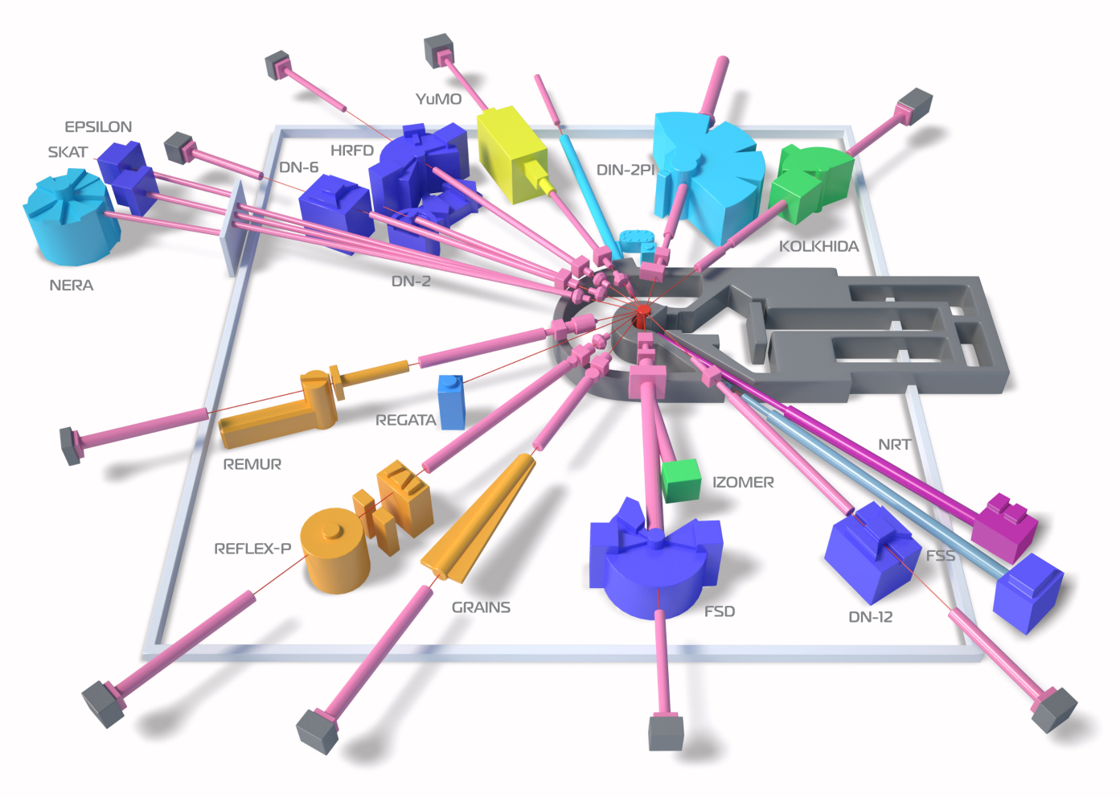
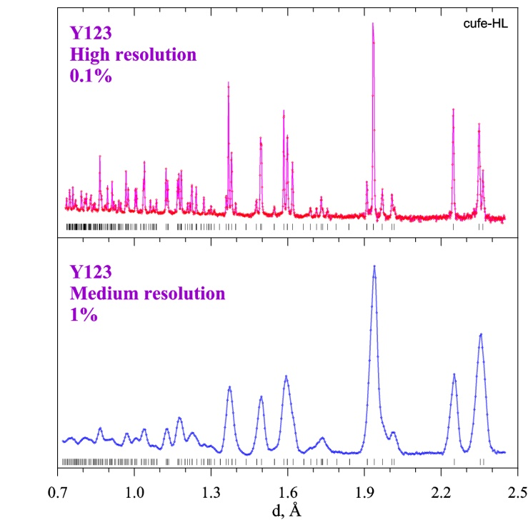
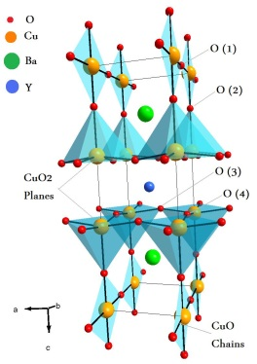
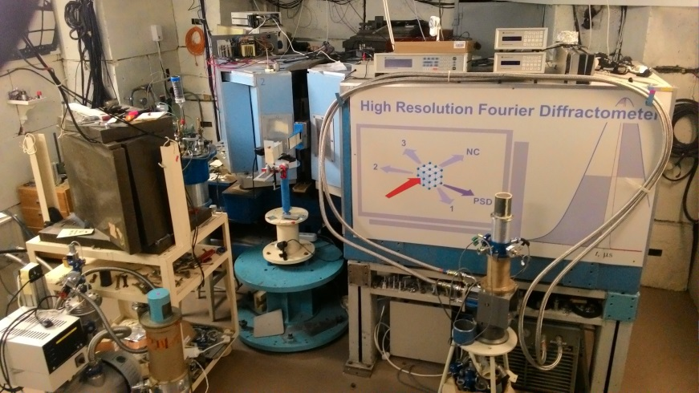
General information about HRFD
R(t, θ) = Δd/d = [(Δt₀/t)² + (Δθ/tgθ)²]^{1/2}
R→0 if Δt₀→0 or L→∞
and Δθ→0 or θ→π/2
t ~ L, R= Δd/d≈0.001, word level in resolution
Notes:
I would like to remind you that this diffractometer occupies channel 5 of our facility. The main purpose is precisely investigation of crystal structure and some microstructure effects in powders. And it there is among the best diffractometers in the world by resolution level. On the right picture you see comparison of diffraction patterns measured on common diffractometer at IBR-2 and high resolution pattern obtained at HRFD. Another advantage of this instrument is possibility to work in both high resolution and low resolution mode but high intensity mode.
To get high resoolution according this equation for TOF diffractometers we reduce neutron pulse width by special correlation techniques.

Slide 3
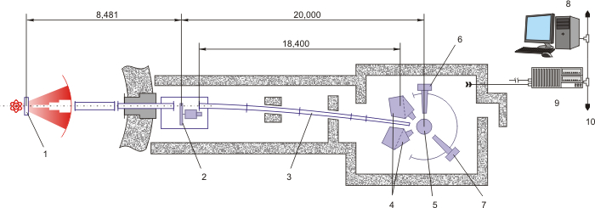
Directions of HRFD modernization
1 – Moderator
2 – Fourier Chopper
3 – Guide Tube
4 – Main Detector
5 – Sample Position
6 – 90°-Detector
7 – PSD Detector
8 –Control and Operative
9 – Data Acquisition
10 –Ethernet Data Transfer
Electronics for data acquisition
Software for data acquisition
Sample environment
Neutron guide
Fourier chopper
The main detectors
2014-2015
2015-2016
Notes:
The main components of diffractometer are shown on this slide. This is the special neutron chopper – Fourier chopper, curved mirror neutron guide, scintillation detectors and electronics for data acquisition.
Significant part of modernization of electronics components were made in 2014 and 2015
In my talk Ill focus on components which were installed in 2016 (in last year). This is neutron guide and the most important component of HRFD – Fourier chopper.
It has this name because of specific law of his rotation which helps us to collect data at different frequencies of neutron transmisson and use method similar to inverse Fourier transform for recover diffraction pattern.

Slide 4
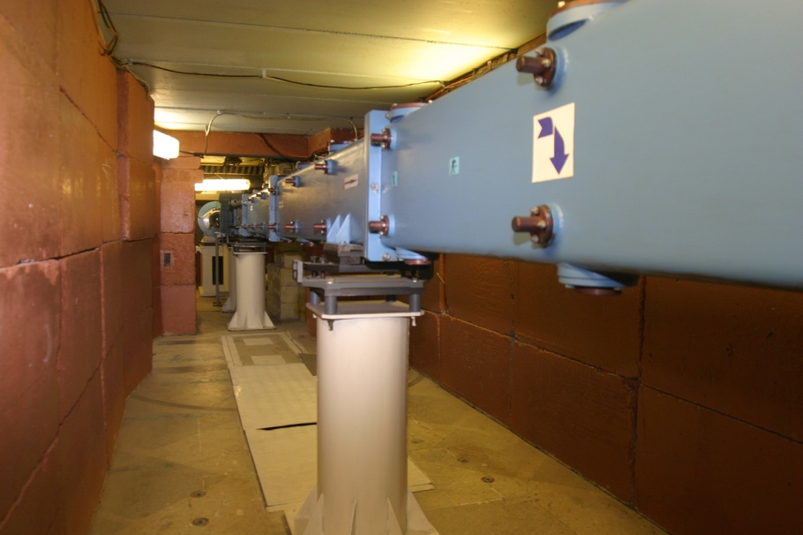
General information about HRFD
IBR-2
1 – Moderator
2 – Fourier Chopper
3 – Guide Tube
4 – Main Detector
5 – Sample Position
6 – 90°-Detector
7 – PSD Detector
8 –Control and Operative
9 – Data Acquisition
10 –Ethernet Data Transfer
It was made in 1991,
⁵⁸Ni (M=1)
Entrance 200×30 mm,
Exit 100×10 mm.
Notes:
Neutron guide helps us to get maximum number of thermal neutrons at sample position. Neutron guide became outadate. It was installed in 90th and had some mistakes in construction.

Slide 5
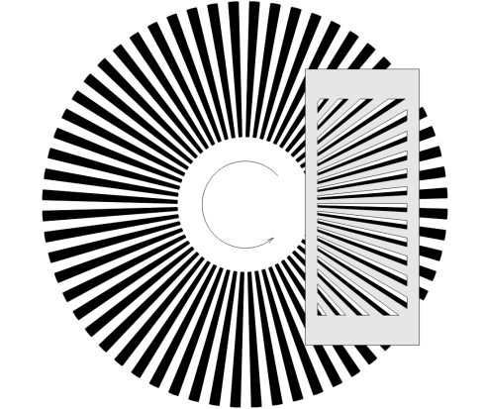
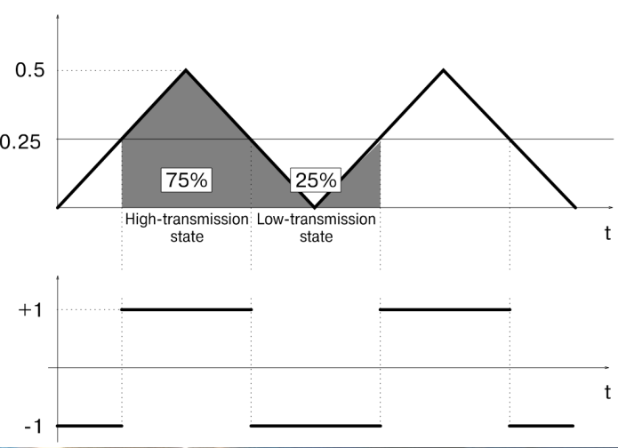
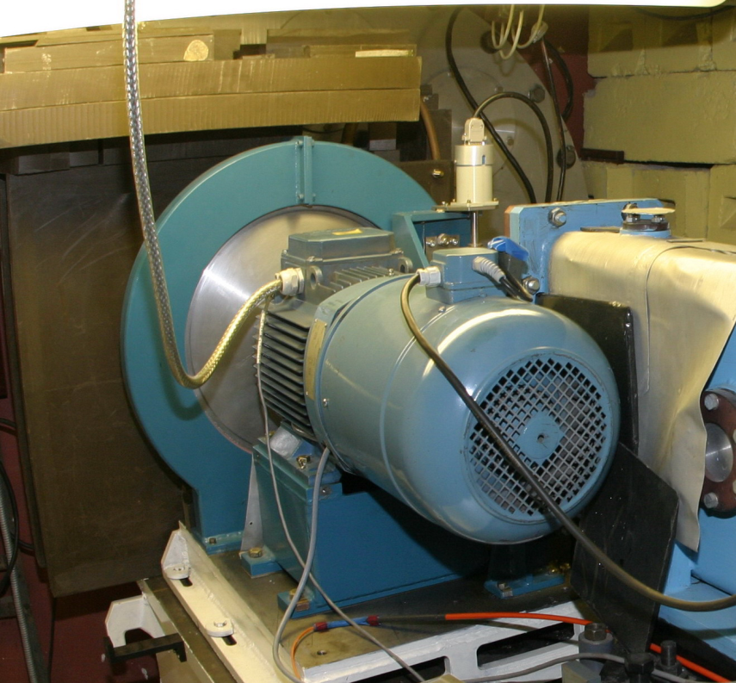
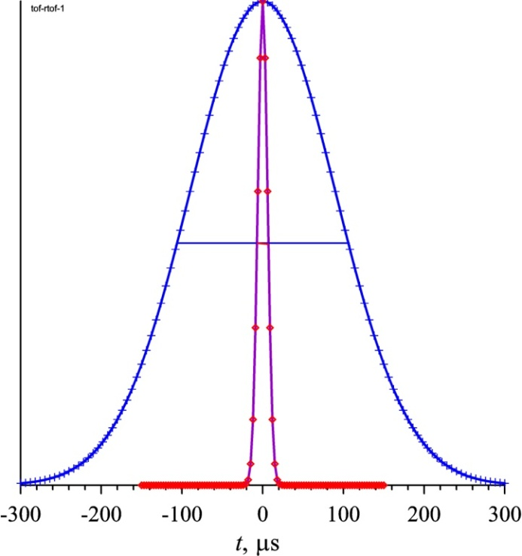
General information about HRFD
IBR-2
1 – Moderator
2 – Fourier Chopper
3 – Guide Tube
4 – Main Detector
5 – Sample Position
6 – 90°-Detector
7 – PSD Detector
8 –Control and Operative
9 – Data Acquisition
10 –Ethernet Data Transfer
Contrast = (High-Tr)/(Low-Tr) ≈ 25
IBR-2, TOF
W = 350 μs
R = 0.01
IBR-2, RTOF
W = 15 μs
R = 0.001
Notes:
Fourie chopper reduces neutron pulse from reactor to helps to get high resolution at short flight paths. The old Fourier Chopper was made and installed in 90-th too It had low contrast of transmission function, allowed installation of only low resolution encoder of rotation that considerably degrade signal of opened or closed position of rotor, high enough level of vibration that also degraded quality of collected data.

Slide 6
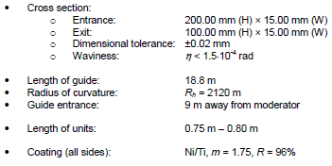

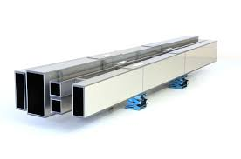
Suggestion for modernization – neutron guide
Neutron flux at sample position | ~6*10⁶ n/cm²/s (2011)
It was made in 1991,
⁵⁸Ni (M=1)
Entrance 200×30 mm,
Exit 100×10 mm.
Neutron flux will be increased in 2.5-3 times!
Notes:
We had got good suggestion from Swiss Neutronics, purchased new neutron guide and it was installed in summer 2016. Here you see parameters of new neutron guide. Difference between ald and new one is in cross section, focusing, Radius of curvate and type of covering.

Slide 7

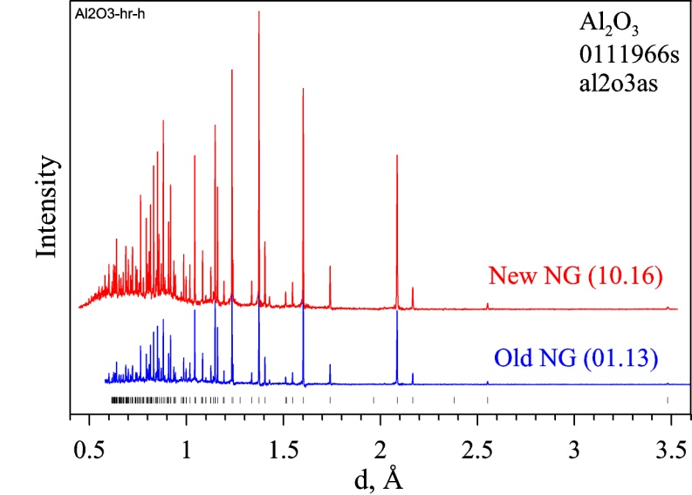
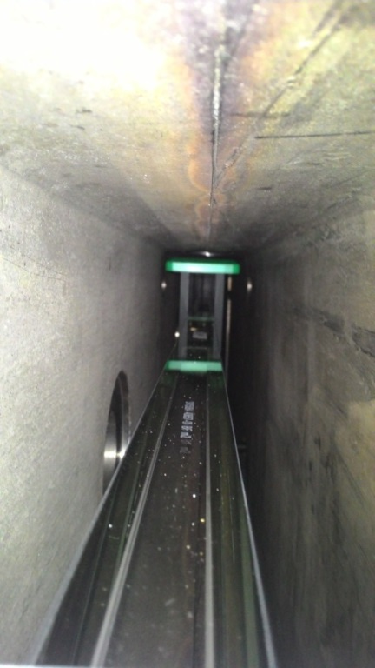
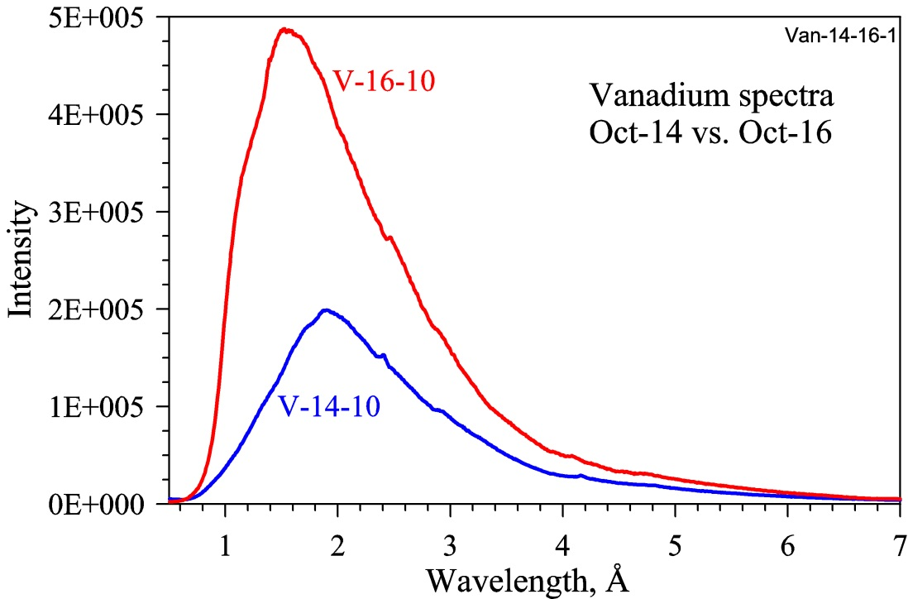
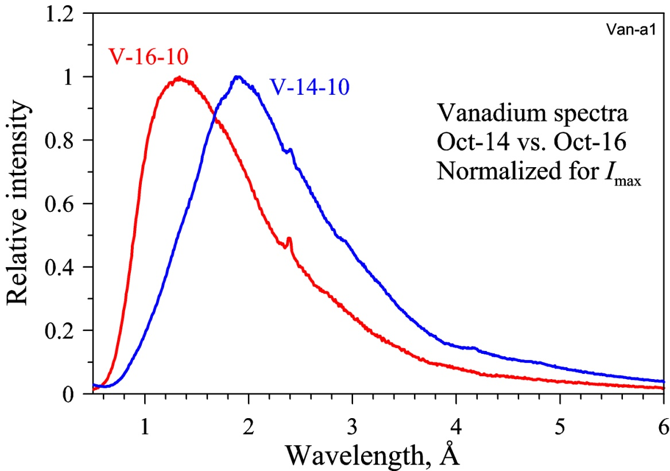
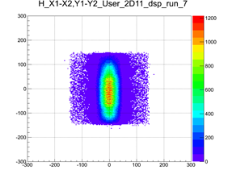
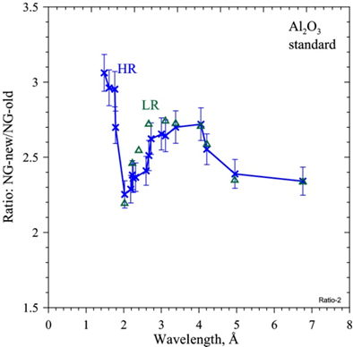
Modernization of HRFD
Notes:
On the right picture you see installed new neutron guide to old neutron guide case. First neutrons have shown that neutron flux was considerable increased.
Here there is wavelengths distribution of neutrons at sample position measured before and after new neutron guide installation. In small window you see normalized to 1 the same spectra. One can see that new effective spectrum of neutrons is shifter to short wavelengths to high energies of neutrons. Distribution of neutrons at exit of neutron guide is symetric which was shown by measuremnt of beam by PSD detector

Slide 8
Modernization of HRFD
By activation method:
Before ~6·10⁶ n/cm2/s
After ~1.37·10⁷ n/cm2/s
Notes:
On this slide you see the same graphs. And Ratio of some diffraction peaks of corundum measured before and after neutron guide installation. You can see that average effect is about 2.5 that is in agreement with our expectation. Activation method on golden foils has shown also that neutron flux was increased more than in two times.

Slide 9

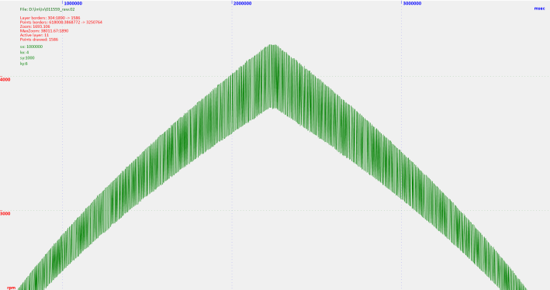
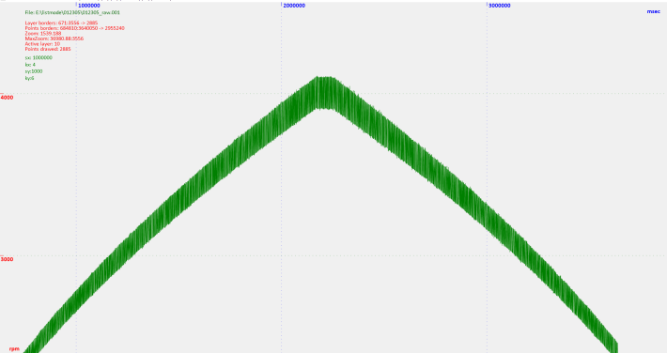
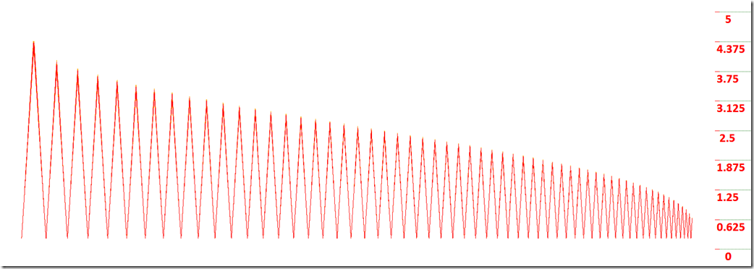
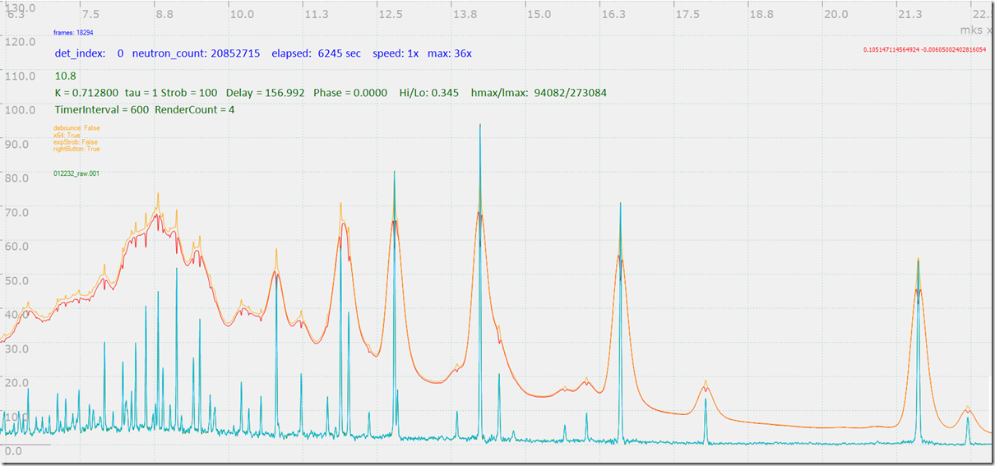
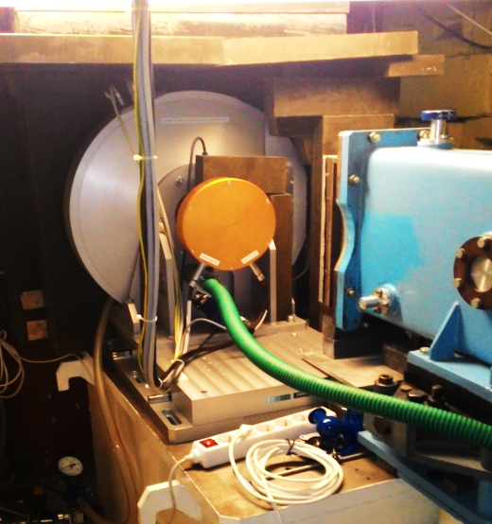
Modernization of HRFD
Old New
Rotation 0 → 4000 → 0 rmp
Contrast TF: from ~ 25 → 100
Low level of vibration
Max velocity: 4000 → 6000 rpm
Better quality of rotation signal (PICK-UP)
Notes:
In this summer new Fourier chopper was also installed. This chopper was ordered at Mirratron company in 2014. And in 2016 they finished this project.
In contrast to old chopper where disk was rotated in air, disk of new chopper rotates in vacuum. It significantly deacreased level of vibration. New chopper has better in 4 times contrast of transmission function of neutrons. Due to setup more precise rotation encoder quality of rotation signal was also improved.
It helped us to increase ratio effect/background in obtained high resolution patterns in 1.5 times. On top figures you see comparison of signal of chopper rotation from old device and from new one. Lower dispersion is better.

Slide 10

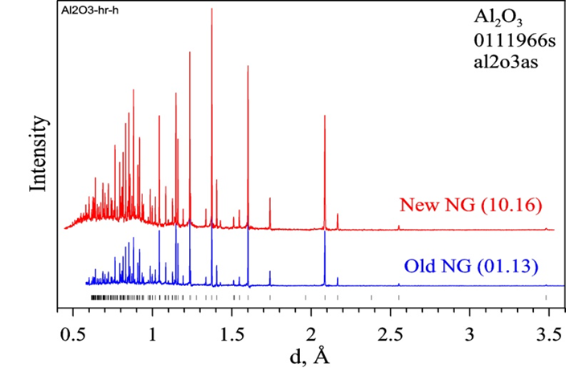
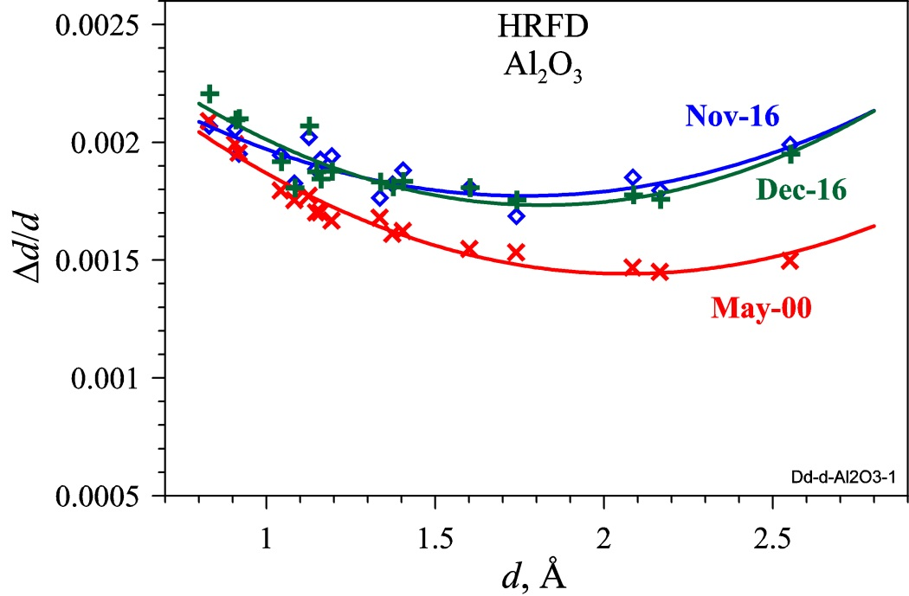

Modernization of HRFD
+
Notes:
My next slide shows results of new chopper and neuton guide installation on High resolution mode of HRFD. Diffraction peaks have become more intensive particulary at short wavelengths. But resolution degraded on 21%. But it is still very high resolution. We connect this degradation with increasing of angular divergence of neutrons at neutron guide exit. We hope we decide this problem by soller collimator.

Slide 11
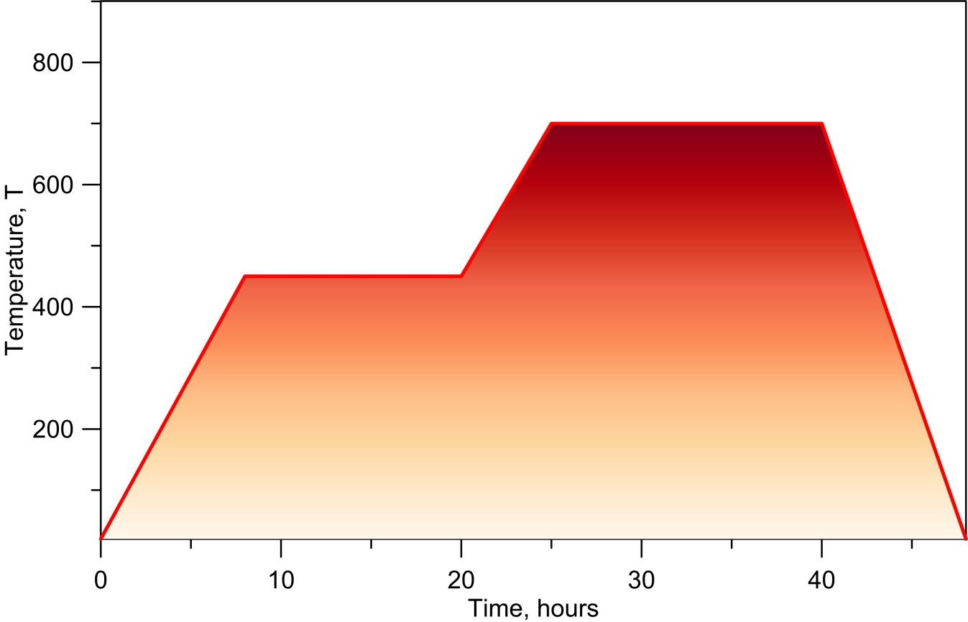
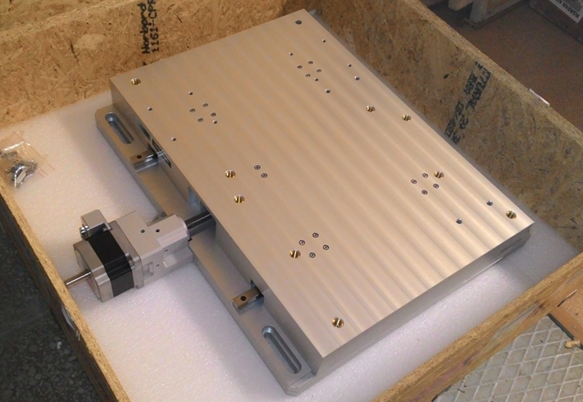
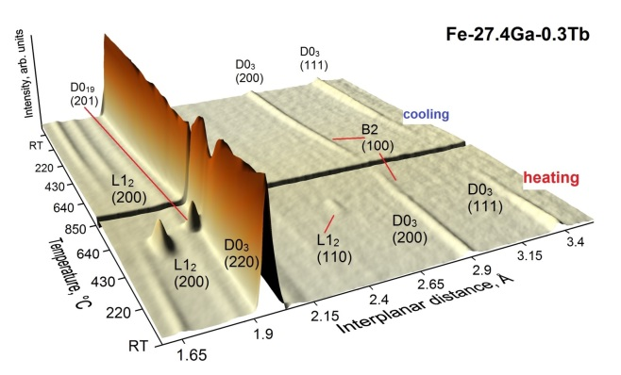
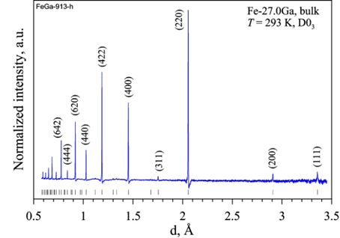
New possibilities for High Intensity experiments
HR – High Resolution
HR
High Intensity
High Intensity
HR
High Intensity
HR
HR
High Intensity
High Resolution
HI Flux: in ~5 times more!
Time economy!
Notes:
Because of our station works not only in high resolution mode but also in high intensity mode we purchased and installed precise linear translator for the chopper. After installation of new neutron guide Due to full removing of the chopper from the neutron beam we have in 5 times more neutrons at sample position in High intensity mode if we compare to situation before when we could not move the chopper remotely and needed to find manualy the maximum of transmission function. Possibility of remote control of chopper placement helps very well in combine experiment then we study some transition process by high intensities and in some crucial points to do high resolution experiment to analyze crystal and microcrystal parameters. For example It could be some processes in power cells or more standard experiment with temperature depended phase-transitions. Example is shown on this graph. During heating or annealing high intensity experiment is applied to study phase transitions but in some key points high resolution applied.

Slide 12
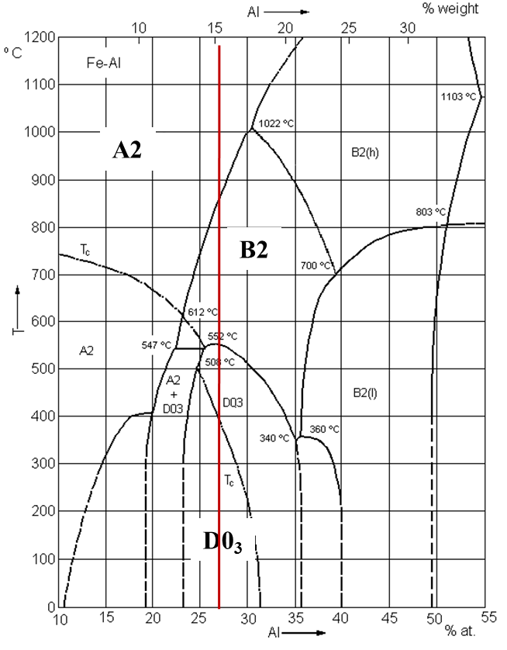
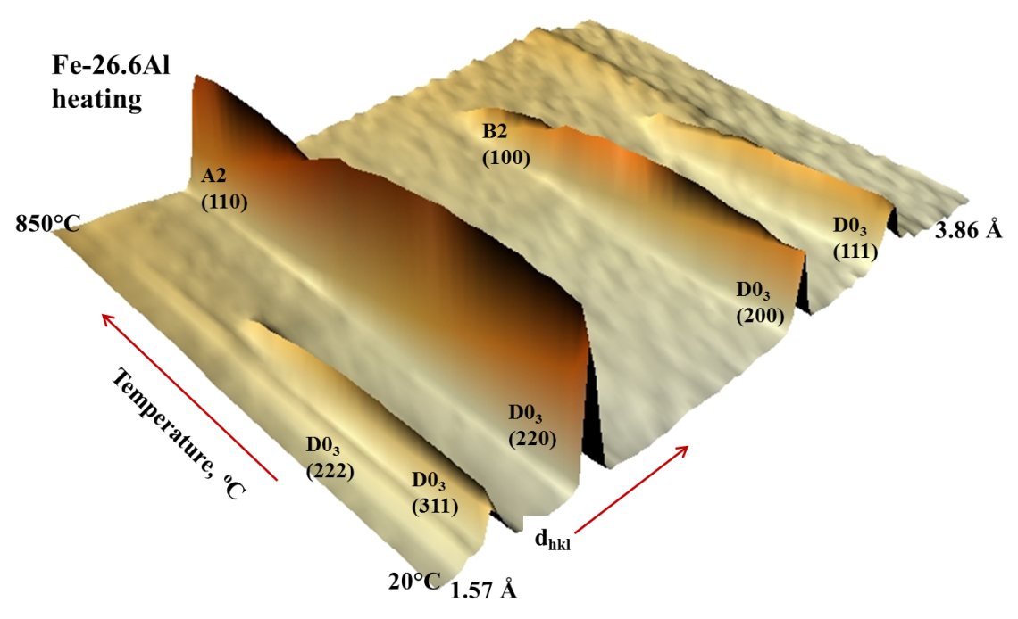
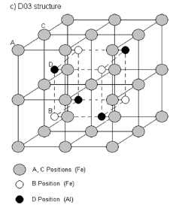
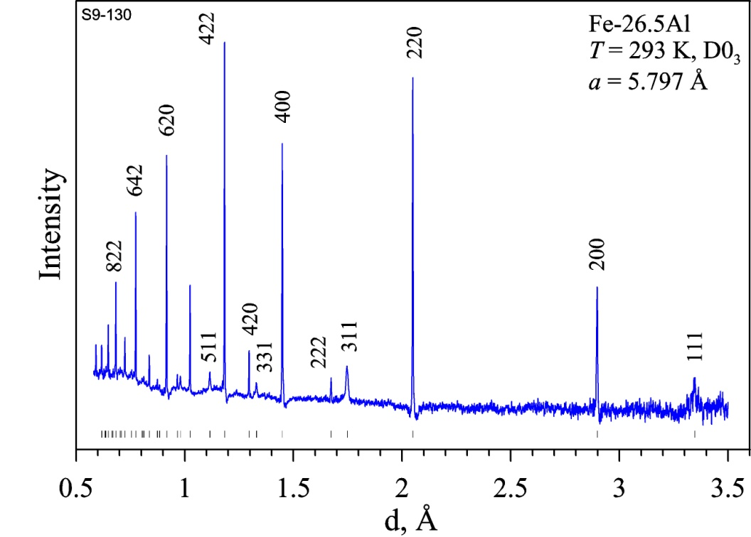
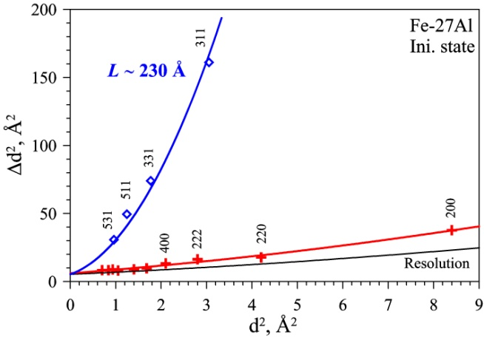
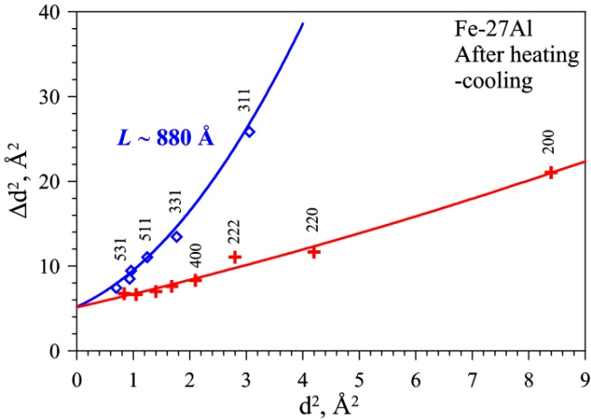
New sight at Fe-Al phase diagram
JETP Letters, 104 (2016)
Notes:
These kind of experiments we made to study phase transition in some functional alloys. For example here phase content and type of phases during temperature changes was studied in high intensity mode but at room temperature before and after heating and at highest temperature point microstructure of alloy was studied by high resolution. It was obtained that earlier considered single phase condition has evidenses of second phase and phase diagram can should be reviewed.

Slide 13
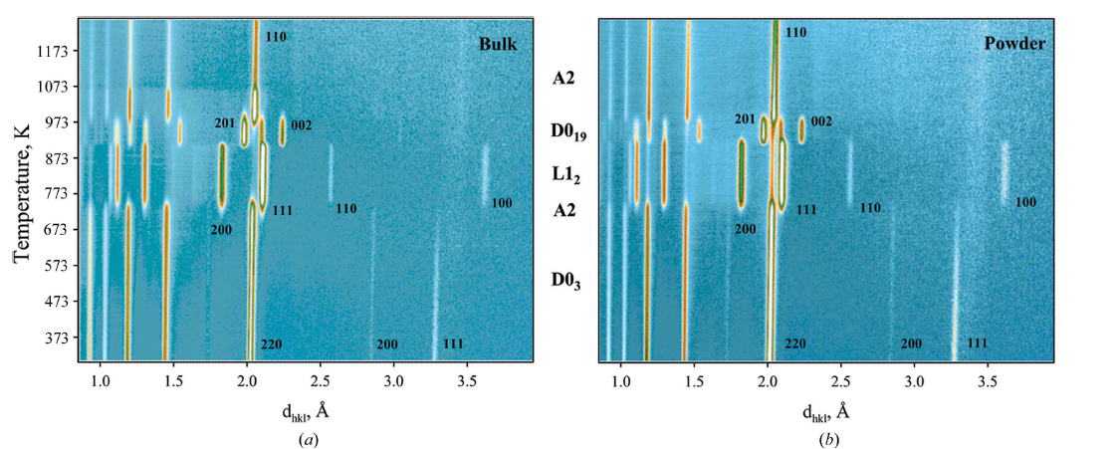
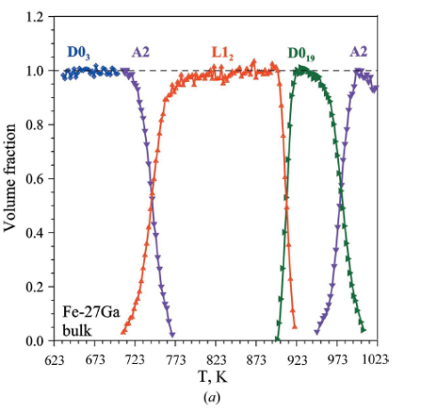
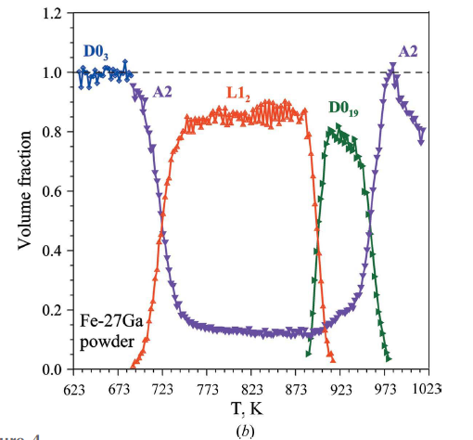
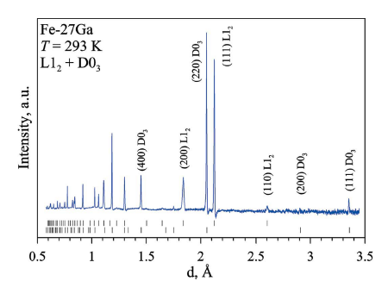
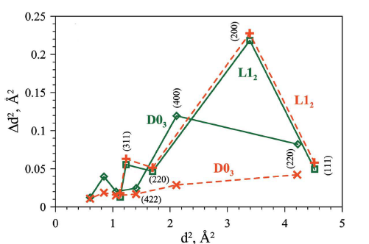
Comparative study of structural phase transitions in bulk and powdered Fe-27Ga alloy by real-time neutron thermo-diffractometry
J. Appl. Cryst., 50 (2017)
Notes:
In this work compare phase transitions and bulk and powder sample. Phase content and temperature of transitions were studied by high intensity mode. But microstructure details were studied by high resolution mode. It was obtained that there is visible (noticible) difference between powder and bulk sample as in phase content as well in microstructure parameters.

Slide 14
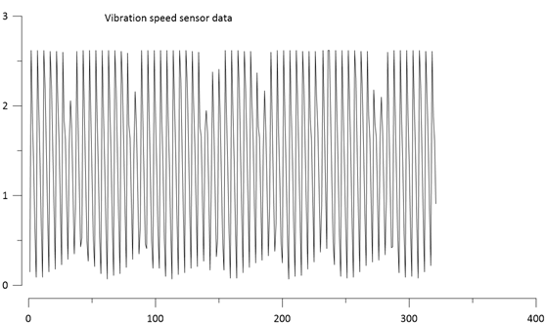
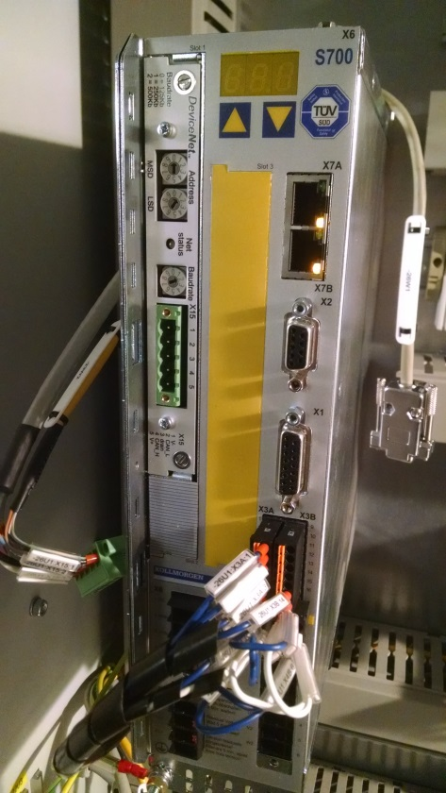
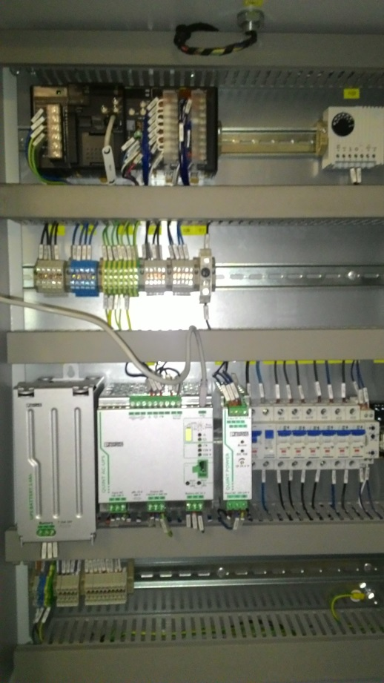
Recent problems
Vibration Sensor
ServoDrive
UPS
Vibration sensor
Servo Drive
Warranty case!
UPS
Notes:
From bad news unfortunately in this month new chopper does not work due to problems with several important components. The chopper is quite complicate device and have many electronics details. Now we have broken Power Supply, Vibration sensor and servo-drive computer which control directly the chopper motor. All happened problems in the chopper control system are warranty case we hope it will be solved soon.

Slide 15
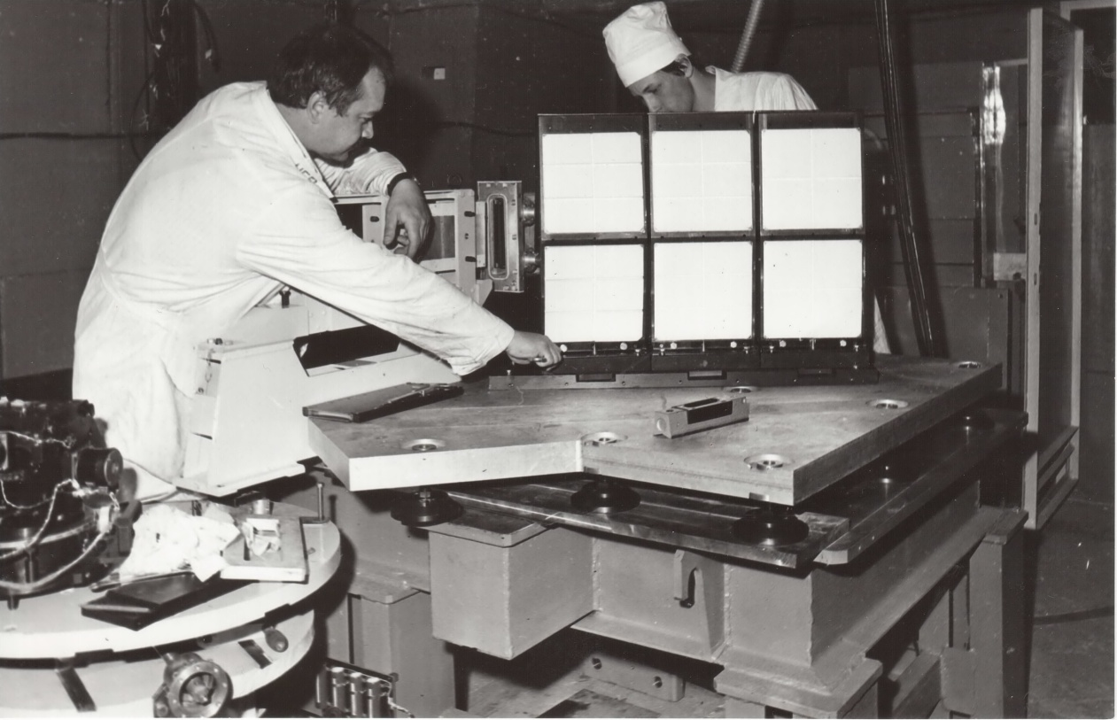
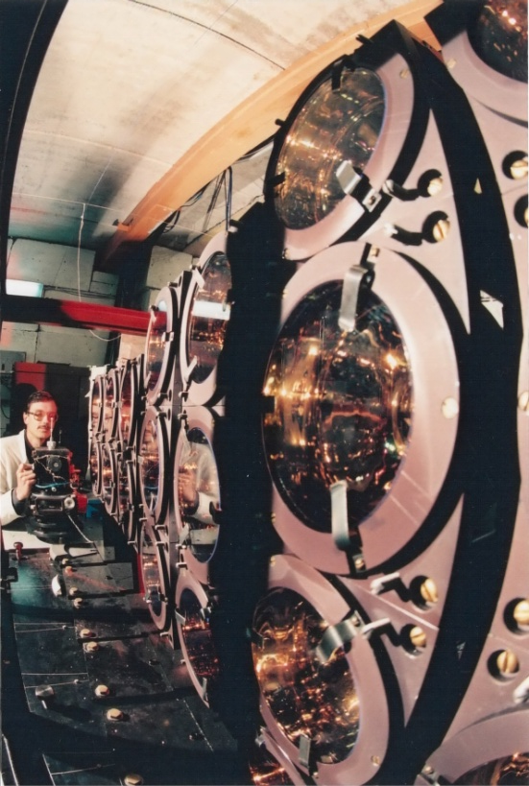
Suggestion for modernization - detectors
25 years old.
Aperture of the main detectors based on ⁶Li scintillators: 0.16 sr.
Very long time for data acquisition!
High gamma sensitivity.
Notes:
Now I can go to next suggestion for modernization: The main detectors. The current detectors life-time is expired. They are 25 years old! But it is not all. Its have very small aperture (area) – 0.16 steradians! Which drammaticaly influence at general efficiency (luminosity) of diffractometer.

Slide 16
New Back Scattering Detector ZnS(Ag)/⁶LiF
V.A.Kudryashev, ICANS-XIX
Ω = 1.5 Sr
S = 13.5 m²
≈190 elements
R_{g}: from 0.0004
to 0.0009
Ring
W, str
0
0.050
∅
1
0.202
2
0.208
3
0.216
Geometrical contribution to the resolution function for sample of 5x5x5 mm³
4
0.225
5
0.237
1 | 2 | 3 | 4 | 5 | 6 | 7 | 8
3.7E-4 | 5.4E-4 | 6.1E-4 | 6.7E-4 | 7.3E-4 | 7.8E-4 | 8.3E-4 | 8.8E-4
6
0.252
7
0.202
8
0.221
Efficiency of neutron detection will be increased in 10 times!
Σ
1.813
Notes:
Installing of new detector with large square and based on ZnS-scintillator improves efficiency of neutron detection in 10 times! And considerably decrease gamma-background. (Zink sulphide) . Here you see draft and some calculations for possible new detector. Total price of this detector is about 600 kDollars Based on last news. Spectrometers Department of our Lab can made this type of detector.

Slide 17
Conclusions
T
H
A
N
K
Y
O
U
!
In 2016 new neutron guide was purchased and installed. As result HRFD has a new neutron guide and neutron flux at sample position was increased more than 2 times.
In 2016 new Fourier chopper (made by Mirratron) was installed. It has shown many advantages over old one and many warranty cases.
Totally in High resolution we increase efficiency of the diffractometer in approximately 3 times. In High Intensity mode in 5 times.
- The main proposed modernization for next period:
New ZnS backscattering detector (~ 600 k$) . It may be made by Spectrometers Department of FLNP.
Technical and software support of HRFD:
N.D. Zernin, A.P. Sirotin and V.V. Zhuravlev
T.B. Petukhova, S.M. Murashkevich and D.A. Balagurov
Notes:
And at the end I would like to express thanks

