Slide 1
"Instruments and Methods of Experimental Nuclear Physics. Electronics and Automatics of Experimental Facilities”
7th International School for Young Scientists and Students
(Dubna, 7–11 November 2016)
E.I. Litvinenko
FLNP JINR

Slide 2
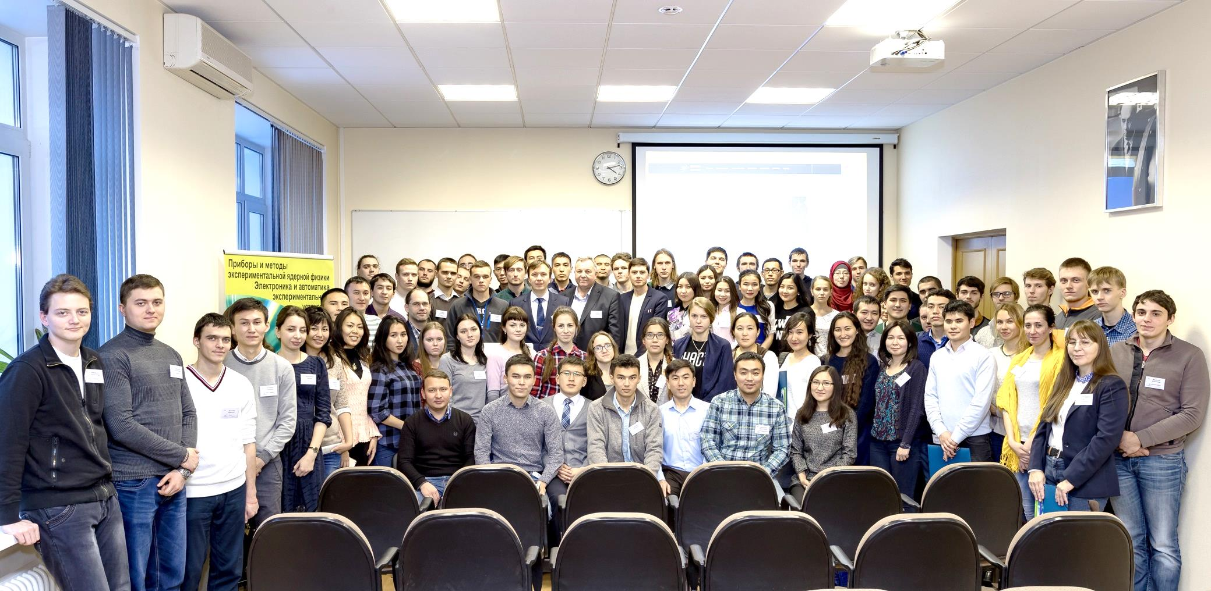
Group photo of the participants
Frank Laboratory of Neutron Physics, JINR, Dubna, 7 November 2016
79 students, postgraduates and young
specialists from JINR member-states (Belarus, Kazakhstan, Russia, Ukraine)
http://d-instruments.ru

Slide 3
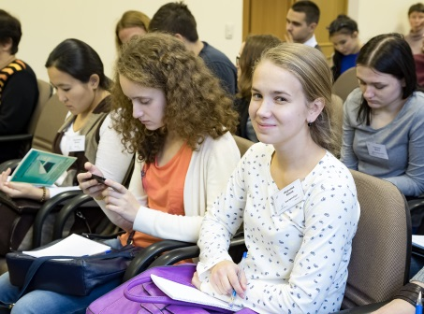
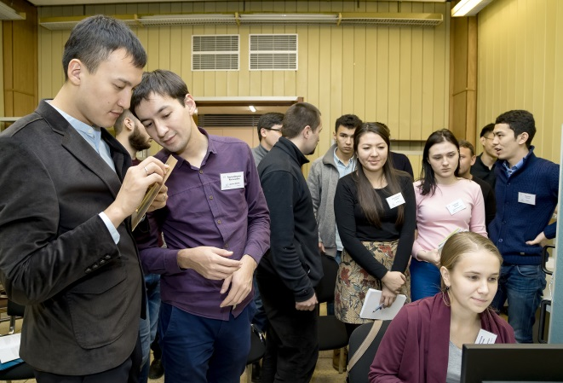
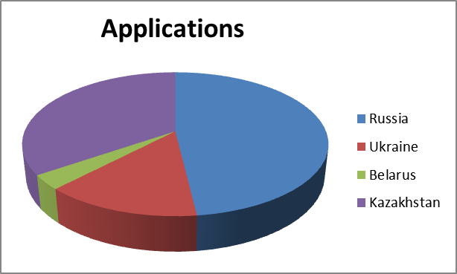
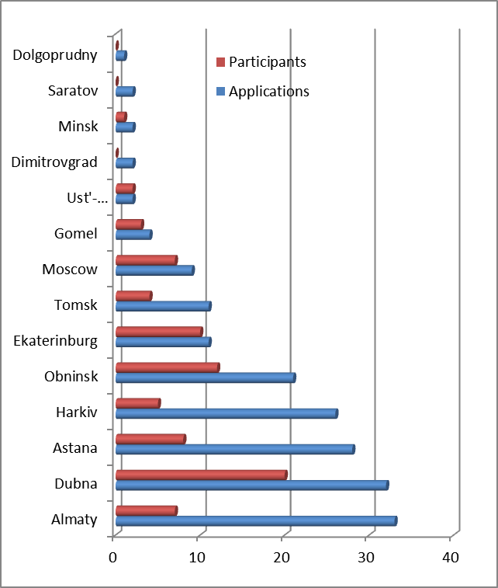
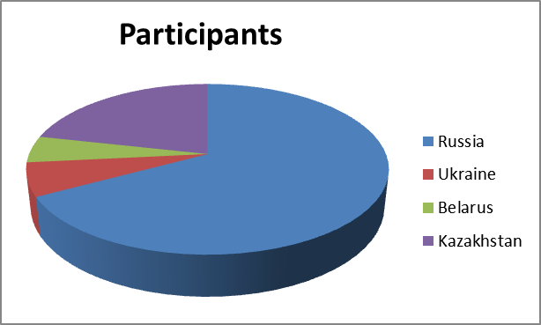
The 7th School's geography
Countries:
Cities:

Slide 4
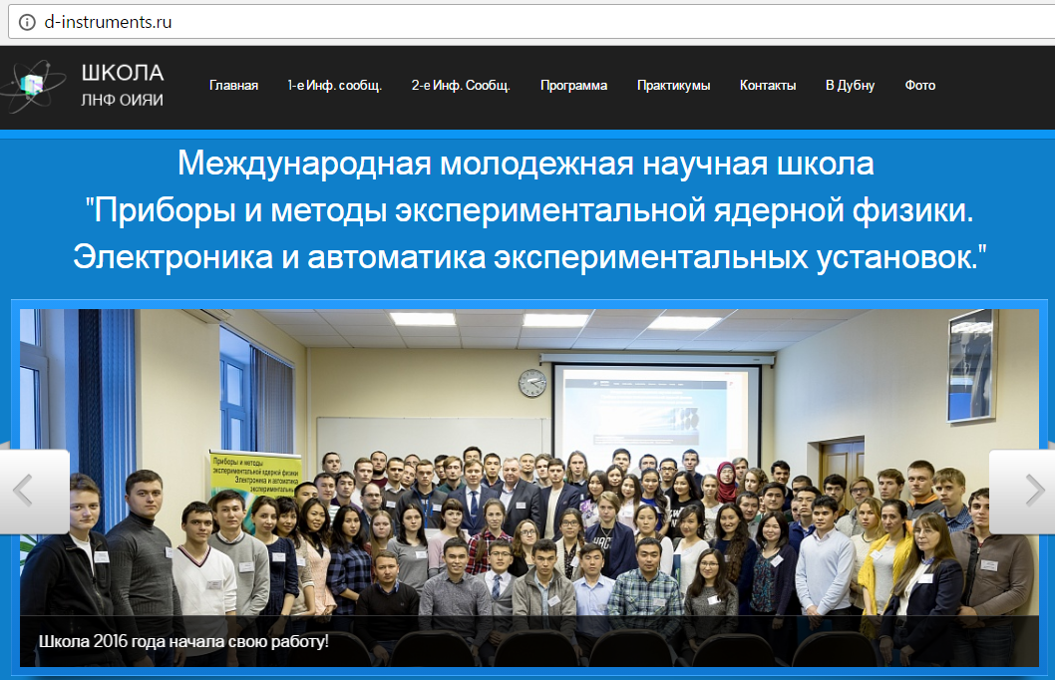
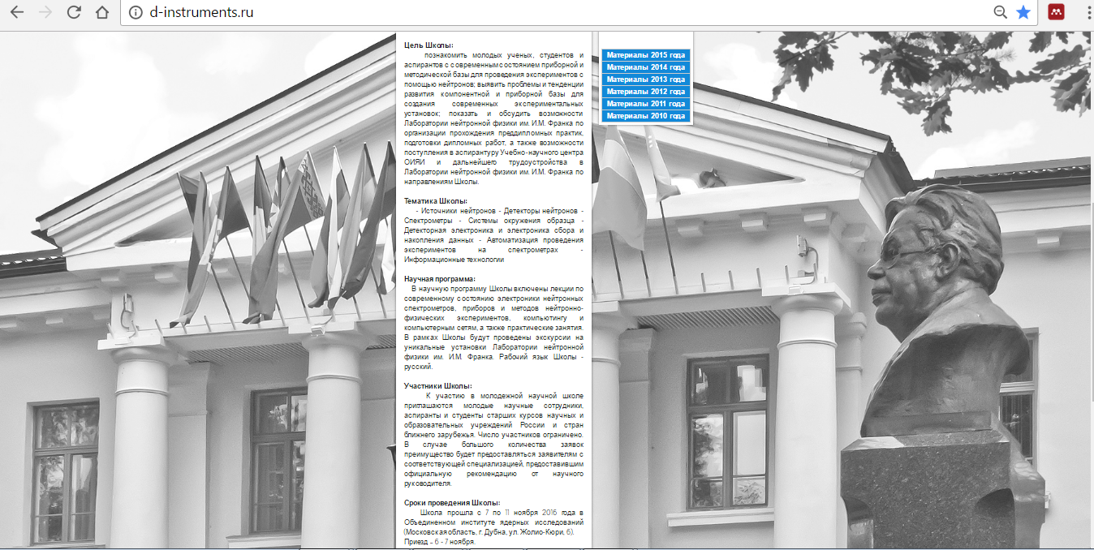
Organizing Committee
New school web site

Slide 5
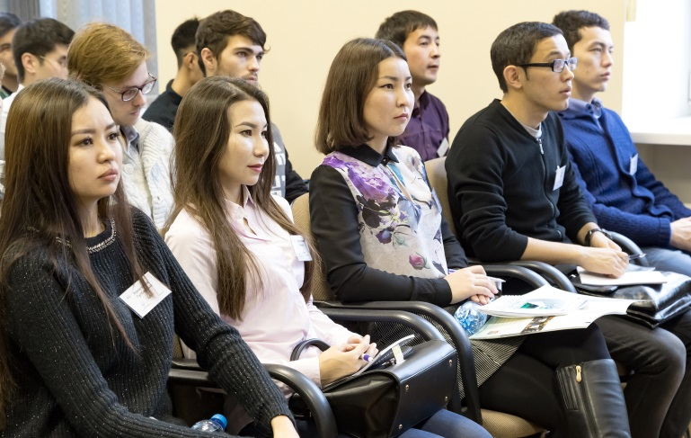
The same main topics and the program items
Neutron sources
Neutron detectors
Neutron spectrometers
Sample environment systems
Detector electronics and data acquisition
Automation of experiments on spectrometers
Information Technology
Topics covered during the school were in line with the main activities carried out under theme -1122-.
The School scientific program included 13 lectures of leading scientists and specialists of JINR.
8 laboratory works (practicums) were carried out, during which the attendees could take part in the solution of several problems within the topics of the lectures.
The students visited the IBR-2 reactor and the IREN facility.
Forum for presentation and discussion of students’ research reports - 11 reports for competition and 1 noncompetition report. 4 best reports were awarded with diplomas.
The round table with the organizers of the School - the students gave their opinion about the level of organization and quality of activities and made useful suggestions concerning the organization and program of future schools.
School program devoted to the issues of creation and development of the instrument base of experimental facilities was aimed to the tools for neutron scattering experiments.

Slide 6
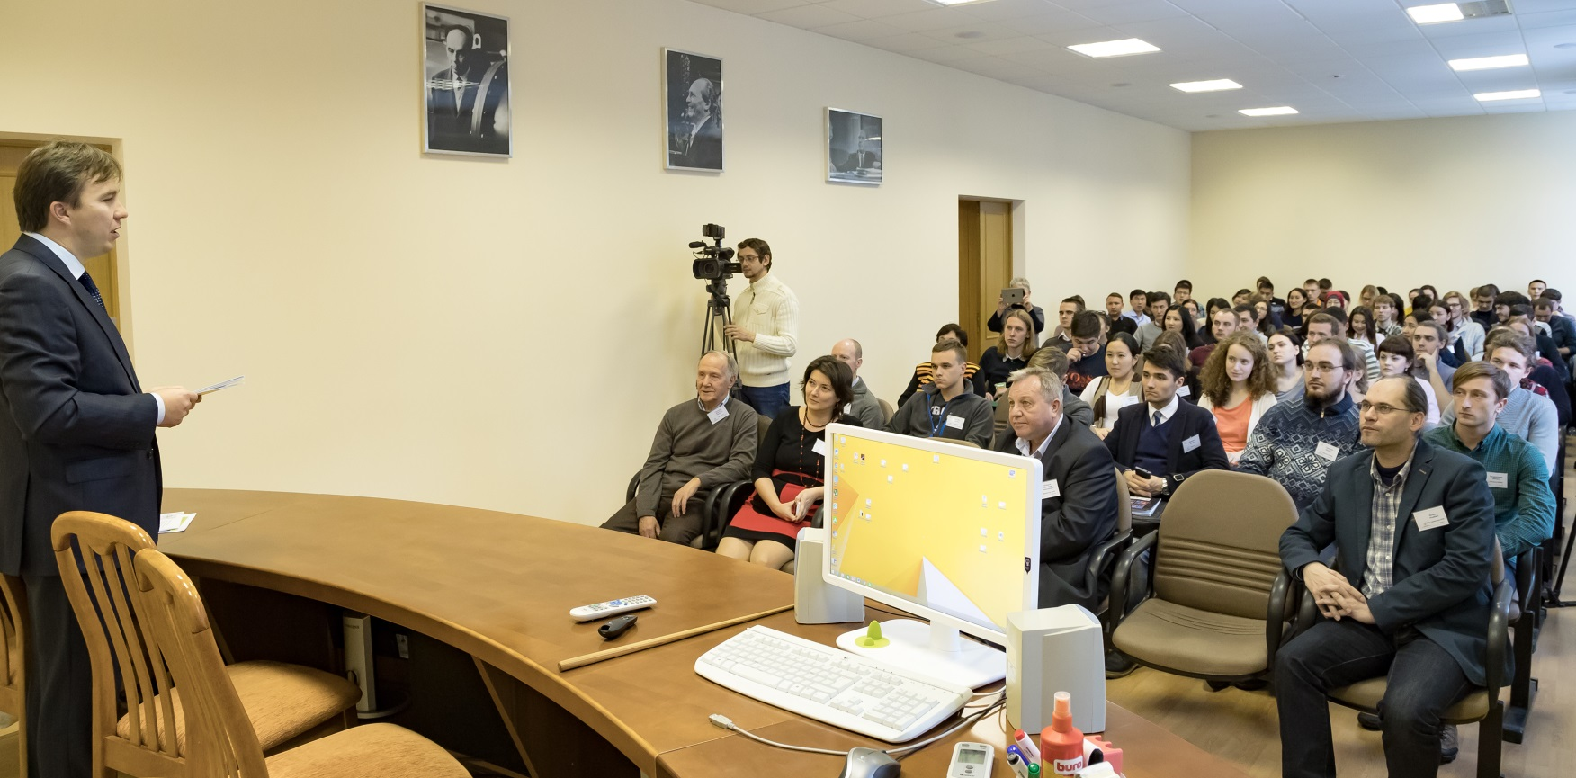
The lections
Topical reviews:
“Joint Institute for Nuclear Research.” Dr. V.N. Shvetsov
“Neutron Physics at the JINR” Dr. V.N. Shvetsov
“Pulse research reactor IBR-2” Prof. E.P. Shabalin
“Neutron methods of studying condensed matter” Prof. A.V. Belushkin
"The department of the spectrometers complex of IBR-2, its tasks and perspective directions“ Dr. S.A. Kulikov
"Opportunities for study and work at JINR“ Dr. O.A. Culicov
“Modern neutron detectors” Dr. V.N. Shvetsov
Instrumental:
"Some aspects of work of gaseous and scintillation detectors“ Dr. V.V. Kruglov
"Electronics for acquisition and accumulation of data with neutron spectrometers of the reactor IBR-2“ Dr. V.I. Prikhodko
"Actuators and sample environment systems on spectrometers of the IBR-2“ Dr. A.P. Sirotin
“Sample environment. Cryogenics” A.N. Chernikov
"Software of the spectrometers“ Dr. A.S. Kirilov
“Status and prospects of development of network and computer infrastructure of the JINR” Dr. T.A. Strij

Slide 7
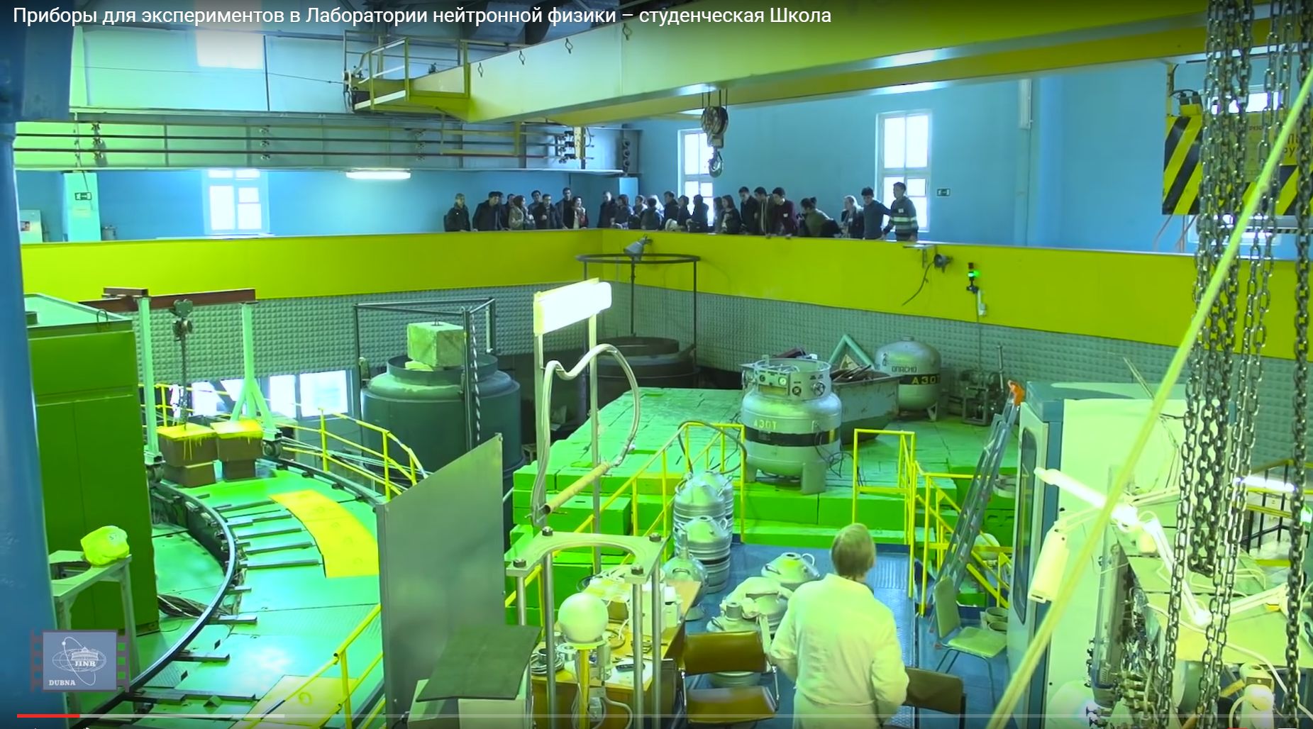
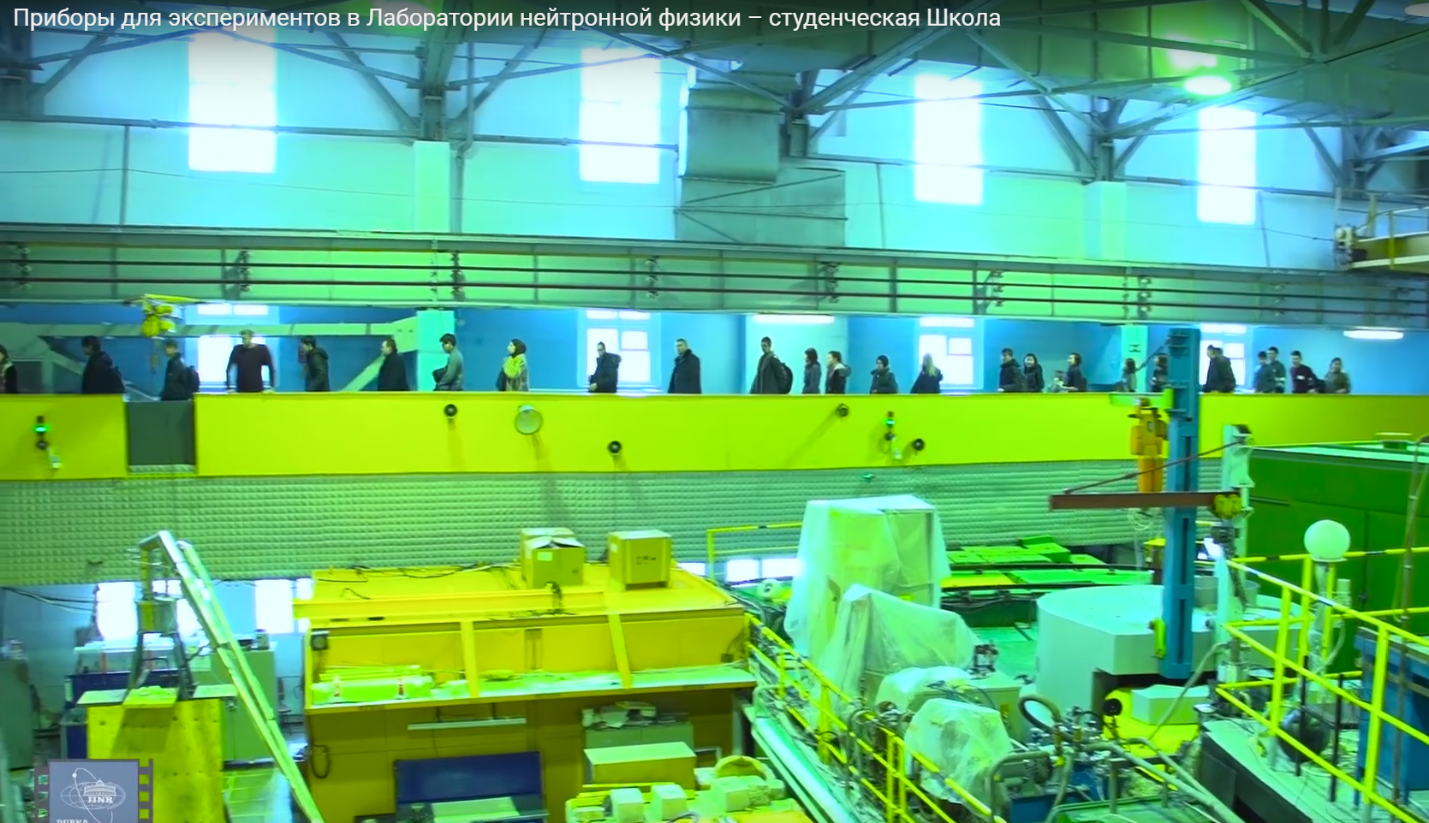
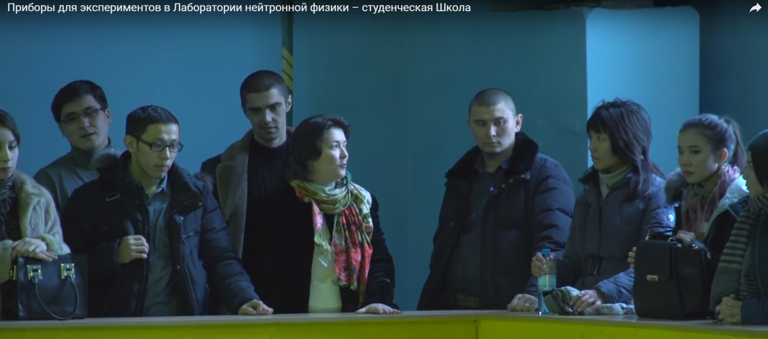
Excursions to the reactor

Slide 8
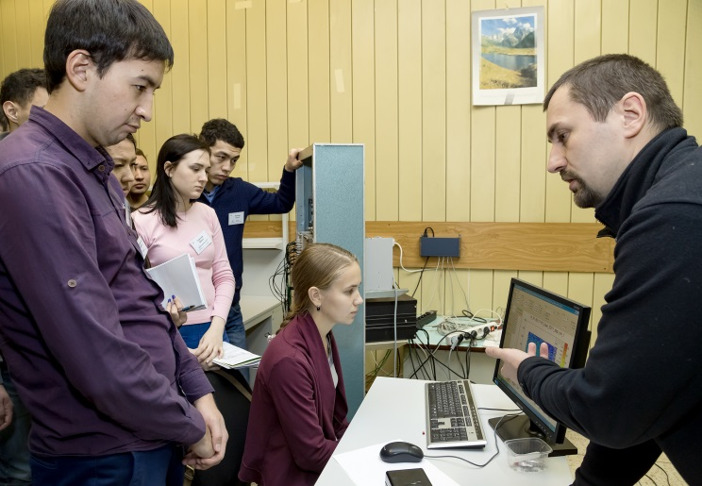
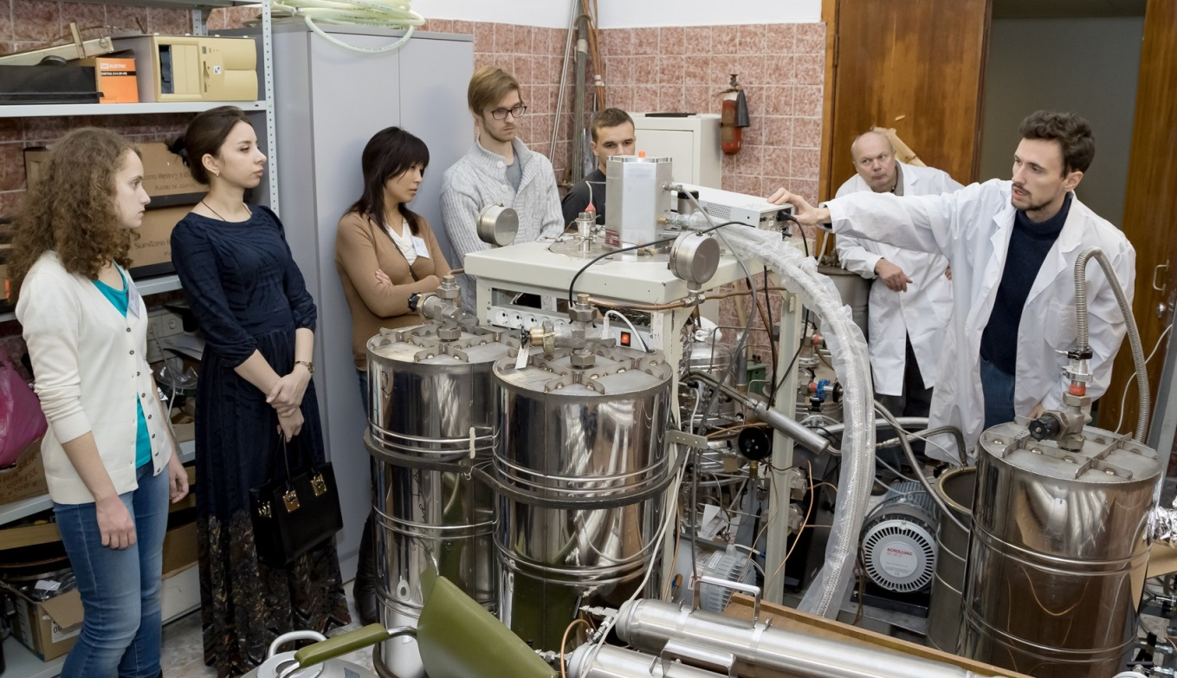
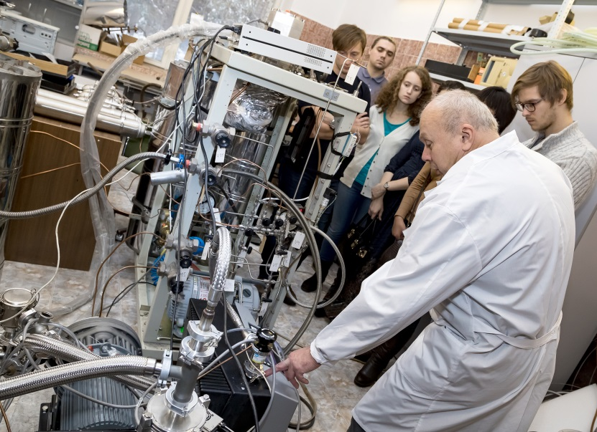
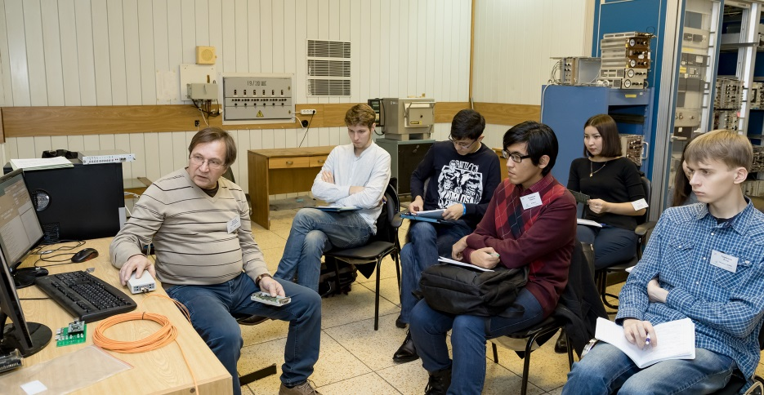
The practicums
Practical acquaintance to the control system of the spectrometer
Defining the parameters of a PID temperature for the control system with the controller LS325, the furnace and the sample
Determination of the dynamic parameters of the stepper motor and the precision of the triggering of the limit switch actuator
The observation of the signals from the neutron detectors. Measurement of the amplitude spectra of signals
The use of the Quartus II for the design of the typical logical modules for DAQ systems of neutron spectrometers using programmable logic arrays ALTERA
Measurement of coordinate spectra of thermal neutrons
The assembly of the cryostat with the cryo refrigerator of the closed cycle
Connecting the PC to the LAN of the FLNP

Slide 9
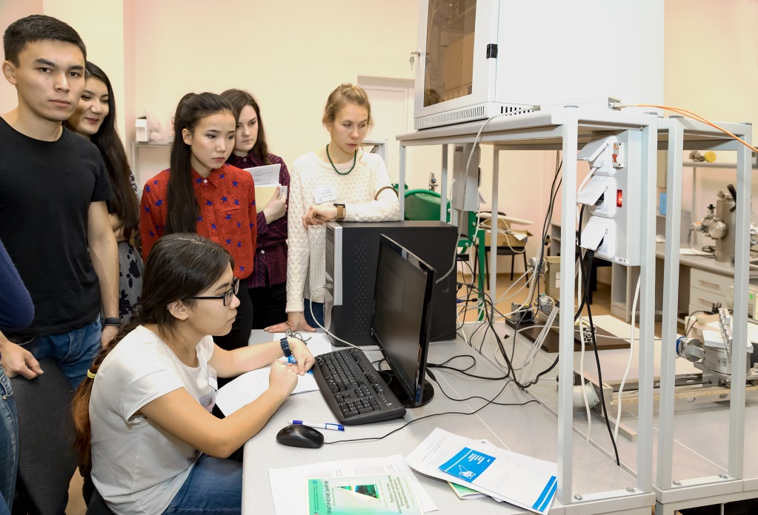
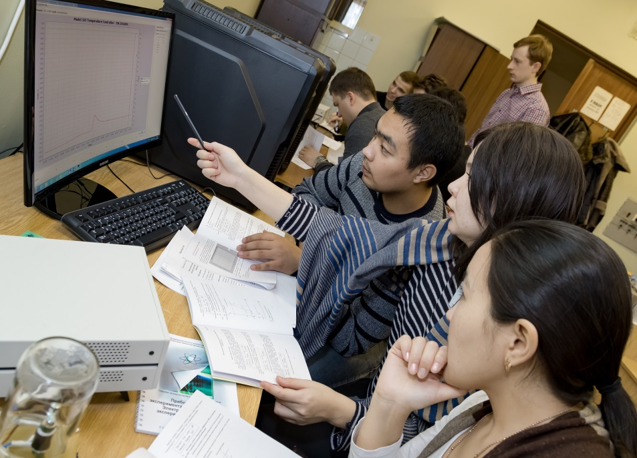
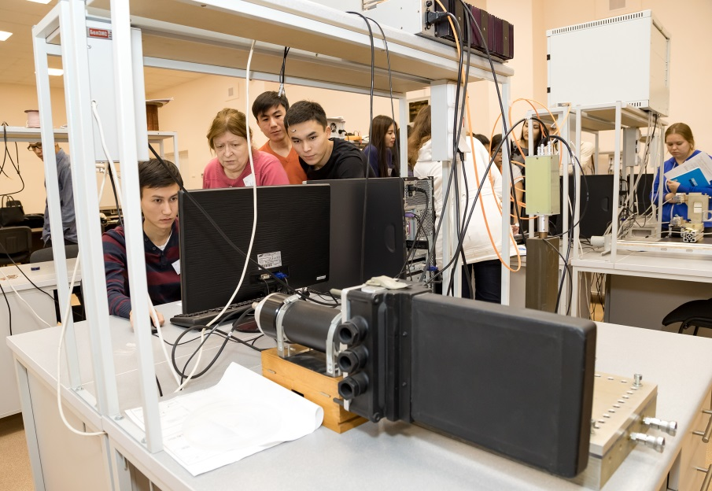
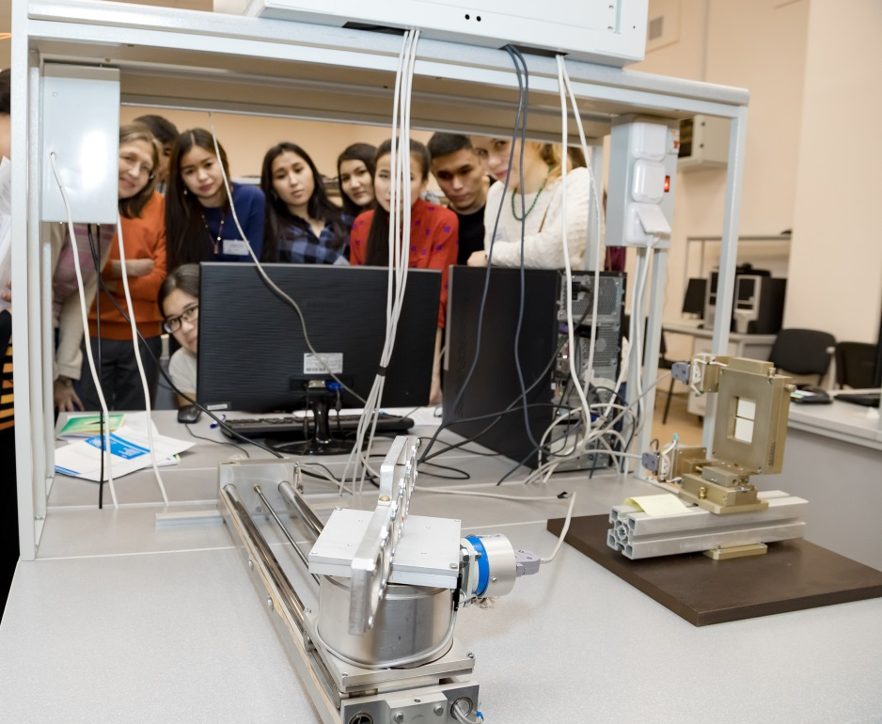
New spacious classrooms for practical training

Slide 10
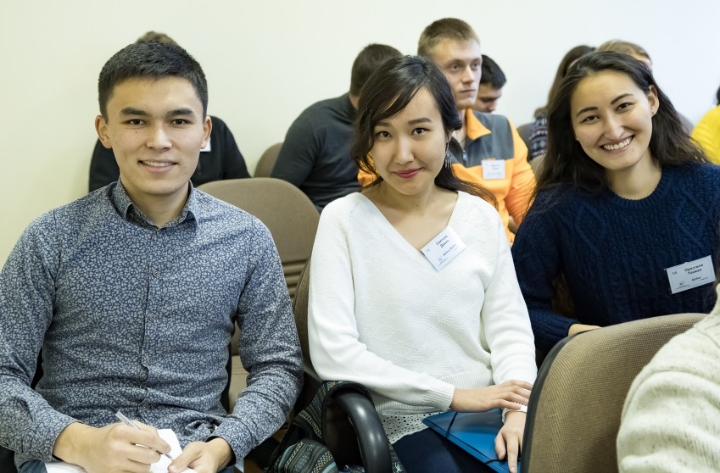
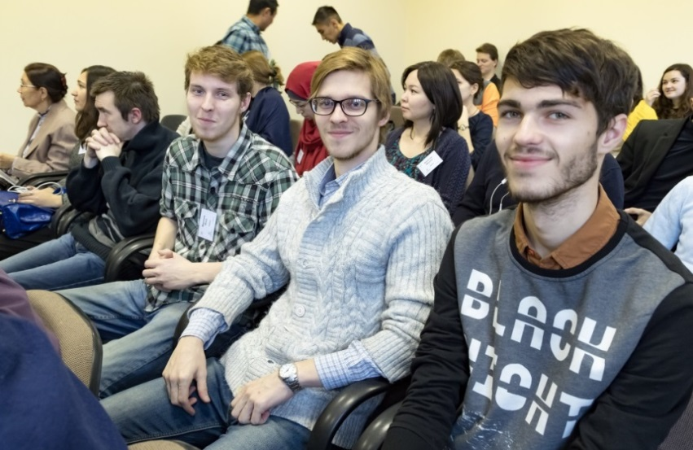
The competition of student reports
Pinch effect in D 3He-9Be plasma
Justification applicability of fiber optic sensors for the purposes of monitoring temperature and strain inside the reactor
Development of the circuit of two-channel amplifier for the spectrometry
Research of processes of high-temperature corrosion SiC coatings
Metallic nanotubes: synthesis, properties and potential practical use
The detection of neutrons at a critical stand in INP
Effect of dust on the electron energy distribution function in the plasma, which is supported by an external electric field
Optimize focusing structure of the storage ring of electrons for maximum efficiency injection
Modeling the effect of tightening CT radiation in the environment GEANT4
Neutron spectrometry using spheres Bonner
Determination NaI detector response function for gamma rays with an energy of 4.43 MeV
Determination of parameters of the installation «TANGRA»

Slide 11
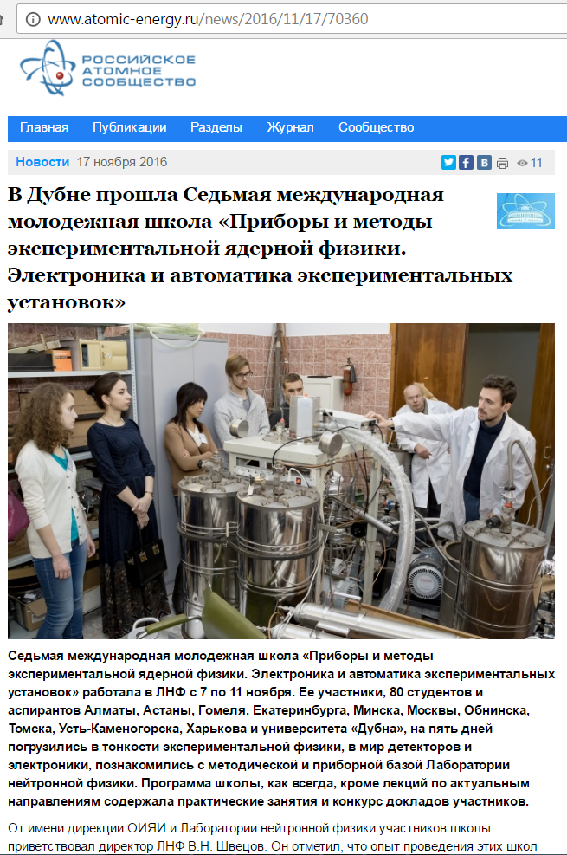
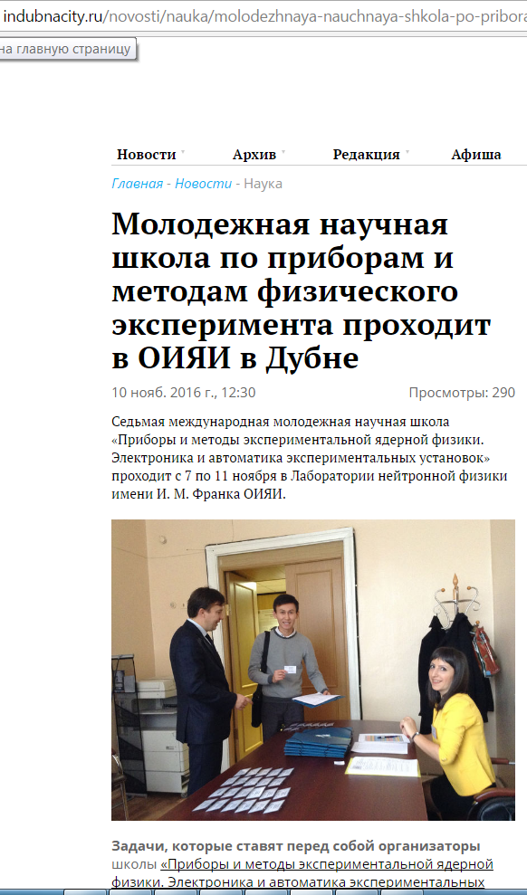
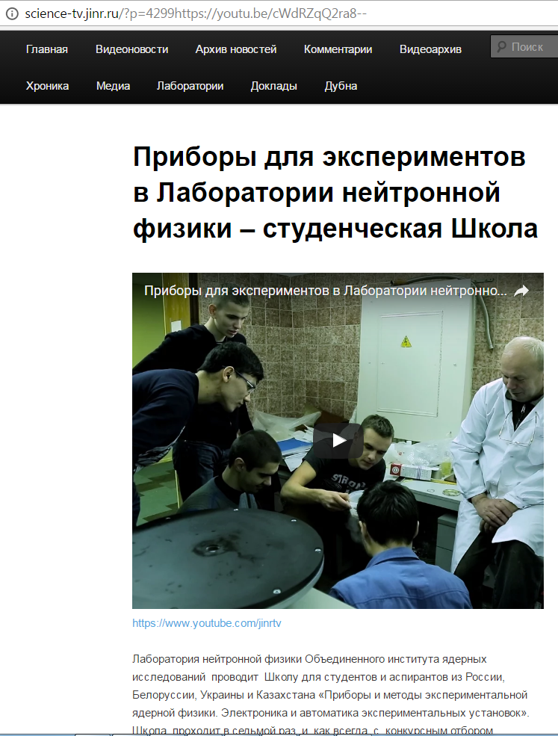
Press about the 7th School

Slide 12
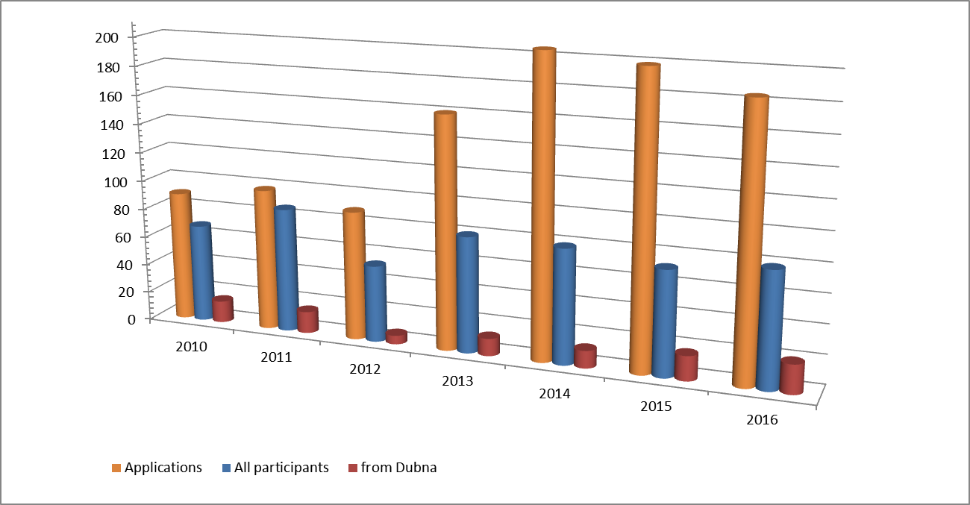
Annual changes in the numbers of applicants and the students
The number of students of our schools is kept at the level of 70-80
Organizing Committee – 7 employees
Lecturers – 11 people
Tutors of practicums – 13 employees
Excursion organization – 8 employees
Jury of the competition of student reports - 5
in reality - 31 people
(all from JINR)

Slide 13
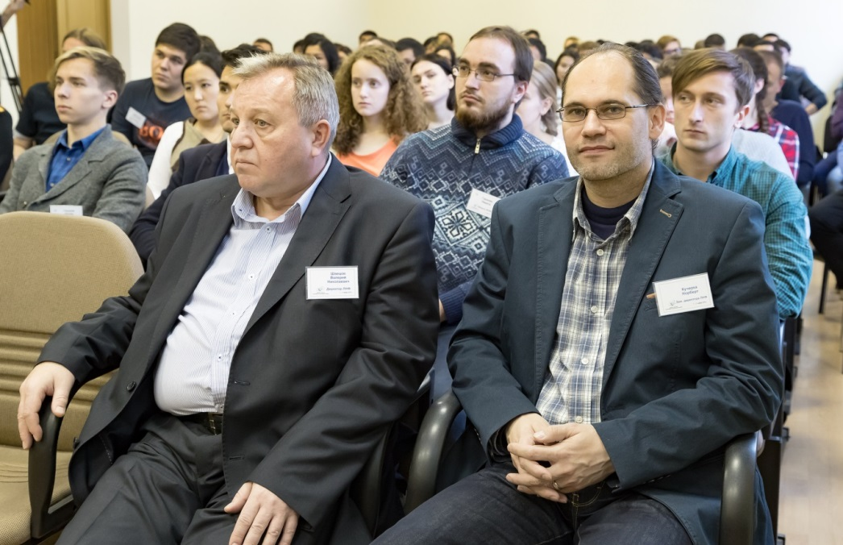
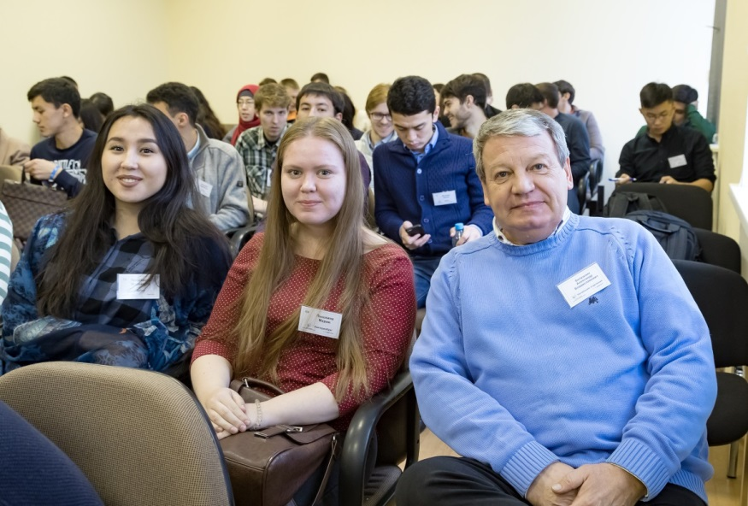
Thinking about the future
In his opening speech the director of FLNP Valery Shvetsov said: "We are conducting a school for the JINR participating countries, but it benefits also for our laboratory, because after each school 1-2 people come to us to work, and not only from the school participants, but also those who have heard of us from them.".
Two participants of the 7th School started to work in our sub-division in January 2017 and one student is preparing to start the practice
The School students have the opportunity to see different aspects of the work of employees who are engaged in the development and creation of instruments
There is a growing understanding that it is necessary to increase the prestige of the work on the creation of devices for scientific experiments by all possible means
The Organizing Committee is discussing the format of the next Schools

Slide 14
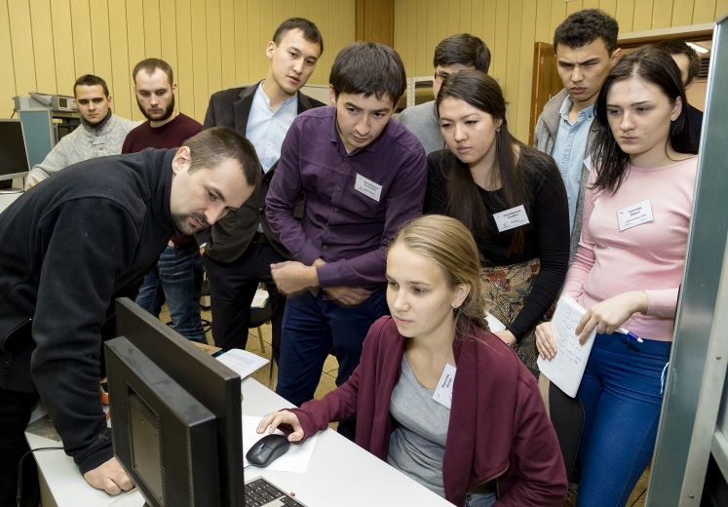
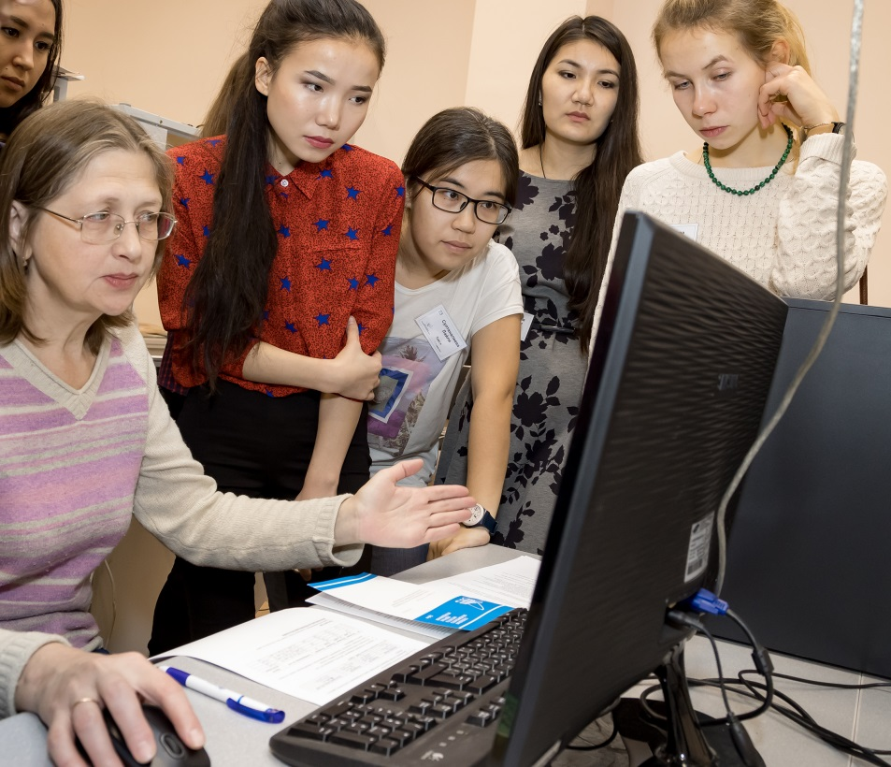
Thank you for your attention

