Slide 1
Jury’s recommendations on the award of the Venedikt Dzhelepov Prize for 2020
V. Matveev
128th session
of the Scientific Council

Slide 2
The Venedikt Dzhelepov Prize is awarded for outstanding achievements in the field of experimental and theoretical research aimed at addressing applied problems with the use of nuclear physics methods
The Jury composed of the following members
V. Matveev (Chairman)
V. A. Bednyakov
N. A. Rusakovich
V. N Shvetsov
G. A. Shelkov

Slide 3
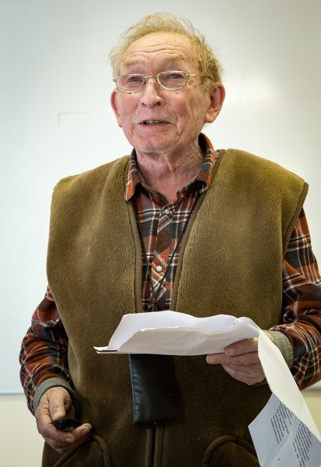
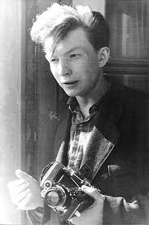
has resolved to award this Prize to Eugene P. Shabalin (FLNP JINR) for his pioneering work for the design and construction of the world first heterogenous cryogenic neutron moderator at the IBR-2 reactor
Notes:
Eugene Shabalin – chief scientist at Frank Lab of Neutron Physics, world recognized specialist in the theory of pulsed reactors, laureate of the State Prize of the USSR, Government Prize of the Russian Federation, one of the creators of the unique IBR-2 reactor. Based on his ideas and under his supervision the world first heterogenous pellet-type cryogenic neutron moderator was established at the IBR-2 reactors.

Slide 4
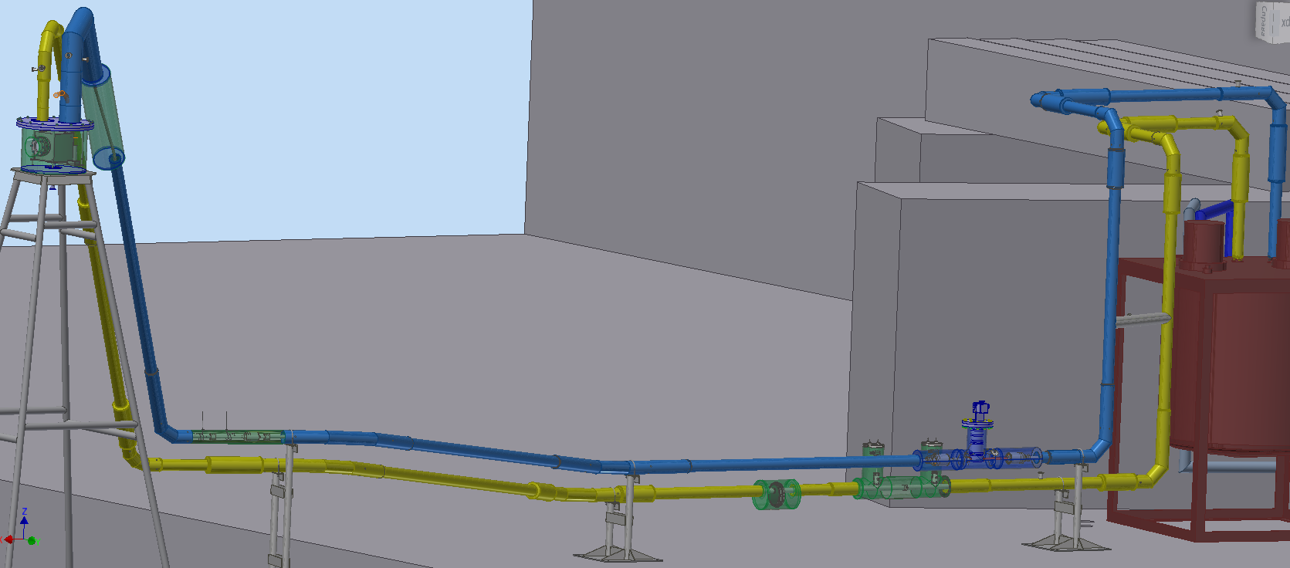
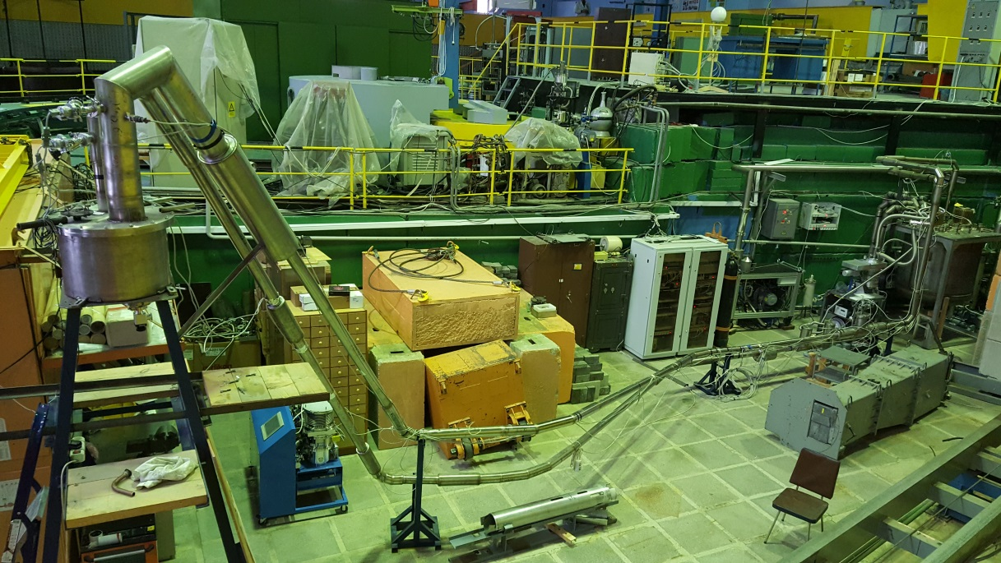
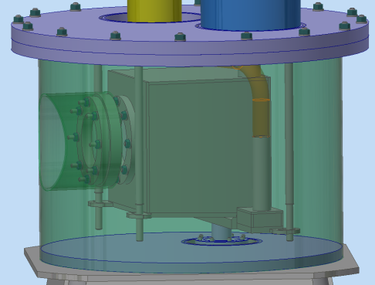
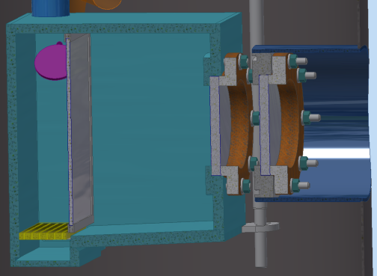
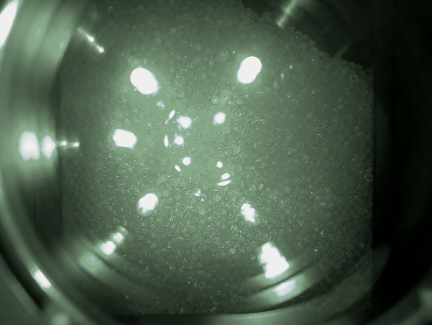
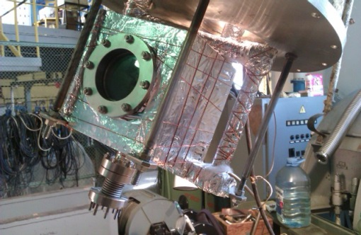
Полномасштабный стенд КЗ 201
ГЛАВНАЯ ЦЕЛЬ – эмпирически доказать возможность применения метода пневмотранспортировки шариков в камеру замедлителя КЗ 201
Имитатор камеры
Notes:
Results from the first stand.

Slide 5
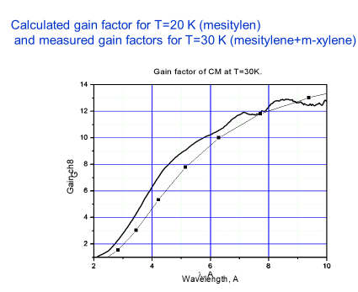
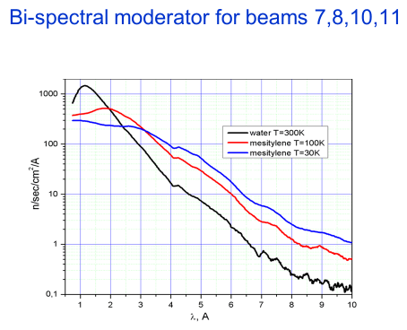
Notes:
Cold neutrons production increased up to 13 times at the neutron wavelengths up to 10 Angstrom. Experimental results from IBR-2 beams #7,8,10 and 1

Slide 6
Jury’s recommendations on the award of the Venedict Dzhelepov Prize
Jury has decided as follows:
The 2020 Dzhelepov Prize is awarded to
E. P. Shabalin for development and construction of the world’s unique heterogeneous cryogenic neutron moderator at the IBR-2.
I ask the Scientific Council to approve this recommendation

