Slide 1
Programme Advisory Committee for Nuclear Physics
52nd meeting
25 June 2020
Marek Lewitowicz

Slide 2
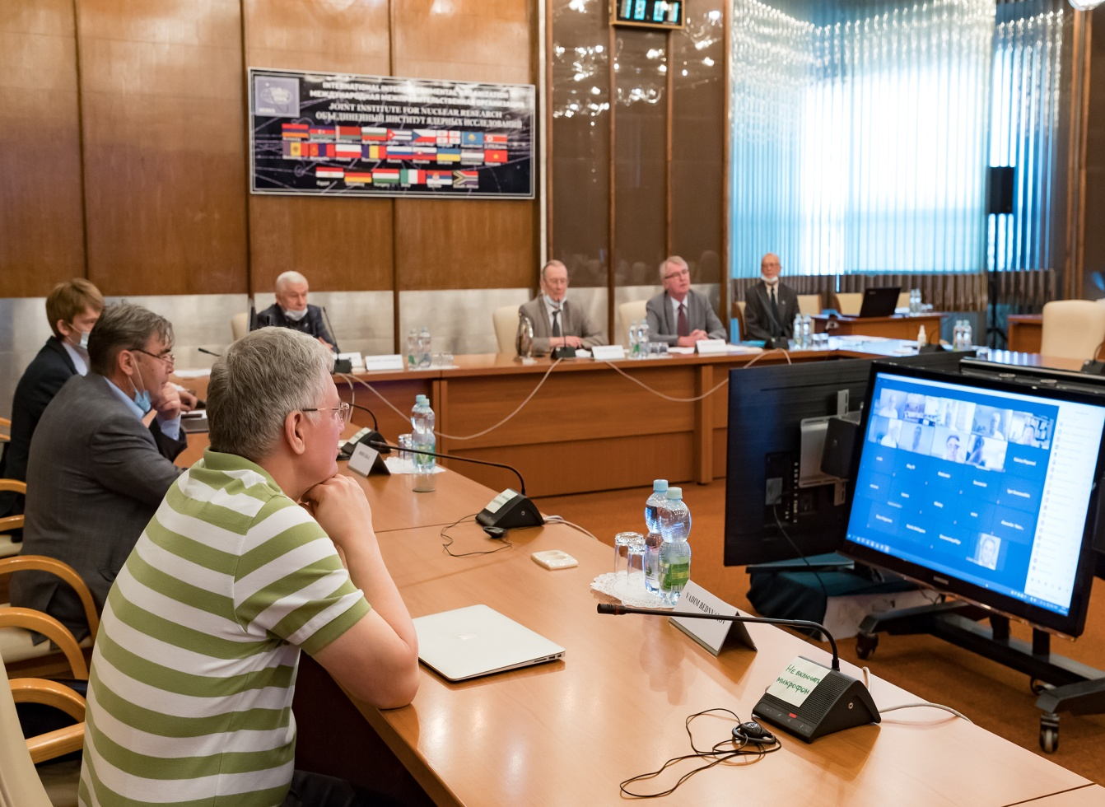
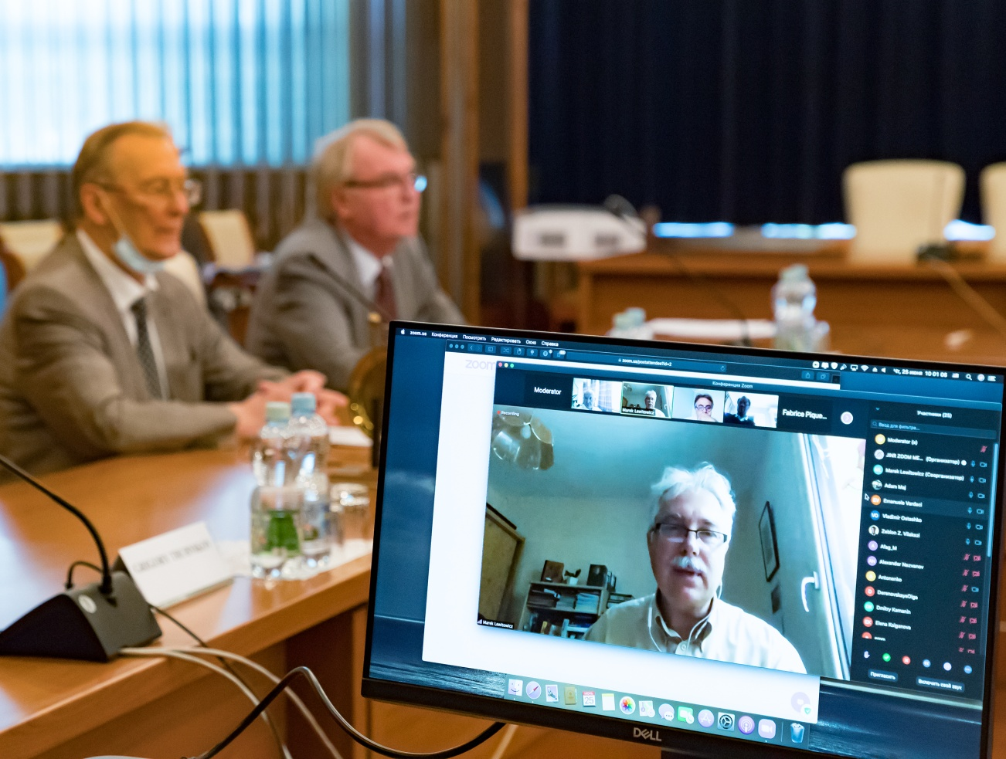
One of the first remote PAC meetings at JINR

Slide 3
Programme Advisory Committee for Nuclear Physics, 52nd meeting, 25 June 2020
1. Opening of the meeting M. Lewitowicz
2. Implementation of the recommendations of the previous PAC meeting M. Lewitowicz
3. Information on the Resolution of the 127th session of the JINR Scientific Council (February 2020) and on the decisions of the S. Dmitriev JINR Committee of Plenipotentiaries (June 2020)
4. Report on the concluding theme “Improvement of the JINR Phasotron and Design of Cyclotrons G. Karamysheva
for Fundamental and Applied Research”
Referees: A. Maj, C. Petitjean, ,Z. Vilakazi, E. Vardaci
5. Status of preparation of a new project “Modernization of the EG-5 accelerator and development of its A. Doroshkevich
experimental infrastructure”
Referees: G. Kim, M. Lewitowicz, V. Nesvizhevsky, V. Ostashko
6. Proposal for opening a new project: “Muon ordinary capture for the nuclear matrix elements in 2β-decays D. Zinatulina
(project MONUMENT)”
Referees: C. Beck, F. Piquemal, C. Petitjean, I. Štekl,
7. Preparation of the PAC recommendations
8. PAC recommendations
9. Closing of the meeting

Slide 4
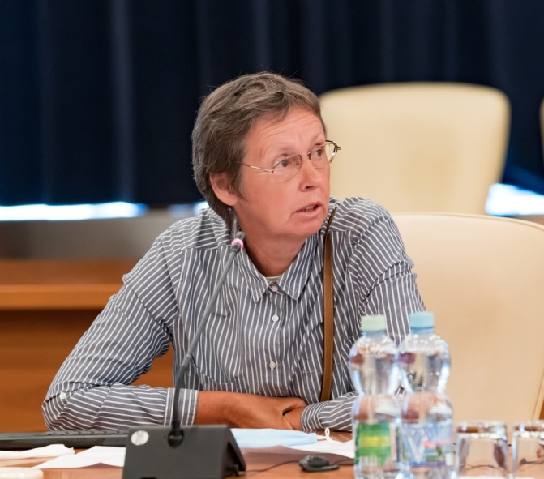
Theme “Improvement of the JINR Phasotron and Design of Cyclotrons for Fundamental
and Applied Research”
Improvement of the JINR Phasotron and beam channels.
Shakun N.G., Yakovenko S.L.
Design and modernization of the cyclotrons for medical purposes.
Karamysheva G.A.
Research and development of the superconducting cyclotron for proton therapy for IPP CAS (Hefei, China).
Shirkov G.D.
Investigation of the high-current beam acceleration in cyclotrons.
Vorozhtsov S.B.
Galina Karamysheva

Slide 5
Theme “Improvement of the JINR Phasotron and Design of Cyclotrons for Fundamental
and Applied Research”
Improvement of the JINR Phasotron and beam channels.
Improving of the power supply system of the Phasotron and beam lines was performed. Modern semiconductor converters feeding the magnetic systems instead of the motor generators have been put into operation;
Automatic control system for the transport line has been implemented together with improvement of regulation and stabilizing system by replacing electronic equipment and new software development.
All switching devices were replaced with modern ones in the power supply systems of the beam lines;
Galina Karamysheva
As a result of the modernization, the electric-power saving amounted to about 900 kW.
In 2016-2019, Phasotron operated an average of 1000 hours per year. Of these, 80% were spent for medical research, 13% for experiments PHASE, BURAN and 7% of the time for the needs of the accelerator.
In 2020, the planned Phasotron operating time is 500 hours. It will be used mostly for radiobiological research.

Slide 6
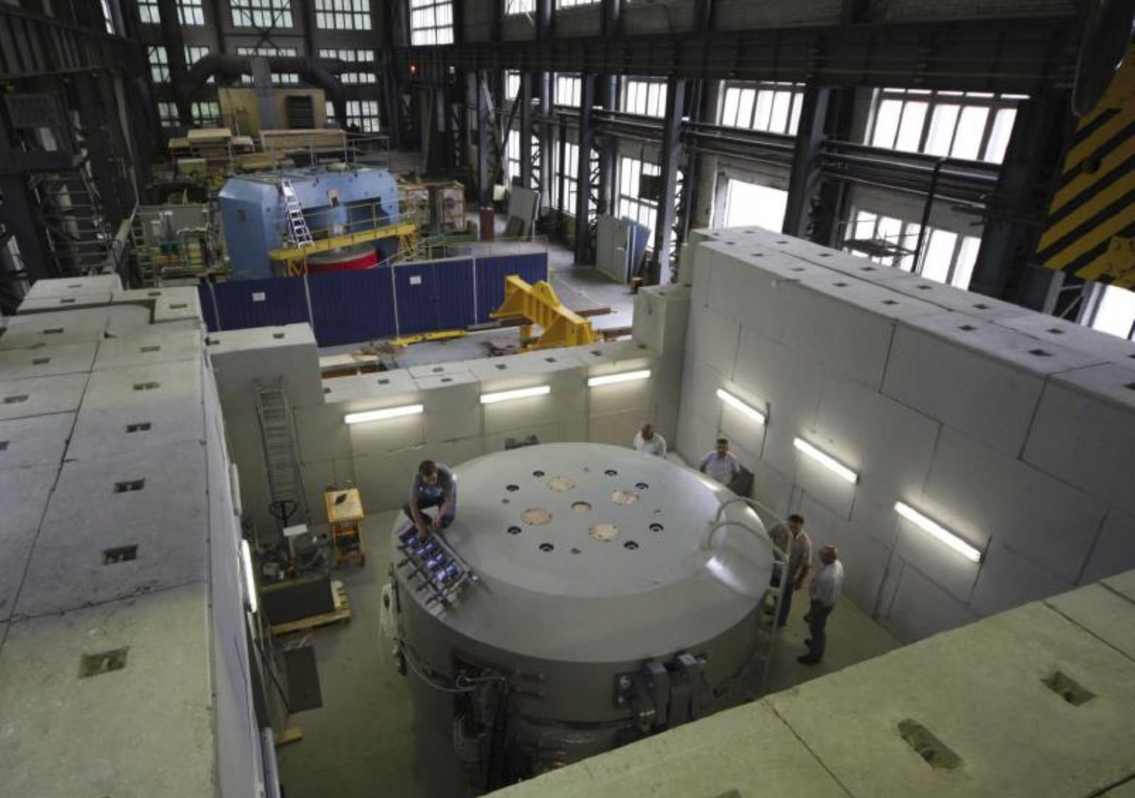
C235 V3 cyclotron (IBA, Belgium)
Design and modernization of the cyclotrons for medical purposes.
The hospital center of radiation medicine was founded recently in Dimitrovgrad for clinical application of advanced cancer therapy methods.
The C235 V3 cyclotron improved by specialists from the JINR was manufactured by IBA company in Belgium.
The C235 V3 cyclotron:
was mounted,
its magnetic field was properly configured,
acceleration conditions were optimized,
beam extraction system tests were carried out in JINR after which the system was supplied to Dimitrovgrad.

Slide 7
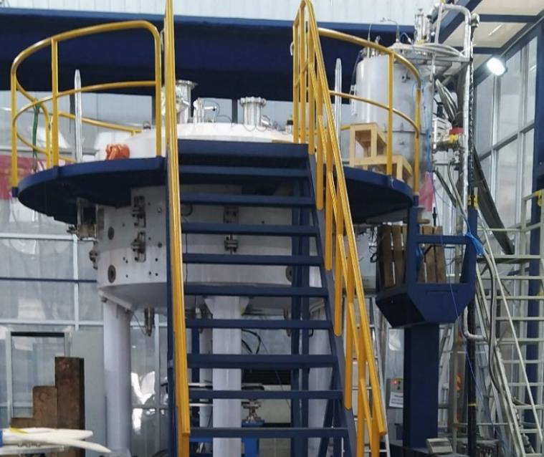
Theme “Improvement of the JINR Phasotron and Design of Cyclotrons for Fundamental
and Applied Research”
Research and development of the superconducting cyclotron for proton therapy for IPP CAS (Hefei, China)
Main cyclotron SC200 characteristics:
Compact design
Fixed energy, fixed field and fixed RF frequency
Accelerated particles: protons
Bending limit W=200 MeV
Superconducting coils enclosed in a cryostat, all other parts are warm
Injection by PIG ion source
Extraction with an electrostatic deflector and passive magnetic channels
Main results:
Design of the cyclotron was finished.
Accomplished:
adequate model of the magnet,
adequate model of plug dimensions and dee tips geometry in the center.
Accelerating field was simulated.
Beam dynamics simulation shows sufficient quality of the center region and the acceleration zone.
No resonances were observed in the whole accelerating region in beam dynamics simulations.
Efficiency of the beam extraction up to 70 %.
Cyclotron is manufactured. Assembling, shimming and commissioning are under way.

Slide 8
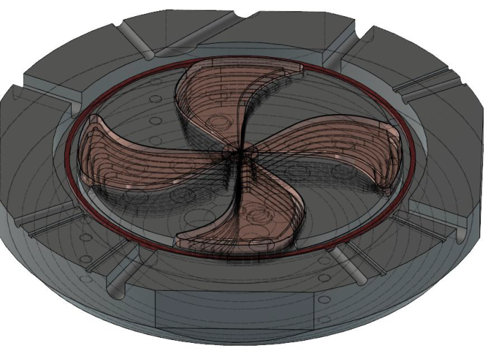
Theme “Improvement of the JINR Phasotron and Design of Cyclotrons for Fundamental
and Applied Research”
Research and development of the superconducting cyclotron for proton therapy
Magnet type | SC coil, warm yoke
Ion source | PIG
Final energy, MeV | 230
Pole radius, mm | 1350
Mean magn. field (center), T | 1.5
Dimensions (height×diameter), m | 1.7 × 4
Weight, tonnes | 130
RF frequency, MHz | 91.5
Harmonic number | 4
Number of RF cavities | 4
Voltage, center/extraction kV | 35/90
RF power, kW | 40
New development:
SC-230 superconducting cyclotron
Design of cyclotron with:
Low power consumption.
High quality of the beam.
Minimum engineering efforts and challenges.
Reasonable size and weight
An accelerator with such parameters can become potentially the cheapest and most energy-efficient accelerator for proton therapy due to low-energy consumption of the accelerating system. The SC230 accelerator has become a candidate for further realization of the biomedical research programme at JINR.

Slide 9
Theme “Improvement of the JINR Phasotron and Design of Cyclotrons for Fundamental
and Applied Research”
JINR Nuclear Physics PAC statements & recommendations
The report presented by the authors was of high technical standard and clearly showcases the depth of JINR’s expertise.
However, it is unclear which direction JINR will choose towards the realization of a modern proton therapy facility. Clear criteria need to be formulated according to which the choice of the dedicated medical accelerator can be made. In particular, it would be commendable if more details are presented, for example, on how many patients and fractions for proton therapy are planned.
Recommendation.
The PAC took note of the report on the concluding theme “Improvement of the JINR Phasotron and Design of Cyclotrons for Fundamental and Applied Research”.
The PAC recommends continuing the studies planned by the team in the field of development, construction and upgrade of cyclotrons, continuing cooperation in the field of medical cyclotrons within the framework of one of the themes of the Dzhelepov Laboratory of Nuclear Problems.
The PAC recommends that the JINR Directorate make soon a decision on this direction and support the realization of an optimized facility for proton therapy with high priority.

Slide 10
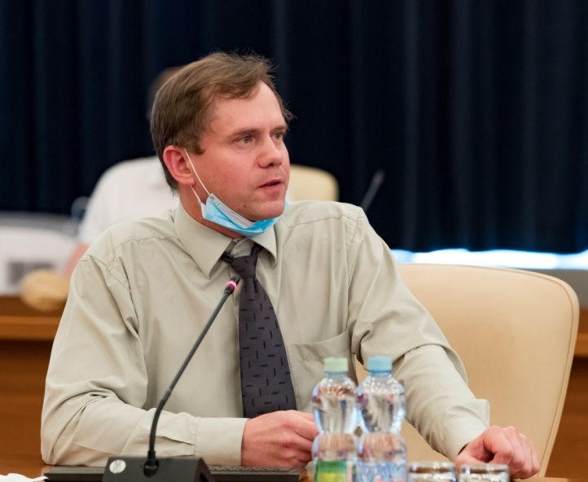
The preparation of a new project
“Modernization of the EG-5 accelerator and development of its experimental infrastructure”
The PAC heard the well prepared and documented report on the plans for the development of the EG-5 accelerator and its experimental infrastructure at FLNP.
The authors following the previous NP PAC recommendations compared in detail two technical solutions: a modernization of the existing EG-5 accelerator and a purchase of a new accelerator with similar design parameters.
Alexander Doroshkevich
Scientific program
1. Nuclear physics. The study of the properties of excited nuclei, reactions with the emission of charged particles, fission physics, obtaining relevant data for astrophysics, nuclear energy and the problem of transmutation of nuclear waste using neutron- and gamma-induced reactions.
2. Condensed matter physics. Application of neutron physics methods in other fields of science and technology:
Radiation material science;
Radiobiology;
Nuclear medicine;
Solid state Physics.
3. Applied and methodical
research

Slide 11
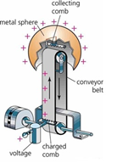
Modernization of the EG-5 accelerator and development of its experimental infrastructure
Goal
Providing technical conditions for the implementation of the scientific program of PTP JINR (Theme: 03-4-1128-2017/2022).
Main Tasks
Revival the research of reactions with fast quasimonoenergetic neutrons at JINR;
Providing the microbeam project implementation;
Development of methods of elemental analysis of deep profiles due to:
increasing performance of the spectrometer;
developing new methods for elemental analysis of nanopowder and micropowder object;
Training of human resources.
Technical task
Restoring the technical parameters of the EG-5 accelerator:
Energy of over 4,1 MeV
at the beam current of more 50mkA.
Ways of realization
- Tube replacement;
- Modernization of the EG -5 infrastructure;
- Young staff training.

Slide 12
Project Costs
Stage / Option |  | Cost, k$
1 | Repair of the accelerator tower premises | 167
2 | Replacement of a high-voltage tube with divider and ion source | 318
3 | Replacing a compressor in the gas compressor section | 64
4 | Automation of technological systems of EG-5 | 105
5 | Modernization of EG-5 research infrastructure: Installation of a spectrometers complex RBS “Endstation RC43” | 628
6 | Installation of a laboratory for the research samples preparation | 218
Total: |  | 1500
Stage / Option |  | Cost, k$
1 | Overhaul / building of the new accelerator premise | 700
2 | Service equipment purchase: (Recirculation equipment for the accelerator premise; uninterruptible power supply system; chiller for accelerator systems and gas compressor stations; SF6 gas; general laboratory equipment) | 1000
3 | Accelerator purchase | 4300
4 | Modernization of EG-5 research infrastructure: Installation of a spectrometers complex RBS “Endstation RC43” | 628
5 | Installation of a laboratory for the research samples preparation | 218
Total: |  | 6 846
Estimated project cost:
0,5 M$ / year (3 years)
Estimated project cost:
2,290 M$ / year (3 years)
+ detailed SWOT analysis of both solutions
12

Slide 13
The preparation of a new project
“Modernization of the EG-5 accelerator and development of its experimental infrastructure”
JINR Nuclear Physics PAC statements & recommendations
The PAC heard the well prepared and documented report on the plans for the development of the EG-5 accelerator and its experimental infrastructure at FLNP.
The authors compared in detail two technical solutions: a modernization of the existing EG-5 accelerator and a purchase of a new accelerator with similar design parameters.
Recommendation.
The PAC recommends the realization of modernization of the EG-5 accelerator with first priority.
The PAC recommends preparing and opening a project to modernize the existing accelerator and associated experimental infrastructure activities under the theme “Investigations of Neutron Nuclear Interactions and Properties of the Neutron” with financing from the budget of the current Seven-Year Plan for the Development of JINR, starting in 2021.
13

Slide 14
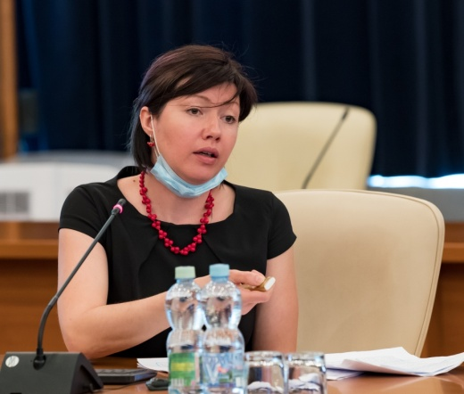
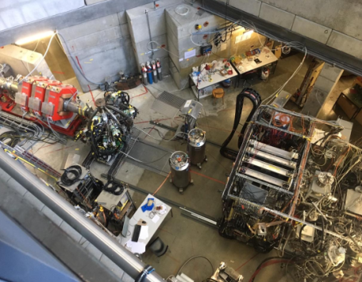
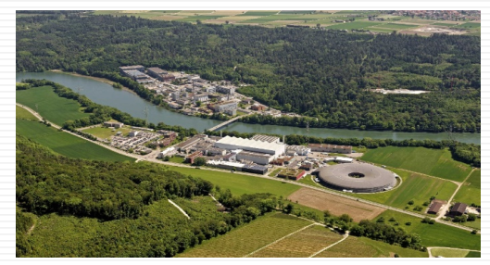
New project: “Muon Ordinary capture for the NUclear Matrix elemENTs in 2β-decays (project MONUMENT)”
Daniya Zinatulina
The PAC heard the proposal to open a new project “Measurement of ordinary muon capture for testing nuclear matrix elements of 2β-decays (project MONUMENT)”.
This project is aimed at carrying out measurements of muon capture at several daughter candidates on 2β-decay nuclei.
πE1

Slide 15
New project: “Muon Ordinary capture for the NUclear Matrix elemENTs in 2β-decays (project MONUMENT)”
Objectives and estimated results
It is proposed to carry out a research program which includes three beam time periods at the πE1-2 beam line of PSI over three years to pursue the following scientific objectives:
Measurement of the total muon capture rates in the isotopically enriched isotopes ⁹⁶Mo, ¹⁰⁰Mo, ⁴⁰Ca, ⁵⁶Fe and ³²S. The measurements are related to the Nuclear Matrix Elements calculations for the Double Beta Decay of ⁹⁶Zr.
Extraction of the partial muon capture rates to the bound states in ⁷⁶As, ⁹⁶Nb, ¹⁰⁰Nb, ⁴⁰K, ⁵⁶Mn and ³²P following Ordinary Muon Capture (OMC) in ⁷⁶Se, ⁹⁶Mo, ¹⁰⁰Mo, ⁴⁰Ca, ⁵⁶Fe and ³²S, respectively. Comparison with the calculated nuclear matrix elements which will be carried out by theory groups (not funded through this proposal).
The radioactive production rates will be compared with the proton and neutron emission model to derive the muon-capture strength function and the associated giant resonance (GR) peak. These results will be compared with recent theoretical results.
The muonic X-rays spectra measured in OMC will be implemented to the already existing Mesoroentgen electronic catalogue (muxrays.jinr.ru).

Slide 16
Recommendation.
The measurements of muon capture will be carried out at the meson factory of the Paul Scherrer Institute (PSI) in Switzerland. This application was reviewed and approved by the PSI User committee; the beam time was officially granted in 2020 for a preliminary study of ¹³⁶Ba with a further experimental programme for at least three years.
The participants of the MONUMENT project have required expertise and experience in the field of high-precision nuclear spectroscopy and its implementation for studying not only rare processes but also muon capture.
The PAC recommends opening the project MONUMENT for 2021–2023 with first priority and providing the project with full requested funding.

Slide 17
THANK YOU FOR YOUR ATTENTION!

