Slide 1
Lightweight sites in WLCG Maarten Litmaath, CERN

Slide 2
Rationale
One of the goals of WLCG Operations Coordination activities is to help simplify what the majority of the sites, i.e. the smaller ones, need to do to be able to contribute resources in a useful manner, i.e. with large benefits compared to efforts invested.
Classic grid sites may profit from simpler mechanisms to deploy and manage services. Moreover, we may be able to get rid of some service types in the end.
New and existing sites may rather want to go into one of the cloud directions that we will collect and document.
There may be different options also depending on the experiment(s) that the site supports.
There is no one-size-fits-all solution. We will rather have a matrix of possible approaches, allowing any site to check which ones could work in its situation, and then pick the best.

Slide 3
Boundaries – storage & data access
Under the aegis of the WLCG Data Steering Group
Data federations
Multi-site storage
Caches
Diskless sites
Big data technologies
A number of these areas will be covered by other presentations in today’s session
Further information
WLCG workshop June 2017 Data session
May 2017 GDB
Here we focus on computing resources instead
Potential for
paradigm changes

Slide 4
Boundaries – EGI and OSG
In OSG every WLCG site mainly supports just a single LHC experiment
The sites are managed in close collaboration with the US project in each experiment
US-ATLAS, US-CMS, US-ALICE
Both US-ATLAS and US-CMS have already been working on lighter ways to provision their resources
Ubiquitous Cyberinfrastructure, Virtual Clusters
Tier-3 in a box, Pacific Research Platform
In EGI the situation is a lot more complex
Multi-experiment sites, many countries/cultures/projects/…, more MW diversity, experiments have less influence, …
Here we should focus on the EGI sites then
While learning from the OSG sites

Slide 5
T2 vs. T3 sites
T3 sites have not signed the WLCG MoU
Typically dedicated to a single experiment → can take advantage of shortcuts
T2 sites have rules that apply
Availability / Reliability targets
Accounting into EGI / OSG / WLCG repository
EGI: presence in the info system for the Ops VO
Security regulations
Mandatory OS and MW updates and upgrades
Isolation
Traceability
Security tests and challenges
Evolution is possible
Some rules could be adjusted
The infrastructure machinery can evolve

Slide 6
How to enable computing
Services that currently are or may be needed to enable computing at a grid site:
Computing Element
Batch system
Cloud setups
Authorization system
Info system
Accounting
CVMFS Squid
Monitoring

Slide 7
How to enable computing
Services that currently are or may be needed to enable computing at a grid site:
Computing Element
Batch system
Cloud setups
Authorization system
Info system
Accounting
CVMFS Squid
Monitoring
Reduce the catalog of required services, where possible?
Replace classic, complex portfolio with alternative, more widespread technologies?
Simplify deployment, maintenance and operation of what needs to remain?

Slide 8
Less diversity would help
Batch systems on the rise
HTCondor
Slurm
CE implementations on the rise
HTCondor
ARC
Configuration systems on the rise
Puppet
Ansible

Slide 9
Tap into popular technologies?
Cloud systems on the rise
OpenStack
…
Container systems on the rise
Docker
Singularity
Kubernetes
Mesos
OpenStack Magnum
OpenShift
...
Many winners for now?

Slide 10
Lightweight sites – classic view
How to provide resources with less effort?
Keep things basically the same, but easier
Site responses to a questionnaire show the potential benefits of shared repositories
OpenStack images
Pre-built services, pre-configured where possible
Docker containers
Ditto
Puppet modules
For site-specific configuration

Slide 11
Lightweight sites – alternative view
CE + batch system not strictly needed
Cloud VMs or containers could be sufficient
They can be managed e.g. with Vac or Vcycle
Several GridPP sites are doing that already
All 4 experiments are covered
The resources are properly accounted
They can directly receive work from an experiment’s central task queue
Or they can rather join a regional or global HTCondor pool to which an experiment submits work
Proof of concept used by GridPP sites for ALICE
Cf. the CMS global GlideinWMS pool → scalable to O(100k)

Slide 12
Distributed site operations model
A site needs to provide resources at an agreed QoS level
HW needs to be administered by the site
Other admin operations could be done by a remote, possibly distributed team of experts
Site resources within a region could be integrated into a regional cloud
Example: JINR cloud extending to partner sites
Or they could be integrated by a regional virtual HTCondor batch system
VMs/containers of willing sites may join the pool directly
CEs and batch systems of other sites can be addressed through Condor-G
The virtual site exposes an HTCondor CE interface through which customers submit jobs to the region
HTCondor then routes the jobs according to fair-share etc.

Slide 13
Volunteer computing …
The LHC@home project coordinates volunteer computing activities across the experiments
ATLAS have benefited from 1-2% extra resources for simulation workloads
See this recent talk by David Cameron
It could become a way for a computing-only lightweight site to provide its resources
The central infrastructure can scale at least for simulation jobs
The resources can be properly accounted in APEL

Slide 14
… and lightweight sites
Real sites can be trusted
No need for volunteer CA or data bridge
A separate, easier infrastructure would be set up
BOINC can even coexist with a batch system on the same WN
Successfully demonstrated at IHEP, Beijing
Also here HTCondor is used under the hood
Standard for experiments and service managers

Slide 15
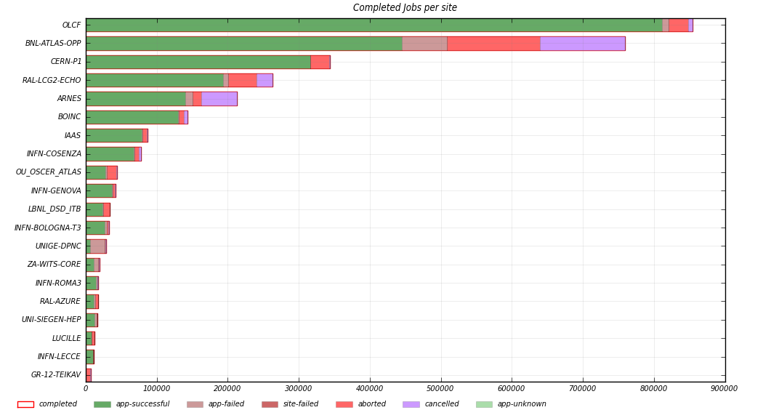
Recent ATLAS T3 stats

Slide 16
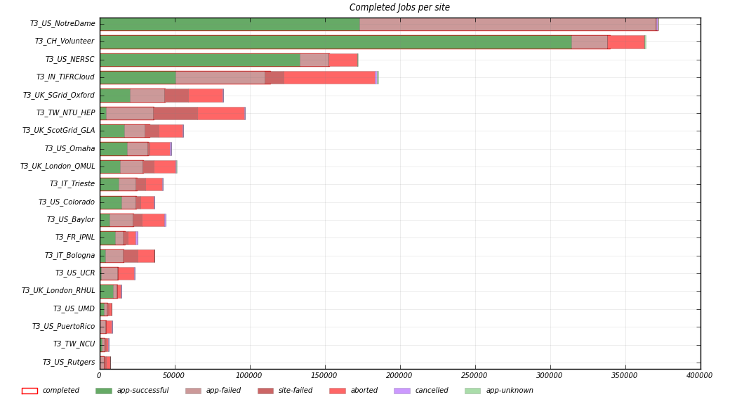
Recent CMS T3 stats

Slide 17
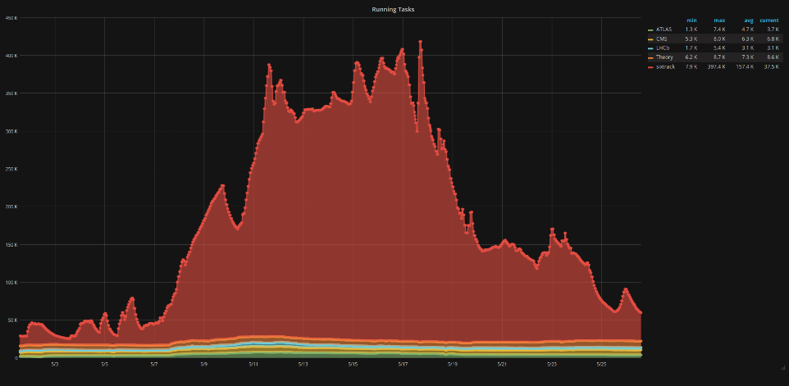
Volunteer potential
400k
300k
SixTrack
200k
100k
8th BOINC Pentathlon 2017

Slide 18
Computing resource SLAs
The resources themselves can also be “lightweight”
Please see this recent talk by Gavin McCance
Extra computing resources could be made available at a lower QoS than usual
Disk server CPU cycles, spot market, HPC backfill, intervention draining, …
Jobs might e.g. get lower IOPS and would typically be pre-emptible
Machine-Job Features (MJF) functionality can help smooth the use
They would have an SLA between those of standard and volunteer resources → a mid-SLA

Slide 19
Lightweight operations
We would like to have sites which can run almost “by themselves”
With minimal oversight and operational efforts from people at the site
Could we make use of Machine Learning algorithms to improve our monitoring?
Automatic classification and filtering of log messages
Definition of metrics that characterize the state of operations
Early identification of remarkable trends

Slide 20
Conclusions and outlook
Many small sites currently need to invest efforts that are not commensurate with their size nor available funding
Multiple areas are being investigated to allow small sites to become more lightweight
Sites are envisaged to be able to pick the best choice from a matrix of solutions
WLCG thus may evolve toward increased flexibility and sustainability !

