Slide 1
Dubna experimental projects aimed at researching exotic nuclei
Sergey Sidorchuk,
Flerov Laboratory, Dubna

Slide 2
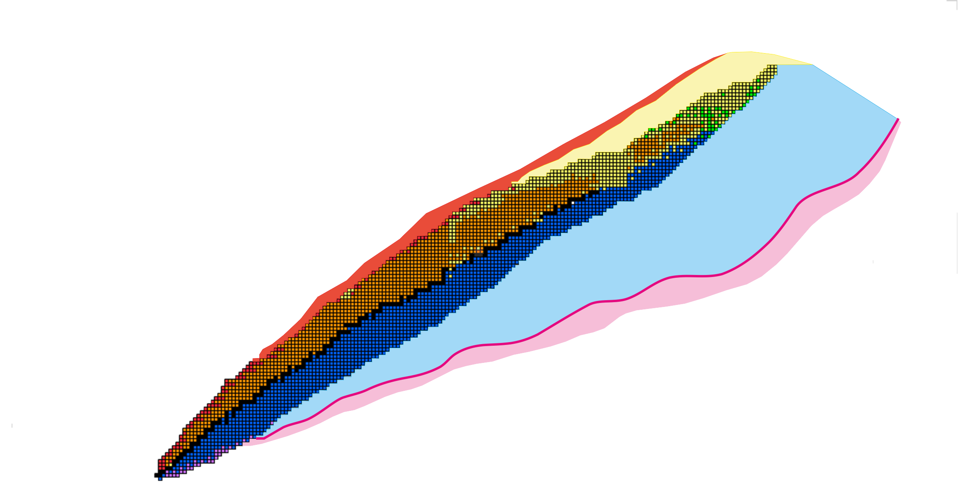
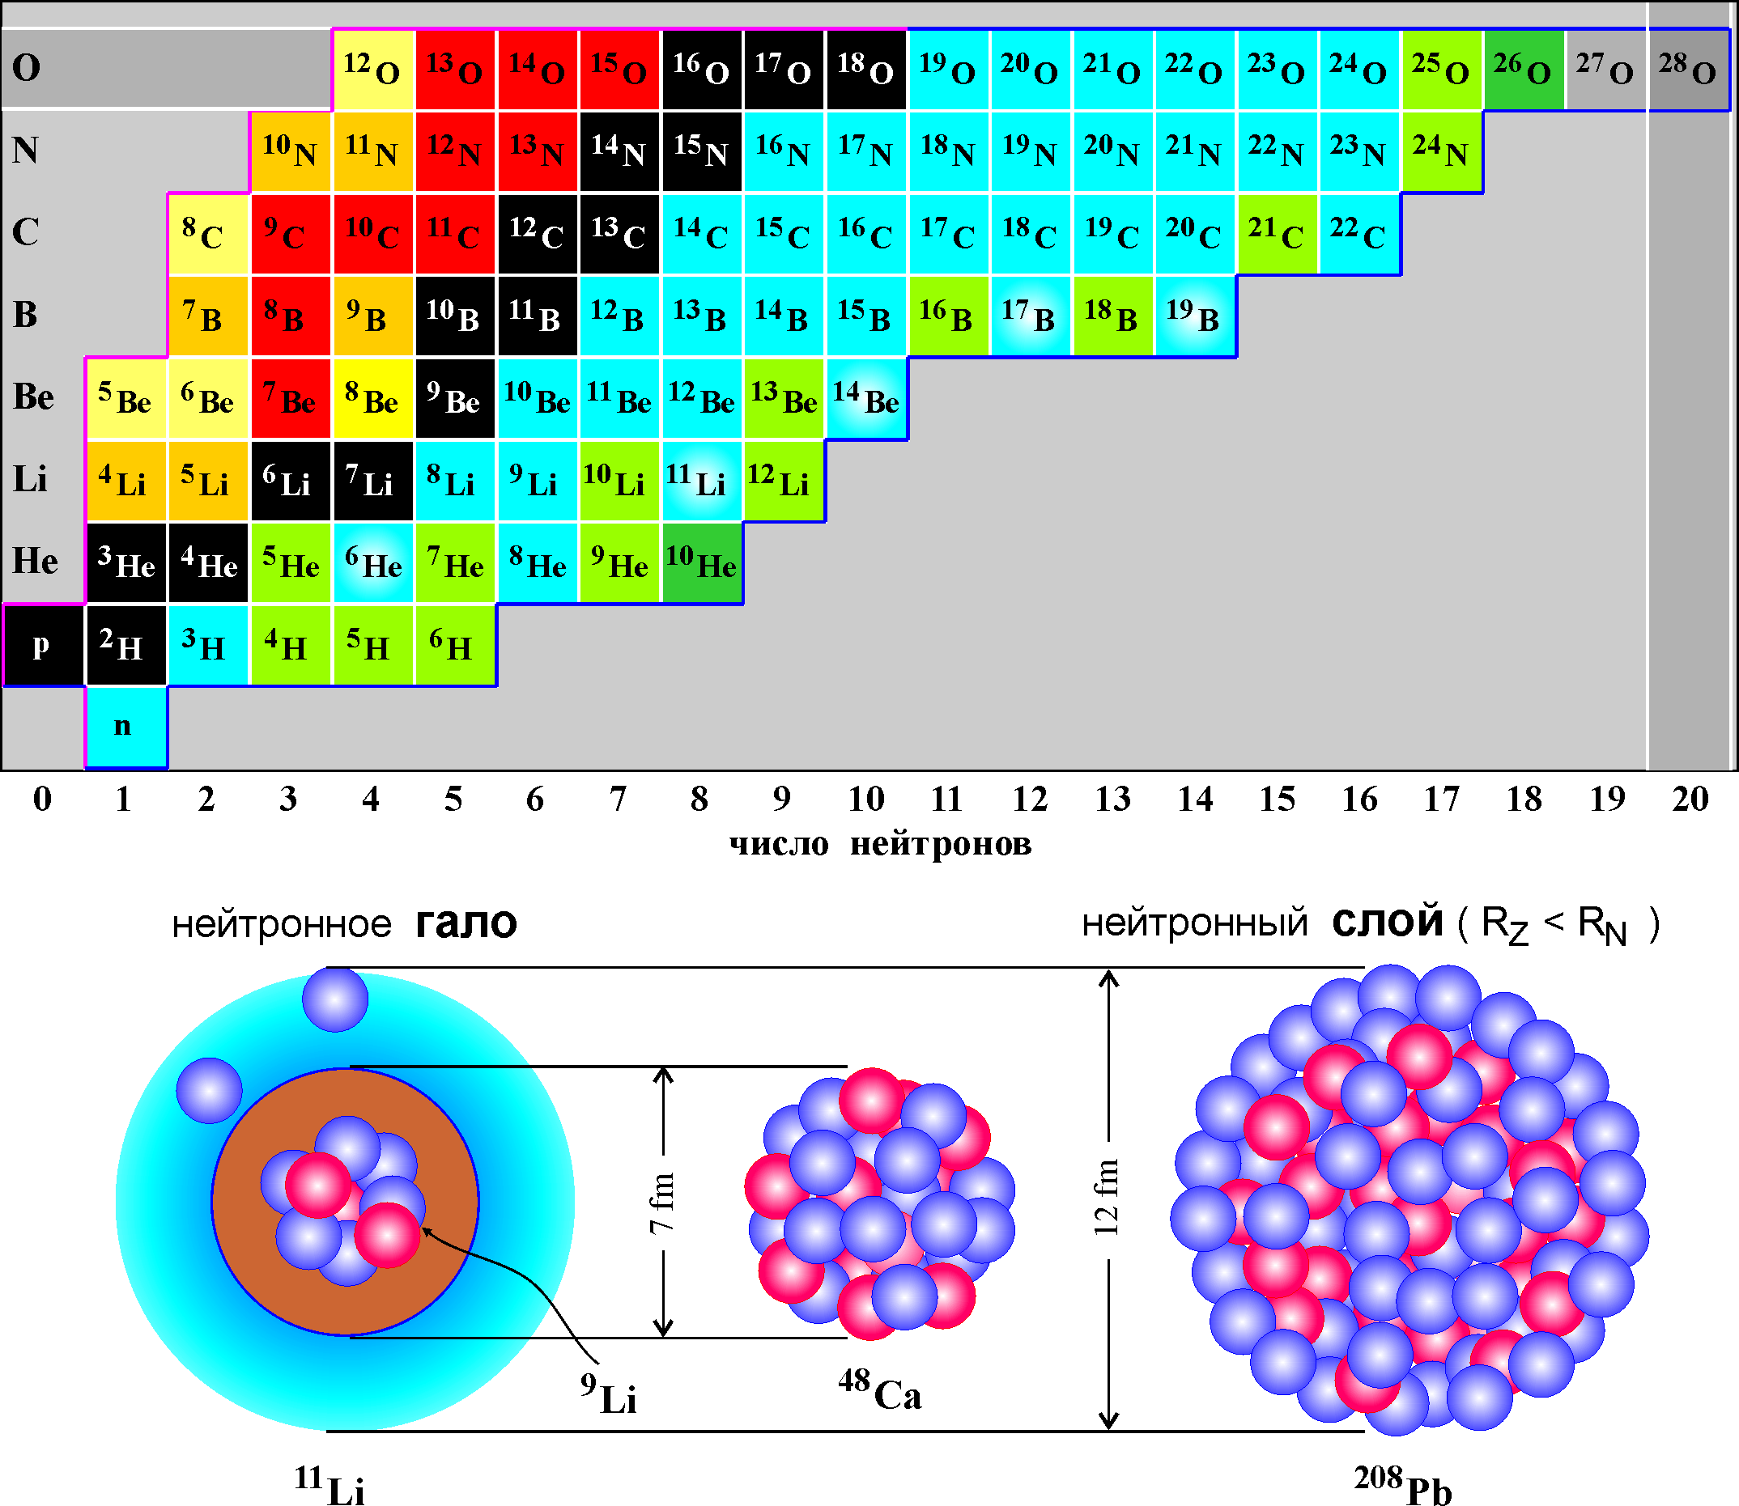
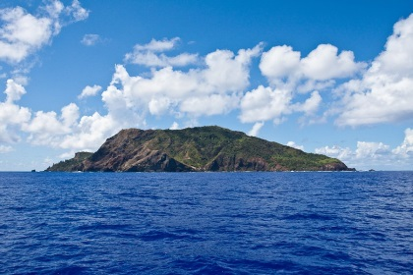
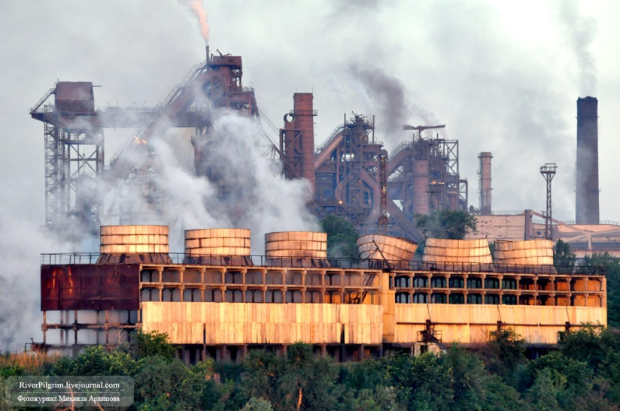
Industrial Age
of Nuclear Physics
Stability
Island
Nucleon-stable isotopes
Nuclei beyond the neutron
stability border
Z=120, A=298-300
60 α-particles
+ 60 neutrons
α
n
α
n
α
α
n

Slide 3
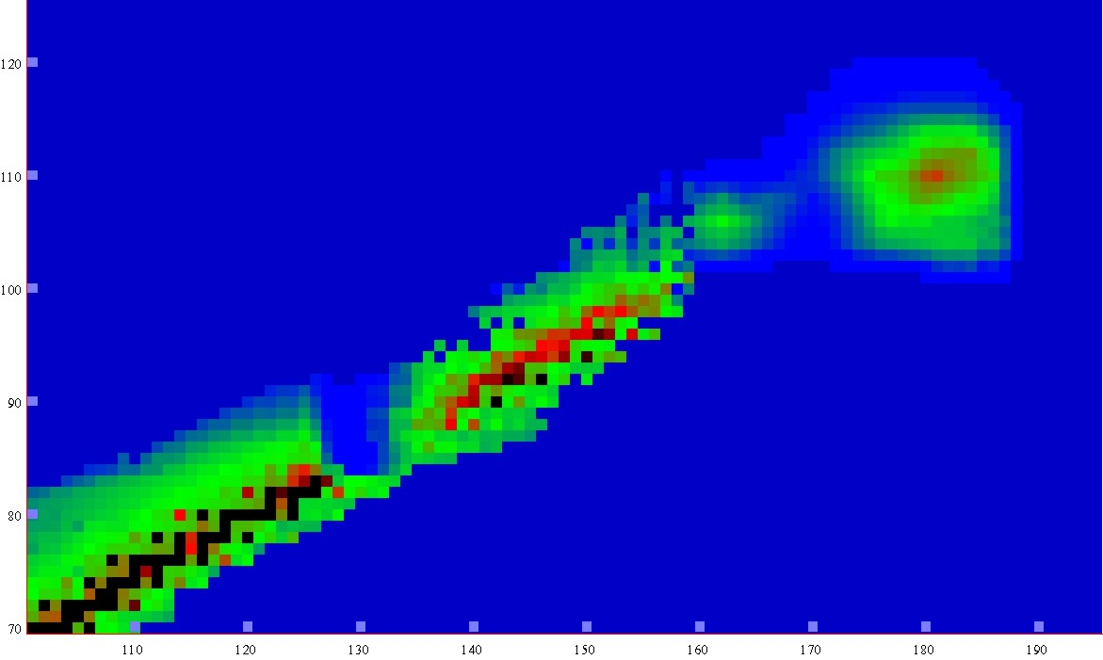
Half-lives
Microscopic theory
-5
0
5
10
15
LogT_{1/2} s
New lands
New lands
1μs
1s
1h
y
1My
Island of
Stability
120
Bombarding particle ⁴⁸Ca
Target materials: U, Pu, Am, Cm, Bk, Cf
Island of
Stability
Shoal
110
shoal
Proton number
Peninsula
100
peninsula
Ca(Z=20)+Bk(Z=97)=117
90
Continent
continent
Sea of Instability
80
70
100
110
120
130
140
150
160
170
180
190
Neutron number
Notes:
3

Slide 4
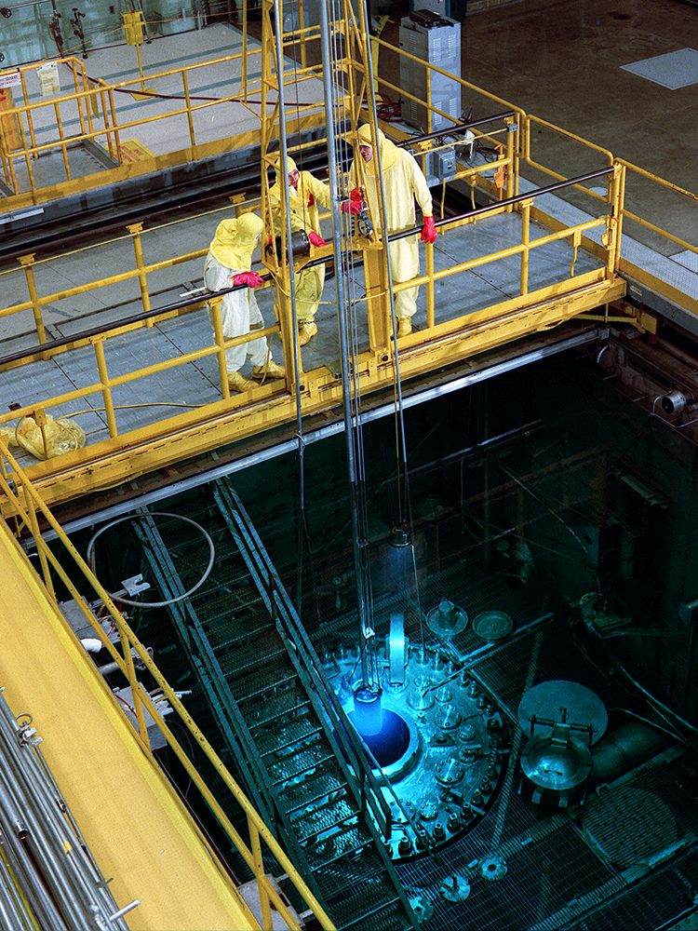
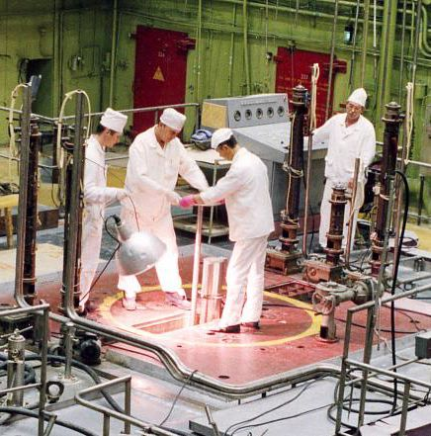
Production of actinides at the
High flux reactors
HFIR, ORNL, Oak Ridge, USA
CM-3, IAR, Dimitrovgrad, RF

Slide 5
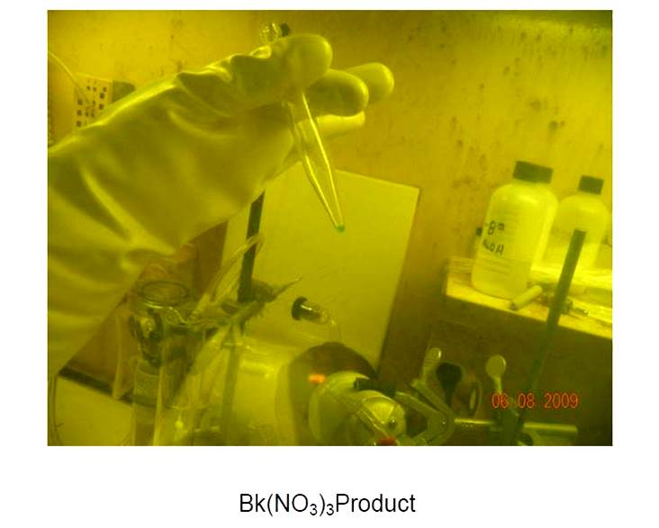
²⁴⁹Bk: 22 mg ,
1 year of the reactor operation,
1 M$ cost

Slide 6
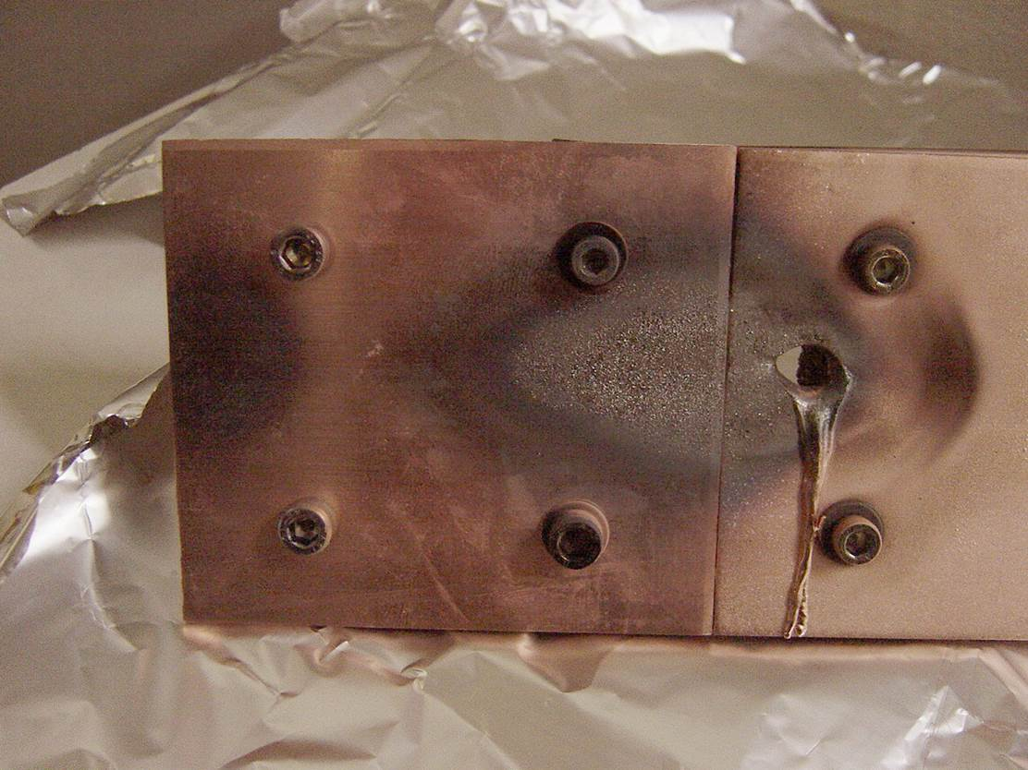

What is 10¹² particles/s of ⁴⁸Ca?
20 μA$×280 MeV≈6 kW$

Slide 7
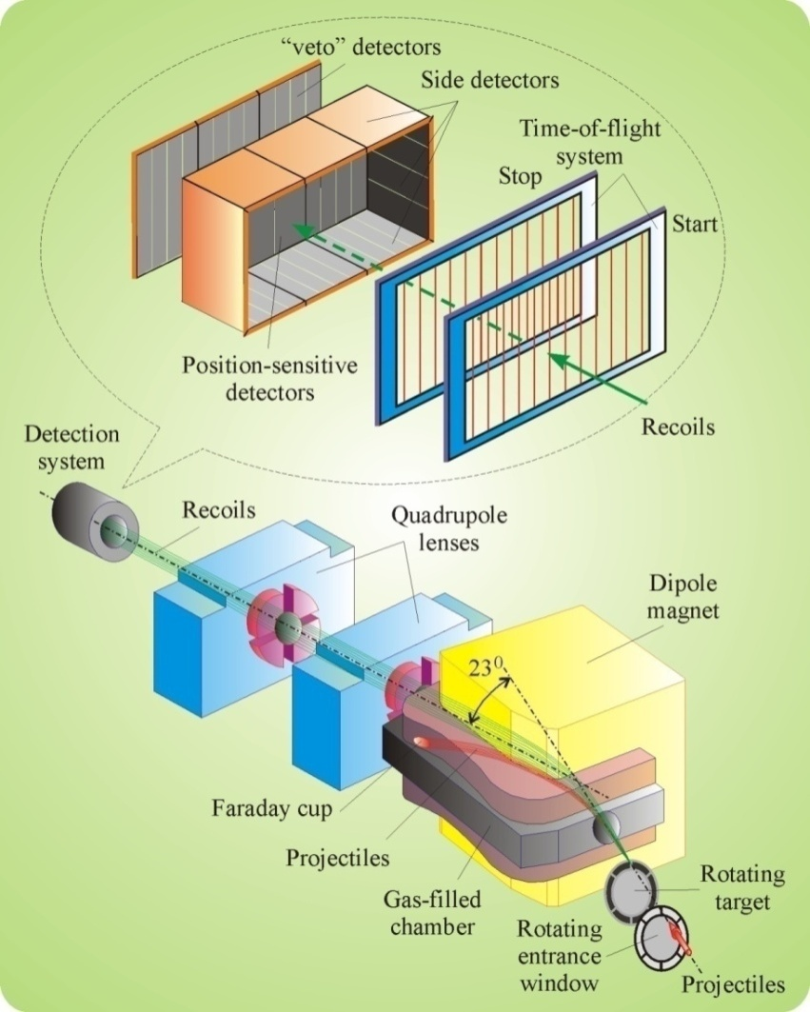
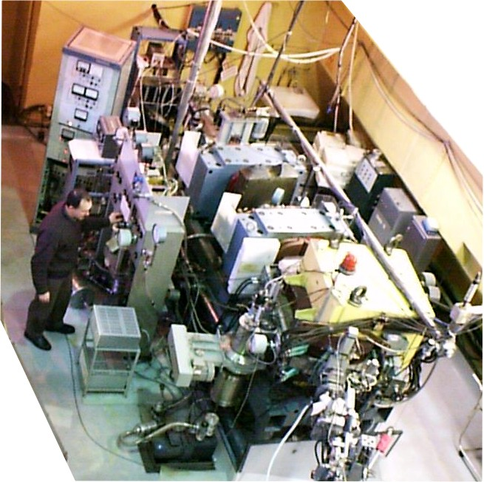
Dubna gas-filled recoil separator

Slide 8
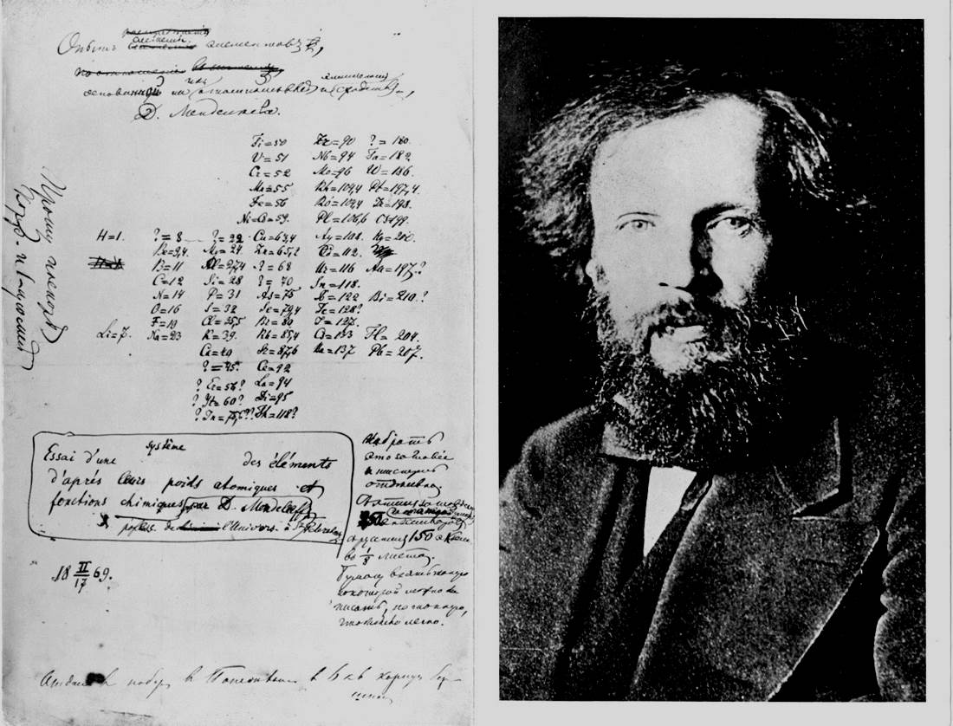
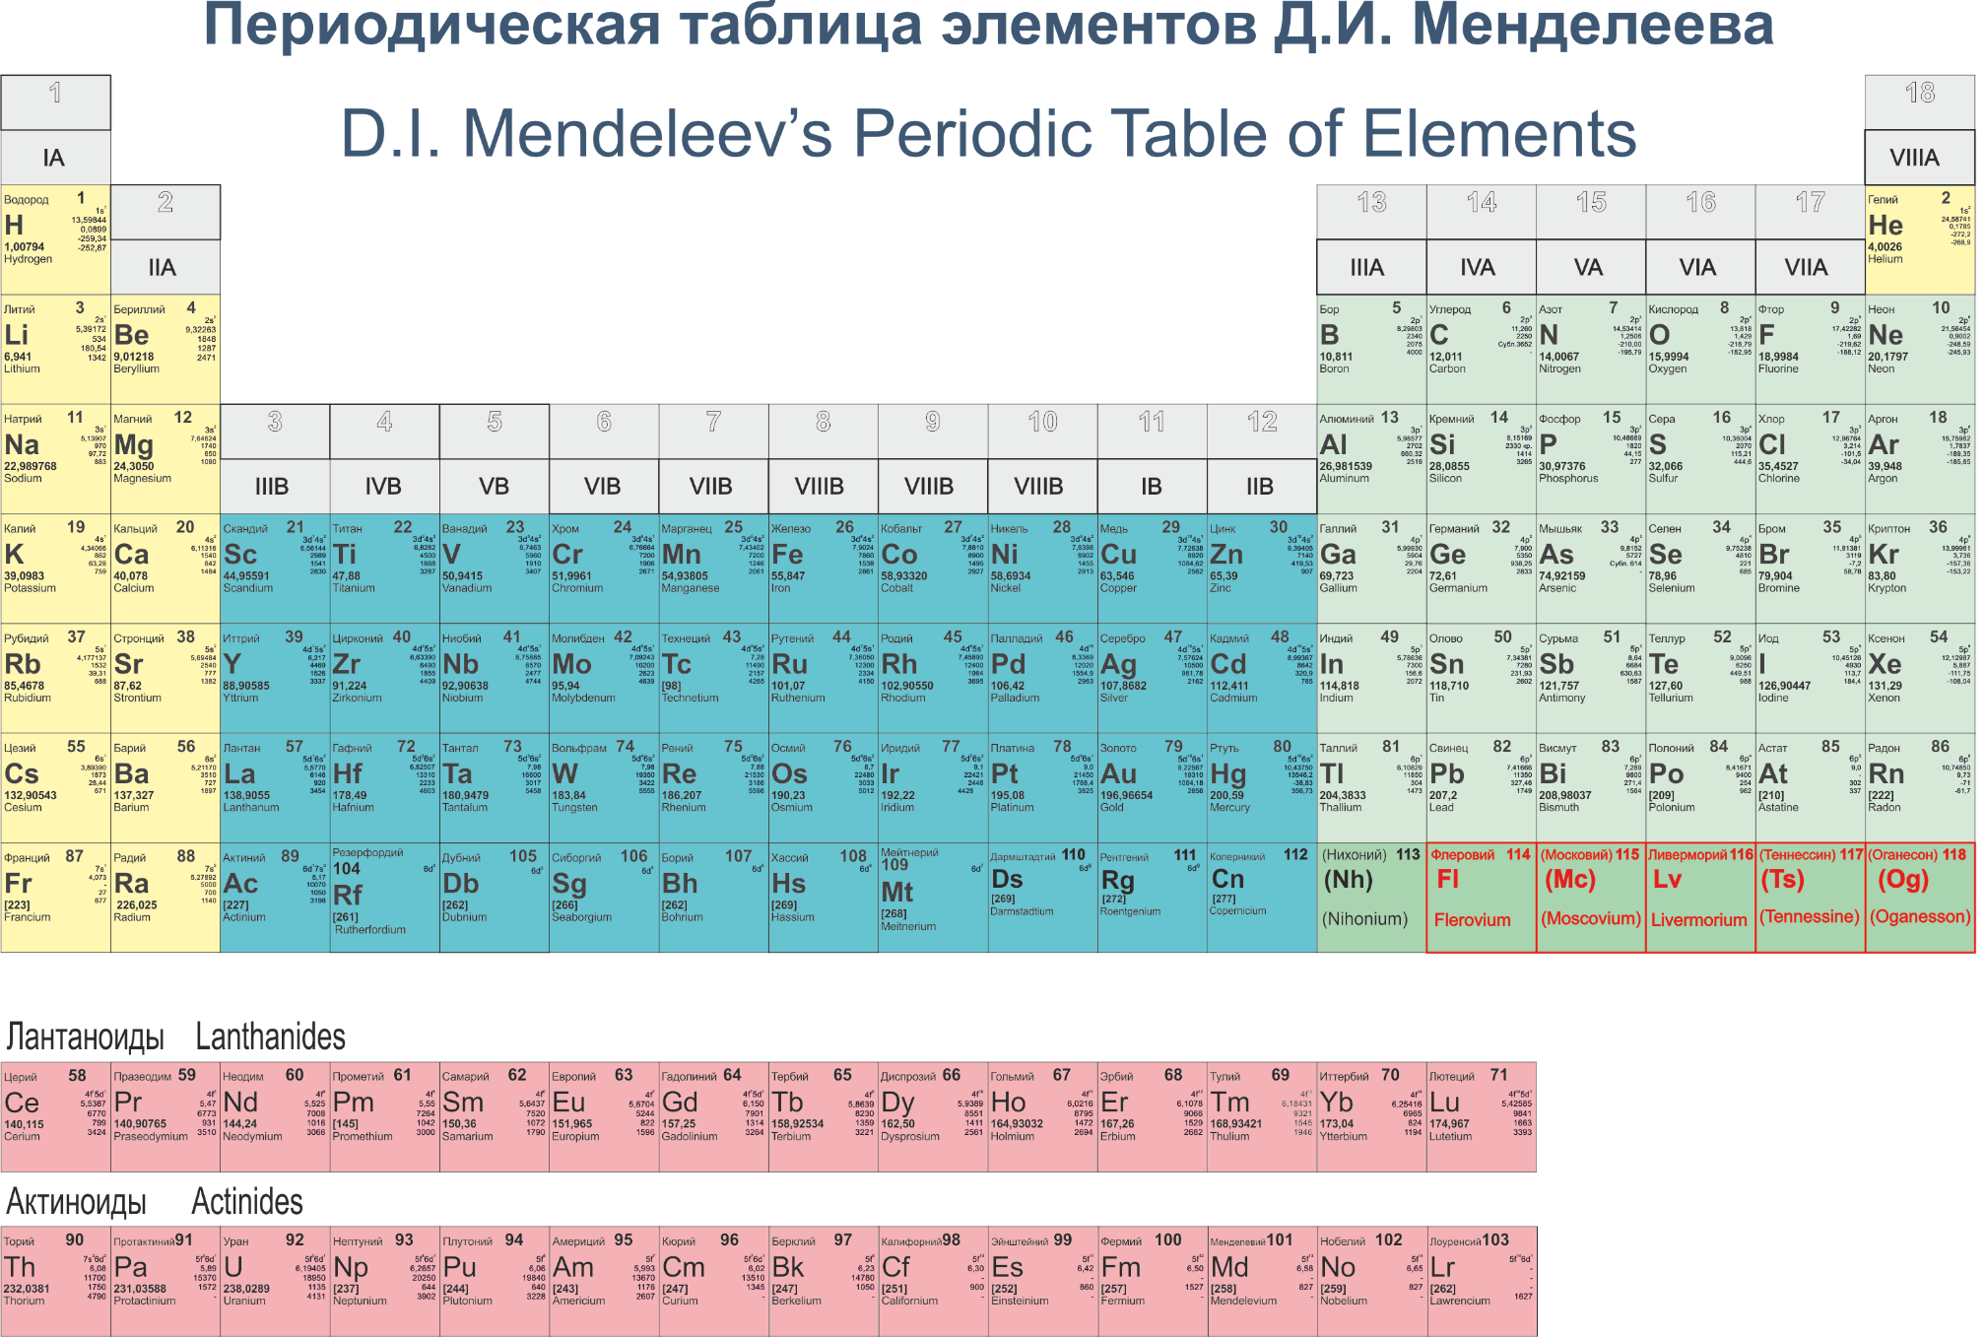

Slide 9
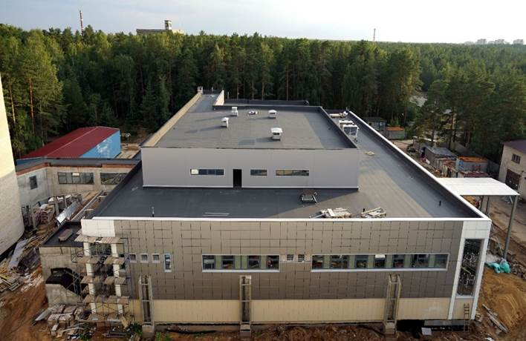
SHE-factory
Synthesis and study of properties of SHE.
Search for new reactions for
SHE-synthesis.
Chemistry of new elements.

Slide 10
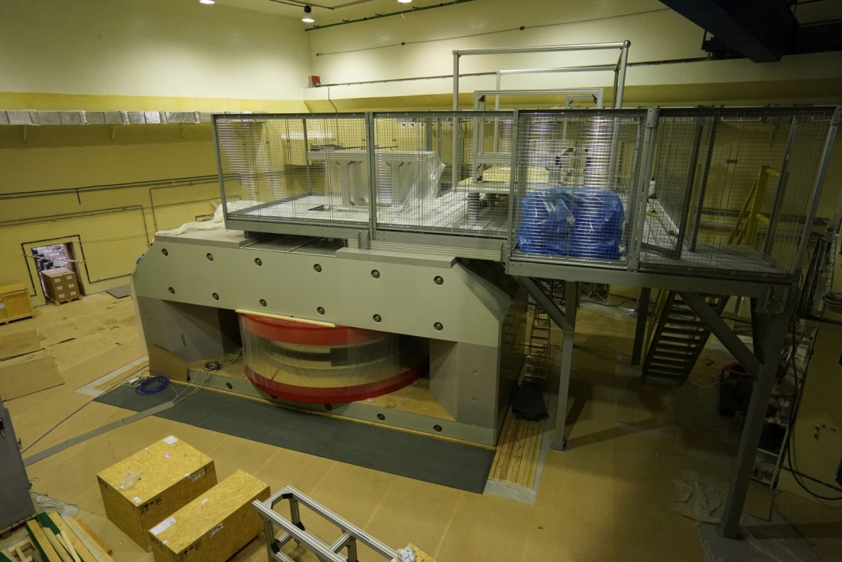
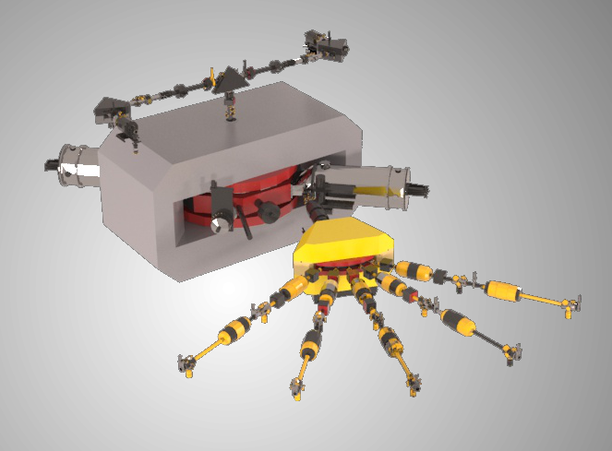
DC-280 cyclotron
DC280 E=4÷8 MeV/A
Ion | Ion energy [MeV/A] | Output intensity
⁷Li | 4 | 1×10¹⁴
¹⁸O | 8 | 1×10¹⁴
⁴⁰Ar | 5 | 6×10¹³
⁴⁸Ca | 5 | 0,6-1,2×10¹⁴
⁵⁴Cr | 5 | 2×10¹³
⁵⁸Fe | 5 | 1×10¹³
¹²⁴Sn | 5 | 2×10¹²
¹³⁶Xe | 5 | 1×10¹⁴
²³⁸U | 7 | 5×10¹⁰

Slide 11
Light exotic nuclei
Neutron and proton halo;
New isotopes on the nucleon
stability borders;
Two-proton radioactivity;
Complicated shapes of exotic nuclei;
Astrophysical applications;
Nuclear structure beyond the stability borders;
Breakdown of the shell structure.
Nucleon-stable isotopes
Nuclei beyond the proton stability border
Nuclei beyond the neutron
stability border

Slide 12
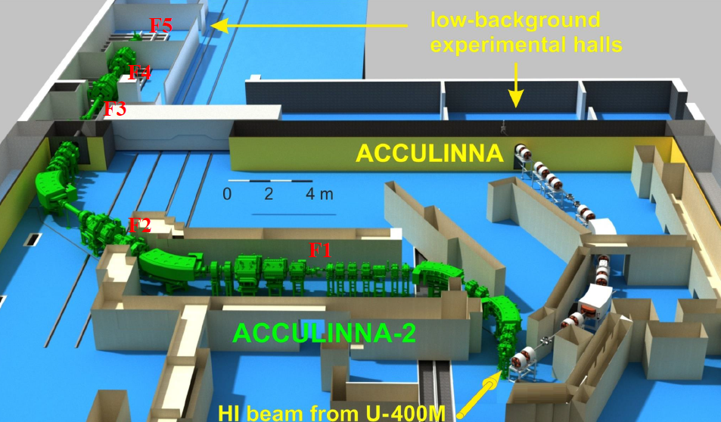
АCCULINNА → АCCULINNА-2
Physical target
Production target
Primary beam 10¹² s⁻¹
Secondary beam 10⁵ s⁻¹

Slide 13
Double magic
nuclei?
⁹He
¹⁰He
P1/2
⁵He
⁶He
⁷He
⁸He
⁴H
⁵H
⁶H
⁷H
P3/2
³He
⁴He
²H
³H
S
protons
neutrons
protons
neutrons

Slide 14
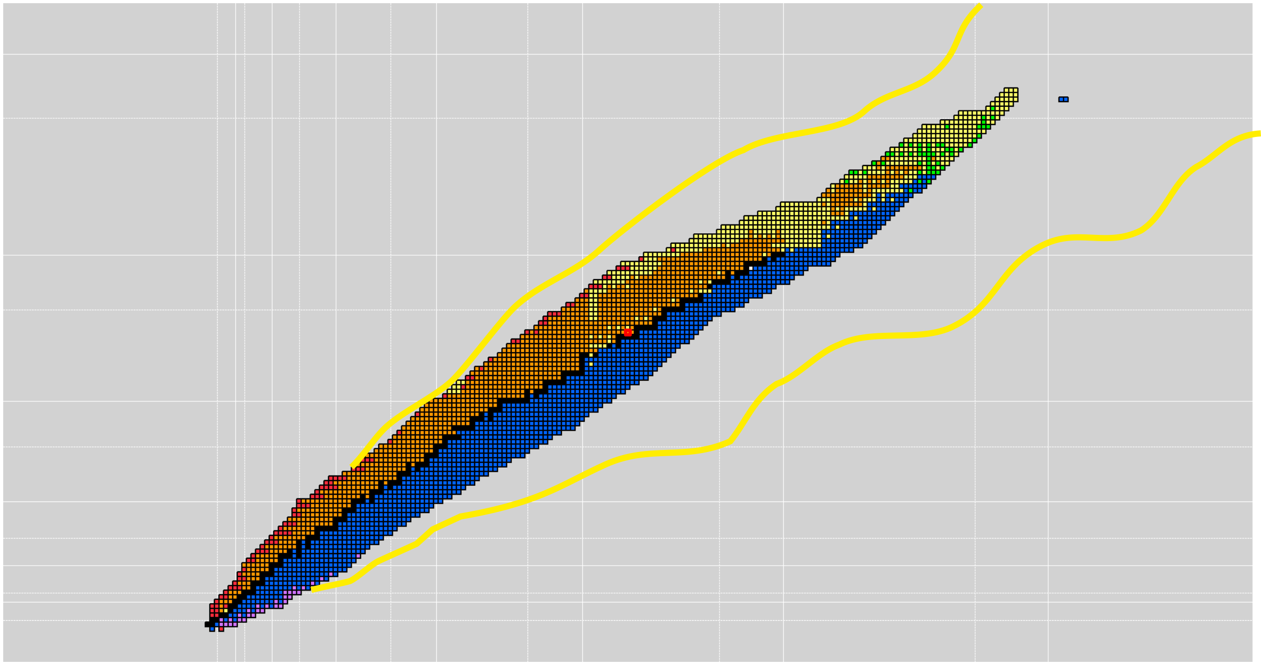
Nuclear shells
far from the
β-stability line
SH
¹²⁸Pd
¹²Be
1f_{7/2}
(8)-[28]--28
¹¹Li
⁷⁸Ni
2ћω
2s
1d_{3/2}
(4)-[20]--20
¹⁰He
1d
2s_{1/2}
(2)-[16]
1d_{5/2}
(6)-[14]
⁴⁰Mg
1p_{1/2}
1ћω, 1p
(2)-[8]----8
²⁹F
1p_{3/2}
(4)-[6]----2
8
0, 1s
1s_{1/2}
(2)-[2]----2

Slide 15
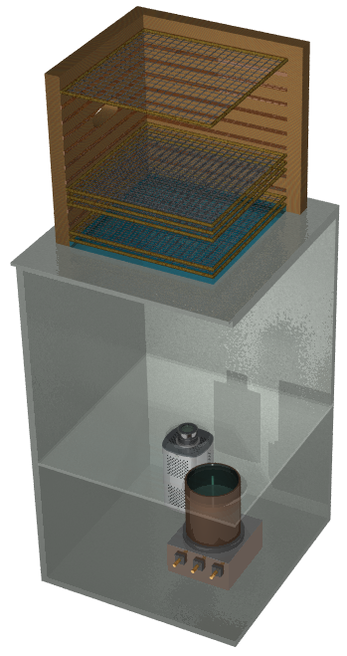
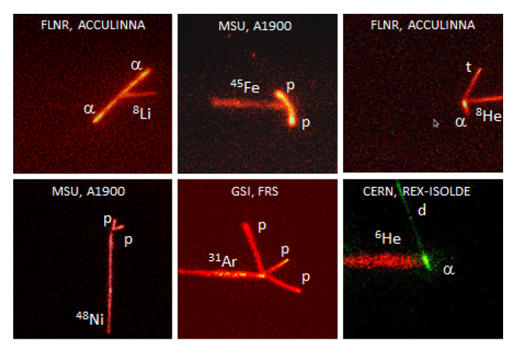
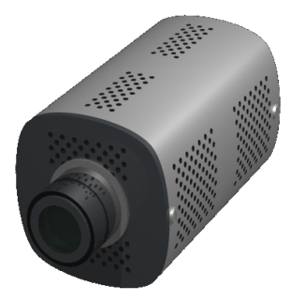
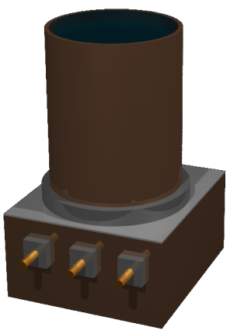
Optical Time Projection Chamber
CCD 2/3’’
1000 × 1000 pix
12-bits
image ampl.
(× 2000)
PM 5’’
Gas (1 atm) : 49% He + 49% Ar + 1% N₂ + 1% CH₄
M. Ćwiok et al., IEEE TNS, 52 (2005) 2895
Active volume: 20×20×15 cm³; drift velocity: ≈ 1 cm/μs
K. Miernik et al., NIM A581 (2007) 194

Slide 16
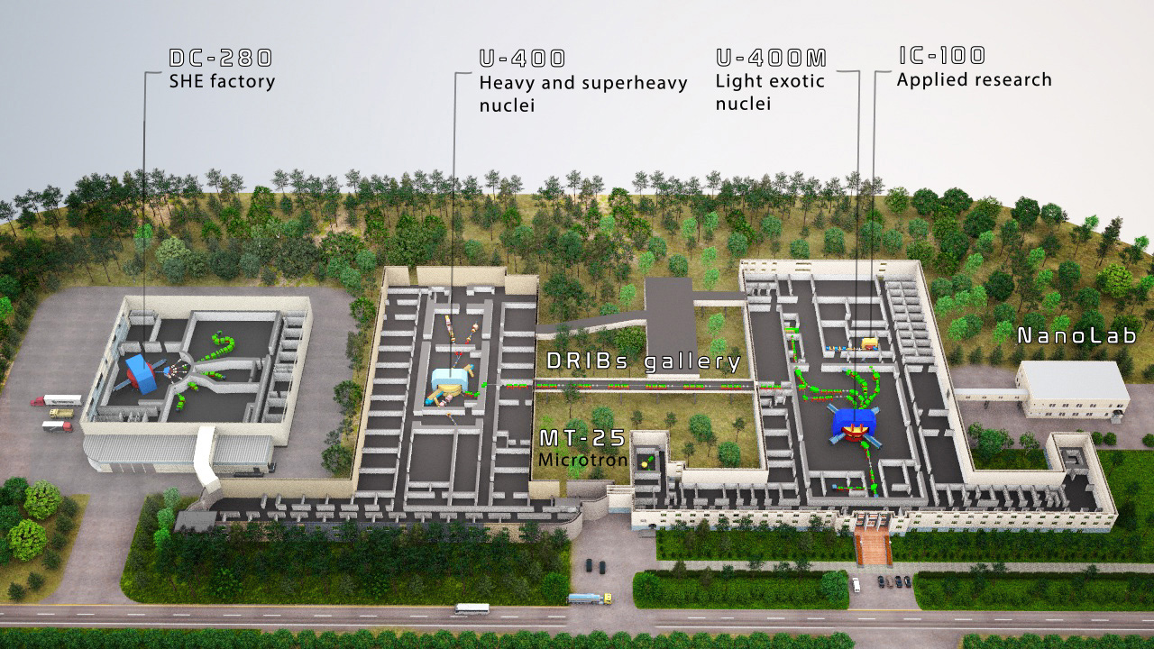
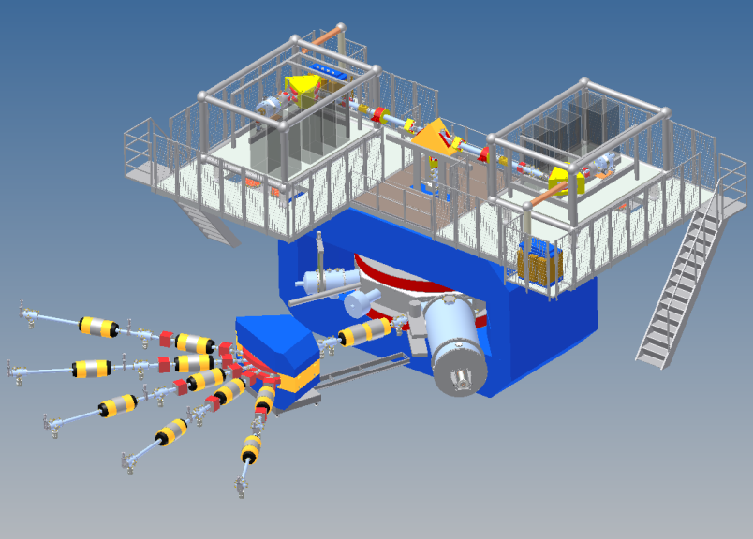

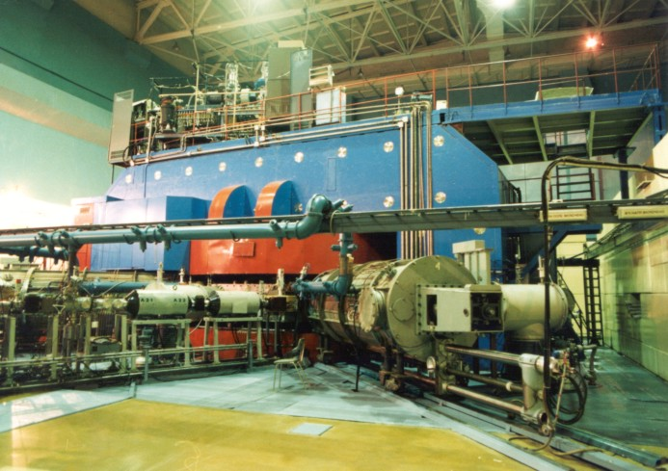

Slide 17
THANK YOU!

Slide 18
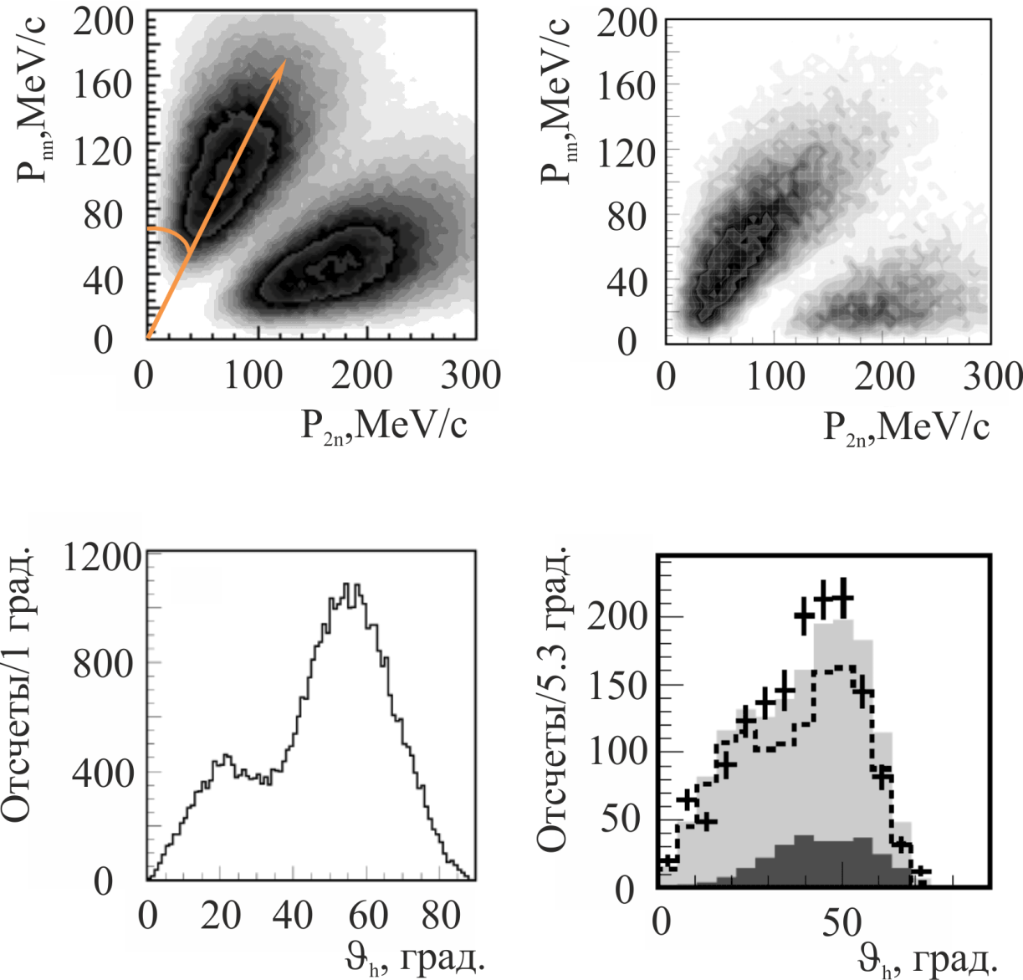
Трехтельные импульсные корреляции ⁶Не,
в реакции КСР ⁴Не(⁶Не,2α)2n

