Slide 1



«Increasing Bandwidth of data acquisition systems on IBR-2 reactor spectrometers in FLNP»
Presenters: Shvetsov V. V.
Primary author: Drozdov V.A.
Co-author: Shvetsov V. V.
E-mail: shvetc_vas@mail.ru
NEC’2017

Slide 2
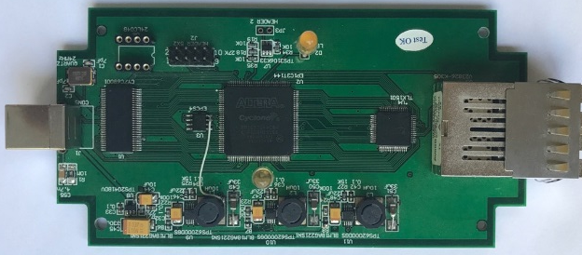
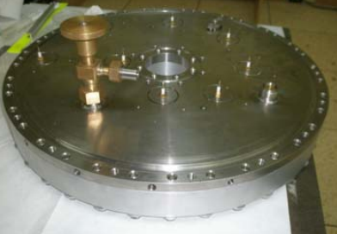
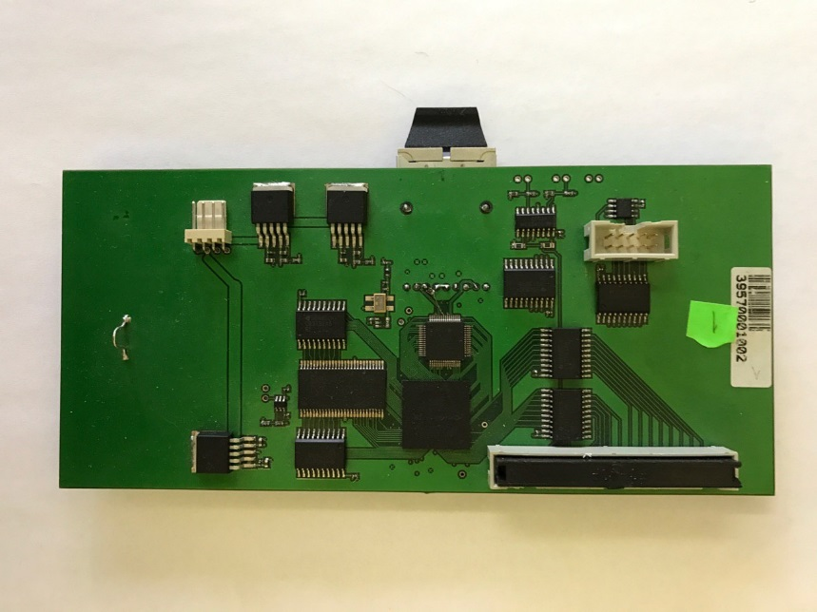
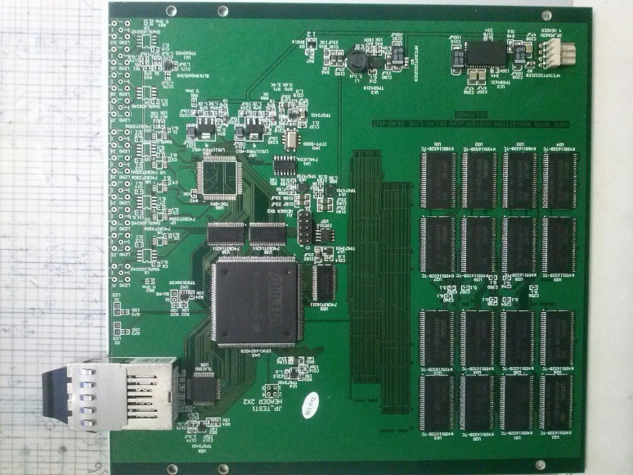
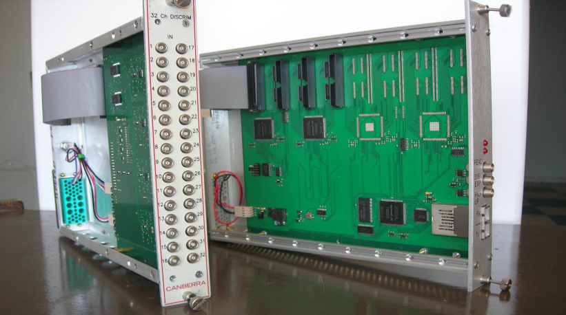
The relevance of the tasks
Modern detector systems with point detector elements currently used on and being developed for FLNP spectrometers can be connected to data acquisition systems based on MPD-240 and De-Li-DAQ 2D modules, respectively. The MPD-240 module enables data acquisition from a maximum of 240 elements with a maximum load of up to 8 mega events per second. This requires the bandwidth of computer communication channels of up to 50 MB/s, which is impossible with the USB 2.0 interface.
The device under development will increase 10 times the capacity of data acquisition systems.
2
NEC’2017

Slide 3
Goals and objectives
This work describes development of the new optical converter FLINK USB 3.0 to connect MPD-240 and De-Li-DAQ 2D modules with a computer through an USB 3.0 interface.
Variants of using USB 3.0 interface for the existing data acquisition systems in FLNP are considered;
A new FPGA project design of the optical converter is described;
The results of FPGA design debugging on the test development kit and on the first developed and manufactured samples of the converter are presented.
3
NEC’2017

Slide 4
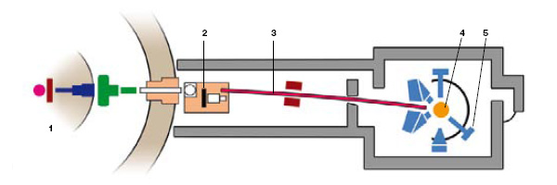
Neutrons from the reactor (1) go through the chopper (2) along the neutron guide (3) to the sample, irradiate the sample (4) and are scattered on it due to diffraction. The diffracted neutrons are registered by the detector system (5). Signals from the detector system, starts of the reactor and chopper come to the data registration system built on the basis of the MPD-240 module allowing “raw” data collection in the list mode. In such a system processing and computation of high resolution spectra are carried out off-line.
4
NEC’2017

Slide 5
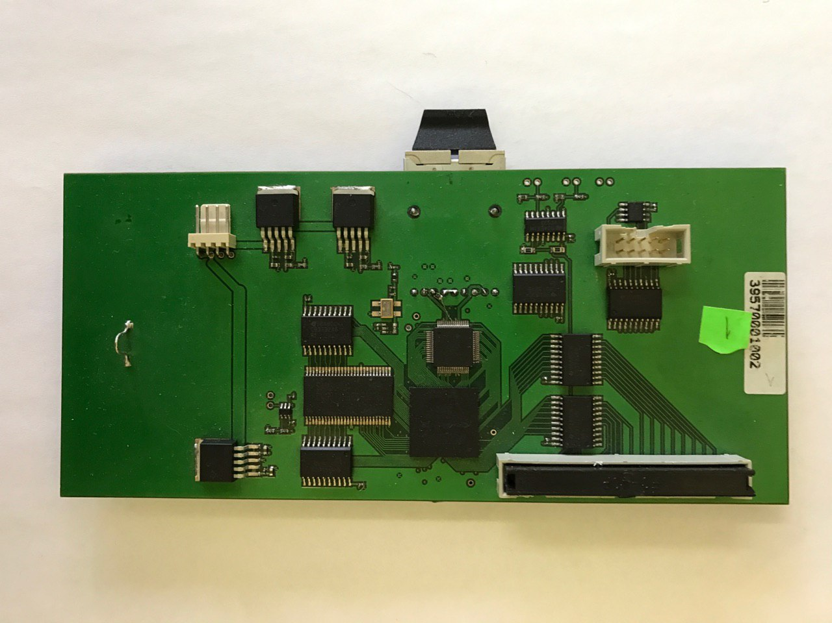
Types of data acquisition systems on the IBR-2 spectrometers
5
MPD-16
NEC’2017

Slide 6

MPD-240
6
NEC’2017

Slide 7
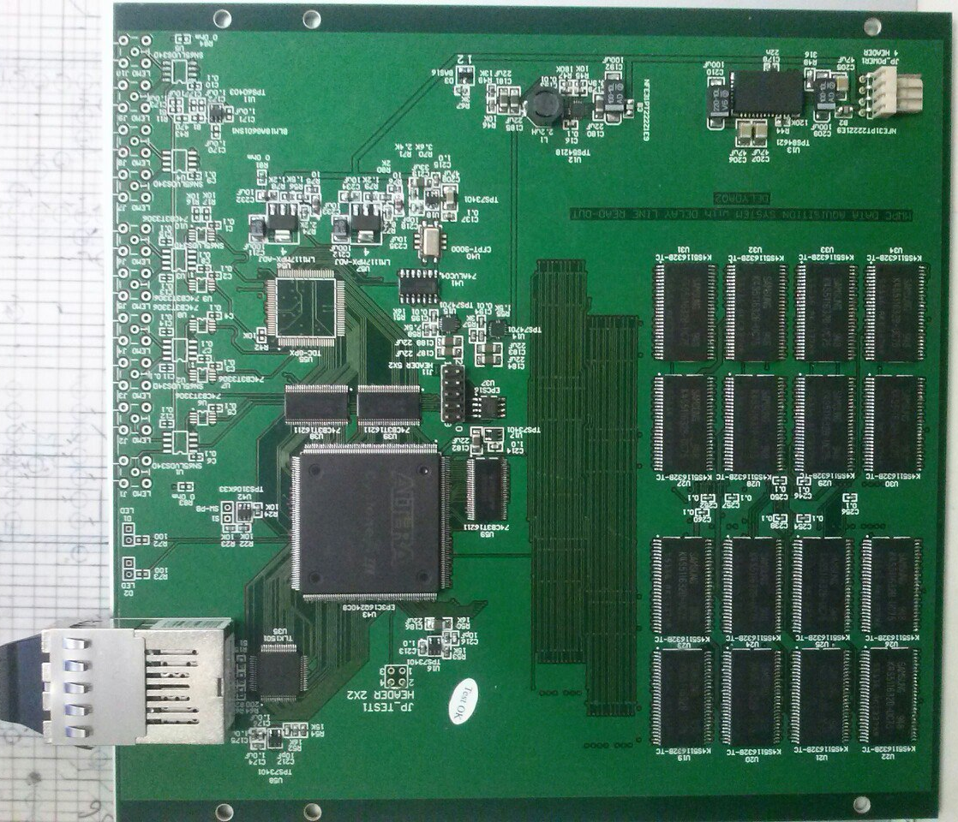
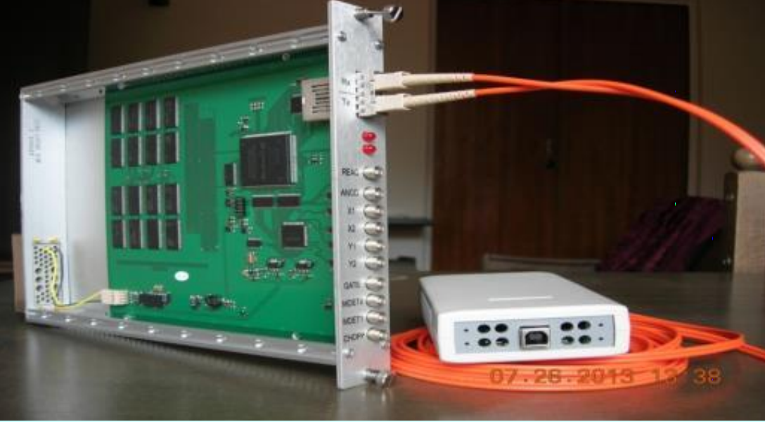
De-Li-DAQ 2D
7
NEC’2017

Slide 8
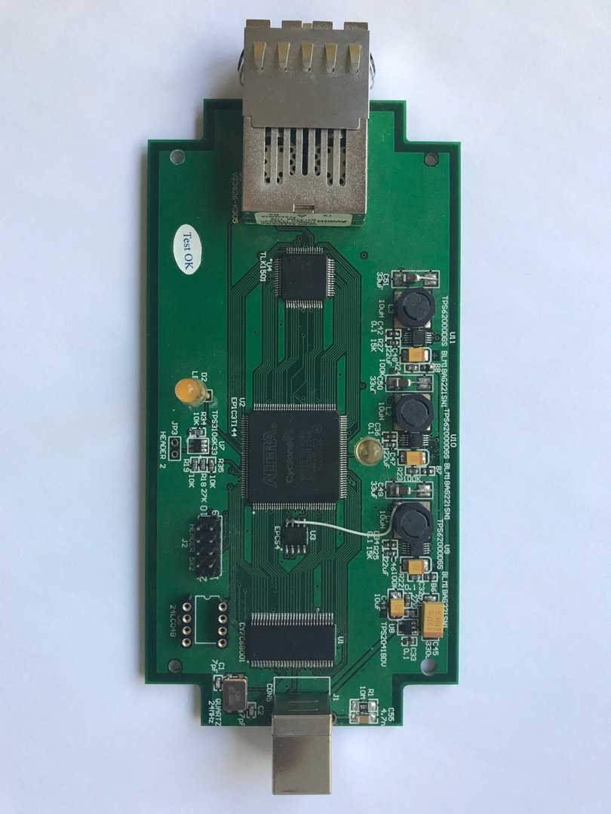
FLINK
8
NEC’2017

Slide 9
The data from the detectors are transmitted to the data acquisition system, then with a speed of 1.25 Gb/s to the FLINK module by the optical interface and finally, with a speed of 10 MB/s to the computer memory by the serial USB 2.0 interface.
D1
DAQ
1.25 Gibit/s
10 MB/s
F-link
PC
Fiber-optic cable
USB 2.0
Dn
9
NEC’2017

Slide 10
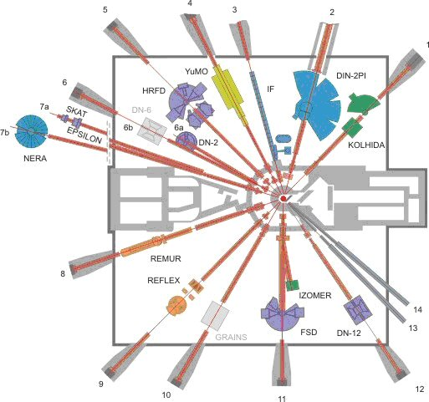
IBR-2 facilities
10
NEC’2017

Slide 11
USB 3.0. advantages
Maximum effective data rate is 375 MB/s
Malfunction or error probability is lower than with the USB 2.0 interface due to additional twisted pair shielding;
Feed current increases from 500 mA to 900 mA.
Within the framework of the problem of USB 3.0 integration, the following options are considered:
11
NEC’2017

Slide 12

Attaining the objectives
Variant 1:
Fiber-optic to USB 3.0 converters
D1
DAQ
1.25 Gibit/s
375 MB/s
10 MB/s
USB 3.0
F-link
PC
Fiber-optic cable
Fiber-optic cable
USB 3.0
USB 2.0
Dn
$$250 m$$
12
NEC’2017

Slide 13
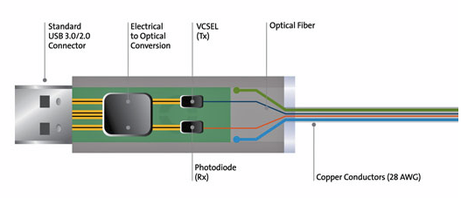
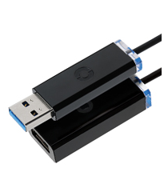
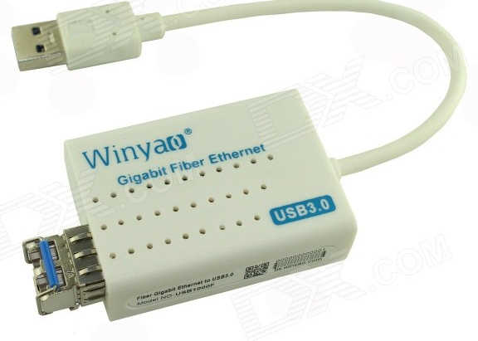
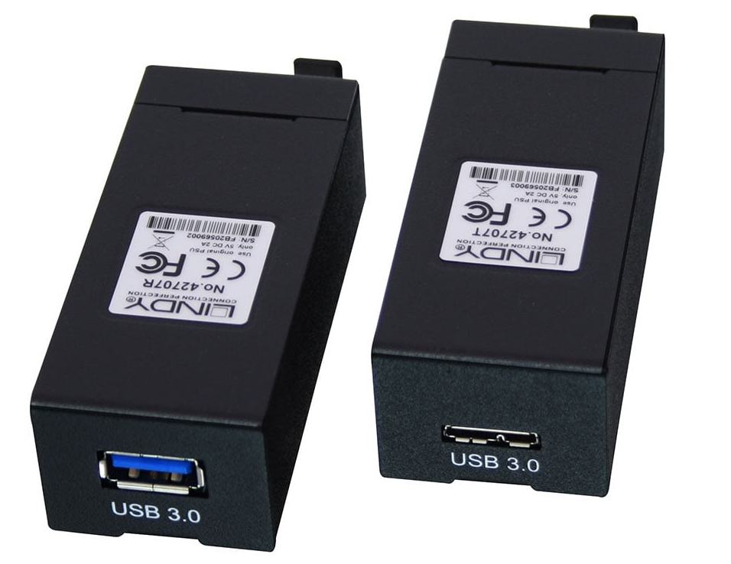
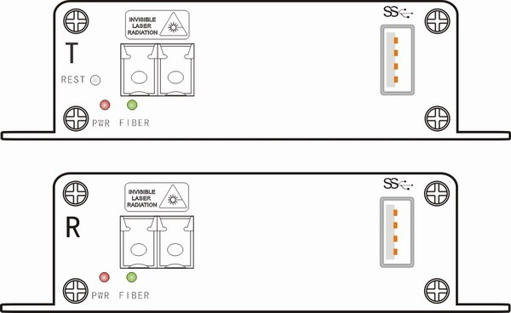
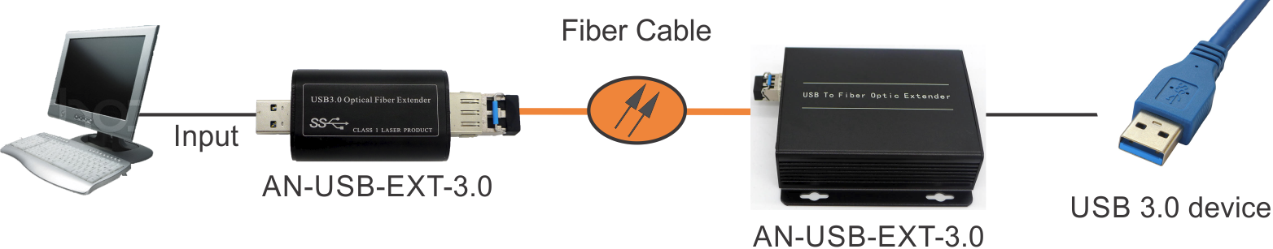
USB 3.0 to Fiber Optical extender
13
NEC’2017

Slide 14

Development of new blocks with USB 3.0 interface is more promising. This permits increasing the data transmission bandwidth up to 375 MB/s preserving the possibility of remote connection as required for FLNP spectrometers
In developing the new blocks there will be taken into account new requirements for characteristics of the existing data acquisition systems that arose in the process of their operation as well as to meet the requirements of the newly developed projects.
Fiber-optic to USB 3.0 converters
D1
DAQ
375 MB/s
USB 3.0
PC
Fiber-optic cable
Fiber-optic cable
USB 3.0
Dn
$$250 m$$
14

Slide 15
Attaining the objectives
Variant 2:
D1
DAQ
2.5 Gibit/s
100 MB/s
1.25 Gibit/s
10 MB/s
F-link
PC
Fiber-optic cable
USB 3.0
USB 2.0
Dn
This will allow us to use a maximum data transmission speed of the fiber interface of old blocks and will increase 10 times the bandwidth of the data transmission channel.
15
NEC’2017

Slide 16
Advantages and disadvantages
variant1
advantages | disadvantages
Transmission speed up to 375 MB/s | Complexity of commissioning
Simplified architecture
variant 2
advantages | disadvantages
Easy commissioning | Transmission speed is lower than with direct connection
The second option allows increasing the data transmission rate by developing just one module, which allows more effective use of all the modules already installed on the spectrometers.
16
NEC’2017

Slide 17
Solution
To date, data transmission at 100 MB per second satisfies the requirements for the volume of the transmitted data. Moreover, integration of new FLINK modules will go faster. So, such work was the first to be performed.
17
NEC’2017

Slide 18
FLINK USB 3.0 architecture
In the framework of solving this problem the architecture of the new module consisting of three main integrated has been developed:
18
NEC’2017

Slide 19
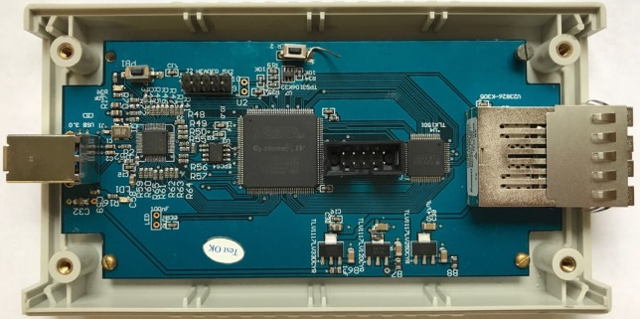
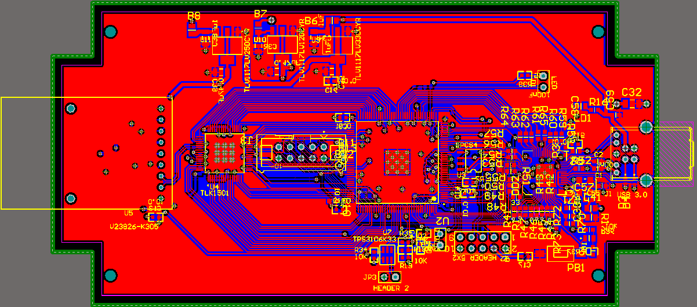
FLINK USB 3.0
To date, first five samples of FLINK-USB 3.0 converters have been manufactured.
19
NEC’2017

Slide 20
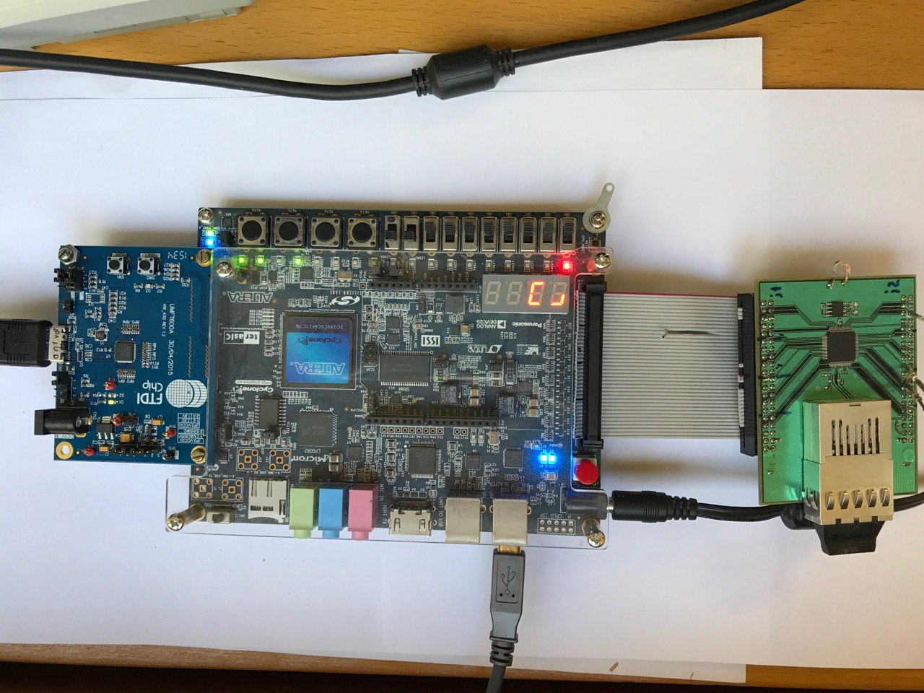
Test kit
The FT600/FT601 is a USB 3.0 to FIFO interface bridge chip with the following advanced features: Supports USB 3.0 Super Speed (5Gbps)/USB 2.0 High Speed (480Mbps)/USB 2.0 Full Speed (12Mbps) transfer. Supported USB Transfer Type: Control/Bulk/Interrupt Up to 8 configurable endpoints (PIPEs). Supports 2 parallel slave FIFO bus protocols 245 and FIFO mode, FT601 with 32 bit parallel interface has a data bursting rate up to 400MB/s. Supports 4 IN channels and 4 OUT channels on FIFO bus connectivity. Built-in 16kB FIFO data buffer RAM.
Optical interface module
FTDI UMFT 600A
Cyclone V debugging set
20
NEC’2017

Slide 21
Design of firmware FLINK USB 3.0
21
NEC’2017

Slide 22
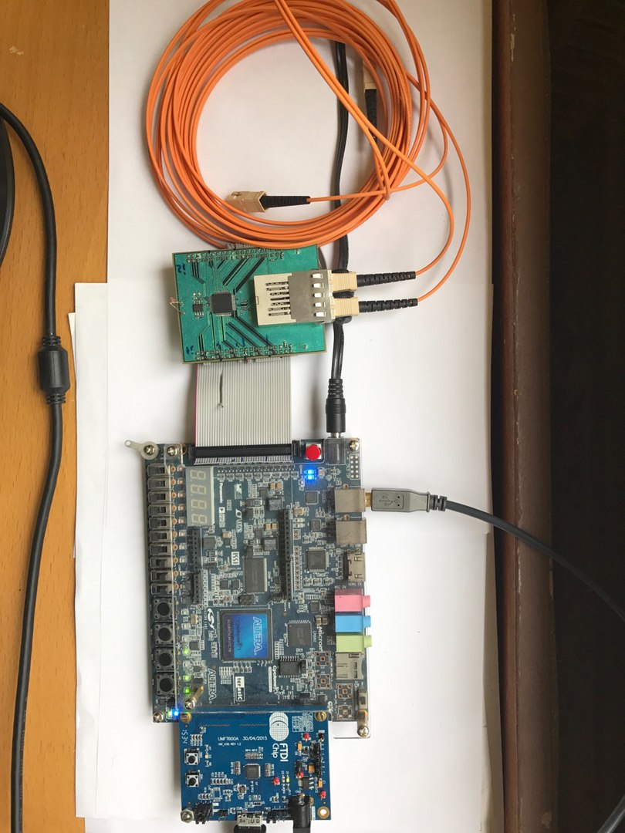
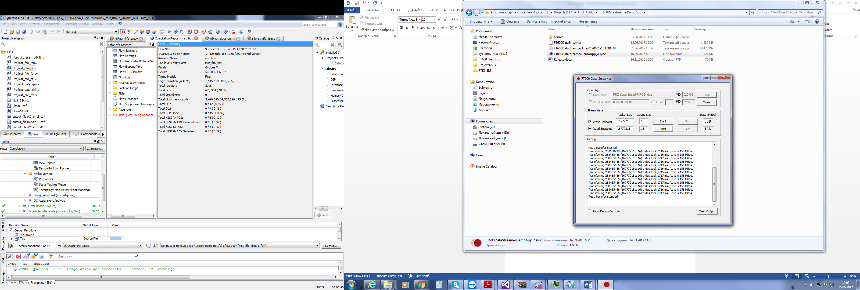

Operation in LoopBack mode
This speed is a maximum feasible one in transmitting data through TLK1501.
22
NEC’2017

Slide 23
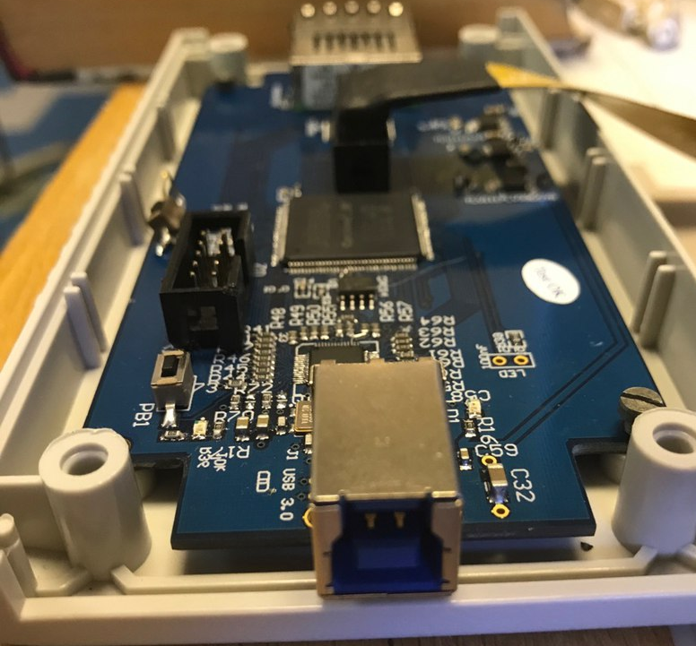
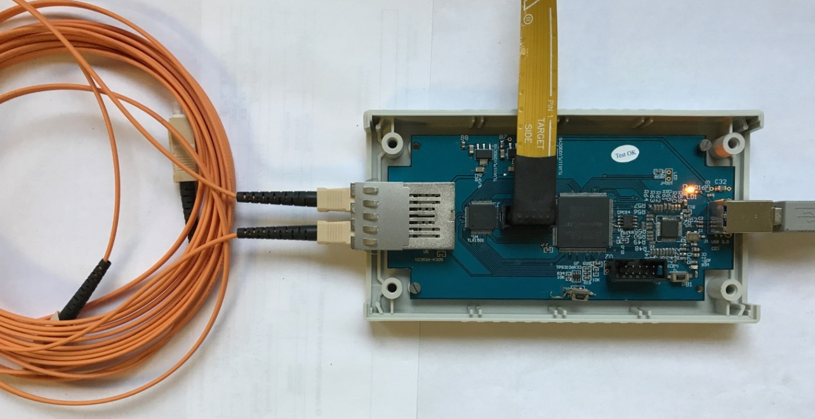
FLINK USB 3.0
During the first cycle of reactor operation the system is to be tested on the spectrometers of the IBR-2 reactor in real experimental conditions.
23
NEC’2017

Slide 24
Results
As a result, the variant of increasing by developing a new optical convertor, FLINK USB 3.0, has been realized.
  High-speed chip from FTDI FT600 is used;
  FPGA Cyclone IV EP4CE6E22C8N is used;
  New FPGA project design for data exchange between the computer and the data acquisition system via the USB 3.0 interface is developed.
The testing kit based on Cyclone V 5CGXF5C6F27C7N Starter Kit, debugging kit USB 3.0 FTDI UMFT600A and the Fiber Optic Transceiver kit is developed.
The FPGA project design with a new FLINK USB 3.0 module allows over 10 times increase of the bandwidth of the data transmission channel) from the data acquisition and processing systems De-Li-DAQ-2D and MPD.
24
NEC’2017

Slide 25
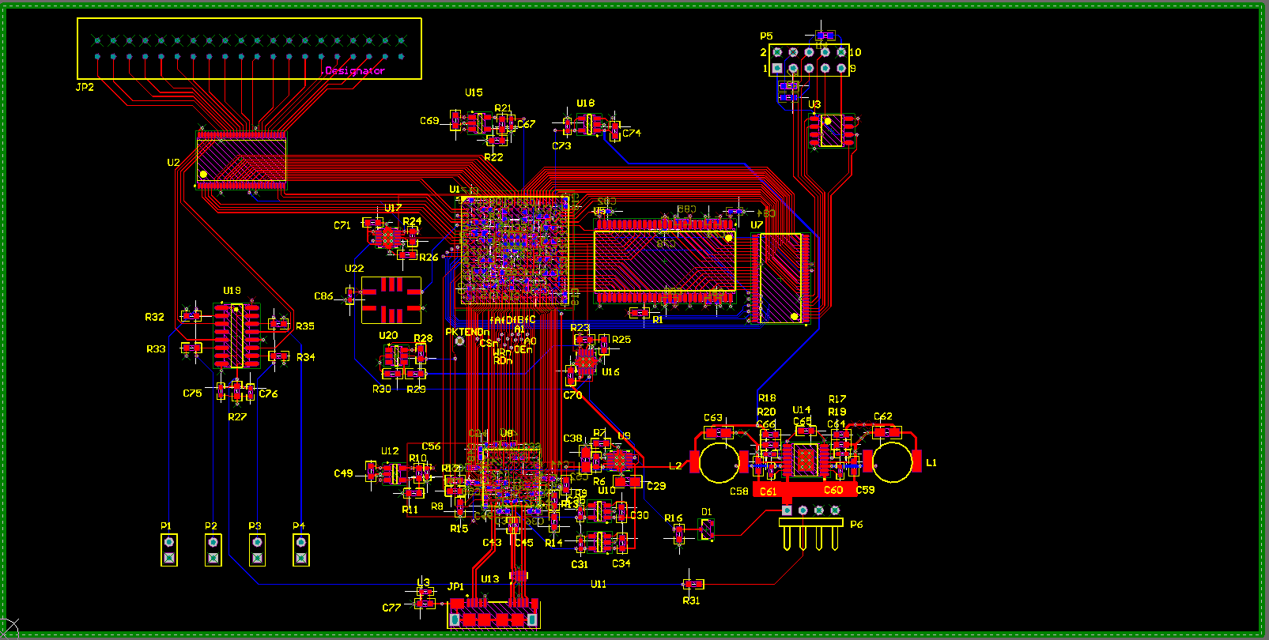
MPD-16 USB 3.0
Work to increase the bandwidth of data acquisition systems will continue. A new MPD-16 module with USB 3.0 interface has already been designed. Work on developing the firmware for MPD-240 and De-Li-DAQ modules is under way today.
25
NEC’2017

Slide 26
Thanks for your attention!
26

Slide 27
«Increasing throughput capacity of data acquisition systems on IBR-2 reactor spectrometers in FLNP»
Presenters: Shvetsov V. V.
Primary author: Drozdov V.A.
Co-author: Shvetsov V. V.
E-mail: shvetc_vas@mail.ru
NEC’2017

