Slide 1
Evolution of tools for WLCG operations Julia Andreeva, CERN IT
NEC 2017 , Budva, 26.09.2017

Slide 2
WLCG Operations. Introduction.
Over last years we accumulated a lot of experience in operating huge heterogeneous infrastructure
Still there are new challenges ahead of us
Amount of required resources in particular for High Luminosity LHC is growing while dedicated effort is rather decreasing
Technology evolution -> new kind of the resources like HPC, commercial clouds, volunteer computing. Resources are heterogeneous and more dynamic than classical GRID resources. How to integrate them transparently?
WLCG relies on the resources provided by several GRID infrastructures (OSG, EGI, NorduGrid). Should work transparently across infrastructures boundaries and in close collaboration with their operations teams
Julia Andreeva CERN IT, NEC 2017 , Budva, 26.09.2017

Slide 3
Operational tasks and corresponding tools
Tasks | Tools
Knowledge of infrastructure topology and configuration | Information System: GocDB, OIM, REBUS, BDII, experiment-specific topology and configuration systems like ATLAS GRID Information System (AGIS)
Testing of the distributed sites and services | Experiment Test Framework (ETF) and Site Availability Monitor (SAM) Perfsonar for Network
Accounting of the performed work and understanding whether MoU obligations are met | Accounting systems : APEL, Gratia, EGI accounting system, accounting systems of the LHC experiments, REBUS (for pledges)
Monitoring of the computing activities | Multiple monitoring systems covering all areas of the LHC computing activities: data processing, data transfer, data access, network utilization, etc…
Problem & request reporting and tracking | Global Grid User Support (GGUS)
Julia Andreeva CERN IT, NEC 2017 , Budva, 26.09.2017

Slide 4
Evolution of the WLCG operations tools. Common trends.
Identify areas where things can be simplifies. Where there are potential bottlenecks need for modifications considering new requirements, growing scale or technology evolution
Turn into a common solution systems which proved to work well in a scope of a single experiment
Where possible use open source SW
Julia Andreeva CERN IT, NEC 2017 , Budva, 26.09.2017

Slide 5
Information System Evolution
Julia Andreeva CERN IT, NEC 2017 , Budva, 26.09.2017

Slide 6
WLCG IS Landscape
Primary sources
Experiment-specific topology and configuration systems (AGIS, SiteDB…)
Experiment workload and data management systems, operations,
testing
monitoring
accounting
GocDB
OIM
REBUS
WLCG central systems for
operations
testing
monitoring
accounting
BDII
Others
Julia Andreeva CERN IT, WLCG Workshop, Manchester, 21.06.2017

Slide 7
Drawbacks and limitations
Multiple information sources. Sometime contradictory information. No single place where data can be integrated, validated and fixed. No single source providing information for all consumers in a consistent way.
No complete and correct description of storage resources (with protocols and storage shares). Every experiment has to perform this task on its’ own. Therefore, we do not have a global picture on the WLCG scope.
No clear and common way for integration of non-traditional/non-grid resources (commercial clouds, HPC, etc…). As a rule they are also mainly described in the experiment-specific systems and again missing in the global WLCG resource description.
Clearly, there is a potential to address all these problems in a common way
See next presentation of Alexey Anisenkov on Computing Resource Information Catalogue (CRIC)
Julia Andreeva CERN IT, WLCG Workshop, Manchester, 21.06.2017

Slide 8
Testing distributed sites and services Thanks to Marian Babik for contribution to this presentation
Julia Andreeva CERN IT, NEC 2017 , Budva, 26.09.2017

Slide 9
Experiments Test Framework (ETF)
Measurement middleware
Actively checks status of services
Focuses on atomic tests
Direct job submissions
Worker node testing
Core storage operations
Generic, based on open source
OMD, check_mk, nagios, stompclt
Main source for monthly WLCG A/R reports
Actively used in WLCG deployment campaigns
HTTP, IPv6, CC7, RFC, HTCONDOR-CEs, etc.
ETF Core Framework
Involves configuration, scheduling, API, etc.
Plugins
Wide range of available plugins - covering broad range of services
Contributed by experiments, PTs, TFs, etc.
Worker Node Framework
Micro-framework to run tests on the WN
Numbers
Test frequency ~ 10Hz, 33k tests/hour
8 clusters: 4 experiments + central instance, IPv6, T0, CC7, pS (@OSG)
Julia Andreeva CERN IT, NEC 2017 , Budva, 26.09.2017

Slide 10
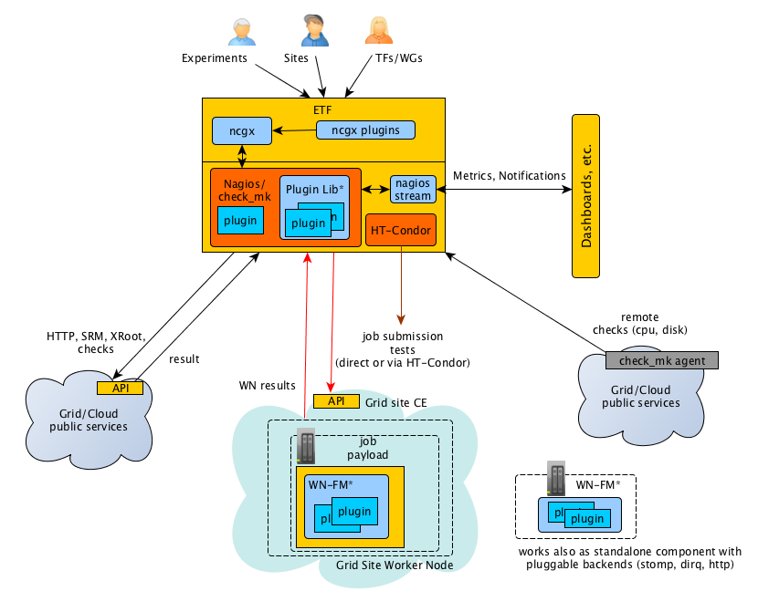
ETF Architecture
Types of tests supported by ETF:
Remote API – simple storage tests (get/put/del), job submissions to multiple backends (ARC, HT-Condor-CE, CREAM, etc.)
Agent-based testing (local testing on the worker nodes, remote hosts)
Results published via message bus to Dashboards, ElasticSearch, etc.
Julia Andreeva CERN IT, NEC 2017 , Budva, 26.09.2017

Slide 11
ETF Roadmap
In the short-term focusing on IPv6 transition – establishing new instances and adding new tests
Writing native Condor job submission plugin with multi-backend support and putting in production the new WN micro-framework
Adding new Xroot tests
Integration with MONIT/Grafana, new SAM dashboards
Migration to fully container-based (docker) deployment model
Julia Andreeva CERN IT, NEC 2017 , Budva, 26.09.2017

Slide 12
Testing network infrastructure
Thanks to Marian Babik for contribution to this presentation
Julia Andreeva CERN IT, NEC 2017 , Budva, 26.09.2017

Slide 13
WLCG Network Throughput Working Group
WLCG Network Throughput WG formed in the fall of 2014 within the scope of WLCG operations with the following objectives:
Ensure sites and experiments can better understand and fix networking issues
Measure end-to-end network performance and use the measurements to single out on complex data transfer issues
Improve overall transfer efficiency and help us determine the current status of our networks
Core activities include:
Deployment and operations of perfSONAR infrastructure
Gain visibility into how our networks operate and perform
Network analytics
Improve our ability to fully utilize the existing network capacity
Network performance incidents response team
Provide support to help debug and fix network performance issues More information at https://twiki.cern.ch/twiki/bin/view/LCG/NetworkTransferMetrics
Julia Andreeva CERN IT, NEC 2017 , Budva, 26.09.2017

Slide 14
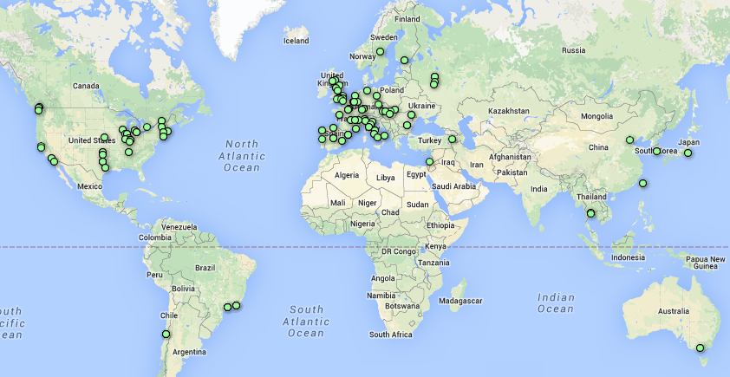
WLCG perfSONAR Deployment
246 Active perfSONAR instances
160 Running latest version (4.0.1)
New experiments based meshes
CMS Latency/Bandwidth
ATLAS Latency/Bandwidth
LHCb Latency/Bandwidth
BelleII Latency/Bandwidth
In total
93 latency services
115 traceroute services
102 bwclt/pscheduler services
Initial deployment coordinated by WLCG perfSONAR TF
Commissioning of the network followed by WLCG Network and Transfer Metrics WG
Julia Andreeva CERN IT, NEC 2017 , Budva, 26.09.2017

Slide 15
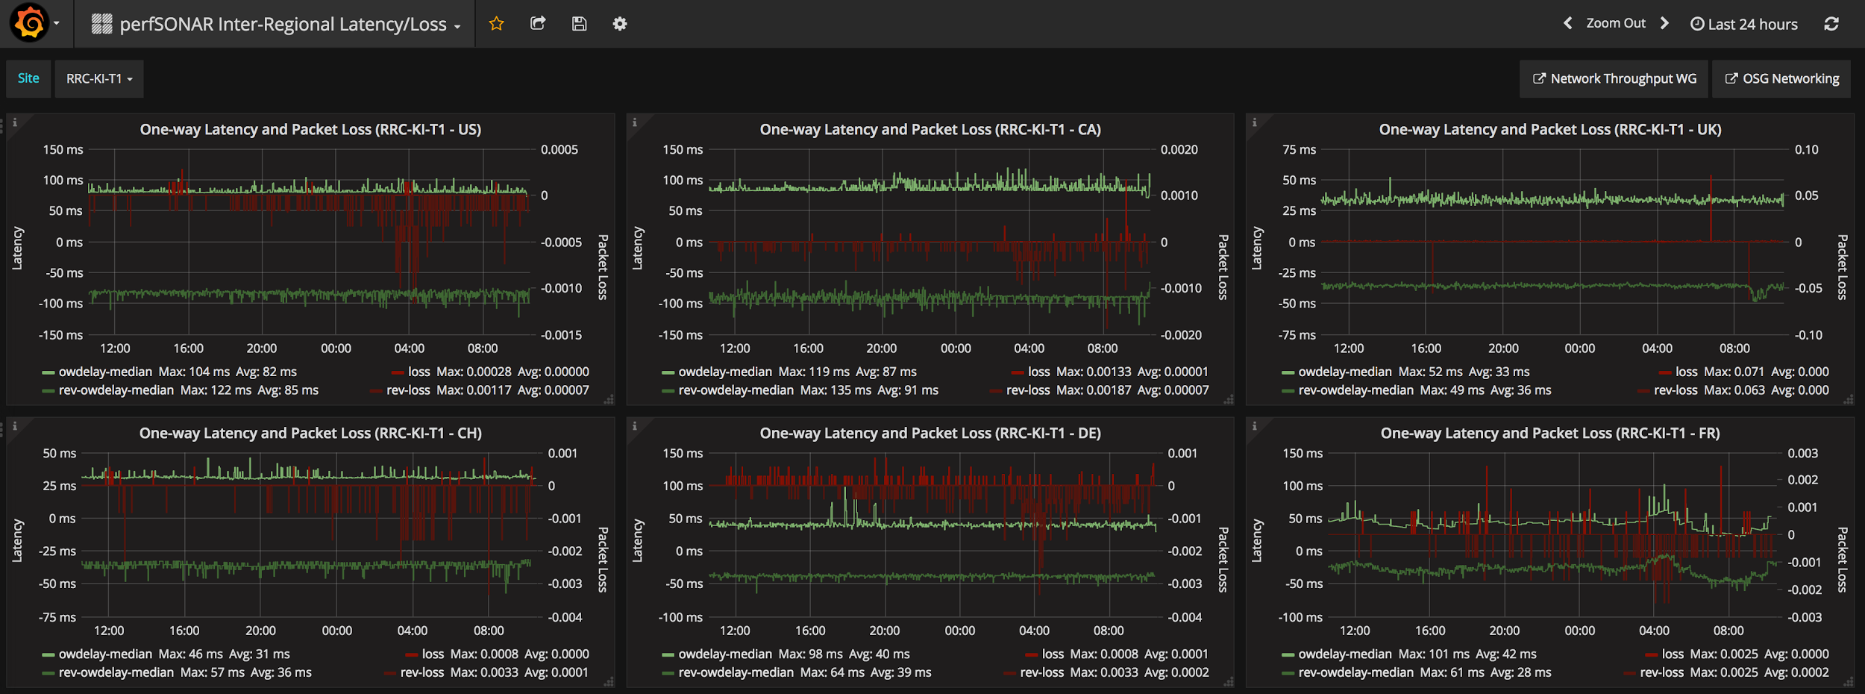
Global deployment, continuous measurements and advanced processing platform run by OSG makes it possible to create novel dashboards, alerts/alarming as well as perform complex network analytics
Julia Andreeva CERN IT, NEC 2017 , Budva, 26.09.2017

Slide 16
Network Throughput WG Roadmap
Near-term - focus on improving efficiency of our current network links
Continuing developments in the network analytics, integration of the further flow/router information and FTS data, alerting/notifications, etc.
Validation and deployment campaign for perfSONAR 4.0.2 and 4.1
perfSONAR 4.1 is planned mid next year and will drop SL6 support, this will require a major campaign since all sites will need to re-install
Updates to central services (configuration, monitoring, collectors, messaging, etc.)
Long-term - plan for significant changes in the long-term
Increased importance to oversee network capacities
Sharing the future capacity will require greater interaction with networks
While unclear on what technologies will become mainstream, we know that software will play a major role in the networks of the future
HEP likely no longer the only domain that will need high throughput
Tracking the evolution in the SDNs where new pilots/demonstrator projects will be proposed
Julia Andreeva CERN IT, NEC 2017 , Budva, 26.09.2017

Slide 17
Accounting
Julia Andreeva CERN IT, NEC 2017 , Budva, 26.09.2017

Slide 18
CPU accounting
CPU consumption is one of the main metrics which is used to understand how the sites fulfill their MoU obligations
For CPU accounting WLCG uses the EGI accounting system based on APEL
WLCG Accounting Task Force created in spring 2016 aimed to fix multiple problems with the CPU accounting (data correctness and UI)
Reviewed the set of accounting metrics and agreed on those which should be exposed in the accounting portal and included in the monthly accounting reports
Data validation had been performed , an automatic system for data validation has been setup
Provided feedback on the EGI accounting portal and followed up on portal improvements
Improved generation of monthly accounting reports
Julia Andreeva CERN IT, NEC 2017 , Budva, 26.09.2017

Slide 19
Storage Space Accounting
Currently we do not have Storage Space accounting working on the WLCG global scope
Existing solutions inside experiments are mostly based on SRM which is not a mandatory service any more, therefore will provide only partial solution in the future
In technical terms aim to apply a solution which will work both for accounting and operations
Julia Andreeva CERN IT, WLCG Workshop, Manchester, 21.06.2017

Slide 20
Requirements
After the WLCG accounting review in April 2016, some work has been performed to understand the requirements for the global WLCG storage space accounting system.
Input from the experiments has been discussed at the WLCG Accounting Task Force meetings and Grid Deployment Board. It is summarized in the storage resource reporting proposal
The main goal of the WLCG Storage space accounting is to provide high level overview of the free and used storage space with the granularity of VO storage shares at the sites with possible split of those shares by areas for some dedicated usage
Julia Andreeva CERN IT, NEC 2017 , Budva, 26.09.2017

Slide 21
High level overview of the used and available space
Total used and total available for storage shares used by the experiments
(should be available by at least one non-SRM protocol)
Number of files if possible but not strictly required
Frequency not higher than once per 30 minutes
Accuracy order of tens GB
CLI or API for querying
Julia Andreeva CERN IT, NEC 2017 , Budva, 26.09.2017

Slide 22
Implementation
The same way of querying storage for free/used space for accounting and operations
CRIC for description of the storage topology
MONIT infrastructure for data flow (data transport, data repository, UI/API)
Julia Andreeva CERN IT, NEC 2017 , Budva, 26.09.2017

Slide 23
Architecture
Topology
Usage
CRIC
Thanks to Dimitrios Christidis for his contribution to this presentation
Storage Systems
MONIT infrastructure
WSSA Tool
Backend
Grafana
Collection
Transport
layer
Storage
Visualisation
Julia Andreeva CERN IT, NEC 2017 , Budva, 26.09.2017

Slide 24
Current Status
Data from ATLAS Rucio, AGIS, SRM queries
Storage on Elasticsearch and InfluxDB
Prototype dashboard
Julia Andreeva CERN IT, NEC 2017 , Budva, 26.09.2017

Slide 25
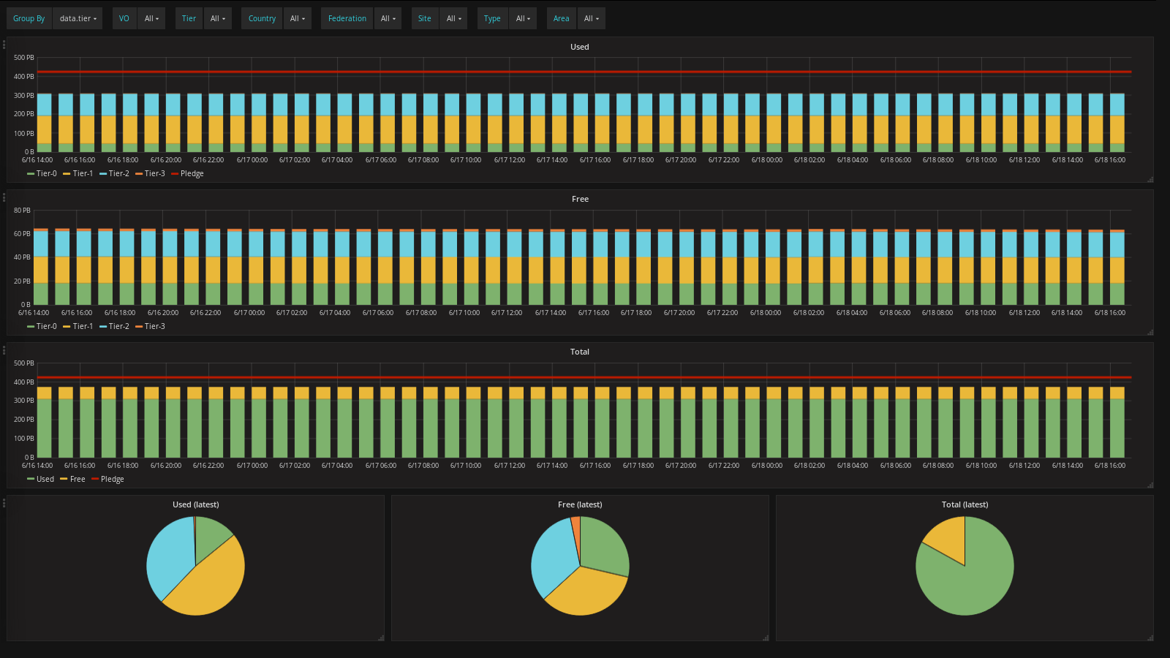
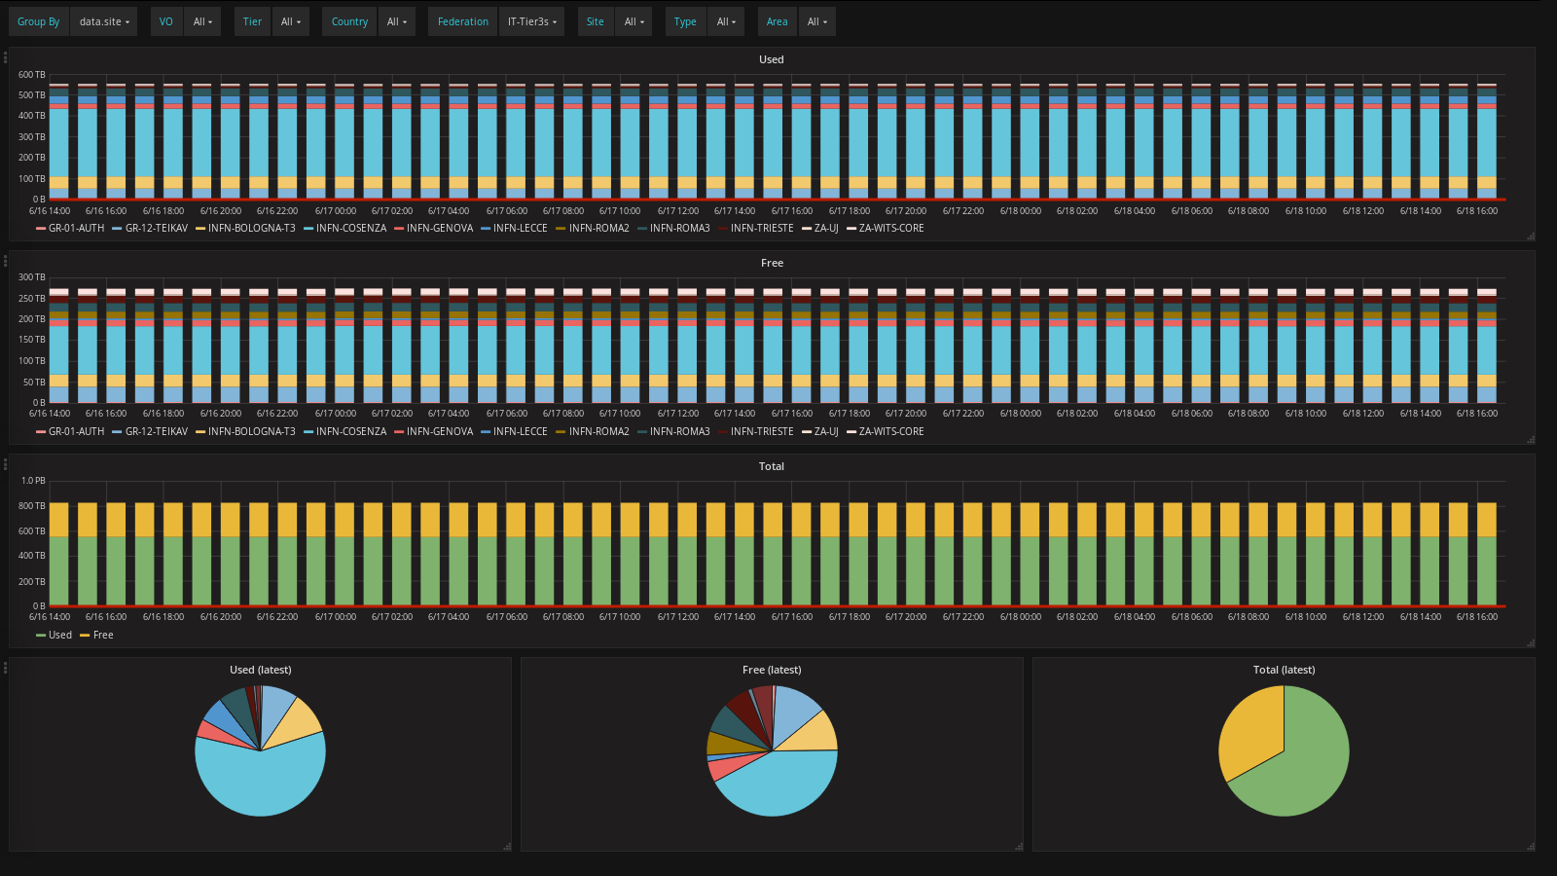
User Interface
Possibly to group/filter by VO, site, country, federation, tier
Julia Andreeva CERN IT, NEC 2017 , Budva, 26.09.2017

Slide 26
Gradual transition and validation
Use what is available now
Switch to new data source as it becomes available
Data from SRM is retained
Validation
Comparison with experiment accounting systems
Similar to the CPU accounting approach
Julia Andreeva CERN IT, NEC 2017 , Budva, 26.09.2017

Slide 27
Monitoring
Thanks to Alberto Aimar for contribution to this presentation
Julia Andreeva CERN IT, NEC 2017 , Budva, 26.09.2017

Slide 28
Monitoring use cases
Data Centres Monitoring
Monitoring of DCs at CERN and Wigner
Hardware, operating system, and services
Data Centres equipment (PDUs, temperature sensors, etc.)
Experiment Dashboards
WLCG Monitoring
Sites availability, data transfers, job information, reports
Used by WLCG, experiments, sites and users
Both hosted by CERN IT, in different teams
Mandate
Regroup monitoring activities hosted by CERN/IT (Data Centres, Experiment Dashboards and others)
Move to external open source technologies
Continue existing services, but conform with CERN IT practices
Julia Andreeva CERN IT, NEC 2017 , Budva, 26.09.2017

Slide 29
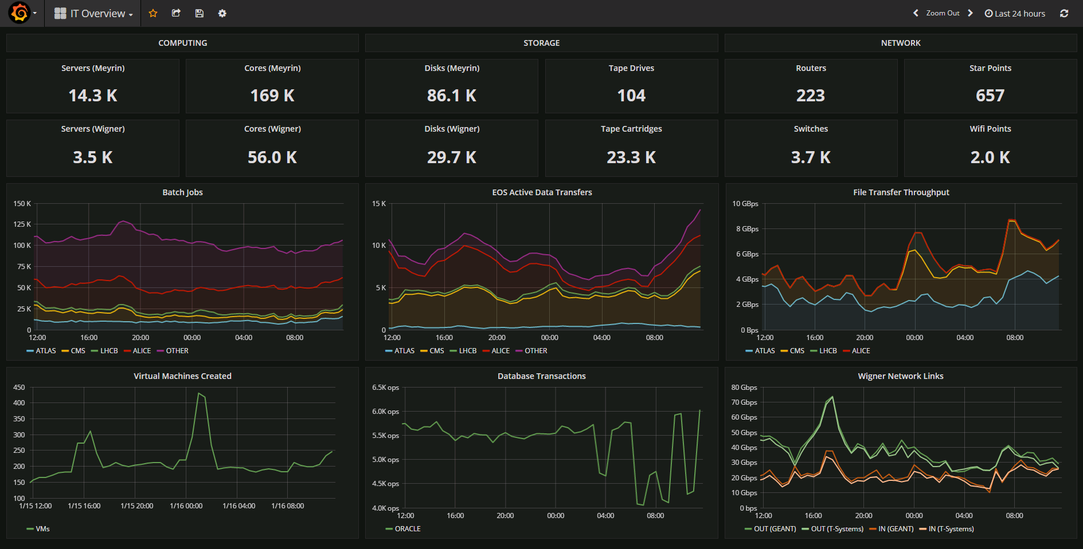
Data Centres Monitoring

Slide 30
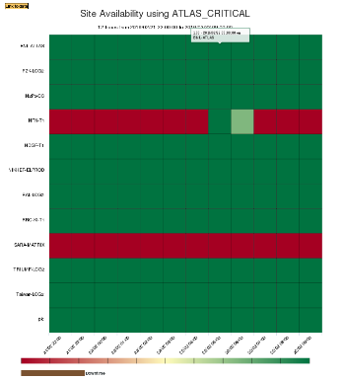
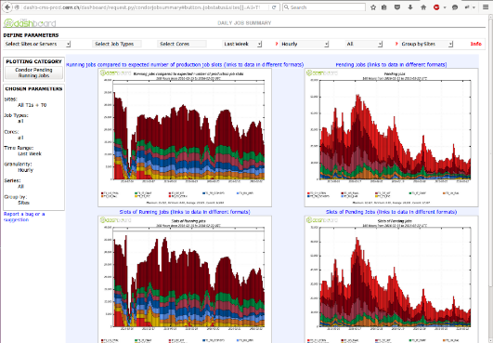
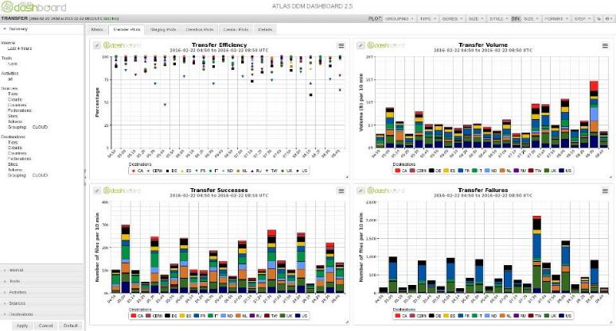
Experiment Dashboards
Job monitoring, sites availability, data management and transfers
Used by experiments operation teams, sites, users, WLCG

Slide 31
Unified Monitoring
Data Centres
Monitoring
Data Sources
z
Storage &Search
Data Access
Transport
Metrics Manager
Hadoop HDFS
Collectd / Lemon
XSLS
Data mgmt and transfers
ATLAS Rucio
ElasticSearch
FTS Servers
Flume
Kibana
DPM Servers
InfluxDB
XROOTD Servers
Grafana
CRAB3
AMQ
Job
Monitoring
WM Agent
Farmout
Jupyter (Swan)
Kafka
Processing & Aggregation
Grid Control
CMS Connect
Zeppelin
PANDA WMS
Spark
ProdSys
Infrastructure
Monitoring
Nagios
Hadoop Jobs
VOFeed
OIM
GNI
GOCDB
REBUS

Slide 32
Monitoring strategy and implementation
Regroup monitoring activities
Data Centres, WLCG and Experiment Dashboards, ETF, HammerCloud
CERN IT practices, management of services, tools (e.g. GGUS, SNOW)
Adopt only established open source technologies
Input JSON, sources based on Collectd, Flume, JDBC, ActiveMQ, HTTP
Transport and data buffering based on Kafka (500 GB / 72 h)
Processing of data streams based on Kafka and Spark
Storage based on ElasticSearch (30 days, raw), InfluxDB (5 years, aggregated), HDFS (forever, raw)
Dashboards based on Grafana and Kibana
Reports/notebooks on Zeppelin and analytics based on HDFS, Spark
Julia Andreeva CERN IT, NEC 2017 , Budva, 26.09.2017

Slide 33
Summary
WLCG tools for operations are constantly evolving following the technology evolution and computing requirements for High Luminosity LHC
Need to be flexible and agile in order to integrate transparently new types of resources
Where possible use open source solutions
Analyze accumulated experience, on the global scope and inside the experiments. Decide which tools and/or concepts proved their effectiveness inside a single experiment can be extended to the WLCG scope
Julia Andreeva CERN IT, NEC 2017 , Budva, 26.09.2017

Slide 35
Backup slide. Unified Monitoring Architecture
Data Sources
Storage &
Search
Data Access
Transport
AMQ
Flume AMQ
Flume Kafka sink
Flume sinks
FTS
Kafka cluster
(buffering) *
HDFS
Rucio
DB
Flume DB
XRootD
Jobs
HTTP feed
Flume HTTP
ElasticSearch
User
Views
UserData
Processing
Data enrichment
Data aggregation
Batch Processing
User
Jobs
…
Logs
Flume
Log GW
Lemon
syslog
…
Lemon metrics
Flume Metric GW
CLI, API
app log
Others (influxdb)
Today: > 500 GB/day, 72h buffering

