Slide 1
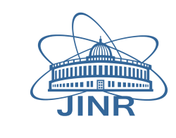
Yuri Panebrattsev “Interactive Platform of Nuclear Experiment Modeling” XXVI International Symposium on Nuclear Electronics&Computing Budva, Montenegro, 25 - 29 September, 2017

Slide 2
Hejdar Agakishiev¹, Victoria Belaga^{1,3}, Evgenii Dolgy^{2,3}, Vasil Gurev⁵, Dmitry Kamanin¹, Ksenia Klygina¹, Pavel Kochnev^{2,3}, Mantile Leslie Lekala⁸, Vusi D. Malaza⁶, Noel M. Mkaza⁶, Andrey Olchak ⁷, Marina Osmachko¹, Stanislav Pakuliak¹ , Yuri Panebrattsev^{1,2}, Yuri Pyatkov⁷, Georgy Rainovsky⁵, Pavel Semchukov¹, Alexander Strekalovsky¹, Georgy Tikhomirov⁷, Rumen Tsenov¹, Ivan Vankov⁴, Elena Vesna⁷, Natalia Vorontsova¹, Shaun Wyngaardt⁶ International Conference NUCLEAR POWER FOR THE PEOPLE Varna, Bulgaria, 11–14 September, 2017
Project Team
¹ JINR, Dubna, Moscow region, Russia ² InterGraphics LLC, Dubna, Moscow region, Russia ³ Dubna University, Dubna, Moscow region, Russia ⁴ INRNE, Sofia, Bulgaria ⁵ University of Sofia, Bulgaria ⁶ Stellenbosch University, RSA ⁷ NRNU MEPHI, Moscow, Russia ⁸ UNISA, RSA

Slide 3
Virtual Laboratory of Nuclear Fission
The goal of the project is to include current scientific data into the educational process, to conduct virtual and online laboratory research based on using modern scientific equipment and data obtained from the existing physical facilities.

Slide 4
The project is comprised of
three educational levels:
Elementary level. A typical target group at this level are high school students, science teachers, undergraduate students and participants of summer practices.
Basic level. The goal at this level is to study various types of radiation detectors, nuclear electronics & DAQ systems and some major methods of experimental data processing.
Advanced level. A typical target group at this level are students who plan to prepare their bachelor and master theses based on the measurements at the LIS project. This level may be useful as a training before independent work as experimentalists in nuclear physics.

Slide 5
Input knowledge
Elementary level: high school physics
Basic level: university course on general physics; section “Nuclear Physics”
Advanced level: university courses “Quantum Physics” and “Nuclear Physics”

Slide 6
Project content
About: About Virtual Laboratory of Nuclear Fission
Part 1: Some Concepts of Nuclear Physics
Part 2: How to Measure Radioactivity
Part 3: Theoretical Models of the Atomic Nucleus
Part 4: How to Measure Nuclear Fission
Part 5: Light Ions Spectrometer – Measurements
Part 6: Light Ions Spectrometer – Data Analysis
Interactive Environment for Nuclear Experiment Modeling

Slide 7
Part 1: Some Concepts of Nuclear Physics
1. World of the Atom
2. Atomic Nucleus
3. Mass and Energy
4. Fusion and Fission
5. Radioactivity:
– Alpha Decay
– Beta Decay
– Gamma Decay
– Spontaneous Fission
6. Radioactive Decay Law
7. Quiz
8. Exercises

Slide 8
Part 2: How to Measure Radioactivity
1. Introduction
2. Radioactive Sources
3. Interaction of Radiation with Matter
4. Radiation Detectors:
– Gas-Filled Detectors
– Scintillation Detectors
– PIN Diodes
– Detectors Based on
Microchannel Plates
5. Measurement of Radioactivity
6. Quiz
7. Practicum

Slide 9
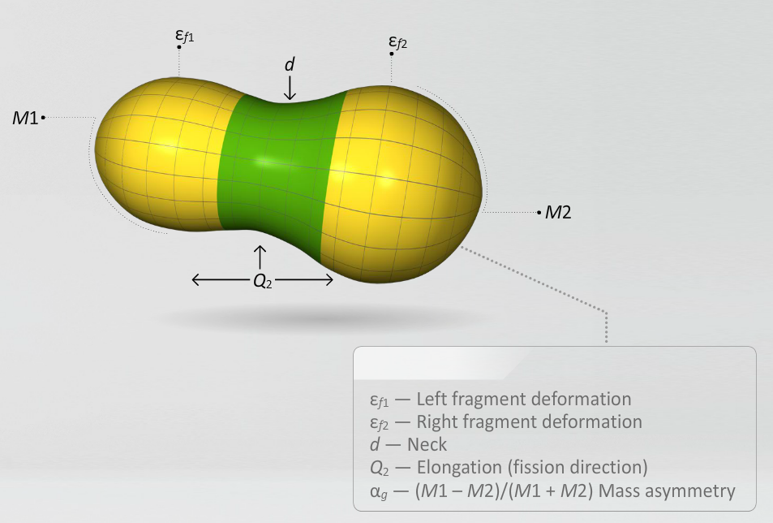
Part 3: Theoretical Models of the Atomic Nucleus
1. Introduction
2. Nuclear Models
– Liquid Drop Model
– Fermi Gas Model
– Shell Model
– Collective Model
3. Quantum Mechanics in Nuclei
4. Fission and Quantum Tunneling
5. Basic Regularities of Spontaneous Fission
6. Collinear Cluster Tri-Partition (CCT)
7. Quiz
8. Exercises

Slide 10
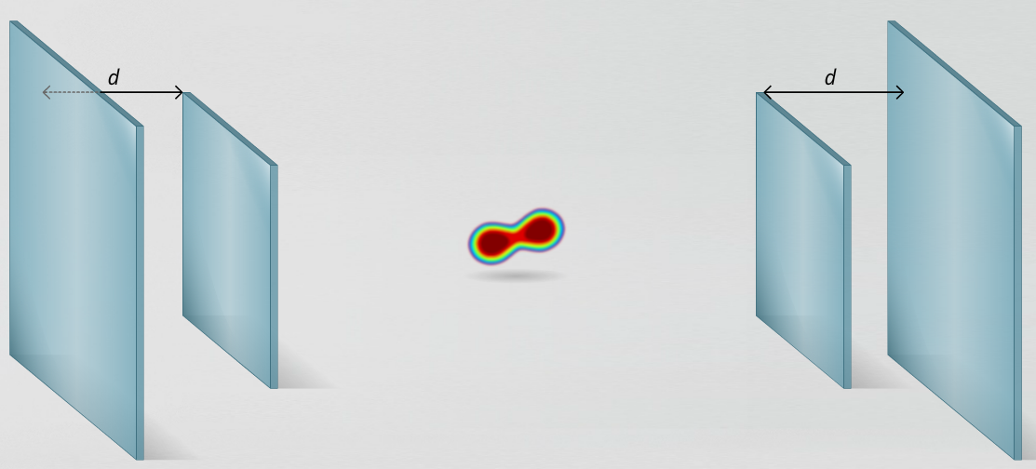
Part 4: Nuclear Fission Experiment
1. Introduction
2. Physics of Binary Fission
3. Methods of Detection of Fission Fragments
4. Energy Measurements of Fission Fragments from Californium-252
5. Time Measurements of Fission Fragments
6. Quiz
7. Practicum

Slide 11
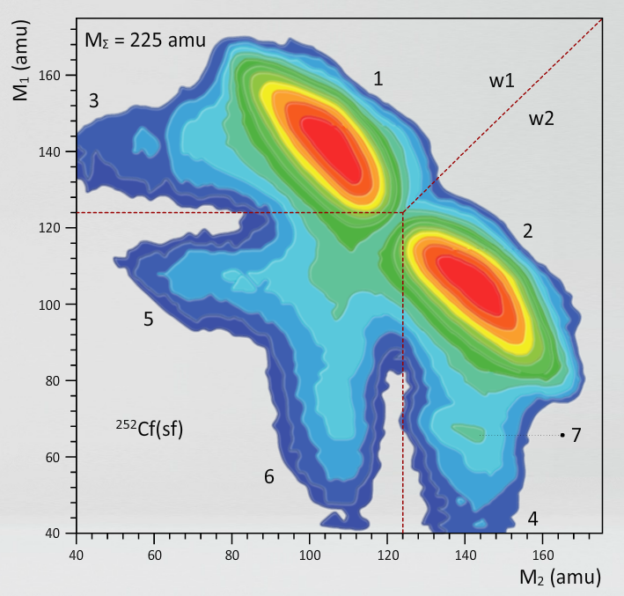
Part 5: Light Ions Spectrometer – Measurements
1. Physical Motivation
2. LIS Setup
3. Electronics of the LIS Setup
4. Block Diagram and Data Acquisition System
5. CAMAC Practicum
6. PIN Diode Calibration
7. Time of Flight Calibration

Slide 12
Part 6: Light Ions Spectrometer – Data Analysis
1. Introduction
2. Data Viewer
3. Preparation to Time Calibration
4. Time Calibration
5. Preparation to Energy Calibration
6. Energy Calibration
7. Mass Calculation

Slide 13
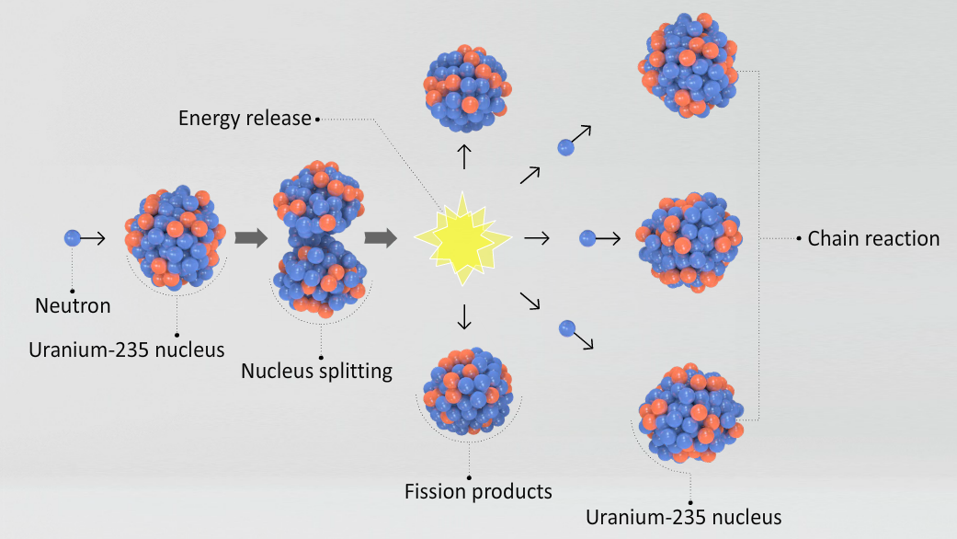
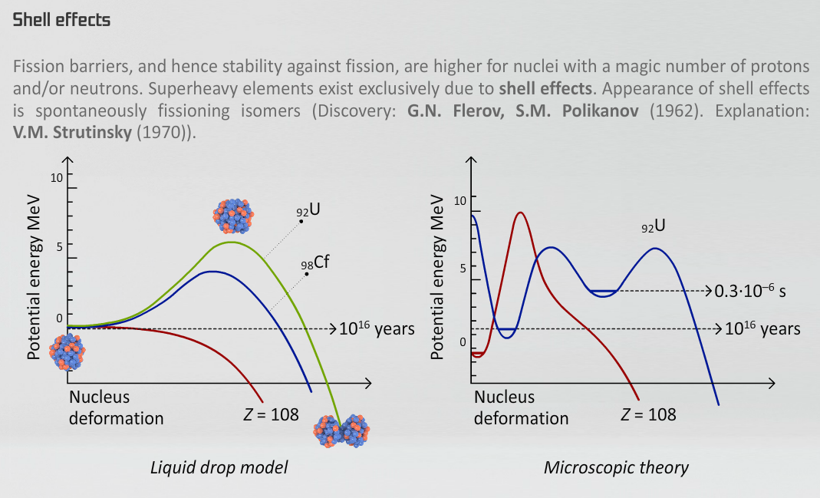
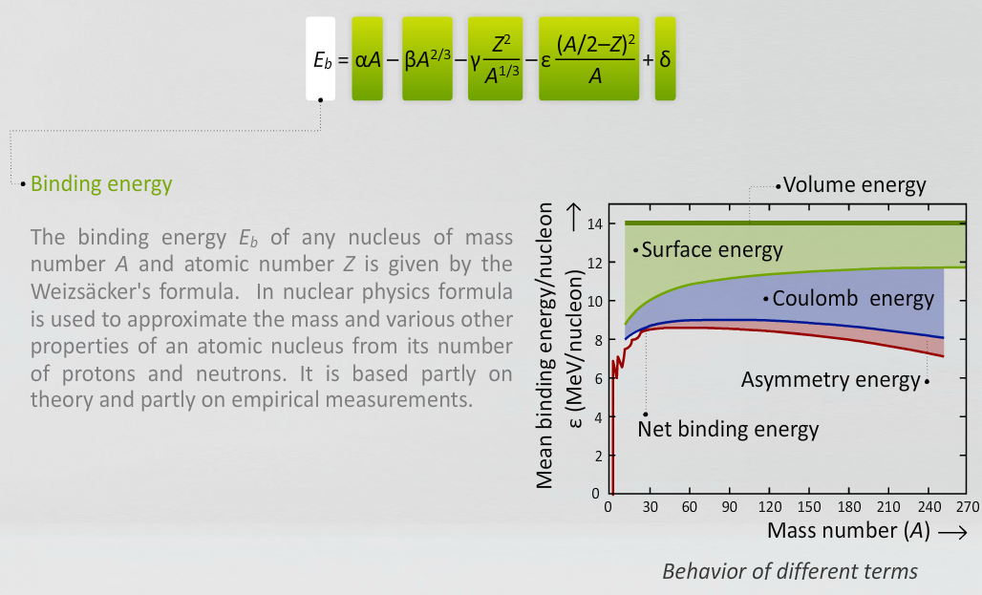
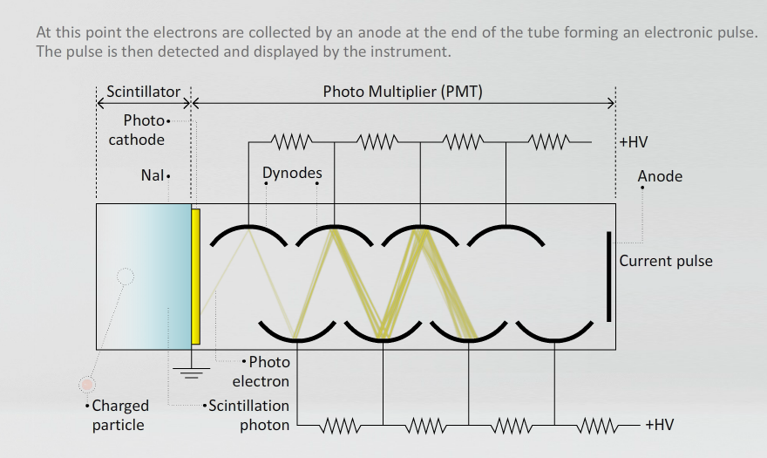
Theory

Slide 14
Theory: Interactive Formulas

Slide 15
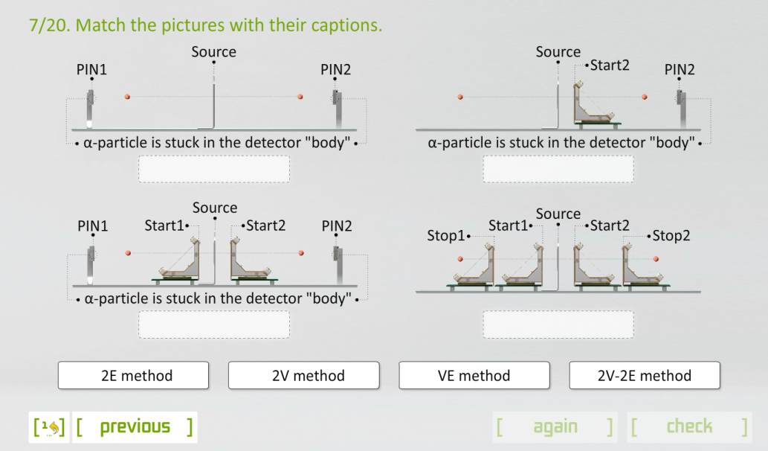
Quizzes

Slide 16
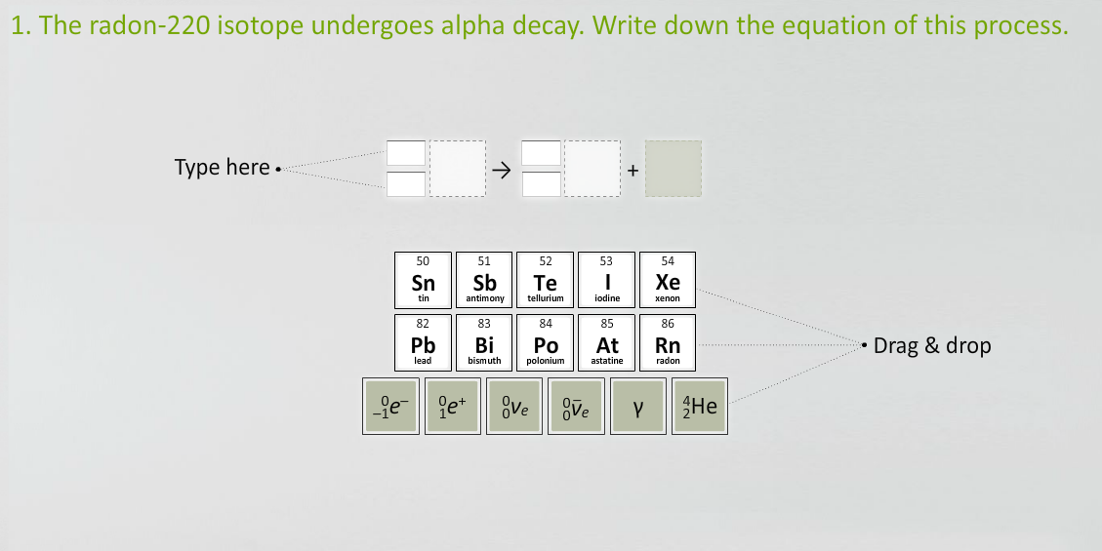
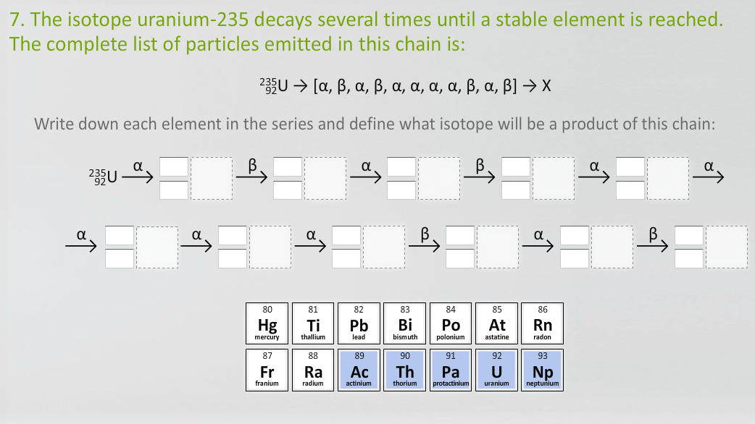
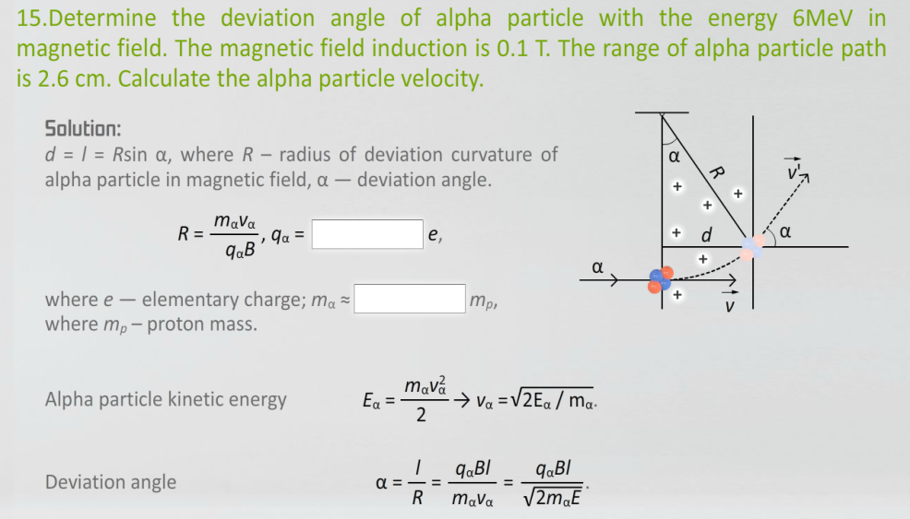
Exercises

Slide 17
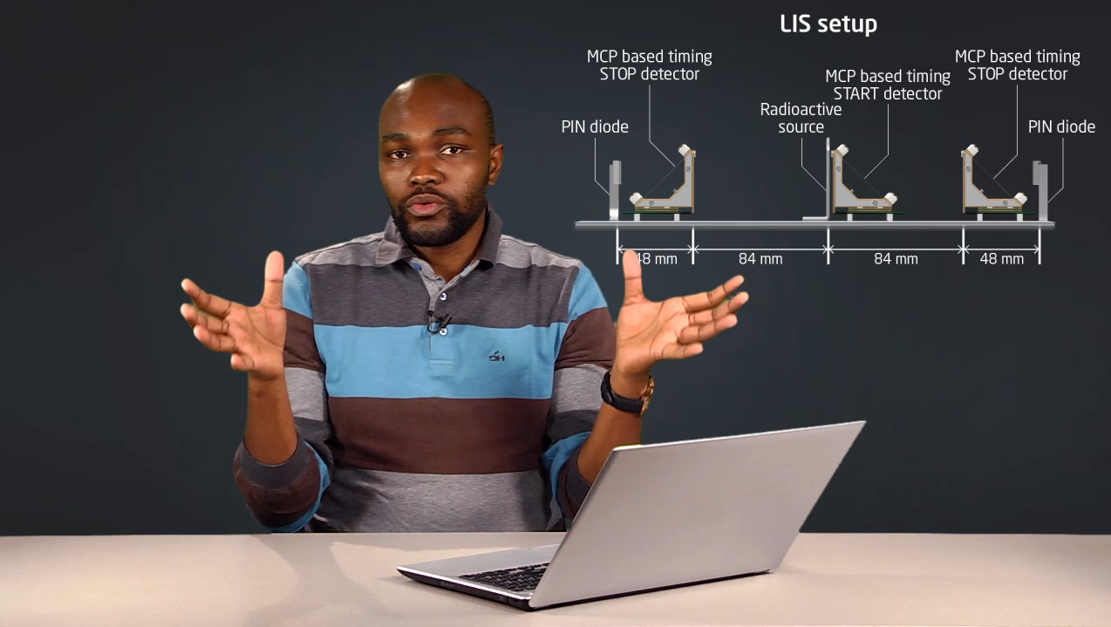
Video Lectures
Vusi Daid Malaza. Stellenbosch University, Faculty of Military Science, Military Academy, Saldanha, South Africa

Slide 18
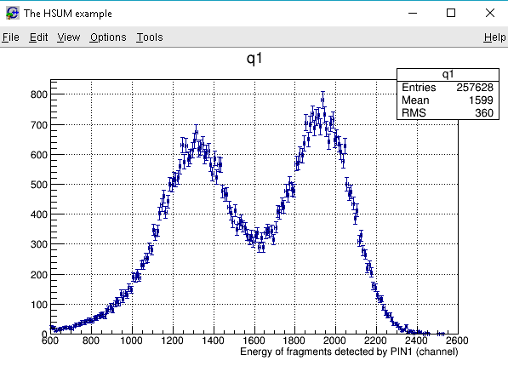
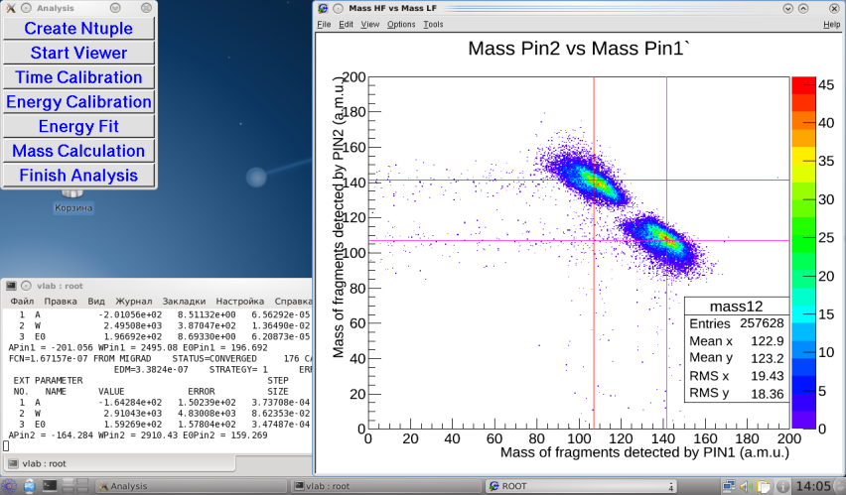
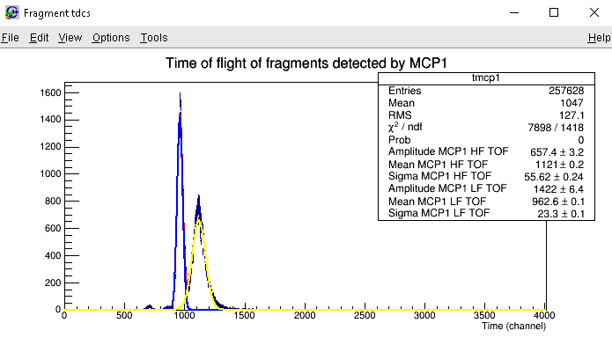
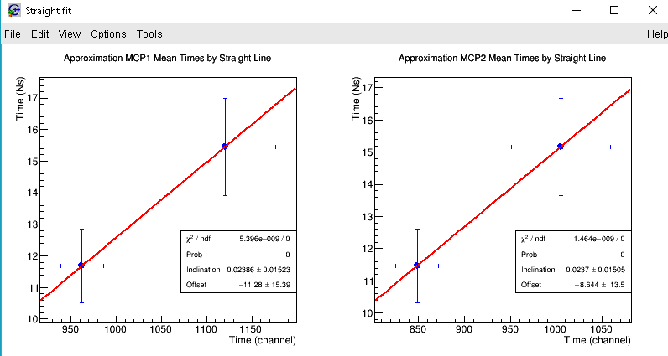
Light Ions Spectrometer – Data Analysis

Slide 19
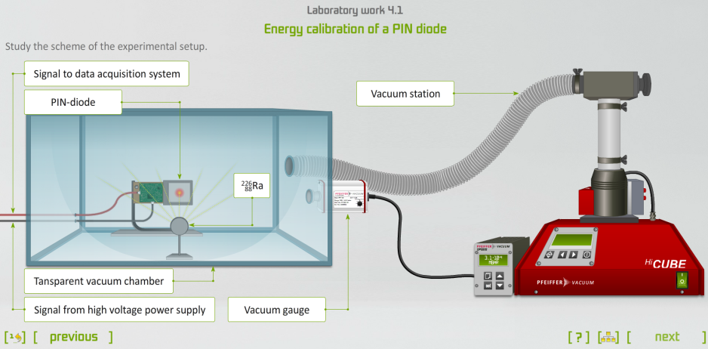
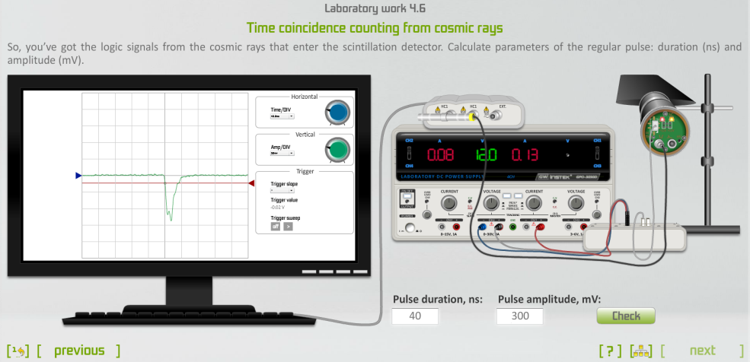
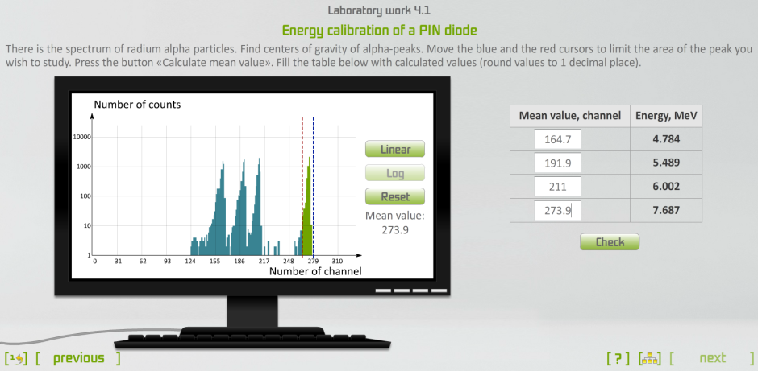
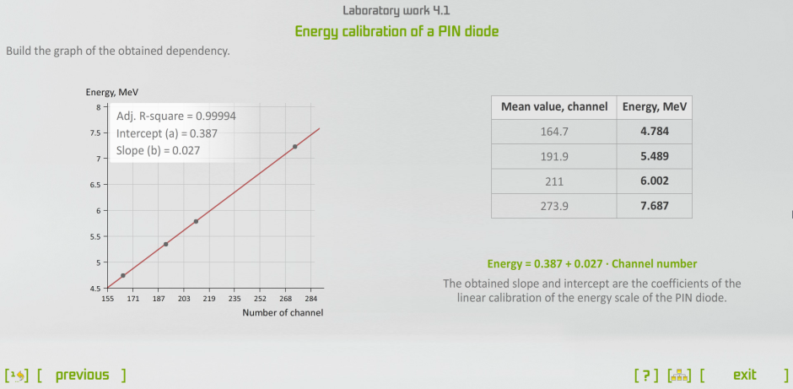
Virtual Practicum

Slide 20
Virtual Practicum

Slide 21
Virtual Practicum

Slide 22
Virtual Practicum
Study of signals from pulse generator
Signal measurement using oscilloscope
Spectrum registration of scintillation detector with the NaI crystal
Energy calibration of PIN diode
Measurement of radiation energies and thickness of 252Cf-sourse
Calibration from the precision pulse generator
Time calibrator grading
Time coincidence counting from cosmic rays
Time coincidence counting from a pulse generator
Work with vacuum system for physical experiment
Assembling of the detector system of the time-of-flight and energy spectrometer
Work with the CAMAC slave controller. Study of a register module

Slide 23
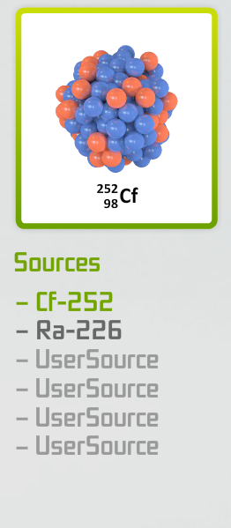
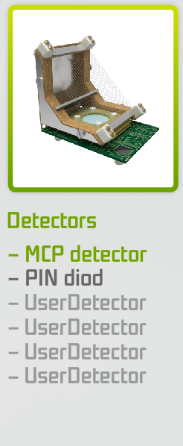
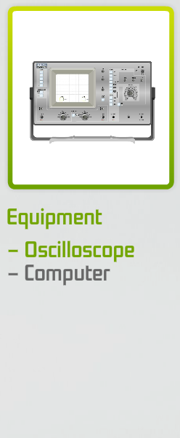
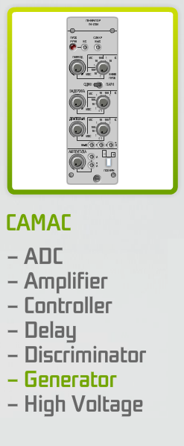
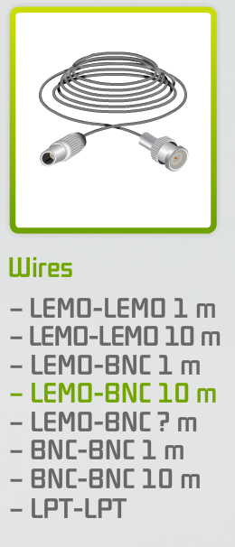
Interactive Environment for Nuclear Experiment Modeling
Libraries of the Setup Builder

Slide 24
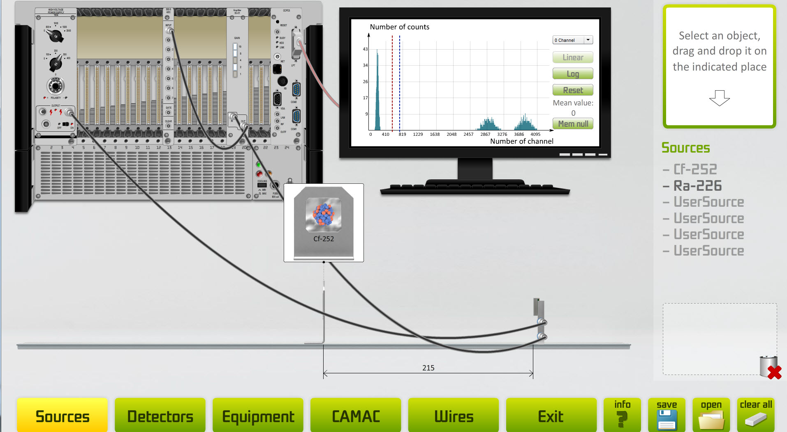
Interactive Environment for Nuclear Experiment Modeling
You can arrange your own setup

Slide 25
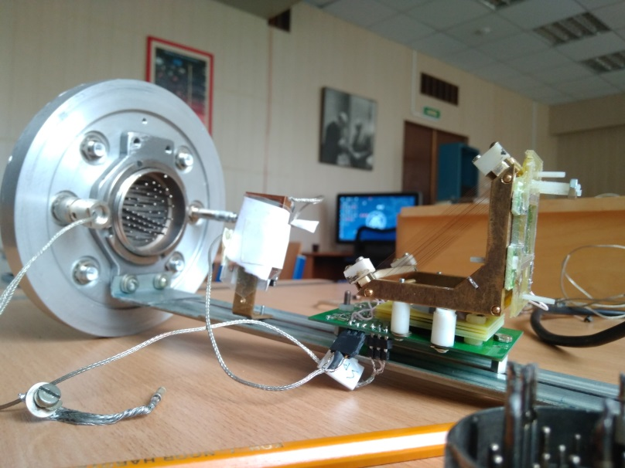
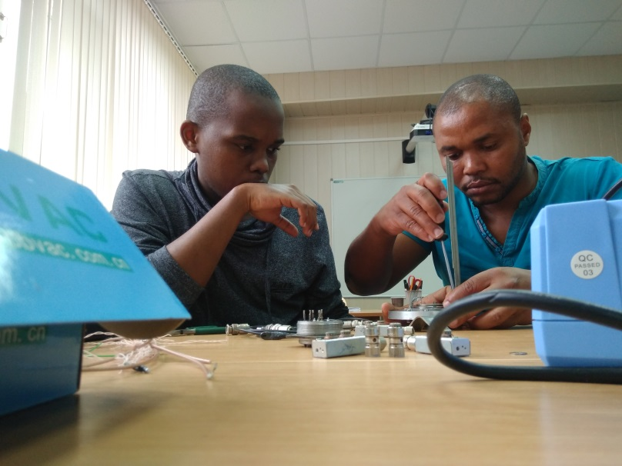
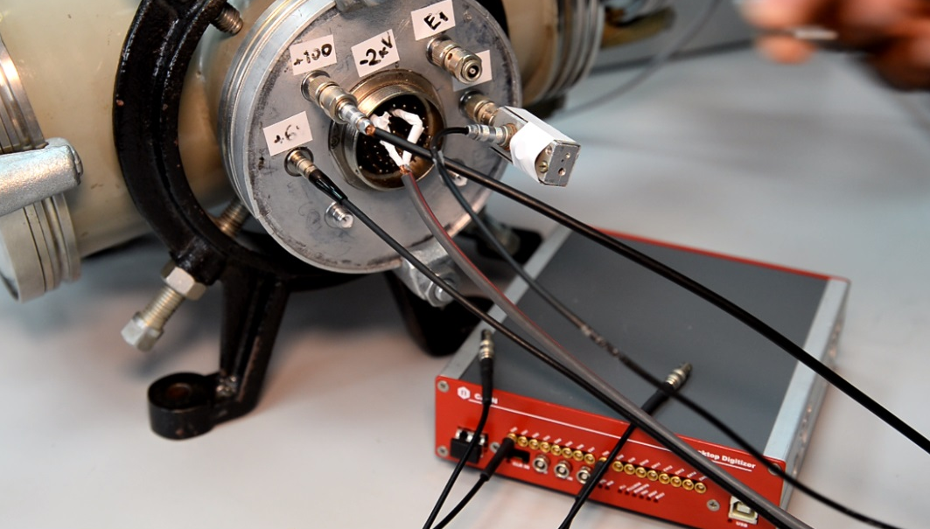
New Practicum Based on Modern Equipment
Alexander Strekalovsky
Thabiso Nkwashu
Vusumzi Gosani

Slide 26
New Practicum Based on Modern Equipment
Heidar Agakishiev
Kehinde Tomiwa

Slide 27
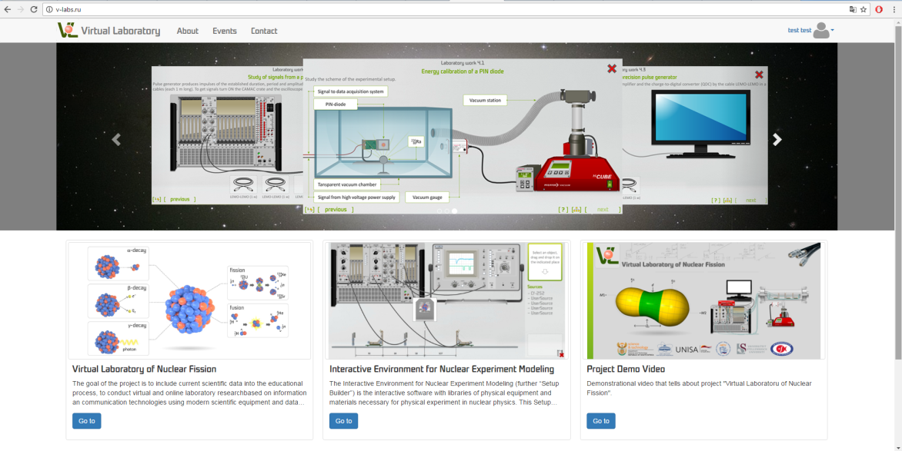
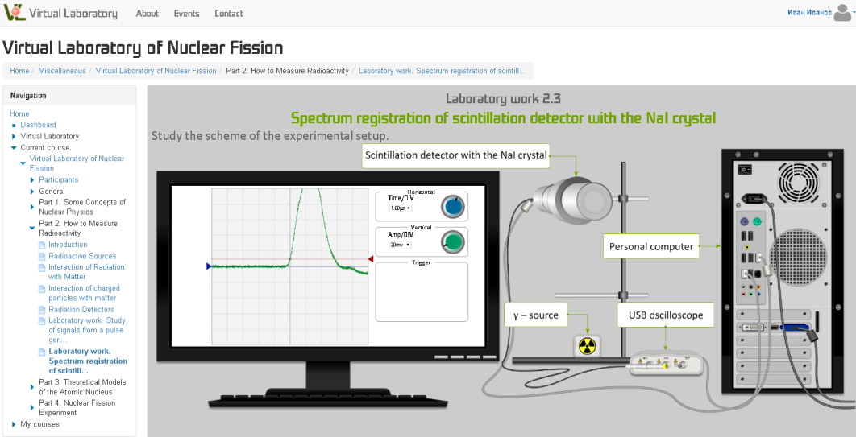
Web-version of the Project. Advantages
Access through the Internet.
You can control the educational process as a tutor.
You can see the progress of passing the course as a student.
You can communicate with peers and tutors.

Slide 28
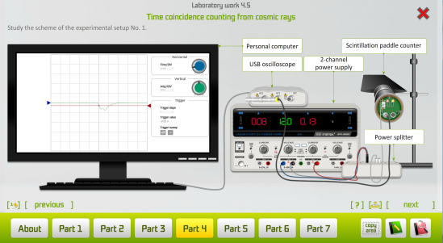
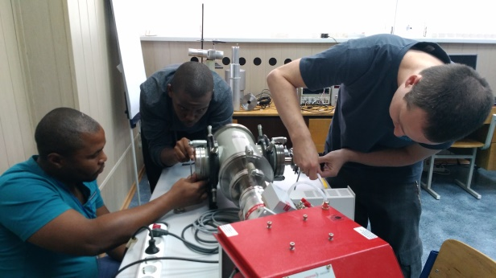
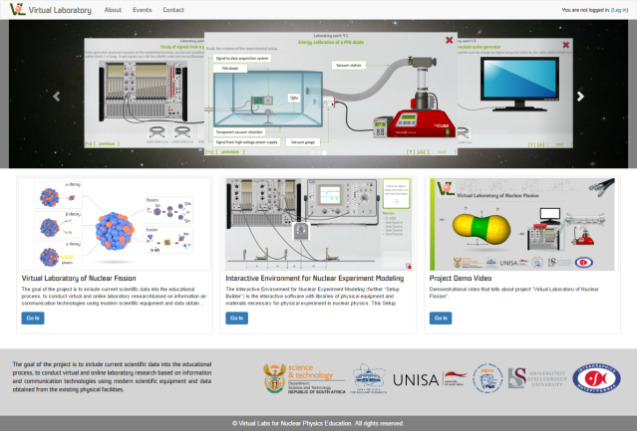
Virtual Laboratory of Nuclear Fission
Software complex “Virtual Laboratory of Nuclear Fission”
Interactive environment for nuclear experiment modeling (Setup Builder)
Hardware complex “Virtual Laboratory of Nuclear Fission” for student practices
Interactive web-version of the project

Slide 29
Next step: Interactive educational research laboratory of detectors and signal processing
Section «Education»
Radiation sources
Detectors
Modern methods of signal measurements from detectors
Methods of signal processing. Basics of work with signals from modern digitizers
Analysis of signals and spectra
Section «Practicum»
The set of research projects
connected with detectors and nuclear electronics, design of detection systems in the interactive environment for nuclear experiment modeling using different types of modern detectors.

Slide 30
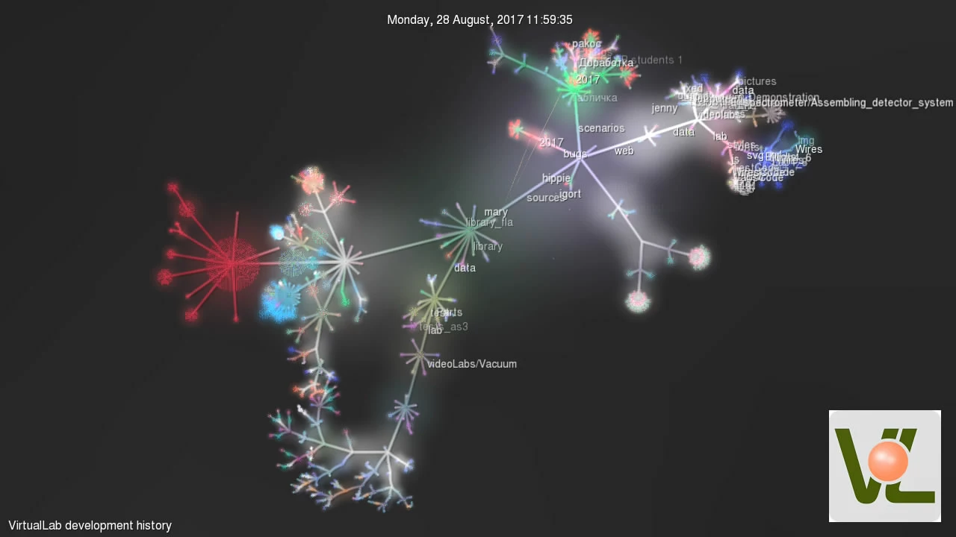
Project Evolution

Slide 31
Virtual Laboratory Milestones
Development of the Virtual Laboratory platform into the learning environment
Similar platforms/models in any required
research area
Virtual Laboratory of Nuclear Fission:
local version
Web-version of the project
Interactive environment for nuclear experiment modeling

Slide 32
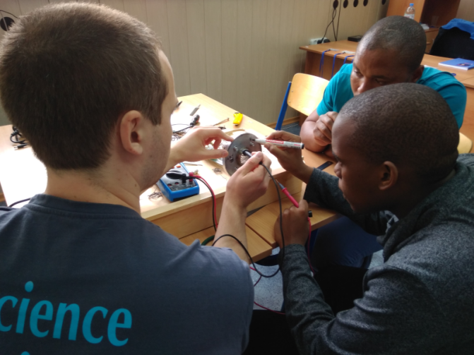
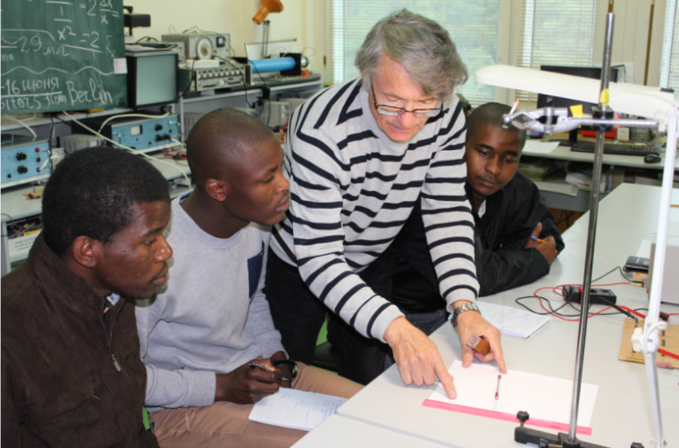
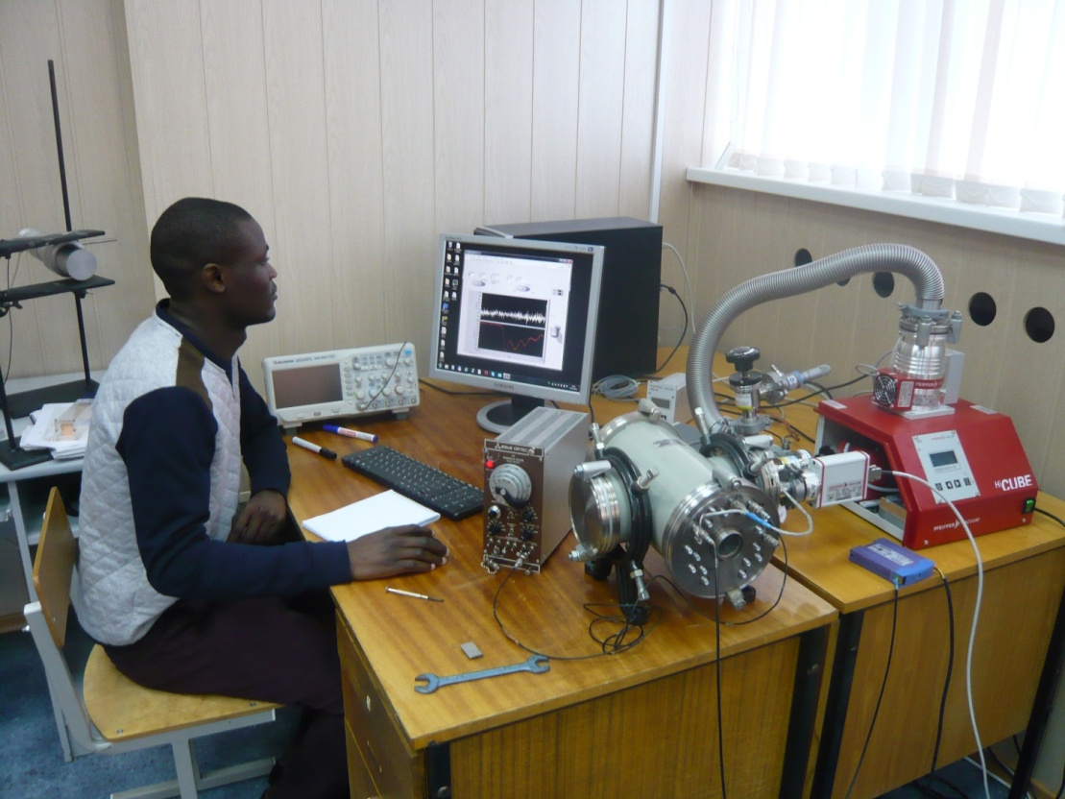
Focus of the Project
For each collaboration university we should have a coordinator and the team of the project developers.
We are ready to organize different trainings in the Joint Institute for Nuclear Research.

Slide 33
Thank you!

