Slide 1
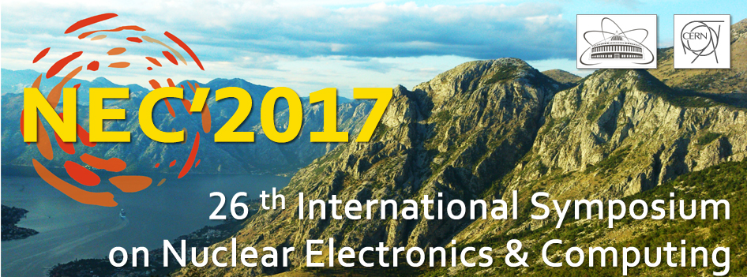
Online courses and new educational programs to support research priorities within the subject-matter of JINR projects on the basis of modern educational platforms
V.V. Belaga, I.A. Bulyakova, E.V. Gorbacheva, K.V. Klygina,
A.O. Komarova, P.O. Kochnev, M.P. Osmachko, Yu.A. Panebrattsev, Yu.E. Penionzhkevich, N.E. Sidorov, N.I. Vorontsova
25-29 September 2017, Montenegro, Budva, Becici

Slide 2
Project goals
Attract motivated students from Russia and JINR Member States to work at JINR
Use modern educational technologies to obtain skills needed for JINR research program
Implement the results obtained at JINR in the educational process in the Universities of JINR Member States
Develop educational content at the level of the leading research centers

Slide 3
edu.jinr.ru

Slide 4
Online courses and new educational programs within the subject-matter of JINR projects

Slide 5
Blended learning model
JINR
certificate
Open informational educational environment

Slide 6
Ability of online education within the subject-matter of JINR research program
Online-course related to certain theme/discipline
Specialization: series of related courses designed to help students master a specific topic
Online master program together with certain University from JINR Member State
Networked master program together with some Universities from JINR Member State
Virtual and remote labs
Online trainings
Networked science projects for students
Outreach programs
Interactive models of JINR Main Facilities

Slide 7
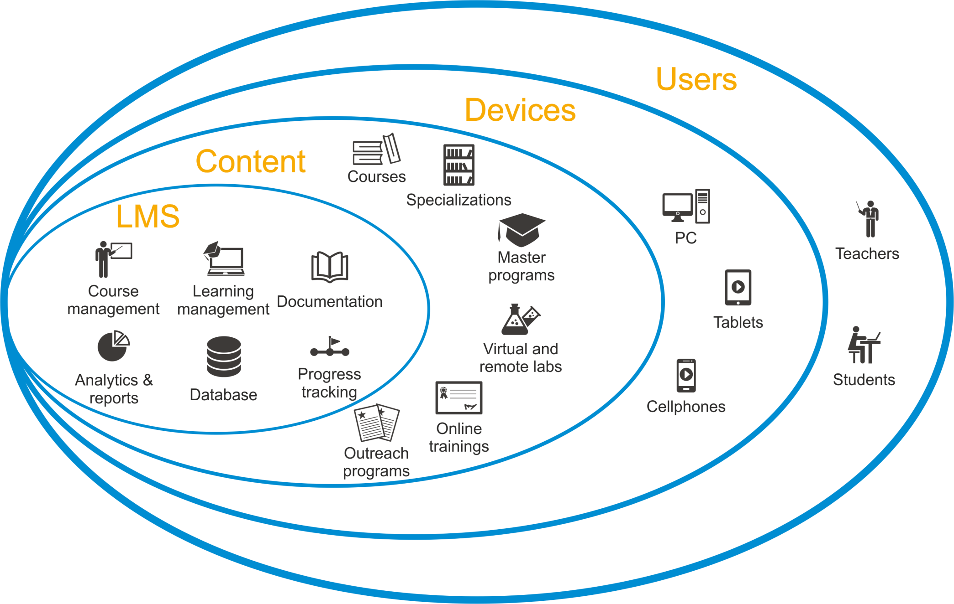
Modern educational platform

Slide 8
LMS (Learning Management System)
Content Development Technologies

Slide 9
SCORM—Sharable Content Object Reference Model
An international standard defined the requirements for the organization of educational material and distant learning systems. The correspondence of online courses to the SCORM standard ensures compatibility of components and the possibility of their repeated use.
LMS
API object provided by LMS
SCORM API
Content

Slide 10
IMS LTI — Learning Tools Interoperability
Specification developed by the international educational consortium IMS Global Learning Consortium, containing recommendations for the structure and rules for the development of external educational applications for their integration with various Learning Management Systems (LMS).
LTI Tool

Slide 11
IMS LTI specification support of Massive Open Online Courses (MOOC platforms
LTI implementation libraries are available for:

Slide 12
edu.jinr.ru

Slide 13
Subjects of online courses
Fundamental and applied research
Study of condensed matter using neutrons
Neutrino physics. Deep-water experiment Baikal
Heavy ion physics. Exotic nuclei. Radioactive beams
Synthesis of new superheavy elements
Heavy ion accelerator complexes
Cryogenic technologies and their use in accelerating technics
Medical and applied physics with heavy ion
Computing for MEGASCIENCE
Distributed and cloud computing
Parallel and hybrid computing
Big Data analytics
Modern technologies of Big Data system engineering
Software engineering (in the development of Big Data systems)
Technologies of acquisition, storing and analyzing data in nuclear physics

Slide 14
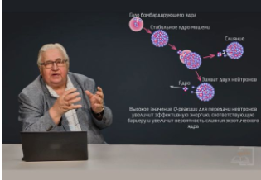
Online courses within the subject-matter of JINR projects
Heavy-ion physics
Yu.E.Penionshkevich
Modern problems of system analysis
and management
E.N.Cheremisina

Slide 15
Online courses within the subject-matter of JINR projects
High Energy Physics
V.A.Nikitin
Virtual Lab of Nuclear Fission
Introduction from Vusi D. Malaza

Slide 16
Thank You!

