Slide 1
State-Funded Educational Institution of Higher Education State University Dubna
Adaptive strategy of personnel training for digital economy objectives in State University Dubna
Professor E.N. Cheremisina
Associate professor V.V. Belaga
Associate professor O.A. Kreider

Slide 2
Prerequisites
Decree of the President of the Russian Federation No. 203 “Strategy for development of information society in the Russian Federation for 2017-2030” dated May 09, 2017
Program “Digital economy of the Russian Federation”
Project “National platform of open education”
Digital economy is the economic activities where the production’s key factor is data in a digital form and processing of its large volumes and use of its analysis results make it possible, compared against traditional forms of economic management, to enhance substantially various types of production, technologies, equipment, storage, sales, and goods and services delivery.
Decree of the President
“Strategy for development of information society
in the Russian Federation for 2017-2030”

Slide 3
Aim of the digital economy
The aim of the digital economy creation is to form an informational, knowledge-based environment that is realized through development of science and execution of educational and enlightenment projects.
Tasks of the digital economy
to form new markets based on the employment of information and communication technologies and to ensure leadership in these markets due to the efficient implementation of knowledge and development of Russian ecosystem of digital economy;
to strengthen Russian economy, including those sectors where business advancement employing information and communication technologies will render competitive advantages to Russian organizations, ensure production efficiency and performance rise;
due to the employment of new technologies, to increase the scope of Russian non-resource export – primarily that of goods and services desirable by foreign consumers;
increase of the competitive capacity of Russian high-tech organizations in the international market

Slide 4
Informational environment
To tackle the tasks of the digital economy, it is essential to form an informational environment that allows:
improving the mechanisms of knowledge sharing;
providing perfection of supplementary education in order to involve children in the scientific research and creative work and to develop their ability to solve non-standard tasks;
using and developing various educational technologies, including the remote ones and e-learning, while executing educational programs;
designing and implementing partnership programs of higher education organizations and Russian high-tech organization, including those concerning improvement of educational programs

Slide 5
Main areas of personnel training
Cloud technologies
3D modeling and
3D print
Robotics
Laser technologies
New materials
Big Data technologies
Internet of Things,
Internet of Everything
Industrial internet
Radio engineering and
electronic component base
Cyber security

Slide 6
Adaptive strategies of personnel training of State University Dubna
Since the current changes concerning the creation of an information society and the shift towards digital economy demand the education system to be flexible, State University Dubna has formed adaptive strategies of personnel training that will enable it to meet the need of the modern society for skilled professionals:
in dedicated training programs for the talented youth.
in scientific and applied research;
in technological entrepreneurship training;

Slide 7
Training for scientific and applied research
Strategy 1.
cooperation with JINR within the execution of NICA megaprojects
execution of a project for creation of an educational program for the space communications centers’ personnel training, ordered by the Russian Satellite Communication Company
technique of the use of electronic training packages in the blended learning model in the Master’s program at System Analysis and Management Institute of Dubna;
creation of an integrated system of handling the graduates of Dubna University;
development prospects of Dubna University as a member of the medical technology cluster;
scientific, training and methodological support of the design process of intellectual management systems
engagement of the talented youth and prominent academicians in the scientific research
execution of internal scientific research works
strategic partnership with the academic and business communities
participation in scientific research projects, including the international ones

Slide 8
Technological entrepreneurship training
Strategy 2.
Creation of temporary teams to implement promising high-tech studies
Participation in design works for the companies that are residents of Special Economic Zone in Dubna
1C-based enterprise management system
Scientific, training and methodological support of the design process of intellectual management systems
Business analytics and Big Data. Entrepreneurial risks
Teaching high-school students the fundamentals of the ICT project’s launch in a startup mode
Training in modern project management techniques
Training in information technologies of project management
Training in enterprise management systems

Slide 9
Execution of dedicated training programs for the talented youth
Strategy 3.
Supplementary program that is executed in parallel with the major educational trajectory in three main lines:
Supplementary educational programs
Undertaking internships at the platforms of the leading companies and scientific research centers, including the foreign ones;
Engagement of leading specialists, academicians and similar (visiting professors);
Assistance in startup opening and promotion;
Innovation: the students independently develop projects and present them to the prospective investors and customers.
Production: the students execute orders from industrial enterprises and scientific institutes.
Research: students work on theoretical problems with a strong scientific potential.

Slide 10
Master’s Degree programs and employers
“System analysis and management”
“Theory and mathematical methods of system analysis and management in engineering systems”
“System analysis of design engineering solutions”
“Cognitive computations and business analytics”
“Intelligent systems of Big Data processing’
“Geo informational technologies in decision-making”
“System analysis and management of sustainable development of complex systems”
«Риэл Гео Проджект»
“Management”
“Project management of sustainable development”
“Applied informatics”
“Corporate management systems”
“Applied informatics in economics”
“Designing and technology of electronic means”
“Information technologies of designing electronic means”
ВНИИгеосистем
“Applied mathematics and informatics”
“Mathematical modeling”

Slide 11
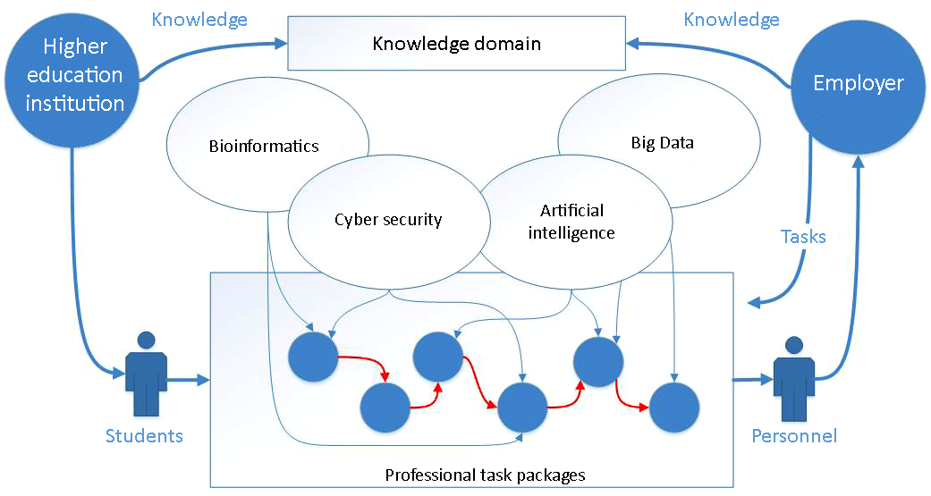
Intelligent technologies in education
The objective is to create and develop an electronic educational environment that allows forming and transferring knowledge in promising technological areas together with the leading enterprises.
The elements of the educational environment of knowledge management are:
knowledge domains that contain information of practical importance by professional activity spheres;
packages of professional tasks in promising technological areas formed together with the employers;
a virtual experiment platform based on cloud technologies;

Slide 12
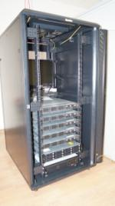
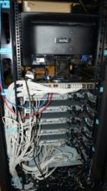
Cloud technologies
A hardware & software system was created to complete the tasks of uninterrupted access to the corporate information and applications, which gives a reduction of administrative system costs and reduction of expenditures for the infrastructure maintenance.
Introduction of the center of cloud technologies assumes a serviced infrastructure for 300 workplaces. “Complexity” level of the operations performed at the workplaces is medium, i.e. standard, office-type. Every workplace is functioning under the control of an MS Windows 7 Pro OS.
Creation of circuit boards and e-modules
Gauging devices

Slide 13
Single informational educational network “Dubna”
Increase of the data transmission rate from 1 Gb to 10 Gb!
School
Access to the dedicated software and cloud services
No.10
АТE 5
School
School
No.1
No.3
АТE 2
Formation of dedicated classes in the schools
School
Central city child health clinic
No.5
АТE 3
School
Business
No.9
Healthcare
School
School
center
Directorate
Early vocational guidance for schoolchildren
Gymnasium
No.7
No.6
City
Education
Board
No.11
School
No.2
School
Assistance with preparation for the Unified State Exam
“Spring”
АТE 4
No.4
Lyceum
ATOL
University
Child
health center
School
TV studio
Institute
No.8
Carrying out of subject-specific schools for schoolchildren and teachers
“Dubna”
Lyceum
School
SCC
LIT
“Opportunity”
JINR

Slide 14
Specialized departments
Specialized department of geo informatics.
National Research Institute of Geo Systems
Specialized department of distributed information computation systems.
LIT of JINR
Specialized department of personal electronics.
LCE of JINR
Invention patents and copyright certificates
“JME. The library of the program builder’s classes – Java Messaging Engine for ECM” program code | A.B. Florko
“Accounting for materials and service rendering for small businesses” program code | T.V. Tyupikova
“Educational program “Accounting at a small enterprise”” program code | T.V. Tyupikova
“Search and analytics expert system” ECM program code | E.A. Ershov
“Corporate knowledge management system” program | A.S. Minzov, M.L. Malkin, S.A. Minzov
System for evaluation of the consensus achievement process sustainability when forming a strategy of an organization’s actions | A.N. Raikov, S.V. Ulyanov
Method and system of automated collective object modeling | Y.A. Panebratsev, V.V. Belaga, N.E. Sidorov and others
Method and system of intelligent error correction for hardware data storages | S.V. Ulyanov, V.N. Dobrynin, V.V. Moroz, M.M. Slobodskikh
Self-organizing quantum robust control methods and systems for situations with uncertainty and risk | S.V. Ulyanov

Slide 15
Formation of infrastructure for digital production
The main contemporary task of development of digital economy in Moscow Area is to create an infrastructure of increased demand for the available fixed assets while forming flexible technological chains “to match the innovative merchandise”.
Digital designing based on the cloud services
Big Data
of digital services of Moscow Region companies
Digital economy of the Northern Moscow Area
IT logistics with a digital quality background

Slide 16
TIME: FEBRUARY 2018 PLACE: STATE UNIVERSITY DUBNA, MOSCOE REGION, DUBNA
State University Dubna
suggests organizing
a scientific and technological seminar on the problems of education for the needs of digital economy:
Cloud technologies. The role and place in education
Geo informational systems in education and management
Creation of educational e-resources
Cyber security
Formation of a new technological basis for digital economy development

Slide 17
Thank you for your attention!

