Slide 1
ON THE WAY TO OPEN EDUCATION
Dubna State University
Institute of Systems Analysis and Management
26thSymposium on Nuclear Electronics and Computing - NEC'2017

Slide 2
Questions on the Road to Open Education
What is open education?
Who needs an open education?
What is the structure of open education?
Who is the developer of educational materials for the system of open education?
How to check the quality of developed courses?
How to protect intellectual property rights to the author of the course?

Slide 3
Open education is the use of computer networks in education, allowing in time to create a single global educational space open to any citizen of the planet.
Open education will include:
set of educational institutions of various types;
set of computer networks of educational institutions connected to the Internet;
a single database and a single knowledge base;
standardized tools for the development of teaching materials;
electronic libraries, catalogs and means of searching for primary sources;
internationally agreed educational standards and educational programs.

Slide 4
Features of open education
Use of information and educational technologies;
Test control of the quality of knowledge;
Economic efficiency;
Flexibility in time, place and pace of training;
Modularity of individual curricula;
Parallelism of training and basic professional activity;
The new role of the teacher is the manager of educational services;
Increased requirements for the self-organization of the student;
Internationality of educational services.

Slide 5
Who will be an open education student:
Teacher of a modern educational institution
Modern specialist in the modern profession
Head of the organization
Potential leader
Eager to acquire soft skill
Those wishing to improve their skills
Who decided to change his profession
Wishing to learn something new
Man with the possibility of using

Slide 6
Brandon Bastide, Executive Director, Education Department, Gallup
Research of the modern information society
Only 14% of students are confident that the knowledge gained at the university will be useful to them in the future;
Only 6% of university teachers are confident that they are preparing students for future work;
Only 11% of employers see in graduates those skills and knowledge that are necessary for work.

Slide 7
Requirements for the education system
improvement of the curriculum,
personalization of training,
advanced training of teachers and teachers,
accessibility of education for the maximum number of people.
For reference:
According to forecasts, by 2025 the number of students will reach 263 million people.

Slide 8
The system of open education is a set of didactic, technical, information and organizational approaches that implement the principles of open education.
Educational process management
Administrative and management
Technical
Staffing
Financial
Marketing
Legal
Information
Security
Research
International Relations
Subsystems open education

Slide 9
ONLINE COURSE CONTENT
1) Course ID
2) Course version
3) Name of the course
4) The total complexity of the course in credit units, the number of weeks of training, the average load per week
5) Name of the university-developer (Full name, Short name)
6) Course authors
7) The main illustration of the course
8) Promotional Video
9) Brief annotation of the course
10) Full annotation of the course
11) Map of the results of education
12) Information on the certificates issued, the rules for the assessment, the description of the assessment system (including the terms of the work audit), the specification of the assessment system, reflecting the relationship of assignments with the course content, including a description of indicators and evaluation criteria, scales and assessment procedures
13) Educational programs that recognize the results of the course (both programs of the university-developer, and programs of other universities, which recognize the results of the course)

Slide 10
Formation of open education
in 2002 it was decided that the Massachusetts Institute of Technology should provide online access to its courses, lectures and educational materials on the MIT OpenCourseWare platform;
in the same 2002, the page of MehMata of the Moscow State University was launched, where video lectures, e-books and textbooks were published, a media library of mathematical materials was assembled;
In 2005, MIT founded the OpenCourseWare Consortium, whose goal is to unite the world's universities to open access to their educational materials.
This gave impetus to the launch of many similar initiatives around the world and gave rise to the whole Open Educational Resources (OER) movement, supported by UNESCO.

Slide 11
THE MOST KNOWN GLOBAL OER-RESOURCES
OER Commons is the largest international platform for the exchange of learning materials between individual teachers and entire organizations.
OAPEN is an electronic library of academic literature from university libraries around the world.
ROAD - a huge catalog of resources from the educational institutions of the planet, mainly scientific, not pedagogical.
All the known MOOC platforms are also here - MIT OpenCourseWare, edX, Coursera, Khan Academy mentioned above.

Slide 12
OPEN EDUCATIONAL RESOURCES IN RUSSIA
A single window of access to information resources is the largest educational catalog in Russia.
A platform with which you can start searching for students, schoolchildren, parents, teachers and teachers. Pedagogical Council, Open Class, Innovative Teachers Network, Intel Education Galaxy - Internet sites for the exchange of professional experience between teachers and teachers.
The oldest in runet portal of distance education Intuit.
Lecterium and Universarium as bright domestic representatives of video courses and MOOC.

Slide 13
Russian Open Education Portal (https://openedu.ru/).

Slide 14
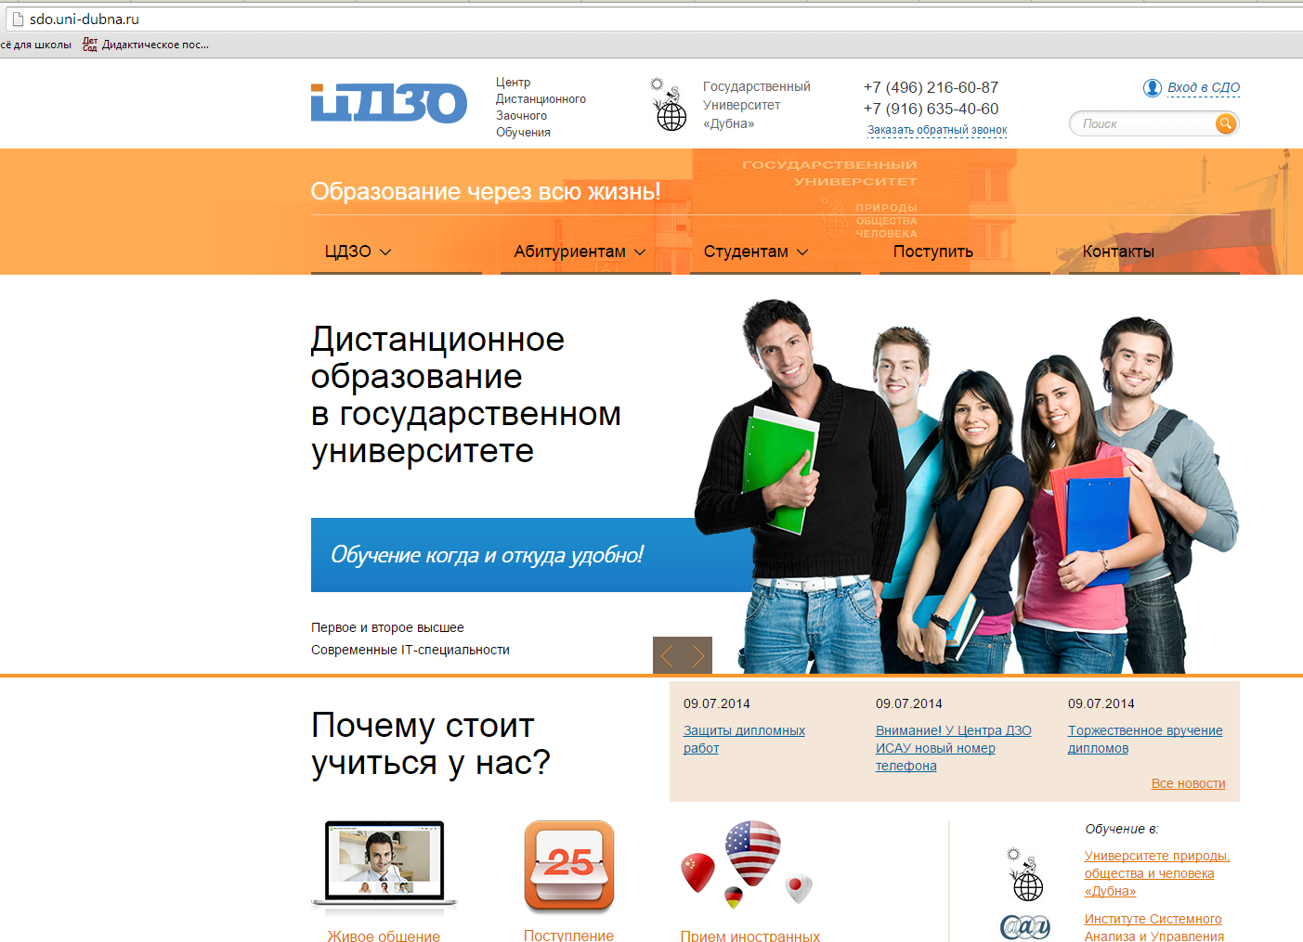
Distance learning system of the University of Dubna

Slide 15
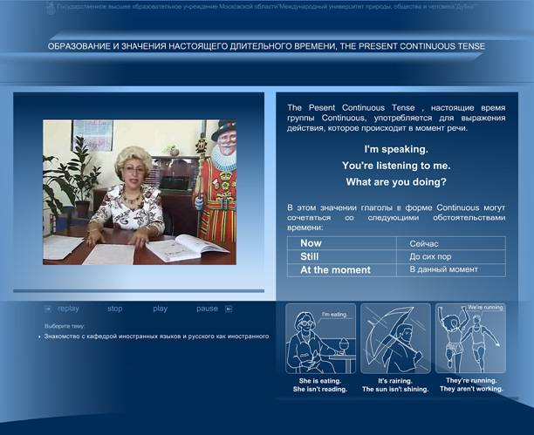
Distance learning system of the University of Dubna

Slide 16
Open initiatives, whether open access to science, open government or open educational resources, are a requirement and a challenge to the information age. Find the line between freedom of information dissemination and respectful attitude to someone else's work, form a culture of creating quality content, counter censorship on the Internet and direct its resources to the public good of each of us.
Ivan Begtin
Director non-profit partnership "Information Culture"

Slide 17
The questions to be solved are already on the way:
What is all this open education? Modernization of distance or distance learning?
How to effectively organize the development and creation of e-courses?
How to determine the quality of educational resources?

