Slide 1

Dubna State University
NEC’2017, 25-29 September 2017 , Montenegro, Budva, Becici

Slide 2
The current version of virtual computing lab provides a set of software and hardware-based virtualization tools that enable the flexible and on-demand provision and use of computing resources in the form of "cloud" Internet services for carrying out research projects, resource-intensive computational calculations and tasks related to the development of complex corporate and other distributed information systems.

Slide 3
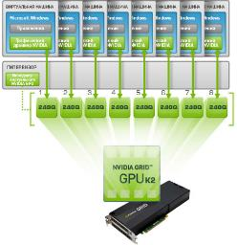
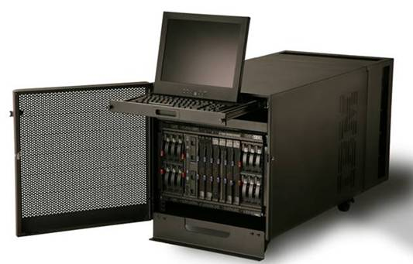
Current student’s nodes of Virtual Computing Lab

Slide 5
The introduction of containerization technology as a stand-alone component of Virtual Cloud Computing Laboratory (VCL), serves to improve the process of corporate information systems deployment and use in the training of IT professionals. Compared to hardware virtualization of the VCL, the underlying operating system kernel can be used for all containers.
On the one hand this way introduces restrictions on the use of other operating systems while, on the other hand, it improves payload on the server of a similar configuration. This can be achieved due to the specifics of the containerization architecture, which we will examine on the example of Docker.

Slide 6
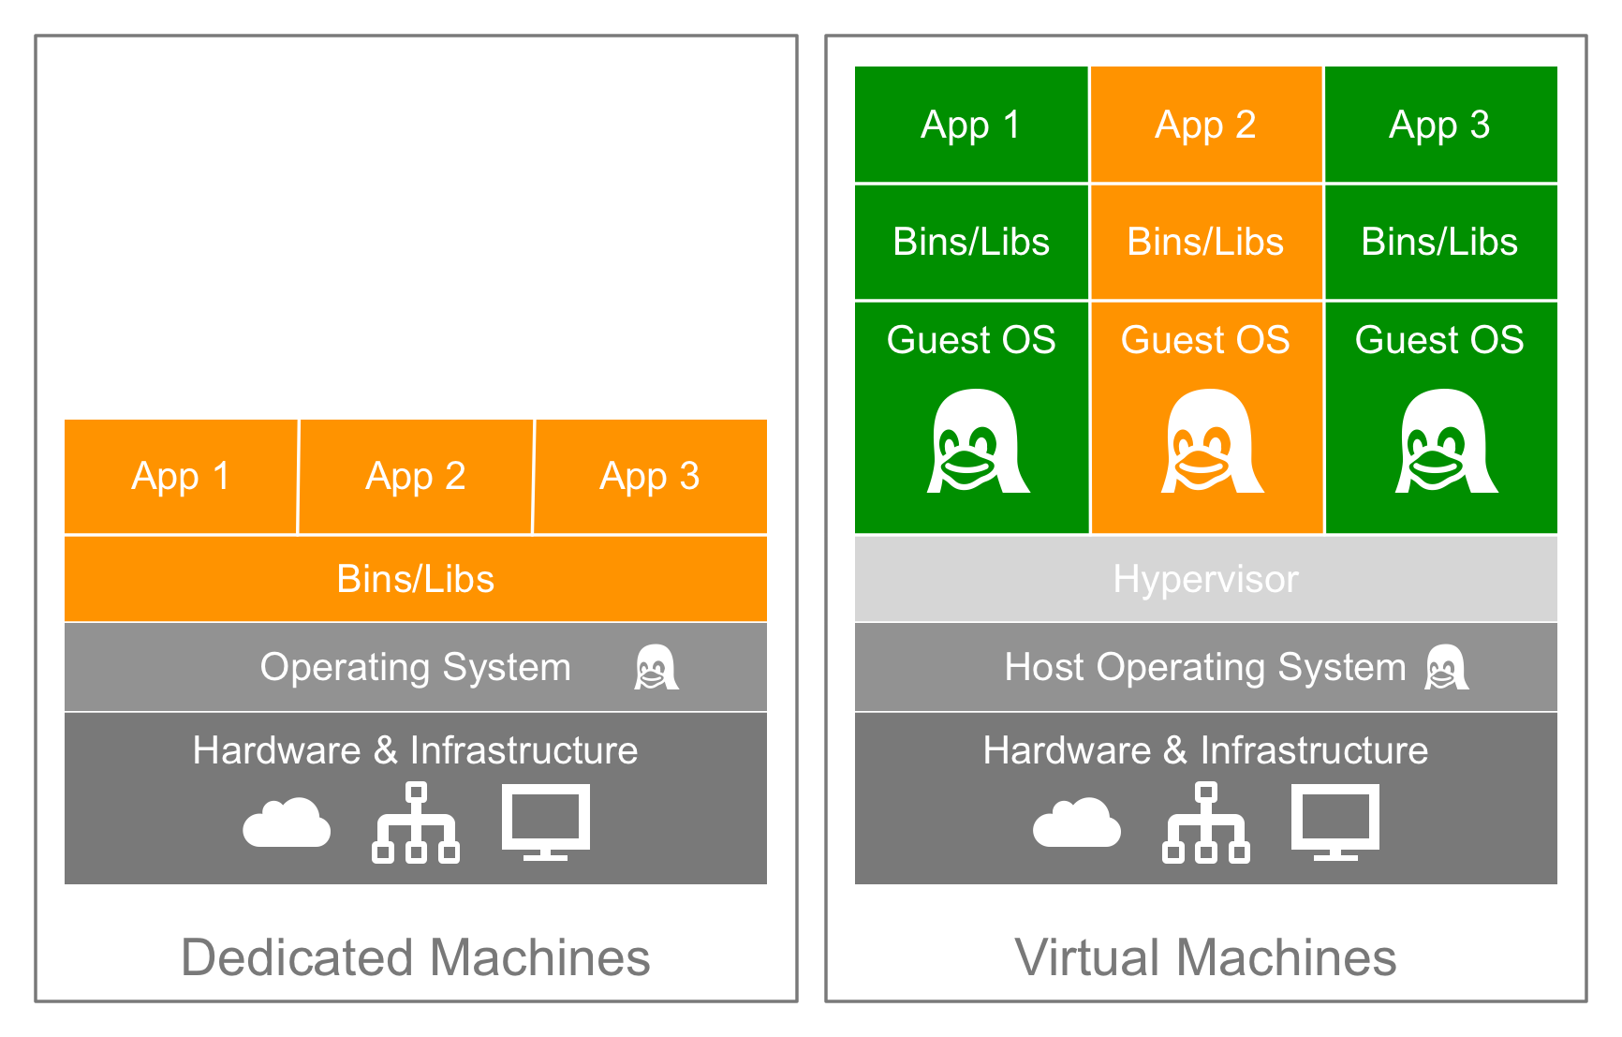
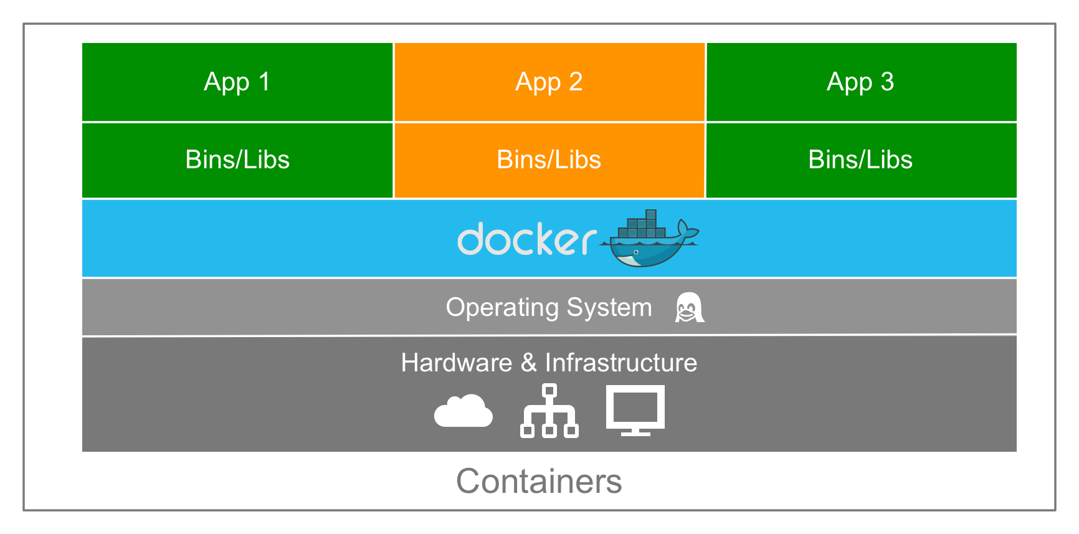

Slide 7
Conceptual hybrid model of Docker use in VCL

Slide 8
Example of using docker containers for practical studies
Practical case: Quick Oracle RDBMS deployment on virtual machine inside Virtual computing Lab, allows students to perform practical tasks on working with the database via Oracle SQLite.
Step 0. Install Docker Community Edition on Linux (Centos7) on VM
# yum install docker-ce
Step 1. Installation of container that includes preconfigure Oracle 12
# docker pull tokareva/oracle-12c
Step 2. Run container with Oracle RDBMS 12C
# docker run -d -p 8080:8080 -p 1521:1521 tokareva/oracle-12c

Slide 9
Run Oracle container on VM inside VCL

Slide 10
Connect to Oracle RDBMS inside container

Slide 11
The advantages of VCL:
1) To study a full lifecycle of Corporate information systems.
2) To provide a set of software and hardware-based virtualization tools that enable the flexible and on-demand provision and use of computing resources in the form of "cloud" Internet services for carrying out research projects, resource-intensive computational calculations and tasks related to the development of complex corporate and other distributed information systems.
3) To provide dedicated virtual servers for innovative projects that are carried out by students and staff at the Institute of System Analysis and Management.

Slide 12
The usage of Docker allows:
1) To apply preconfigured cases for training students to solve real business tasks for troubleshooting in information systems.
2) To enable the operations of creating images and launching containers on the server.
3) To provide the capacity to quickly create, start, stop, move, and delete, and stay in a safe sandbox for running applications
4) To use hardware resources more effectively.

Slide 13
Conclusion:
VCL promotes the integration of the scientific and educational potential of Dubna State University and the formation of industry and academic research partnerships with leading companies that are potential employers of graduates of the Institute of System Analysis and Control, while the implementation of containers technology in educational process means — from one side — a new stage of virtualization in design process of large partner's corporative IT systems, and correspondently — a new challenge for renovation and update courses curricula.

Slide 14
THANK YOU!

