Slide 1
Data Storage Evolution
Fedor Pavlov
Storage Technology Consultant, Dell EMC
fedor.pavlov@dell.com

Slide 2
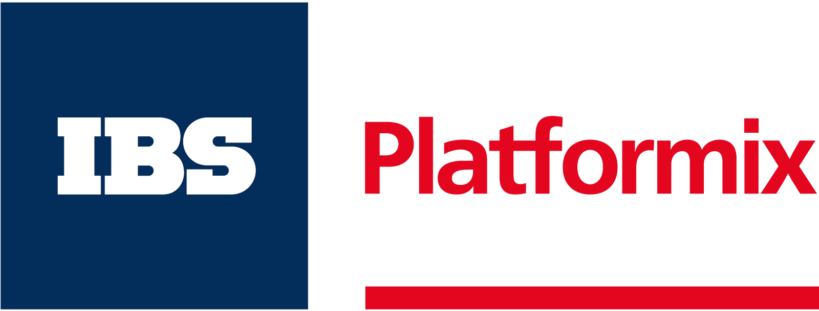
Agenda:
A brief history of Storage
Storage Evolution. Challenges and Trade-Off’s of storage design
ScaleIO
Conclusion

Slide 3
1:
A brief history of storage

Slide 4
Dell+Nutanix
OEM agreement
(Dell XC)
RAID
VMware GSX & ESX
EMC Symmetrix
The first array-based replication
The first 1TB-array
The first platform independent storage
(Mainframe + Open Systems)
Market to support
the HCA hype:
VCE VxRail
VMware VSAN 6.2
Cisco HyperFlex
HPE CSA
Intel x86 in Symm
Storage Federation
Nutanix
HDS focused
on storage arrays
1987
1990
1994-95
2000
2001
2009
2014
2016

Slide 5
Dell+Nutanix
OEM agreement
(Dell XC)
RAID
VMware GSX & ESX
EMC Symmetrix
The first array-based replication
The first 1TB-array
The first platform independent storage
(Mainframe + Open Systems)
Market to support
the HCA hype:
VCE VxRail
VMware VSAN 6.2
Cisco HyperFlex
HPE CSA
Intel x86 in Symm
Storage Federation
Nutanix
HDS focused
on storage arrays
1987
1990
1994-95
2000
2001
2009
2014
2016

Slide 6
Dell+Nutanix
OEM agreement
(Dell XC)
RAID
VMware GSX & ESX
EMC Symmetrix
The first array-based replication
The first 1TB-array
The first platform independent storage
(Mainframe + Open Systems)
Market to support
the HCA hype:
VCE VxRail
VMware VSAN 6.2
Cisco HyperFlex
HPE CSA
Intel x86 in Symm
Storage Federation
Nutanix
HDS focused
on storage arrays
1987
1990
1994-95
2000
2001
2009
2014
2016

Slide 7
Dell+Nutanix
OEM agreement
(Dell XC)
RAID
VMware GSX & ESX
EMC Symmetrix
The first array-based replication
The first 1TB-array
The first platform independent storage
(Mainframe + Open Systems)
Market to support
the HCA hype:
VCE VxRail
VMware VSAN 6.2
Cisco HyperFlex
HPE CSA
Intel x86 in Symm
Storage Federation
Nutanix
HDS focused
on storage arrays
1987
1990
1994-95
2000
2001
2009
2014
2016

Slide 8
Dell+Nutanix
OEM agreement
(Dell XC)
RAID
VMware GSX & ESX
EMC Symmetrix
The first array-based replication
The first 1TB-array
The first platform independent storage
(Mainframe + Open Systems)
Market to support
the HCA hype:
VCE VxRail
VMware VSAN 6.2
Cisco HyperFlex
HPE CSA
Intel x86 in Symm
Storage Federation
Nutanix
HDS focused
on storage arrays
1987
1990
1994-95
2000
2001
2009
2014
2016

Slide 9
Dell+Nutanix
OEM agreement
(Dell XC)
RAID
VMware GSX & ESX
EMC Symmetrix
The first array-based replication
The first 1TB-array
The first platform independent storage
(Mainframe + Open Systems)
Market to support
the HCA hype:
VCE VxRail
VMware VSAN 6.2
Cisco HyperFlex
HPE CSA
Intel x86 in Symm
Storage Federation
Nutanix
HDS focused
on storage arrays
1987
1990
1994-95
2000
2001
2009
2014
2016

Slide 10
Dell+Nutanix
OEM agreement
(Dell XC)
RAID
VMware GSX & ESX
EMC Symmetrix
The first array-based replication
The first 1TB-array
The first platform independent storage
(Mainframe + Open Systems)
Market to support
the HCA hype:
VCE VxRail
VMware VSAN 6.2
Cisco HyperFlex
HPE CSA
Intel x86 in Symm
Storage Federation
Nutanix
HDS focused
on storage arrays
1987
1990
1994-95
2000
2001
2009
2014
2016

Slide 11
2:
Evolution of Storage

Slide 12
Discretization
Distributed Apps
Cloud-Native
Dell+Nutanix
OEM agreement
(Dell XC)
RAID
VMware GSX & ESX
EMC Symmetrix
Federation
Private Cloud
The first array-based replication
The first 1TB-array
The first platform independent storage
(Mainframe + Open Systems)
Market to support
the HCA hype:
VCE VxRail
VMware VSAN 6.2
Cisco HyperFlex
HPE CSA
Direct Attached Storage
Consolidation:
Storage Area Network, Network Attached Storage
Data Consolidation, Data Protection,
Concentrated workloads
Intel x86 in Symm
Storage Federation
Nutanix
HDS focused
on storage arrays
1987
1990
1994-95
2000
2001
2009
2014
2016

Slide 13
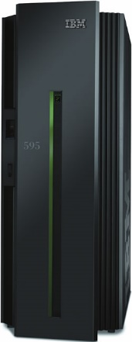
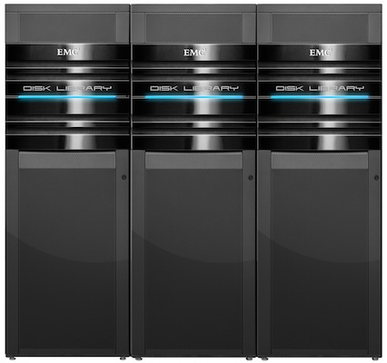
Phase 1: Consolidation
Monolithic systems
Scales “vertically”
Quite expensive
Great for consolidated workloads
Great for “Unparalleled” workloads

Slide 14
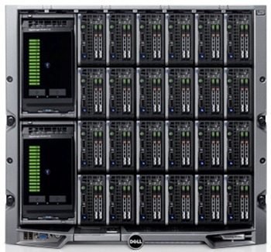
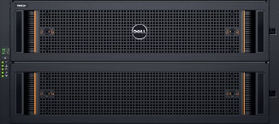
Phase 2: Federation
Data Center consists of individual “Blocks”
Data Center scales-out horizontally
Provides exceptionally high level of availability (99.9990% – 99.9999%)
Main application fields are still from consolidated to semi-distributed workloads and ordinary enterprise tasks

Slide 15
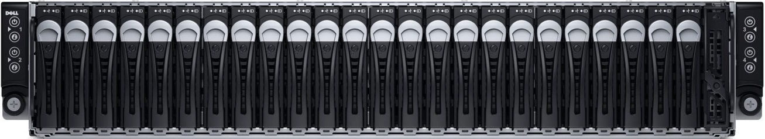
Phase 3: Dispersed
Data Center consists of individual “Nodes”
Data Center scales-out horizontally
Great for distributed workloads
Fundamental for Hyper-Convergence

Slide 16
Storage design challenges and trade-off
Challenges are always the same:
Reliability
Performance
Scale
Cost

Slide 17
Storage design challenges and trade-off
Consolidated Storage
- Ease of management
- Centralized Control-Plane
- High Performance (for consolidated workloads)
Distributed Storage
- Massive Saleability
- High Performance (for highly parallel workloads)
Federated
Consolidated
Dispersed

Slide 18
Example: Luster File System
Luster Client
Metadata Server
OST1
OST2
OST3
…

Slide 19
Example: Luster File System
Classic (Consolidated) storage
Luster Client
Metadata Server
OST1
OST2
OST3
…
Massive Scale

Slide 20
Storage design challenges and trade-off
Storage Appliance (HW+SW)
- Fully tested. Reliable.
- Single-vendor support for HW+SW
Software Storage
- HW-agnostic
- Independent Lifecycle
- Should deliver lower TCO

Slide 21
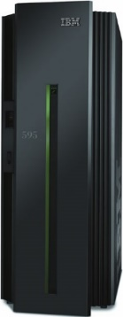
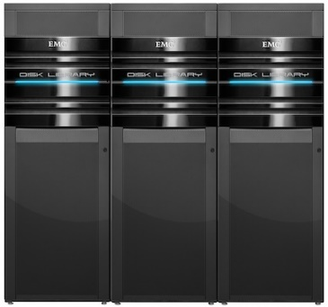
Storage design challenges and trade-off
Dedicated Storage
- Abstracted from compute.
- Reliable. Well-known.
- Independent scaling
Converged Storage
- Easier to manage
- Simple, discrete architecture
- Linear scaling of compute+storage

Slide 22
3:
ScaleIO

Slide 23
ScaleIO
What is ScacleIO?
Software-Defined Storage
Deployed on standard x86 Servers
Scales linearly upto 1000s of nodes
And it’s a Block Storage! (suits for traditional consolidated applications)

Slide 24
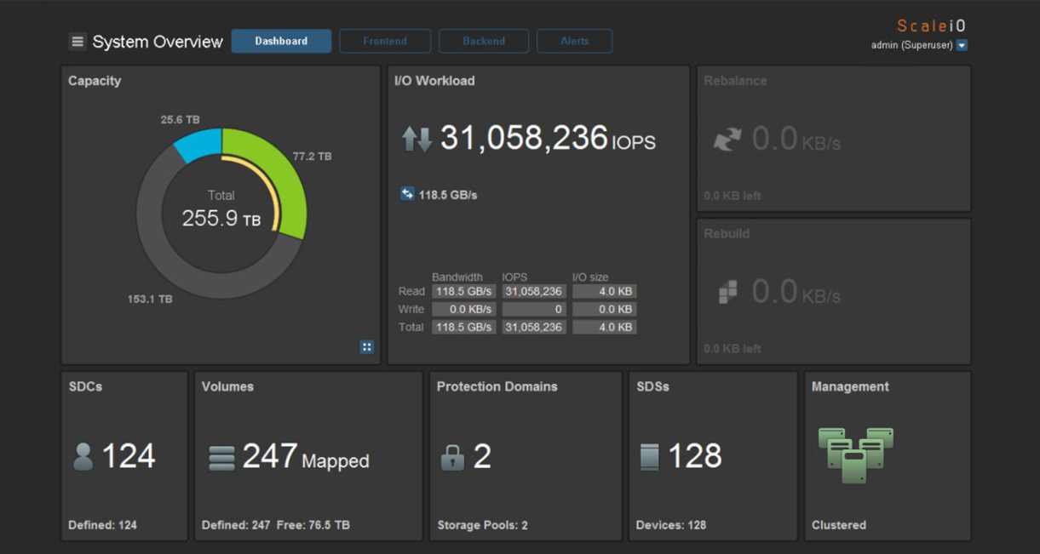

Slide 25
ScaleIO Benefits
MASSIVE SCALABILITY
EXTREME PERFORMANCE
SUPREME ELASTICITY
UNPARALLELED FLEXIBILITY
COMPELLING ECONOMICS
Unique ability to grow from 3 to 1,000+ nodes
Tens of millions of IOPS; linear performance growth
Scale up or down, in or out with no downtime
Choice of deployment; infrastructure agnostic; management & features
Greater TCO savings vs. traditional SAN
Notes:
ScaleIO is software that creates a server-based SAN from local server storage to deliver flexible and scalable performance and capacity on demand. It was designed with enterprise-grade resilience as a must-have to deliver the scalability, elasticity, flexibility and performance needed to meet your business needs, today, and your long term goals for the future. Let’s look at the many benefits it offers.

Slide 26

ScaleIO deployment options
STORAGE ONLY
HYPER-CONVERGED
APPS
APPS &
STORAGE
C
C
C
S
C
S
C
S
C
MORE
STORAGE
APPS &
STORAGE
STORAGE
MORE APPS
& STORAGE
S
C
S
C
S
C
S
S
S
S
C
S
C
S
C
S
S
S
ETH/IB
ETH/IB
Notes:
In a Storage-only Architecture:
The SDC exposes ScaleIO shared block volumes to the application.
Access to OS partition may still be done “regularly”
ScaleIO data client (SDC) is a block device driver
The SDS owns local storage that contributes to the ScaleIO storage pool
ScaleIO data server (SDS) is a daemon / service
In a Hyper-Converged Architecture:
The SDC & SDS reside within the same host
An SDC and an SDS can live together.
SDC serves the I/O requests of the resident host applications.
SDS serves the I/O requests of various SDCs.

Slide 27
High I/O Parallelism
Eliminates single points of failure
No central point of routing
Prevents unnecessary network traffic and redundant SDS resource usage
Allows performance to scale linearly
C
C
C
C
C
S
S
S
S
S
Notes:
This slide shows the power of the distributed architecture of ScaleIO. Every SDC knows how to direct an I/O operation to the destination SDS. There is no flooding or broadcasting. This is extremely efficient parallelism that eliminates single points of failure. Since there is no central point of routing, all of this happens in a distributed manner. Each SDC does its own routing, independent from any other SDC. The SDC has all the intelligence needed to route every request, preventing unnecessary network traffic and redundant SDS resource usage. This is, in effect, a multi-controller architecture that is highly optimized and massively parallel. It allows performance to scale linearly as the number of nodes increases. ScaleIO is capable of handling asymmetric clusters with different capacities and media types.
A fully converged configuration will have even higher parallelism and load distribution between the nodes. Any combination of the fully converged and two-layer configuration options is valid and operational.
Note to presenter: Metadata is not in the data path – removes the scaling limitation that exists within other architectures.

Slide 28
3.8 PB in a single rack
Capacity (PB)
30% more
Notes:
Gen 1 hardware vs Gen 2 hardware
Start small at 144TB and scale to 3.8 PB in a single rack with support of up to 8 sites.

Slide 29
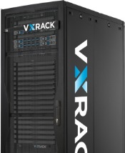

ScaleIO consume options
0101
011011011
0110011011
0010
110
011110010
11011
VCE VxRack
System
with FLEX
ScaleIO Ready
Node
ScaleIO
Software
Software Defined
Maximum flexibility
Lowest Risk, Highest Value,
Lowest TCO
Ultra
Scale-Out SDS
Scale-Out
Block Storage
Turnkey Software Defined IaaS
Software Only
Complete flexibility
End user supplies server
End user supplies switch
End user supplies rack
Dell PowerEdge Servers tuned, optimized and validated for ScaleIO
Hyper-converged or Storage only
All-Flash configurations
Fully productized platform
VCE factory integrated & logically configured
VCE Support & lifecycle assurance
Notes:
EMC ScaleIO has delivered upon the promise of software-defined, scale out, block storage on standard server hardware with extreme performance, massive scale and superior elasticity. Now you can choose how you wish to consume ScaleIO. There are 3 Consumption Models available.
ScaleIO Software: Ultra Scale-out SDS
Software Only
Complete flexibility
End user supplies server
End user supplies switch
End user supplies rack
ScaleIO Ready Node: Scale-out Block Storage Node
Dell PowerEdge Servers tuned, optimized and validated for ScaleIO
Hyper-converged or Storage only
All-Flash configurations
VCE VxRack FLEX: Turnkey Fully Engineered Solution
Fully productized platform
VCE factory integrated & logically configured
VCE Support & lifecycle assurance

Slide 30
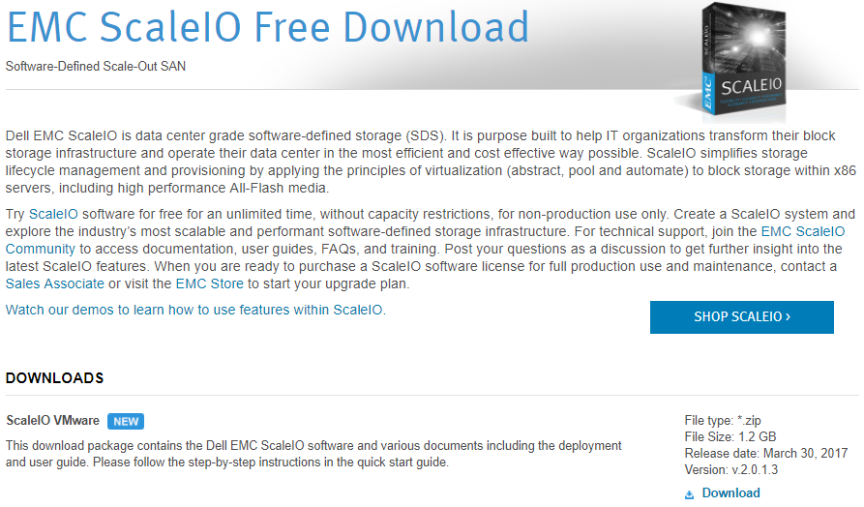
http://emc.com/getScaleio

Slide 31
4:
Conclusion

Slide 32
What is Software-Defined?

Slide 33
Software defines architecture
of IT infrastructure

Slide 34
If an Application has consolidated architecture – it runs best on classic centralized storage
Example: Databases

Slide 35
If an App’s architecture is distributed – it runs best on scale-out distributed storage
Example: VDI, HPC

Slide 36
You chose storage when you design your application.
Storage has been always defined by Software.

Slide 37
Choose your application architecture smart!

Slide 38
What is Software-Defined Storage?

Slide 39
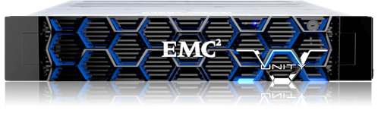
What is Software-Defined Storage?
Dell EMC Unity

Slide 40
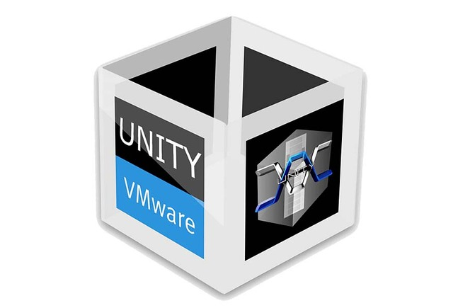
What is Software-Defined Storage?
Dell EMC Unity
Unity VSA
emc.com/getUnity

Slide 41
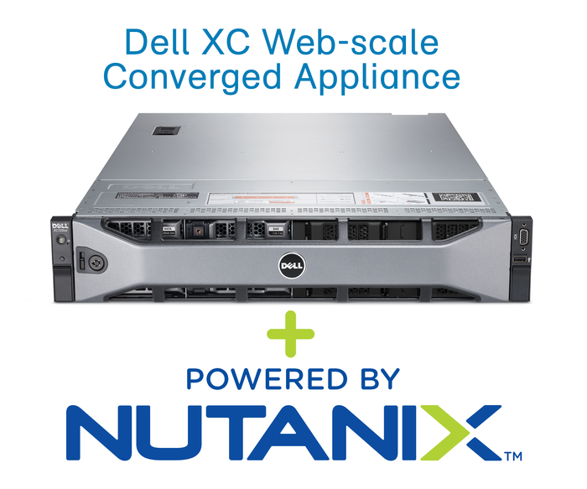
What is Software-Defined Storage?

Slide 42
What is Software-Defined Storage?
- Tightly coupled with hardware
- No license migration

Slide 43
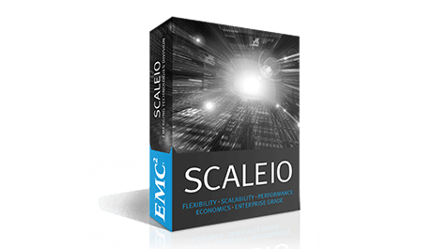
What is Software-Defined Storage?
Dell EMC ScaleIO

Slide 44
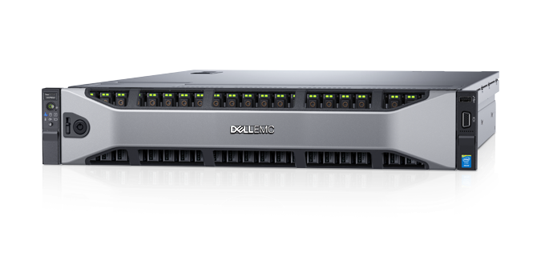
What is Software-Defined Storage?
Dell EMC ScaleIO Ready Nodes

Slide 45
What is Software-Defined Storage?

Slide 46
What is Software-Defined Storage?
Definitely, not a technology.

Slide 47
(it might be a synonym for a any storage in general)

Slide 48
(or a euphemism for a case when storage vendor doesn’t sell servers)

Slide 49
What is Software-Defined Storage?
It’s a way of purchasing storage

Slide 50
Storage has been always defined by Software.
Design your application architecture carefully, cause it will define whole infrastructure effectively

