Slide 1
NICA Computing
NEC’2017 27-09-2017
A.G.Dolbilov
Yu.I.Minaev
B.G.Shchinov
I.V.Slepnev

Slide 2
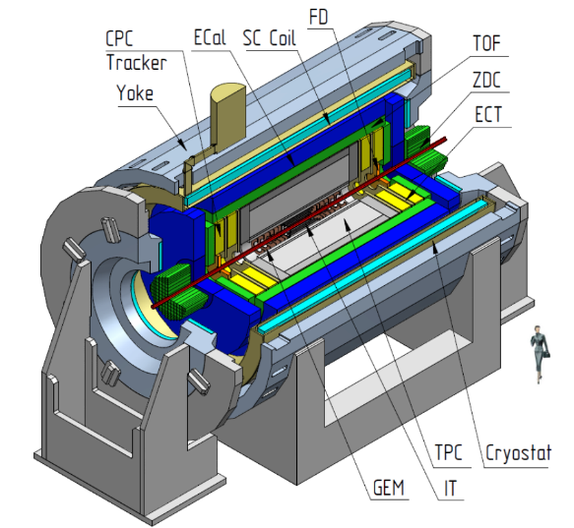
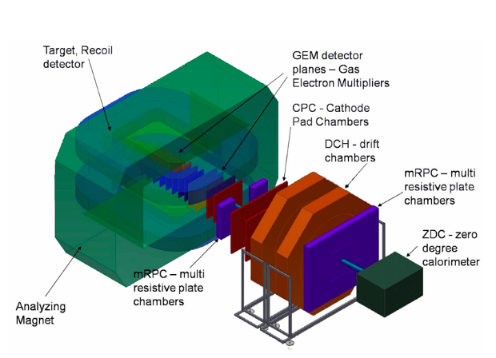
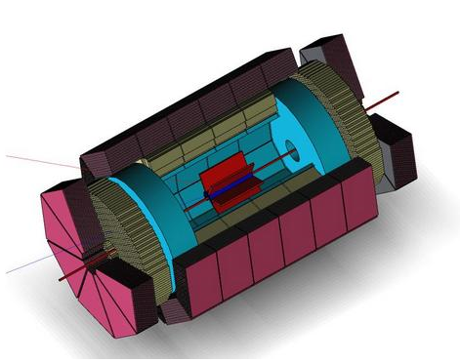
NICA Detectors
BM&N
MPD 2020
SPD 2023

Slide 3
Computing for NICA based on
Type of the processing model
Data flow
Requirements for the organization of computing
NICA local and external network
ON-Line and OFF-Line Computing and Storage farms
Monitoring computing environment for NICA complex

Slide 4
Required knowledge for NICA Computing
what kind of data
what's the data frequency
what is the volume of
what volume and how long to store on-line
what volume is taken off-line
what is the volume move to the archival tapes
how many months a year working complex ( by years)
how many years working installation
how much Monte Carlo is needing
how many physicists will take this process and where
how many copies and what should be kept forever

Slide 5
MPD Data Types
Acronym | Description | Persistency
RAW | Raw data as it comes from the detector | Transient
ESD | Event Summary Data. Auxiliary data to CTF containing the output of the reconstruction process linking the tracks and clusters | Temporary
MC | Monte Carlo. Simulated energy deposits in sensitive detectors. Removed once the reconstruction of MC data is completed | Transient
AOD | Analysis Object Data containing the real track parameters in a given vertex and for a given physics event. AODs are collected on dedicated facilities for subsequent analysis | Persistent
MCAOD | Analysis Object Data for a given simulated physics event. Same as AOD with addition of kinematic information that allows comparison to MC. MCAODs are collected on dedicated facilities for subsequent analysis | Persistent

Slide 6
MPD Estimated Event Size
Detector | Number of FEE Channels | Channel Occupancy | Information Type | Event Size (KiB) | Readout Rate (MiB/s)
CPC | 10000 | ⎯ | Timestamp | ⎯ | < 100
FFD | 96 | ⎯ | Timestamp | ⎯ | < 100
ZDC | 96 | ⎯ | ADC Samples | ⎯ | < 100
*IT | ⎯ | ⎯ | ADC Samples | ⎯ | ⎯
TOF/Barrel | 13440 | 0.15 | Timestamp+ Width 12bytes | 24 | 162
TOF/Endcap | 6720 | 0.15 | Timestamp+ Width 12bytes | 24 | 81
ECal/Barrel | 22680 | 0.09 | ADC Samples, 30 bytes | 122 | 417
ECal/ Endcap | 45360 | 0.09 | ADC Samples, 30 bytes | 122 | 834
TPC | 95232 | 0.6 | ALTRO code, 12 bytes | 670 | 7000 (Peak 20000)
 |  |  |  | ~1000 | ~10000

Slide 7
The required number of cores Intel® Xeon® v4 2.60GHz
Detector | Average Data Rate, MiB/s | # of streams | FLP CPU cores | EvB-1 CPU cores | EvB-2 CPU cores | lossless LZ compression |  | 5% online reconstru-ction | Total CPU cores
CPC | 50 |  | 1,4 |  |  | 6,3
FFD | 50 |  | 1,4 |  |  | 6,3
ZDC | 50 |  | 1,4 |  |  | 6,3
*IT | ⎯ |  | ⎯ |  |  | ⎯
TOF/Barrel | 162 |  | 4,6 |  |  | 20,3
TOF/Endcap | 81 |  | 2,3 |  |  | 10,1
ECal/Barrel | 834 | 720 | 720,0 |  |  | 104,3
ECal/ Endcap | 417 | 360 | 360,0 |  |  | 52,1
TPC | 7000 (Peak 20000) | 24 | 200,0 |  |  | 1250,0
Total | 8644 |  | 1291,2 | 123,5 | 123,5 | 1080,5 |  | 350 | 2969
 |  |  |  | idial CPU |  |  | real CPU
FLP Stream speed, MB/s/CPU |  |  |  | 50 |  |  | 35
EvB speed, MB/s/CPU |  |  |  | 100 |  |  | 70
Compression speed, MB/s/CPU |  |  |  | 12 |  |  | 8
CPU Utilization efficiency |  |  |  |  |  |  | 70%

Slide 8
MPD Channels: DAQ - ON-Line
~1471 channel with 1 Gbps and 10 Gbps
The “peak” speed from MPD detectors can reach up to 1200 Gbps

Slide 9
MPD Network: DAQ - On-Line
Switches wiring diagram of the MPD detector

Slide 10
MPD On/Off-Line farm Network infrastructure
Example of structural diagram of On-Line NICA cluster based on Spine & Leaf topology

Slide 11
NICA Cluster: structured scheme
Scheme of NICA distributed cluster with shared file systems such as GlusterFS, Ceph, EOS...

Slide 12
NICA Network: external logical scheme LHEP <> LIT
The core of the network system, switching will be performed on the Cisco Nexus 9504 4 x 100Gbps

Slide 13
NICA Network: external LHEP <> LIT
2 new cable line between the sites LIT and LHEP for NICA complex. ~4.7Km

Slide 14
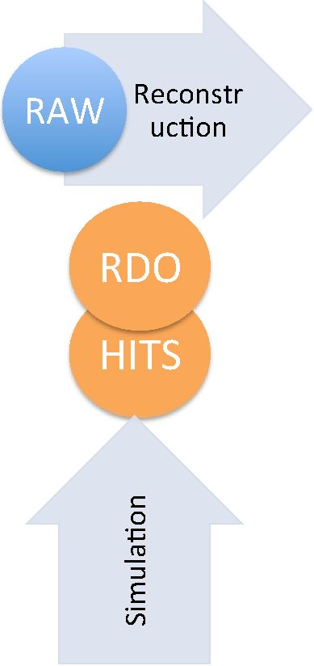
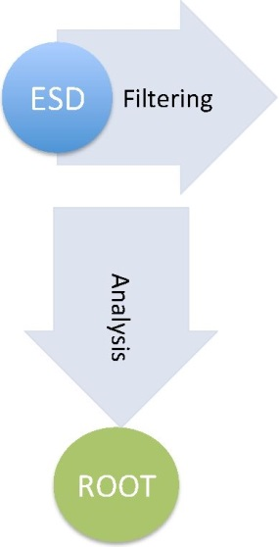
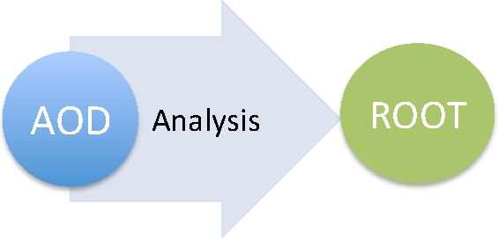
Data flow and processing model by Alice

Slide 15
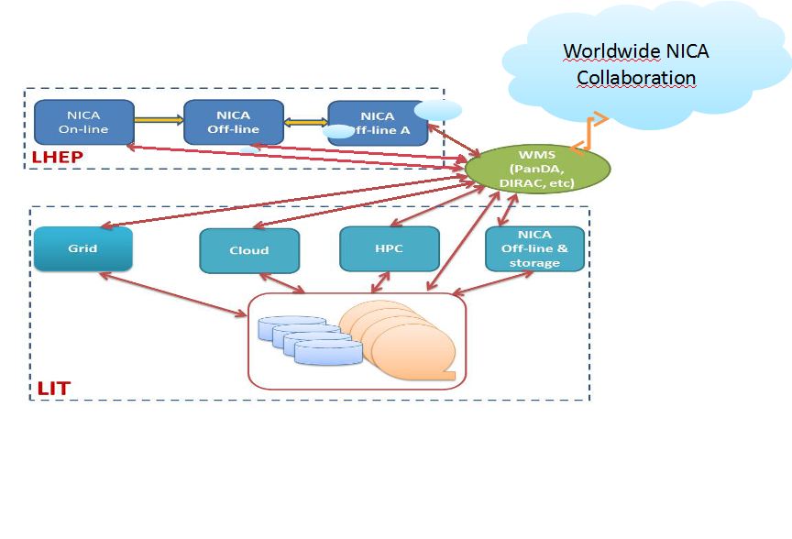
NICA distributed model of data processing

Slide 16
LIT VMs HPC Cluster

Slide 17
Computing for ON/OFF-Line Cluster
 | ON-Line | OFF-Line | LIT
Network | 2 x 100 Gbps | 2 x 100Gbps | 2 x 100Gbps
File System | CEPF | Gluster | EOS
Batch System | - | SGE | HTCondor
Distributed computing infrastructure | - | AliEn, PanDA, DIRAC… | AliEn, PanDa, DIRAC…

Slide 18
Monitoring
Hierarchical monitoring
Centralization of each part of monitoring
Distributed to different sites for reliability

Slide 19
Monitoring NICA

Slide 20
Thank You
NEC’2017 27-09-2017

Slide 21
BM&N Network: DAQ
The “peak” speed from BM&N detectors can reach up to 20 Gbps

Slide 22
Computing for MPD NICA

