Slide 1
Federated Data Storage System Prototype for LHC experiments
and data intensive science
Andrey Kiryanov, Alexei Klimentov,
Artem Petrosyan, Andrey Zarochentsev
on behalf of BigData lab @ NRC “KI” and
Russian Federated Data Storage Project
1
Notes:
1

Slide 2
Russian federated data storage project
In the fall of 2015 the “Big Data Technologies for Mega-Science Class Projects" laboratory at NRC "KI" has received a Russian Fund for Basic Research (RFBR) grant to evaluate federated data storage technologies.
This work has been started with creation of a storage federation for geographically distributed data centers located in Moscow, Dubna, St. Petersburg, and Gatchina (all are members of Russian Data Intensive Grid and WLCG).
This project aims at providing a usable and homogeneous service with low requirements for manpower and resource level at sites for both LHC and non-LHC experiments.

Slide 3
Basic Considerations
Single entry point
Scalability and integrity: it should be easy to add new resources
Data transfer and logistics optimisation: transfers should be routed directly to the closest disk servers avoiding intermediate gateways and other bottlenecks
Stability and fault tolerance: redundancy of core components
Built-in virtual namespace, no dependency on external catalogues.
EOS and dCache seemed to satisfy these requirements.

Slide 4
Federation topology
RUSSIA
EOS
dCache
SPbSU
PNPI
JINR
NRC «KI»
SINP MSU
MEPhI
ITEP
CERN
DESY

Slide 5
Initial testbed proof of concept tests and optimal settings evaluation
CERN
PNPI
SPbSU
Managers: entry point, virtual name space. Metadata sync between managers.
File servers: Data storage servers.
Clients: user interface for synthetic and real-life tests.
Managers
PNPI
Metadata
PNPI
SPbSU
SINP
MEPhI
SPbSU
File I/O
JINR
NRC “KI”
ITEP
CERN
File servers
Clients: xrootd client, voms client,
test and expriment tools

Slide 6
Extended testbed for full-scale testing
Managers: entry point, virtual name space. Metadata sync between managers.
File servers: data storage servers. Two types of storages – highly reliable and normal.
Clients: user interface for synthetic and real-life tests.
NRC “KI”
JINR
NRC “KI”
Default FST
Managers
Metadata
JINR
PNPI
SPbSU
SINP
MEPhI
SINP
File I/O
JINR
NRC “KI”
ITEP
CERN
MEPhI
Clients: xrootd client, voms client,
test and expriment tools
File servers

Slide 7
Test goals, methodology and tools
Goals:
Set up a distributed storage, verify basic properties, evaluate performance and robustness
Data access, reliability, replication
Tools:
Synthetic tests:
Bonnie++: file and metadata I/O test for mounted file systems (FUSE)
xrdstress: EOS-bundled file I/O stress test for xrootd protocol
Experiment-specific tests:
ATLAS TRT Athena-based reconstruction program for high multiplicity (I/O and CPU intensive)
ALICE ROOT-based event selection program (I/O intensive)
Network monitoring:
perfSONAR: a widely-deployed and recognized tool for network performance measurements
Software components:
Base OS: CentOS 6, 64bit
Storage system: EOS Aquamarine, dCache 2.16
Authentication scheme: GSI / X.509
Access protocol: xrootd

Slide 8
Network performance measurements
Throughput
> 100Mb/s
10Mb/s ÷ 100Mb/s
< 10Mb/s
No data
X
Throughput from
Site X to Site Y
Y
Throughput from
Site Y to Site X

Slide 9
Bonnie++ test with EOS on initial testbed: MGM at CERN, FSTs at SPbSU and PNPI
Data read-write
Metadata create-delete
pnpi-local – local test on PNPI FST
spbu-local – local test on SPbSU FST
pnpi-all – UI at PNPI, MGM at CERN, Federated FST
spbu-all – UI at SPbSU, MGM at CERN, Federated FST
cern-all – UI at CERN, MGM at CERN, Federated FST
sinp-all – UI at SINP, MGM at CERN, Federated FST
cern-pnpi – UI at CERN, MGM at CERN, FST at PNPI
cern-spbu – UI at CERN, MGM at CERN, FST at SPbSU
metadata I/O performance depends solely on a link between client and manager
data I/O performance does not depend on a link between client and manager

Slide 10
Experiment-specific tests with EOS for two protocols: pure xrootd and locally-mounted file system (FUSE)
Experiment’s applications are optimized for different protocols (remote vs. local)

Slide 11
Our first experience with EOS and intermediate conclusion
Basic stuff works as expected
Some issues were discovered and communicated to developers
Metadata I/O performance depends solely on a link between client and manager while data I/O performance does not depend on it
Experiment-specific tests for different data access patterns have contradictory preferences with respect to data access protocol (pure xrootd vs. FUSE-mounted filesystem)

Slide 12
Data placement policies
Number of data replicas depends from data family (replication policy has to be defined by experiments / user community);
Federated storage may include reliable sites(“T1s”) and less reliable sites (“Tns”);
Taking aforementioned into account we have three data placement scenarios which can be individually configured per dataset:
Scenario 0: Dataset is randomly distributed among several sites
Scenario 1: Dataset is located as close as possible to the client. If there’s no close storage, the default reliable one is used (NRC “KI” in our tests)
Scenario 2: Dataset is located as in scenario 1 with secondary copies as in scenario 0
These policies can be achieved with EOS geotags and dCache pool and replica managers.

Slide 13
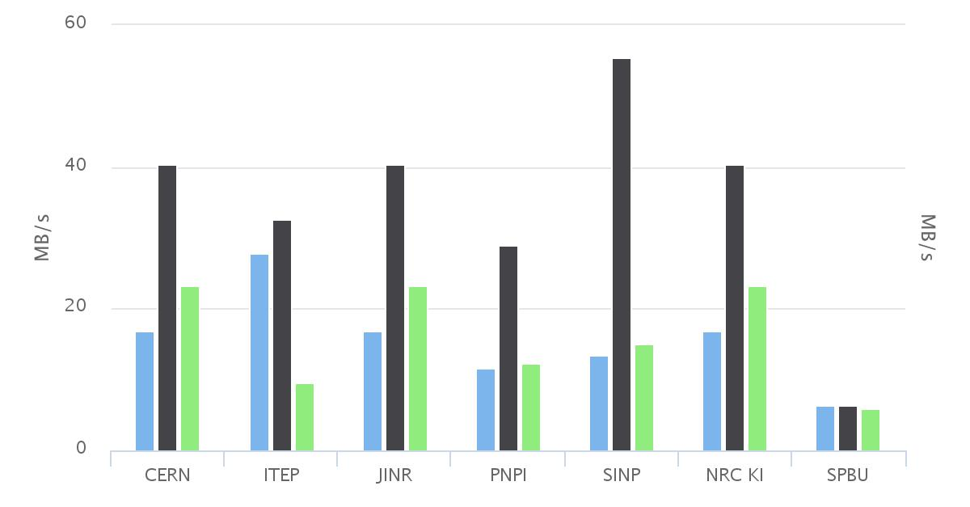
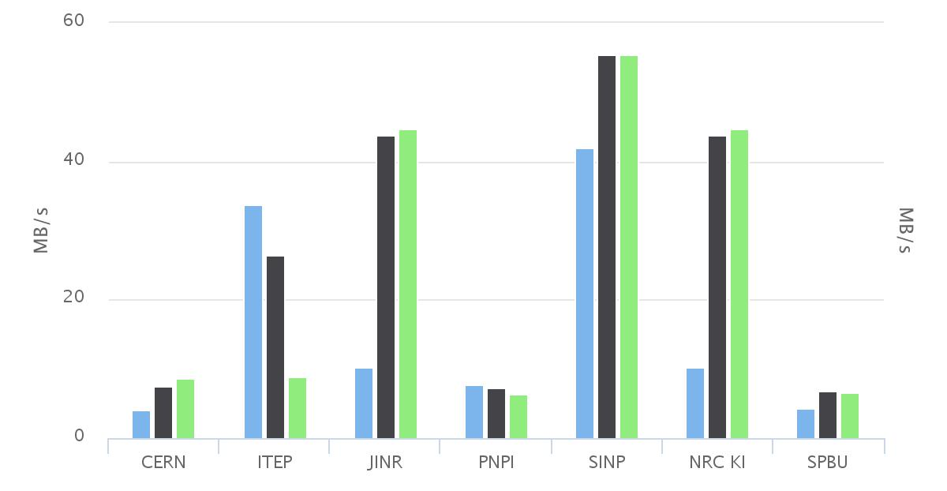
Synthetic data placement stress test for EOS
Stress test procedure is as follows:
Scenario 0: Files are written to and read from random file servers
Scenario 1: Files are written to and read from a closest file server if there is one or the default file server at NRC “KI”
Scenario 2: Primary replicas are written as in Scenario 1, secondary replicas as in Scenario 0. Reads are redirected to a closest file server if there is one or to the default file server at NRC “KI”
– this client can find data on a closest file server
– closest and default file server is the same
Xrootd write stress test
Presence of the closest server does not bring much of improvement, but presence of the high-performance default one does. Replication slows down data placement because EOS creates replicas during the transfer.
Xrootd read stress test

Slide 14
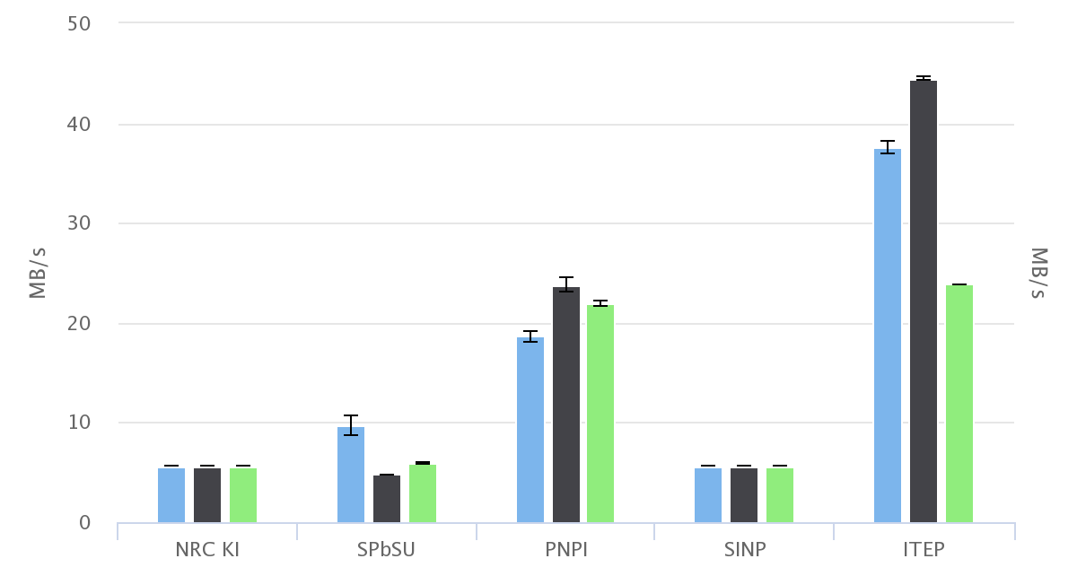
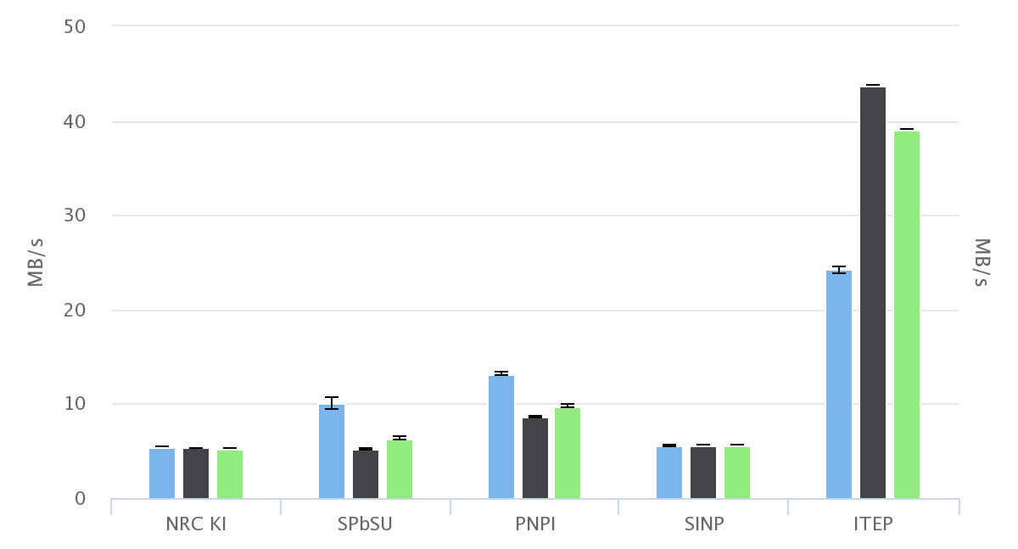
Synthetic data placement stress test for dCache
Stress test procedure is as follows:
Scenario 0: Files are randomly scattered among several file servers
Scenario 1: Files are written to and read from a closest file server if there is one or the default file server at NRC “KI”
Scenario 2: Primary replicas are written as in Scenario 1, secondary replicas as in Scenario 0. Reads are redirected to a closest file server if there is one or to the default file server at NRC “KI”
– this client can find data on a closest file server
– closest and default file server is the same
Xrootd write stress test
dCache creates replicas in the background after the transfer.
Xrootd read stress test

Slide 15
First experience with dCache
Well-known and reliable software used on many T1s
Different software platform (Java) and protocol implementations
dCache xrootd implementation does not support FUSE mounts
This is supposed to be fixed in dCache 3 within a collaborate project between NRC “KI”, JINR and DESY (thanks to Ivan Kadochnikov)
No built-in security for control channel between Manager and File servers
Firewall-based access control works well for a single site
This is solved by stunnel in dCache 3, but we didn’t have a chance to test it yet
No built-in Manager redundancy
Also part of dCache 3 feature set

Slide 16
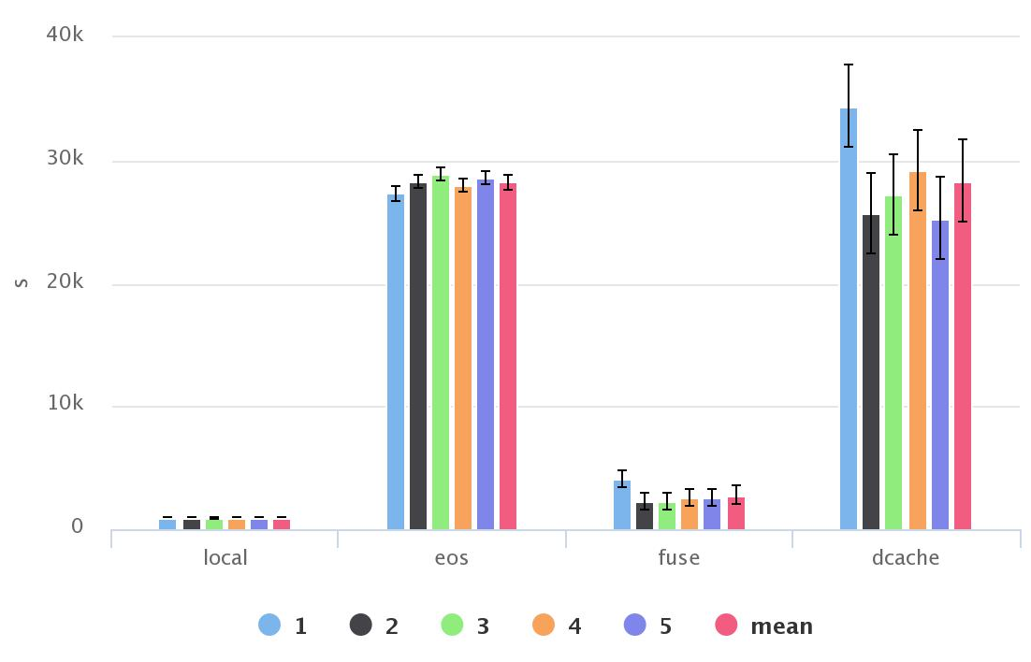
ATLAS test on initial testbed for different protocols.
Times of five repetitions of the same test along with a mean value.
Four test conditions on the same federation: local data, data on EOS accessed via xrootd, data on EOS accessed via FUSE mount, data on dCache accessed via xrootd.
As we can see, first FUSE test with a cold cache takes a bit more time than the rest, but it’s still much faster than accessing data directly via xrootd.
First run with dCache also shows this pattern (internal cache warm-up?)
Tests were run from PNPI UI

Slide 17
Summary
We have set up a working prototype of federated storage:
Seven Russian WLCG sites organized as one homogeneous storage with single entry point
All basic properties of federated storage are respected
We have conducted an extensive validation of the infrastructure using synthetic and experiment-specific tests
We have exploited EOS as our first technological choice and we have enough confidence to say that it behaves well and has all the features we need
We have finished testing of dCache 2 and our first results look very promising. We’re on our way to dCache 3 testing.
One of the major concerns expressed so far was xroot not being a standard protocol. While standard HTTP clearly misses some of the necessary features, HTTP/2 feature set looks much closer to what we need.
We need a well-defined standard protocol supported by major software stacks as both EOS and dCache are going to stick around for at least another decade.

Slide 18
Acknowledgements
This talk drew on presentations, discussions, comments and input from many. Thanks to all, including those we’ve missed.
P. Hristov and D. Krasnopevtsev for help with experiment-specific tests.
A. Peters for help with undestending EOS internals.
P. Fuhrmann and dCache core team for help with dCache.
This work was funded in part by the Russian Ministry of Science and Education under Contract No. 14.Z50.31.0024 and by the Russian Fund for Fundamental Research under contract “15-29-0794_2 офи_м”
Authors express appreciation to SPbSU Computing Center, PNPI Computing Center, NRC “KI” Computing Center, JINR Cloud Services, ITEP, SINP and MEPhI for provided resources.

Slide 19
Thank you!

