Slide 1
HEP Computing Tools for Brain Studies
R. Mashinistov, A. Beche, K. De, F. Delalondre, A. Klimentov and
F. Schuermann
University of Texas at Arlington (UTA) (Arlington, TX USA)
Brookhaven National Laboratory (BNL) (Brookhaven, NY USA)
École polytechnique fédérale de Lausanne (EPFL) (Lausanne, Switzerland)
National Research Center “Kurchatov Institute” (NRC KI) (Moscow, Russia)

Slide 2
Outline
Introduction
PanDA - Production and Distributed Analysis Workload Management System
Extending PanDA beyond Grid
Blue Brain Project (BBP) computing model
PanDA portal at BBP
Summary & conclusions

Slide 3
Introduction
In Mar 2017 we launched the pilot project with Blue Brain Project (BBP, Swiss Federal Institute of Technology in Lausanne).
The proof of concept project aimed to demonstrate efficient application of the (Big,mega)PanDA Workload Management System, initially developed for HEP applications, for the supercomputer-based reconstructions and simulations offering a radically new approach for understanding the multilevel structure and function of the brain.
In the first phase, the goal of this joint project is to automate BBP workflow execution on a variety of distributed computing systems.

Slide 4
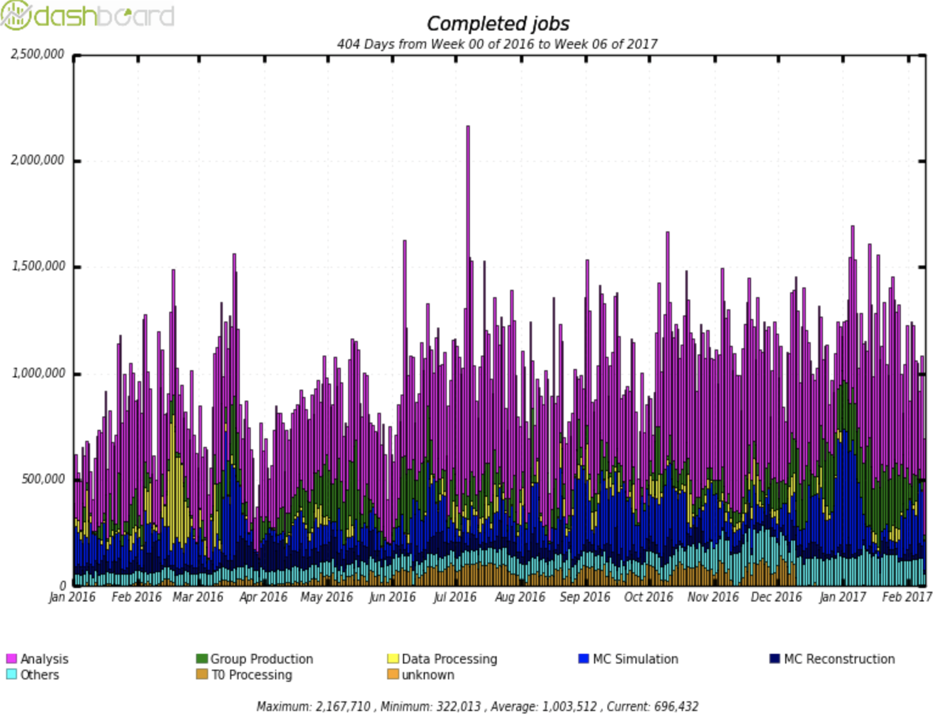
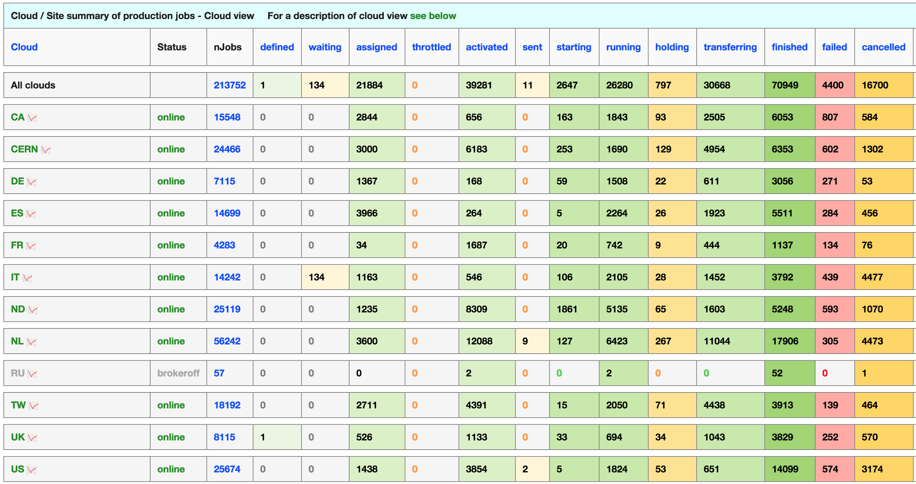
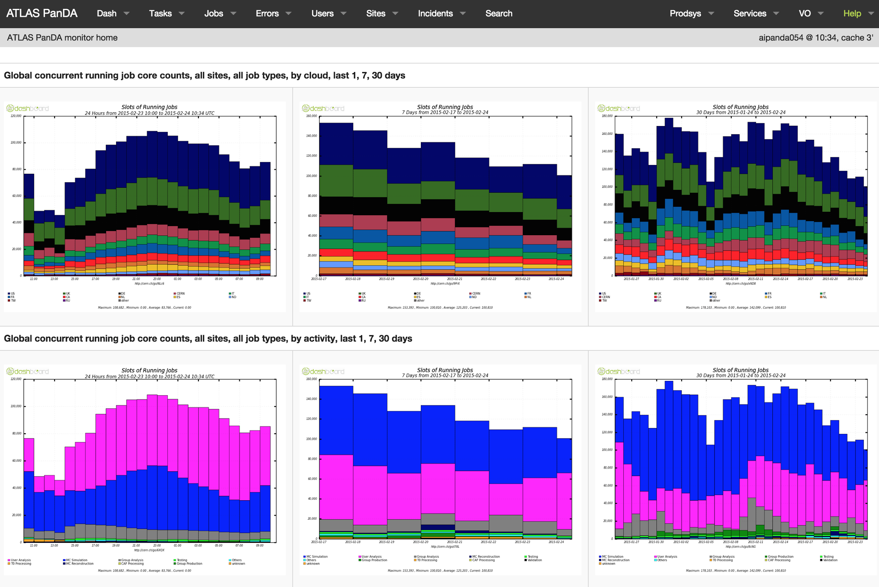
Workflow Management. PanDA. Production and Distributed Analysis System
https://twiki.cern.ch/twiki/bin/view/PanDA/PanDA
PanDA Brief Story
2005: Initiated for US ATLAS (BNL and UTA)
2006: Support for analysis
2008: Adopted ATLAS-wide
2009: First use beyond ATLAS
2011: Dynamic data caching based on usage and demand
2012: ASCR/HEP BigPanDA
2014: Network-aware brokerage
2014 : Job Execution and Definition I/F (JEDI) adds complex task management and fine grained dynamic job management
2014: JEDI- based Event Service
2014:megaPanDA project supported by RF Ministry of Science and Education
2015: New ATLAS Production System, based on PanDA/JEDI
2015 :Manage Heterogeneous Computing Resources
2016: DOE ASCR BigPanDA@Titan project
2016:PanDA for bioinformatics
2016:COMPASS adopted PanDA (JINR, CERN, NRC-KI), NICA (JINR)
PanDA beyond HEP : LSST, BlueBrain
Global ATLAS operations
Up to ~250k concurrent jobs
25-30M jobs/month at >150 sites
~1400 ATLAS users
First exascale workload manager in HENP
1.4 Exabytes processed in 2016
Exascale scientific data processing today
BigPanDA Monitor
http://bigpanda.cern.ch/
ATLAS Production System Performance. Daily Completed Jobs.

Slide 5
Extending PanDA to Supercomputers
BigPanDA is an extension of the PanDA WMS to run ATLAS and non-ATLAS applications on Leadership Class Facilities and supercomputers, as well as traditional grid and cloud resources.
Use of supercomputers in ATLAS
Supercomputing centers in USA, Europe, and Asia, in particular the Titan supercomputer at Oak Ridge Leadership Computing Facility (OLCF), the National Energy Research Supercomputing Center (NERSC) in USA, Ostrava supercomputing center in Czech Republic, and “Kurchatov Institute” in Russia (NRC KI) are now integrated within the ATLAS workflow via the PanDA WMS.
PanDA is a pilot based WMS. Using a pilot and pilot submission system customized for actual SC allows to integrate any opportunistic resources
Each supercomputer is unique: Unique architecture and hardware, Specialized Operating System, “weak” worker nodes, limited memory per worker node, different job submission systems, Unique security environment, Own usage policy etc.
See also J.Wells,D.Oleynik and M.Borodin talks

Slide 6
Extending PanDA beyond HEP. BigPanDA in Genomics
At NRC KI PALEOMIX pipeline was adapted to run on local supercomputer resources powered by PanDA.
It was used to map mammoth DNA on the African elephant reference genome
Using software tools developed initially for HEP and Grid reduced genomics payload execution time for Mammoths DNA sample from weeks to days.
~ 4-5 weeks
135
chunks
…
~ 4 days
PanDA

Slide 7
Blue Brain Project – a Swiss Brain Initiative
The goal of the Blue Brain Project is to build biologically detailed digital reconstructions and simulations of the rodent, and ultimately the human brain.
The supercomputer-based reconstructions and simulations built by the project offer a radically new approach for understanding the multilevel structure and function of the brain.
The novel research strategy allows the project to build computer models of the brain at an unprecedented level of biological detail.
Supercomputer-based simulation turns understanding the brain into a tractable problem, providing a new tool to study the complex interactions within different levels of brain organization and to investigate the cross-level links leading from genes to cognition.
http://bluebrain.epfl.ch

Slide 8
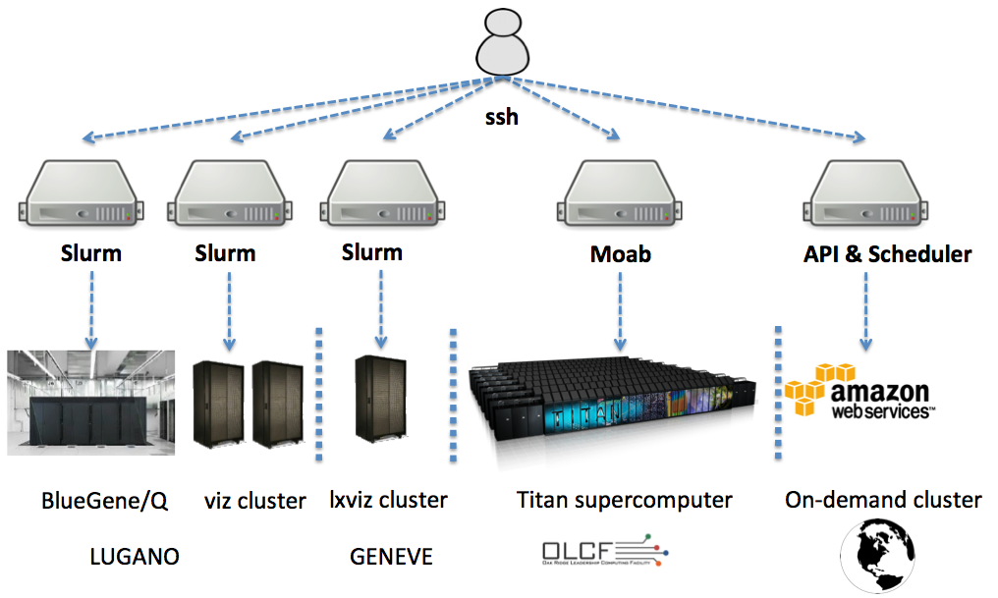
BBP Target resources

Slide 9
BBP resources metrics
Intel x86-NVIDIA GPU based BBP clusters located in Geneva (47 TFlops) and Lugano (81 TFlops)
BBP IBM BlueGene/Q supercomputer ( 0.78 PFlops and 65 TB of DRAM memory) located in Lugano
Titan Supercomputer with peak theoretical performance 27 PFlops operated by the Oak Ridge Leadership Computing Facility (OLCF)

Slide 10
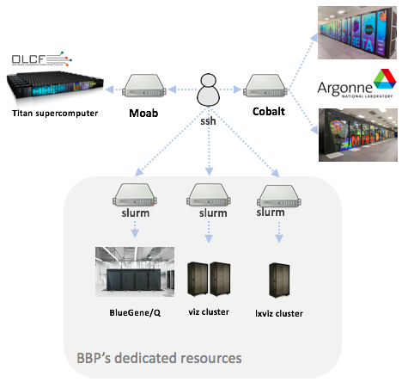
Computing model of the Blue Brain Project
Moving from machine specific setup… to common functional building blocks
Software deployment --> Modules
Data distribution --> Manual method (rsync)
Job scheduling --> site specific scheduler

Slide 11
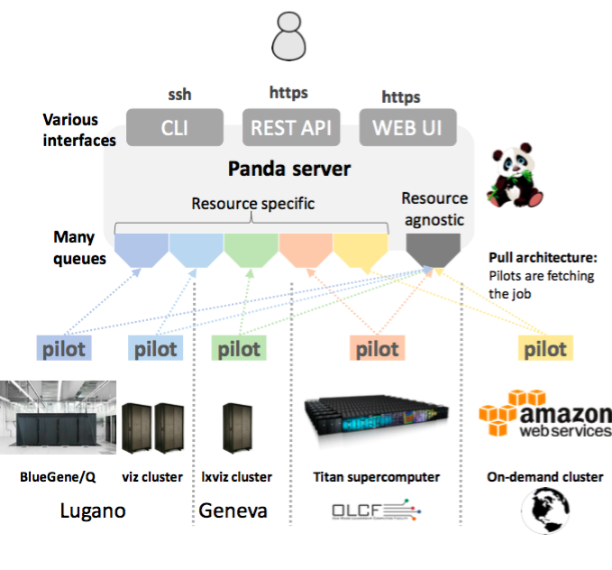
Computing model of the Blue Brain Project
Moving from machine specific setup… to common functional building blocks
Software deployment --> Modules --> NIX
Data distribution --> Manual method (rsync) --> Globus Toolkit
Job scheduling --> site specific scheduler --> BigPanDA
PanDA server

Slide 12
Initial PanDA test @ BBP
For initial test in March 2017 PanDA Server + Client were installed to the VM at the Campus Biotech (Geneva).
Job submission has been done via the python based PanDA Client. Pilot were started manually on Geneve and Lugano clusters including BlueGene/Q, Titan and Amazon resources.
PanDA Server
SQL
PanDA DB
PanDA Client
https
REST API
REST API
https
Pilot
Pilot
Pilot
Resource A
Resource B
Resource Z

Slide 13
PanDA Portal @ BBP (1/2)
Authentication
File Catalog
Data Transfer System
Data Management
System
Web Services
PanDA Server
SQL
PanDA DB
SQL
PanDA Monitor
PanDA Client
https
REST API
REST API
Pilot Scheduler
https
Pilot Scheduler
Pilot
Pilot
Pilot
Resource A
Resource B
Resource Z

Slide 14
PanDA Portal @ BBP (2/2)
Authentication
File Catalog
Data Transfer System
Data Management
System
Web Services
PanDA Portal
PanDA Server
SQL
PanDA DB
SQL
PanDA Monitor
PanDA Client
https
REST API
REST API
Pilot Scheduler
https
Pilot Scheduler
Pilot
Pilot
Pilot
Resource A
Resource B
Resource Z

Slide 15
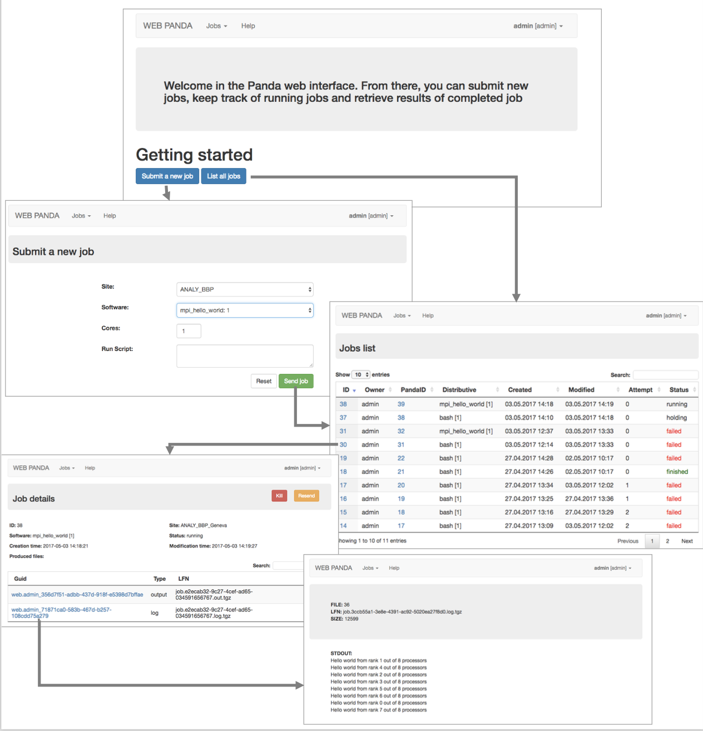
User Interfaces
Web interfaces
submit jobs
monitor jobs
View results summary
Authentication, Authorization
integrated with BBP SSO
ldap groups aware
Multiple available sites (PanDA Queue)

Slide 16
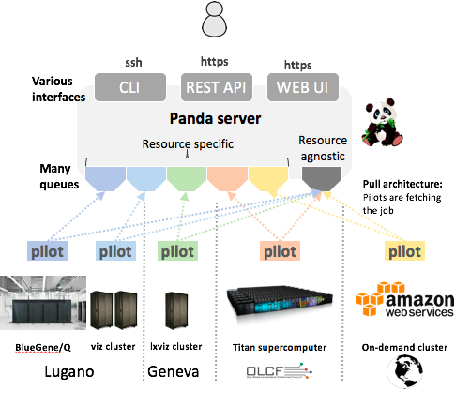
Summary & Conclusion
Phase 1 of “Proof of the concept” was successfully finished
The test jobs were successfully submitted to the targeted resources via PanDA portal.
The project demonstrated that the software tools and methods for processing large volumes of experimental data, which have been developed initially for experiments at the LHC, can be successfully applied to BBP.
Phase 2 of “Pre-production” is under considerations
PanDA server

Slide 17
Thanks
This talk drew on presentations, discussions, comments, input from many
Thanks to our ATLAS and (Big,Mega)PanDA colleagues
F.Barreiro, T.Maeno, P.Nilsson, D.Oleynik, A.Poyda, J.Wells, T.Wenaus….

