Slide 1
NFV Cloud Infrastructure for Researchers
NEC 2017
V.Antonenko, R.Smeliansky
Applied Research Center for Computer Networks,
Moscow State University
28 September 2017, Budva

Slide 2



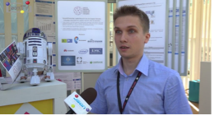


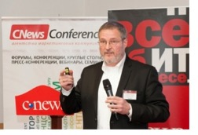

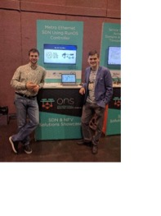


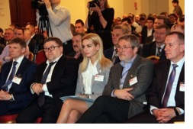

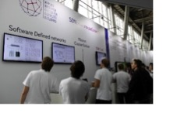













Applied Research Center for Computer Networks
ARCCN is the first Russian research center created to develop technologies and products for computer networks of the new generation.
Main R&D directions:
SDN&NFV for Telecom operators and Enterprise networks
Research and development of software and platforms for the next generation networks of Enterprise and Telecom operators
Information Centric Network - Changing the Internet Paradigm
Defining the methodology of ICN interaction with the traditional paradigm of the Internet and practical use of its methods
QoS management in the Next Generation Networks
Research, development and implementation of QoS mechanisms in Enterprise and Telecom networks
Security in Software-Defined Networks
Principles and practices for securing Software-Defined Networks. Threats and countermeasures
SDN-based Internet-of-Things (IoT)
Development of the high-level support system for devices and IoT applications in a distributed heterogeneous cloud environment
Cloud computing in a heterogeneous data center environment
Framework for virtual infrastructure development in a heterogeneous data center environment
R&D in the framework of the Federal Target Programs
R&D for the Federal Target Programs of the Ministry of Industry and Trade of the Russian Federation and the Ministry of Education and Science of the Russian Federation
The project aims at:
R&D in the area of computer networks and Internet technologies in Russia;
Development of the most breakthrough computer networks technologies of the new generation;
Creation of the only SDN Competency Center in Russia;
Training of qualified stuff for SDN R&D (in cooperation with our industrial partners);
Demos and tests to prove the effectiveness of new technologies for the challenges of industry and business.

Slide 3

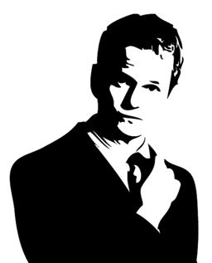

Challenges & Requirements
Modern scientific research is faced with
…
Challenges
Requirements
Infrastructure heterogeneity
Distributed science
Data processing
Deeply reconfigurable
Economical
Easy formation of collaborations
“Friction-free” movement and processing of data
Access to experimental
devices
Notes:
Deeply reconfigurable – нам нужна управляемая SLA сетевая инфраструктура, так как необходимо гибко подстраиваться под нужды пользователей. Под гибкостью понимается возможность многоуровнего управления (от приложений на абонентских машинах до приложений контролирующих передачи данных в сети)
Introductions
Modern scientific research is impossible without the sophisticated computational and data-processing infrastructure.
Different science domains present a variety of challenges to the cyber-infrastructure, which today may consist of desktop computers, small institutional clusters, cloud resources and supercomputers purpose-built to address specific problems. These challenges can be summed up as:
Infrastructure heterogeneity. Different computational solutions may require differently optimized computational and data-processing architectures. For example part of a given computational workflow may be executed using “map-reduce”, followed by calculations in a tightly-coupled, massively parallel MPI environment. Recent advances in many-core systems present new infrastructure optimization points by allowing the use of Intel MIC[1] or GPGPU [2] co-processors targeted at specific computational approaches.
Data processing. A number of science domains are beginning to encounter a problem that is generically referred to as the “Big Data” problem, where the ability to generate the data by scientific instruments exceeds the ability of the computational elements to process them due to e.g. inadequate network bandwidth and/or insufficient computational power.
Added to that are issues with long-term data storage and provenance.
Distributed science. Today’s progress of science relies on collaborative efforts by multiple institutions and requires cyber resources belonging to multiple organizations. The multi-disciplinary nature of science requires the participation of experts from multiple domains. For example bio-informatics brings together computer scientists and geneticists with the goal of designing efficient genotype processing algorithms.
These challenges are compounded by the reductions in operating budgets of many scientific organizations, which require that the existing or newly constructed cyber-infrastructure is utilized by many collaborative projects across multiple science domains to improve the economies of scale. It’s also very important for scientific mobility.
In order to answer these challenges we need a new kind of cyber-infrastructure that will simultaneously
Be deeply reconfigurable, i.e. able to match the requirements of a wide range of computational problems.
Be economical, i.e. support simultaneous uses by scientists from multiple domains
Support easy formation of collaborations around available institutional infrastructure by allowing their participants to flexibly ‘opt-in’ portions of their resources without relinquishing control over them.
Provide for ‘friction-free’ movement of data and computation as determined by the dataset sizes and availability of computational resources.
Allow for connecting experimental devices and instruments for the purposes of generating or processing data.
We explore a new approach to constructing such an infrastructure based on Software-Defined Infrastructure (SDI) technologies that combine performance with the required deep programmability. We also describe our efforts to construct a widely-distributed testbed called “GRANIT – Global Russian Advanced Network InitiaTive” in Russia to help answer the many architectural, deployment and usability questions that we expect to encounter while turning our vision into reality.

Slide 4
Network World is Changing…
Scientific
devices
Mobile
Devices
IoT
SD-WAN
Geo-distributed consumers
Re-processing data
vRAN
SD-WAN
HPC
vCDN
IaaS/PaaS
SDN Controller
vCPE
SLA
HA
Internet
SD-WAN
HPC
Management and Orchestration Platform
Big Data
Academia and Education
Notes:
Убрать военные элементы и верхнюю часть…

Slide 5
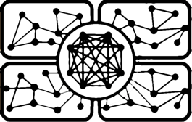


Software Defined Infrastructure
Software Defined
Networks Federation
Software Defined
Infrastructure
Virtualization
&
Scalability
Consistent policies
among federates
Notes:
Раскрыть сочетания SDN – SDS – SDI
Рассказать чем отличается SDI от SDX
SDI – федерация сетей, представляющих физические ресурсы
конфигурации которых программно управляемые
обеспечению виртуализация и масштабирование
в граничных точках обеспечения программными методами, обеспечивается согласования
С другими федератами
The move towards SDI began largely with the development of the OpenFlow [16] protocol and the concomitant emergence of the concept of Software-Defined Networking (SDN). Today SDN is understood to be broader than OpenFlow, however this protocol deserves to be called one of the first building blocks towards SDN.
The broadest set of ideas defining SDI today originates from the project named GENI (Global Environment for Network Innovation) [17], initiated by the US National Science Foundation. GENI is an international federation of testbeds by now spanning several countries and offering its resources to many researchers across the globe. GENI resources include cloud compute and storage resources, OpenFlow switches and programmable wireless networks.
GENI control software federates together multiple resource providers and allows users to create “slices” of infrastructure - programmable topologies of resources collected from those providers, connected by various network fabrics which offer bandwidth-on-demand services or higher-level SDN services. These slices are, in effect, independent virtual systems or networks target-built for specific experimental or computational activities.
The individual slices operate in parallel and independently from each other, with performance isolation provided by the specific virtualization or slivering technologies, that allow for programmatic partitioning of various resource types, such as compute hypervisors, individual network paths (VLANs and MPLS) or individually-addressable storage volumes.
Resource slivers are mono-typed and user-programmable, i.e. a user may specify, for example, the specific operating system image or file system type in compute and storage slivers, respectively. The slivers within a slice are interconnected into a user-defined topology with dedicated network links of specified performance. Slices may connect to the commodity Internet via a variety of gateway technologies.
Taken together, programmable compute, storage and networking form the foundation of the Software-Defined Infrastructure.
We note that the technologies for low-level slivering and programming computational and storage resources are generally well-understood today, although open problems remain when it comes to proper isolation of these sliver types from each other and quantifying their performance in a multi-user system. Network slivers, on the other hand, represent a relatively new idea, which with the emergence of SDN added a new level of programmability, not envisioned before.
Specifically, SDN technologies allow the interposition of user control directly into the network elements within the slice topology, that belong to a specific network provider, thus creating new points for inserting user-specified network traffic forwarding policies. Prior to the introduction of OpenFlow, the level of virtualization and programmability of networks was limited to the creation of bandwidth on-demand paths through one or more network providers [19]. Now users can dictate not only the topologies of the slice interconnects, but actually affect the behavior of the network traffic inside those slices.
These new capabilities coupled with the push by multiple vendors to create OpenFlow-compliant networking equipment capable of serving at different networking layers and different market segments, create new opportunities for extending the notion of SDI deeper into the networking domain. The development and extension of the concept of SDNs into new areas is actively continuing and, along with developing further abilities to orchestrate different resources together into complex slice topologies and behaviors is included as part of our vision in this paper.
The tight coupling of network, computational and storage resources in GENI allows it to become a federated platform unifying multiple independent resource providers for the purposes of solving a variety of computational problems, whose solutions today are limited by their ability to move data, e.g. gene sequencing or processing of high-volumes of other kinds digital data from physics, astronomy, biology or other science domains. For us the problems of data movement within slices in service of science applications represent a critical area for advancement, in order to support the needs of domain sciences.
Key Problems for Science Applications and SDI
A. Use Cases
We begin with a few examples of using SDI technologies for scientific computational research. Considering the strong connection between SDI and cloud technologies, one of the easiest areas to apply is to problems that are easily parallelizable. These types of problems are frequently encountered today, for example, in gene sequencing. In part it is because most of the software was originally written for analysis on personal computers, but it is also due to relatively small size of individual genetic datasets, so that they can be packaged together with applications into a virtual machine image.
Using slices created out of institutional private clouds federated using GENI technologies, scientists gain access to a platform that can easily launch large numbers of parallel analyses. However, unlike with public clouds, the users are not limited to using datasets that are baked into the images: their applications may query databases or datasets stored inside or the slice, as necessary and still see predictable data transfer performance. Additionally, the slices may host other auxiliary resources that include, for example, graphical front ends for access by the users. All elements of these infrastructure configurations are completely dynamic, created on-demand as the users see fit.
A more complex example includes a problem that requires elements of parallel computation, but also where some part of the computational process is tightly-coupled and requires MPI on a cluster or supercomputer with an MPI-friendly interconnect. In this case several collaborating organizations can create a virtual system or slice that includes not only cloud computational elements, but also portions or slivers of supercomputers belonging to them, which are connected to the slice when needed. The data needed for processing on the supercomputer can be transferred via the slice network links into the supercomputer and afterwards saved into permanent storage or transferred elsewhere for further processing.
Requirements and Open Problems
As we mentioned, any virtual system or slice created for a science application consists of three basic sliver types: compute, storage and network. A science application may require heterogeneous computational and storage resources to be present in a slice for solving various steps within the computation. The topology of the slice must support the needs of the application by allowing the movement of data or computation to where it is most efficient, for example, transferring a dataset to available processing compute elements or saving the resulting datasets into permanent storage - all tasks that are difficult today, requiring manual user intervention, as with DTNs and making data sharing, especially in collaborative environments, a difficult task.
In order to provide a predictable high-productivity environment for domain scientists this virtual system must be able to
Guarantee the performance of individual slivers. A user may formulate their requirement in the form of an SLE (Service Level Expectation), which quantifiably describes their expected behavior. For example for compute slivers it may be specified in the form of expected computational performance, size and I/O speeds for storage, bandwidth and latency for network links.
Dynamically control the placement of virtualized slivers into the physical infrastructure of federated providers in order to satisfy the SLE, the indicated topology connecting storage and compute slivers and the anticipated traffic forwarding policies within this topology. Also includes being able to easily recreate a slice configuration whenever a particular experiment or computational activity must be rerun.
Be able to efficiently move data or computation, which includes both provisioning links with sufficient bandwidth, as well as providing policies for in-slice control over traffic forwarding which optimize data movement in response to application objectives.
Some of these questions are being answered in GENI and other research projects. Our focus is on broadening the application of SDI and its extension to new types of resources. Here we describe some of the research directions we plan to take in developing the GRANIT testbed as related to the three requirements formulated above.
Heterogeneous Network Virtualization and Bridging
As we mentioned, computational resources in GENI today are represented by cloud-like computational containers capable of launching easily parallelizable tasks. However many computational science domains reliy on tightly coupled models of computation, which require large amounts of inter-node communications via e.g. MPI. The speed and effectiveness of the computations depends directly on the efficiency of the backplane network fabric connecting the nodes. Most supercomputer architectures today rely on InfiniBand interconnects to support these requirements.
InfiniBand is architected for high-performance systems requiring delay-sensitive communications, while Ethernet is firmly entrenched in the data center and even metro-area and some wide-area networks. The popularity of InfiniBand is justified by its relatively low cost and the availability of software solutions that take advantage of it. At the same time, using Ethernet for time-critical communications is still challenging, although the vendor community is working on some converged solutions (like, for example, Data Center Bridging [802.1Qbb, 802.1Qaz etc.]).
In the traditional static computing architectures this dichotomy between InfiniBand and Ethernet does not present a problem, since there is no need to bridge and control the two together - the data is transferred e.g. via DTNs using Ethernet from outside the cluster into the supercomputer file system, as we described in Section II, while the nodes inside the supercomputer communicate via InfiniBand.
However, with the ability to federate various resources via GENI technologies, comes the opportunity to tightly interconnect nodes of multiple clusters for the purposes of marshaling their power for addressing a single problem. In this case the InfiniBand fabrics of the supercomputers must be virtualized and joined together with traditional MAN/WAN mechanisms using Ethernet. This would allow partitions of multiple supercomputers to be joined together in slices with other types of computational or data-generating resources.
Thus efficient virtualization and bridging of InfiniBand to Ethernet is one of the problems we plan to address. This fits with the first requirement for satisfying user SLEs. The partitioning of the problem data and codes across the slivers belonging to different supercomputers also represents an interesting area of research we plan to investigate. This could take the form of several tightly coupled models launched on their respective supercomputer partitions and exchanging coupled data in real-time over the bridged InfiniBand/Ethernet fabric. Alternatively, it could be a single problem code and dataset launched on multiple partitions simultaneously as if they were a single supercomputer, with some links experiencing higher latencies due to bridging over Ethernet between different locations. Determining the efficient ways of achieving these partitions, benchmarking the results and devising strategies for determining resource allocation tradeoffs to achieve the best performance are part of our scope.
Software-Defined Storage
Software-Defined Storage or SDS represents an important component of the overall SDI system. The key problem to be solved here relates to extremely high expectations placed on data consistency and reliability in the traditional systems. These are a good match for a SAN local to a particular supercomputer, however in a distributed environment due to the CAP (Consistency, Availablity and Partition tolerance) theorem [21] we must find more flexible ways of operating storage in a slice, by making intelligent tradeoffs between those three attributes. Examples of the initial tradeoffs in this area can be seen in the design and deployment of distributed NoSQL databases [22] or distributed storage systems like GlusterFS [23] and CouchDB [24].
These tradeoffs, as applied to block and object storage as well as file systems in a virtualized SDI environment will involve novel user-programmable behaviors that we plan to concentrate some of our research efforts.
Description Languages
A system for supporting scientific experiments and computation must offer its users a way of describing their requirements to the slice. Languages, suitable for describing the experiments are referred to as domain-specific languages (DSLs), and in this case are intended for describing the requests of creating the virtual infrastructure suitable for the experiment. Significant amount of work has been invested in this direction in GENI, where the declarative GENI RSpecs [25] are used for
Describing the requirements to the desired virtual system
Describing the resources available within the federation for allocation to virtual system
Describing the allocated resources back to the user including details of allocation needed for accessing and using the resources.
One key issue lies in the fact that GENI represents a kind of Infrastructure-as-a-Service (IaaS), thus focusing on the task of allocating and interconnecting together the resources in the desired topology. However, for serving science the IaaS paradigm may present abstractions that are too low level to be useful. The user must be able to specify not only the necessary resources, but also to some extent pre-define the behavior of the individual slivers by e.g. assigning and configuring applications in them, defining storage access policies for e.g. shared datasets and finally, determining the policies for forwarding traffic within the allocated virtual network, that answer the needs of the application (e.g. prioritize specific types of traffic, route different kinds of traffic in different ways across the topology and so on). All these configurable behaviors fall well within the SDI paradigm, however are not answered by existing GENI technologies.
We plan to invest significant efforts in designing and implementing a family of domain-specific languages that answer the needs described above. The related effort would be to design algorithms that operate on these
Figure 1: Map of the future testbed
language representations in order to perform the allocation and placement of resources that go into the different virtual systems - a problem that combines aspects of resource scheduling, placement and authorization.
Software-Defined eXchanges
The final aspect of this problem area that represents interest to us is the ability to bridge together virtual systems created, for example, by multiple collaborations in order to join their efforts for further collaborative activities and allow the movement of data between their collaborative infrastructures. This requires that multiple virtual systems peer with each other in a controlled fashion.
One of the emergent ideas in this area is the idea of a Software-Defined eXchange [26] - a virtual point location where peering networks can exchange traffic in a way that satisfies their internal policies. The simplest form of an SDX replaces the bulky and expensive to configure BGP protocol with a logical SDN-controlled fabric that can enforce the rules for traffic exchange between the peering partners.
Considering the significant efforts being made by the vendors to extend OpenFlow into new areas of network control and management, we can expect this concept to mature and extend not only to Layer 3 IP networks, but also to Layer 2 and, perhaps, transport networks. The flexibility provided by OpenFlow in terms of traffic matching allows to create sophisticated filtering and forwarding policies at SDXs that are easier to implement and, importantly, validate, than the existing BGP-based solutions.
We plan to investigate the suitability of the SDX paradigm to peering virtual systems serving multiple science applications. This idea also dovetails with our planned research activities into domain-specific languages, as SDXs present a new kind of application running in a slice, which has specific configuration parameters and abstractions that will need to be incorporated into our DSL.

Slide 6
Experiment Anatomy and Challenges
Data Mining
Knowledge Extraction
Data Storage Capacity
DB: Data Size & Rates
Networking
  High-bandwidth links from Detectors to DC
  Automation of configuration ”white-boxing”
DC Architectures
  Rack Disaggregation: Rack-scale Design
Cloud Infrastructure
  Orchestration and automation of compute provisioning
  Scalable clouds and global scientific clouds

Slide 7
The Worldwide LHC Computing Grid
TIER-0 (CERN):
data recording, reconstruction and distribution
nearly 170 sites,
40 countries
~350’000 cores
TIER-1:
permanent storage,
re-processing,
analysis
500 PB of storage
> 2 million jobs/day
TIER-2:
Simulation,
end-user analysis
10-100 Gb links
© Tim Bell - CERN Computing Infrastructure

Slide 8
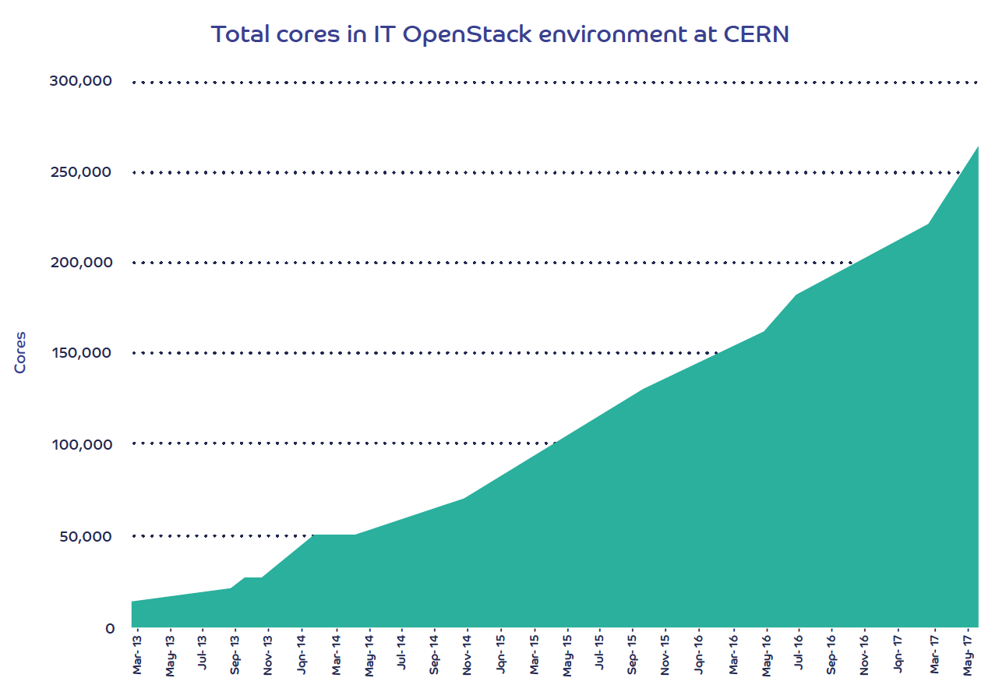
CERN Cloud Architecture
Top cell controller
rabbitmq
API server
nova-cells
nova-api
>190K cores in production under OpenStack
>90% of CERN compute resources are virtualised
>5,000 VMs migrated from old hardware in 2016
>100K cores to be added in the next 6 months
DB infrastructure
Child cell controller
Child cell controller
nova-api
nova-api
rabbitmq
rabbitmq
nova-scheduler
nova-cells
nova-scheduler
nova-cells
nova-conductor
nova-conductor
nova-network
nova-network
Compute node
Compute node
nova-compute
nova-compute
© Arne Wiebalck: CERN Cloud Report, 2016 HEPiX Spring Meeting at DESY Zeuthen
© CERN Openlab Project White Paper, September 2017
Notes:
Having started in 2012, we went into production in 2013 on Grizzly and have since then done online upgrades of 6 releases.
currently running around 50 cells distributed across 2 data centres with around 7,500 hypervisors.
Automation is key… a single framework for managing compute resources within limited staffing, many of whom are only at CERN for a few years and return to their home countries.

Slide 9
Knowledge Extraction: Experiment VM Lifecycle
As Is:
To BE:
Initialization
Configuration
Template(s)
Scaling
Deinitialization
Execution
Healing

Slide 10
Function Examples
DB Software
  SQL: Redis, Oracle, Impala, …
  No-SQL: Hbase, Monga, …
Data Processing Software
  Spark, Hadoop
Visualization Software
  Grafana, Kibana
MQ Software
  Kafka, ZeroMQ, RabbitMQ
…

Slide 11
C2 Software Stack
С2 Orchestrator
С2 GUI
Network Function Virtualization Orchestrator (NFVO)
С2 Monitoring
С2 Manager
Virtual Network Function Manager (VNFM)
С2 Network
С2 Core
(+ OpenStack Plugin)
Virtual Infrastructure Manager (VIM)

Slide 12
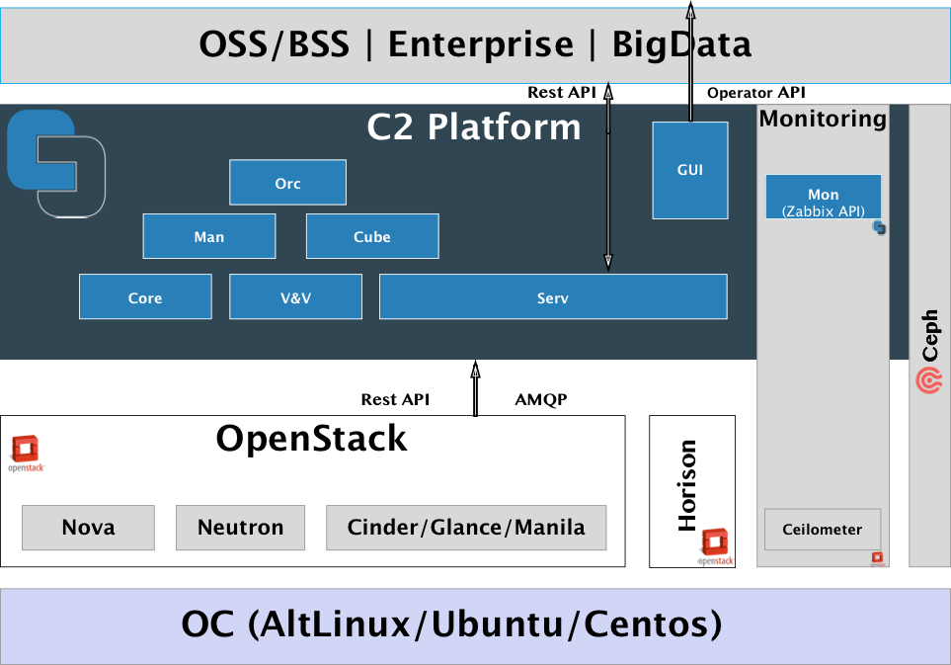
C2 Reference Architecture

Slide 13
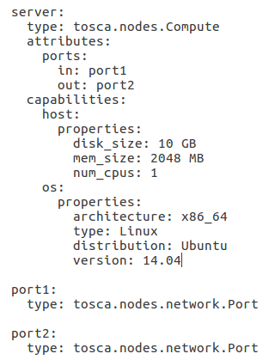
TOSCA Function Template
Input parameters descriptions
Logic entities descriptions
Orchestration policies description
Output parameters description

Slide 14
Function Life-cycle
Function specification
  TOSCA
  No matter IaaS/PaaS/SaaS/Telco/BigData or any other
Resource scheduling for each function instance
  Consider the scheduling policies (VM-VM, VM-PM, Healing, Scaling)
Deploying the certain function instance. For example:
  DC cluster
  HPC cluster
Configuring the certain function instance
  Construction complex service with ”chains”
Service execution
  Automatic scaling and healing
Function Instance undeploying: Release resources
Notes:
TODO: Перевод

Slide 15
Where our initiative will make the valuable impact?
Helix Nebula Initiative
CERN OpenLab Project

Slide 16
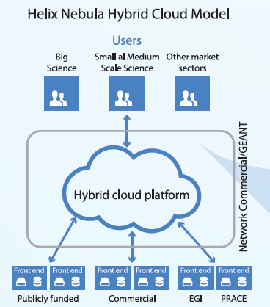
The Helix Nebula Initiative
Brings together
research organisations,
data providers,
publicly funded e-infrastructures,
commercial cloud service providers
In a hybrid cloud with procurement and governance approaches suitable for the dynamic cloud market
(c) 19 October 2016, Bob Jones, CERN, IT department
In-house

Slide 17
CERN OpenLab Project Applications
Data Acquisition
Data Processing
  Simulation
  Image-based event identification
Big Data Analysis
Data Engineering

Slide 18

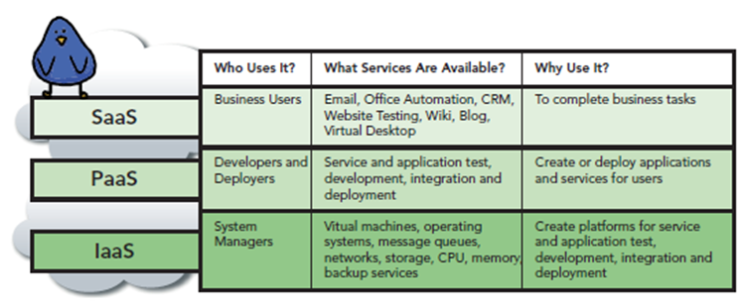


Where the Focus of Cloud Infrastructure Should Be?
A hybrid cloud platform for the research community
Combining services at the IaaS level to support science workflows
MANO
NFVO
New focus
Source: CloudComputing for Govies, DLT Solutions,
David Blankenhorn, Van Ristau and Caron Beesley
VNFM
HNSciCloud
PCP
VIM
The R&D services to be developed are to be integrated with
Resources in data centres operated by the buyers group
European-scale publicly funded e-Infrastructures

Slide 19
How to Describe Experiment?
Virtual Machine
bottrek:
type: tosca.nodes.C2Compute
attributes:
ports:
in: port1
out: port1
capabilities:
host:
properties:
disk_size: 160 GiB
mem_size: 16 GiB
num_cpus: 8
Operational System
bottrek:
…
properties:
os_image: GIB
zabbix_configuration: automatically
initialization_system: false
Network Port
port1:
type: tosca.nodes.network.C2Port
properties:
mirroring: true
order: 1

Slide 20
How to Describe Experiment?
Management Network
mgmt_net:
type: tosca.nodes.network.Network
Management Port
mgmt_port:
type: tosca.nodes.network.C2Port
properties:
need_ip: true
order: 0
requirements:
- binding: bottrek
- link: mgmt_net
External Router (optional)
ext_router:
type: tosca.nodes.Router
properties:
external: true
External port
router_port:
type: tosca.nodes.network.Port
requirements:
- binding: ext_router
- link: mgmt_net

Slide 21
How to Describe Experiment?
Healing Policy
icmp_policy:
type: tosca.policies.Healing.Zabbix
properties:
triggers: [ICMP_60]
targets: [bottrek]
default_action: reboot
Scaling Out Policy
scaling_out_policy:
type: tosca.policies.Scaling.Out.Zabbix
properties:
targets: [bottrek, ext_router, mgmt_net]
triggers: [CPU_60sec_80perc]
Scaling In Policy
scaling_in_policy:
type: tosca.policies.Scaling.In.Zabbix
properties:
triggers: [CPU_60sec_20perc]
targets: [bottrek, ext_router, mgmt_net]

Slide 22


Physical Infrastructure
CPE
DC
IPSec tunnel
IPSec
Rack Switch
eth0
eth1
eth0
C2 Controller
wlan
eth1
Ext Gate
eth0
eth0
C2 Compute 1
C2 Compute 2
External Network

Slide 23

Virtual Infrastructure
CPE
DC
IPSec tunnel
IPSec
vxlan
eth0
Rack Switch
vxlan1
br-lan
exit_vlan
eth1
eth0
C2 Controller
vlan
vxlan
wlan
eth1
Ext Gate
br-int
br-gate-vlan
br-gate-vxlan
vxlan
br-tun
Control Plane OpenFlow
С2 CUBE OpenFlow
eth0
eth0
C2 Compute 1
C2 Compute 2
br-tun
Control Plane
OpenFlow
Control Plane
OpenFlow
br-tun
External Network
br-int
br-lb
br-lb
br-int
DHCP
NAT
Hadoop

Slide 24
Virtual Service
CPE
DC
IPSec tunnel
IPSec
vxlan
eth0
Rack Switch
vxlan1
br-lan
exit_vlan
eth1
eth0
C2 Controller
SFC
to gate
vlan
vxlan
wlan
eth1
Ext Gate
br-int
br-gate-vlan
br-gate-vxlan
vxlan
br-tun
SFC
to mac1
Control Plane OpenFlow
С2 CUBE OpenFlow
eth0
eth0
C2 Compute 1
C2 Compute 2
br-tun
Control Plane
OpenFlow
Control Plane
OpenFlow
br-tun
External Network
br-int
br-lb
br-lb
br-int
DHCP
NAT
SFC
to mac_ext
Hadoop
SFC
to mac2

Slide 25
Conclusion
Today an experiment is Data mining + Knowledge extraction
Knowledge extraction means manage and support service life-cycle
  Function specification
  Policy Resource scheduling for each function instance
  Deploying the certain function instance.
  Configuring the certain function instance
  Service Automatic scaling and healing
  Function instance undeploying: Release resources
The architecture of C2 MANO platform that aims to orchestrate and manage the cloud services was presented

Slide 26
THANK YOU!
Questions?
Vitaly Antonenko – vantonenko@arccn.ru
Ruslan Smeliansky – rsmeliansky@arccn.ru

Slide 27
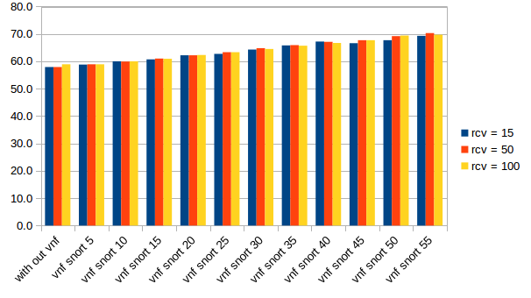
How long could be the chain?

Slide 28
Balance the traffic load

Slide 29
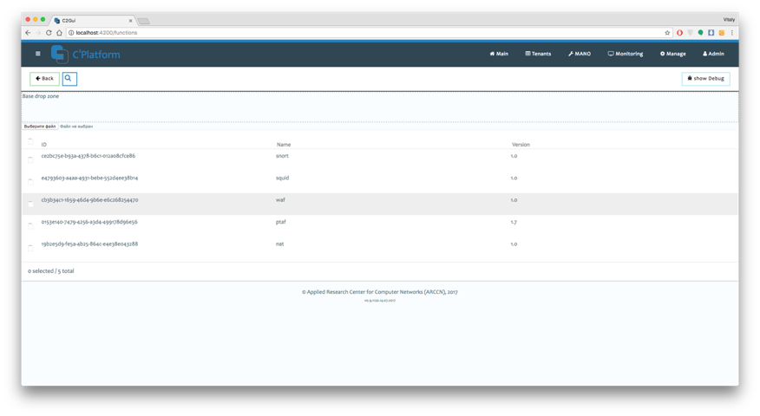
Place your screenshot here
C2 GUI Регистрация функций
Облегчает процесс регистрации новых функций в платформе

Slide 30
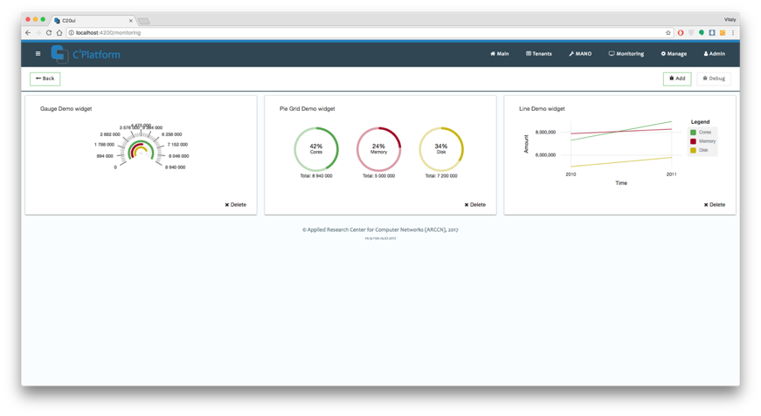
Place your screenshot here
C2 Мониторинг функций
Облегчает процесс мониторинга состояния каждого экземпляра функции в режиме реального времени

Slide 31
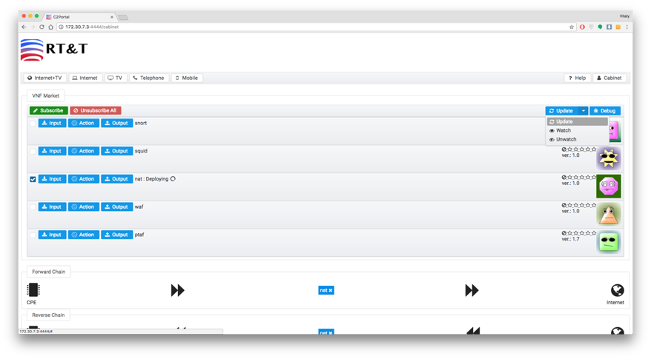
Place your screenshot here
C2 Portal Подписка на функции
Позволяет пользователю подписываться в один клик на необходимый сервис через личный кабинет

Slide 32
Challenges
Innovative IaaS level cloud services integrated with procurers in-house resources and public e-infrastructure to support a range of scientific workloads
Compute and Storage
  support a range of virtual machine and container configurations including HPC working with datasets in the petabyte range
Network Connectivity and Federated Identity Management
  provide high-end network capacity via GEANT for the whole platform with common identity and access management
Service Payment Models
  explore a range of purchasing options to determine those most appropriate for the scientific application workloads to be deployed
Ref: Bob Jones, CERN

Slide 33
CERN OpenStack Project
July 2013
CERN OpenStack
Production Service
February 2014
CERN OpenStack
Havana Release
October 2014
CERN OpenStack
Icehouse Release
March2015
CERN OpenStack
Juno Release
September 2015
CERN OpenStack
Kilo Release
August 2016
CERN OpenStack
Liberty Release
April 2012
September 2012
April 2013
October 2013
April 2014
October 2014
April 2015
October 2015
April 2016
ESSEX
Nova
Swift
Glance
Horizon
Keystone
FOLSOM
Nova
Swift
Glance
Horizon
Keystone
Quantum
Cinder
GRIZZLY
Nova
Swift
Glance
Horizon
Keystone
Quantum
Cinder
Ceilometer
HAVANA
Nova
Swift
Glance
Horizon
Keystone
Neutron
Cinder
Ceilometer
Heat
ICEHOUSE
Nova
Swift
Glance
Horizon
Keystone
Neutron
Cinder
Ceilometer
Heat
JUNO
Nova
Swift
Glance
Horizon
Keystone
Neutron
Cinder
Ceilometer
Heat
Rally
KILO
Nova
Swift
Glance
Horizon
Keystone
Neutron
Cinder
Ceilometer
Heat
Rally
LIBERTY
Nova
Swift
Glance
Horizon
Keystone
Neutron (*)
Cinder
Ceilometer
Heat
Rally
Magnum (*)
Barbican (*)
MITAKA
Nova
Swift
Glance
Horizon
Keystone
Neutron
Cinder
Ceilometer
Heat
Rally
Magnum
Barbican
(*) Pilot

Slide 34
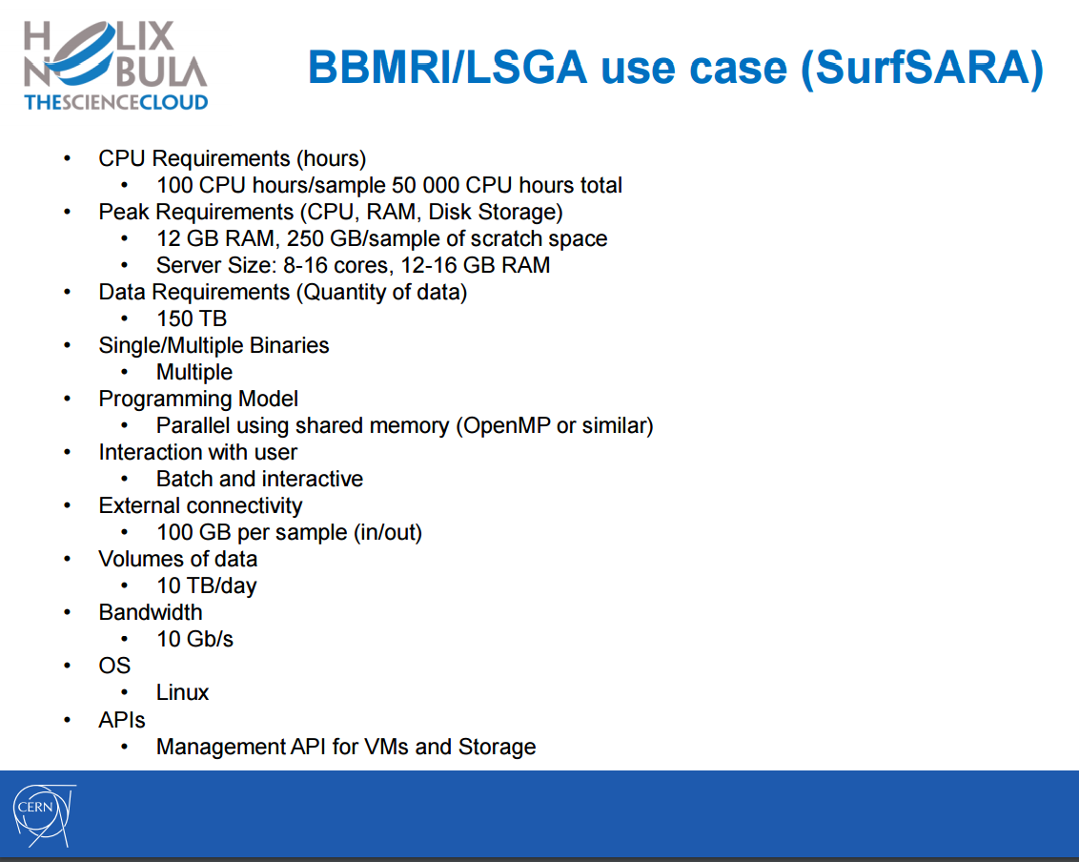
Foreseen users:
- bioinformaticians who will do most of the large scale processing
- less tech-savvy end-users will perform analysis
Data types: genotype & phenotype information.
Data can be assumed to be anonymised but it is still sensitive
Helge Meinhard, CERN, 17 March 2016

Slide 35
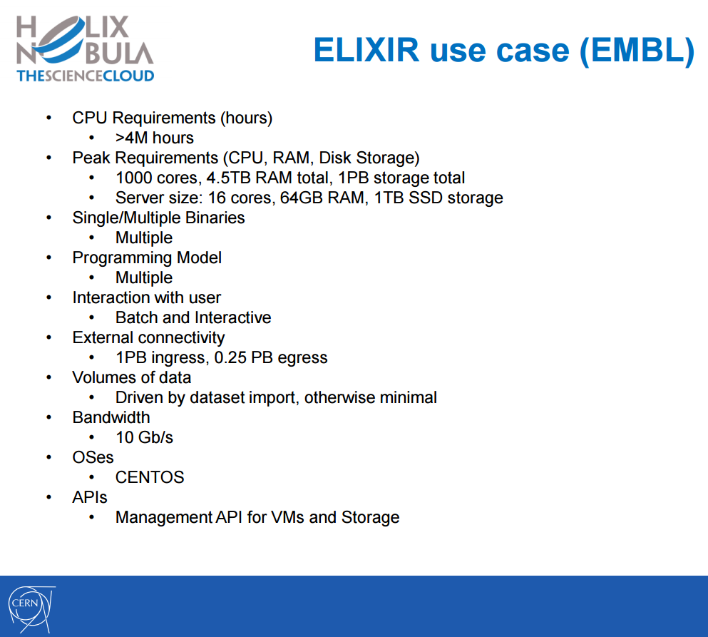
Long tail of science
Foreseen users: individual researchers/small labs in the need of accessing highly performant IT resources to analyse their data on
Data types: Due to the nature of the use-cases, the exact type of datasets can’t be predicted upfront. However, the infrastructure will need to ensure datasets will be kept private to the single user, with the possibly to share them among other users / publicly provided sufficient authorisation is granted.
Helge Meinhard, CERN, 17 March 2016

Slide 36
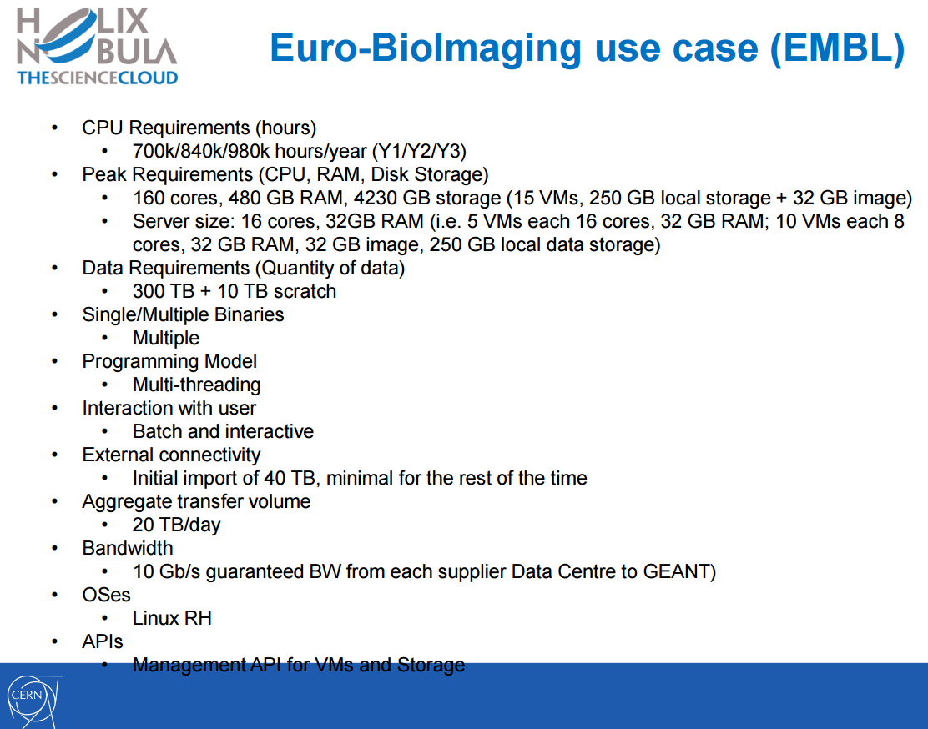
Foreseen users: the EuroBioImaging consortia through the representatives in EMBL
Data types: private and public datasets consisting of images coming from human cells, Drosophila and fungi, with a plan to further extend the coverage adding more datasets and cell types. No sensitive data are currently foreseen.
Helge Meinhard, CERN, 17 March 2016

