Slide 1
Alexander Avrorin
on behalf of Baikal Collaboration
Data management and processing system for Baikal-GVD

Slide 2
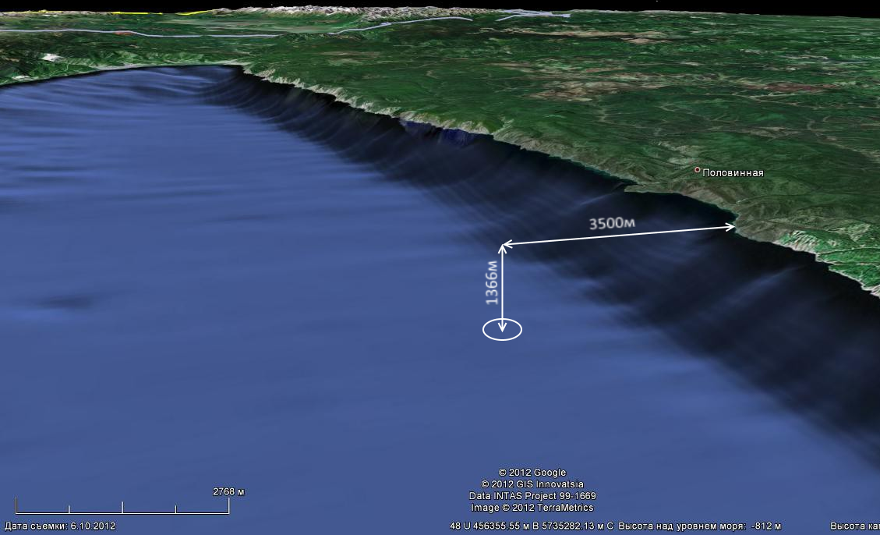
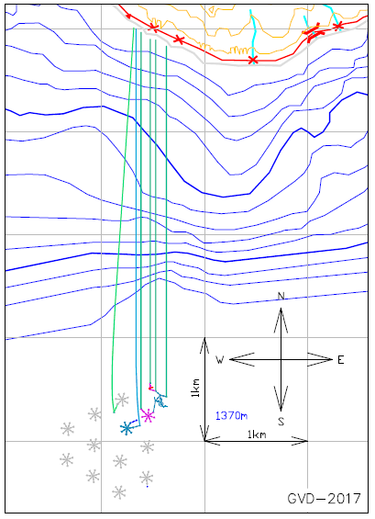
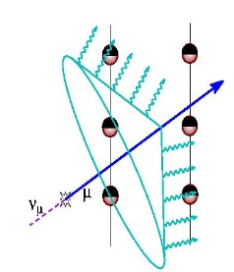
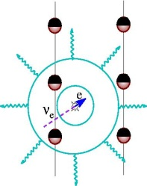
Baikal-GVD
A large-scale neutrino detector in Lake Baikal.
A 3D underwater array of photodetectors.
Submerged at the depth of ~1 km, 3.5 km from the shore.
Modular: detector is comprised of multiple independent clusters (sub-arrays). Each cluster is a neutrino telescope by itself!
GVD Layout
Detection principle
Target
Telescope (E,Ω)
muon (ν_{μ})
muon
cascade
ν_{e}:ν_{μ}:ν_{τ}
WATER
input
cascade
(ν_{e},ν_{μ},ν_{τ})
Notes:
Baikal-GVD [1] is a project for a kilometer scale underwater neutrino telescope in lake Baikal,
designed primarily for the study of astrophysical neutrino fluxes. The telescope consists of clusters
- functionally independent detectors comprised of eight strings of optical modules (OMs) each.
Photomultipliers located in optical modules register Cerenkov radiation emitted by secondary particles
produced by neutrino interactions with the observed medium, allowing for reconstruction
of direction and energy of the primary particle. The first cluster in baseline configuration was
completed in 2016, followed by another one this year; both clusters are currently acquiring data.

Slide 3
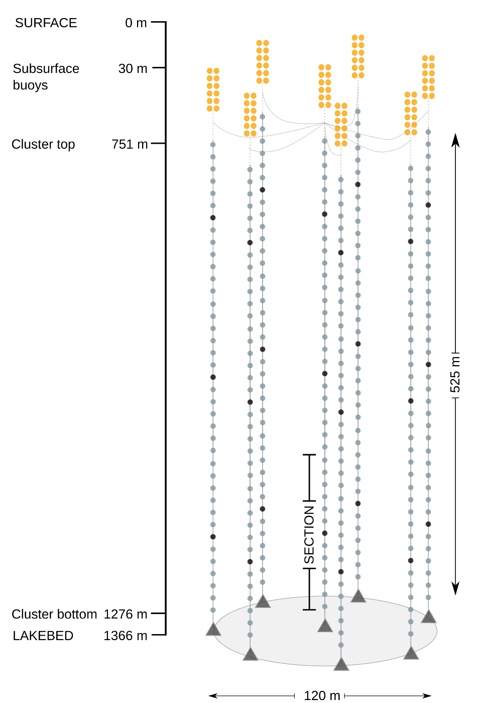
A GVD Cluster
Each cluster consists of 8 flexible strings of optical modules. An optical module (OM) contains a photodetector and control electronics.
12 consecutive OMs comprise a section. Each string contains 3 sections totaling 36 photodetectors.
When a cluster trigger fires, each section sends a section record to the shore. The section record contains filtered FADC samples of the output of all photodetectors in the section within 5 μs time window.
Each cluster is equipped with an acoustic positioning system (APS) that allows tracking OM coordinates.
Aside from a photodetector, OMs are equipped with an array of sensors (humidity, pressure etc).
Assuming standard trigger parameters, the cluster output is ~50 Gb/day. This number can vary due to seasonal variations in the background.

Slide 4
Data pipeline
CLUSTER
SHORE CENTER
JINR
ANALYSIS
Section records
CLUSTER
OPERATION
SOFTWARE
STORAGE &
PROCESSING
Service records
Monitoring records
Reconstruction
Calibrations
Astronomy
…
Events
Acoustic data
APS Polling
OM monitoring
Telemetry polling
Monte-Carlo simulation

Slide 5
BARS: Baikal Analysis and Reconstruction Software
NT-200+ software was initially developed in Fortran.
For GVD it was decided to migrate to C++.
New data analysis framework for GVD is called BARS: Baikal Analysis and Reconstruction Software.
BARS is a CERN ROOT library based on MARS software developed for MAGIC experiment.
BARS provides:
Standardized data formats.
Standardized interface for common tasks: noise suppression, reconstruction, calibration etc.
Data processing management (event loop architecture from MARS).
A set of high-level utilities for common tasks (e.g. data export).
A well-defined and easily extensible OOP architecture. Implementing, e.g. new noise suppression, is easy and it will be swappable with other noise suppression components.

Slide 6
BARS: Event loop
Data is stored in containers.
Processing is done by modules.
Ideally, modules are stateless and the state is kept in containers.
Data analysis is executed in 4 stages:
Initialization
Module objects are created and order of module execution is defined.
Preprocessing:
Modules create container objects they provide, or subscribe to those they depend on. Containers can only be created at this stage.
Processing:
Modules sequentially execute their logic on containers. After the last module finishes execution, all the container objects are reset and the loop begins again until one of the modules calls a break.
Postprocessing: cleanup.
Allows interface standardization, separation of labor (high-level analysis is tweaking module parameters).
MODULES
CONTAINERS
Read events
Event
Read calibration data
Calibration data
Calibrate events
Event mask
Noise filtration
Write events

Slide 7
BARS: Filtration
In BARS noise suppression and cuts are achieved with special filter modules.
Filter modules take events as an input and produce event mask containers. Event masks mark every impulse in the event as either signal or noise.
Use cases:
Causality filter would mask pulses that do not satisfy a muon track causality.
Software trigger will mask all pulses in the event, that does not satisfy trigger condition.
A filter can take an MC event container and use its data to only mask pulses from bundles.
If a filter receives an event mask among other inputs, it will only consider unmasked pulses.
A mask summation module can subscribe to multiple masks and produce a binary sum. This creates a kind of mask arithmetic that allows building problem-oriented noise suppression sequence from a set of standard components.
Event
Input mask
Filter module
Output mask

Slide 8
Automatic processing
Automated processing
Steps (general overview):
Read raw telescope output.
Extract signal parameters from FADC samples (amplitude, FWHM etc).
Join section records into events. This step is required to have more than one section in event.
Evaluate data quality metrics.
Automated processing operates as a set of shell scripts invoking BARS event loop macros.
Processing is logged to a relational database, indicating which steps succeeded and which failed.
The processing database can be explored via a web-interface.
When automatic processing of a run is finished a set of standard ROOT-files are created within an established file-system hierarchy.
Section records
Monitoring records
Service records
Custom binary format.
Import binary data
Parameter extraction
An array of extracted pulse-objects
per section record.
Join section records
Joint events
Monitoring data
…

Slide 9
Quality control
To identify and quantify the problems with data two quality metrics have been developed:
The first metric evaluates performance of the trigger system. If all the information is self-consistent corresponding flag is set for the trigger event. Otherwise unsuitable flag is put in order to use it potentially in the next steps of data analysis. About 98.5% of events have a clear trigger origin. Most of the rest occurs at the vicinity of dead time window and require more study.
The second metric looks at the trigger participation rates for channels and sections. It is evaluated by fitting three types of histograms: rate vs time, time intervals distribution between events, and Poisson distribution. Positions of trigger pulses that must be at the middle of 5 mks FADC slices are also monitored.
The data quality estimation takes place after processing. If the metrics indicate a problem, an automatic alarm is set and the person in charge is notified.
Notes:
Inner workings of trigger system are analyzed using the information of local trigger coincidence on FADC, request and acknowledgement signal counters, timers on CMs and CC.

Slide 10
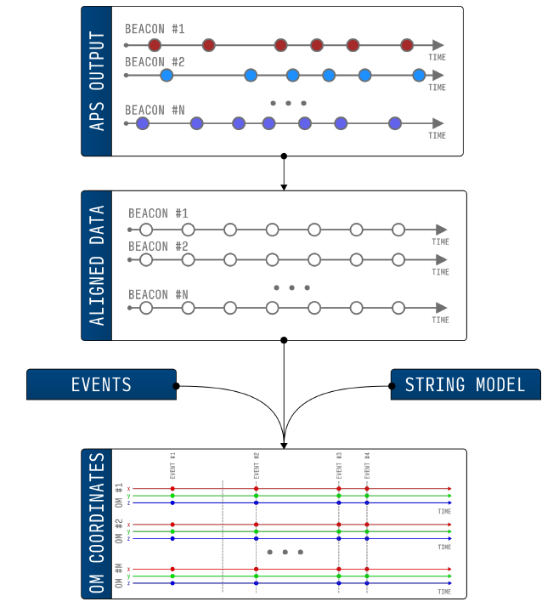
APS processing
Baikal-GVD strings are flexible and OM position deviations can reach tens of meters. In order to track OM coordinates, an acoustic positioning system (APS) has been developed by EvoLogics GmbH (Germany) and deployed at the site of the experiment.
APS is an array of acoustic modems (called beacons and nodes) installed along the strings of the detector.
APS regularly (40-60 seconds for a cluster) polls beacons for node acoustic signal delays and uses this data to triangulate beacon coordinates.
The APS output is a list of timestamped coordinates for each beacon.
Processing:
First, each beacons position is linearly interpolated at regular intervals producing aligned data.
Then, a string model is fitted to the aligned data and OM coordinates are interpolated for each event. This step is performed during reconstruction, OM coordinates are not stored.
After acoustic data is aligned, the quality control metrics (beacon record density, distances between beacons on the same string and distances between parallel beacons on neighboring strings) are computed.
Notes:
Now, a few words on acoustic system processing.

Slide 11
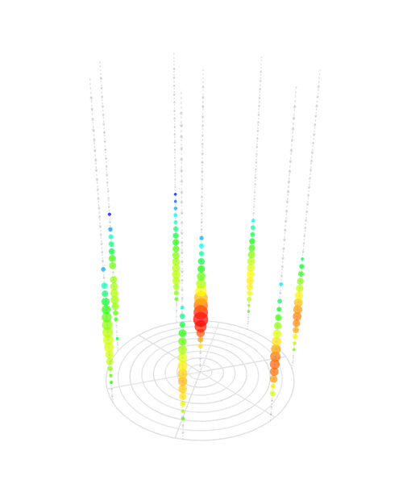
Monte-Carlo simulation
Fortran-based software that was developed for the first generation Baikal NT-200 telescope and is independent from primary data analysis suite used in Baikal Collaboration.
The simulation is performed in two stages.
Primary and secondary particle interactions are modeled within the observed medium.
The trigger conditions and noise signals are applied afterwards and the output is stored in a binary file.
MC data is stored in the unified event format — an array of time and amplitude values for all pulses in the event. Unified events are a default input for every noise suppression and reconstruction module in BARS. This approach allows us to use MC and experimental data interchangeably when running analysis that should work with both.
A SIMULATED CASCADE EVENT
Notes:
Finally, Monte-Carlo

Slide 12
Summary
First cluster of Baikal-GVD has been deployed in 2015 and was updated to a standard configuration in 2016; a second cluster has been deployed this year. Each cluster generates ~50 Gb of data per day.
A new data analysis and processing ROOT-based framework is under active development and is being used both for offline and automated processing.
An automated processing software for raw data has been developed.
THANK YOU

