Slide 1
Control and monitoring of the starting minimum of Booster injection system
A.A.Fateev, V.V.Tarasov, E.V.Gorbachev, H.P.Nazlev

Slide 2
Contents
Work objectives
Booster injection system
Devices requirements and parameters
Software
Test results
Conclusions

Slide 3
Work objectives
Creation of prototype control and monitoring unit for the supply of deflection plates based on cRIO and LabVIEW
Creation of Tango Controls device servers
Creation of GUI client for easier system control

Slide 4
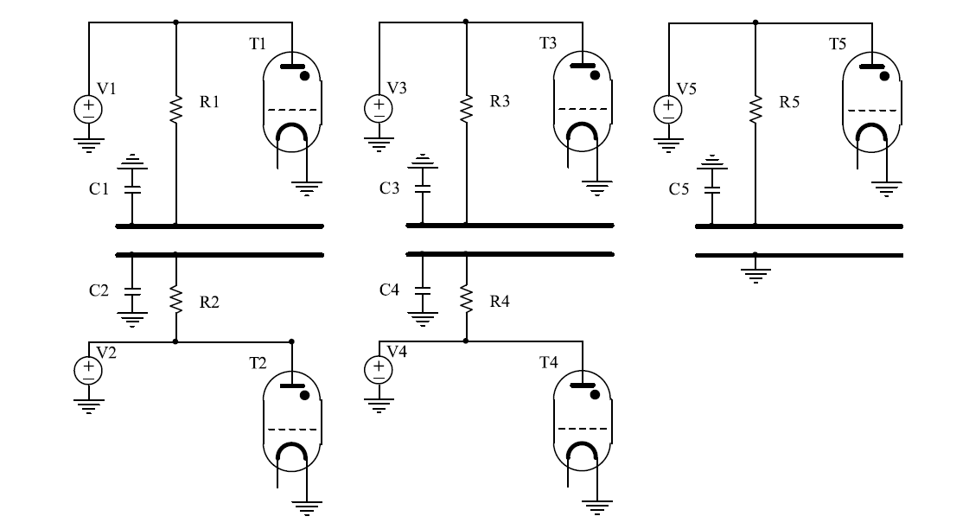
Booster injection
The NICA booster injection system will consist of three pairs of electrostatic deflecting plates (inflector plates) to provide the injection of the ion bunches into the Booster in single-turn, multi-turn and multiple injection modes.
The starting minimum will include only one pair of inflector plates. One of them is grounded.

Slide 5
System parameters
Maximum electrical potential on the plate………………………… 60kV
Charging time of the plate…………………………………………..<50µS
Duration of the plateau of the pulse, not less than………………. 30µS
Heterogeneity of voltage on the plateau…………………………..≤1%
The discharge time of the plate……………………………………. ≤0.1µS
Residual voltage after discharge of plates…………………………≤0.5kV
Number of pulses in a row…………………………………………..1 – 3
Pulse iteration rate……………………………………………………10 Hz

Slide 6
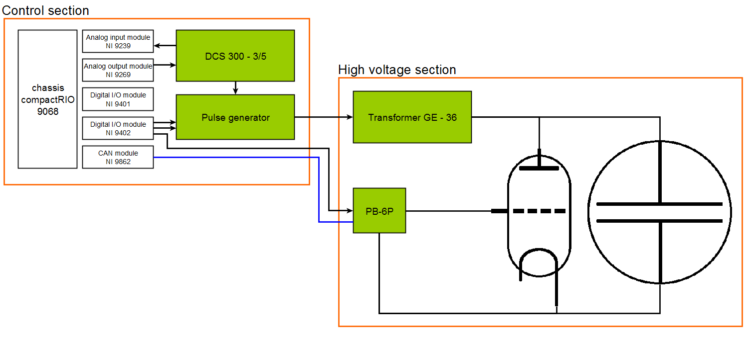
Power and control scheme
The control system is based on National Instruments cRIO hardware.

Slide 7
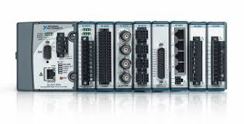
What is cRIO-9068
667 MHz dual-core ARM Cortex-A9 CPU, 1 GB flash, 512 MB DDR3 RAM
8 slot chassis
Artix – 7 FPGA
NI Linux Real-Time OS
Work with LabVIEW Real-Time or C / C ++ on Ethernet(2 gigabit) or RS-232
Modules, who we use:
NI 9239 – analog input module, for voltage measurement NI 9269 – analog output module, for voltage control
NI 9401 – slow digital I/O module, for safety and lock signals
NI 9402 – fast digital I/O module, for triggering of individual blocks
NI 9862 – CAN interface module, for thyratron drivers control
The FPGA firmware is developed in LabVIEW FPGA. Interface with NICA control system was developed as TANGO devices using C++ and running on system controller.

Slide 8
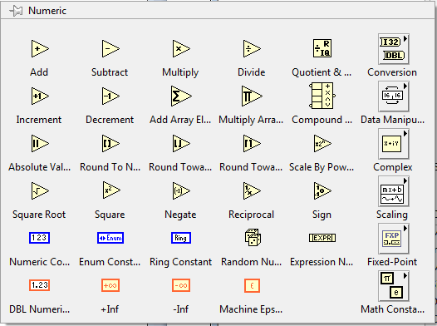
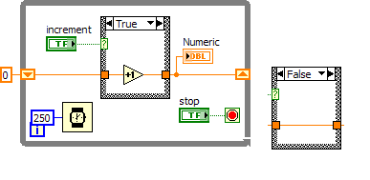
LabVIEW
Laboratory Virtual Instrument Engineering Workbench (LabVIEW) is a system-design platform and development environment for a visual programming language from National Instruments.

Slide 9
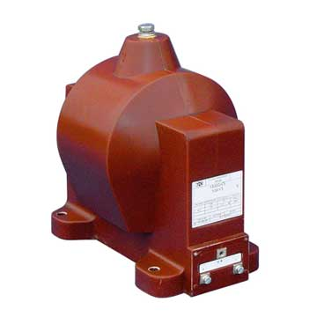
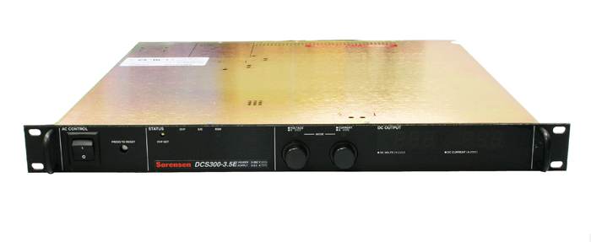
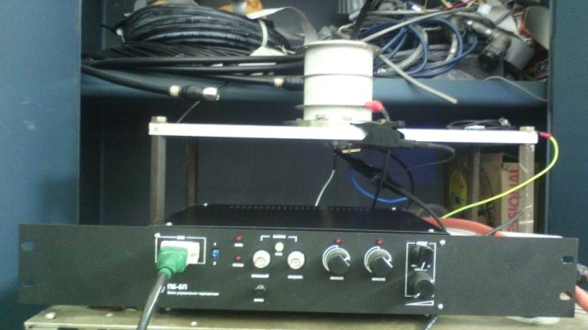
Device parameters and requirements
DCS-300/3.5
- Remote start
- Output level control 0 - 300 V, accuracy 0.1%
- Switching ON the output pulse (~ 100 ms before injection), accuracy 1 ms
- Switching OFF the output pulse (~ 10 ms before injection), accuracy 1 μs
2. Thyratron TPI2-10k/50-75 and thyratron driver PB-6P
- Adjustable start time and jitter ≤ 10 ns
- Control the thyratron grids and filaments parameters via CAN interface
3. Thyristor pulse generator
- Trigger pulse with amplitude> 10 volts, 50 ohm impedance (an additional pulse amplifier with delay time <20ns was designed)
- Pulse duration not less than 2 μs
- Adjustable start time in the range 0.5 - 2 ms before injection, with step not more than 1 μs and jitter not more than 100 ns
4. GE-36 Charging Transformer
- Measurement of amplitude and shape of the output pulse with the help of ADC (digital oscilloscope) with a range of 0 - 5 V (0.1%)
5. Safety and lock signals

Slide 10
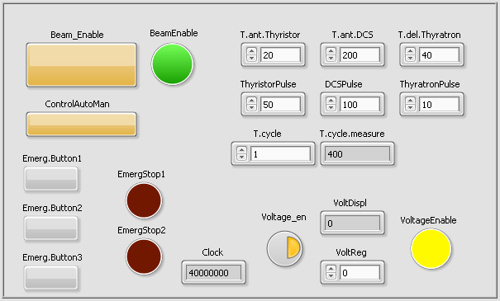
LabVIEW VI prototype and its options
Timing control for time delays, advances and pulse width
Auto/manual modes of injection time control
Voltage control of a voltage source
Emergency buttons and indicators

Slide 11
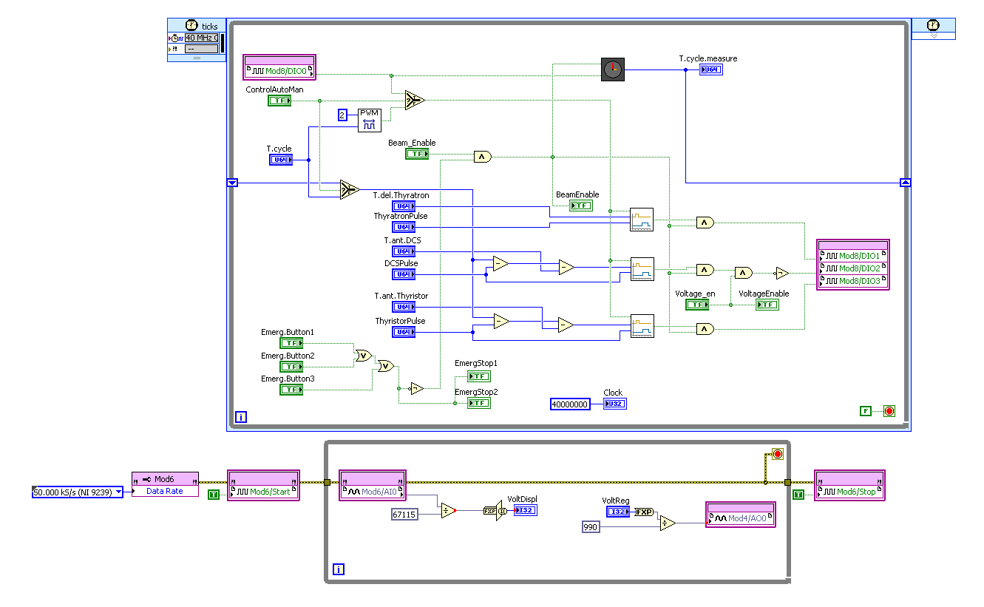
LabVIEW VI prototype and its options

Slide 12
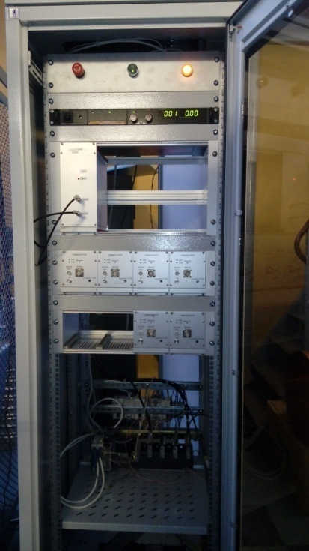
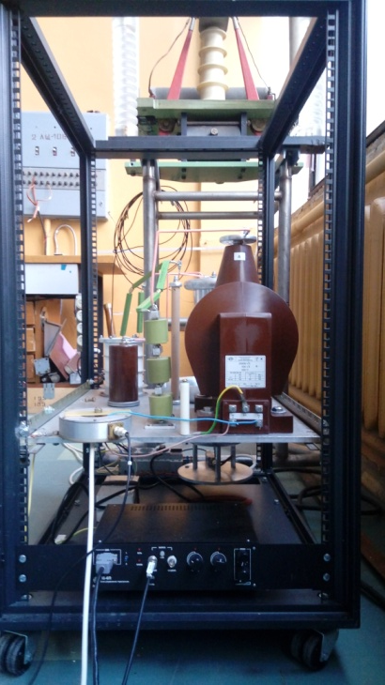
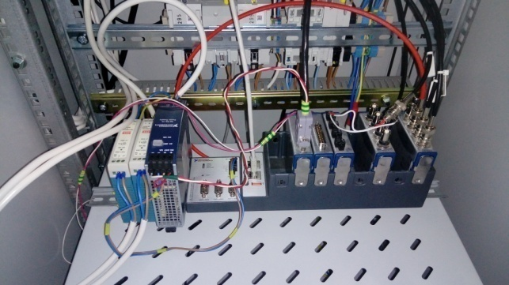
Power and control hardware

Slide 13
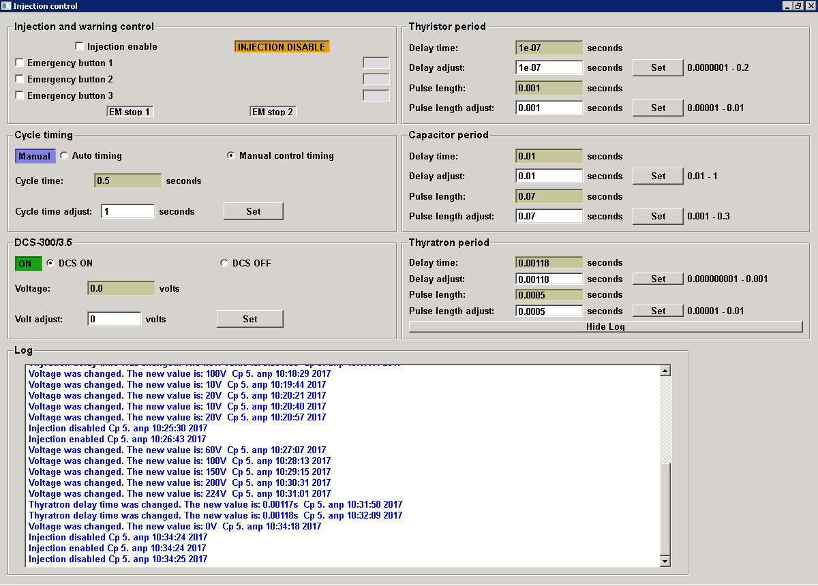
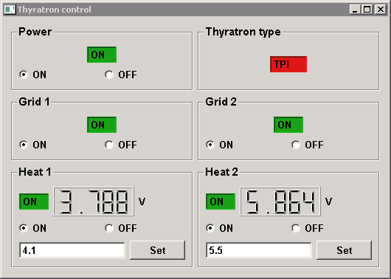
GUI clients
Client for thyratron driver
Main GUI client

Slide 14
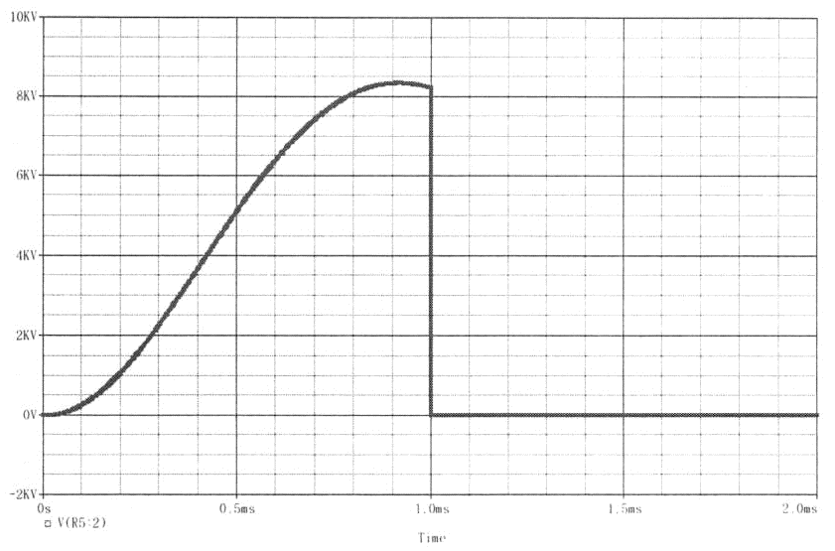
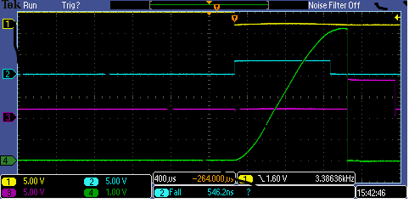
Test results
yellow - disconnection of the controlled charging key
cyan - starting the thyristor key
purple - launch of thyratron
green - voltage at equivalent load, 10kV / div

Slide 15
Conclusions
The main result of the tests was the obtaining of the specified parameters of a high-voltage output pulse at an equivalent load of 450 pF.
The voltage on the equivalent load exceeds 60 kV. The amplitude of the post-pulses does not exceed 300V. The discharge time does not exceed 100 nsec.
A successfully completed test program allows us to conclude that the main parameters of the power supply system of the Booster inflector plates comply with the technical specification.
The system is ready to connect to the real load on the Booster installation.

Slide 16
Thank you for attention!

