Slide 1
NEC’2017 in numbers
Total: 142 registrants
By counties: 13 states, including
BELARUS
BULGARIA
CHINA
CERN
CZECH REPUBLIC
FRANCE
GERMANY
ITALY
MOLDOVA
NETHERLANDS
RUSSIA
SLOVAKIA
SWITZERLAND
USA
By talks: 89, including
Plenary: 36
Sectional: 53
IT Education (Round Table) – 10 presentations

Slide 2
NEC’2017
Organizing Committee (V.V. Korenkov, JINR, co-chairperson, I. Bird, CERN, co-chairperson P.V. Zrelov, JINR, deputy chairperson, I.A. Filozova, JINR, scientific secretary S. Backovic, O.V. Belov, N.V. Gorbunov, V.V. Glagolev, P. Hristov, A. Khrgian, T. Kurtyka, L. Mapelli, A.V. Nechaevskiy, O.Yu. Rumyantseva, E.N. Russakovich, I.S. Pelevanyuk, Y.K. Potrebenikov, V.I. Prikhodko, S.I. Sidortchuk, D.B. Stankus, T.A. Strizh, I. Vankov, T.N. Zaikina, "Jadran Group" Company;
International Program Committee;
JINR and CERN directors;
Sponsors: Niagara Computers, JET Infosystems, Dell-EMC, IBS Platformix
Organizers, jury, lecturers of International School on Heterogeneous Computing Infrastructure for students and postgraduates;
Local organizing committee.
Services of hotels Splendid and Montenegro Star;
All participants.
… and surprisingly nice weather

Slide 3
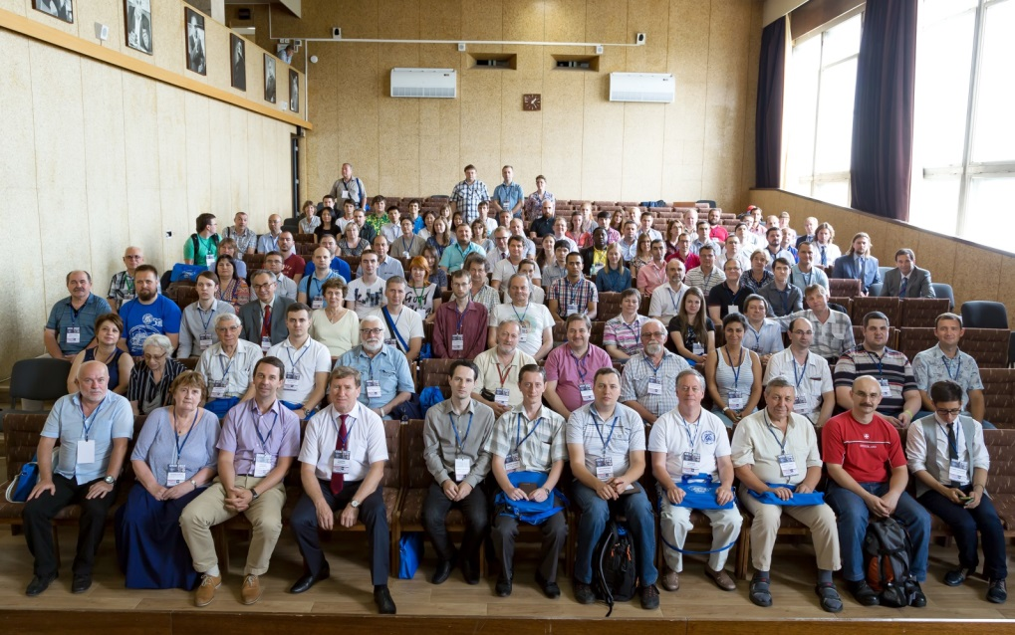
Distributed Computing and Grid-technologies
in Science and Education
02-06 July 2018, Dubna, JINR, LIT

