Slide 1
Software contribution from MIPT: development of services and tools for BM@N
6th Collaboration Meeting of the BM@N Experiment at the NICA Facility, October 26–27, 2020
Peter Klimai

Slide 2
MIPT Projects for BM@N
MIPT projects for BM@N include services for:
Visualization,
Monitoring,
Statistics collection, and more
About MIPT-NPM:
http://npm.mipt.ru/ru/
https://research.jetbrains.org/groups/npm

Slide 3
Project Summary
Project | Progress since last meeting (2020-04) | Status
NICA Scheduler Configurator GUI | New features added, improved design | In production
Monitoring service | Telegraf-based monitoring added with major Grafana dashboards update | In production, TODO: Add HTTP(S) monitoring
Visualization service event display | Released with new name VisionForge | Working on ROOT integration
Slow control viewer | Reworked and improved | Pending deploy to production
Statistics collection script | New | Version ready for extensive testing
Event metadata service | New | Pgsql and Cassandra db tests

Slide 4
NICA Scheduler Configurator GUI

Slide 5
NICA Scheduler Configurator: Task
NICA-Scheduler is a module of BmnRoot software
Uses existing batch system (SLURM, SGE, Torque) to distribute user jobs on the cluster
Jobs for distributed execution are described and passed as XML file: $ nica-scheduler my_job.xml
Details: http://bmn.jinr.ru/nica-scheduler/
Task: Create a GUI editor for scheduler XML files

Slide 6
Implementation details
NICA Scheduler GUI Features:
JVM and JS versions using Kotlin multiplatform
Common data model (eliminate code duplication)
Pre-copy parameter support added 2020-05
JS version improved overall styling 2020-07
Deployed at https://bmn-scheduler.jinr.ru/
Source code:
https://git.jinr.ru/nica_modules/mpd-scheduler-gui

Slide 7
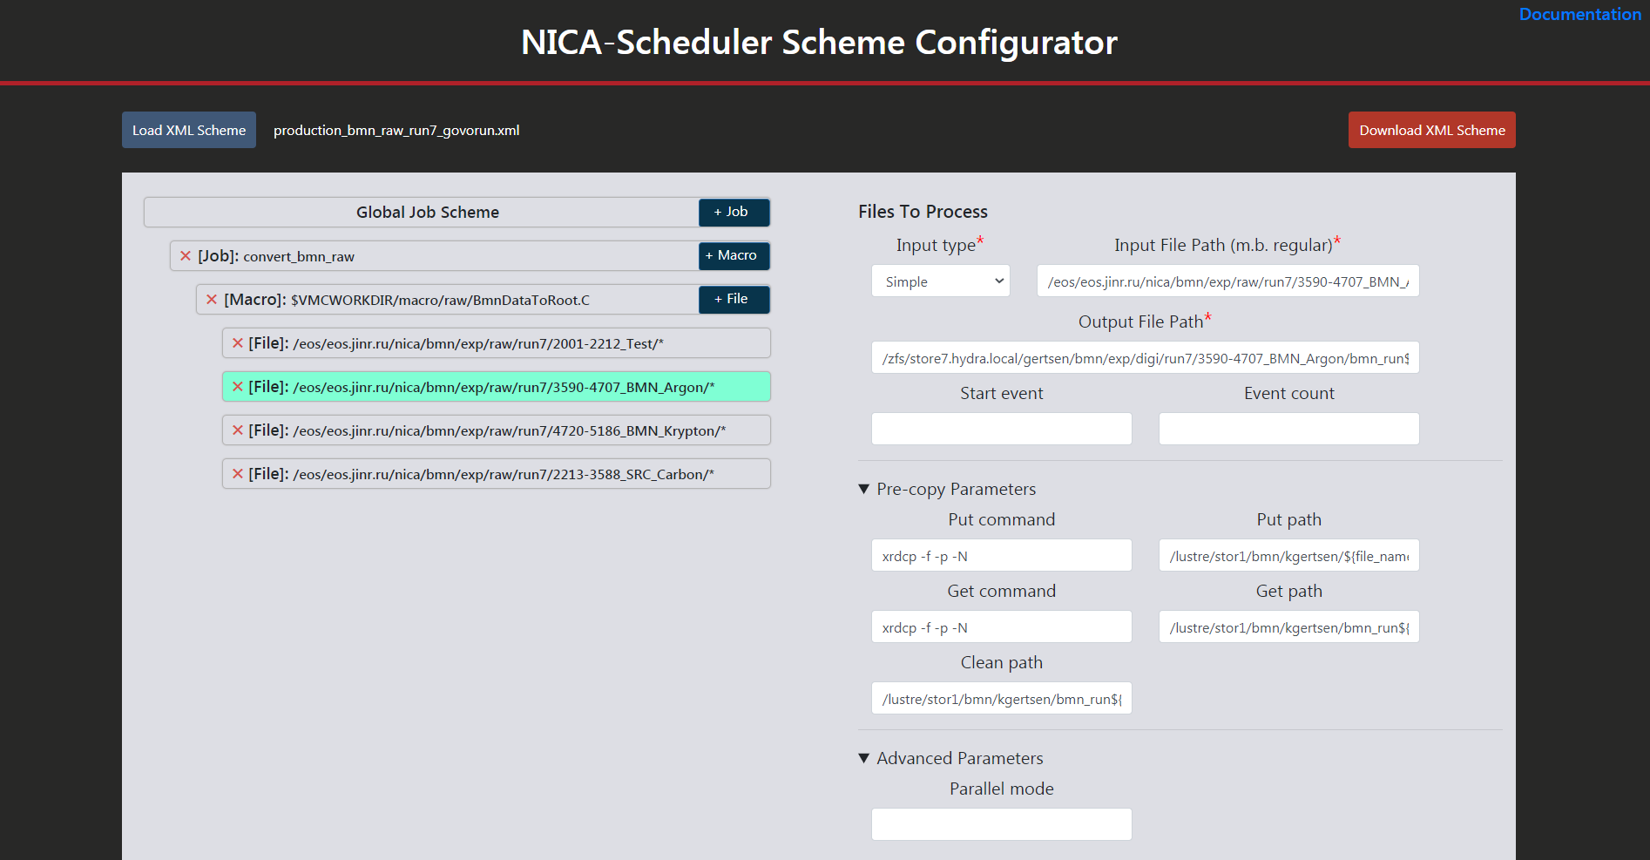
New design for JS version
https://bmn-scheduler.jinr.ru/

Slide 8
Monitoring Service

Slide 9
Monitoring Service - Task
Monitoring Service Features
Ping and PG-SQL request to check database server status
Configurable via JSON file
Email notifications
Response time stored in InfluxDB
Use Grafana for visualization and additional alerting
NEW: Monitor server parameters such as Disk, CPU, Memory, etc.
Sources:
https://git.jinr.ru/nica/bmnroot/-/tree/dev/uni_db/services/monitoring

Slide 10
Monitoring Service - Components
ICMP ping
PG-SQL request
Monitored Host
mon-service.py
Monitored Host
Mail server
InfluxDB
Monitored Host
Grafana Web UI
Grafana
Metrics for
CPU, disk,
memory, etc.
Telegraf
https://mon-service.jinr.ru

Slide 11
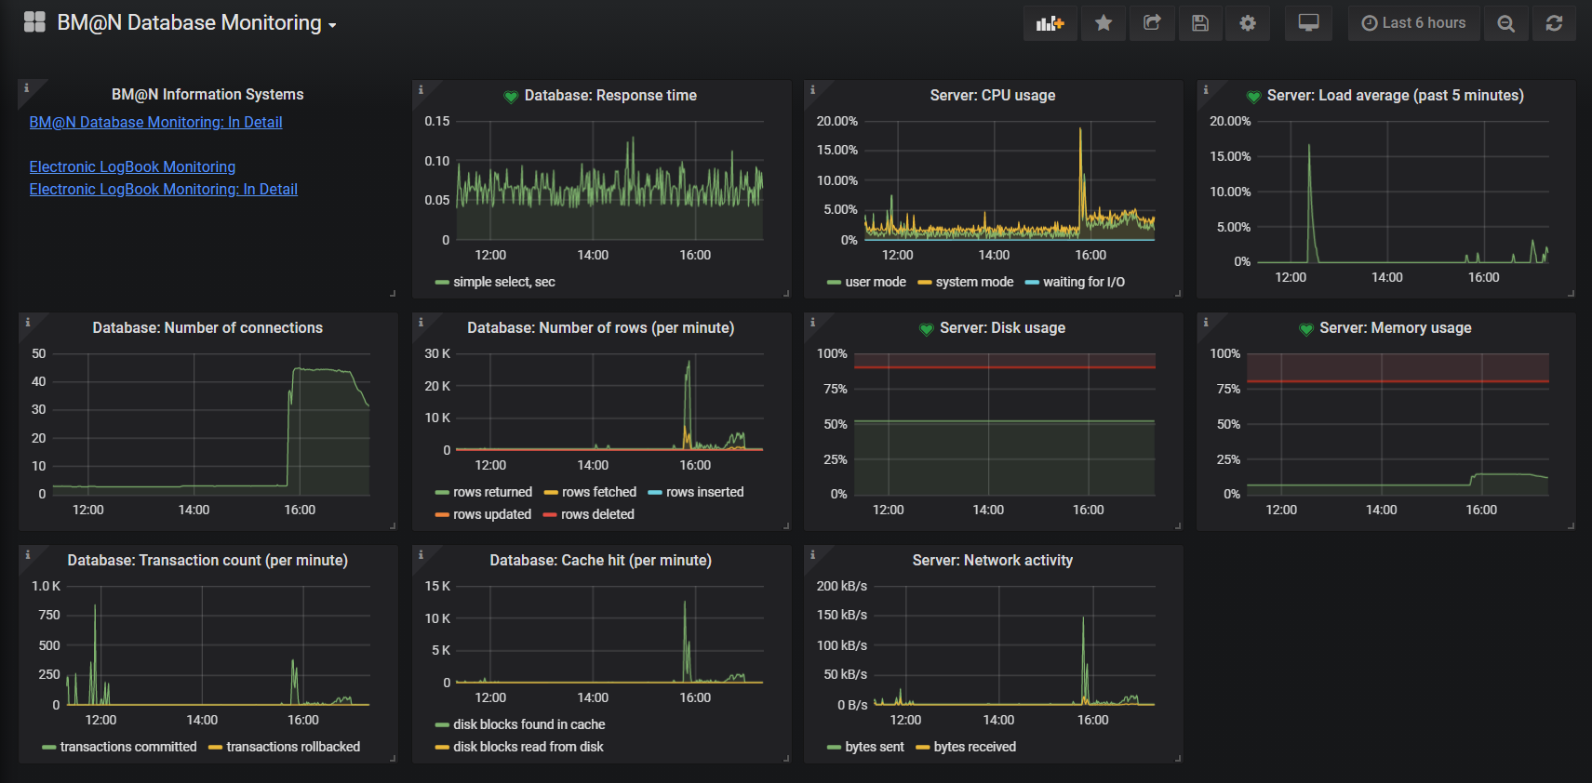
Grafana View – 1 of 4
https://mon-service.jinr.ru

Slide 12
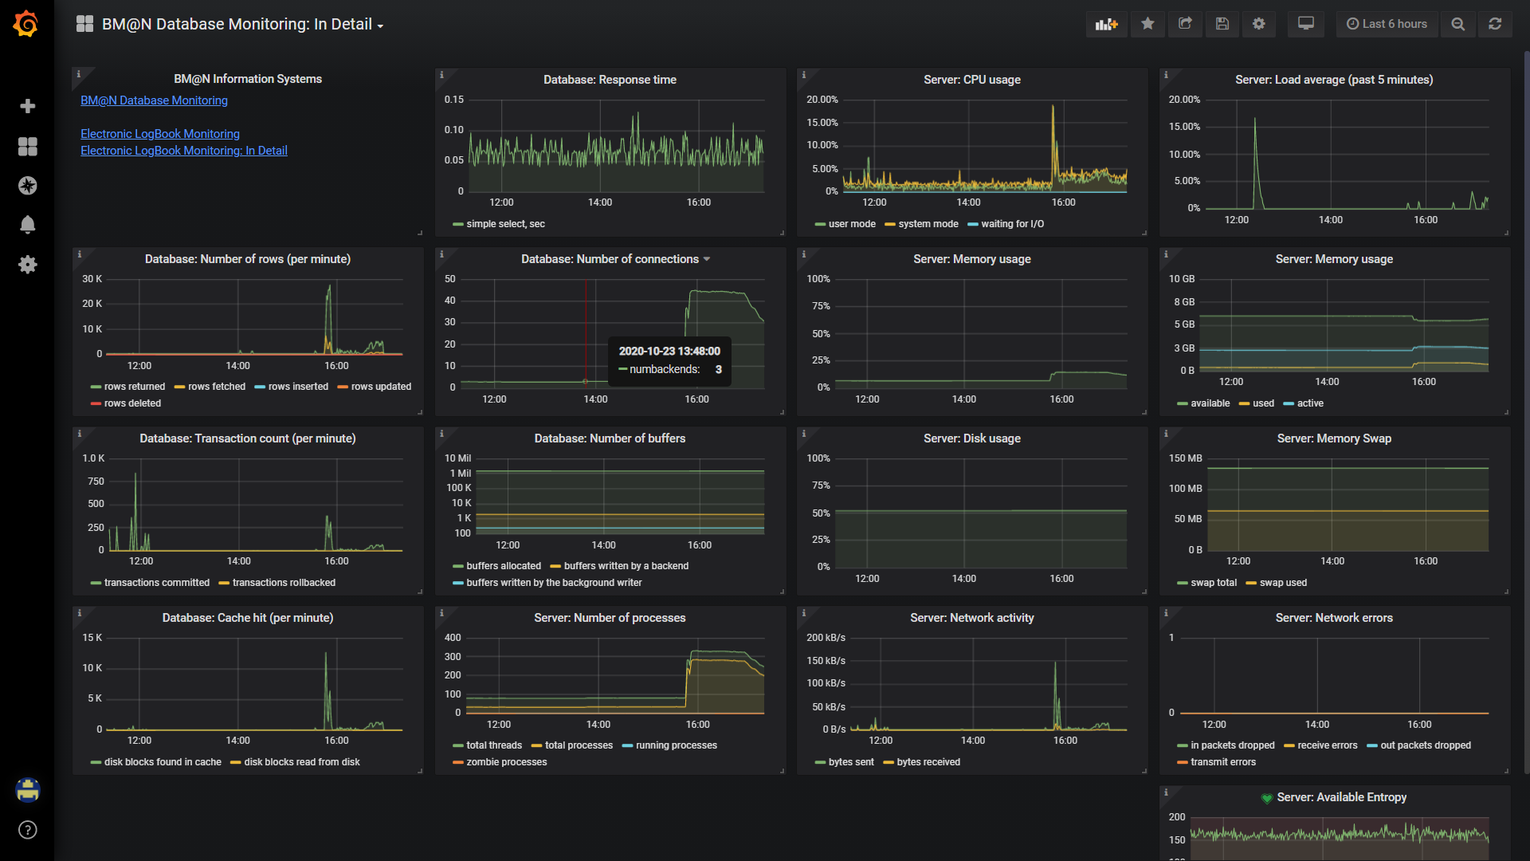
Grafana View – 2 of 4

Slide 13
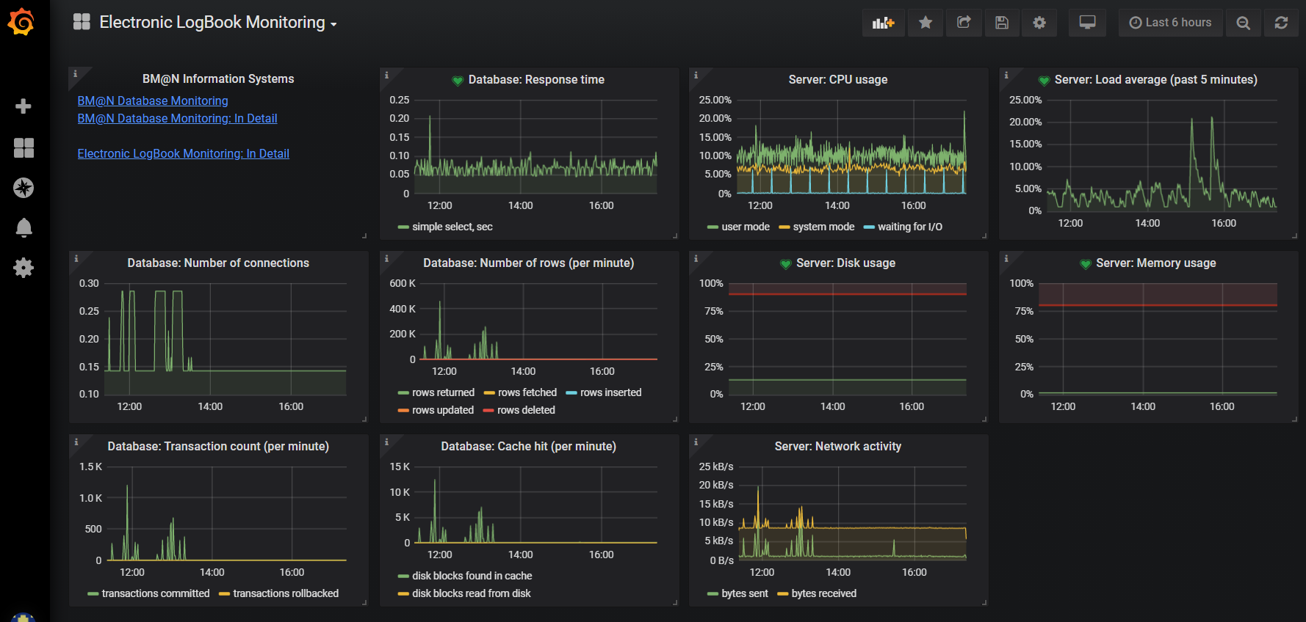
Grafana View – 3 of 4

Slide 14
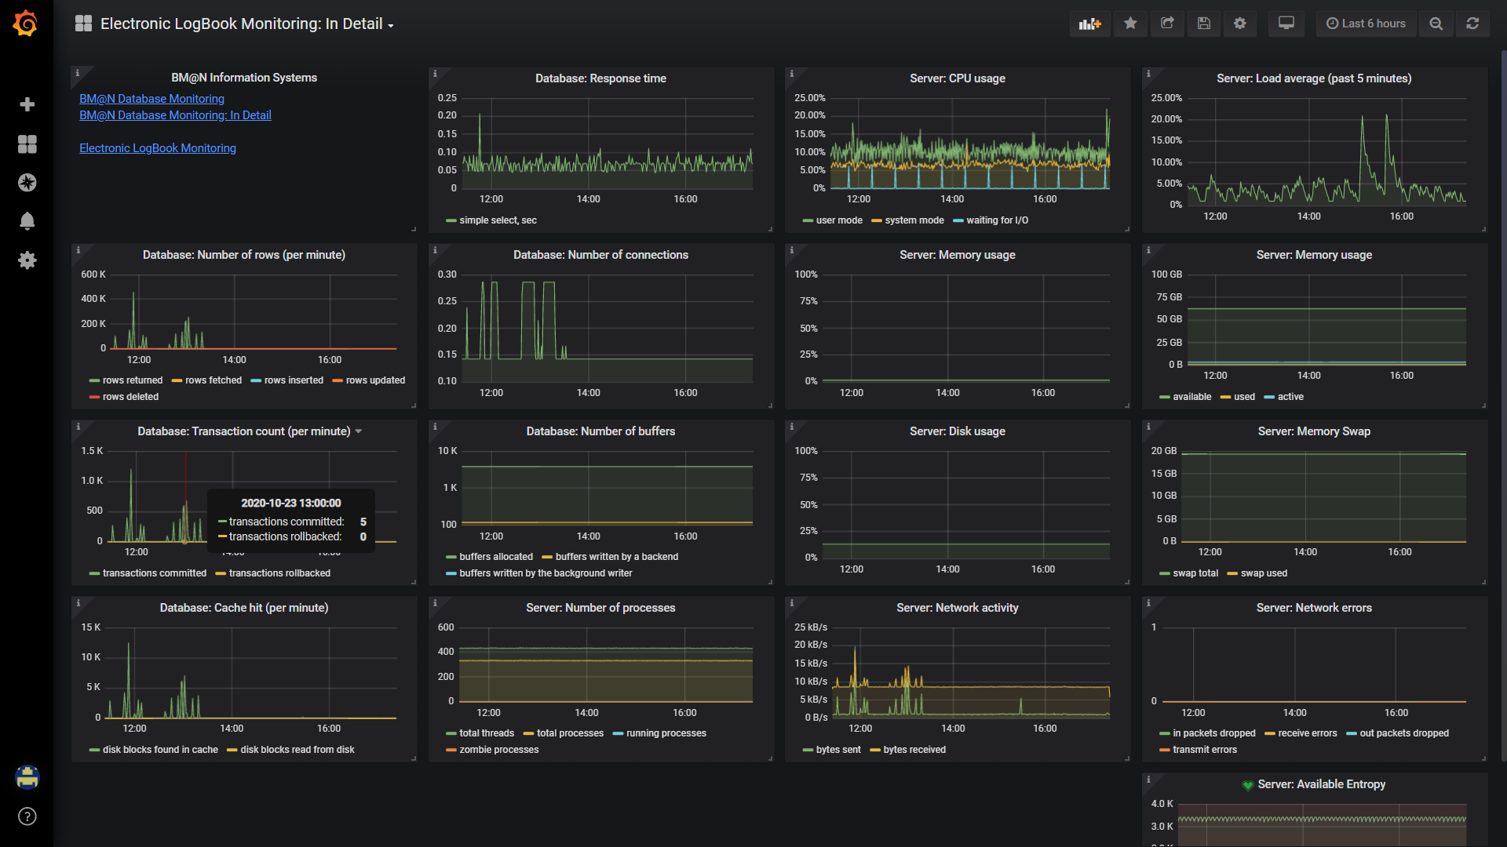
Grafana View – 4 of 4

Slide 15
Visualization – Event Display Next-Gen
Sponsored by

Slide 16
Visualization as a service
Visualization runs as a stand-alone service
It communicates with other services via HTTP
The service itself uses plugin system to include new visualization types
Adapters are made to convert ROOT/GEANT/whatever format into visualization tree

Slide 17
Introducing VisionForge
Developed as Kotlin multiplatform application
Available at https://github.com/mipt-npm/visionforge
Features
Working Three-JS rendering engine
Caching and template usage for performance optimization
Styling capabilities
Layering
Implementation for all primitives needed for BM@N geometry
Basic online object manipulation capabilities
Complete reader for GDML format

Slide 18
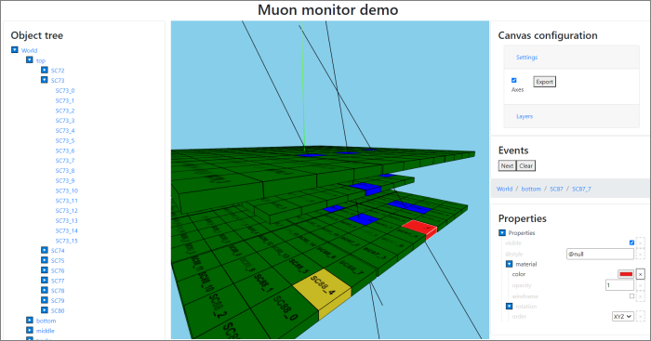
Muon Monitor Demo

Slide 19
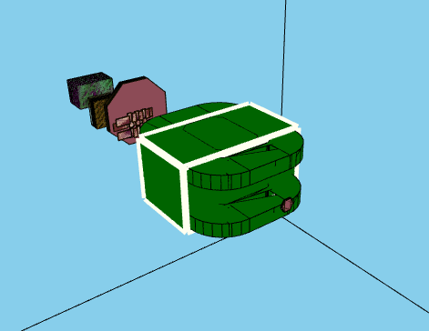
BM@N Geometry

Slide 20
Current work and plans
Finalization of ROOT plugin to convert TGeoManager to JSON
https://github.com/Unrealf1/RootExtraction
VR via Three-JS
OpenGL backend
Non-3D plugins

Slide 21
Slow Control Viewer

Slide 22
Slow Control Viewer – Task
Task
Web interface for slow control system of BM@N
Existing SCS Tango has MySQL DB with all sensor data obtained during runs
Show sensor data graph based on run no. or time interval, and parameter name
User selects:
User-friendly alias for parameter name OR parameter list as stored in DB
Run no. OR time interval
Parameter can be 1d array – in this case a multigraph is displayed
Implementation
Uses Dash framework, all packed in Docker container
https://git.jinr.ru/nica_db/tango_web

Slide 23
Slow control viewer v1.0 (2019)
SC data
Run data

Slide 24
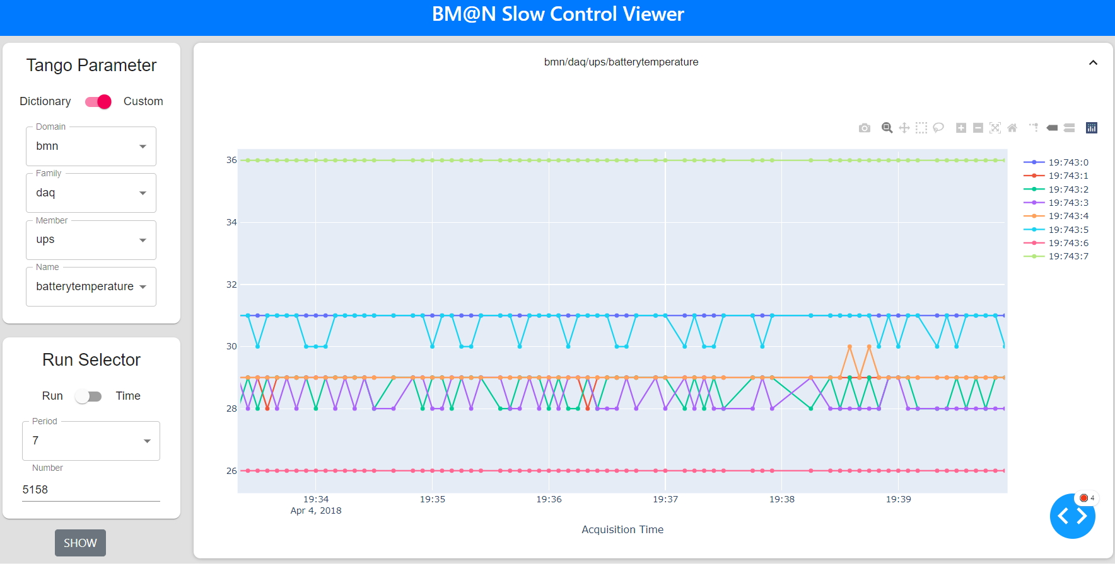
NEW Slow Control Viewer v2.0 (2020-10)

Slide 25
Statistics Collection

Slide 26
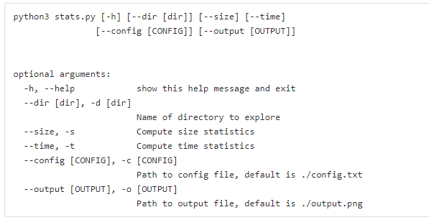
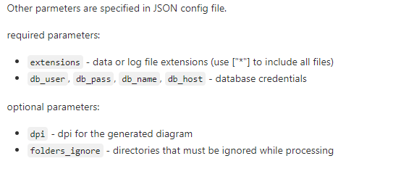
Statistics Collection Script
Task
Show histograms, and summary data, for:
File size and size per event in a given directory (.data, .root files – configurable)
Parse logs to get time of processing for macros (including time per event)
Implemented as Python script
https://git.jinr.ru/nica/bmnroot/-/tree/dev/uni_db/services/statistics

Slide 27
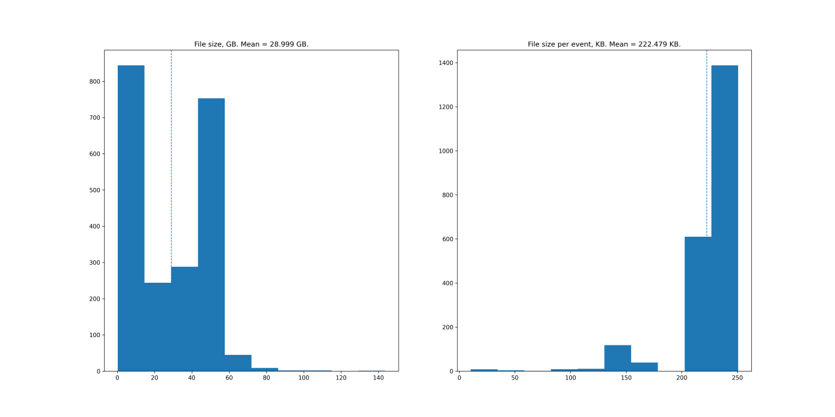
File Size Graph Example
# python3 stats.py --size --dir /eos/nica/bmn/exp/raw/run7/ --config config-size.json --recursive

Slide 28
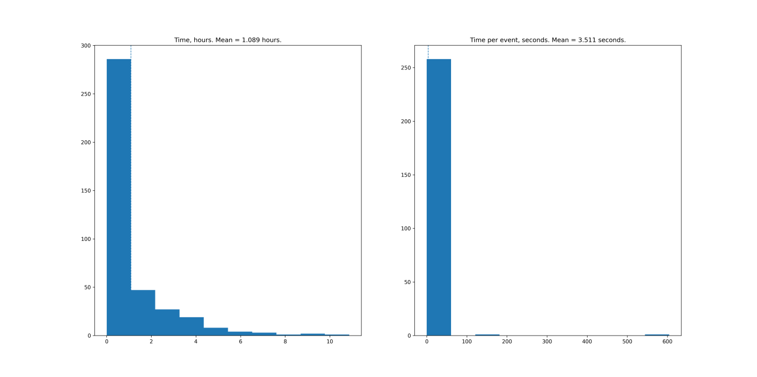
Time Graph Example
# python3 stats.py --time --dir /eos/nica/bmn/users/gertsen/logs/batch_raw_run5/ --config config-time.json

Slide 29
Event Indexing

Slide 30
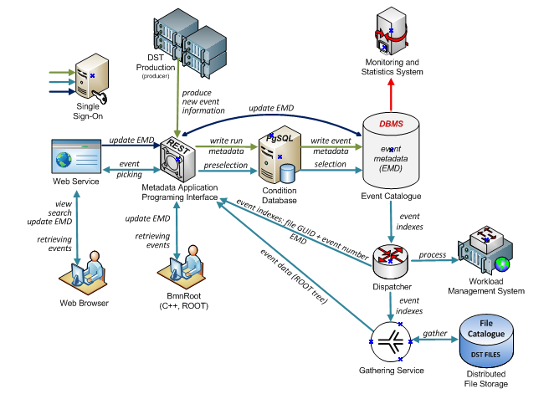
Event Metadata Architecture

Slide 31
EMD DBMS Choice – Task
Proposed DB schema (https://git.jinr.ru/nica/bmnroot/-/issues/58):
file_id (int, 8 byte)
event_number (int, 4 byte)
software_id (int, 2 byte)
period_number (int, 4 byte)
run_number (int, 4 byte)
primary_vertex (boolean)
detector_hit (int, 4 byte)
primary_tracks (int, 4 byte)
all_tracks (int, 4 byte)
positive_tracks (int, 4 byte)
particles (int, 4 byte)

Slide 32
Example Requests to DB
It is desirable to have queries similar to (SELECT … FROM … WHERE …):
period = 7 AND software_version = 20.02.0 AND primary_tracks > 5
period = 6 AND software_version = 19.05.0 AND primary_vertex = false AND detector_hit[bits:0-5] > 20
period = 5 AND run_number > 100 AND primary_vertex = true AND particles[bits:5-9] > 4
period = 4 AND software_version = 19.10.0 AND primary_tracks > 6 AND all_tracks > 40 AND particles[bits:10-14] > 6

Slide 33
DBMS Tests - PostgreSQL
Main question so far is the choice of EMD DBMS. As decided, our team’s focus is PgSQL DB and Cassandra DB (NoSQL).
PostgreSQL with 1B events was tested
On test server, test queries typically take about 30s if all event table fits in memory and cashed
Full table scan is used, with no indexing so far

Slide 34
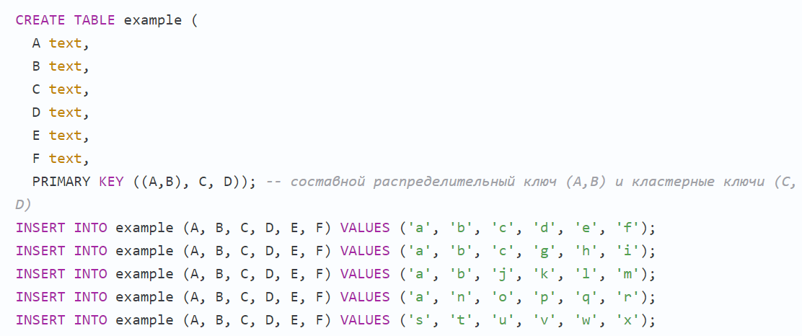
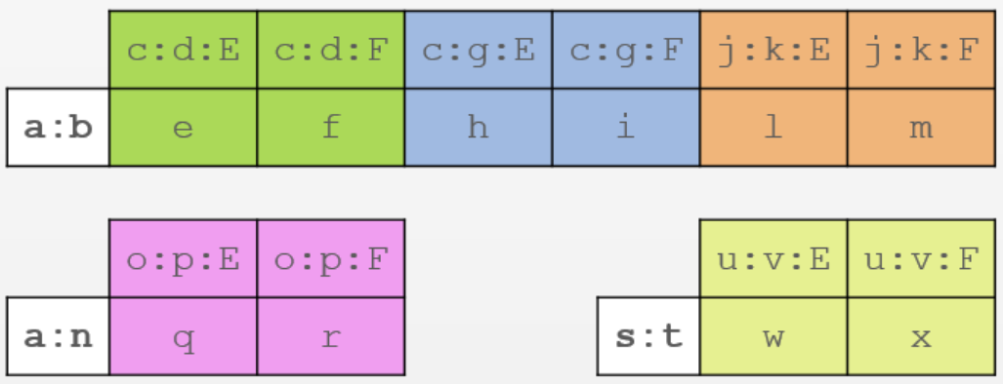
DBMS Tests – Cassandra (WIP)
Cassandra
Overall, Cassandra / NoSQL requires us to think differently
First requests, then data
Both key-value and column-based database
Need to plan requests very carefully. Normally, new request = new table and data duplication.
ALLOW FILTERING exists, but is killing performance
CQL has many limitations compared to SQL
E.g. comparison can only be applied to last element of partition or clustering key
Comparison is only <, > (no bitwise operators etc.)
https://habr.com/ru/post/203200/

Slide 35
Cassandra Example
Cassandra progress
Installed Cassandra 3.0.9 on the test server
Event generator working
500M events generated (currently 20K events/sec writing rate on 1 server)
Table with
PRIMARY KEY = ((period_number, software_id, primary_tracks), file_id, event_number)
It is projected for requests of the form
SELECT... WHERE period_number=... AND software_id=... AND primary_tracks=…
Can also use IN instead of =, but time increases linearly
Comparison (only <, >) is allowed only for the last part of clustering key
About 1.5 seconds

Slide 36
Example requests
cqlsh> SELECT COUNT(1) FROM ei4.events WHERE period_number = 7 AND software_id = 3 AND primary_tracks = 5;
count
--------
297720
(1 rows)
cqlsh> SELECT COUNT(1) FROM ei4.events WHERE period_number = 7 AND software_id = 3 AND primary_tracks = 5 AND file_id = 1 AND event_number > 600;
count
--------
297719
(1 rows)
cqlsh> SELECT * FROM ei4.events WHERE period_number = 7 AND software_id = 3 AND primary_tracks = 5 AND file_id = 1 AND event_number > 600 AND detector_hit < 10000 ALLOW FILTERING;
period_number | software_id | primary_tracks | file_id | event_number | all_tracks | detector_hit | particles | positive_tracks | primary_vertex | run_number
---------------+-------------+----------------+---------+--------------+------------+--------------+------------+-----------------+----------------+------------
7 | 3 | 5 | 1 | 288329075 | 157 | 1897 | 137059354 | 5 | True | 456
7 | 3 | 5 | 1 | 396905270 | 38 | 6503 | 1241871400 | 0 | True | 276
cqlsh> SELECT COUNT(*) FROM ei4.events WHERE period_number = 7 AND software_id IN (2,3) AND primary_tracks IN (5,6,7,8,9) AND file_id = 1 AND event_number > 600 AND detector_hit < 10000 ALLOW FILTERING;
count
-------
12
1.5 s.
1.5 s.
0.5 s.
5 s.

Slide 37
Cassandra WIP
TODO
Test newer version, most importantly due to CUSTOM INDEX support
Increase write speed with optimal batch size
More tables/requests and scale

Slide 38
Thank You!

