Slide 1
The target station, mechanics of the beam diagnostics tools, X-ray tests of the carbon beam pipe
LLC “Vacuum systems and technologies”
A. Kubankin at all.
October 2019

Slide 2
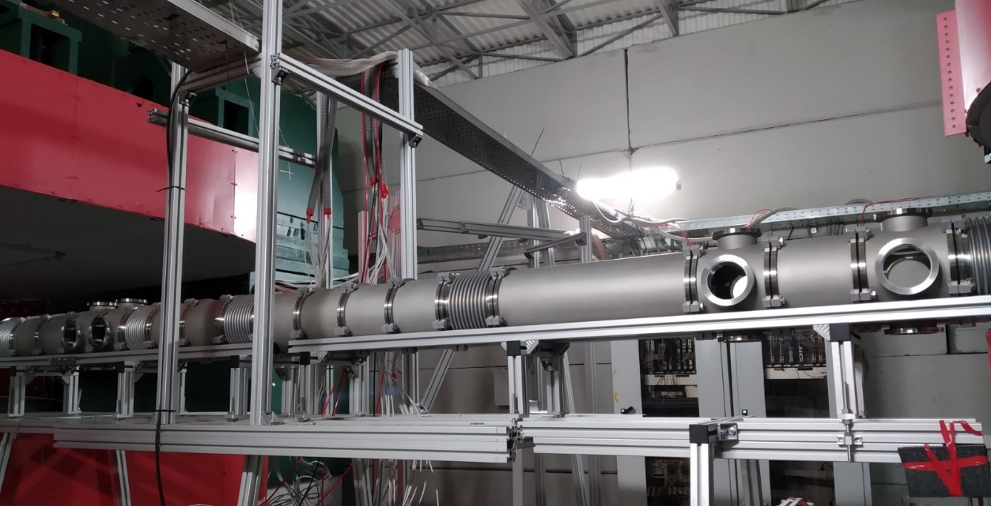
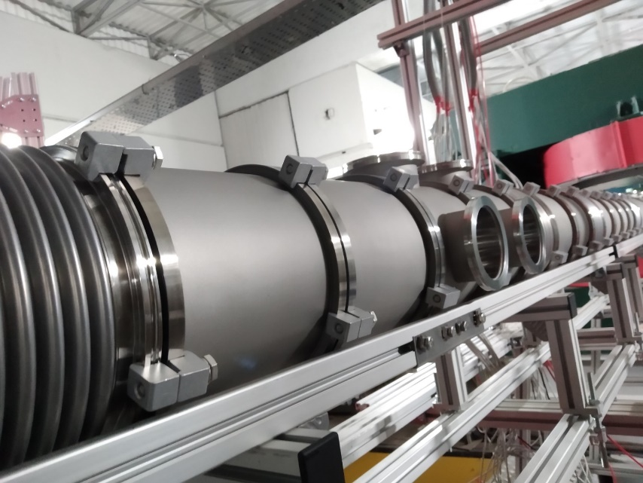
Radiation Physics Laboratory of Belgorod State University LLC “Vacuum systems and technologies” LLC “R@D Vacuum”
Manufactured beam pipe before the target

Slide 3
Content
The target station
The mechanics of beam diagnostics tools
X-ray tests of the carbon beam pipe

Slide 4
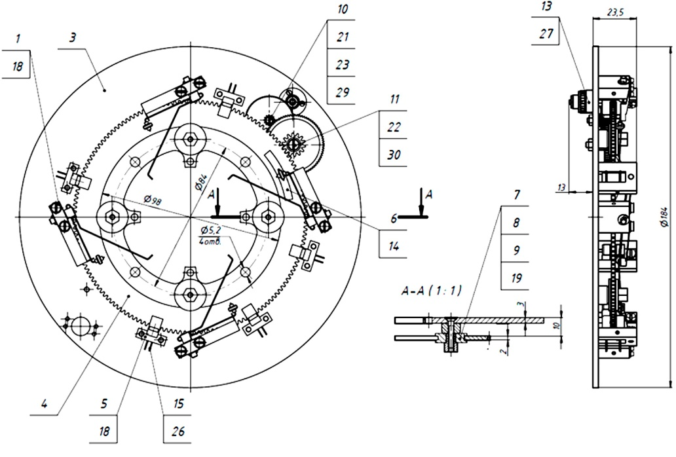
The target station with piezoelectric actuator

Slide 5
The target station with pneumatic actuator

Slide 6
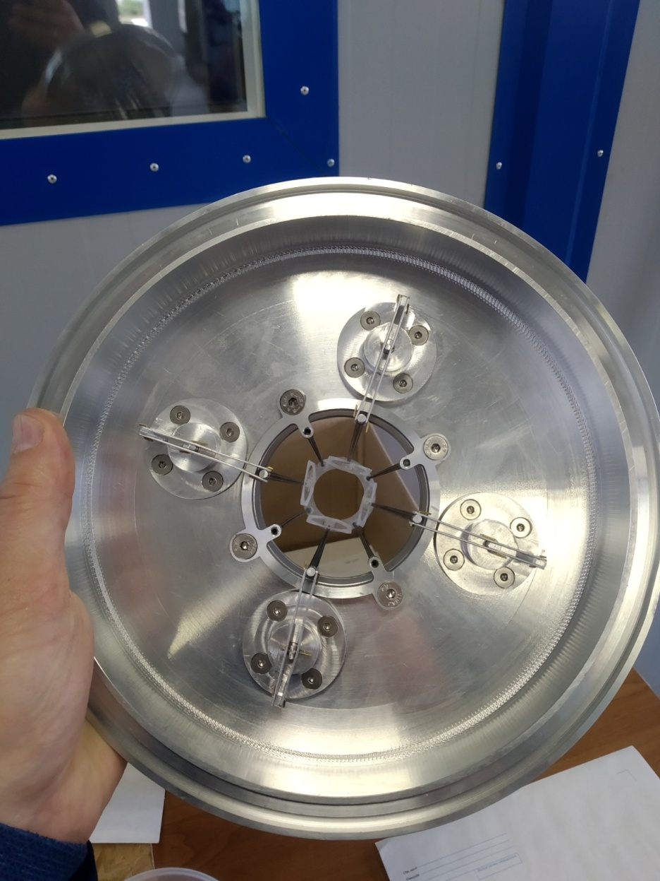
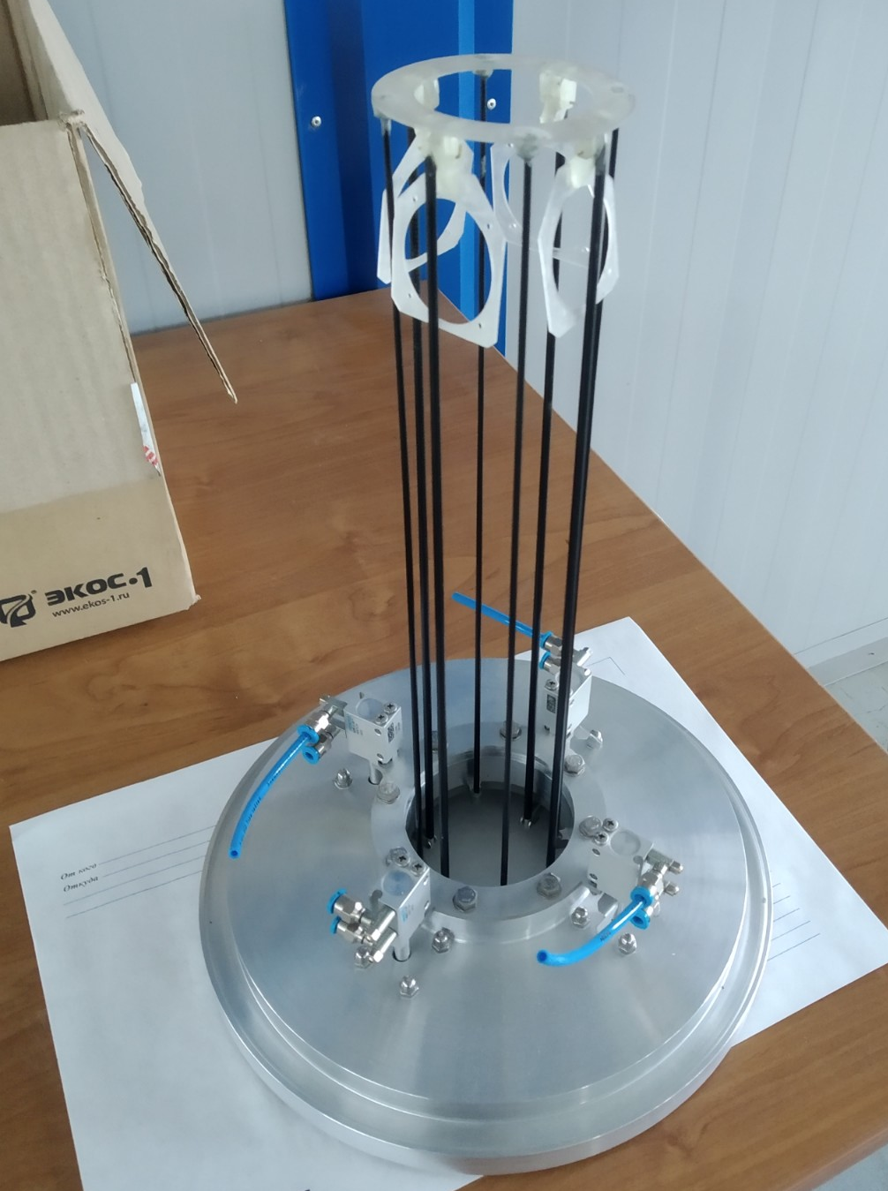
The target station with pneumatic actuator

Slide 7
The mechanics of beam diagnostics tools
magnet
Main requirements for the mechanics:
- vacuum compatibility;
- no magnetic materials.
magnet
Two flanges for mounting of beam
diagnostics tools
X-Y Si-profilemeter

Slide 8
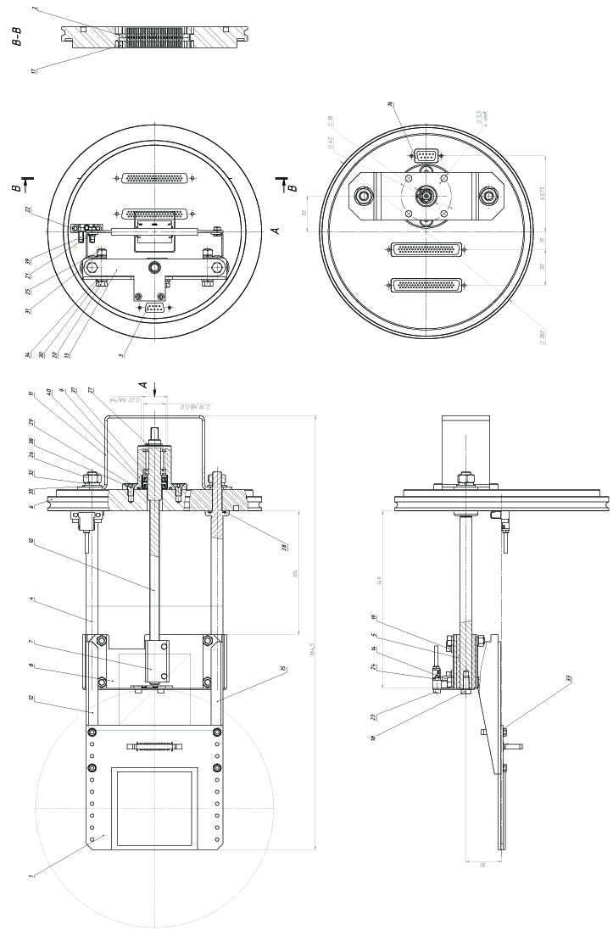
The mechanics of beam diagnostics tools

Slide 9
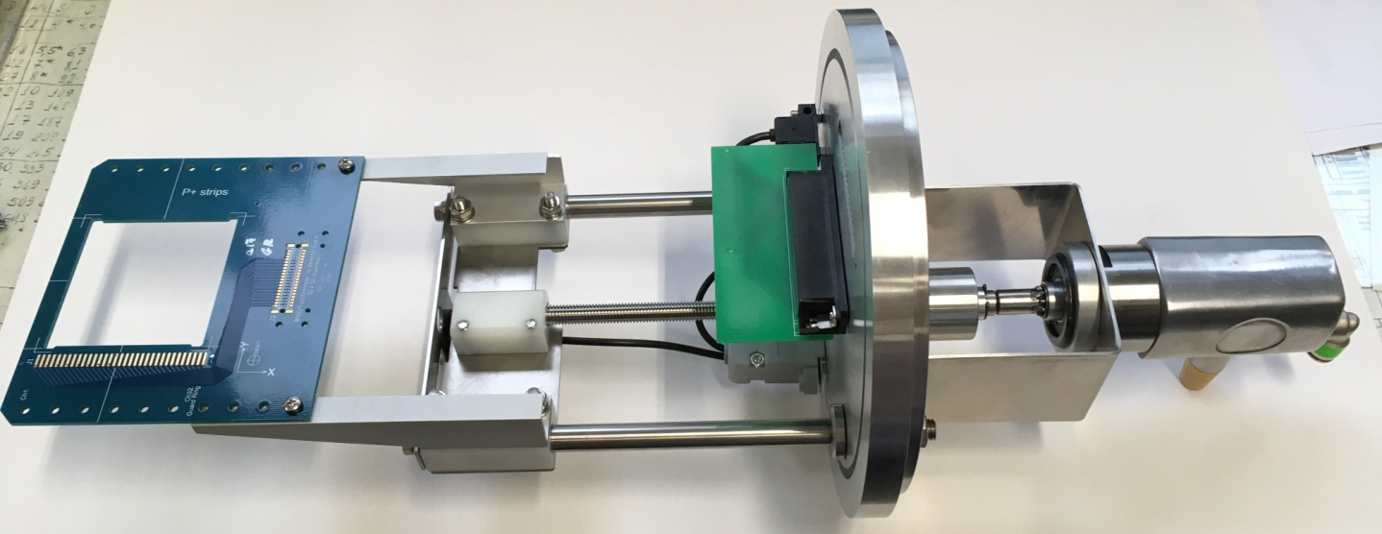
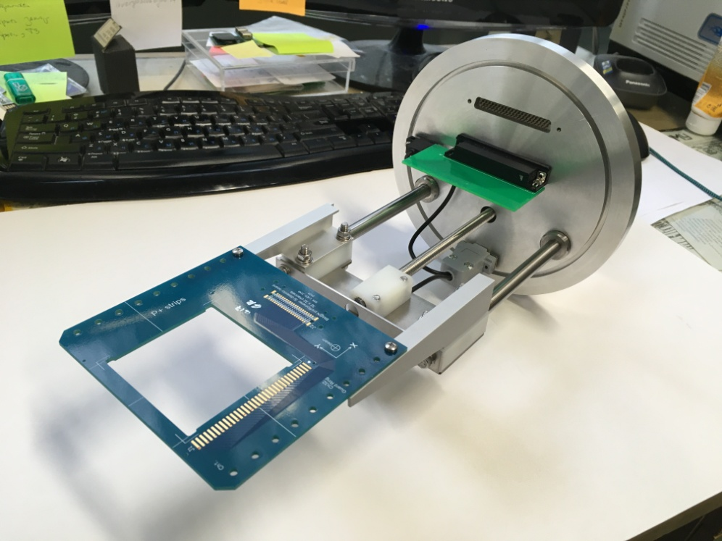
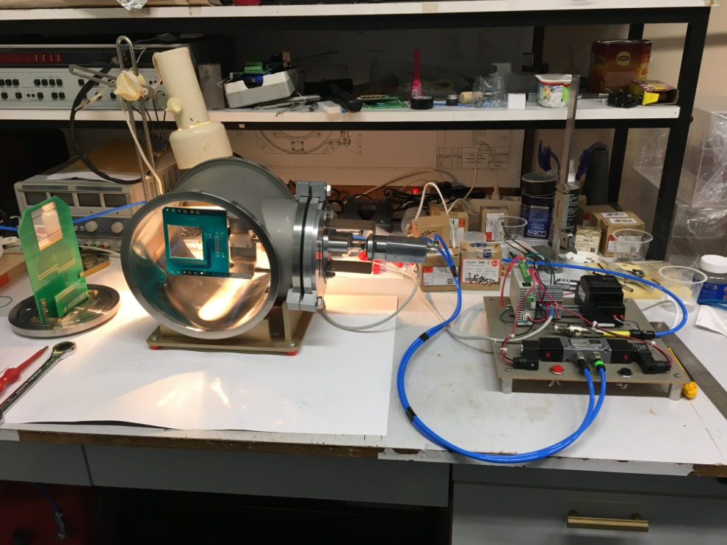
The mechanics of beam diagnostics tools

Slide 10
X-ray tests of the carbon beam pipe
One of important tasks of BM@N setup development is quality control of the carbon beam pipe.
The task: development of the experimental setup for measurement of thickness of carbon tubes (beam pipe) wall.
Main characteristics:
- accuracy of thickness measurement must be better than 100 um for thicknesses of 0.5...5 mm;
- possibility to perform the measure in scanning mode including edges of the tube (scanning must be without any «black» areas of the tube surface);
- tube diameter 50…100 mm;
- minimal area of the tube surface element smaller than 1 mm².

Slide 11
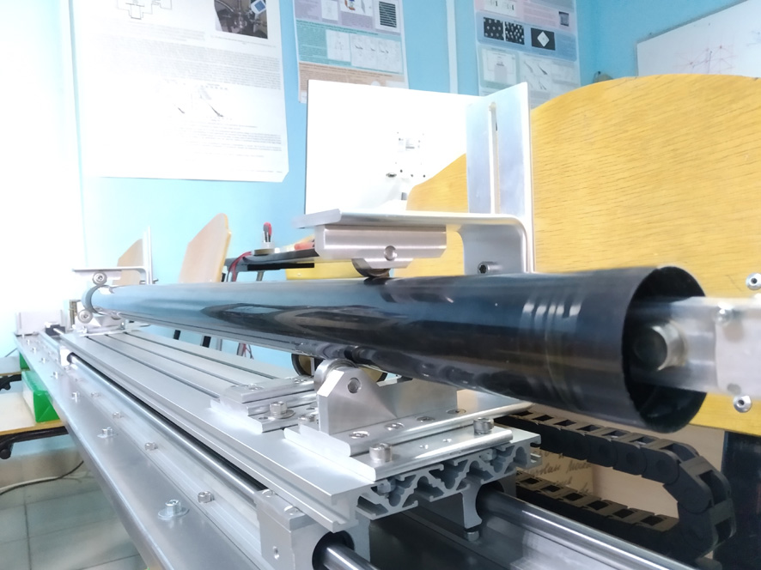
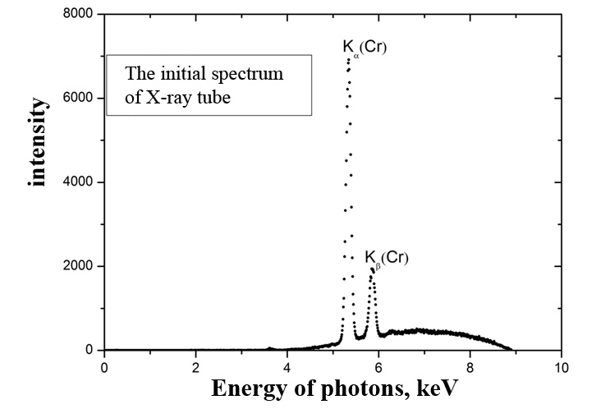
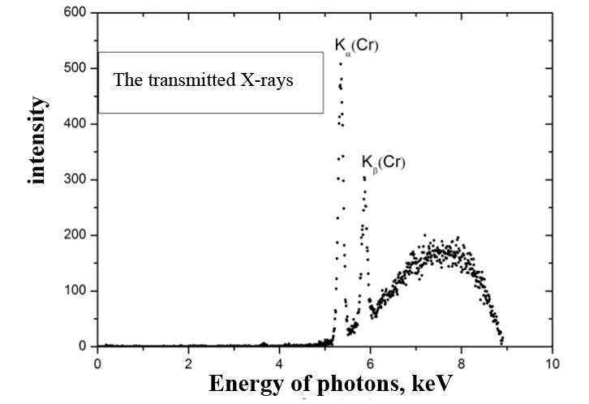
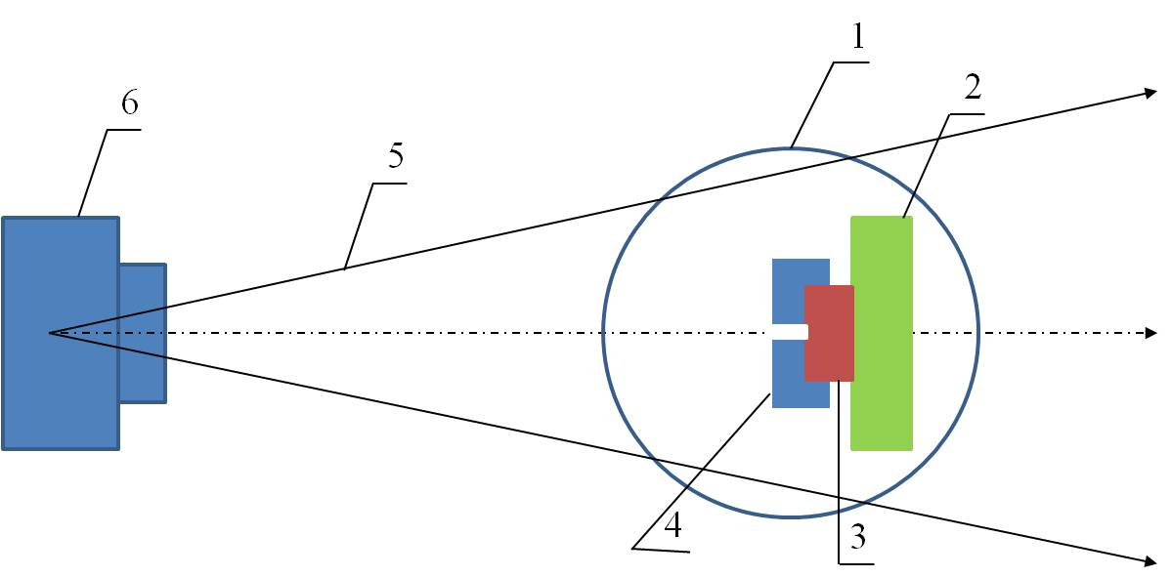
X-ray tests of the carbon beam pipe
The experimental setup. 1 – the tube; 2 – X-ray spectrometer mount plate;
3 – X-ray spectrometer; 4 – lead collimator; 5 – area of X-ray flux; 6 – X-ray tube.

Slide 12
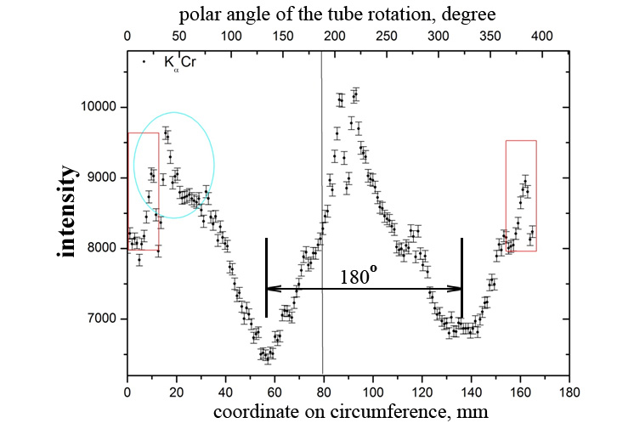
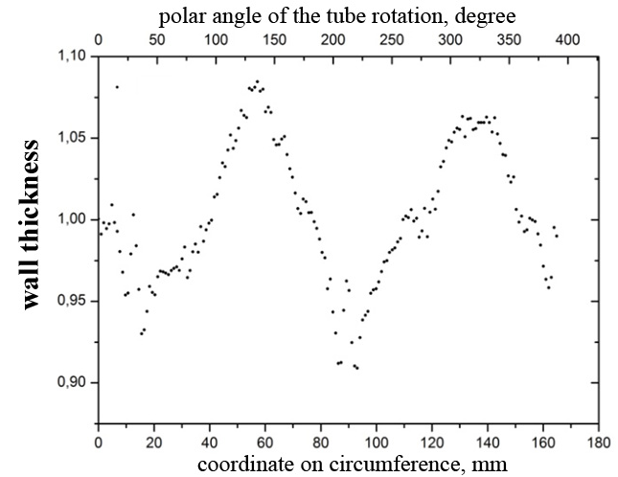
X-ray tests of the carbon beam pipe
The results of the wall thickness measurements for a fixed coordinate
along axis of the tube.

Slide 13
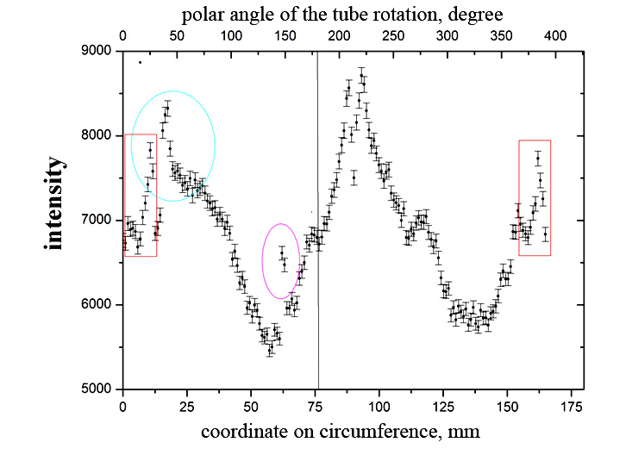
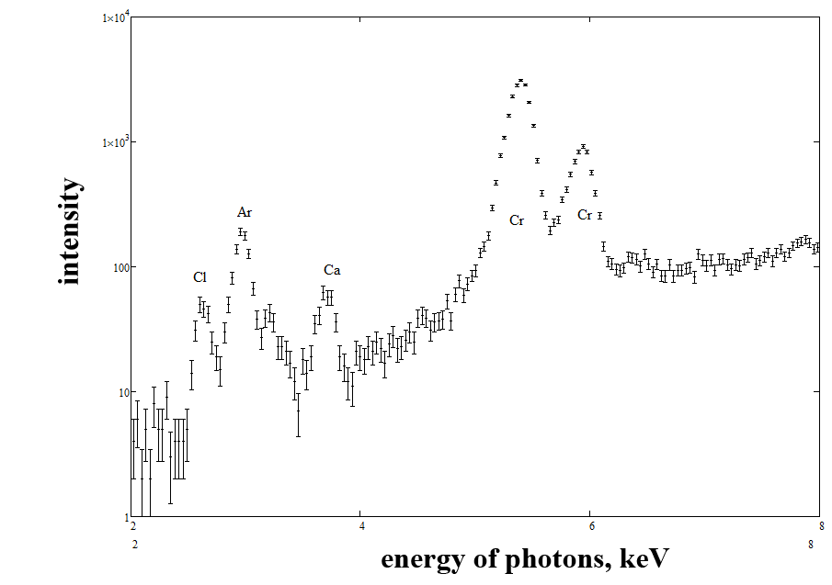
X-ray tests of the carbon beam pipe
Measurement of transmitted X-ray intensity
The achieved accuracy of the wall thickness measurement: better than 10 um for the time of measurement 10 seconds (one point).
The additional result: possibility to control local elemental composition of the tube material on the base of measurement of X-ray fluorescence spectra.
Measurement of X-ray fluorescence spectrum

Slide 14
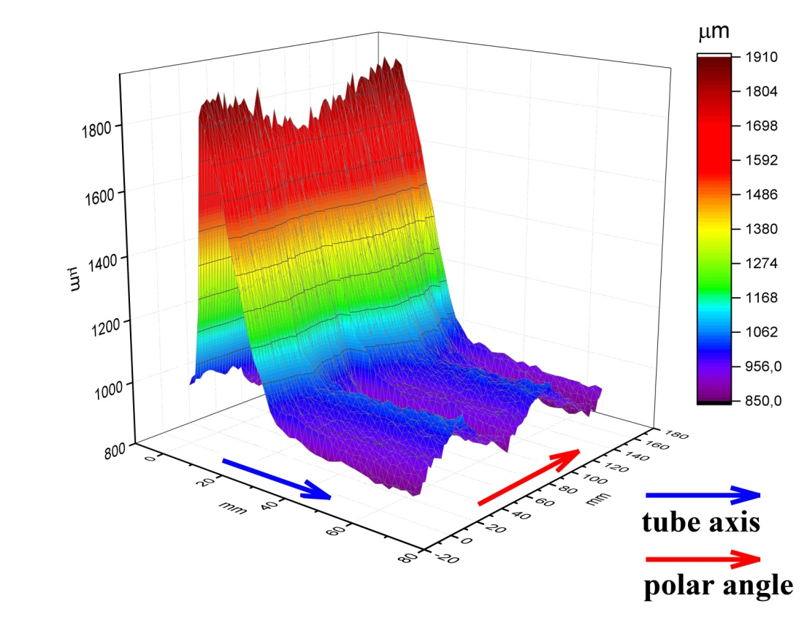
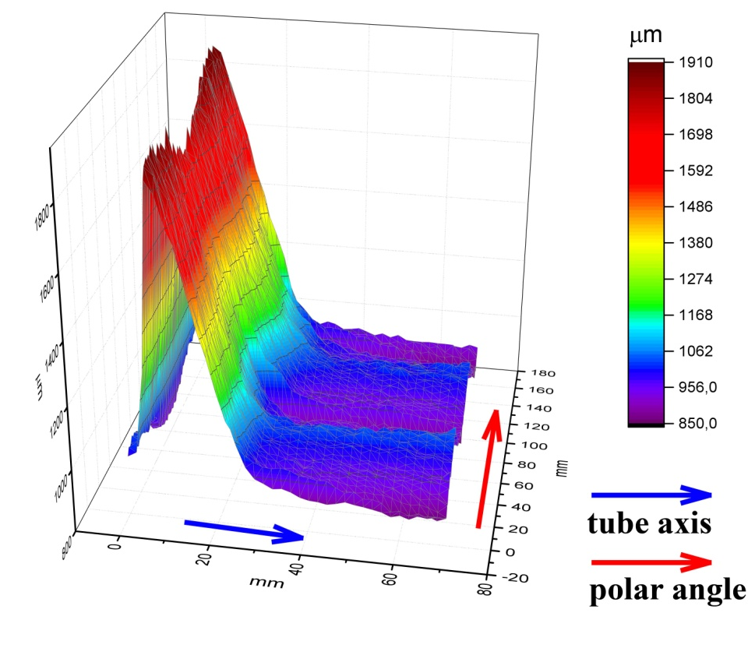
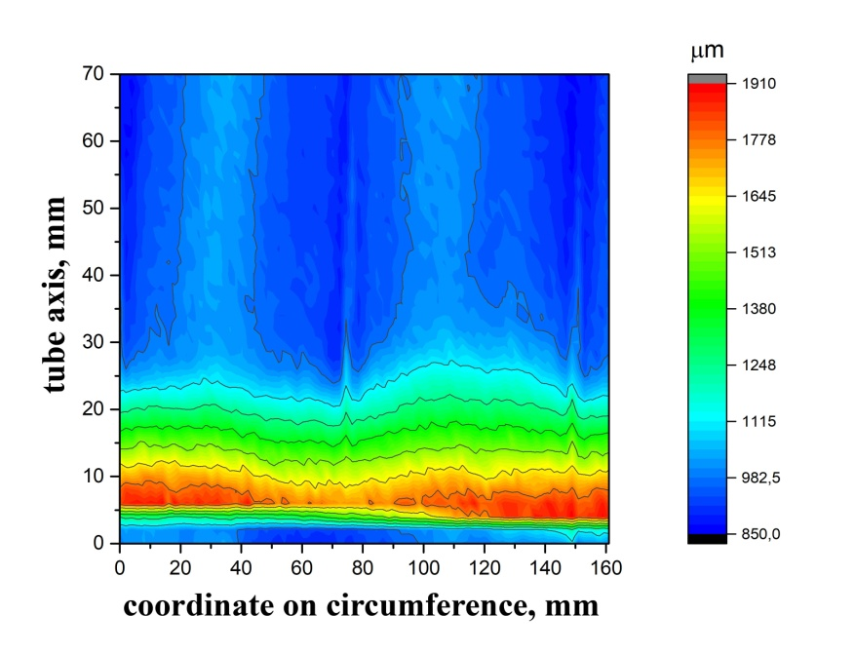
X-ray tests of the carbon beam pipe
X-ray 3D map of the wall thickness distribution

Slide 15
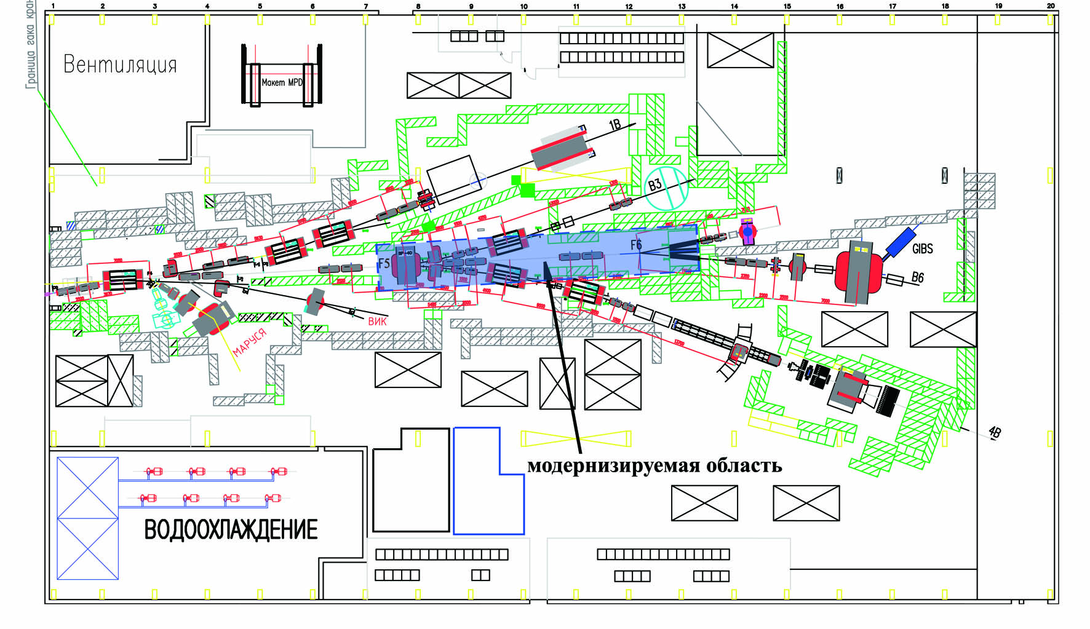
The vacuum beam pipe
The modernized area of the beam pipe

Slide 16
The main results
The following parts of BM@N experimental setup have been developed and produced: mechanics of the beam diagnostics tools and target station. The both devices do not have magnetic materials and can be used in conditions of strong magnetic field.
The experimental setup for measurement of wall thickness of carbon beam pipe is developed and tested.
The production of the vacuum ion beam pipe will start soon.

Slide 17
Thank you so much for the attention!

