Slide 1
$K_{s}^{0}$ mass resolution
Presented by Khukhaeva Anastasia

Slide 2
Parts of the presentation
Problem description
Research methods
Results and conclusion

Slide 3
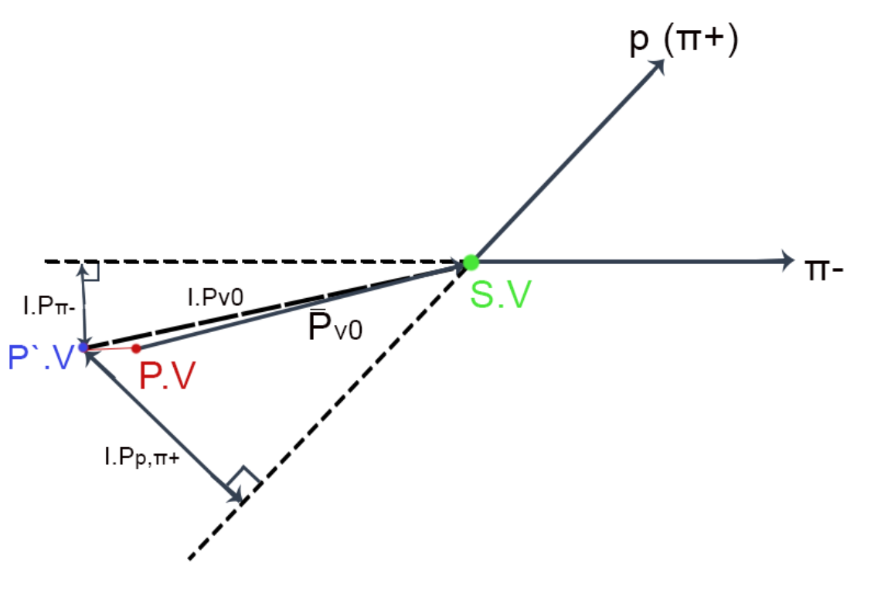
Problem description
Why we are not seen $K_{s}^{0}$:
Small spectrometer acceptance for $K_{s}^{0}$
Small production section of $K_{s}^{0}$ at threshold of reaction

Slide 4
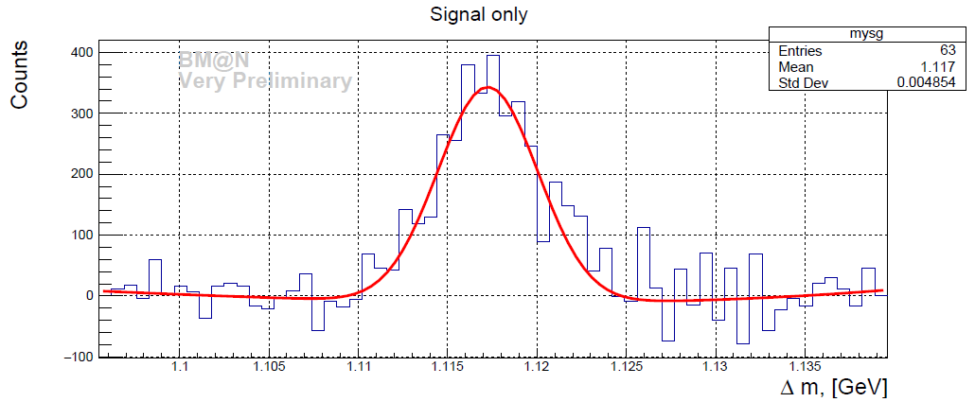
Real data in Run6
The fit reveal the width of the signal equal to 4.85 Mev

Slide 5
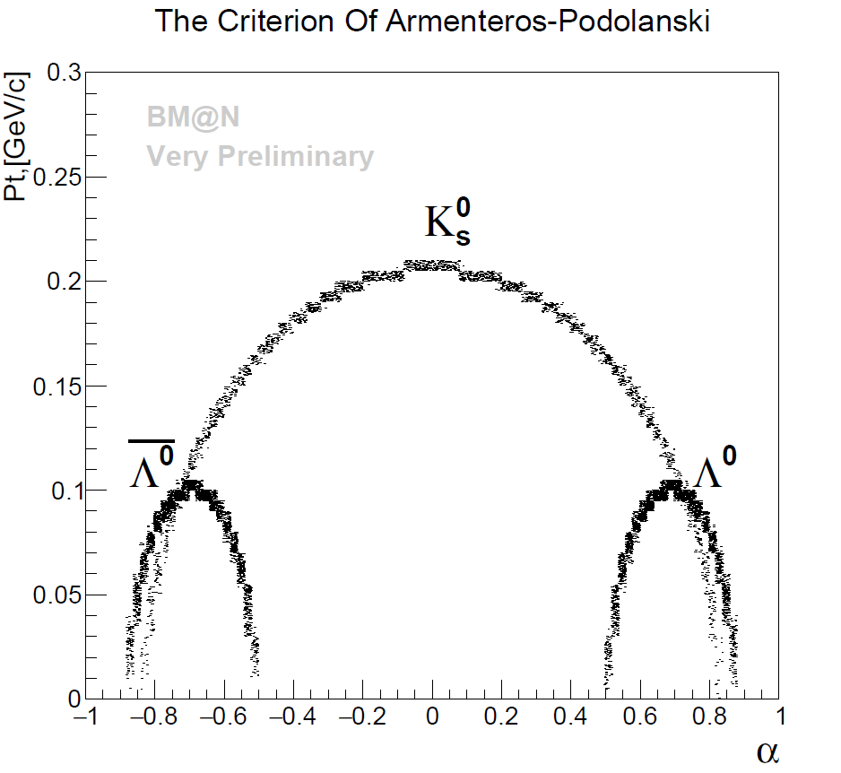
The Criterion of Armenteros-Podolanski
$P_{t}$ - transvers momentum of the products
α =$\frac{P_{l}^{+}− P_{l}^{−}}{P_{l}^{+}+ P_{l}^{−}}$
$P_{l}^{+}$ - longitudinal momentum of positively charged particles
$P_{l}^{−}$ - longitudinal momentum of negatively charged particles

Slide 6
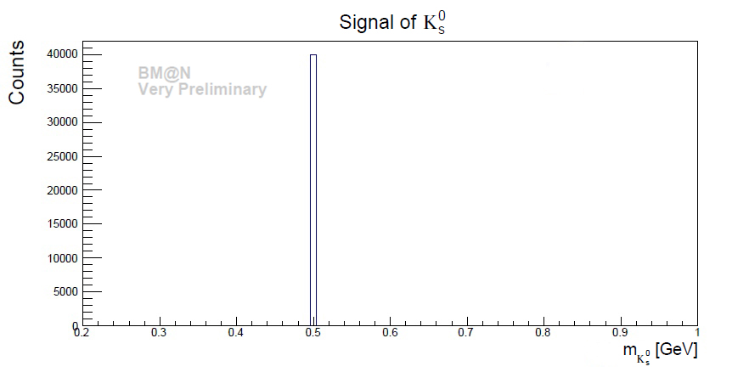
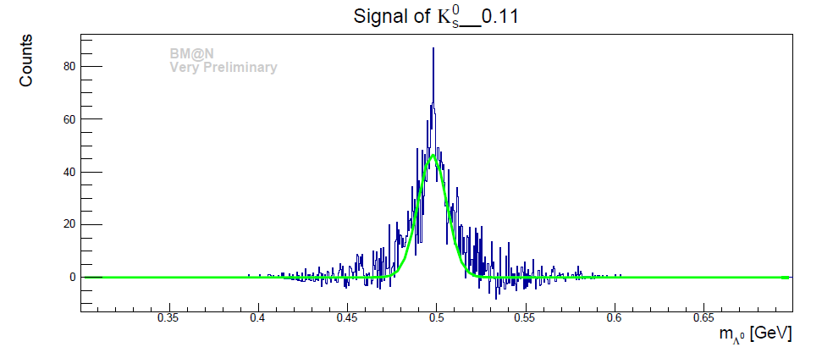
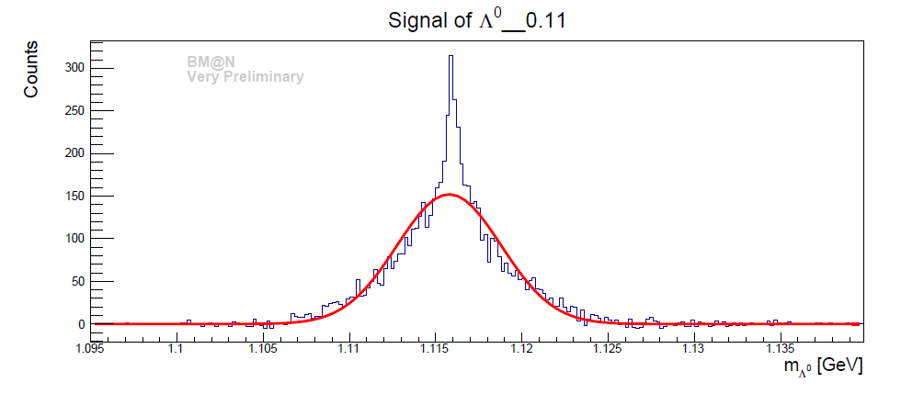
The resulting histogram

Slide 7
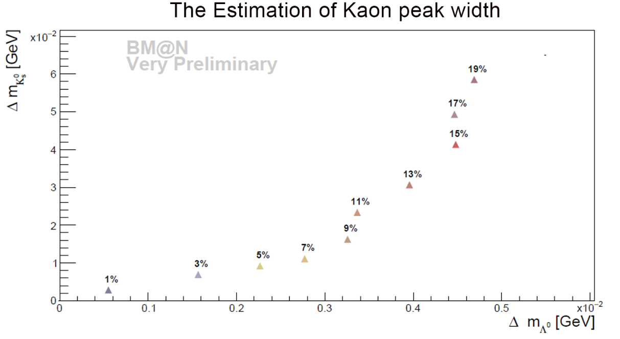
The resulting graph
We may expect the width of the $K_{s}^{0}$ in the region of
58.53 ± 1.22 MeV

Slide 8
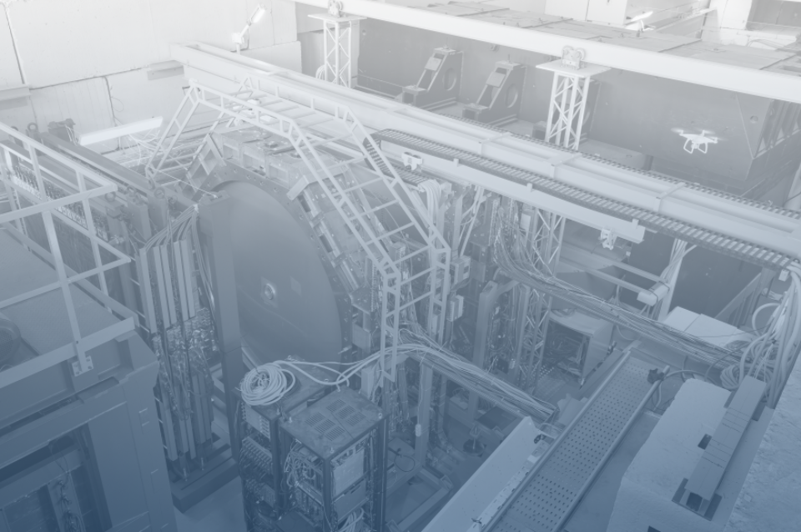
6th BM@N Collaboration Meeting
Thank you all for your attention!

