Slide 1
NICA injection complex status
A. Martynov on behalf of NICA team

Slide 2
Table of Contents
Structure and layout of the injection complex
LU-20 injector:
  Source of polarized Ions
  Modernized foreinjector
  Transportation channel overview
  Obtained results during Nuclotron runs 52-54
Heavy ions linear accelerator (HILAc)
  Design & parameters
  Commissioning

Slide 3
Structure of the complex
Transfer to collider rings
Nuclotron
SPI
RFQ
LU-20
LIS
p↑, d↑, ions z/A>0.3 5 MeV/u
HILAc
Booster
ESIS
RFQ
IH1
IH2
Au³¹⁺ 3.2 MeV/u
Polarized p↑ and d↑ beams, protons and light ions
are planned to be accelerated with existing Linac LU-20,
Heavy ions: HILac + Booster

Slide 4
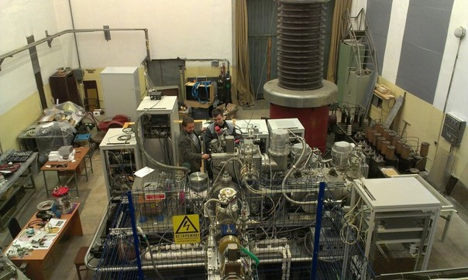
Source of polarized ions (SPIon)
The main purpose of the SPI-project is to produce the intensity of the accelerated polarized beams (D+,H+) at the JINR Accelerator Complex up to 10¹⁰ p/pulse

Slide 5
SPIon
3 runs in 2016-2017 (#52-54) with d↑, 1 run (#54) with stable p↑ beam.
 | Polarized deutrons | Polarized protons
Obtained beam current in 2017 (source) | 2 mA | 0.4 mA
Project beam current (source) | 5-6 mA | 5-6 mA
Obtained beam intensity in 2017 (Nuclotron) | 2.2x10⁹ ppc | 1.8x10⁸ ppc
Project beam intensity (Nuclotron) | 1-2x10¹⁰ ppc | 1-2x10¹⁰ ppc
Plans:
1) Measure and match beam emittance from SPI to LEBT
2) Install buncher in front of DTL (int. x3)

Slide 6
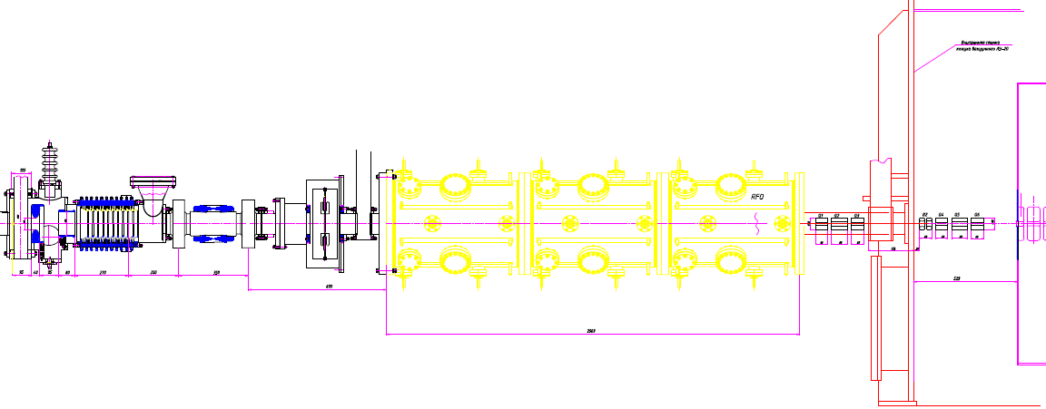
LU-20 injection line
LEBT
RFQ
MEBT
QT + (Bu) +QT
Source
LU-20 (DTL)
10 keV/u(SPI)
0.5 keV/u (LIS)
31 keV/u
156 keV/u
5 MeV/u
Ion source output
LEBT output
RFQ output
Lu-20 output

Slide 7
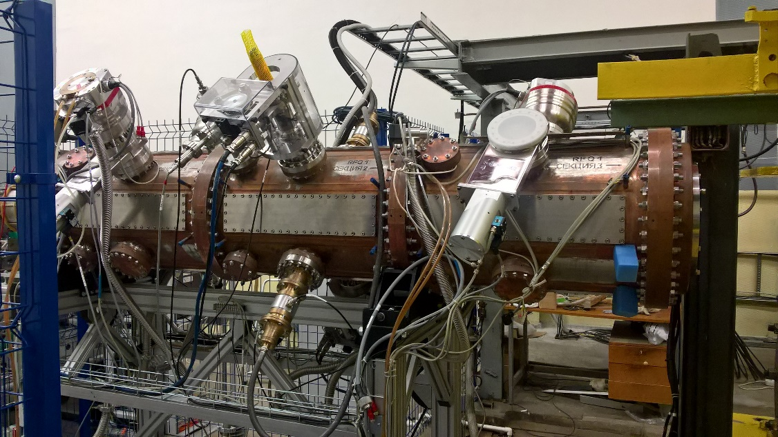
RFQ
In collaboration with ITEP, VNIITF (Snezhinsk), MEPHi (2016)
q/A | 1.0 | 0.5 | ≥ 0.3
Injection energy, [keV] | 31 | 61.8 | 103
Max current, [mА] | 10 | 20 | 10
Output energy [keV/u] | 156
Norm emittance (output) [π·cm·mrad] | ≤ 0.5
RFQ length, [m] | 2.2
Transmission, % | > 85% | > 89% | > 93%
In LU-20 acceptance with buncher | 70 % | 71 % | 80 %
In LU-20 acceptance without buncher | 15 % | 15 % | 20 %

Slide 8
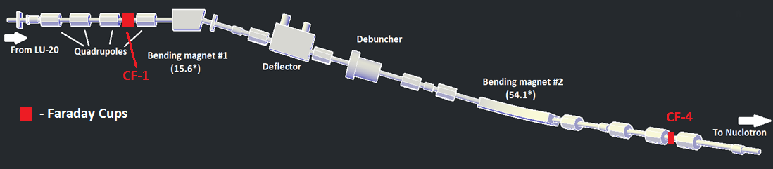
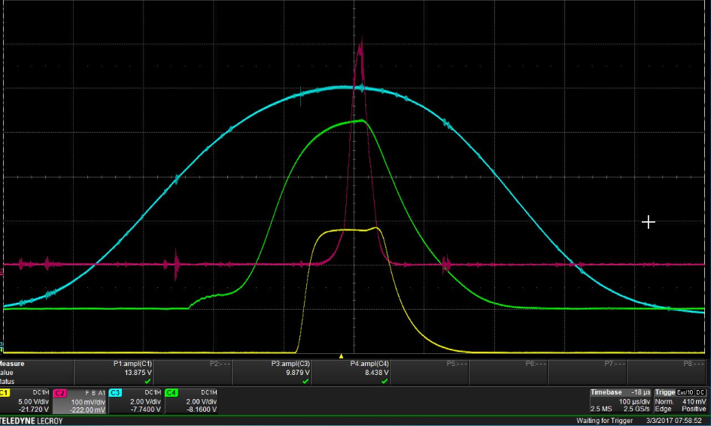
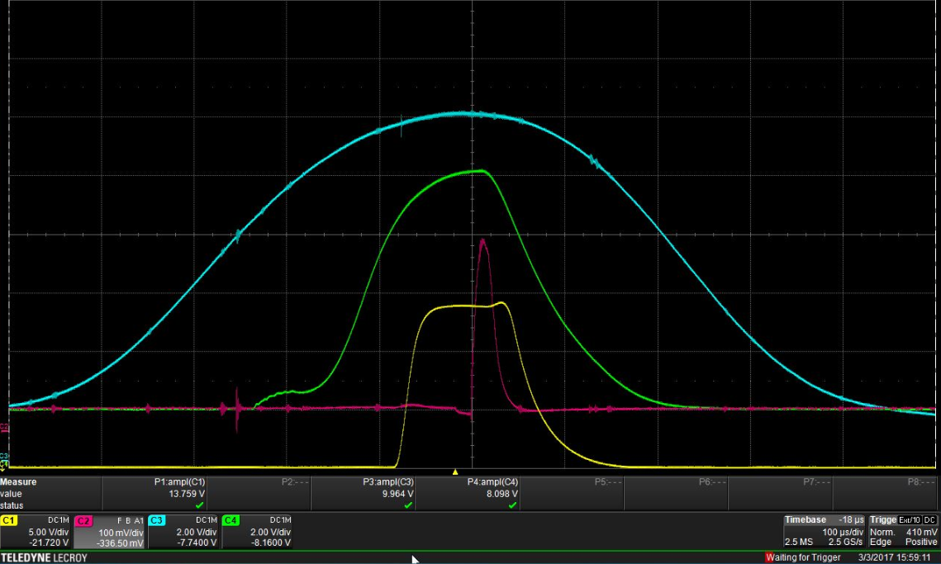
Transportation channel to Nuclotron
CF-1
Protons acceleration: I = 500 μA.
For polarized protons I = 38 μA.
CF-4
Protons acceleration: I = 300 μA.
For polarized protons I = 30 μA.
Beam loss in channel:
Protons: 40%
Polarized protons: 21%
Beam current
RF of LU-20
RF of RFQ
Accelerating
voltage

Slide 9
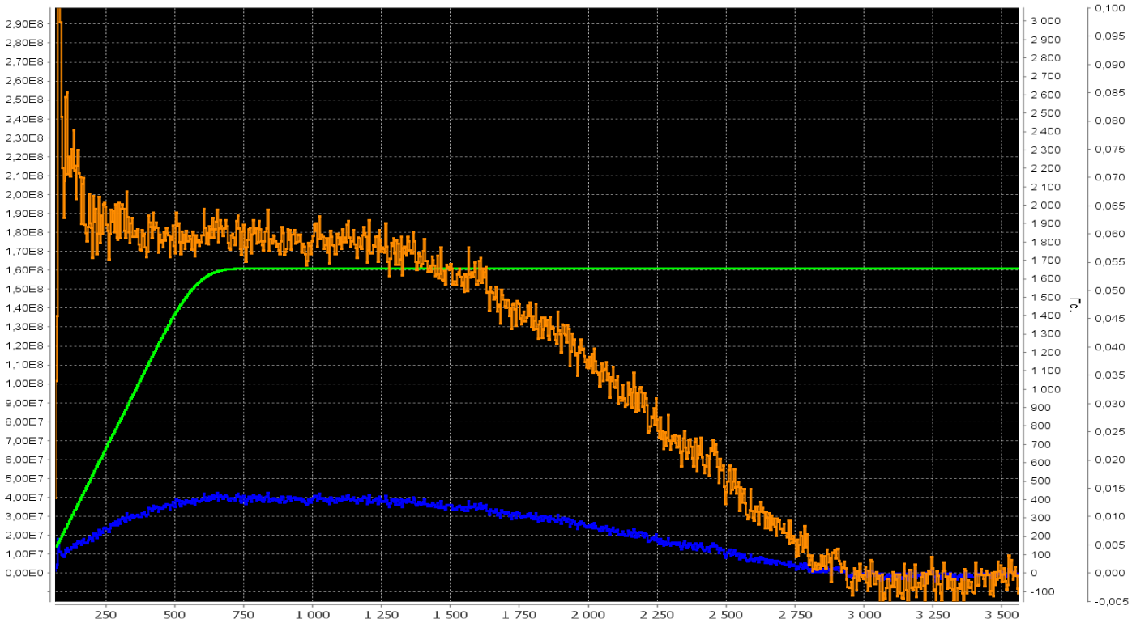
p↑ beam at Nuclotron
1.8 E8
1650
Beam voltage ,U
Beam intensity, particles/sec.
Magnetic field, Gs
Time, ms

Slide 10
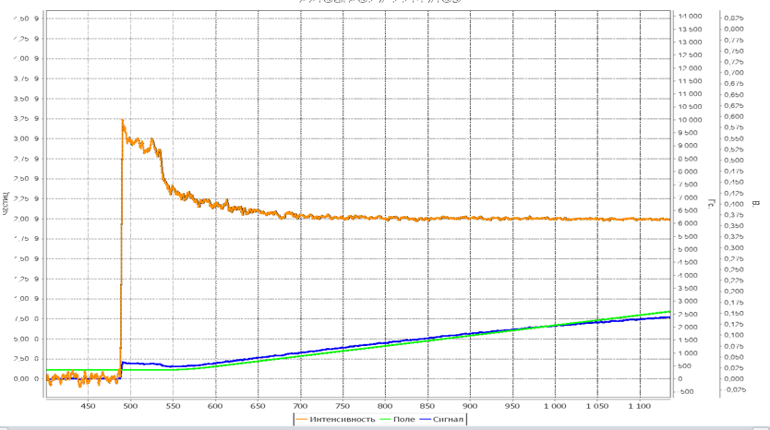
d↑ beam at Nuclotron
2.0 E9
Magnetic field, Gs
Beam voltage ,U
Beam intensity, particles/sec.
2500
Time, ms

Slide 11
Beam loss overview
Obtained results (run 54)
SPI
LEBT
RFQ
MEBT
LU-20
HEBT
Nuclotron
100%
80%
70%
16%
8-12%
3-10%
Theoretical beam loss (with buncher)
SPI
LEBT
RFQ
MEBT+ Buncher
LU-20
HEBT
Nuclotron
100%
80%
70%
50%
25-38%
10-32%
Measured parameters of accelerated beam
 | d | d↑ | p(H⁺) | p↑ | Li³⁺ | C⁵⁺/C⁶⁺
I_{RFQ}, μA | 3000 | 2000 | 3600 | 520 | 10000 | 12000
I_{CF-1}, μA | 500 | 500 | 500 | 38 | 430 | 400
I_{CF-4}, μA | 400 | 100 | 420 | 30 | 340 | 320
Intensity, ppc | 8x10⁸ | 2.2x10⁹ | 2x10⁹ | 1.8x10⁸ | 2x10⁹ | 3.5x10⁸

Slide 12
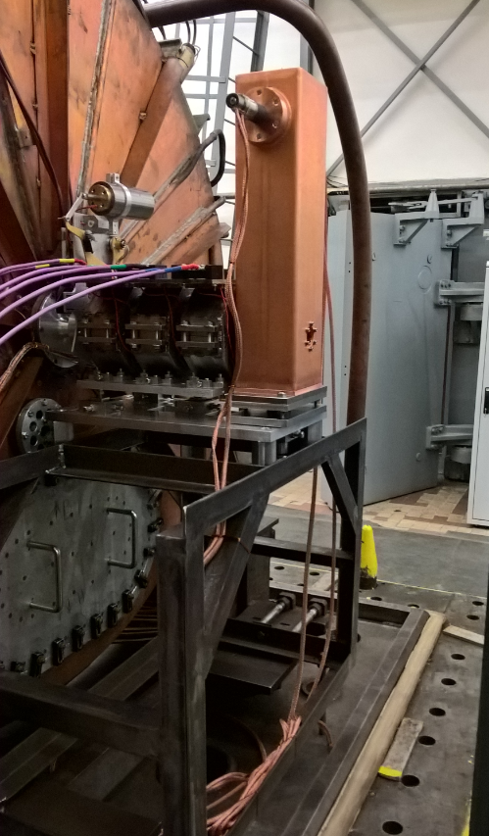
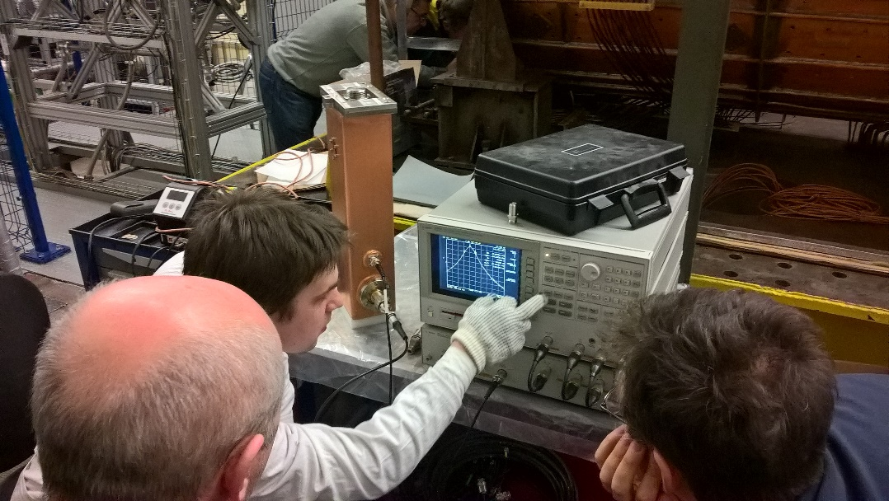
Next steps
Buncher installation in front of LU-20 and MEBT (ITEP)
Replacement of debuncher at transportation channel from LU-20 to Nuclotron (INR RAS).
Beam diagnostics.
Replacement of power supplies for elements of transportation channel.
Channel optics optimization.
Buncher tuning and installation (april 2017)

Slide 13
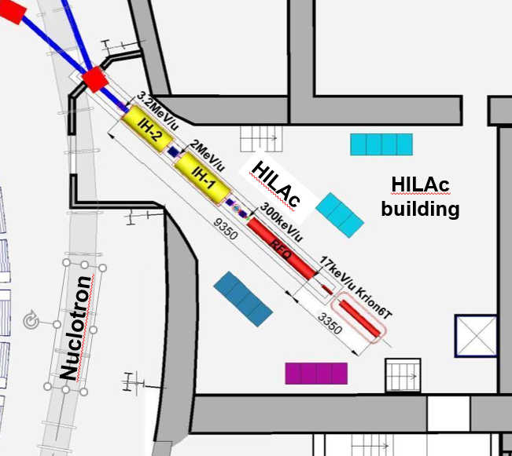
Heavy ions linac (HILAc)
Heavy Ions Linear Accelerator
NICA Injector for Au³¹⁺ 3.2 MeV/u
to Booster & Nuclotron
In collaboration with
“BEVATECH OHG”(Germany),
JINR, INR, ITEP(Russia).

Slide 14
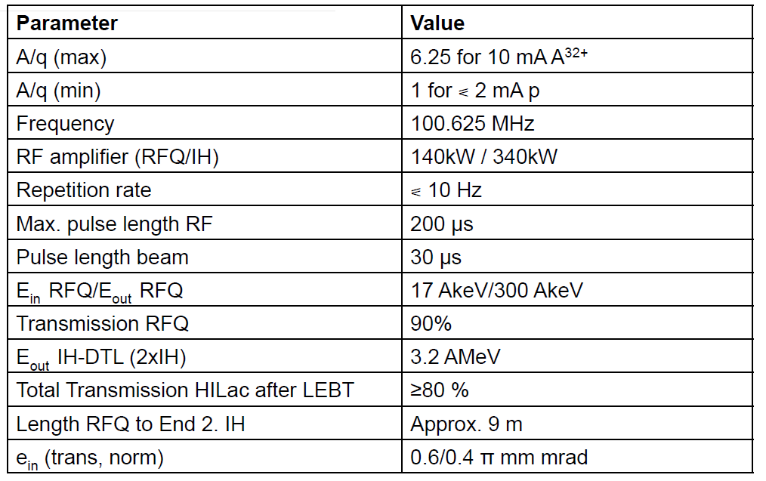
HILAc design parameters

Slide 15
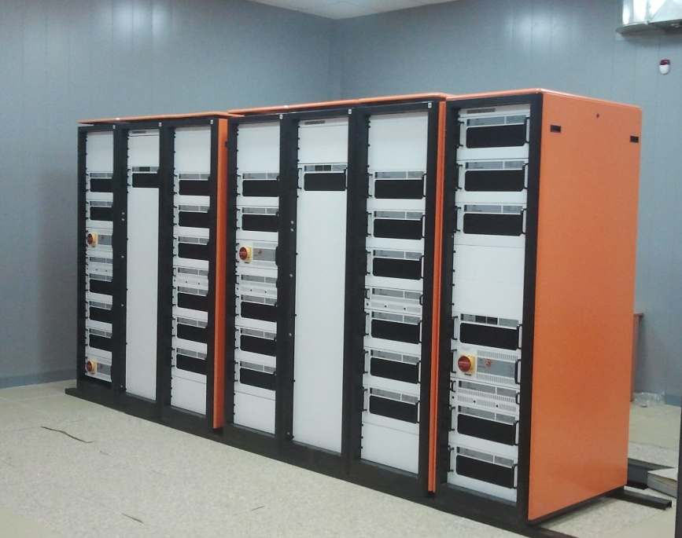

RF Amplifiers
IH2
RFQ
IH1
Three solid state amplifiers,
100MHz, 10Hz rate:
140 kW, 340 kW, 340 kW
Max. pulse length RF: 200 μs
Operational vacuum @ 5,5*10-7 mbar
Achieved vacuum conditions @ 7*10-8 mbar

Slide 16
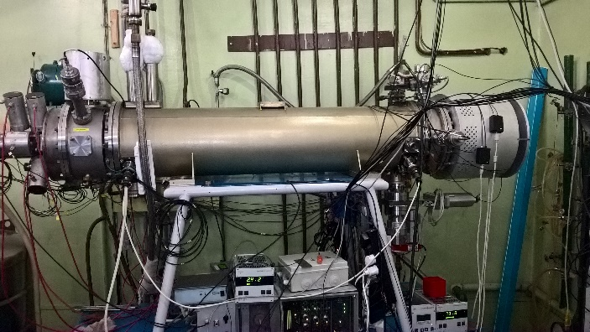
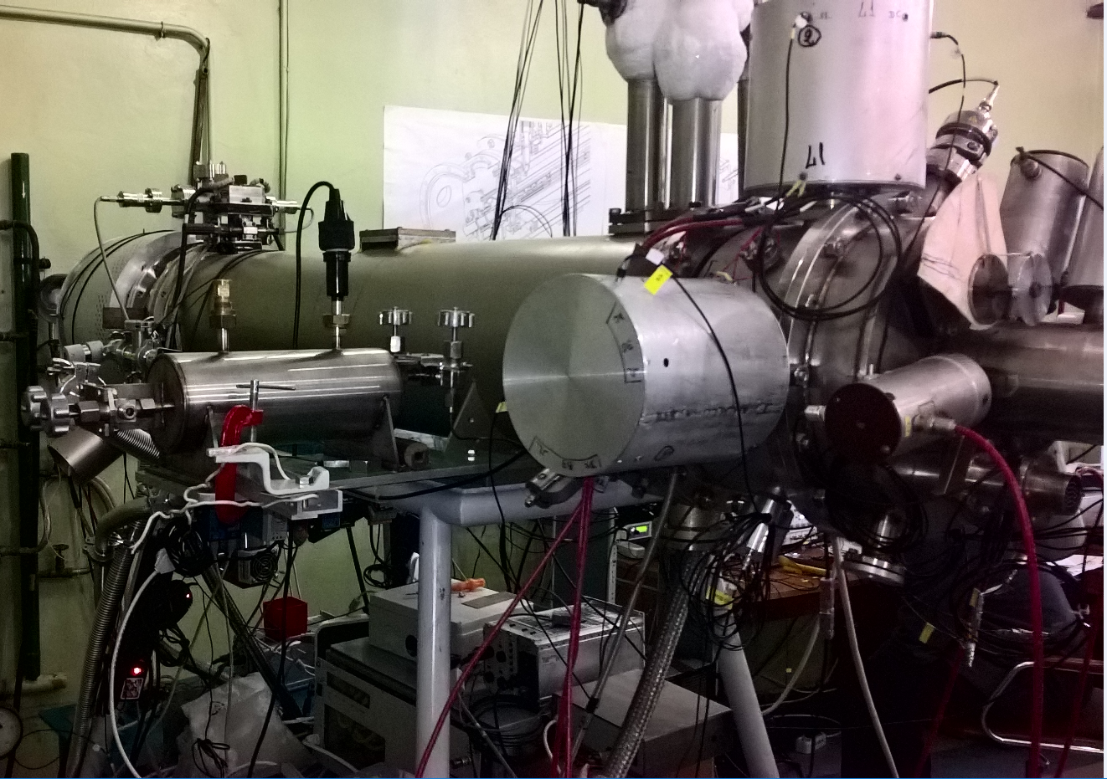
Krion-6T ESIS
 | Project | At test bench | At Nuclotron run #50 (2014)
Element | Au³¹⁺ | Tu⁵⁰⁺ | Ar¹⁶⁺
Ion intensity, ppp | 1.4x10⁹ | 3x10⁷ | 4x10⁸
Magnetic field, T | 6 | 5.4 | 4.6
Extraction time from ESIS, μs | 8 - 30 | 8 | 8
Energy of electron string, keV | 25 | 9-10 | 5-6
RMS emittance | 0.6 π mm mrad (for 8 μs extraction time) 0.15 π mm mrad (for 30 μs extraction time)
Plans:
1) Preparation for Ar¹⁶⁺ and Kr²⁶⁺ injection in 2017.
2) Improvement of internal Au and Bi injection.
3) Experiments in Au production in magnetic field up to 6Т.

Slide 17
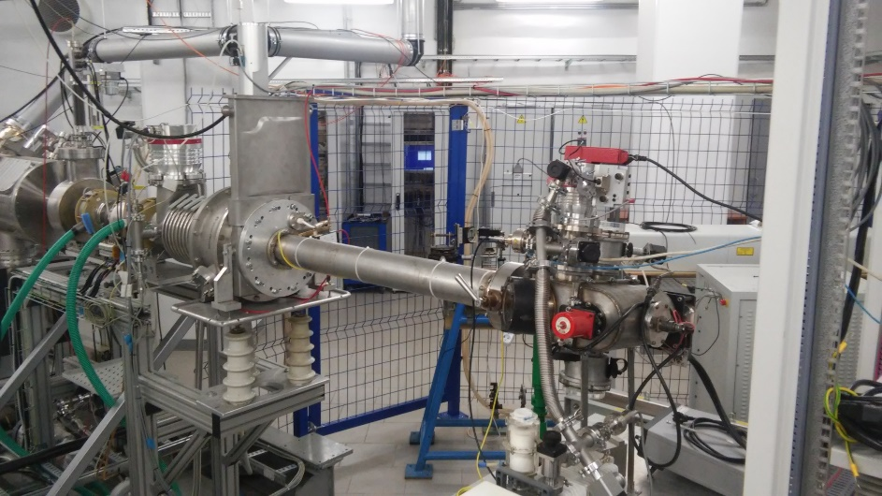
Laser ion source and LEBT
LEBT: Ein=3 keV/u Eout=17 keV/u

Slide 18
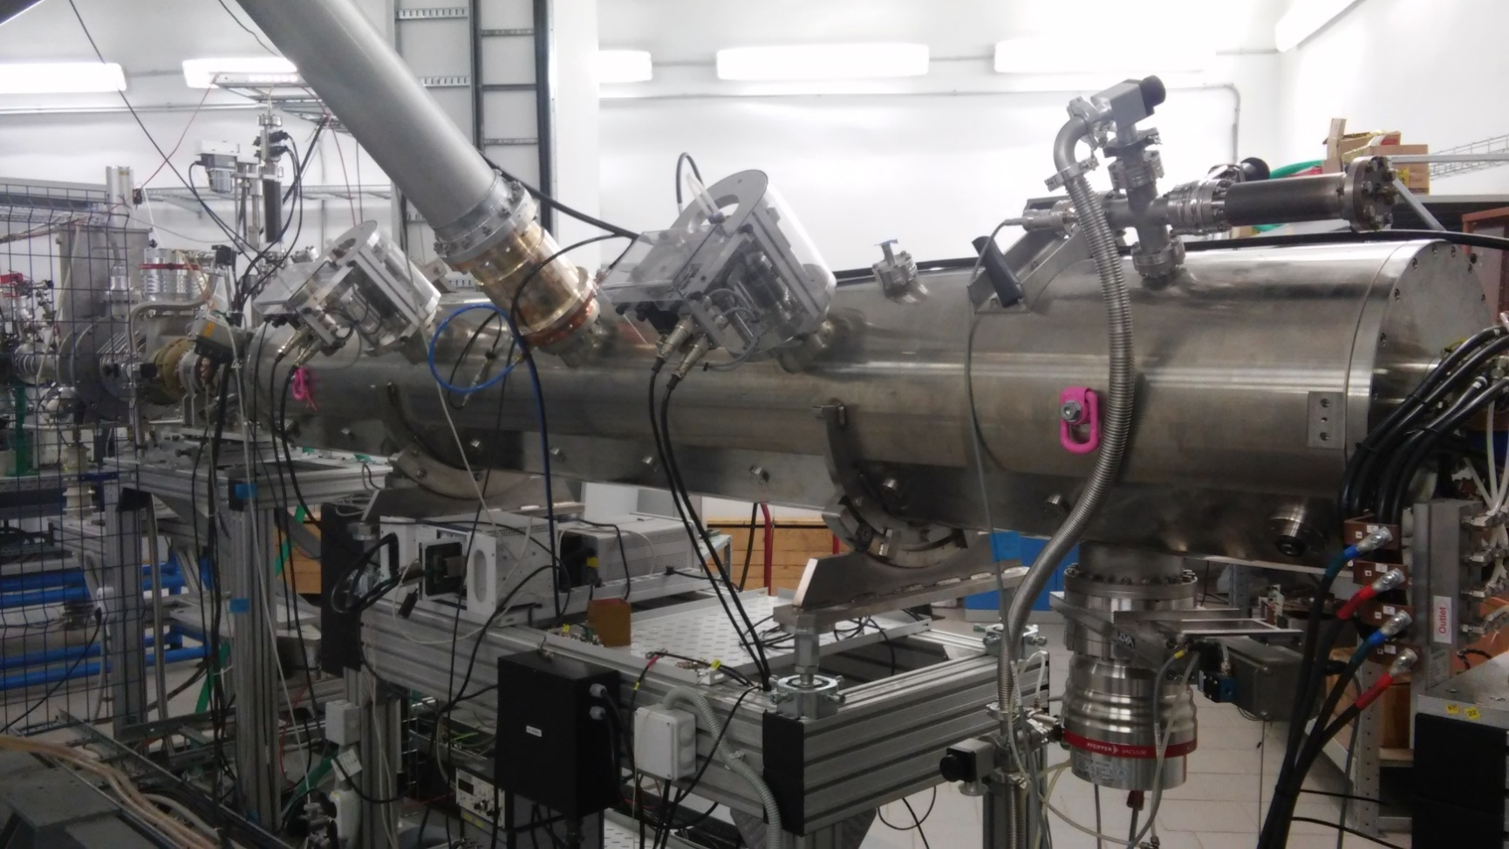
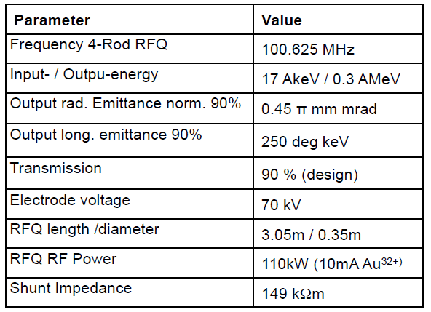
RFQ

Slide 19
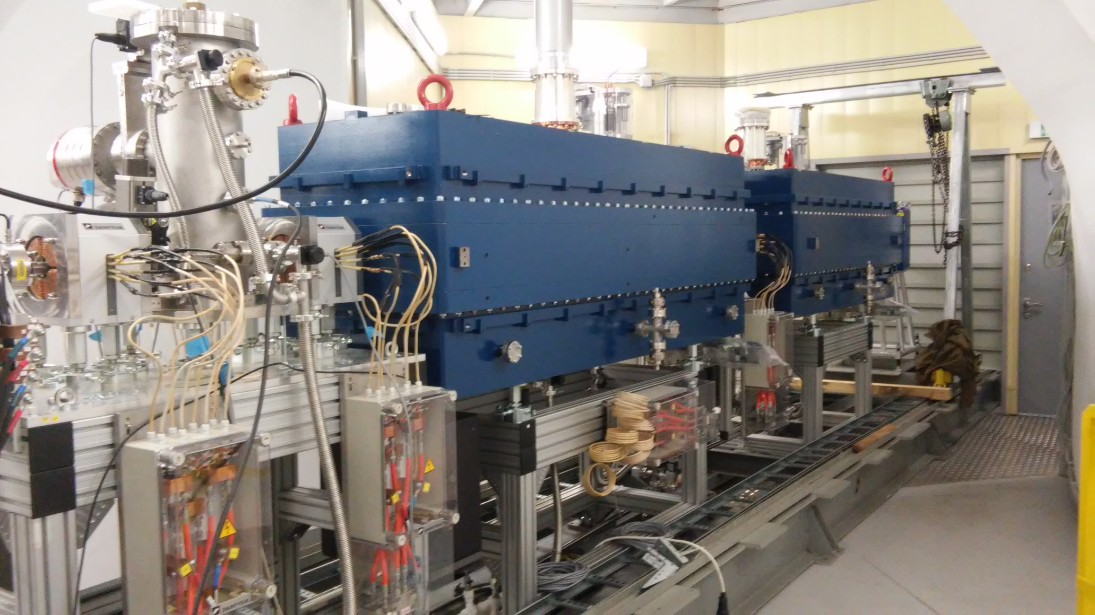
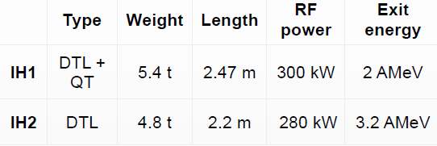
Buncher+IH1+IH2
DTL structure «KONUS» (KOmbinierte NUll grad Struktur) – combined structure with zero synchronous phase.

Slide 20
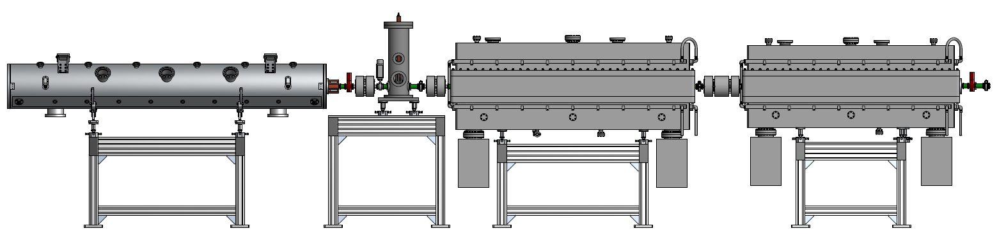
Test bench for HILAc comissioning
FC-Faraday cup, S-steerer, CT-current transformer, PP-phase probe,
D-doublet, T-triplet, B-buncher.
Experimental Eout= 3.2 MeV
CT1
PP1
PP2
CT2
PP3
FC
B
IH 1
IH 2
Analyzing
magnet
Source
RFQ
S2v, S2h
D1
D2
T1
T2

Slide 21
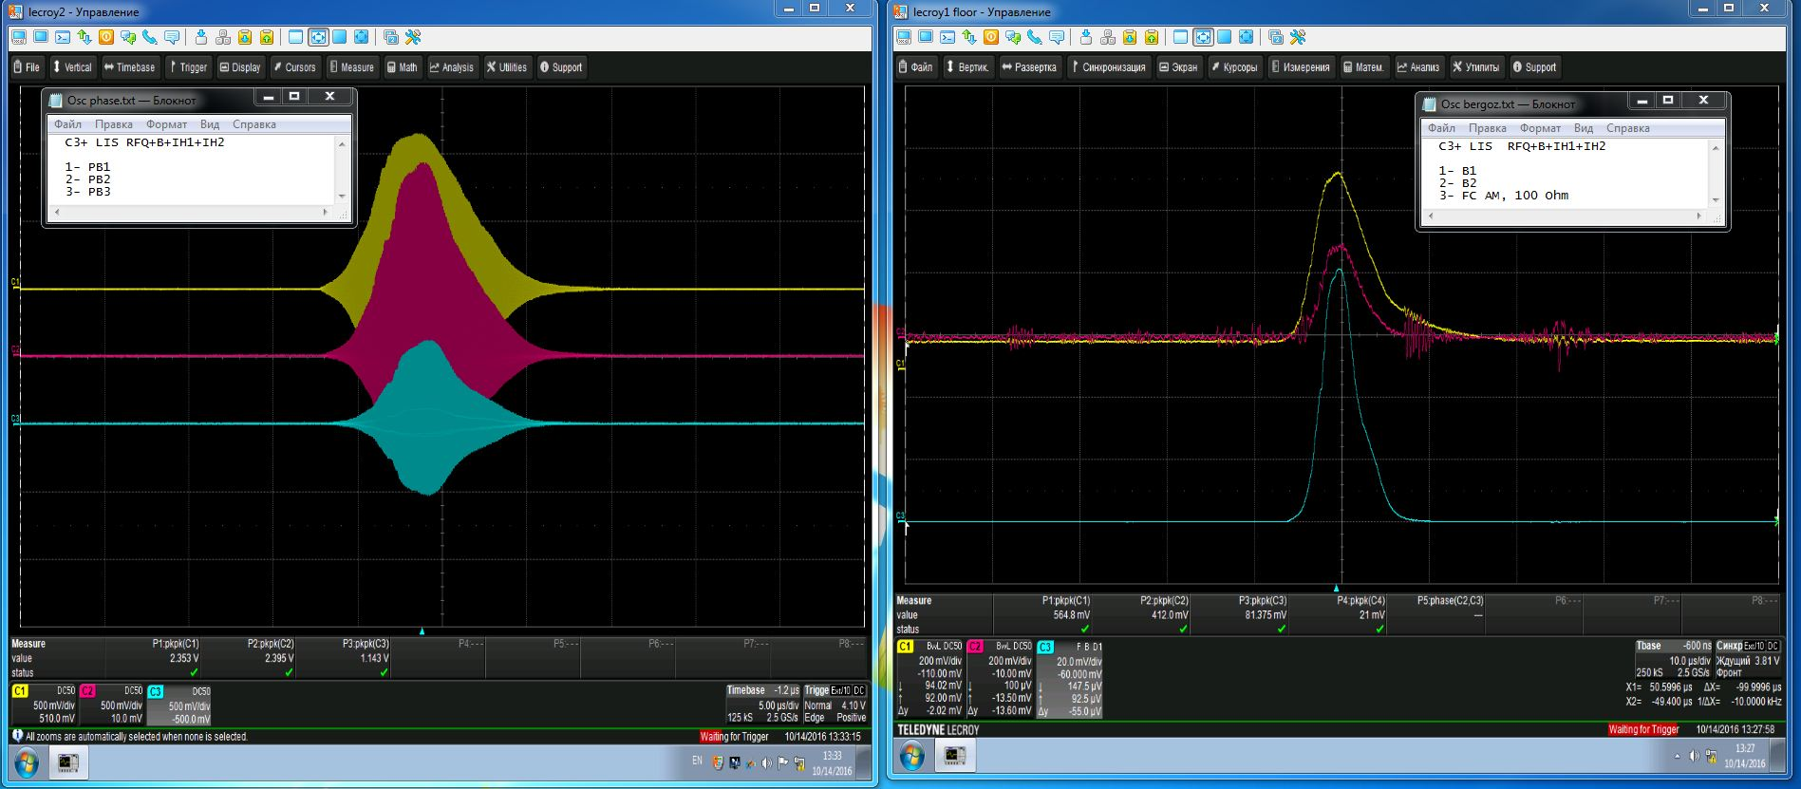
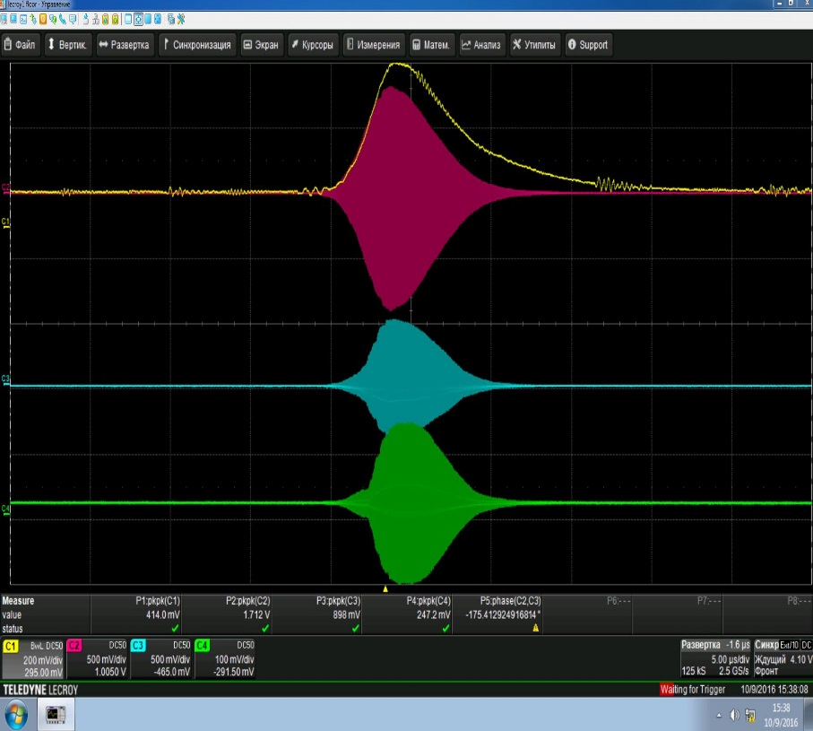
C3+ ions from Laser Ion Source
Phase probe’s signals
MEBT (red), IH1(blue), IH2(green)
Current transformer’s
and Faraday cup signals

Slide 22
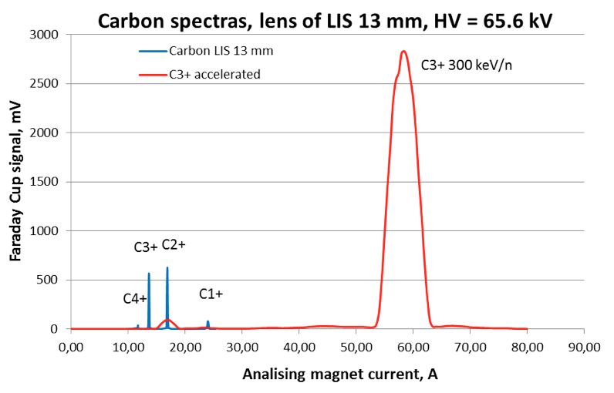
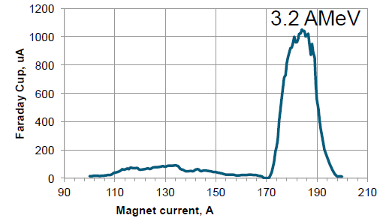
C3+ ions from Laser Ion Source
Experimentally found energy ≈ 3.2 MeV
RFQ at nominal energy of 300 AKeV
Energy spectrum after HILAc
Experimental energy matches with design parameters of HILAc

Slide 23

Next steps
Development of transportation channel from HILAc to Booster.
Debuncher installation (already manufactured and delivered by Bevatech).
ESIS source installation.
HILAc’s LEBT optimization (drift space should be shorter due to beam dynamics calculations).
Beam diagnostics.
Thank you for attention!

