Slide 1
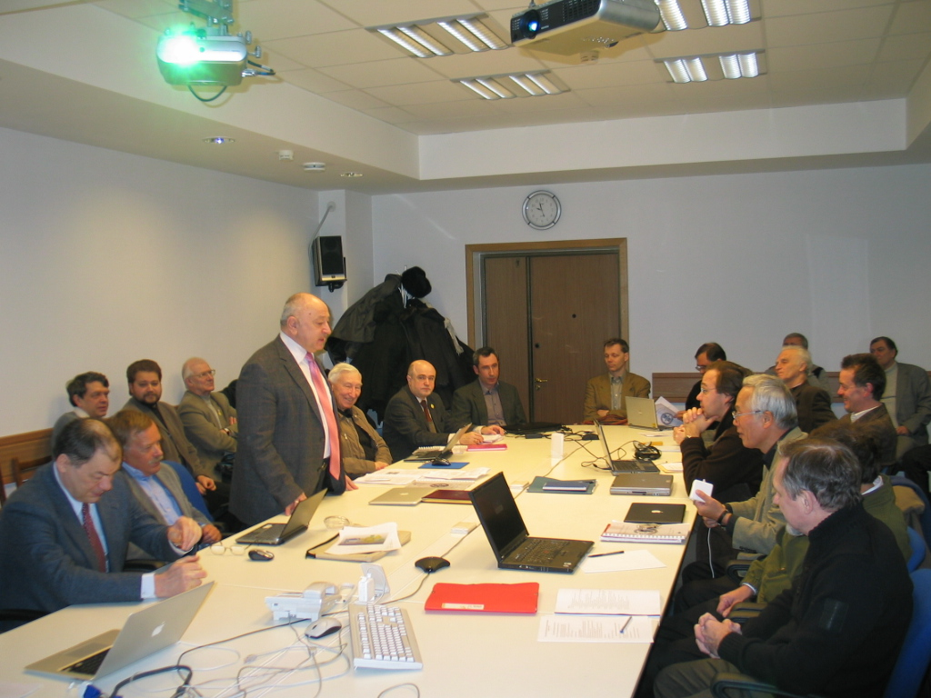
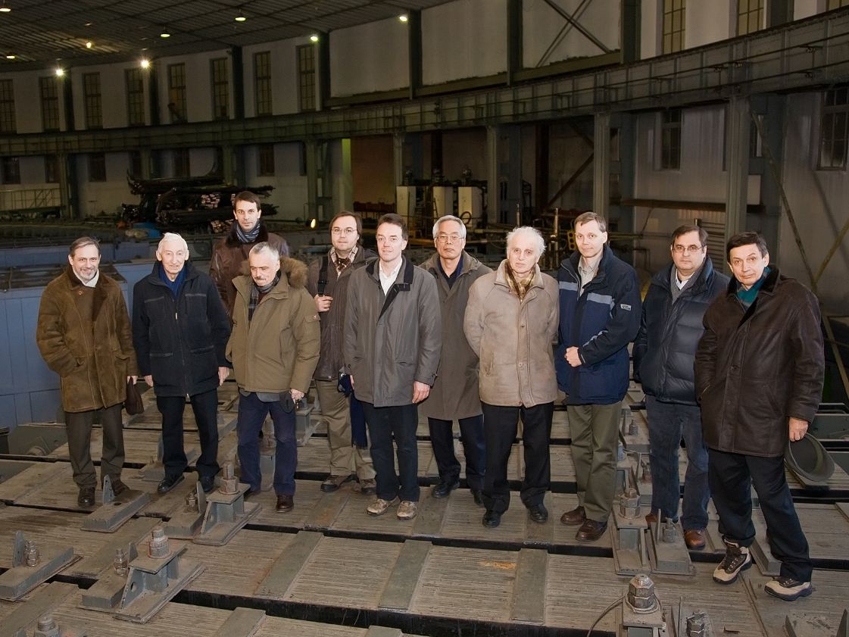
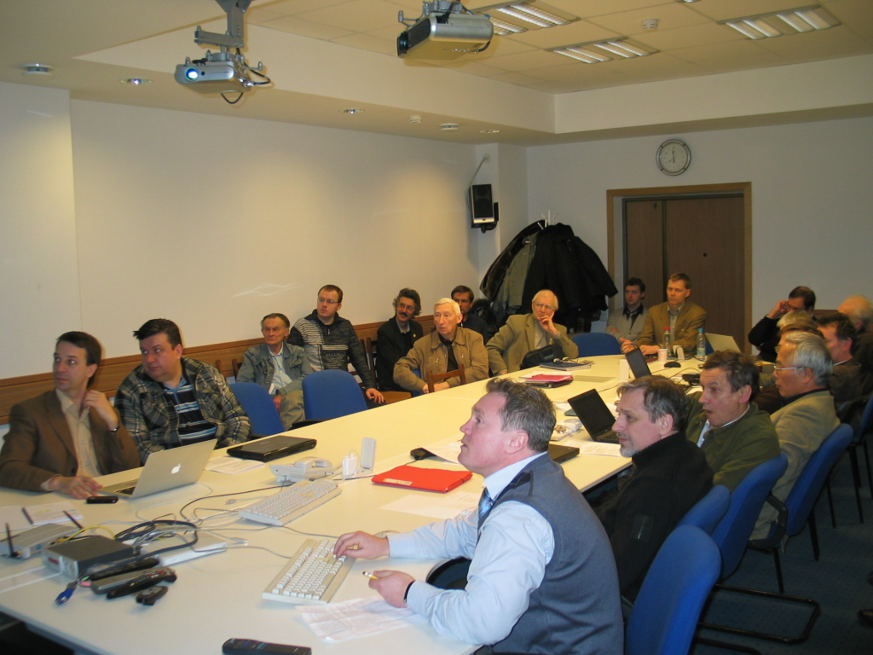
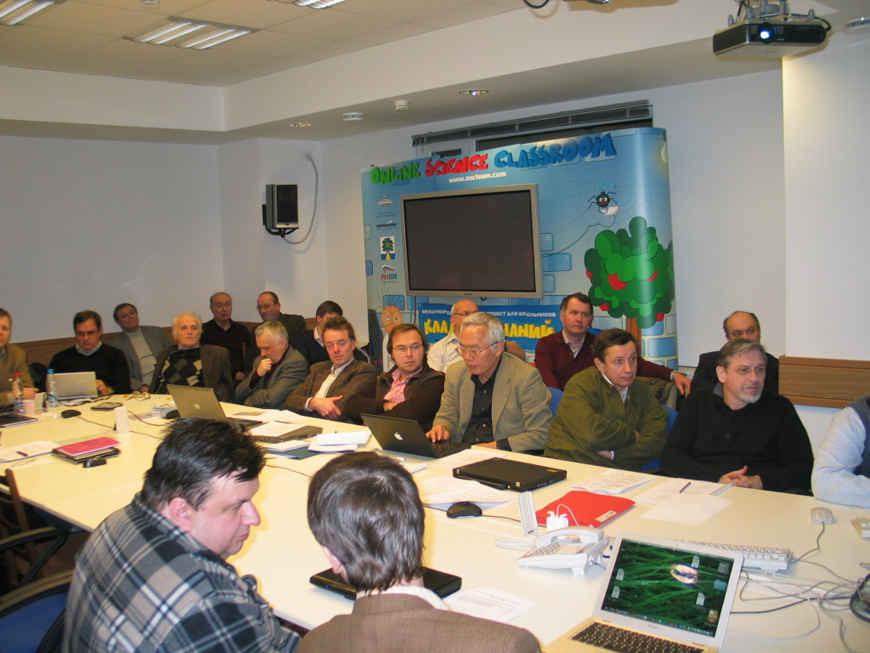
Chronology
of
The NICA MACs
1. 2010 January
2. 2010 October
3. 2011 June TeleConf
4. 2012 June
5. 2013 October
6. 2015 October
7. 2017 May

