Slide 1
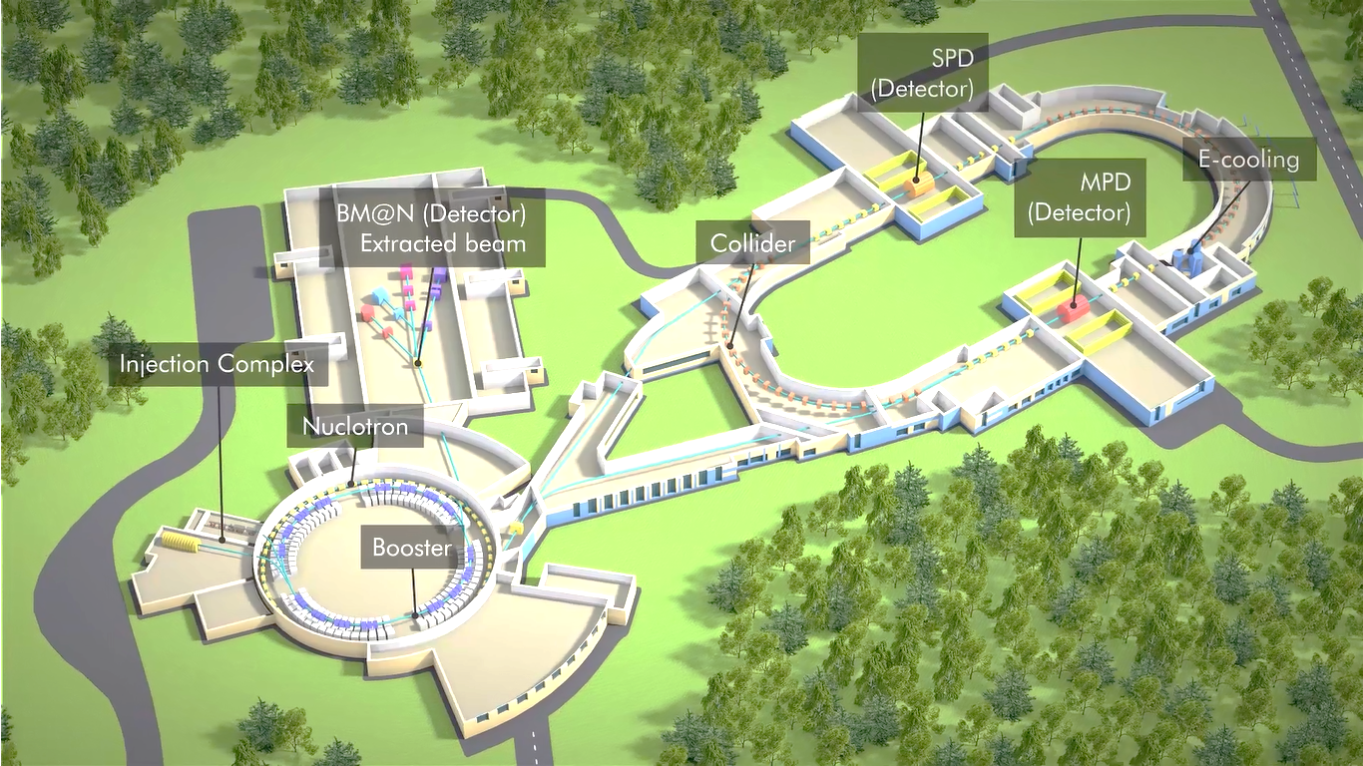
Machine Advisory Committee for NICA
Three stages of the NICA project: status and tasks
I.Meshkov
What has been done since 2015 and what more needs to be done.
JINR, Dubna 22-23 May 2017

Slide 2
Machine Advisory Committee for NICA
Three stages of the NICA project: status and tasks
I.Meshkov
Outline
1. Stage I: Experiment “The Baryonic Matter at Nuclotron”
2. Stage II : Search for The Mixed Phase and New Physics In Heavy Ions’ Collisions
at NICA Collider
3. Stage II-a: The basic configuration of the NICA complex
3.1. Status of The NICA civil construction (11.05.2017)
4. Stage II-b: The project (full) configuration of the NICA complex
5. Stage III: Polarized Beams’ Mode of The Collider
6. NICA Milestones
7. NICA Megaproject
JINR, Dubna 22-23 May 2017

Slide 3
NICA Stage I: Experiment “The Baryonic Matter at Nuclotron”
We need for full scale BM@N commissioning in 2019 to have in operation:
Injection complex: KRION, HILAc, LU20 (A.Martynov, 2nd today talk)
The Booster (H.Hodzhibagiyan, A.Smirnov,, and A. Galimov, 3 talks today 11:40 - 13:00)
BT Line Booster – Nuclotron (is developed by BINP, A.Tuzikov (O.Kozlov), tomorrow 16:00)
Nuclotron upgraded (A.Sidorin, today 10:50)
BM@N Detector setup (V.Golovatyuk, tomorrow 9:30)
BM@N Detector
Injection complex
Nuclotron upgrade
BT Line B => N
Booster
I.Meshkov NICA MAC 22-23 May 2017

Slide 4
NICA Stage II: Search for The Mixed Phase and New Physics
In Heavy Ions’ Collisions at NICA Collider
The stage II is split in two phases:
Stage II-a: The basic configuration of the NICA complex
Stage II-b: The project (full) configuration of the NICA complex
BM@N Detector
Injection complex
Nuclotron upgrade
BT Line B => N
Booster
I.Meshkov NICA MAC 22-23 May 2017

Slide 5
Stage II: Search for The Mixed Phase and New Physics In Heavy Ions’ Collisions at NICA Collider
First of all the stage II-a needs to have
the NICA Collider in operation.
That is why we formed at present meeting of the NICA MAC
a session dedicated to the collider physics – 4 talks:
O.Kozlov & S.Kostromin, P.Zenkevich, A.Bolshakov & A.Kolomiets,
E.Syresin, A.Philippov (today, 13:40 – 15:40)
BM@N Detector
Collider
Injection complex
Nuclotron upgrade
Channel B=>N
Booster
I.Meshkov NICA MAC 22-23 May 2017

Slide 6
Stage II: Search for The Mixed Phase and New Physics In Heavy Ions’ Collisions at NICA Collider
We need for commissioning in 2020 the stage II-a, i.e. “The basic configuration
of the NICA complex” to have in operation
Collider magnet and vacuum system
(H.Khodzhibagiyan, and A.Smirnov, today 11:40 - 12:35)
Collider RF systems in a reduced version (under development by BINP)
Stochastic cooling system – 1 channel per ring (I.Gorelyshev, tomorrow 11:30)
MPD
BM@N Detector
Collider
Injection complex
Nuclotron upgrade
BT Line N-C
Channel B=>N
Booster
MPD in a reduced version (V.Golovatyuk, tomorrow, 9:30)
BT Line Nuclotron-Collider (under development by SIgmaPhi, France –
- A.Tuzikov (O.Kozlov), today, 16:00)
I.Meshkov NICA MAC 22-23 May 2017

Slide 7
Stage II: Search for The Mixed Phase and New Physics In Heavy Ions’ Collisions at NICA Collider
We need for the stage II-a to develop also at the NICA complex
The beam diagnostics and The NICA control system
(two talks by E.Gorbachev, tomorrow, 16:30 – 17:25)
MPD
BM@N Detector
Collider
Injection complex
Nuclotron upgrade
BT Line N-C
Channel B=>N
Special attention is paid to so-called Machine-Detector Interface (MDI) problems (V.Golovatyuk, tomorrow, 9:55)
Booster
We must not forget the problems of NICA infrastructure
Radiation conditions at the NICA complex (G.Timoshenko, tomorrow, 11:55)
NICA complex infrastructure (Yu.Mitrofanova, tomorrow, 12:20)
I.Meshkov NICA MAC 22-23 May 2017

Slide 8
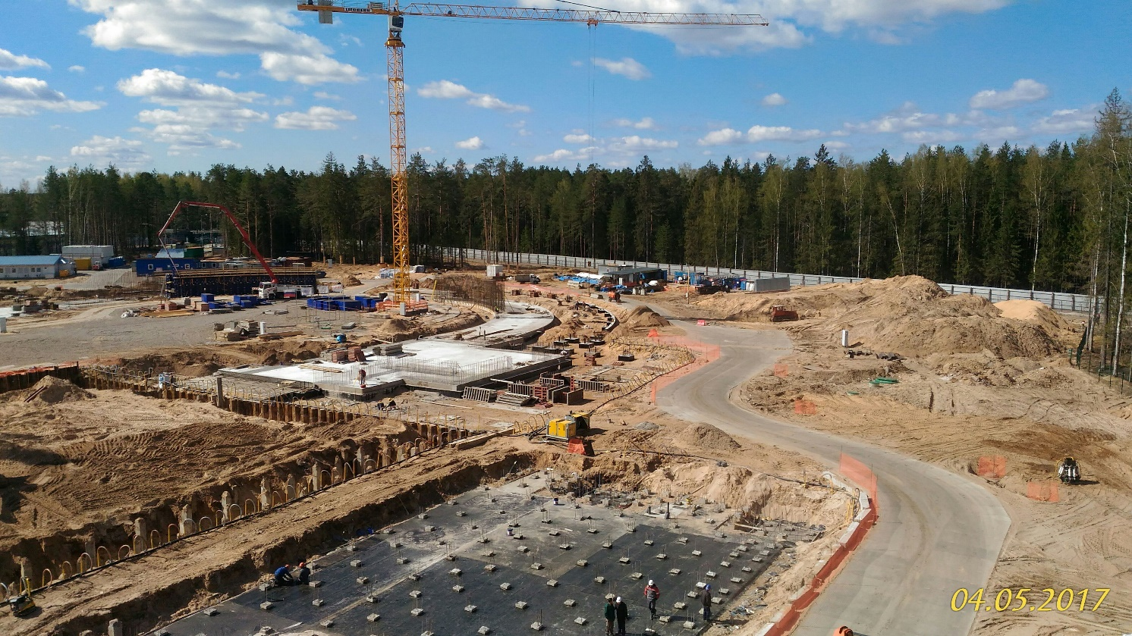
Stage II: Search for The Mixed Phase and New Physics In Heavy Ions’ Collisions at NICA Collider
For the stage II-a we must already have a building!
Contrary to the famous sentence “Carthago delenda est”,
we should have a slogan:
“NICA must be built!”
MPD
BM@N Detector
Collider
Injection complex
Nuclotron upgrade
BT Line N-C
BT Line B => N
Booster
04 May, 2017
Tomorrow, 13:25 => After-lunch excursion to
the Collider construction site, Booster and Nuclotron, 60′
A.Dudarev, A.Butenko
I.Meshkov NICA MAC 22-23 May 2017

Slide 9
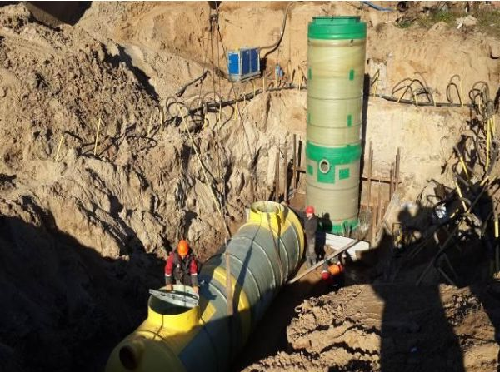
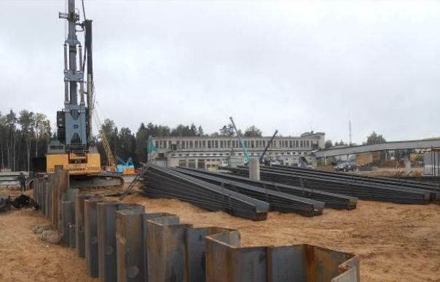
STATUS OF THE NICA CIVIL CONSTRUCTION (11.05.2017)
Infrastructure network relocation
(preparation of NICA site for construction works)
Water pipe network – DONE;
Fire fighting water line – DONE;
Waste water disposal – DONE;
Storm water drain – 90%;
FLNR high-voltage cable – DONE;
Communication network – DONE;
2. New high-voltage power line 5×6kV
Cable route – DONE;
MSS-1 (Main step-down substation) reconstruction – DONE;
Substation-13 reconstruction – 70%
3. Earthwork operations
Leveling of the territory – DONE;
Larsen sheet piles installation – 73%;
excavation – 18%.
4. Service roads, construction camp, new check-point, construction of site barrier – DONE.
I.Meshkov NICA MAC 22-23 May 2017

Slide 10
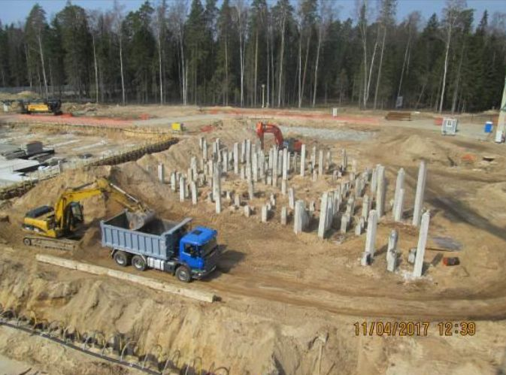
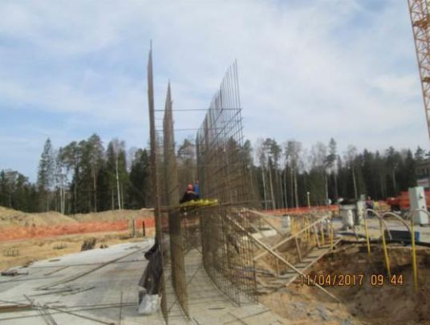
STATUS OF THE NICA CIVIL CONSTRUCTION (11.05.2017)
5. Piling work (201 MRub.)
Arc W – DONE;
MPD hall – DONE;
SPD hall – 94%;
Arc E – 58%;
Beam transport channels (BTC) – beginning
Total number of base piles (40×40): 4194
Completed base piles: 2688 (64%)
Number of outbuilding piles (30×30): 1000
Completed outbuilding piles: 352 (35%)
6. Concrete work (760 MRub.)
Arc W – 24%;
MPD and SPD halls – 1%;
Arc E and BTC – 0%;
Total volume of concrete: 48000 m³
I.Meshkov NICA MAC 22-23 May 2017

Slide 11
Stage II: Search for The Mixed Phase and New Physics In Heavy Ions’ Collisions at NICA Collider
What will we have at the stage II-a (basic configuration):
1. Injector chain: KRION => Booster => BTL BN => Nuclotron
2. BTL Nuclotron => Collider
3. Collider equipped with
RF-1 (barrier voltage system) for ion storage
RF-2 in a reduced version: 2 cavities per ring instead 4 (50 kV RF amplitude instead 100 kV)
1 channel of S-cooling per ring
(cooling of longitudinal deg. of freedom)
Beam diagnostics
And so on…
4. MPD in a reduced version: no Inner Tracker System (ITS)
and no Forward Trackers (“Straw” + CPC – Cathode Pad Chamber)
As result, 22 bunches of the length σ ∼ 2 m per ring that provides
Luminosity of 5e25 cm⁻²⋅s⁻¹.
I.Meshkov NICA MAC 22-23 May 2017

Slide 12
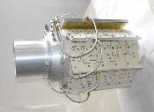
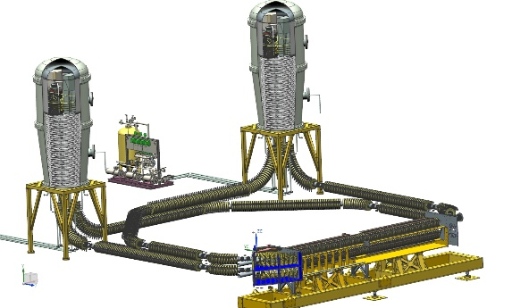
Stage II: Search for The Mixed Phase and New Physics In Heavy Ions’ Collisions at NICA Collider
Stage II-b – “The project (full) configuration of the NICA complex” is scheduled
to be commissioned in 2023 when we will have
upgraded and commissioned Collider and MPD
RF-2 systems in the project version (under development by BINP)
RF-3 systems in the project version (BINP and (?) INR RAS, E.Syresin, today 14:50)
MPD
E-cooling
Collider
upgraded
BM@N Detector
Collider
Injection complex
Nuclotron upgrade
BT Line N-C
BT Line B => N
S-cooling system in the project version (I.Gorelyshev, tomorrow 11:30 )
Booster
E-cooling system (under development by BINP, V.Parkhomchuk, tomorrow 10:40)
I.Meshkov NICA MAC 22-23 May 2017

Slide 13
Stage II: Search for The Mixed Phase and New Physics In Heavy Ions’ Collisions at NICA Collider
Stage II-b – “The full (project) configuration of the NICA complex” is scheduled
to be commissioned in 2023 when we will have
upgraded and commissioned Collider and MPD
MPD
upgraded
E-cooling
Collider
upgraded
MPD
BM@N Detector
Collider
The program of MPD upgrade contains
1. Inner Tracker System (ITS)
2. Forward trackers
(V.Golovatyk, tomorrow 9:30 )
Injection complex
Nuclotron upgrade
BT Line N-C
BT Line B => N
Booster
I.Meshkov NICA MAC 22-23 May 2017

Slide 14
Stage III: Polarized Beams’ Mode of The Collider
The first presentation of the principle scheme of the NICA Collider in the mode of polarized beams (A.Kovalenko, tomorrow 14:25)
followed by the discussion (S. Nikitin, Yu.Shatunov, BINP, tomorrow 14:55)
MPD
E-cooling
BM@N Detector
Collider
Injection complex
Nuclotron upgrade
BT Line N-C
BT Line B => N
Booster
I.Meshkov NICA MAC 22-23 May 2017

Slide 15
NICA Milestones
Component | Developer/Producer |  | Commissioning date
NICA Stage I (BM@N)
1. Heavy ion source KRION |  | VBLHEP JINR |  | November 2018
2. HILAc |  | BEVATECH+VBLHEP JINR |  | Commissioned (2016)
3. Booster synchrotron |  | VBLHEP JINR |  | December 2018
3.1. RF system |  | BINP |  | Ready for mounting
3.2 E-Cooler for Booster |  | BINP |  | Ready for mounting
4. BTL Booster—Nuclotron |  | BINP |  | February 2019
5. BTL Nuclotron—BM@N upgrade |  | VBLHEP JINR |  | February 2019
6. BM@N experiment with Au⁷⁹⁺ |  | VBLHEP JINR |  | November 2019
NICA Stage IIa (Basic configuration)
7. Nuclotron upgrade, fast extraction |  | VBLHEP JINR |  | November 2019
8. BTL Nuclotron—Collider |  | SigmaPhi (France) |  | 1 December 2019
9. Collider – Stage IIa 9.1. RF systems RF-1 RF-2 (2 RF stations per ring) 9.2. Stochastic cooling (1 Channel/ring) 9.3. Beam dump system |  | VBLHEP JINR BINP BINP VBLHEP JINR VBLHEP JINR |  | December 2020 December 2020 December 2020 December 2020 December 2020 December 2020
I.Meshkov NICA MAC 22-23 May 2017

Slide 16
NICA Milestones
NICA Stage IIb (Project configuration)
11. Collider – Stage IIb | VBLHEP JINR | July 2023
11.1. RF systems RF-2 (2 RF stations per ring) RF-3 (8 RF stations per ring) | BINP BINP/INR RAS (?) | October 2022 October 2022
11.2. Stochastic cooling 2 channels per ring | VBLHEP JINR/Izhevsk Cº | October 2022
11.3. Electron cooler | BINP | October 2022
11.4. Feed back system 1 channel per ring | VBLHEP JINR | October 2022
12. MPD – NICA Stage IIb | VBLHEP JINR | December 2022
NICA Stage IIb (project configuration) |  | 2023
NICA Stage III (polarized beams and spin physics) | 2025
I.Meshkov NICA MAC 22-23 May 2017

Slide 17
Status of The NICA Project
April 27, 2016 – NICA Megaproject
2008
April 27, 2016
Order of The Government of Russian Federation
₽ 8.8 billion Russian Federation +
₽ 8.7 billion JINR
2012
2016
Thank you for your attention!

