Slide 1
Booster assembling.
Strategy and plans
A. Galimov
MAC, Dubna
22-23 May 2017

Slide 2
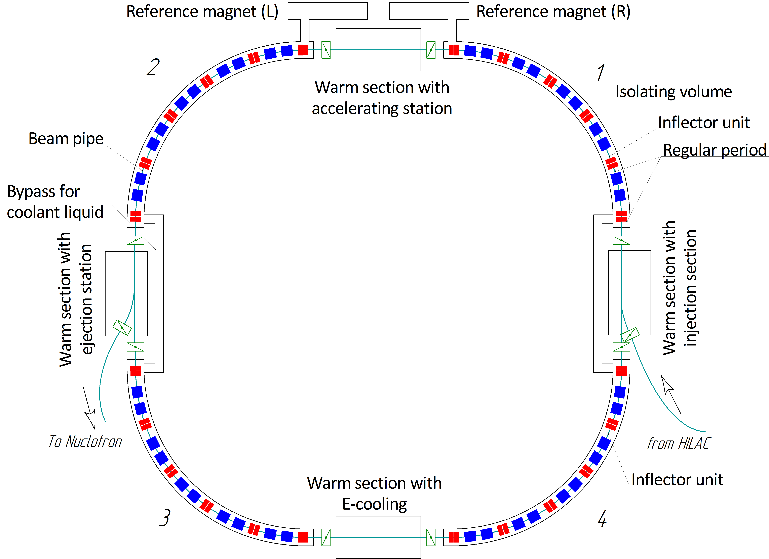

Scheme of the booster
Assemblies | Q-ty, pcs
Dipole units | 40
Quadrupole doublet units | 24
Kit for assembling magnet gaps | 45
Bypass for coolant liquid | 2
Warm sections | 4
Section with reference magnet (L, R) | 2
Feed box (L, R) | 2
Vacuum stations (insulation volume) | 16+10
Vacuum stations (cold beam pipe) | 24

Slide 3
Booster assembling (с
Booster assembling |  | 2018
 |  | I | II | III | IV | V | VI | VII | VIII | IX | X | XI | XII
Regular periods assembling
 | Quadrant 1
 | Quadrant 2
 | Quadrant 3
 | Quadrant 4
Assembling of irregular (warm) sections
 | E-cooling (2017)
 | Injection section
 | Beam extraction section
 | Accelerating station
 | Section with reference magnets
Systems assembling
 | Vacuum system of insulation volume
 | Vacuum System of beam pipe

Slide 4
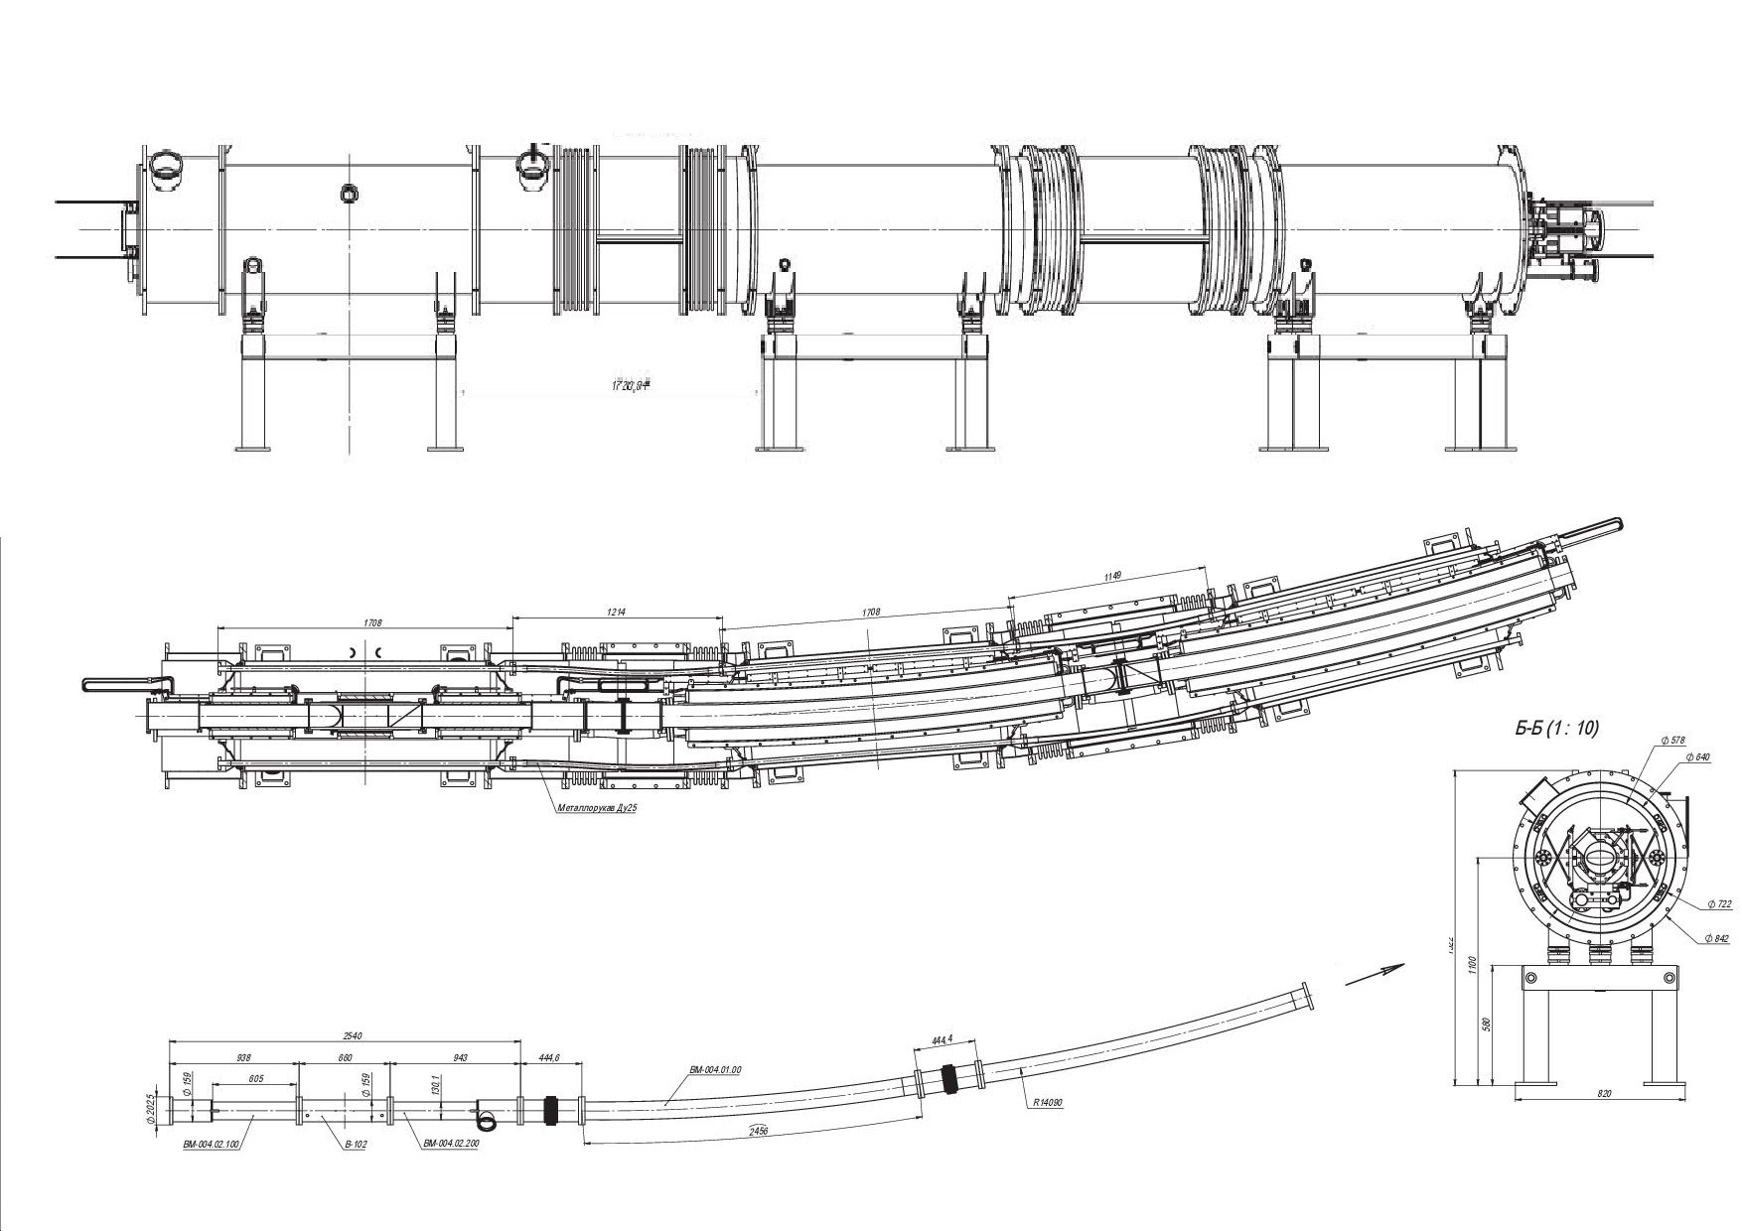
Regular periods
Quadrupole doublet unit
Dipole unit
Dipole unit

Slide 5
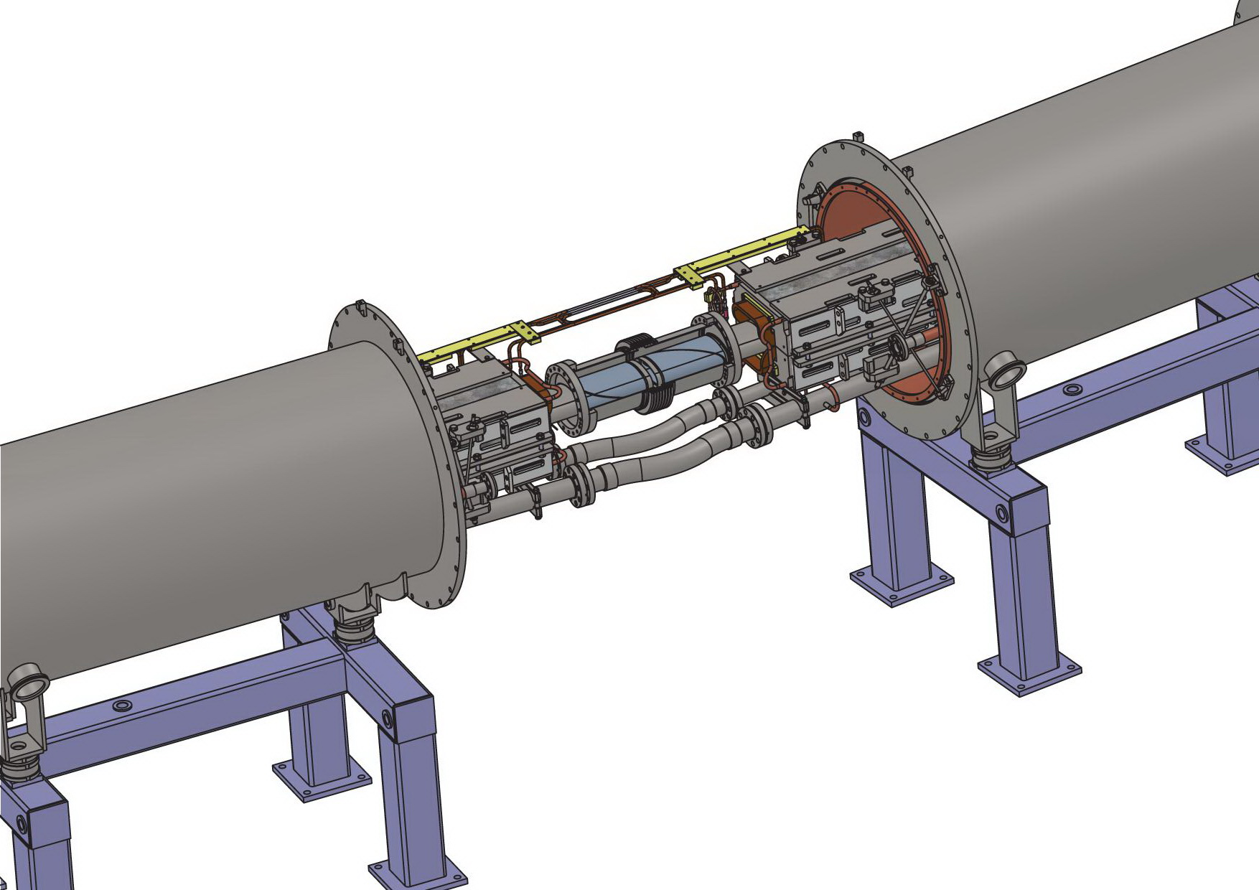
Dipole-dipole assembling
Beam pipe
Bus-bars
Dipole magnet
Dipole magnet
Bellows hoses
Supports

Slide 6
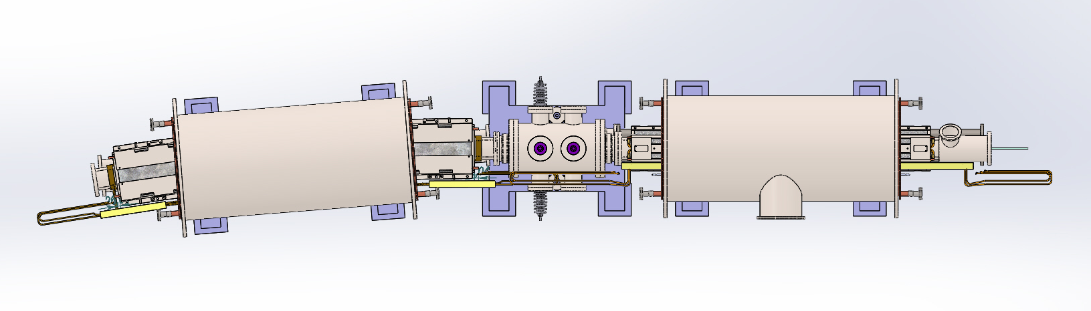
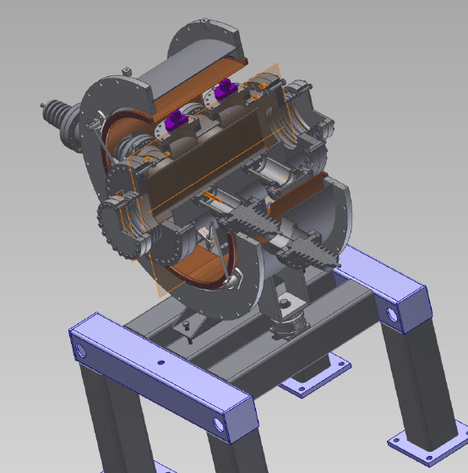
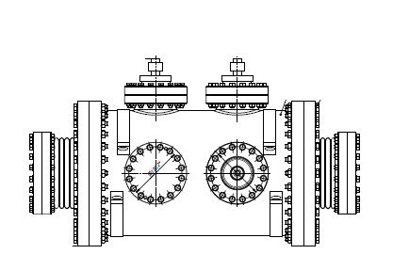
Inflector modules of regular periods
Dipole unit
Quadrupole doublet unit
Inflector vacuum chamber
Inflector unit

Slide 7
Assembly workflow (part 1)
Regular period 1
Unit 1
Unit 2
Unit 3
Alignment of yoke inside vacuum chamber
Transfer unit on position
Mounting unit in tunnel
Assembling of He and N2 headers U1-U2
Assembling of He and N2 headers U2-U3
Soldering of bus-bars U1-U2
Soldering of bus-bars U1-U2
Helium leakages tests
Alignment of the positioning of the magnets in the tunnel

Slide 8
Assembly workflow (part 2)
Quadrant 1
END1
Regular period 1
Regular period 2
Regular period 3
Regular period 4
Regular period 5
END2
Transfer unit on position and mounting
Transfer unit on position and mounting
Assembling of He and N2 headers END1-1-2-3-4-5-END2
Soldering bus-bars END1-1-2-3-4-5-END2
Helium leakages tests of headers connections
Mounting insert between the beam pipes
Mounting turbo-pump stations

Slide 9
Assembly workflow (part 3)
Quadrant 1
END1
Regular period 1
Regular period 2
Regular period 3
Regular period 4
Regular period 5
END2
Helium leakages tests of beam pipe connections
Thermal shield and nitrogen headers assembly
Electrical tests
Vacuum shell assembly
Mounting insulation volume vacuum system
Helium leakages tests of helium and nitrogen headers connections inside vacuum shell
Electrical tests under vacuum
Pumping of beam pipe (long time)

Slide 10
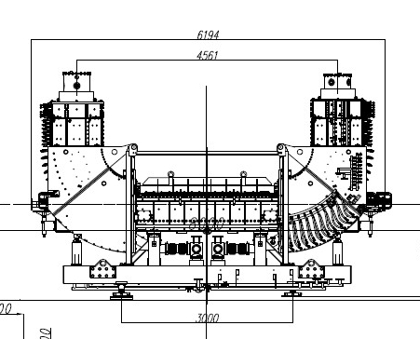
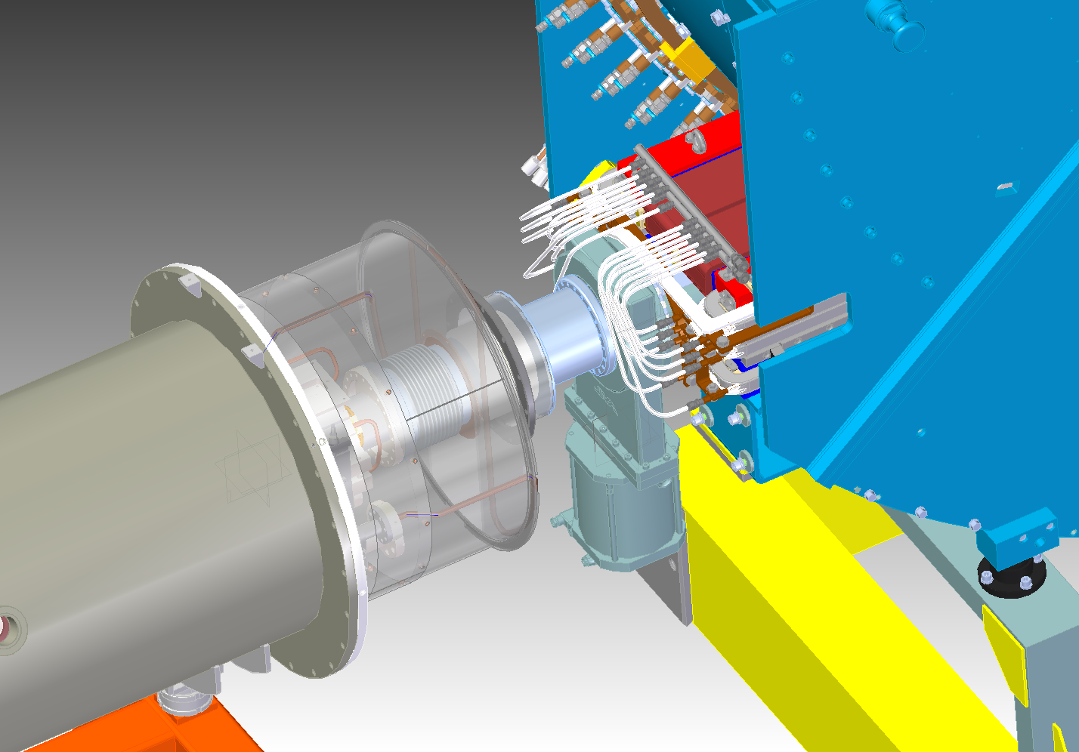

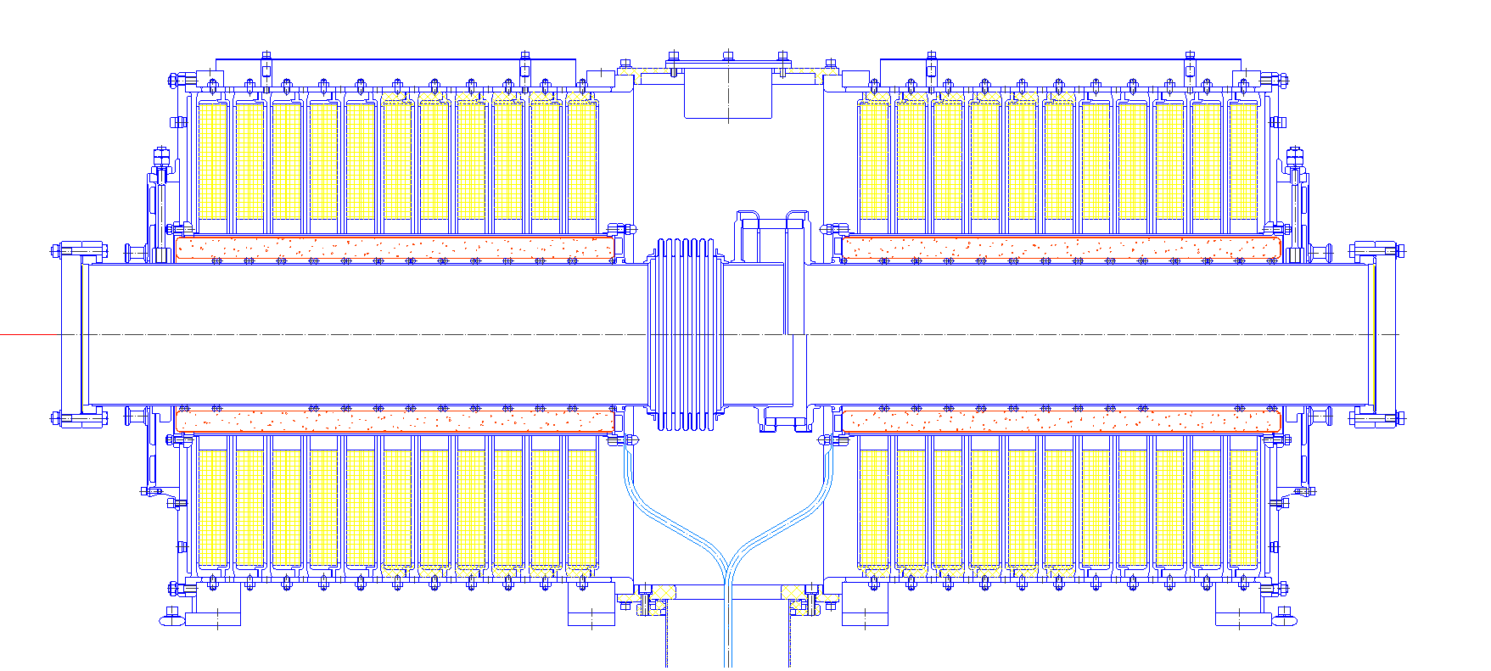
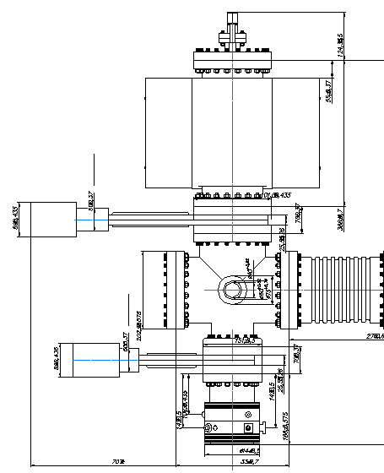
RF-station (under testing)
Warm-cold unit
Bellows
All-metal gate
Notes:
Headline:
Comments:
RUS
ENG

Slide 11
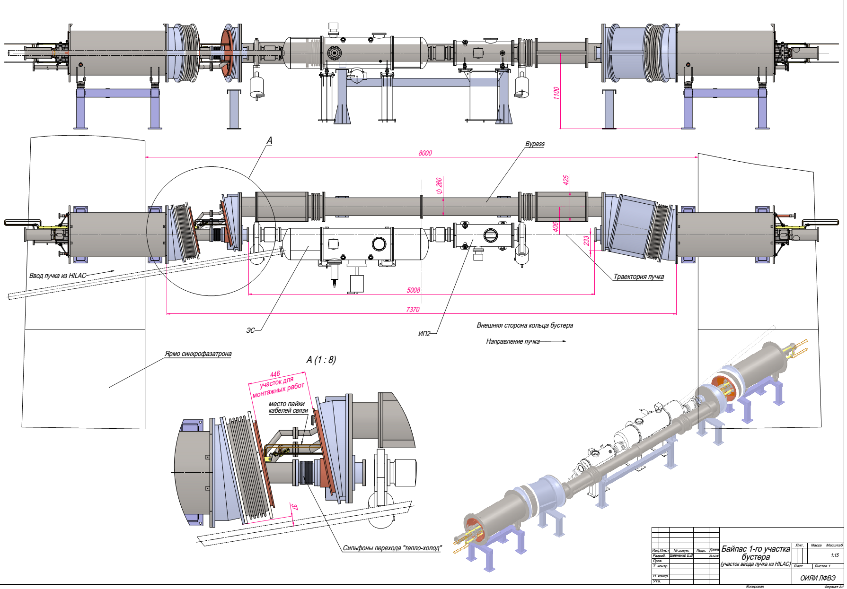
Bypass section

Slide 12
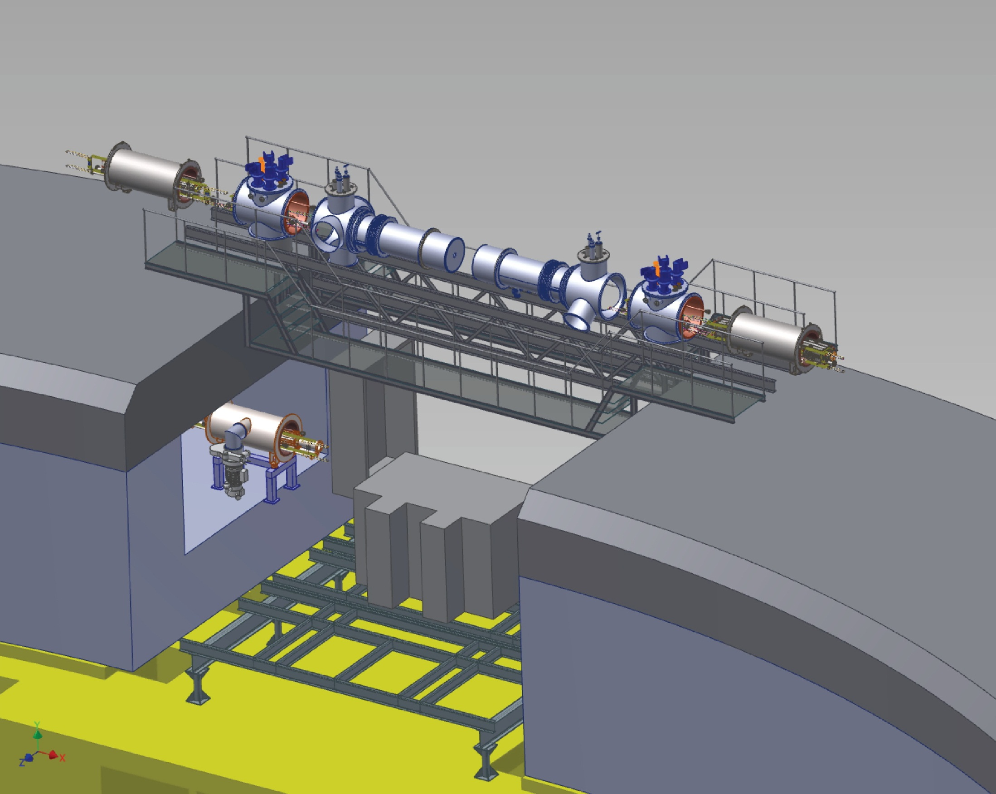
Section with reference magnet
Feedbox “L”
Cryogenic feeder “L”
Cryogenic feeder “R”
Reference magnet
Feedbox “R”
Reference magnet
Platform
Booster “2”
Accelerating stations
Notes:
Headline:
Comments:
RUS
ENG
Section with RM now is under constriction too. Its assembling will begin after installing of accelerating stations and not much differ from assembling of RP. Of course her will be difference from side of power supply connections and

Slide 13
Requirements for beginning assembling
- bridge cranes of build;
- bridge cranes inside the gap of the Synchrophasotron yoke (tunnel);
- energy supply (380/220V, 50Hz);
- water system (cooling equipment);
- compressed air system (suppling equipment);
- interior of Booster tunnel completion (floor, walls, ceiling, light and etc.);
- movable clean zones for beam pipe and vacuum stations assembling;
- instruments (helium leak testers, movable pumping stations, laser tracker tools and etc.);
- geodetic network;
- storing places of complete products;
- places for preparing units and element;
- places for staff;
- tailored logistics

Slide 14
Booster assembling (time-schedule and man-powers)
Booster assembling |  | 2018
 |  | I | II | III | IV | V | VI | VII | VIII | IX | X | XI | XII
Regular periods assembling
 | Quadrant 1 |  |  |  |  |  | 4 | 6 | 4
 | Quadrant 2 |  |  |  |  |  |  |  | 4 | 6 | 4
 | Quadrant 3 |  |  |  |  |  |  |  |  | 4 | 6 | 4
 | Quadrant 4 |  |  |  |  |  |  |  |  |  | 4 | 6 | 4
Assembling of irregular (warm) sections
 | E-cooling (2017) | 3 | 3 | 3
 | Injection section |  |  |  |  |  |  |  |  | 2 | 2 | 2 | 2
 | Beam extraction section |  |  |  |  |  |  |  | 2 | 2 | 2 | 2 | 2
 | Accelerating station |  |  |  | 4 | 4 | 2 | 2
 | Section with reference magnets |  |  |  |  |  |  |  |  | 4 | 4 | 4 | 4
Systems assembling
 | Vacuum system of insulation volume |  |  |  |  |  |  | 2 | 2 | 2 | 2 | 2 | 2
 | Vacuum System of beam pipe |  |  |  |  |  |  | 2 | 2 | 2 | 2 | 2 | 2

