Slide 1
Optimization of the Collider rings’ optics
O.S. Kozlov, S.A. Kostromin
LHEP, JINR, Dubna
Machine Advisory Committee, JINR, Dubna, May 22-23, 2017

Slide 2
Contents
Collider project parameters
Composition of the rings
Dynamic Aperture calculations
Collider optics, MAC 2017

Slide 3
1. Collider project parameters
Circumference, m | 503.04
Number of bunches | 22
Rms bunch length, m | 0.6
Beta-function at IP, m | 0.35
Betatron tunes, Qx / Qy | 9.44 / 9.44
Chromaticity, Q’x / Q’y | -33 / -28
Ring acceptance, π⋅mm⋅mrad | 40
Long. acceptance, Δp/p | ±0.010
Gamma-transition, _{tr} | 7.088
Ion energy, GeV/u | 1.0 | 3.0 | 4.5
Ion number per bunch | 2.0∙10⁸ | 2.4∙10⁹ | 2.3∙10⁹
Rms Δp/p, 10⁻³ | 0.55 | 1.15 | 1.5
Rms beam emittance, hor/vert, (unnormalized), π⋅mm⋅mrad | 1.1/ 0.95 | 1.1/ 0.85 | 1.1/ 0.75
Luminosity, cm⁻²s⁻¹ | 0.6∙10²⁵ | 1.0∙10²⁷ | 1.0∙10²⁷
IBS growth time, sec | 160 | 460 | 1800
Tune shift, ΔQ_{total} =ΔQ_{SC} +2 | -0.050 | -0.037 | -0.011
Collider optics, MAC 2017

Slide 4
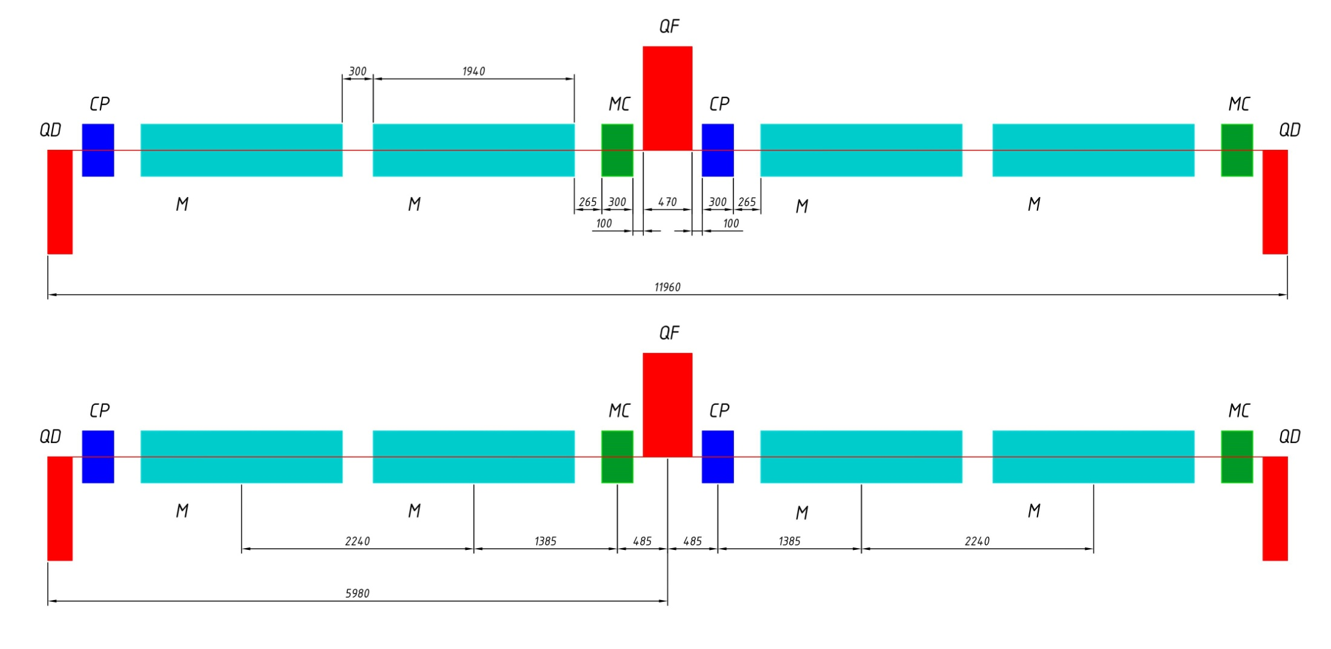
1. Collider ring composition
Arc: FODO periodic Cell
M: horizontal dipole magnet, L=1940mm oq: space QF/QD-CP, L=100mm
QF, QD: regular quadrupole magnet, L=470mm odd: space Dipole-Dipole, L=300mm
MC: multipole corrector, L=300mm od: space Dipole-MC, L=265mm
CP: X,Y dipole corrector+Beam PickUp, L=300mm
Collider optics, MAC 2017

Slide 5
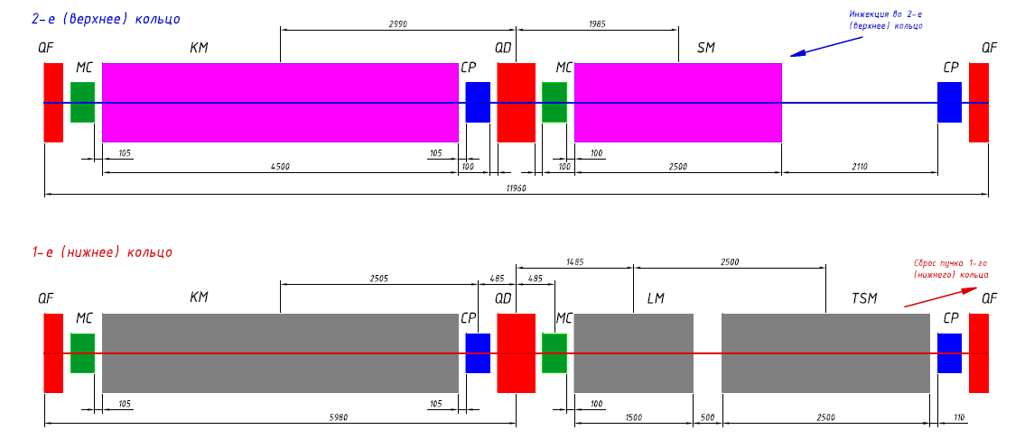
1. Collider ring composition
Arc, missing dipole Cells: – Injection, Dump, Dispersion suppressor.
Lower Ring 1, Upper Ring 2 - Arc North-East side
Collider optics, MAC 2017

Slide 6
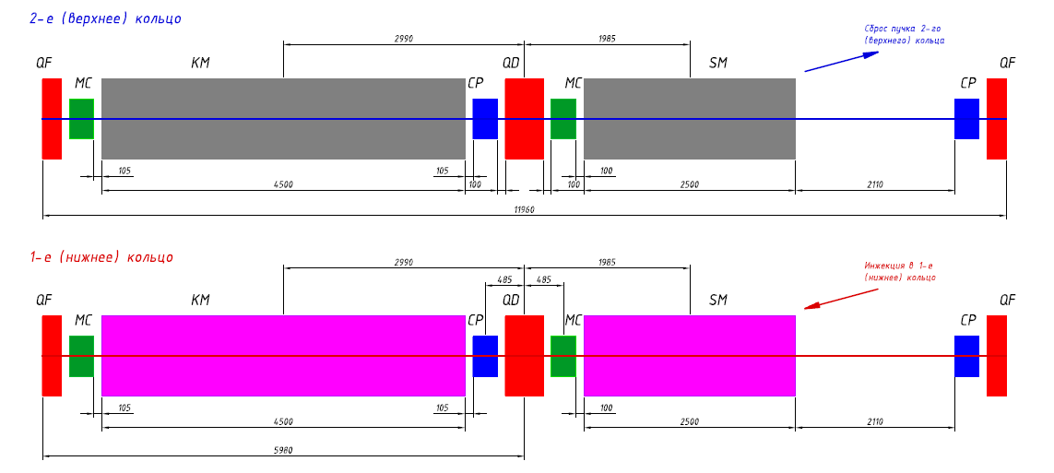
1. Collider ring composition
Arc, missing dipole Cells: – Injection, Dump, Dispersion suppressor.
Lower Ring 1, Upper Ring 2 Arc South-East side
Collider optics, MAC 2017

Slide 7
1. Collider ring composition
Straight sections South: SPD
Straight sections North: MPD
Collider optics, MAC 2017

Slide 8
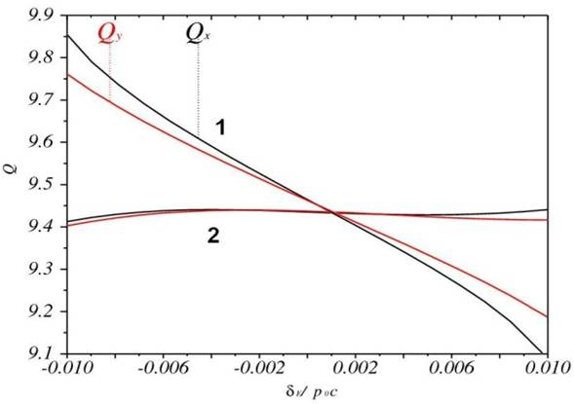
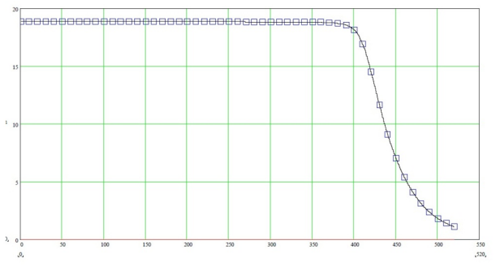
2. Nonlinearities of the magnetic field in Collider
1. Dipole/Quadrupole harmonics
(ΔB/B) _{n} ~ 10⁻⁴ expected values at R_{beam}
2. Chromaticity correction Sextupoles
Tune spread over the momentum acceptance ±4_{p} before (1) and after (2) correction
Natural chromaticities: Q’_{x}=-33, Q’_{y}=-28 (Q’_{x,y}~20 from 2 IPs)
Corrected chromaticities: Q’_{x,y}=0
N_{corr}=24, G’_{max}=150T/m²
3. Fringe Fields, Final Focus Quads in particular
Gradient in QFF1 vs. Longitudinal coor. @ I=10.3kA
Collider optics, MAC 2017

Slide 9
2. Nonlinearities: Fringe Fields
Fringe Field effect in quadrupole:
Δθ/θ ~ β² ·k² · L·ε
=> To decrease Fringe Field effect:
- Increase Quadrupole length ⬄ Decrease Quadrupole strength k;
Decrease beta-function in Lense β (or Decrease IP-QFF1 distance) or Increase β* in IP ;
Decrease Emittance ε.
Fringe Fields in ALL elements are taken into account in MADX
Collider optics, MAC 2017

Slide 10
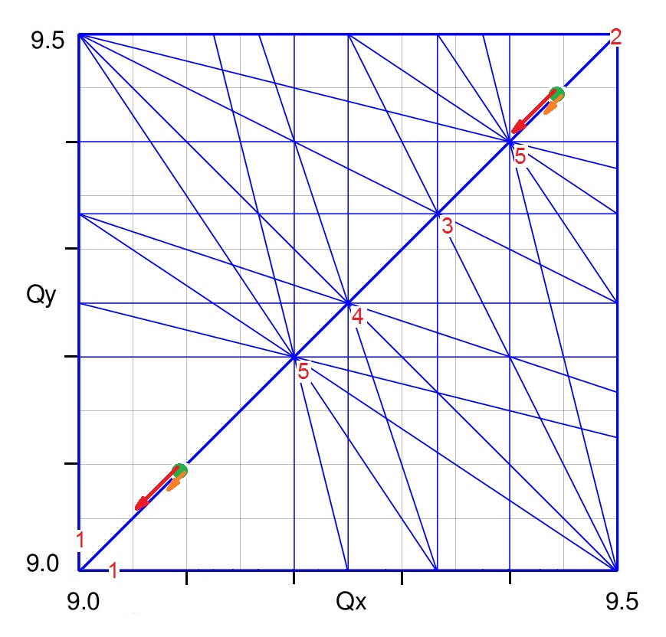
Q-diagram and Resonances
Betatron tunes Qx/Qy regulation: 1. Quadrupole correctors (trim-quads) in long straight sections (tune regulation and matching conditions); 2. Arc quadrupoles (strong change of tune, Q=8÷9.5 ), Imax=11kA;
Nominal Betatron Tunes νx=νy=0.420.44 require for effective Stochastic Cooling in Energy range 34.5 GeV/u;
Qx/Qy=9.10 – second possible working point: ECool up to 3GeV/u, larger DA
Resonance diagram up to 5th order.
Collider Working points and sp. ch. Tune Shifts at 1 / 4.5 GeV/u
Collider optics, MAC 2017

Slide 11
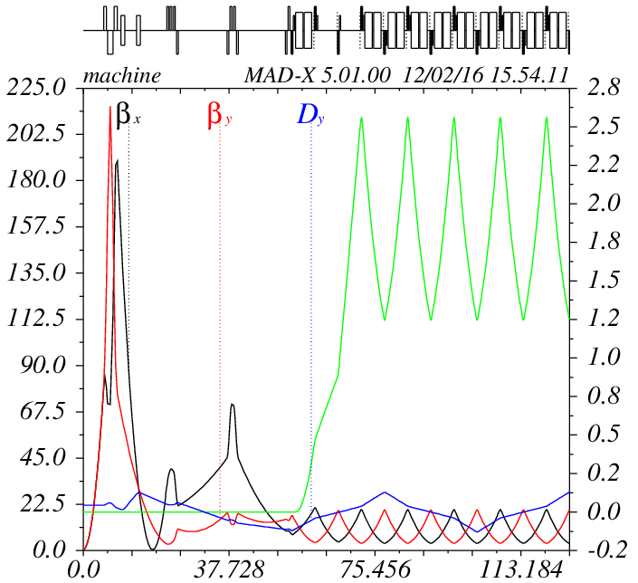
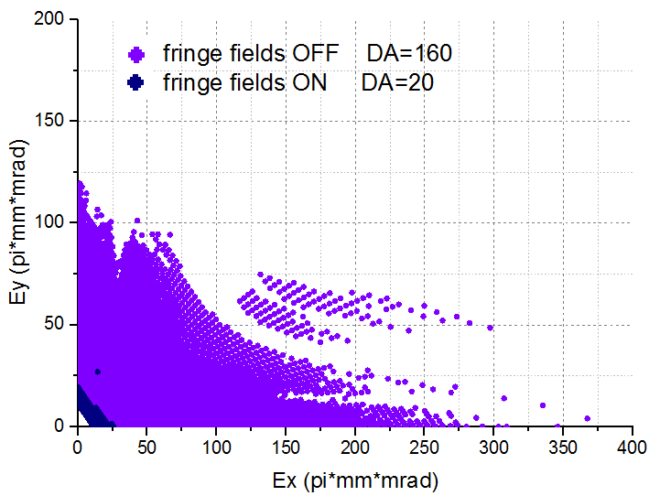
3. Dynamic Aperture calculations
Original Lattice: Q_{x,y} =9.44/9.44, β* =0.35m
Collider optics, MAC 2017

Slide 12
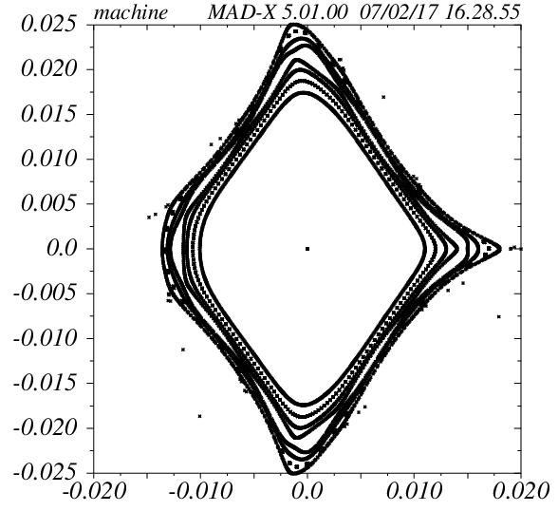
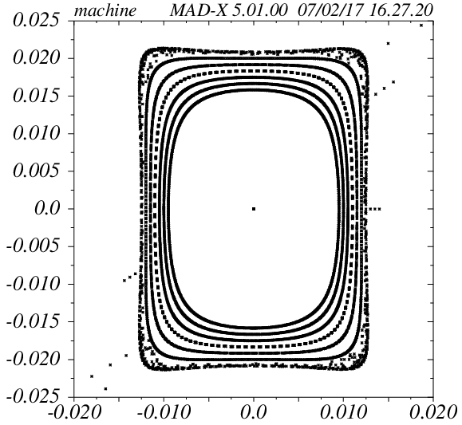
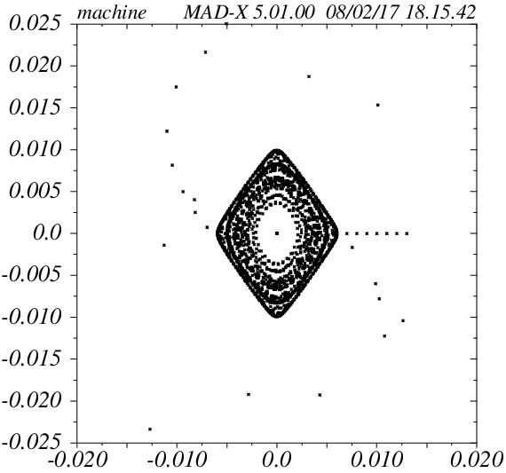
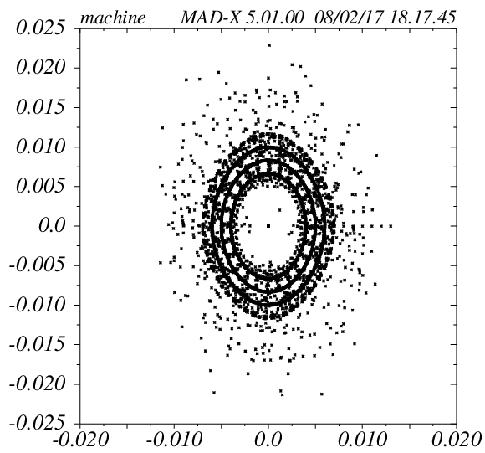
3. Dynamic Aperture calculations
X plane
Y plane
Chrom. Corr. ON
Fringe Field OFF
Chrom. Corr. ON
Fringe Field ON
Collider optics, MAC 2017

Slide 13
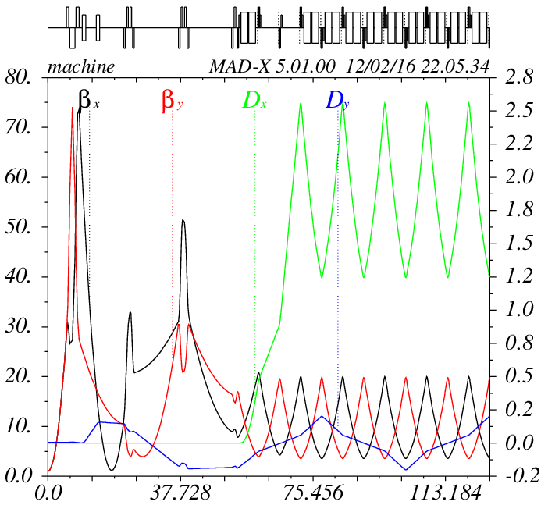
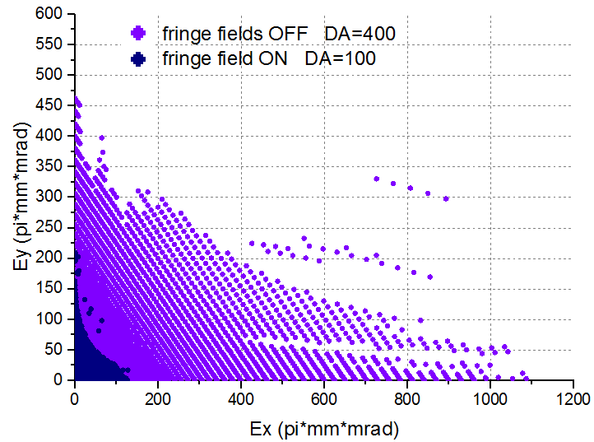
3. Dynamic Aperture calculations
Lattice: Q_{x,y} =9.44/9.44, β* =0.5, 0.6, 0.7, 1.0m
β* = 1.0m
Collider optics, MAC 2017

Slide 14
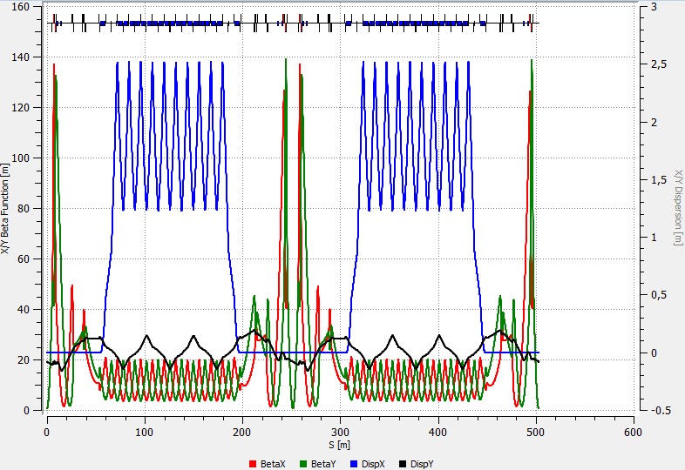
3. Dynamic Aperture calculations
Lattice: Q_{x,y} =9.44/9.44, intermediate β* = 0.6m
Collider optics, MAC 2017

Slide 15
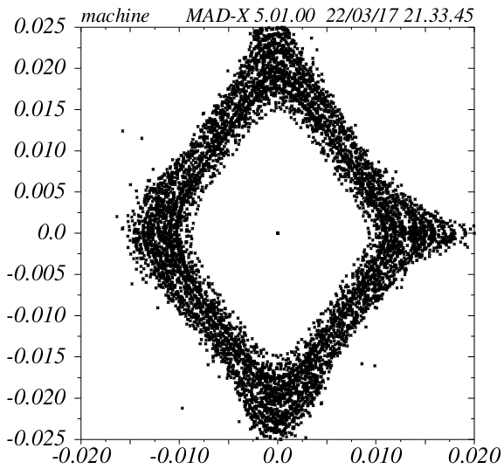
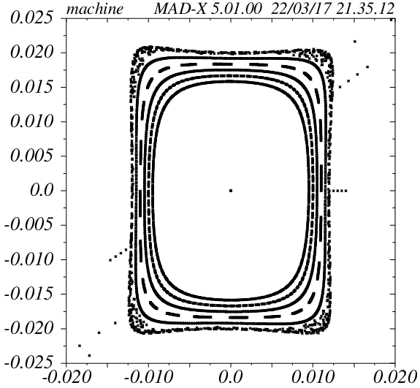
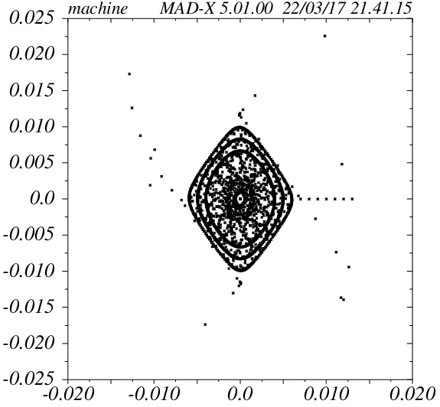
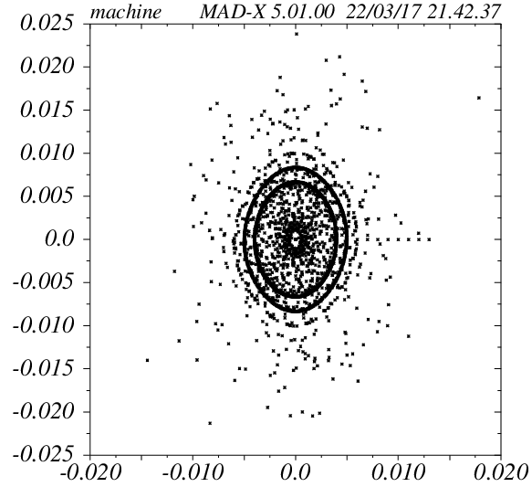
3. Dynamic Aperture calculations
X plane
Y plane
Chrom. Corr. ON
Fringe Field OFF
Chrom. Corr. ON
Fringe Field ON
Collider optics, MAC 2017

Slide 16
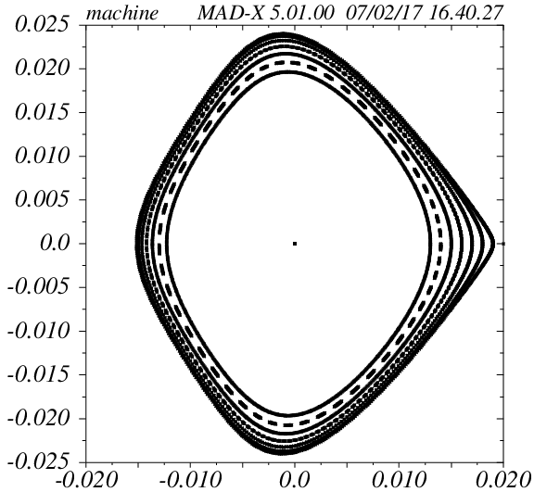
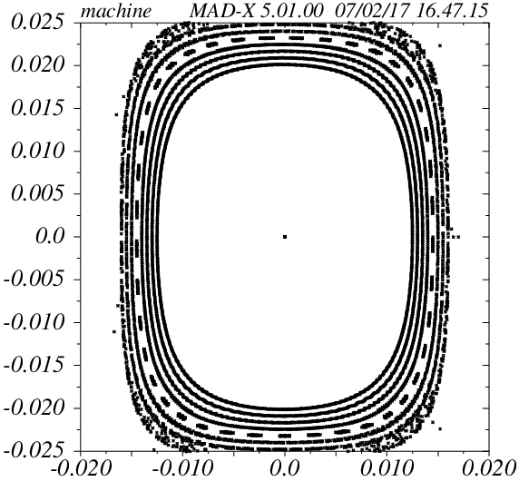
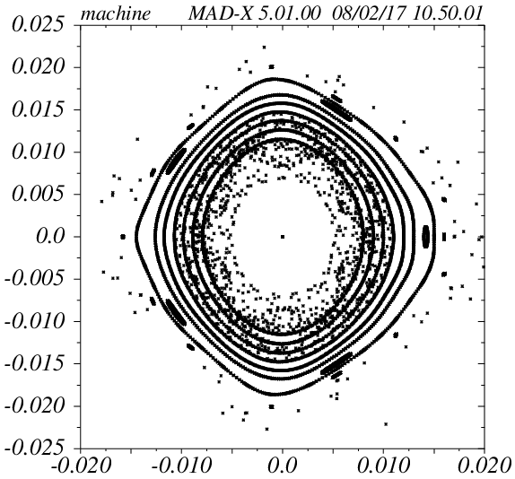
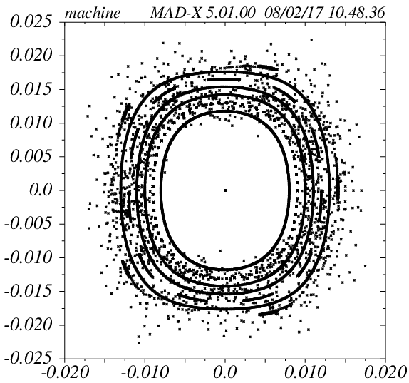
3. Dynamic Aperture calculations
X plane
Q_{x,y} =8.10/10.10
Y plane
Chrom. Corr. ON
Fringe Field OFF
Chrom. Corr. ON
Fringe Field ON
Collider optics, MAC 2017

Slide 17
Conclusions 1
Increase β* at IP increase DA: 0.35m DA<GA, 0.6m DA≥GA ;
For β*=0.6m the required luminosity at E_{k} =3÷4.5 GeV/u of L=1•10²⁷ cm⁻²s⁻¹ will be achieved with ~15% higher bunch intensity;
Ring tunes Q_{x,y} =9.44/9.44 chosen as a project base option due to S-Cooling reasons ;
Tunes q_{x,y} =0.10/0.10 (Q_{x,y} =8.10/10.10) show a largest aperture DA>GA
Collider optics, MAC 2017

Slide 18
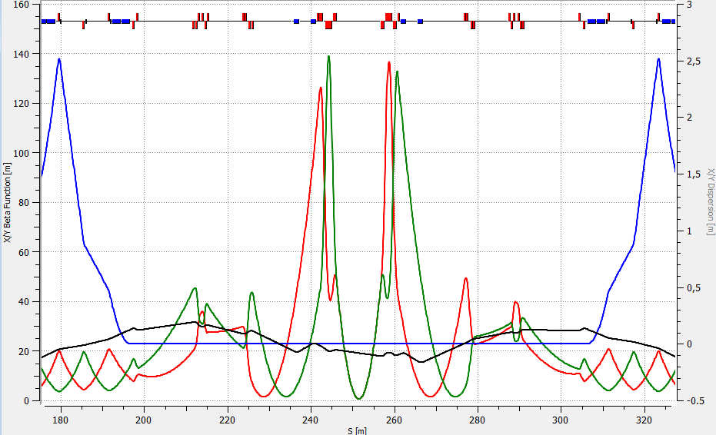
3. Dynamic Aperture calculations (continued)
- Optics for two beams optimization
- Nominal Working point Q_{x,y} =9.44/9.44
Q_{x,y} =9.44/9.44, β* =0.60m
Collider optics, MAC 2017

Slide 19
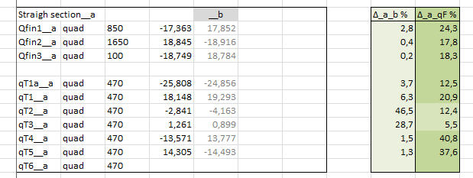
3. Dynamic Aperture calculations (continued)
- Optics for two beams
- Working point Q_{x,y} =9.44/9.44
Quadrupoles in straight sections A and B
Collider optics, MAC 2017

Slide 20
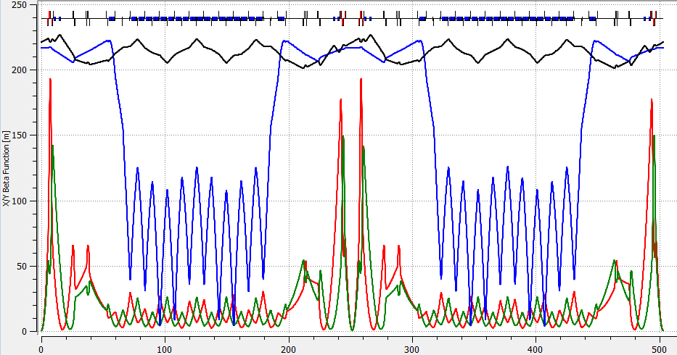
3. Dynamic Aperture calculations (continued)
- Move to Working point Q_{x,y} =9.10/9.10 by qF, qD Quads strength adjustment
Q_{x,y} =9.10/9.10, β* =0.60m
Collider optics, MAC 2017

Slide 21
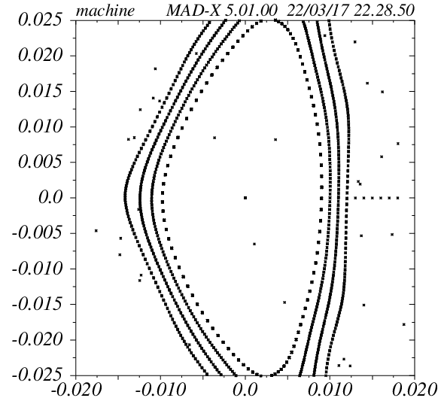
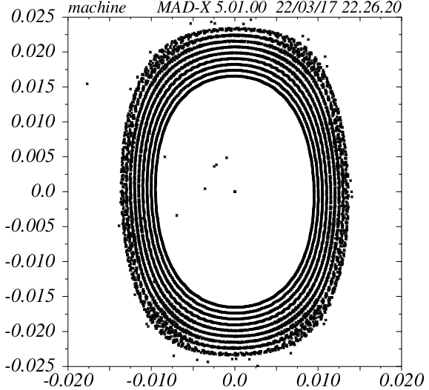
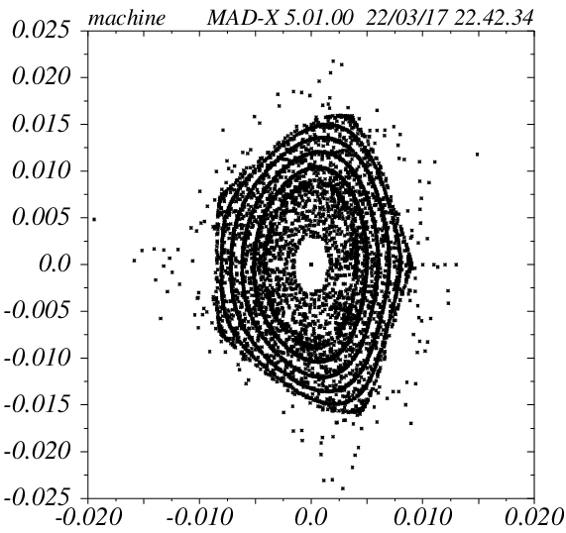
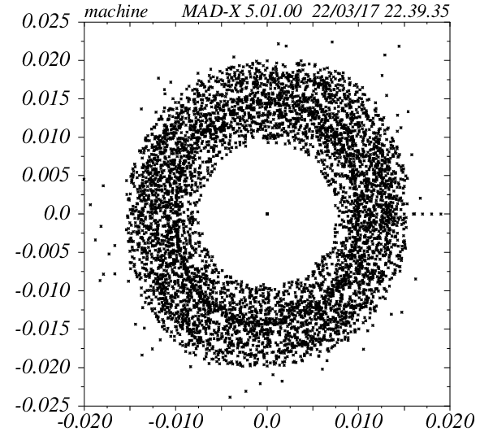
3. Dynamic Aperture calculations
X plane
Q_{x,y} =9.12/9.12
Y plane
Chrom. Corr. ON
Fringe Field OFF
Chrom. Corr. ON
Fringe Field ON
Collider optics, MAC 2017

Slide 22
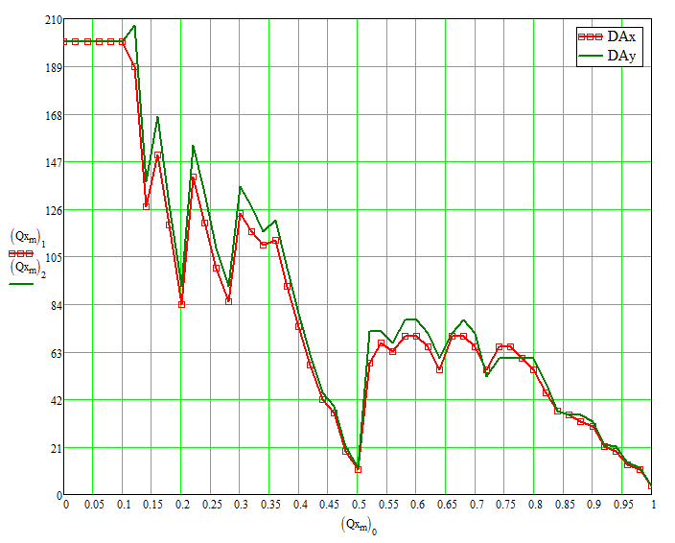
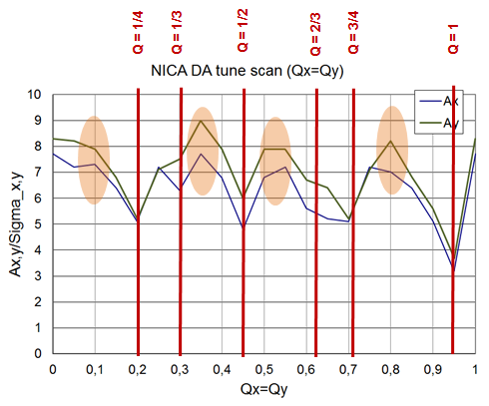
3. Dynamic Aperture calculations
JINR
BINP
“Artificial” Tune Scan (by the phase advance adjusting matrix) along the coupling resonance.
Collider optics, MAC 2017

Slide 23
Conclusions 2
Anti-symmetric optics suitable for both rings compiled;
Half-Ring-A differs from Half-Ring-B in Straight Sections Quads strength ;
Tunes Q_{x,y} =9.10/9.10 produced by 4% decrease of main Quads qF, qD strenght;
Point 9.10/9.10 has largest DA›GA, will be used at StartUp;
Point 9.44/9.44 preferable for S-cooling has a smaller DA
Collider optics, MAC 2017

Slide 24
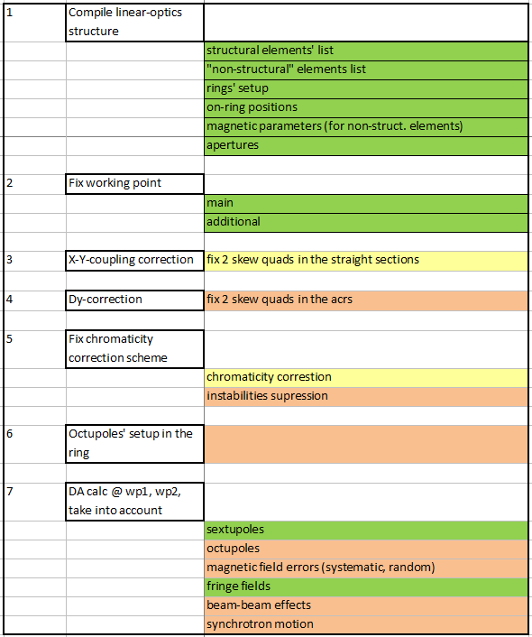
Conclusions 3: Tasks to Do
Collider optics, MAC 2017

Slide 25
Thank you for your attention !

